Slide 1
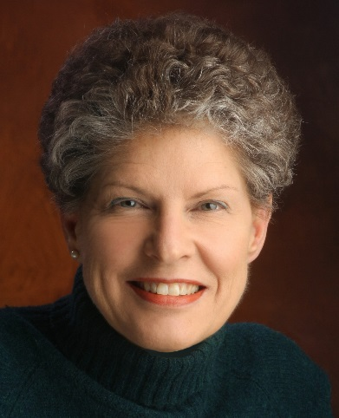
Report, Pre-College Education,Diana Fisher
Main events and achievements of 2017
ST/SD outreach to pre-college educators in Chile, Singapore and the US
Continued emphasis on curriculum and training, including design
and 2/3 implementation of new SD app, Splash!
Main aims for 2018
SD outreach to pre-college educators in Reykjavik
Continue ST/SD support for 37 pre-college educators in Chile
Finish Version 1 of Splash! We have 2/3 of the funding. $14,000 still needed. How do we get the word out?
Support, cooperation, resources needed & potential obstacles/issues.
Funding for pre-college ST/SD outreach efforts internationally and to support experienced SD pre-college educators to attend ISDC
System dynamicists willing to interact with and coach K-12 educators
1 major goal for the Society (as a whole) to achieve over the next 3 years:
Consistent and visible support for the pre-college pipeline of SD in pre-college education

