Slide 1
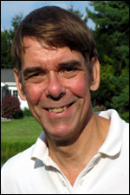
Report, VP of Finance, David Andersen
Main events and achievements of 2017
My report contains unaudited financials for 2017
Full audited report will be presented in Summer PC meeting
Major activities have concentrated on transition of home office to new site
Main aims for 2018
My main task in 2018 will be managing the selection of a site for the home office
Support, cooperation, resources needed &potential obstacles/issues.
I will be working with Admin Committee and whole PC to select future home office site and begin transition activities to that site

Slide 2
Report, Your Report Title, Your Name
Main events and achievements of 2017
1-2 main event or achievements for 2017
Main aims for 2018
1-2 main aim(s) for 2018
Support, cooperation, resources needed & potential obstacles/issues.
What are your needs in 2018 should be placed here.
New for this meeting: 1 major goal for the Society (as a whole) to achieve over the next 3 years:
Please offer a goal from your/your committee’s perspective.
Your Photo here

Slide 3
Your Report Title, Your Name
NO REPORT SUBMITTED
(We propose to use a format similar to this as a placeholder for committees or VP areas that have nothing to report for this meeting)
No photo available

