Slide 1
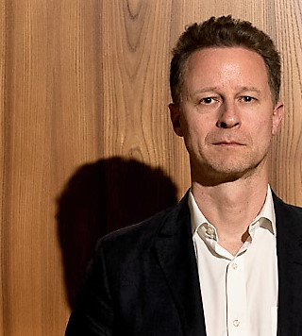
Society Program Oversight Committee (SPOC)
Members: Stefano Armenia, Allyson Beall, Robert Eberlein, Ignacio Martinez-Moyano, Karim Chichakly, Andreas Größler (Chair)
Discussion on conference proceedings
Started searching for program chairs 2018
Evaluation of threads

