Slide 1
Integrating System Dynamics Principles into LLM Assisted CEO Decision Support : A Framework for Strategic Transition Management (1173)
Bridging the Strategy Gap:
Upskilling Executive Leadership for System Dynamics Application in Strategic Decision-Making (1161)
"To move leadership beyond 'luck' by integrating System Dynamics into strategic decision-making"
Arif Mehmood Ph.D.
Chief Technical Officer
https://productivegrowth.net
2026 International System Dynamics Conference
Delft, Netherlands
July 20-24, 2026
CEO and System Dynamics - Skills and Successes

Slide 2
CEOs use mental models to solve problems, but their thinking is often trapped in LESR frameworks
(Linear, Episodic, Static, and Reductionist).
This systematically causes them to overlook the circular cause & effect relationships and interdependencies that truly shape organizational outcomes.

Slide 3
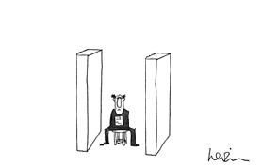
…….a typical CEO is faced with a challenge
Source: Arnie Levin, New Yorker, December 27, 1976

Slide 4
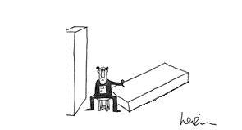
……. plan, design, and implement a solution
Source: Arnie Levin, New Yorker, December 27, 1976

Slide 5
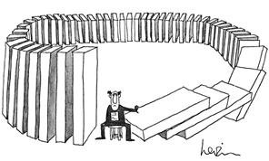
…….but end up creating more challenges
Source: Arnie Levin, New Yorker, December 27, 1976

Slide 6
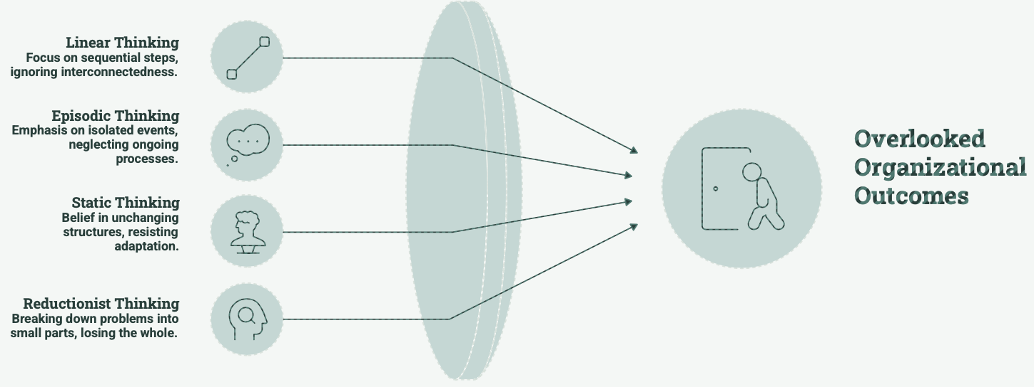
CEOs in LESR Trap
70-90%
Sources:
Cândido, C.J.F., & Santos, S.P. (2015). Strategy implementation: What is the failure rate? Journal of Management & Organization, 21(2), 237-256.
Cândido, C.J.F., & Santos, S.P. (2019). Implementation obstacles and strategy implementation failure. Baltic Journal of Management, 14(1), 39-55.
Doyle, J.K., & Ford, D.N. (1998). Mental models concepts for system dynamics research. System Dynamics Review, 14(1), 3-28.
Schaffernicht, M. (2019). Unrecognized interdependencies in mental models—The case for taking feedback loops into account. Systems Research and Behavioral Science, 36(3), 351-365.
Failure Rate of business strategies fail to achieve intended outcomes

Slide 7
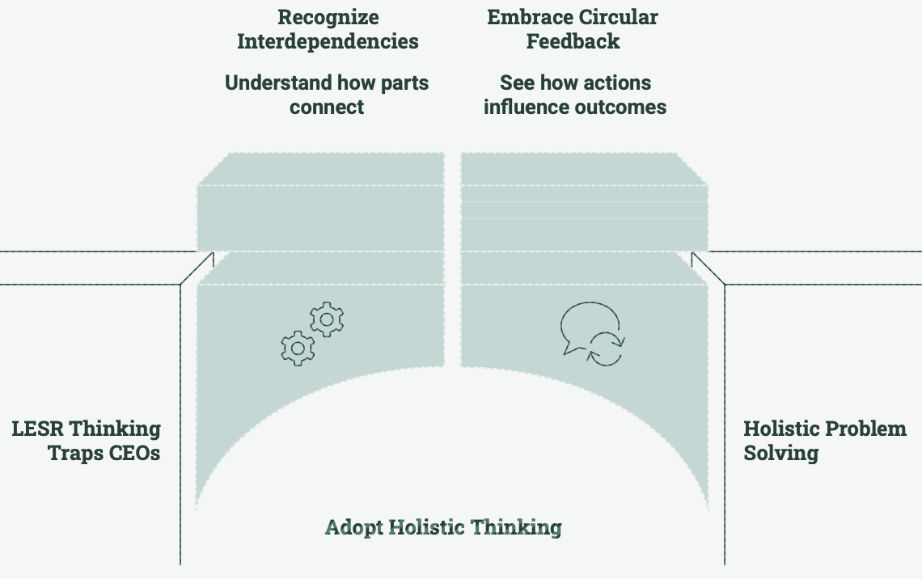
Breaking Free from LESR Thinking

Slide 8
LESR Entrenchment cause-and-effect relationship
Relative Attractiveness of LESR
CEO Adoption of LESR Tools
Market Promotion of LESR Tools
Perceived complexity of SD
Familiarity with LESR Tools
Investment of LESR Tools Development
Breaking this loop typically requires introducing a counter-loop such as:
Reducing perceived complexity (e.g., abstraction layers, UI/UX improvements)
Increasing availability of CEO Advisory SD tools
Demonstrating clear decision advantage over linear tools in high-stakes contexts
Sources:
Cary, M., Deck, C., & others. (2022). The effects of different cognitive manipulations on decision making. University of Texas at Dallas.
Dawes, R. M., Faust, D., & Meehl, P. E. (1989). Clinical versus actuarial judgment. Science, 243(4899), 1668–1674.
Schilbach, F., et al. (2021). The effect of CEO cognitive simplicity on firm-level dynamism. University of Münster.
Sterman, J. D. (2000). Business dynamics: Systems thinking and modeling for a complex world. Irwin/McGraw-Hill.

Slide 9
CEO SD Advisory Tools
Development of simplified CEO SD Advisory Tools
CEO Access to Advisory Tools
CEO Strategic Decision Quality
Perceived Value of SD Tools
SD Resources
Investment in Development of simplified CEO SD Advisory Tools
Better tools → Better CEO decisions → Stronger Results → Higher Trust → More Demand & Investment → Even better tools

Slide 10
CEO SD Advisory Tools
Relative Attractiveness
of LESR
CEO Adoption
of LESR Tools
Perceived complexity of SD
Quick Wins
Organizational Complexity
CEO Adoption
of SD tools
Availability of
SD CEO tools
Demand for
SD CEO tools
Failure rate of Business Strategies
Alternate counter-loop to limit the use of LESR tools:
LESR tools usage → Organizational Complexity→ Failure rate of strategies→ Demand of SD CEO tools→ Availability of SD CEO tools → Less use of LESR tools

Slide 11
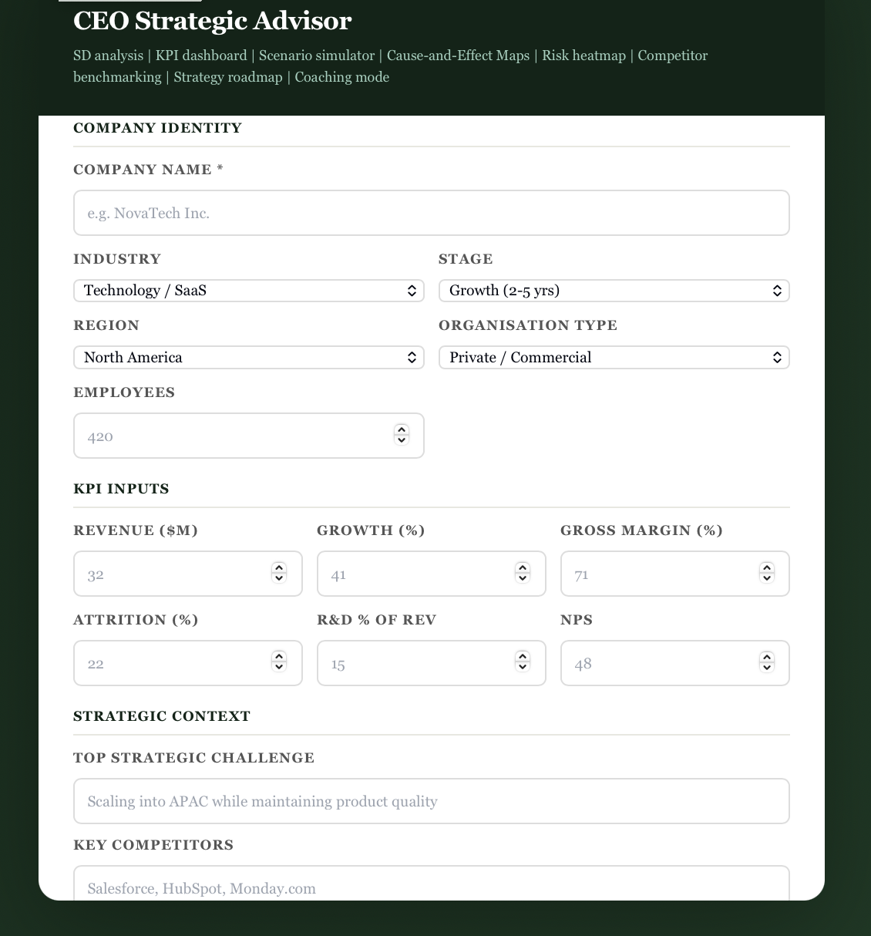
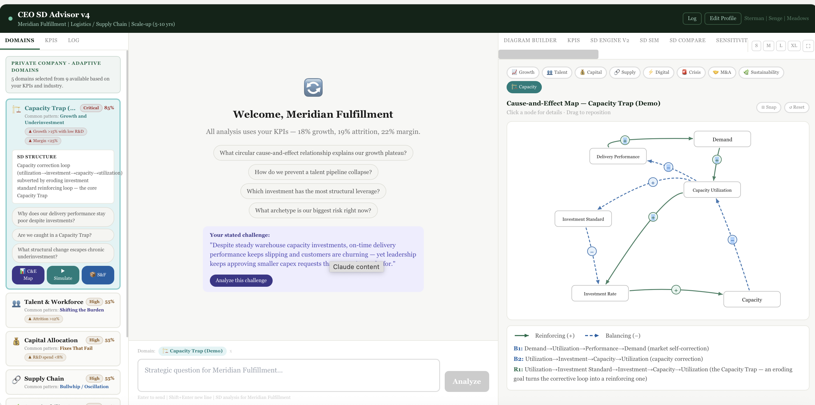
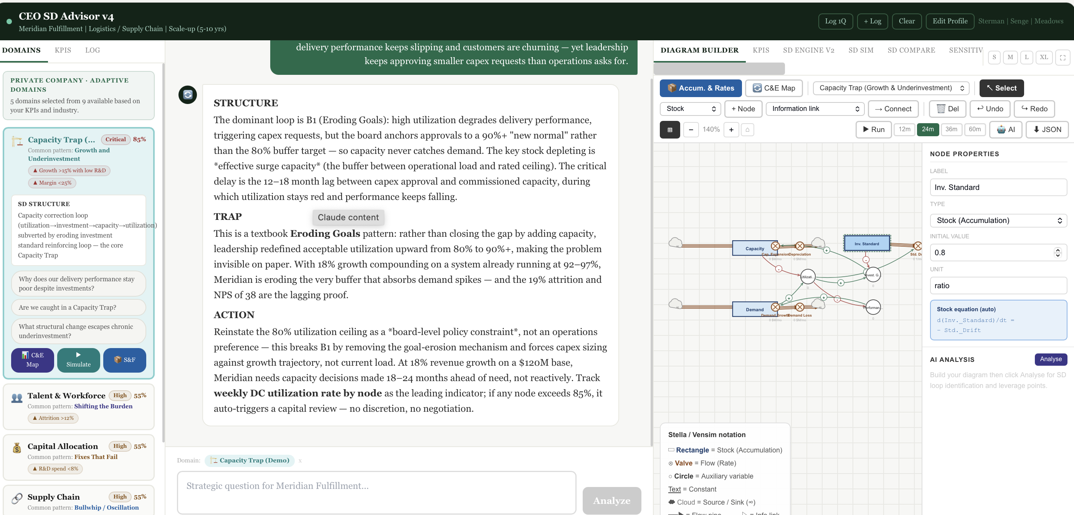
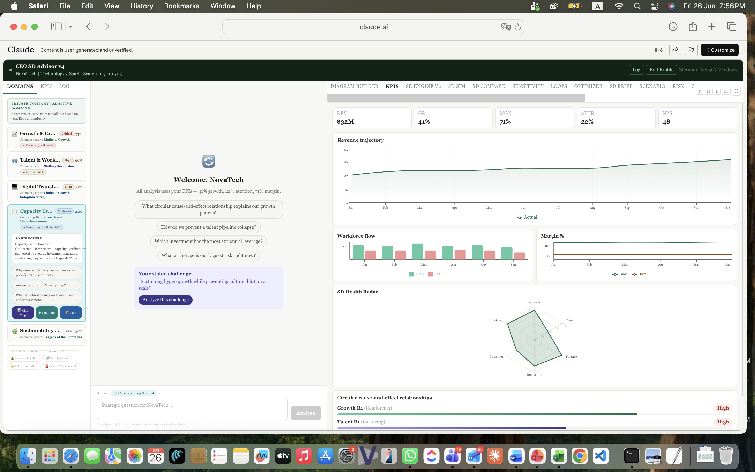
CEO SD Advisory Tool is in progress

Slide 12


Closing Remarks 4 Ls
Long Term:
CEO should prioritize long-term value creation over short-term wins that may weaken the organization later.
Lifelong Learning:
CEOs must commit to lifelong learning to keep pace with rapid changes
Leadership:
CEOs must inspire people by uniting them around vision and purpose
CEOs who embrace SD don't just make better decisions—they build organizations that thrive in complexity, leaving sustainable strategic capabilities that outlast their tenure.
Legacy:

Slide 13


CEOs who embrace System Dynamics don't just make better decisions—they build organizations that
learn, adapt, and thrive in complexity
The Question Is Not:
"Can you afford to upskill in System Dynamics?"
But Rather:
"Can you afford not to?"
amehmood73@gmail.com
https://productivegrowth.net

