Slide 1

Exploring policy mixes for the decarbonization of the Swiss residential sector: a hybrid System Dynamics approach
Matteo Palucci
Joint PhD candidate ETH Zürich-SUPSI

Slide 2
Motivation and objectives
Residential decarbonization is not only a technology problem:
The transition depends on the joint diffusion of PV systems, renewable heating technologies, and building retrofits.
These decisions are shaped by household heterogeneity, energy prices, policy incentives, regulations, and public financing mechanisms.
Existing models often capture either detailed household/building heterogeneity or system-level feedbacks, but rarely both together.
To explore how different policy mixes can support the decarbonization of the Swiss residential sector while accounting for:
technology adoption across heterogeneous building archetypes;
feedbacks between adoption, electricity prices, policy costs, and public budgets;
trade-offs between emissions reduction, energy efficiency, PV deployment, and distributional inequality.

Slide 3
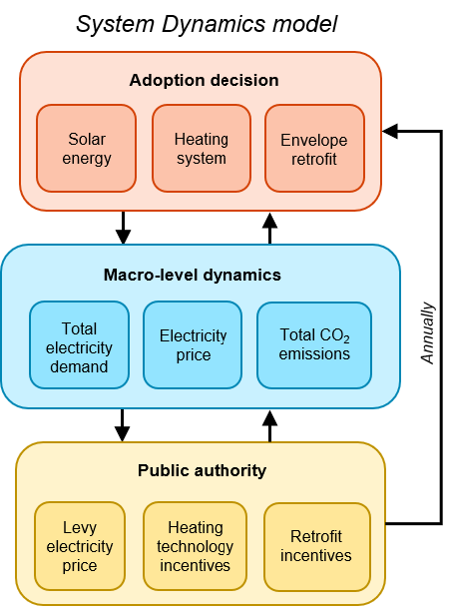
Methodology: A hybrid System Dynamics model
Residential building stock represented through 8,580 building archetypes:
Canton, building type, efficiency, PV presence, heating system.
Within each segment, households endogenously decide on:
PV adoption
Heating system replacement
Building envelope retrofit

Slide 4
Methodology: A hybrid System Dynamics model
Individual decisions affect into macro-level dynamics:
Total electricity demand
Emissions
Electricity price

Slide 5
Methodology: A hybrid System Dynamics model
Public authority behavior is also endogenous
PV
adoption
+
Given a fixed subsidy for PV, the levy on electricity price to finance the subsidies is adjusted endogenously
+
-
Total subsidy needed
Electricity price
Electricity demand
+
Levy electricity price
-
+
HP adoption
+
+
Envelope retrofit
Given a fixed CO2 tax, the specific subsidy for renewable heating and envelope retrofit is adjusted endogenously
Specific incentive
+
-
-
CO2 tax funds

Slide 6
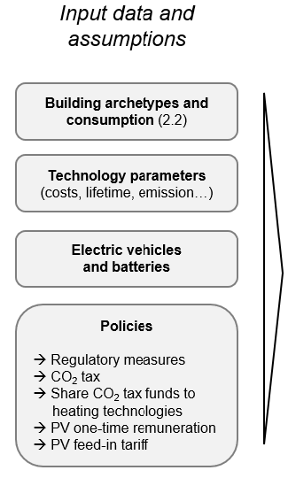
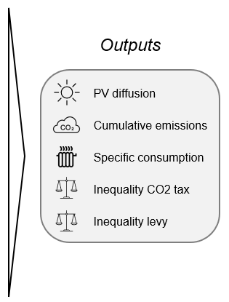
Methodology: Exploratory analysis
The model is run as a large ensemble of 1,500 simulations, varying policy inputs and uncertain techno-economic parameters.

Slide 7
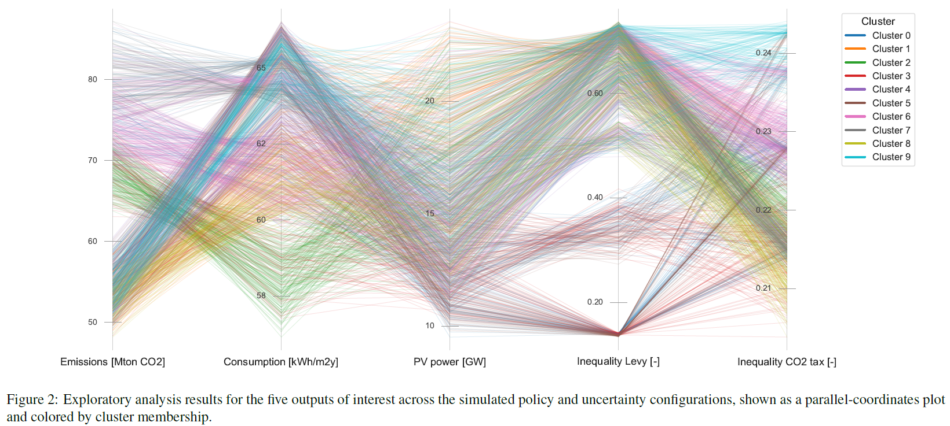
Clustering
Results are clustered using K-means to identify recurring transition pathways and the policy mixes most frequently associated with them.
The 10-cluster solution was retained based on a balance between:
Statistical support from the silhouette analysis
Interpretability of the resulting outcome patterns

Slide 8
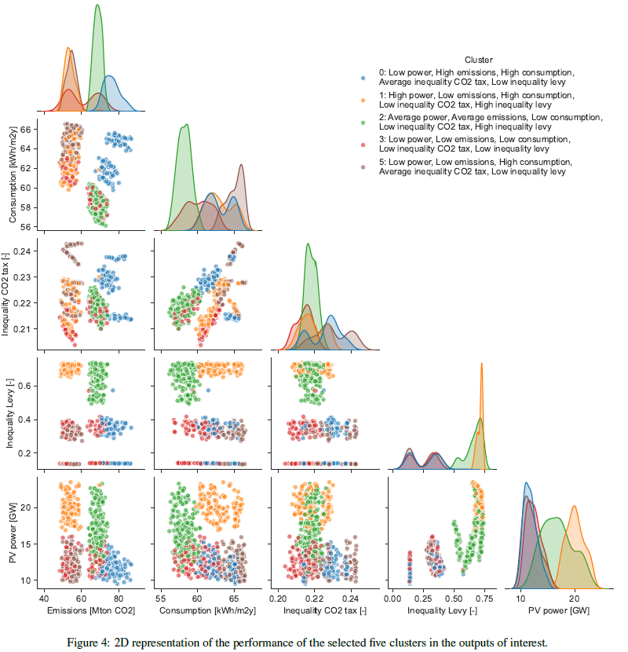
Cluster selection
For the interpretation, only 5 clusters were selected for detailed discussion to avoid overloading the interpretation.
The 5 clusters were chosen to cover the most distinct regions of the outcome space.
Therefore, the selected clusters should be interpreted as representative transition pathways, not as the only possible outcomes.

Slide 9
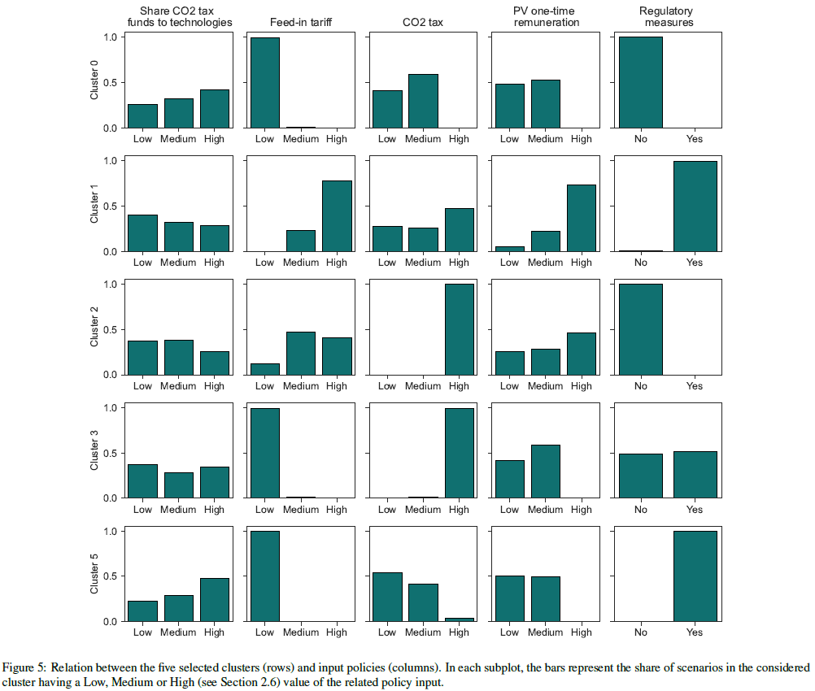
Results: Policy – Outputs relations
The figure links the selected outcome clusters to the policy inputs most frequently associated with them.
Each row represents one representative cluster, while each column reports the distribution of a policy input within that cluster.
The figure should not be interpreted as a marginal effect of each policy, but as an indication of which policy configurations tend to appear together in similar transition outcomes.
A clear pattern is that regulatory measures and higher CO₂ tax levels are more often associated with clusters characterized by lower emissions.
Stronger PV incentives and feed-in tariffs are associated with higher PV deployment, but also with clusters showing higher levy-related inequality.
The allocation of CO₂-tax revenues between heating technologies and retrofits appears less clearly linked to cluster outcomes than the overall CO₂ tax level and the presence of regulatory measures.

Slide 10
Conclusions
Policy mixes matter: no single instrument performs best across emissions, PV deployment, energy efficiency, and inequality.
Regulations and CO₂ taxation are key levers for reducing emissions and final heating demand.
PV incentives accelerate deployment, but their financing through electricity levies can increase distributional inequality.
A hybrid SD approach helps reveal feedbacks and trade-offs that are difficult to capture with isolated policy or technology analyses.

Slide 11
Thank you for your attention!
Questions?

