Slide 1







Generating Sector Maps from Text Using LLMs
Online Poster Presentation
Mehdi Moghadam Manesh, Washington State University
Shayan Firouzian, K. N. Toosi University
Roos Bakker, TNO
@systemdynamics_
THE 44TH INTERNATIONAL SYSTEM DYNAMICS CONFERENCE
Delft, Netherlands and Virtually
#isdc2026
Notes:
Hello, everyone, and thank you for being here. Today, I'm pleased to present our work, Generating Sector Maps from Text Using Larg Language Models”

Slide 2
Problem Statement:
LLMs have shown great promise for SD modeling, but existing work has focused mainly on CLDs and SFDs — no work on generating sector maps
However, sector maps provide unique value beyond what CLDs and SFDs offer. They can serve as a complementary tool to improve model communication, identify structural omissions, refine model boundaries, and support model simplification.
To Bridge This Gap, This Study Makes Three Main Contributions. We:
  Define a standard visual format (why!?)
  Specify a systematic procedure for constructing sector maps from textual descriptions
  Implement the procedure through structured LLM prompts
  and demonstrate it using a case study
@systemdynamics_
THE 44TH INTERNATIONAL SYSTEM DYNAMICS CONFERENCE
Delft, Netherlands and Virtually
#isdc2022
THE 40TH INTERNATIONAL SYSTEM DYNAMICS CONFERENCE
Virtually everywhere!
#isdc2026
Notes:
As a brief introduction LLMs have shown …
To the best of our knowledge
In the following slides, I will explain the reasons and necessity

Slide 3
Why Is a Standard Visual Format Needed?
To use LLMs for generating sector maps, we first need to define what the output should look like.
To address this question, we reviewed all SDR papers (1986 -2024).
  Of the 689 papers, 71 contained sector-level diagrams.
  We found considerable inconsistency—not only in their visual presentation but also in the terminology
    In total, we identified about 20 different labels used for sector-level diagrams.
@systemdynamics_
THE 44TH INTERNATIONAL SYSTEM DYNAMICS CONFERENCE
Delft, Netherlands and Virtually
#isdc2022
THE 40TH INTERNATIONAL SYSTEM DYNAMICS CONFERENCE
Virtually everywhere!
#isdc2026

Slide 4
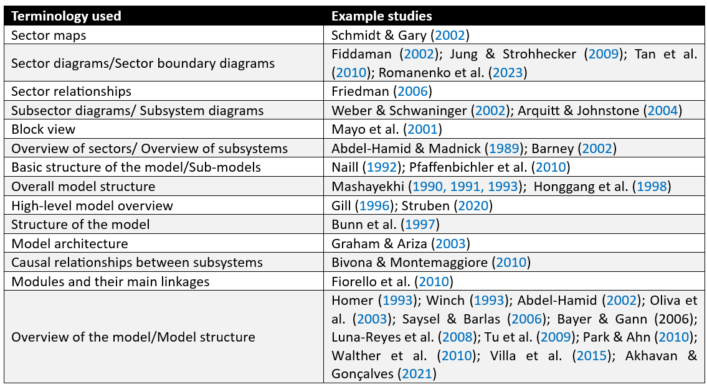
@systemdynamics_
THE 44TH INTERNATIONAL SYSTEM DYNAMICS CONFERENCE
Delft, Netherlands and Virtually
#isdc2022
THE 40TH INTERNATIONAL SYSTEM DYNAMICS CONFERENCE
Virtually everywhere!
#isdc2026
Notes:
This table summarizes the 20 different terms used to describe sector maps in the literature. For example, ...

Slide 5
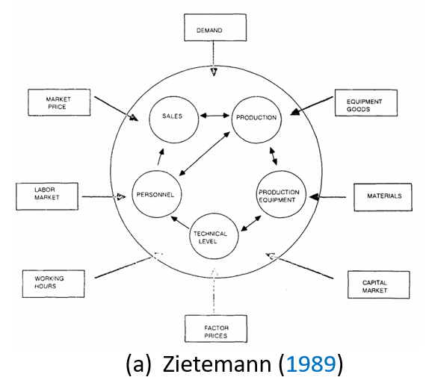
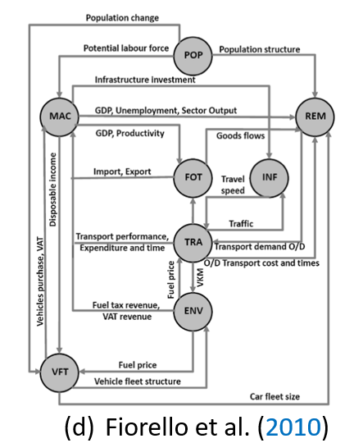
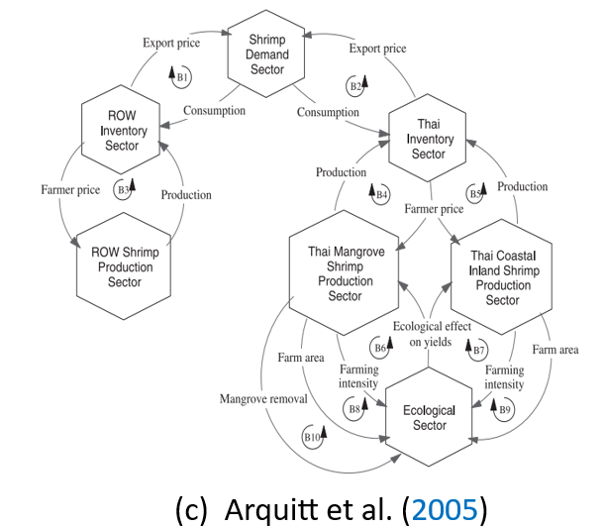
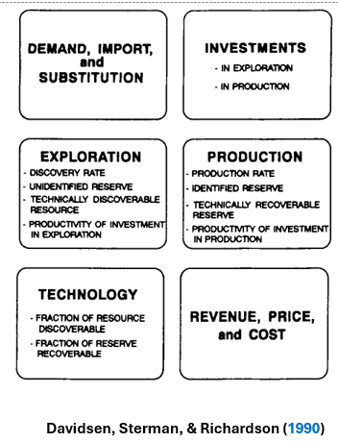
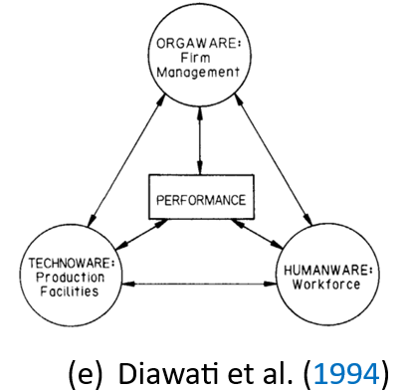
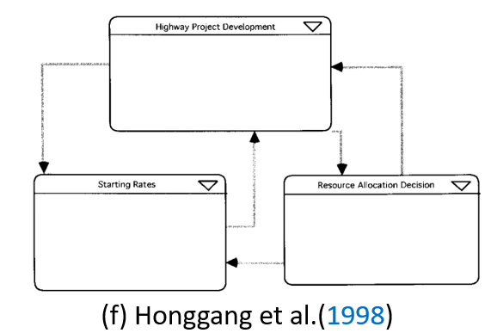
@systemdynamics_
THE 44TH INTERNATIONAL SYSTEM DYNAMICS CONFERENCE
Delft, Netherlands and Virtually
#isdc2022
THE 40TH INTERNATIONAL SYSTEM DYNAMICS CONFERENCE
Virtually everywhere!
#isdc2026
Notes:
Besides inconsistencies in terminology, there are also inconsistencies in visual representations, including:
Sector shapes (circles, hexagons, rectangles, etc.)
The level of detail within sectors
How relationships between sectors are represented (no connections, links, feedback loops, or textual explanations)

Slide 6
These variations highlight the need for a more standardized framework for sector maps
The lack of consistency in sector maps:
Creates ambiguity for practitioners
Makes sector maps more difficult to teach and learn
Makes it difficult to use LLMs because there is no clear target output format
@systemdynamics_
THE 44TH INTERNATIONAL SYSTEM DYNAMICS CONFERENCE
Delft, Netherlands and Virtually
#isdc2022
THE 40TH INTERNATIONAL SYSTEM DYNAMICS CONFERENCE
Virtually everywhere!
#isdc2026

Slide 7
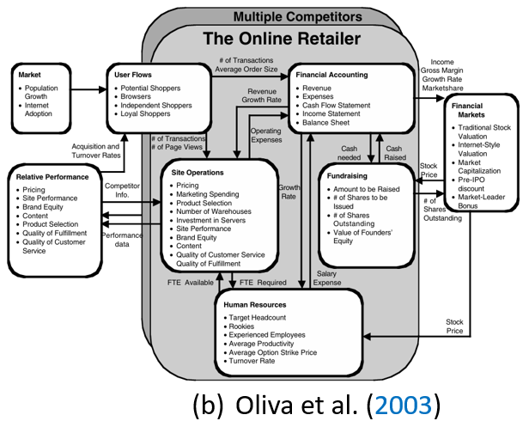
Selection & Modifications a SM Visual Form
Why this form?
Bevel-cornered rectangles with sector names on top — simple, readable, and familiar to SD modelers (STELLA-style)
Variables listed inside each sector — makes sector content and scope explicit; names alone convey little
Labeled arrows — explain the nature of intersectoral connections, not just their existence
Our two modifications for LLM generation:
Single horizontal row layout — explicit and reproducible placement; avoids arbitrary 2D positioning, overlapping links, and clutter
Consistent arrow-placement rule — rightward links along the bottom, leftward links along the top → reduces overlap and makes potential feedback-loop patterns easier to spot
@systemdynamics_
THE 44TH INTERNATIONAL SYSTEM DYNAMICS CONFERENCE
Delft, Netherlands and Virtually
#isdc2022
THE 40TH INTERNATIONAL SYSTEM DYNAMICS CONFERENCE
Virtually everywhere!
#isdc2026
Notes:
Among the various visual representations, we selected the sector-map format proposed by Oliva et al. (2003), which has been used in several other studies. In this format, sectors are shown as bevel-cornered rectangles with the sector name at the top. The variables within each sector are listed inside that sector, and relationships between sectors are represented by labeled arrows.
Given the limited time, I will skip the reasons and modifications we did.

Slide 8
Research Workflow
1
2
4
3
Selection & Modifications a Sector-Map Visual Form
Defining a procedure for generating sector maps from text
Writing structured LLM prompts to implement the procedure
Applying the prompts to an example to demonstrate the approach
@systemdynamics_
THE 44TH INTERNATIONAL SYSTEM DYNAMICS CONFERENCE
Delft, Netherlands and Virtually
#isdc2022
THE 40TH INTERNATIONAL SYSTEM DYNAMICS CONFERENCE
Virtually everywhere!
#isdc2026
Notes:
After the Selection & Modifications of the sector-map visual form, we defined …
Rather than going through Steps 2 and 3 in detail, I will jump to Step 4, where we apply the prompts to an example and look at the results.

Slide 9
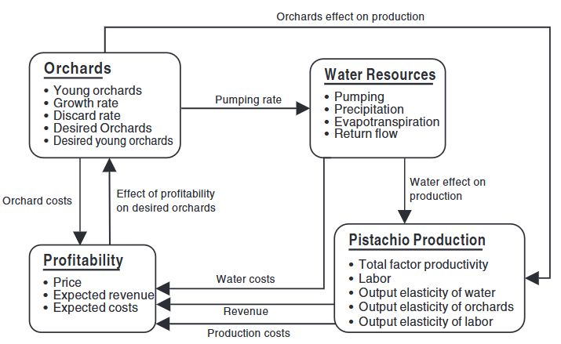
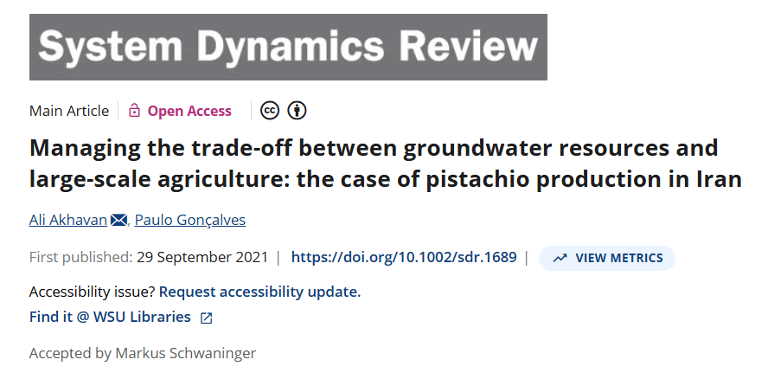
Results
@systemdynamics_
THE 44TH INTERNATIONAL SYSTEM DYNAMICS CONFERENCE
Delft, Netherlands and Virtually
#isdc2022
THE 40TH INTERNATIONAL SYSTEM DYNAMICS CONFERENCE
Virtually everywhere!
#isdc2026
Notes:
We applied a case study that investigates the dynamic relationship between pistachio production and groundwater sustainability in Rafsanjan, Iran.
The original sector map presented in the paper is shown on this slide.

Slide 10
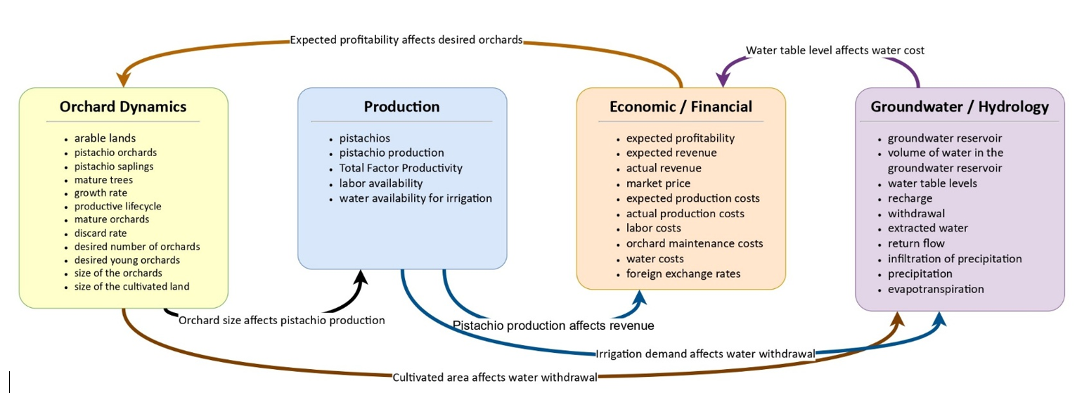
Results
The generated SM identified the same four major sectors
The connections between sectors are generally consistent with the original map.
However,
the sector names are not exactly
The generated map includes more variables within each sector
the descriptions of some relationships differ
In General, the generated output is promising and demonstrates the potential of this approach.
#isdc2022
THE 40TH INTERNATIONAL SYSTEM DYNAMICS CONFERENCE
Virtually everywhere!
Notes:
In this slide, you can see both the original sector map at the top and the sector map generated by LLMs at the bottom.

Slide 11

Thank You for Your Attention!
Questions or discussion?
  Mehdi Moghadam Manesh
@systemdynamics_
THE 44TH INTERNATIONAL SYSTEM DYNAMICS CONFERENCE
Delft, Netherlands and Virtually
#isdc2022
THE 40TH INTERNATIONAL SYSTEM DYNAMICS CONFERENCE
Virtually everywhere!
#isdc2026
Notes:
If you have any questions or would like to discuss this further, please feel free to contact me on LinkedIn.

