Slide 1
THE ROLE OF
COMMUNITY HEALTH PROMOTERS
IN KENYA
EFFECTIVE POLICY FOR SUCCESS
A project of the Alliance for Health Policy and Systems Research
Sponsored by the Gates Foundation
Supervised by WHO
Dr Claire F Brereton
Dr Christopher Khayeka
Dr Joseph Kiprop Choge
Notes:
Many of you know I’ve been involved in a project in Kenya – started late last year and is all about Community Health Workers. One of 3 global modelling projects funded by Alliance, running for 2 years.

Slide 2

PROJECT CALL FROM ALLIANCE FOR HEALTH POLICY AND SYSTEMS RESEARCH JULY 2024
Developing and implementing health systems impact modelling approaches in LMIC
Recognition of importance of investing in health systems strengthening
Inability to quantify impact – global issue ->
New research programme to nurture development of modelling approaches to measure impact
funded by Gates foundation
3 projects chosen from 59 global bids – Kenya, Ethiopia, Indonesia
    Systems projects – beyond single diseases
  Build capability in countries
Supervised by WHO with project oversight and technical support

Slide 3
BACKGROUND
  Kenya - a Lower Middle Income Country
    40% of population live below international poverty line – subsistence lifestyle
    Average life expectancy 63 years
    55 million population, birth rate 3.3 per woman
  Consequences of development
    Growing gap between rich and poor – malnutrition
    Double burden of NCDs and communicable diseases – HIV/AIDS, malaria, diarrhoea, TB, NTDs
  New Community Health Promoter role
    Replacing ‘broken’ volunteer role
Picture removed to meet
file size requirement
Notes:
LMIC – so developing. Like all developing countries NCDs – cardiovascular, diabetes etc.
20 years less than Aus life expectancy.

Slide 4
THE CHALLENGE: EMBEDDING COMMUNITY HEALTH PROMOTERS IN KENYA'S HEALTH SYSTEM
Paradigm Shift in Kenya Community Health Policy
Quality Care Interventions
The Critical Gap
Sept 2023, historic govt initiative to formally integrate Community Health Volunteers into the health system.
A workforce of 110,000 Community Health Promoters (CHPs) focused on preventive / promotive healthcare
CHPs are now a key part of Kenya's health system, but are they effective and efficient?
Major shift from volunteers to formal recognition, support with kits and MONTHLY remuneration
Replacing sporadic development partner support.
New service model - address factors that impacted volunteer performance e.g. supervision, recruitment, resources remuneration.
Gap - what effect will different policies / interventions have on the CHP service; where to put the effort and $$ to optimise CHP services based on needs.
Notes:
Primary strategy gap - techniques to estimate and predict outcomes of different nterventions for optimizing CHP services based on needs.

Slide 5

THE PROJECT
  Understand Community Health Promoters (CHPs) in Kenya
    New paid workforce, not medically qualified, emphasis on prevention, promotion and support
    What is working / what is not ….
    Cause-effect relationships
    Unintended consequences of policies
  Model how the CHP ‘system’ operates
    Address key knowledge gaps
    Predictions over time, selected study sites => national recommendations
    Simulate the effects of different policy scenarios on CHP services
    Results to Ministry of Health policy makers
    => POSITIVE CHANGE
  Build a health system modelling capability in Kenya
Pictures removed to meet
file size requirement

Slide 6
MAJOR PROJECT ACTIVITIES
Startup activities
Protocol and ethics
Team education and modelling workshop CB Kenya visit
Study site selection
Stakeholder mapping and interviews
89 interviewees across 6 representative subcounties – Swahili and other languages
Pictures removed to meet
file size requirement
Data gathering
Kenya Health Information System, CHP dashboard, Kenya National Bureau of Statistics
Modelling
Qualitative model – presented to policy group and sponsors
Quantitative model with agreed scenarios
Dissemination and stakeholder engagement
Ongoing – Ministry of Health Community Health policy group
AMREF – African Medical and Research Foundation
Project sponsors

Slide 7
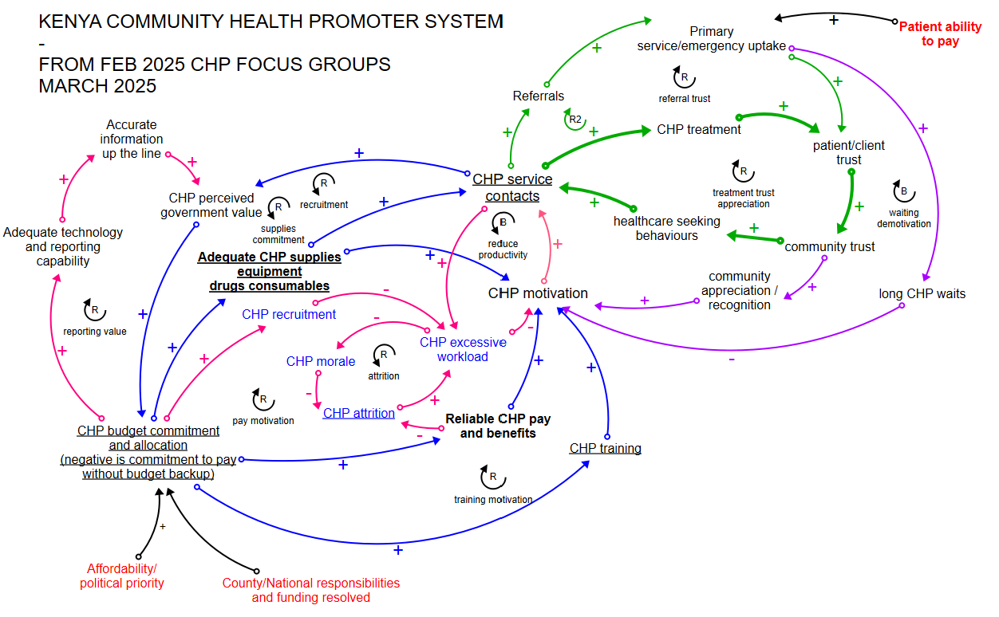









Top level Causal Loop Diagram

Slide 8
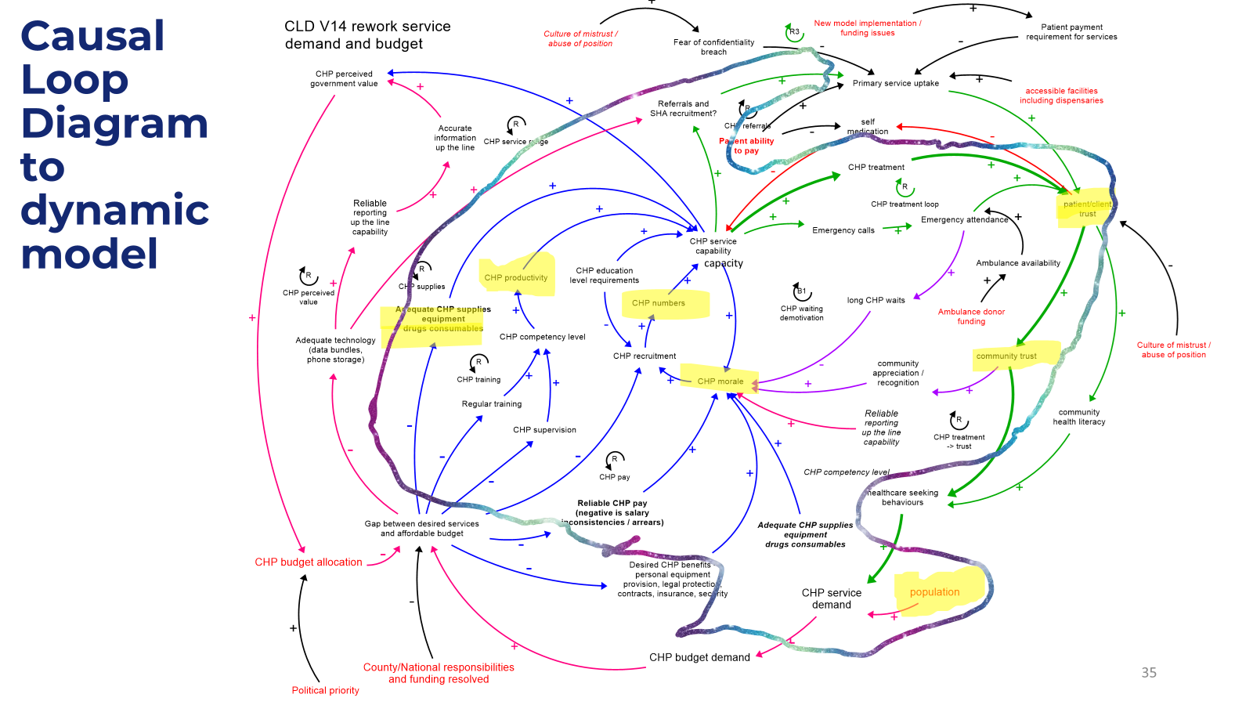

Slide 9
Simplified CHP model
Cause-effect loop with malaria
community case management
reducing prevalence

Slide 10
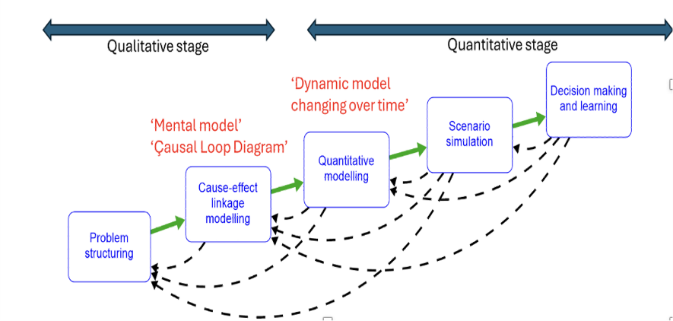
Dynamic (quantitative) modelling
    Quantifying the ‘mental model’
    From 2020 to 2040 (CHP service started 2023)
      Modelling workload and bottlenecks, impact on disease, compare between different demographics
      Quantify ‘soft’ variables, e.g. relationships between morale, workload, trust and productivity, with evidence from literature
      Arrayed by subcounty, country and whole-of-country to facilitate comparisons
      Data availability issues:
        Political sensitivity of data
        Data from Ministry of Health systems – 4 month unavailability after caused by US AID withdrawal
Notes:
I have used DHIS2 – free courses. Data available in pivot tables and visual, can be exported. Others in team can learn too.

Slide 11

MODEL BASELINE AND ASSUMPTIONS ESTABLISHED
Major assumptions:
n approach that gives policymakers and program implementers a powerful prediction capability over time. This methodology enables:
1) Population growth across age group assumptions taken from KNBS, UNPOP, County CIDPs. Birth rates falling, older population increasing.
2) Demand for CHP services is linked to poverty levels. Calibrated at national level to TimelyKenya ‘Healthcare Systems since Devolution’ survey 2025.
3) CHP workload is calculated as emergency call out work plus 10 household visits per year for 100 households. More households than CHPs treated as unmet demand.
4) CHP malaria testing/treatment is only available in endemic counties. If treatment supplies are available and test supplies are not, treatment is are given without tests.
Full assumption list is available in backup material
n approach that gives policymakers and program implementers a powerful prediction capability over time. This methodology enables:
Initial model settings:
n approach that gives policymakers and program implementers a powerful prediction capability over time. This methodology enables:
1) Supervision assumption is set at 5 hours per CHP per year
2) Community trust levels are set as per ‘TimelyKenya’ survey at 87% in 2025. No regional breakdown was available.
n approach that gives policymakers and program implementers a powerful prediction capability over time. This methodology enables:
Notes:
Emergency callout includes malaria cases

Slide 12
Link to model demo
Picture removed to meet
file size requirement

Slide 13
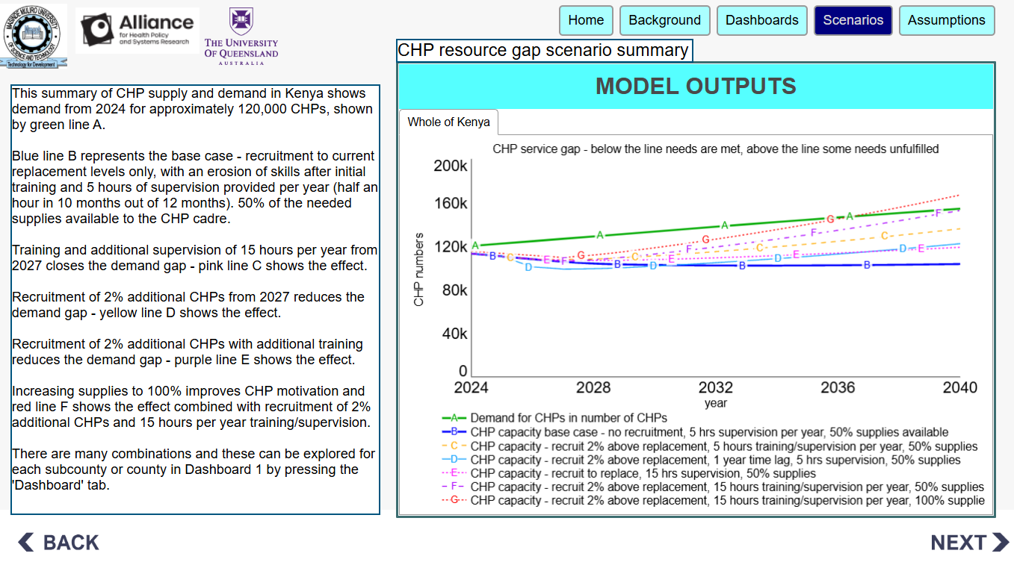
Backup model outputs – CHP resources
Notes:
First samples of interface – numbers of CHPs and affect on needs. Understood that many things influence CHP recruitment – whilst we can model this, do we also need to model things that lead to it
Scales noted.
By analyzing these patterns, decision-makers can develop more targeted strategies for CHP recruitment, training, and deployment to address specific regional healthcare needs and challenges.

Slide 14
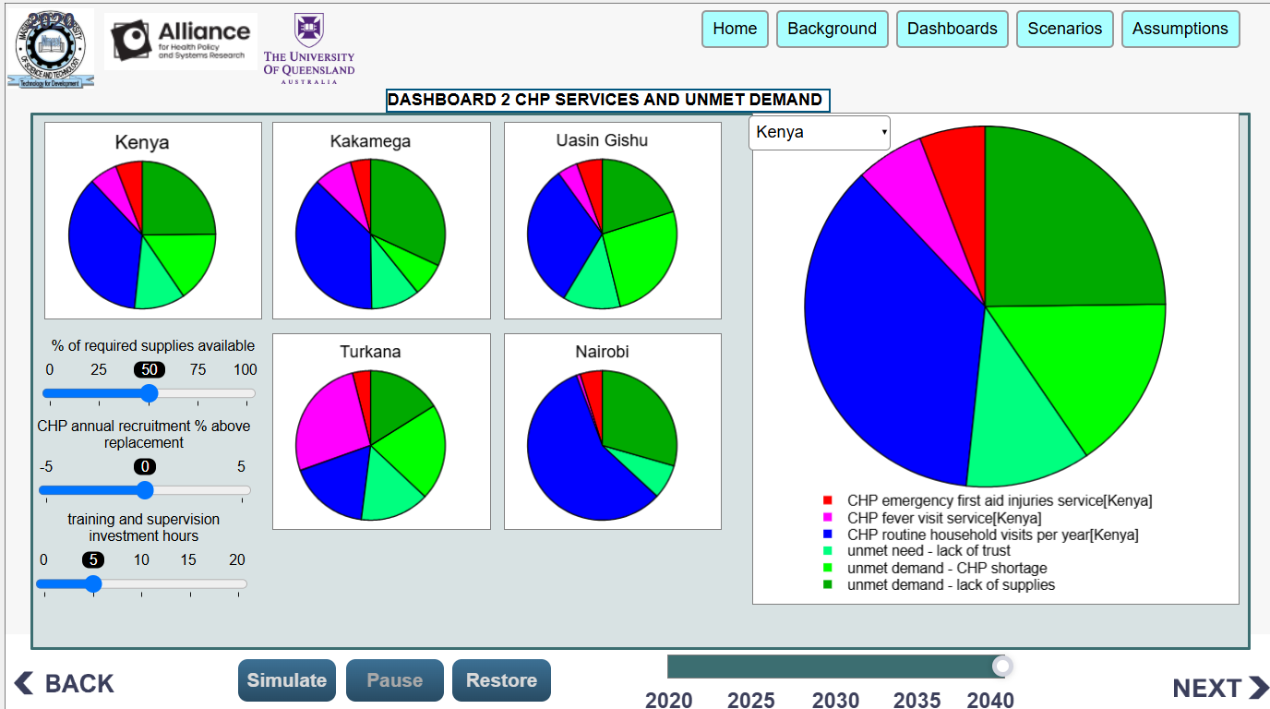
Backup model outputs – unmet demand
Notes:
First samples of interface – numbers of CHPs and affect on needs. Understood that many things influence CHP recruitment – whilst we can model this, do we also need to model things that lead to it
Scales noted.
By analyzing these patterns, decision-makers can develop more targeted strategies for CHP recruitment, training, and deployment to address specific regional healthcare needs and challenges.

Slide 15
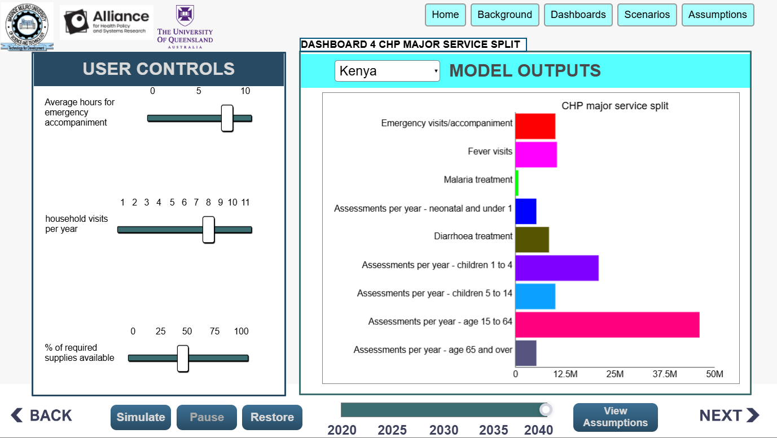
Backup model outputs – service split
Notes:
First samples of interface – numbers of CHPs and affect on needs. Understood that many things influence CHP recruitment – whilst we can model this, do we also need to model things that lead to it
Scales noted.
By analyzing these patterns, decision-makers can develop more targeted strategies for CHP recruitment, training, and deployment to address specific regional healthcare needs and challenges.

Slide 16
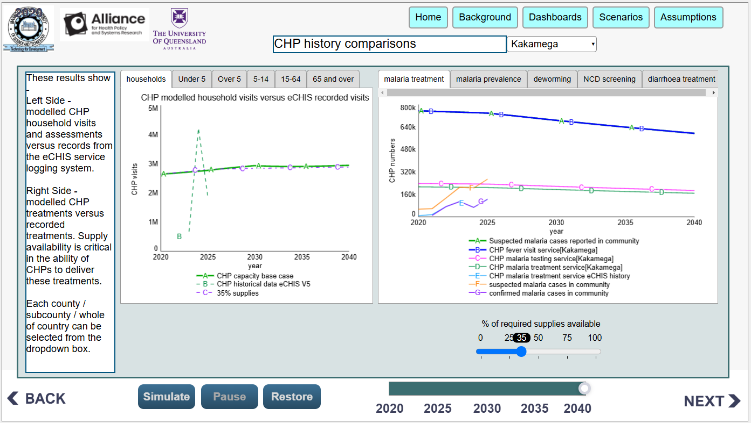
Backup model outputs – service comparisons
Notes:
First samples of interface – numbers of CHPs and affect on needs. Understood that many things influence CHP recruitment – whilst we can model this, do we also need to model things that lead to it
Scales noted.
By analyzing these patterns, decision-makers can develop more targeted strategies for CHP recruitment, training, and deployment to address specific regional healthcare needs and challenges.

Slide 17

POLICY RECOMMENDATIONS TO DATE
FROM QUANTITATIVE MODEL
Implement the CHP training and support programmes as planned in 2026/27, supported by predictive evidence of their benefits.
Implement a localized ongoing CHP recruitment/replacement programme to meet demand gaps.
Investigate areas where modelled CHP numbers appear to be adequate; N.B. test and refine model assumptions if required.
Treat CHP supplies as a core system driver for CHP services rather than an operational issue. The model demonstrates the criticality of supplies to CHP services and client trust
Consider malaria community case management for coastal endemic counties and for Turkana county.
FROM QUALITATIVE MODEL
Stipend reliability and external factors such as client ability to pay for referred services impacts morale.
Expanding role means that prioritization of CHP responsibilities will be required to manage workload.
Picture removed to meet
file size requirement
Notes:
Dr Willis Akhwale and Dr Joseph Choge
Need communication and buy-in from policy makers

Slide 18

THE TEAM
Pictures removed to meet
file size requirement

Slide 19
ACKNOWLEDGEMENTS
  Alliance for Health Policy and Systems research; international partnership hosted by World Health Organization
  – guidance and supervision from Dr Zubin Schroff and A/Prof Tim Roberton
  – funding through Gates Foundation
  Masinde Muliro University of Science and Technology - support and resources
  All the community health teams in Kenya who gave their time freely
  Kenya Ministry of Health – Mr John Wanyungu and Mr Dickson Kirathe for ongoing data extraction support
  Ms Shuai Shao, University of Melbourne - project initiation
  iSEE systems support team
Notes:
Dr Willis Akhwale and Dr Joseph Choge
Need communication and buy-in from policy makers

Slide 20
Thank you.
Notes:
So I am the expert - presentation

