Slide 1


System Dynamics Modeling Applied to Combating Match-Fixing and Money Laundering in the Brazilian Sports Betting Market
Online Poster Presentation
Rafael Souza Santos; Shayene Freita da Silva
Ricardo Matos Chaim; Thiago Sousa Xavier
Joao Gustavo Rocha dos Santos
THE 44TH INTERNATIONAL SYSTEM DYNAMICS CONFERENCE
Delft, Netherlands and Virtually
#isdc2026
Notes:
Title page: Change title to submission name. Bold the name of the presenter and display your name as you want it read by the moderator (eg Bob instead of Robert). Note the suggested timing in the bottom right. Slide timing may be adjusted, but not the number of slides.

Slide 2


Problem Statement
Context: Rapid expansion of sports betting in Brazil
  Market grew from R$2 billion (2018) to multibillion-dollar levels
  Normative gaps created systemic opportunities for illicit practices
Problem: Match-fixing as a growing systemic risk
  Involves money laundering, organized crime, and regulatory gaps
  Static analytical approaches fail to capture adaptive agent behavior
Objective: Analyze the sports integrity ecosystem in Brazil
  How regulatory governance and interinstitutional flows reinforce or undermine sports integrity
THE 44TH INTERNATIONAL SYSTEM DYNAMICS CONFERENCE
Delft, Netherlands and Virtually
#isdc2026
THE 40TH INTERNATIONAL SYSTEM DYNAMICS CONFERENCE
Virtually everywhere!
#isdc2022
Notes:
Keep fonts big (24 pt or bigger). Note suggested timing in the bottom right.

Slide 3
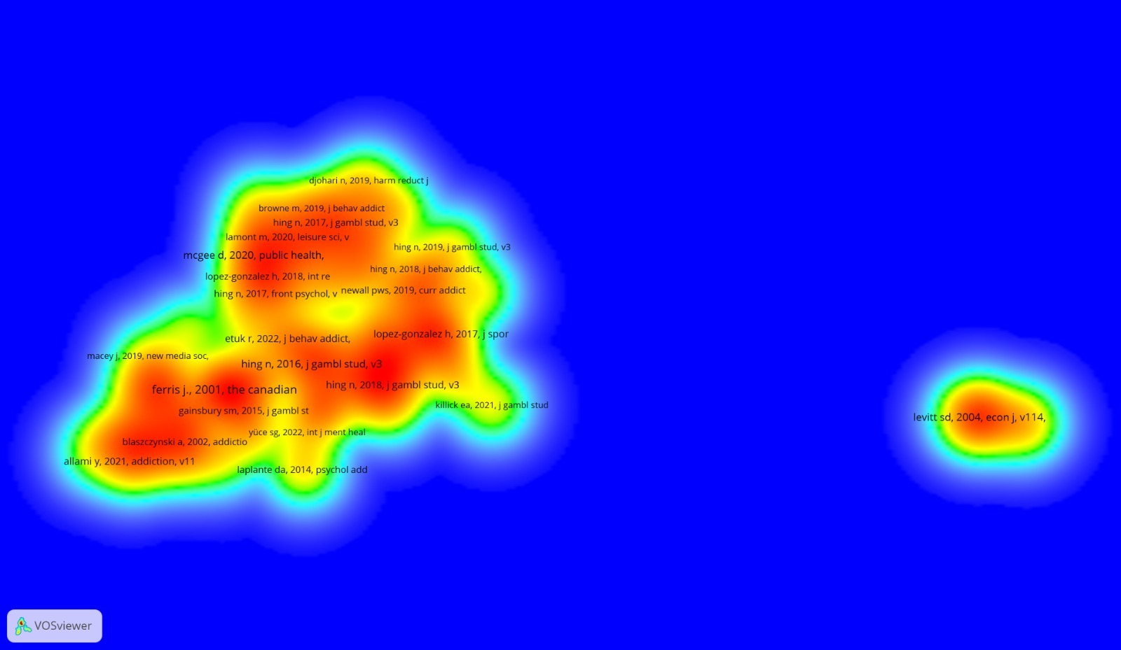
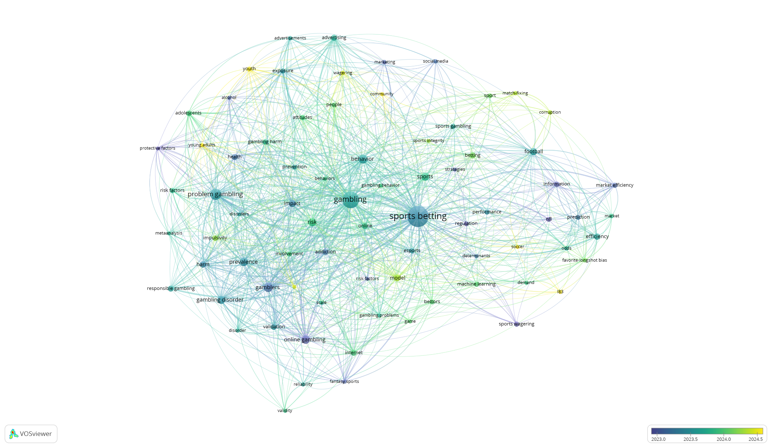
Approach & Literature Review
Method: TEMAC (Theory of Consolidated Meta-Analytic Approach)
  Web of Science query: 1,056 articles → refined to 566 records (3-year filter)
  VOSviewer used for co-citation and bibliographic coupling analysis
Literature reveals a tripartite ecosystem requiring SD modeling
  Bettor profiles and motivations (financial gain, legality perception)
  Public health and gambling addiction risks
  Regulation, economics, and match-fixing integrity (Moriconi, Kane, Torrance)
Brazilian legal framework: Laws 14,790/2023, 9,613/1998, Portaria MESP/MF No. 1/2026
Figure 1: Author co-citation network. Note: Prepared by the author using VOSviewer software.
Figure 2: Keyword co-occurrence network. Note: Prepared by the author using VOSviewer software.
THE 44TH INTERNATIONAL SYSTEM DYNAMICS CONFERENCE
Delft, Netherlands and Virtually
#isdc2022
THE 40TH INTERNATIONAL SYSTEM DYNAMICS CONFERENCE
Virtually everywhere!
#isdc2026
Notes:
Keep fonts big (24 pt or bigger). Note suggested timing in the bottom right.

Slide 4
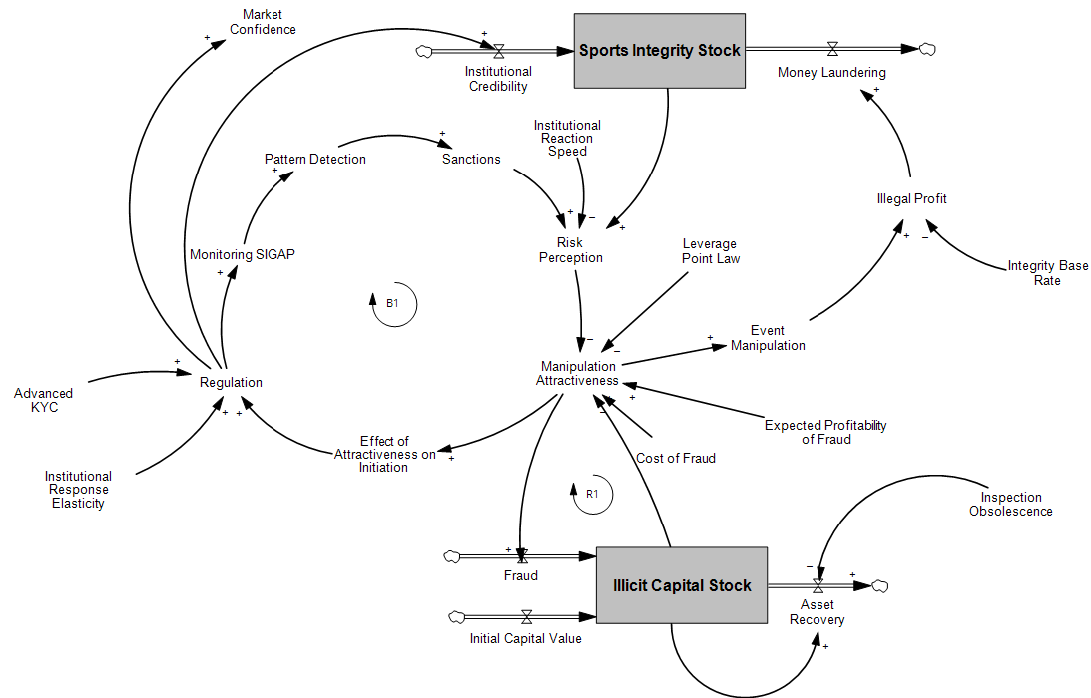
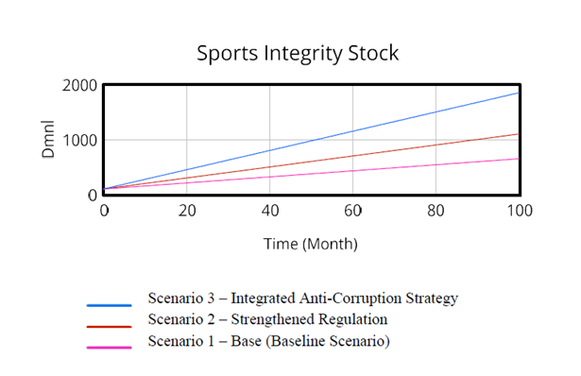
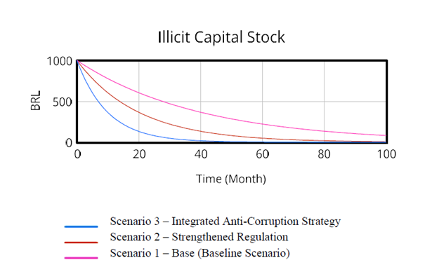
Results
Model Structure: Two core stocks + flows
  Sports Integrity Stock (inflow: Asset; outflow: Money Laundering)
  Illicit Capital Stock (inflows: Fraud, Initial Capital; outflow: Asset Recovery)
Three policy simulation scenarios (100-month horizon, Vensim)
  Scenario 1 (Baseline): High inspection obsolescence — integrity collapses
  Scenario 2 (Strengthened Regulation): KYC + punitive force — partial recovery
  Scenario 3 (Integrated Strategy): Max tracking + fast reaction — full integrity restored
Figure 3. Causal loop and stock-and-flow structure of the sports-integrity / illicit-capital system (Vensim).
THE 44TH INTERNATIONAL SYSTEM DYNAMICS CONFERENCE
Delft, Netherlands and Virtually
#isdc2022
THE 40TH INTERNATIONAL SYSTEM DYNAMICS CONFERENCE
Virtually everywhere!
#isdc2026
Notes:
Keep the text short and fonts big. Some flexibility on font for images. Note suggested timing in the bottom right.

Slide 5
Conclusions
Key findings
  Response speed — not just direction — determines illicit capital exposure
  Isolated policies are insufficient; integrated strategies required
Policy implications
  Combine KYC with liveness verification and rapid institutional reaction
  Reduce inspection obsolescence to neutralize illicit capital accumulation
Future research: calibrate variables across jurisdictions; expand structural model
THE 44TH INTERNATIONAL SYSTEM DYNAMICS CONFERENCE
Delft, Netherlands and Virtually
#isdc2022
THE 40TH INTERNATIONAL SYSTEM DYNAMICS CONFERENCE
Virtually everywhere!
#isdc2026
Notes:
Keep the text short and fonts big. Any questions you want to pose to the audience can go here. Note suggested timing in the bottom right.

