Slide 1

Conceptualizing Adoption Instability from a System Dynamics Perspective
Parallel Presentation
Sinko Wang, Ph.D. Candidate
Saras Chung, Ph.D.
Melissa Jonson-Reid, Ph.D.
Washington University in St. Louis, MO, USA
21st July 2026

Slide 2
Adoption Instability
Formal & Informal
8% formal adoption instability
30% informal adoption instability
Emotional and developmental health of adoptees
Well-being of adoptive parents
Financial burdens on broader social service systems
Background
Gap & Aim
Methods
Results
Implications
(White et al., 2025; Ringeisen et al., 2022)
Notes:
However, living in adoptive families does not guarantee permanency, some children adopted from foster care may experience formal instability (also sometimes called discontinuity).
(Ringeisen et al., 2 022)

Slide 3
Prevent Adoption Instability
Family needs and resources
Foster care adoptees often have adverse childhood experiences.
Children with traumatic experiences may develop emotional or behavioral difficulties.
Adoptive parents may face significant stress and barriers.
Pre- and post-adoption support and services are critical for promoting stability.
Some policies support the adoption of children with special needs and preventive services.
Background
Gap & Aim
Methods
Results
Implications
(Ahn et al., 2018; Brodzinsky & Smith, 2019; Brodzinsky & Palacios, 2023; Domanico et al., 2024)
Notes:
Adoptive parents may face significant stress and barriers in understanding the impact of traumatic experiences and addressing the child's emotional or behavioral challenges.
Fostering Connections to Success and Increasing Adoptions Act expand the funding to support children who are less likely to be adopted
Family First Prevention Services Act of 2018 (P.L. 115–123) expanded the use of Title IV-E to cover preventive services

Slide 4
Gap: Current Conceptualization
Bowlby’s attachment theory
  explains the impact of early separation/loss on later attachment difficulty
  linear impact
Cumulative Risk and Resilience Framework
  risk/protective factor interplay
  but static and doesn't handle change over time
Background
Gap & Aim
Methods
Results
Implications
(Bowlby, 1969, 1973, 1988; Evans et al., 2013; Masten, 2001)

Slide 5
Gap: Current Conceptualization
Post Adoption and Guardianship Instability Framework
  The most directly relevant prior model
  links pre-permanency characteristics → intermediate outcomes → instability
  but depicts this as linear pathways
  treats motivational shifts as contextual inputs rather than dynamic, endogenous mechanisms
Pre-permanency Characteristics
Intermediate Outcomes
Post-Adoption Instability
Background
Gap & Aim
Methods
Results
Implications
(White et al., 2018)

Slide 6
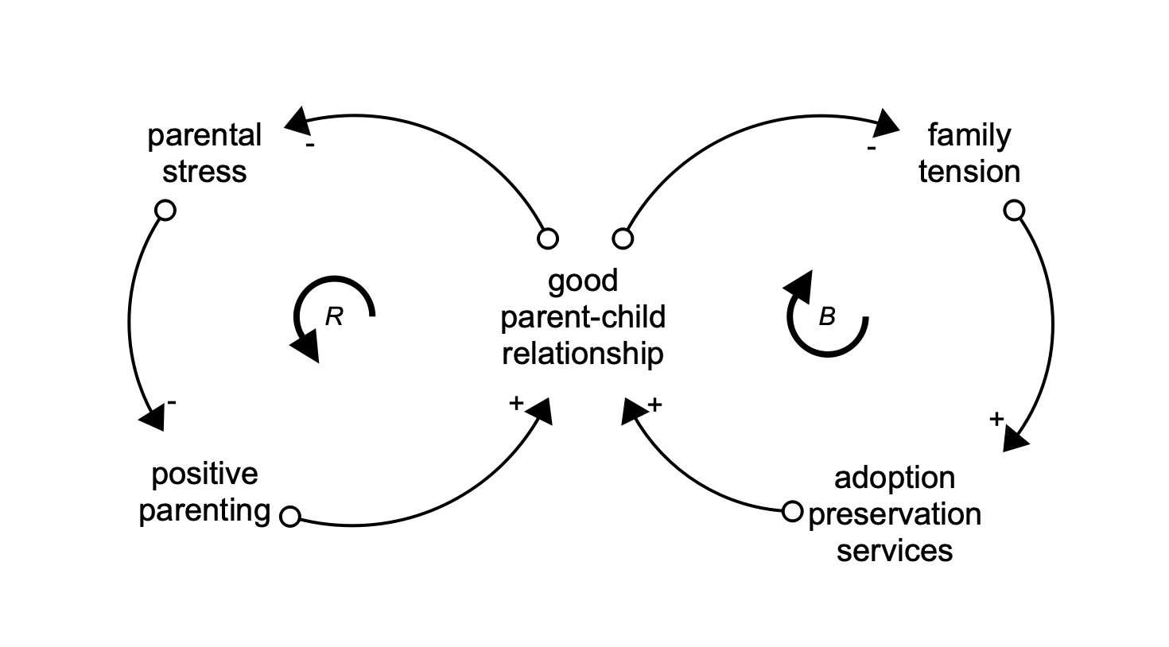
Study Aim
(1) identify what feedback loops contribute to formal and informal post-adoption instability;
(2) understand how pre-adoption child characteristics, family dynamics, and service response interact over time;
(3) examine how formal and informal pathways differ dynamically.
Background
Gap & Aim
Methods
Results
Implications

Slide 7
Methods
CLD
Synthesized empirical findings and theoretical assumptions into three evidence layers
  pre-permanency adversity
  post-adoption family dynamics
  systemic response/support
Prioritized the author's theoretical interpretation over raw statistical association to identify structural pathways
Followed evidence-mapping methodology of Jonson-Reid et al. (2025).
Background
Gap & Aim
Methods
Results
Implications
Notes:
(consistent with prior SD conceptual work, e.g., Morrow-Howell et al., 2017 on productive engagement)

Slide 8
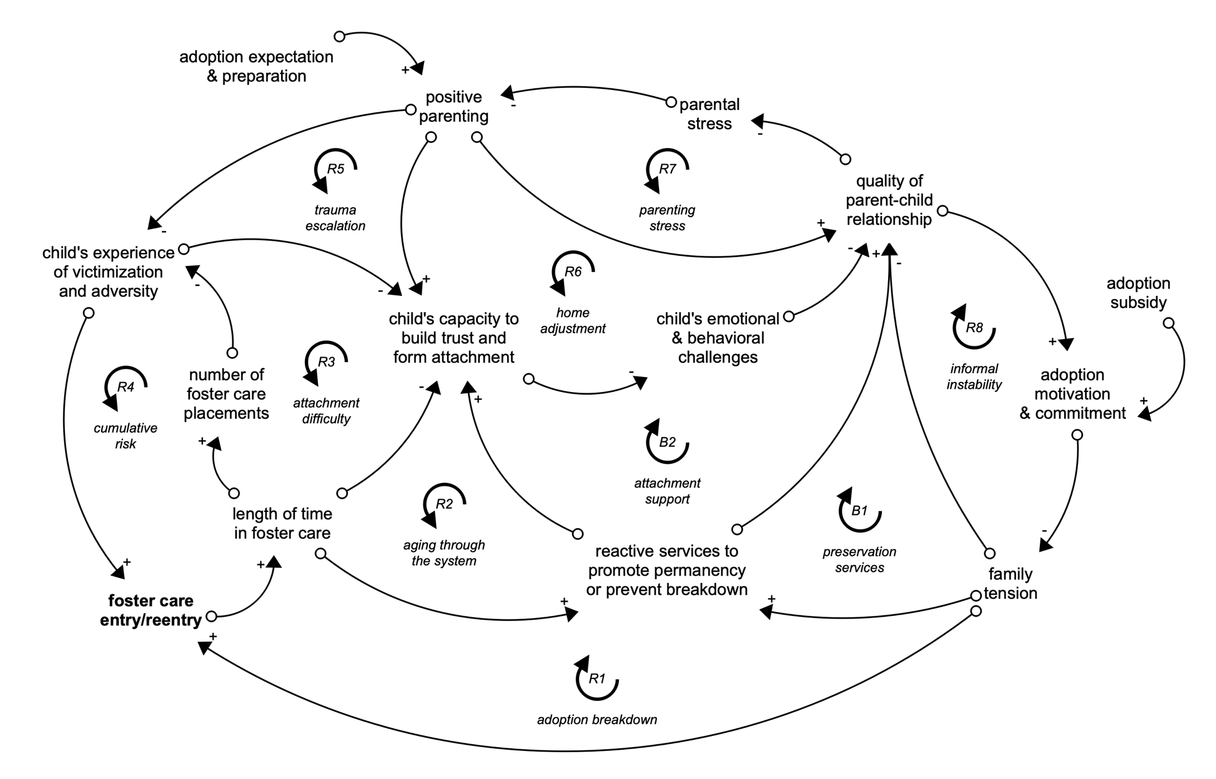
Model Overview
Notes:
This new model shifts the focus from asking which child or caregiver characteristics predict instability to asking how instability emerges over time through interactions among child pre-permanency history, family dynamics, and system responses.

Slide 9
SD Conceptual Model of Adoption Instability
Reinforcing Feedback Loops
System accumulation and formal instability (R1-R4)
Family adjustment and escalation (R5-7)
Commitment and informal instability (R8)
Background
Gap & Aim
Methods
Results
Implications
Notes:
The first four reinforcing feedback loops (R1-R4) help explain how foster care history, time in foster care, placement instability, and adversity can create cumulative vulnerability, which may eventually result in formal adoption instability (i.e., foster care reentry). Each represents a different mechanism.
The next three reinforcing feedback loops (R5-7) focus on post-adoption family dynamics and their interactions with child victimization and attachment difficulty. They help explain the escalation of trauma, maladjustment to adoptive homes, and cumulative parenting stress for adoptive families. They also suggest different pathways through which parenting influences parent–child relationship.

Slide 10
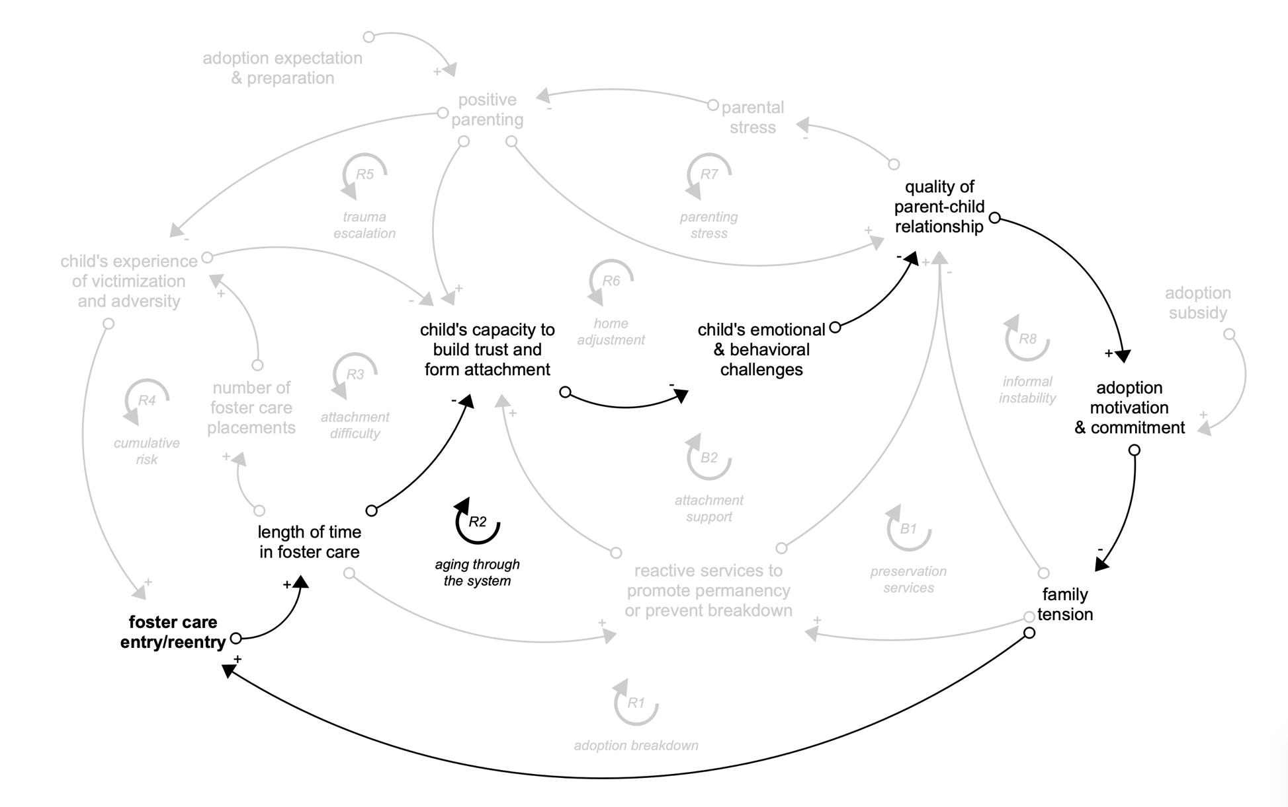
Theme 1: System accumulation and formal instability
Mechanism: further explains how instability can become self-reinforcing:
  With a prolonged stay in care, foster care children may be adopted at an older age, which may indicate greater difficulty forming trust and adapting to family life, which in turn increases vulnerability to further instability.
Empirical Support:
  Rolock & White (2016); Wijedasa & Selwyn (2017); Rolock et al. (2019); Sattler & Font (2021); Goodwin & Madden (2020).
Background
Gap & Aim
Methods
Results
Implications

Slide 11
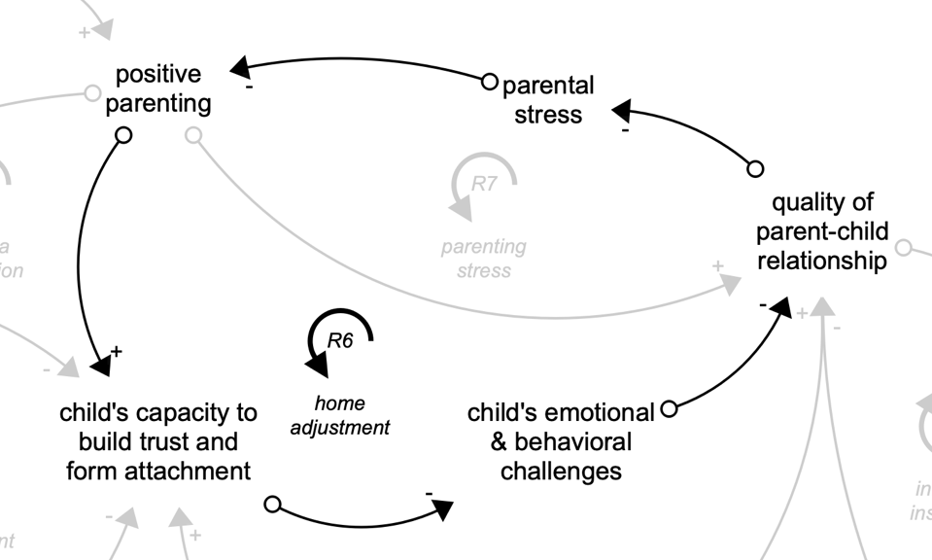
Theme 2: Family adjustment and escalation
Mechanism: Small improvements in trust and attachment can reduce behavioral challenges, thereby improving relationships, lowering stress, and increasing positive parenting. Positive parenting may further strengthen trust and contribute to good post-adoption adjustment
Empirical Support:
  White et al. (2021); Rolock et al. (2021); Palacios et al. (2019).
Background
Gap & Aim
Methods
Results
Implications

Slide 12
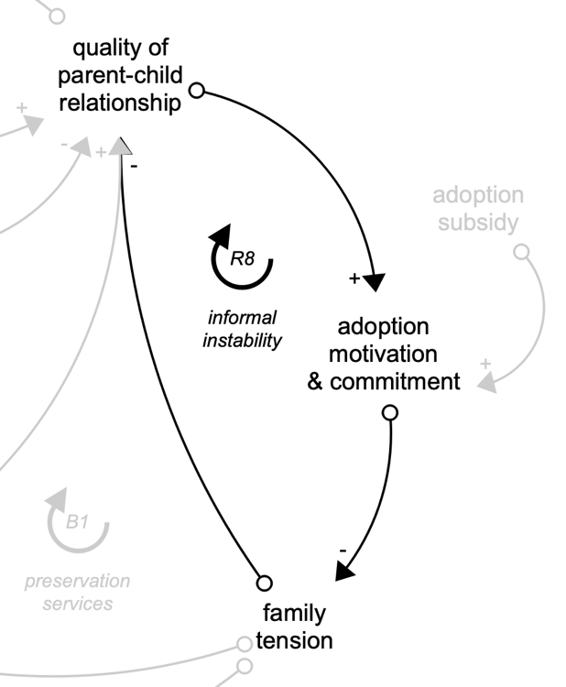
Theme 3: Commitment and informal instability
Mechanism: When relationship quality and adoption commitment weaken, families may experience informal separation, runaway, or other informal instabilities.
  Since these disruptions are often unrecorded in formal systems, they can be more difficult to identify and address in a timely manner.
Empirical Support:
  Rolock et al. (2023); White et al. (2021).
Background
Gap & Aim
Methods
Results
Implications
Notes:
R8 explains the occurrence of informal instability, which is less visible and more likely to arise than formal instability

Slide 13
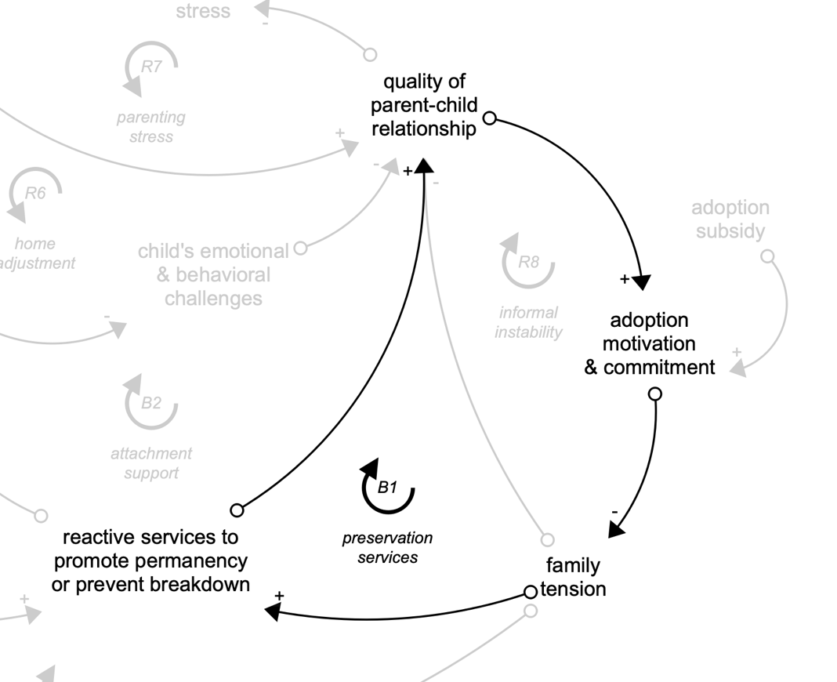
SD Conceptual Model of Adoption Instability
Balancing Feedback Loops
How reactive services buffer the risks leading to post-adoption instability
  B1 (preservation services) represents a preservation-service response to de-escalate family crisis
  B2 (attachment support) captures an attachment-centered service mechanism targeting hard-to-place children
Background
Gap & Aim
Methods
Results
Implications

Slide 14
Theoretical Contribution
Reconceptualizes static predictors as dynamic states
  Parental stress, commitment, relationship quality, and family tension change in response to prior system behavior
  Explains why similar families diverge after finalization
Operationalizes existing theories as feedback mechanisms
  Attachment theory → trust/attachment-capacity loops
  Cumulative risk/resilience → adversity-accumulation loops
Explains inconsistent predictor effects in prior studies
  For example: time in foster care: risk marker (adversity) and protective (service access)
Background
Gap & Aim
Methods
Results
Implications

Slide 15
Implications
Research
  Explicitly maps out the interactions between variables and suggests several testable hypotheses
  Key constructs need better measurement: family tension, motivation/commitment, attachment capacity
Practice & Policy
  Routinely assess family tension and commitment post-finalization
  Fund adoption-competent, trauma-informed, attachment-focused services as a continuum (pre- to post-adoption), not just reactive crisis response
  Build data systems that track informal instability alongside formal reentry
Background
Gap & Aim
Methods
Results
Implications

Slide 16
Limitations & Next Steps
Limitations
  Conceptual CLD, not causal: links come from associations or theoretical assumptions
  Simplifies heterogeneity across children, families, service systems
  Not all variables captured; scope bounded by available evidence
  Needs validation with practitioners, adoptive parents, adoptees with lived experience
Next Step: Stock-and-Flow Simulation Model
Background
Gap & Aim
Methods
Results
Implications

Slide 17
Main Takeaway
Post-adoption instability is a dynamic, endogenous outcome of feedback, accumulation, and delay — not the endpoint of a linear list of risk factors.
This model's contribution is a foundation for future simulation work to quantify these dynamics and identify leverage points before instability escalates.

Slide 18
References
Ahn, H., DePanfilis, D., Frick, K., & Barth, R. P. (2018). Estimating minimum adequate foster care costs for children in the United States. Children and Youth Services Review, 84, 55–67.
Bowlby, J. (1969). Attachment and loss (2nd ed). Basic Books.
Bowlby, J. (1973). Attachment and Loss: Separation, Anger and Anxiety: Volume 2. Plimlico.
Bowlby, J. (1988). A secure base: Parent-child attachment and healthy human development. Basic Books
Brodzinsky, D., & Palacios, J. (2023). The Adopted Child. Cambridge University Press.
Brodzinsky, D. M., & Smith, S. L. (2019). Commentary: Understanding research, policy, and practice issues in adoption instability. Research on Social Work Practice, 29(2), 185–194
Domanico, R., Ringeisen, H., Kluckman, M., White, K., & Rolock, N. (2024). Understanding the health and well-being of adults 10-15 years after adoption from the US foster care system. Journal of Public Child Welfare, 1–19.
Evans, G. W., Li, D., & Whipple, S. S. (2013). Cumulative risk and child development. Psychological Bulletin, 139(6), 1342–1396.
Goodwin, B., & Madden, E. (2020). Factors associated with adoption breakdown following implementation of the Fostering Connections Act: A systematic review. Children and Youth Services Review, 119, 105584.
Jonson-Reid, M., Ballard, E., Wang, S., Zhang, L., Chen, J.-H., Ahn, E., Allen, K., Setili, A., & Dvalishvilli, D. (2025). Creating a public facing dynamic literature map to advance the science in child maltreatment. Children and Youth Services Review, 172, 108271.
Masten, A. S. (2001). Resilience processes in development. In S. Goldstein & R. B. Brooks (Eds.), Handbook of Resilience in Children (pp. 17–37). Springer US.
Palacios, J., Rolock, N., Selwyn, J., & Barbosa-Ducharne, M. (2019). Adoption breakdown: Concept, research, and implications. Research on Social Work Practice, 29(2), 130–142.
Rolock, N., Ocasio, K., White, K., Cho, Y., Fong, R., Marra, L., & Faulkner, M. (2021). Identifying families who may be struggling after adoption or guardianship. Journal of Public Child Welfare, 15(1), 78–104.
Rolock, N., & White, K. R. (2016). Post-permanency discontinuity: A longitudinal examination of outcomes for foster youth after adoption or guardianship. Children and Youth Services Review, 70, 419–427.
Rolock, N., White, K. R., Blakey, J. M., Ocasio, K., Korsch-Williams, A., Flanigan, C. M., Bai, R., Faulkner, M., Marra, L., & Fong, R. (2023). Living apart after adoption or guardianship: Perspectives of adoptive parents and guardians. Children and Youth Services Review, 153, 107107.
Rolock, N., White, K. R., Ocasio, K., Zhang, L., MacKenzie, M. J., & Fong, R. (2019). A comparison of foster care reentry after adoption in two large U.S. states. Research on Social Work Practice, 29(2), 153–164.
Sattler, K. M. P., & Font, S. A. (2021). Predictors of adoption and guardianship dissolution: The role of race, age, and gender among children in foster care. Child Maltreatment, 26(2), 216–227.
White, K., Rolock, N., Testa, M., Ringeisen, H., Childs, S., Johnson, S., & Diamant-Wilson, R. (2018). Understanding post adoption and guardianship instability for children and youth who exit foster care.
White, K. R., Rolock, N., Gillani, B., Bai, R., Koh, E., Jeon, J., Ringeisen, H., Domanico, R., & George, J. (2025). Clinical child behavior challenges and post adoption instability: A multivariable analysis using propensity score weighting. Journal of Child and Family Studies.
Wijedasa, D., & Selwyn, J. (2017). Examining rates and risk factors for post-order adoption disruption in England and Wales through survival analyses. Children and Youth Services Review, 83, 179–189.

