Slide 1

Feedback Dynamics of EV Adoption in Switzerland
Analyzing factors influencing electric vehicle growth
Michael M. Aba (Postdoctoral Researcher)
Co-author: P. Gonçalves
Universita della Svizzera Italiana

Slide 2
Agenda
Introduction and Context
Research motivation and gaps
Core Dynamics of EV adoption
Policy scenarios
Conclusions and Implications

Slide 3
Introduction and Context

Slide 4
Why Transport Electrification Matters in Switzerland
Systemic Transition Challenges
Electrification requires infrastructure, consumer change, market shifts, and policy support for success.
Need for Systemic Approach
Incremental changes are insufficient; systemic strategies must accelerate sustainable transport transformation.
47%
National emissions
70%
Road-based emissions
Source: BAFU 2025)

Slide 5
Problem Statement and Research Question
Slowing EV Adoption Growth
  Despite early growth, electric vehicle adoption in Switzerland is plateauing, raising concerns about meeting climate targets.
Policy Ambitions and Gaps
  Policy roadmaps set ambitious EV targets, but many interim goals remain unmet, highlighting challenges in execution (Roadmap elektromobilitat 2030).
Dynamic Adoption Challenges
  Current studies often overlook dynamic interactions between consumer behavior, infrastructure, and cost reductions over time.
Research Questions Focus
  Study explores key socio-technical factors and policy impacts shaping long-term EV adoption dynamics in Switzerland.
Source: BFS (2025)

Slide 6
System Dynamics Modelling Framework
System Dynamics Approach
  System dynamics models complex, non-linear, and feedback-driven socio-technical transitions like EV adoption.
Model Development Process
  The process includes problem articulation, dynamic hypothesis, causal loop diagram, and stock–flow simulation.
Integrated Behavioral and Economic Factors
  Model combines consumer behavior, economic affordability, and technical parameters like charging infrastructure.
Calibration and Validation
  Historical Swiss vehicle sales data calibrate and validate the model to reproduce adoption patterns.
Notes:
---
This slide references information from the following file: https://usi365-my.sharepoint.com/personal/abam_usi_ch/_layouts/15/Doc.aspx?sourcedoc=%7BF7AAAB68-1A60-413D-87C4-E8D1B29E0F93%7D&file=Switzerland%20Transportation%20case%20study%20-%20manuscript.docx&action=default&mobileredirect=true
The study adopts a system dynamics (SD) modelling approach to analyse electric vehicle adoption as a feedback-driven socio-technical transition. System dynamics, originally developed by Jay W. Forrester, is particularly well suited to problems characterised by complexity, non-linearity, time delays, and path dependence. In the context of EV adoption, these features are evident in the interactions between consumer behaviour, infrastructure deployment, technological learning, and policy intervention. The modelling process follows established SD practice, beginning with problem articulation and the formulation of a dynamic hypothesis, followed by the development of a causal loop diagram (CLD) that captures key feedback mechanisms. This conceptual model is then translated into a quantitative stock–flow simulation implemented in Vensim DSS. The model integrates behavioural components, such as consumer familiarity and perceived utility, with economic variables including vehicle affordability and operating costs, as well as technical factors such as driving range and charging infrastructure coverage. Historical Swiss data on vehicle sales and stocks from 2005 to 2024 are used for calibration and validation, ensuring that the model reproduces observed adoption patterns. By combining elements of multinomial logit choice modelling with dynamic feedback structures, the framework bridges the gap between micro-level behavioural realism and macro-level system evolution. This enables the exploration of long-term scenarios and policy packages in a way that static or optimisation-based models cannot achieve.

Slide 7
CORE DYNAMICS OF EV ADOPTION IN SWITZERLAND
Notes:
---
This slide references information from the following file: https://usi365-my.sharepoint.com/personal/abam_usi_ch/_layouts/15/Doc.aspx?sourcedoc=%7BF7AAAB68-1A60-413D-87C4-E8D1B29E0F93%7D&file=Switzerland%20Transportation%20case%20study%20-%20manuscript.docx&action=default&mobileredirect=true
Reinforcing and Balancing Feedback Loops

Slide 8
Policy & Market Conditions
Refueling
Infrastructure
ZEV Target
Consumer
Choice (DCM)
Vehicle Fleet
Dynamics
Network effects

Slide 9
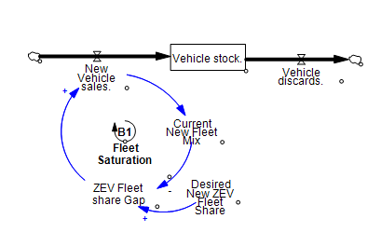
CLD: Fleet Saturation loop
Policy & Market Conditions
Refueling
Infrastructure
ZEV Target
Consumer
Choice (DCM)
Vehicle Fleet
Dynamics
Network effects

Slide 10
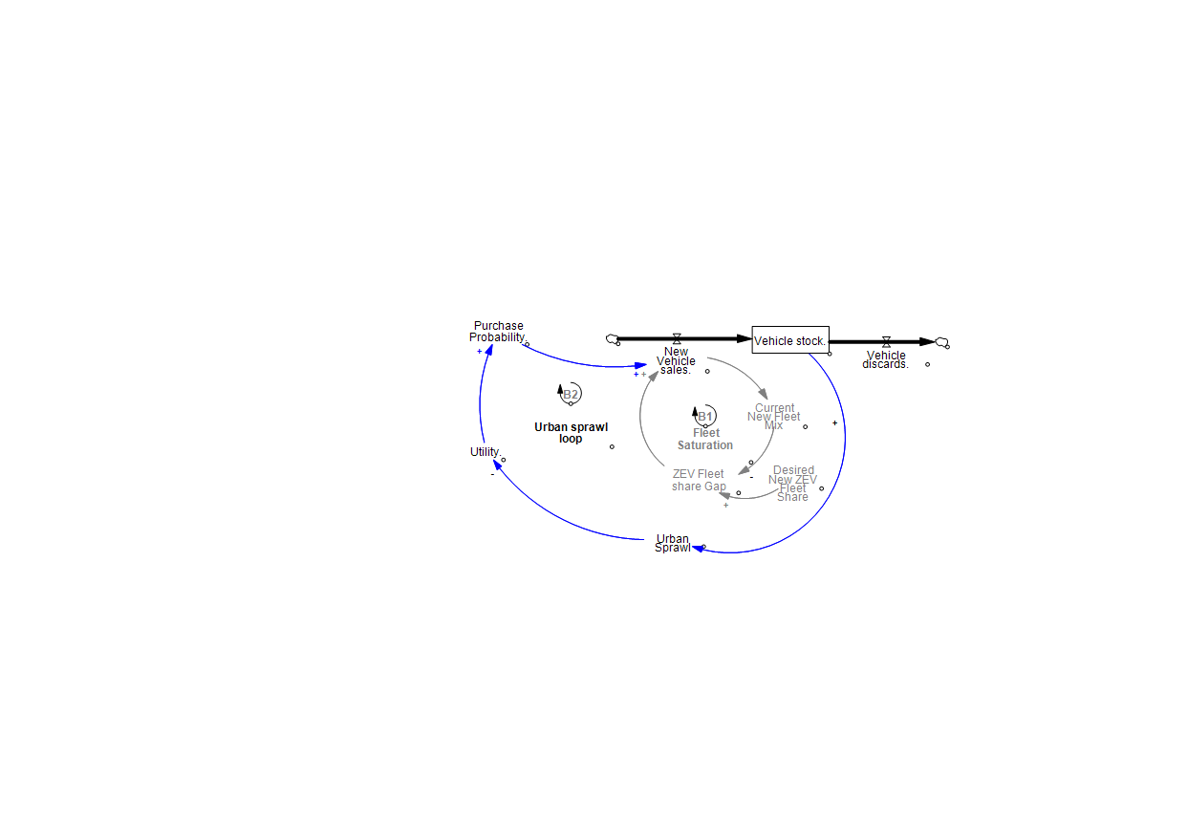
CLD: Urban Sprawl Weakens the Adoption Incentive
Policy & Market Conditions
Refueling
Infrastructure
ZEV Target
Consumer
Choice (DCM)
Vehicle Fleet
Dynamics
Network effects

Slide 11
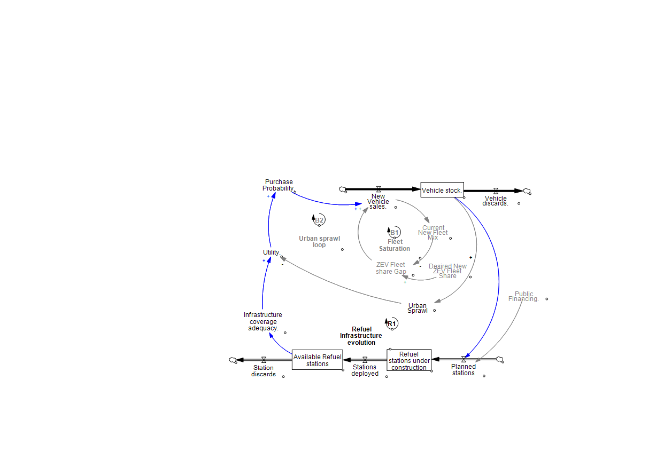
CLD: Infrastructure Availability Drives Adoption
Policy & Market Conditions
Refueling
Infrastructure
ZEV Target
Consumer
Choice (DCM)
Vehicle Fleet
Dynamics
Network effects

Slide 12
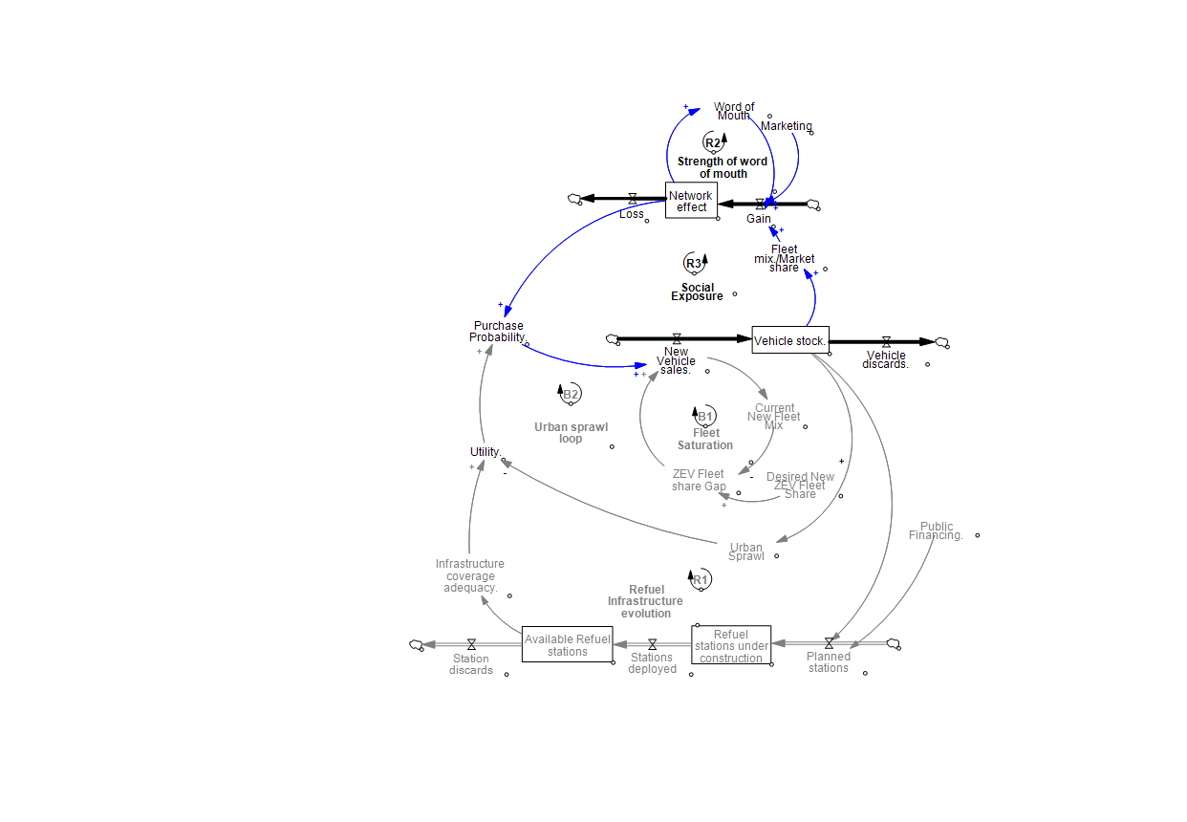
CLD: Visibility and Advocacy Create Market Momentum
Policy & Market Conditions
Refueling
Infrastructure
ZEV Target
Consumer
Choice (DCM)
Vehicle Fleet
Dynamics
Network effects

Slide 13
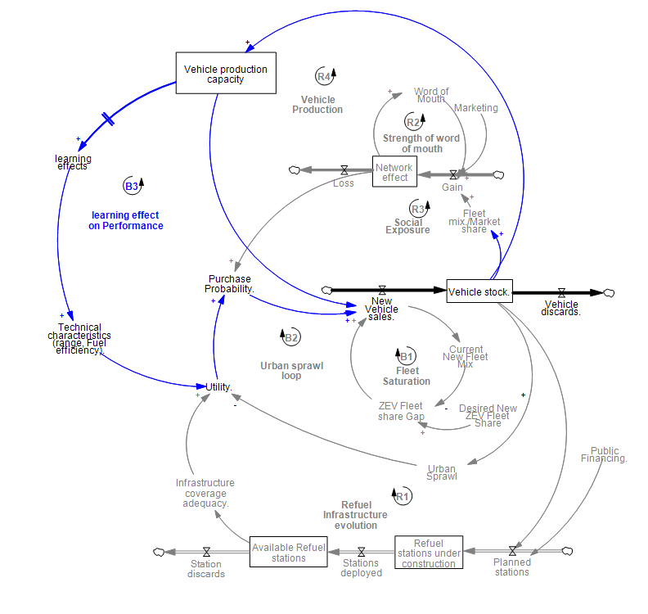
CLD: More Production Creates Better Vehicles
Policy & Market Conditions
Refueling
Infrastructure
ZEV Target
Consumer
Choice (DCM)
Vehicle Fleet
Dynamics
Network effects

Slide 14
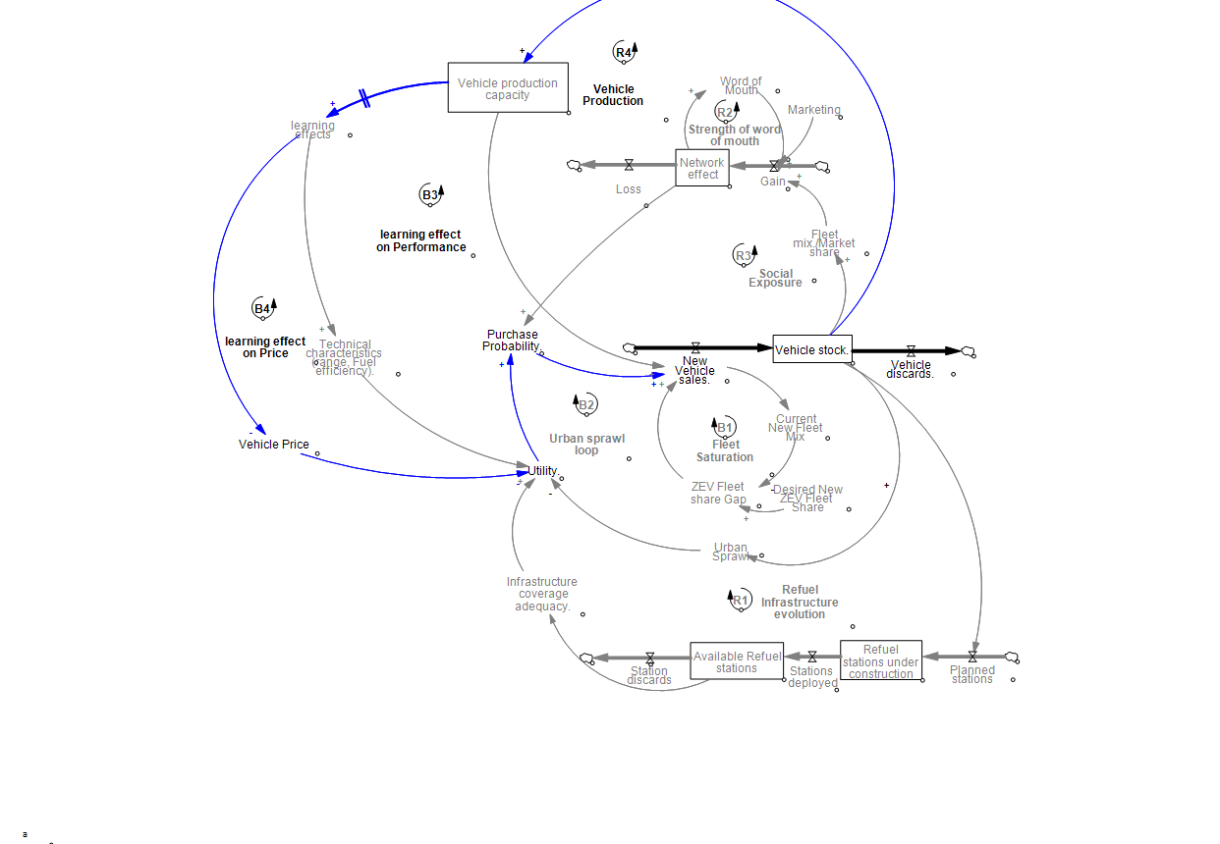
CLD: Learning Effects Drive Down Vehicle Prices
Policy & Market Conditions
Refueling
Infrastructure
ZEV Target
Consumer
Choice (DCM)
Vehicle Fleet
Dynamics
Network effects

Slide 15
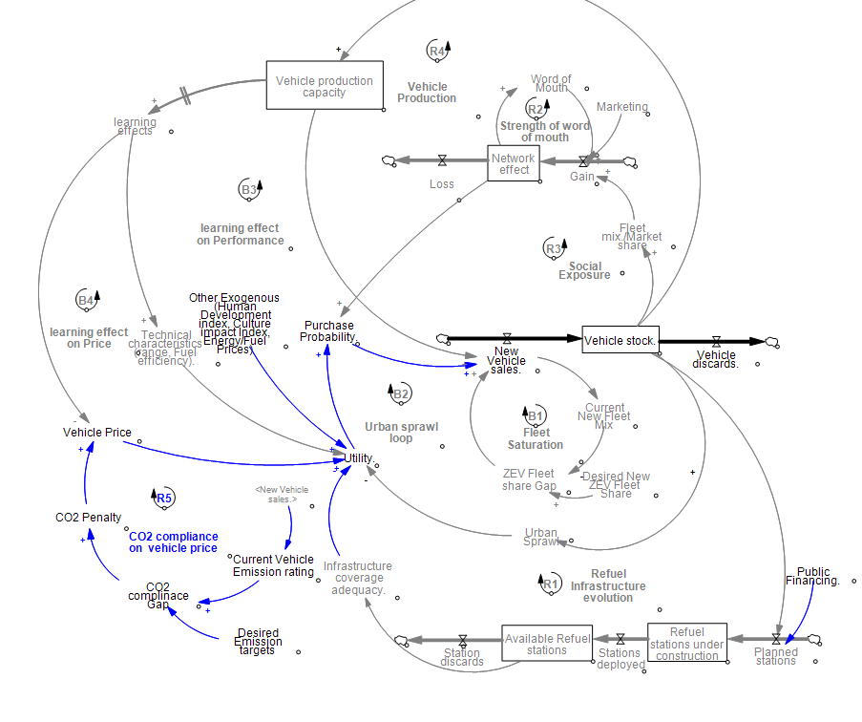
CLD: Emissions Regulations Drive ZEV Adoption
Policy & Market Conditions
Refueling
Infrastructure
ZEV Target
Consumer
Choice (DCM)
Vehicle Fleet
Dynamics
Network effects
Notes:
---
This slide references information from the following file: https://usi365-my.sharepoint.com/personal/abam_usi_ch/_layouts/15/Doc.aspx?sourcedoc=%7BF7AAAB68-1A60-413D-87C4-E8D1B29E0F93%7D&file=Switzerland%20Transportation%20case%20study%20-%20manuscript.docx&action=default&mobileredirect=true
At the heart of the system dynamics model is the interaction between reinforcing and balancing feedback loops that collectively shape the trajectory of electric vehicle adoption. Reinforcing loops capture mechanisms that accelerate adoption once a certain momentum is achieved. For example, as more consumers adopt EVs, demand for charging infrastructure increases, which in turn improves infrastructure coverage and convenience. This reduces range anxiety and increases the perceived attractiveness of EVs, leading to further adoption. Similarly, increased sales volumes contribute to learning-by-doing and economies of scale, which lower vehicle costs over time and further strengthen adoption incentives. In contrast, balancing loops represent constraints that slow or stabilise the system. High upfront purchase prices, limited affordability for lower-income households, lingering advantages of internal combustion vehicles, and slow fleet turnover all act as balancing forces that resist rapid change. The dominance of either reinforcing or balancing loops at different stages of the transition determines whether adoption accelerates, stabilises, or stalls. The model demonstrates that early in the transition, balancing loops dominate, keeping EV adoption marginal. Over time, reinforcing loops begin to activate, but unless they become sufficiently strong, the system may settle into a partial equilibrium where EVs and ICVs coexist. Understanding this feedback structure is essential for evaluating why some policy interventions succeed in accelerating adoption while others have negligible effects.

Slide 16
Model Calibration result
Item | Correlation (R²) | RMSE | Systematic Bias | Variation Error | Covariation Error
Passenger Vehicle Stocks | 0.998 | 26'057.60 | 0.15 | 0.23 | 0.62
ICV Stocks | 0.998 | 15'686.33 | 0.36 | 0.18 | 0.46
EV Stocks | 0.998 | 3'333.75 | 0.24 | 0.01 | 0.74
ICV Sales | 0.705 | 28'437.57 | 0.06 | 0.30 | 0.64
EV Sales | 0.992 | 3'909.30 | 0.22 | 0.49 | 0.30
ICV Sales Share | 0.980 | 0.01608 | 0.04 | 0.34 | 0.62
EV Sales Share | 0.980 | 0.01592 | 0.02 | 0.16 | 0.82
ICV Market Share | 1.000 | 0.000804 | 0.32 | 0.01 | 0.67
EV Market Share | 1.000 | 0.000804 | 0.32 | 0.09 | 0.60
Charging Stations | 0.982 | 1'768.85 | 0.00 | 0.51 | 0.49

Slide 17
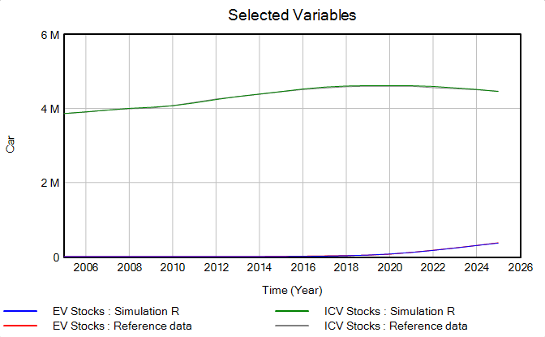
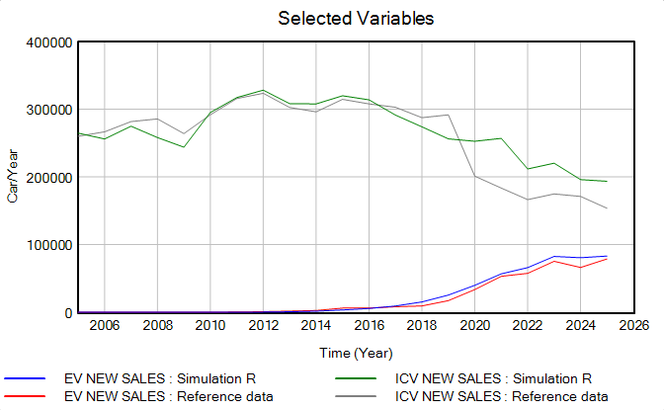
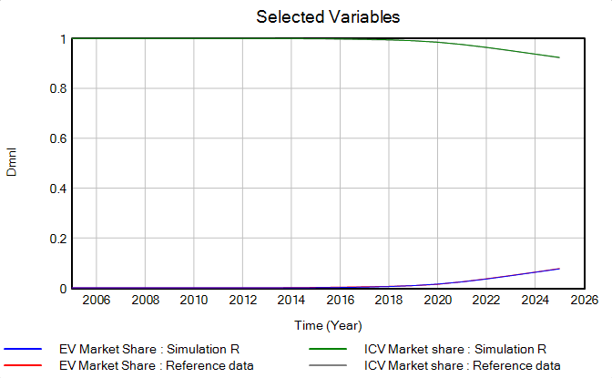
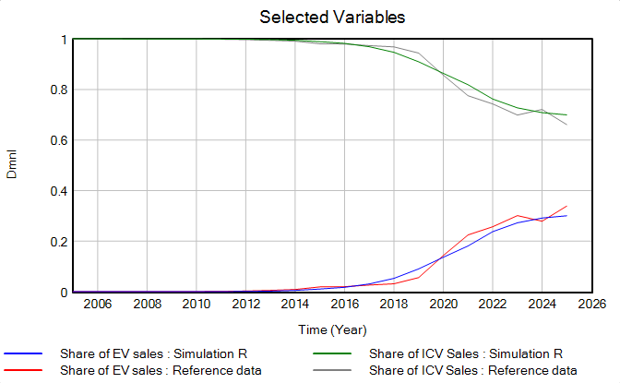
PASSENGER VEHICLE STOCK
PASSENGER VEHICLE SALES
Vehicle stock SHARES
Vehicle SALES SHARES

Slide 18
Policy Interventions
Notes:
---
This slide references information from the following file: https://usi365-my.sharepoint.com/personal/abam_usi_ch/_layouts/15/Doc.aspx?sourcedoc=%7BF7AAAB68-1A60-413D-87C4-E8D1B29E0F93%7D&file=Switzerland%20Transportation%20case%20study%20-%20manuscript.docx&action=default&mobileredirect=true
Comparison of Policy Scenarios

Slide 19
Policy Scenarios
Scenario/Policy | Policy
S0 — BAU (Baseline) | —
S1 — Awareness | Awareness rate amplified via campaign
S2 — Infrastructure Supply Push | 4k Public charging p.a and Home charging station (RtC)
S3 — Subsidy Pull | CHF 5000 / BEV Restored Until 2030
S4 — Combined Policy scenario | All Three Policies
**Note: Importer CO2 compliance policy: 0 g/km by 2035 Aligned with EU ICE phase-out trajectory
Notes:
---
This slide references information from the following file: https://usi365-my.sharepoint.com/personal/abam_usi_ch/_layouts/15/Doc.aspx?sourcedoc=%7BF7AAAB68-1A60-413D-87C4-E8D1B29E0F93%7D&file=Switzerland%20Transportation%20case%20study%20-%20manuscript.docx&action=default&mobileredirect=true
To assess the effectiveness of different policy approaches, the study evaluates multiple intervention scenarios focusing on financial incentives, charging infrastructure expansion, and marketing efforts. Scenario analysis reveals that policy impacts depend not only on their presence but on their ability to alter the underlying feedback structure of the system. Temporary purchase subsidies reduce upfront cost barriers and accelerate adoption during the intervention period, but their effects diminish once subsidies are withdrawn. Infrastructure investment improves convenience and reduces range anxiety, yet on its own produces only modest long-term gains. Marketing and information campaigns, when implemented without addressing cost or infrastructure constraints, have virtually no measurable impact on adoption trajectories. These findings underscore the importance of policy intensity, duration, and coordination. Interventions that fail to weaken dominant balancing loops or strengthen reinforcing mechanisms beyond a critical threshold are effectively absorbed by the system, resulting in policy insignificance. In contrast, policies that enable reinforcing dynamics to activate earlier can have lasting effects, even if they do not fully transform the system on their own. This comparative analysis provides valuable guidance for policymakers seeking to design interventions that move beyond incremental change.

Slide 20
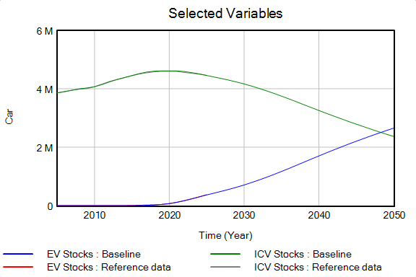
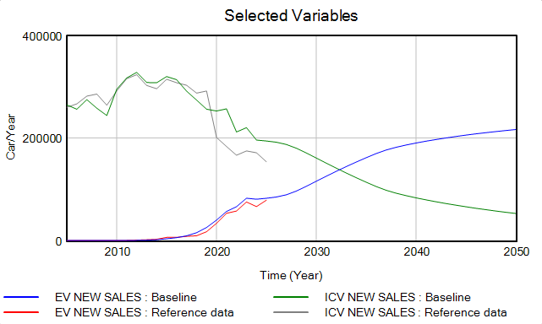
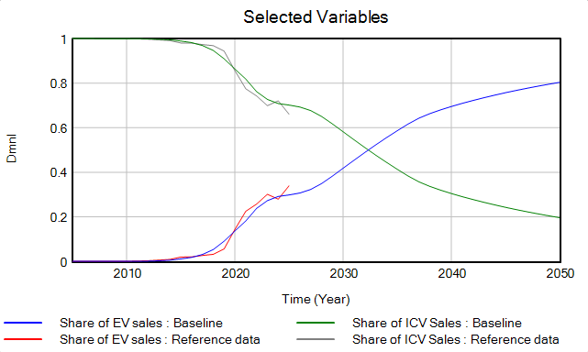
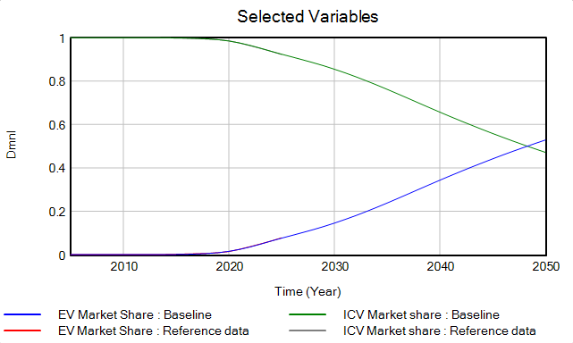
Baseline scenario
Passenger Vehicle stock
Passenger vehicle sales
EV sales reach parity with ICV sales around 2032.
EV stock overtakes ICV stock around 2047.
Transition occurs gradually without additional intervention.
Vehicle stock SHARES
Vehicle SALES SHARES

Slide 21
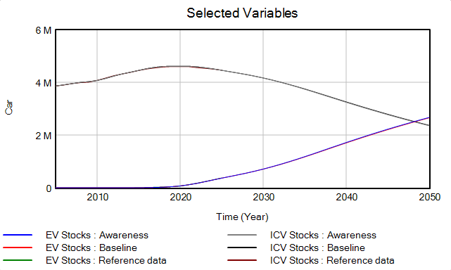
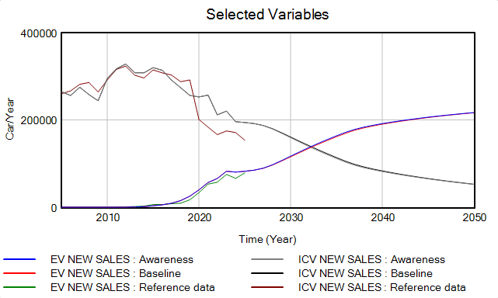
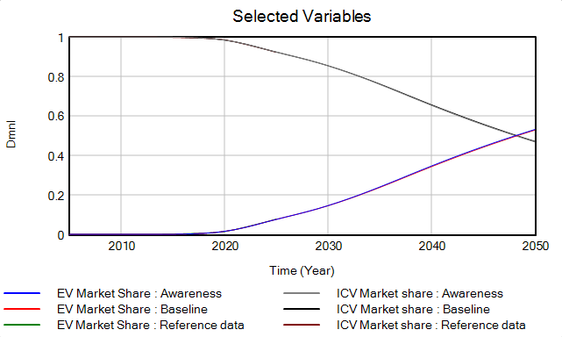
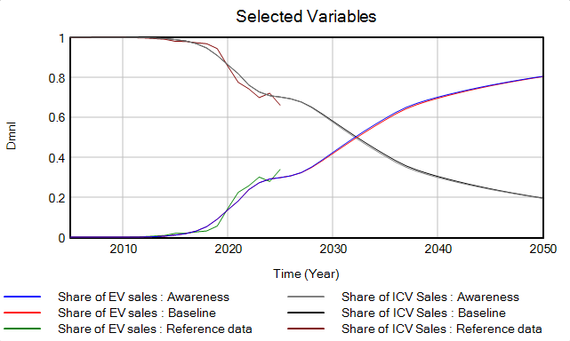
Awareness push Scenario
Passenger Vehicle stock
Passenger vehicle sales
Additional awareness measures produce negligible changes relative to the baseline.
Awareness alone does not appear to be the primary barrier to adoption.
Vehicle stock SHARES
Vehicle SALES SHARES

Slide 22
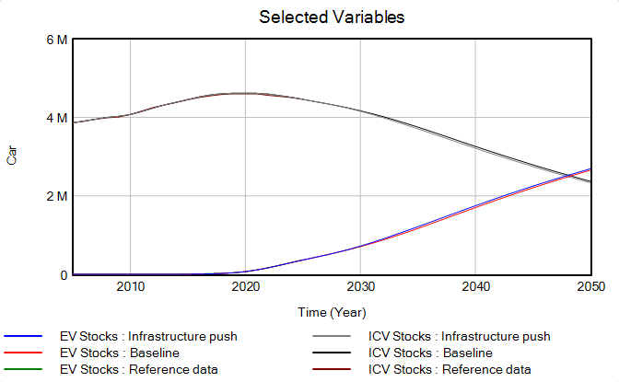
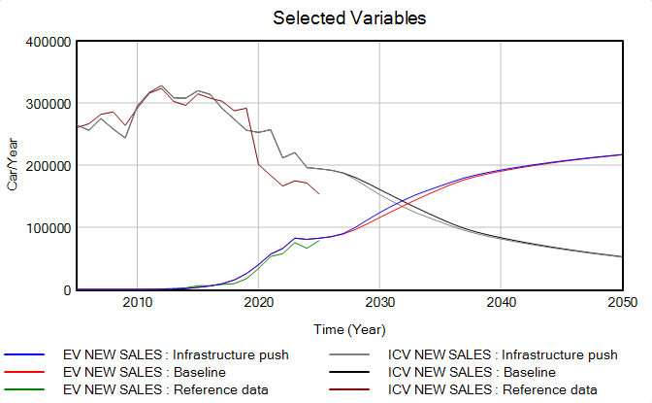
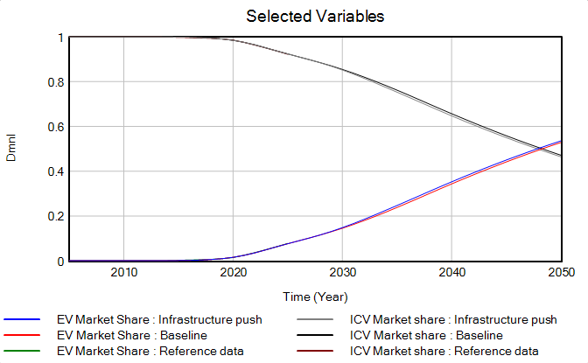
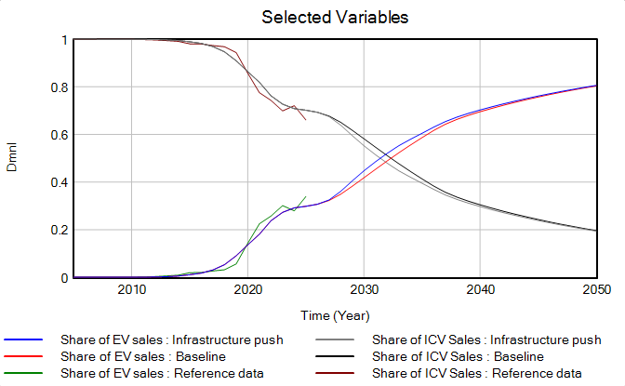
Infrastructure supply Push Scenario
Passenger Vehicle stock
Passenger vehicle sales
Increased infrastructure supply yields only marginal improvements versus the baseline.
Other factors likely represent more significant adoption constraints than charging infrastructure alone.
Vehicle stock SHARES
Vehicle SALES SHARES

Slide 23
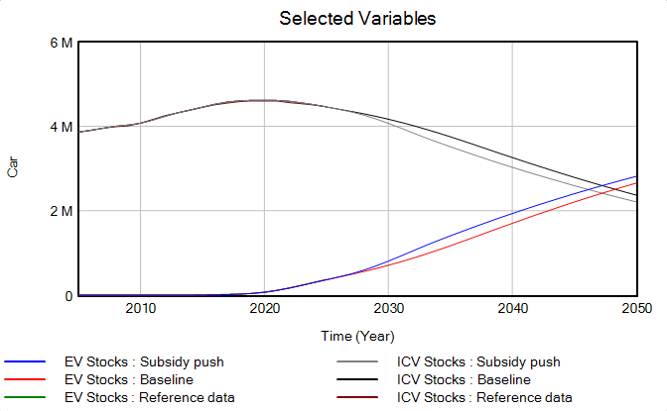
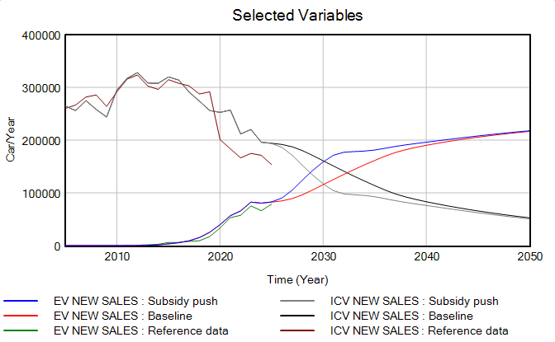
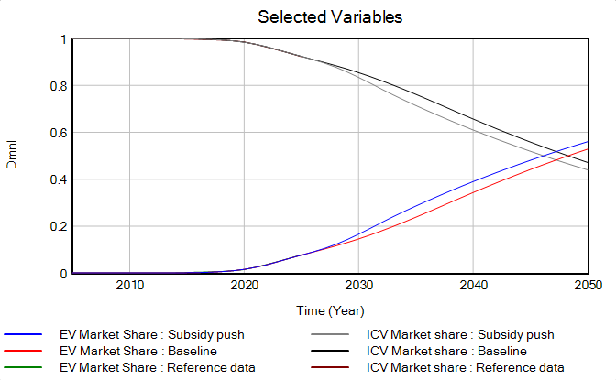
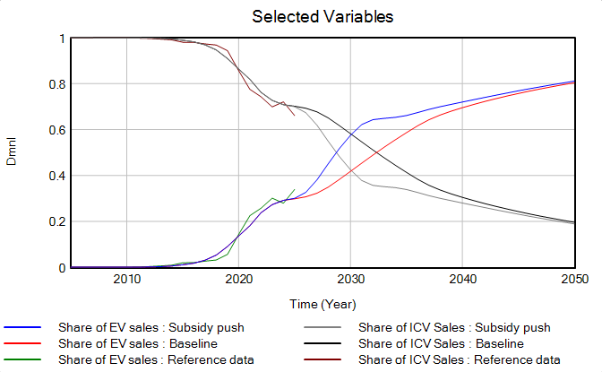
Subsidy-Pull Scenario
Passenger Vehicle stock
Passenger vehicle sales
Subsidies are the most effective policy lever tested, generating the largest increase in EV adoption.
Financial incentives accelerate EV–ICV sales parity by approximately 2 years.
Results suggest vehicle purchase economics remain a more important adoption driver than awareness campaigns or infrastructure expansion alone.
Vehicle stock SHARES
Vehicle SALES SHARES

Slide 24
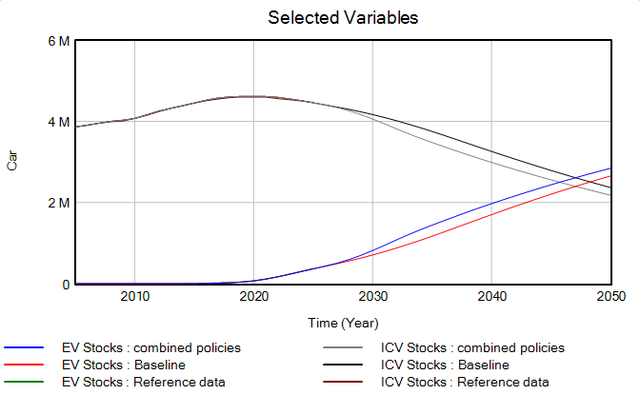
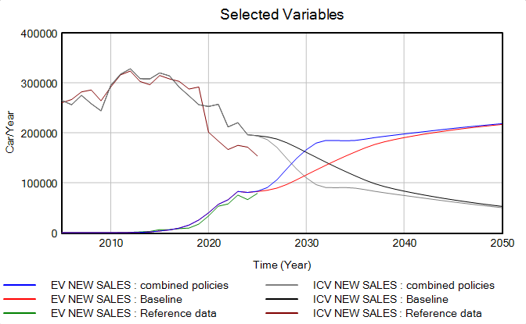
Combined Policy Scenario
Passenger Vehicle stock
Passenger vehicle sales
Vehicle stock SHARES
Vehicle SALES SHARES

Slide 25
Conclusions and Implications
Key Insights
EV adoption progresses naturally under the baseline scenario, with EVs gradually replacing ICVs over time.
Awareness campaigns have minimal additional impact on EV uptake compared to the baseline.
Infrastructure expansion alone delivers limited acceleration of adoption, acting mainly as an enabling factor.
Consumer economics appear to be the primary driver of vehicle choice and adoption behavior.
Policy Implications
Prioritize targeted financial incentives to accelerate EV adoption.
Maintain infrastructure investments to support growth, but not as a standalone strategy.
Shift policy focus from awareness to affordability, as awareness is unlikely to be the main barrier.
Adopt a balanced policy mix combining incentives, infrastructure, and supporting measures to maximize impact

Slide 26
Future works
Incorporate Heterogeneity: Income and powertrain
Consumer behaviour
Policy Optimization

Slide 27

THANK YOU FOR LISTENING

