Slide 1
Are we in the system Dynamics community really going to be able to reach ceo’s and
Other leaders?
John w. Rodat
Public Signals, LLC
System Signals, LLC
“Think in Systems and use the Damn data” international system dynamics conference - 2026
A Skeptic’s Thoughts and Some Possible Positives

Slide 2


60 second self introduction
Talk about “bullwhip”
effects! Try it in #4
In order to fly airplanes, why do
pilots “fly” … simulators?
Me

Slide 3
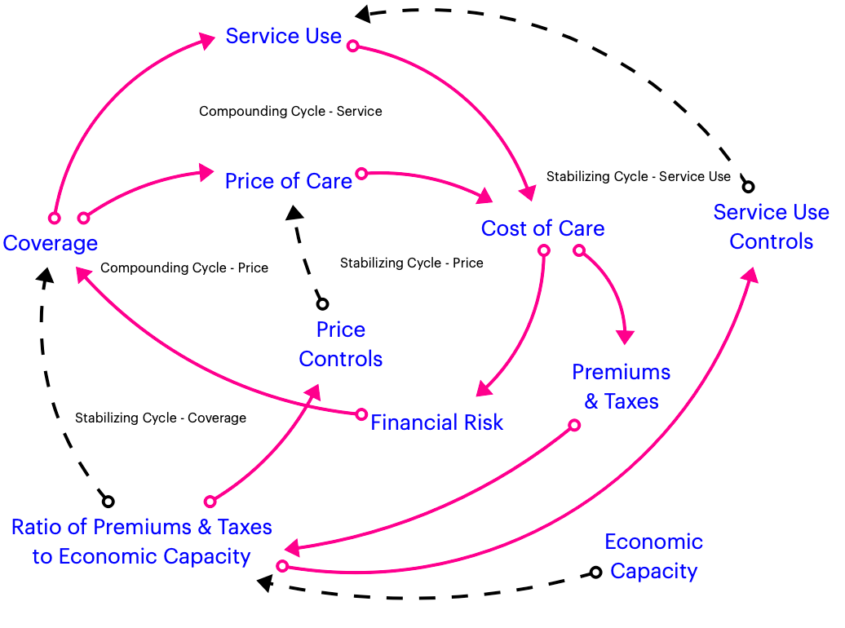
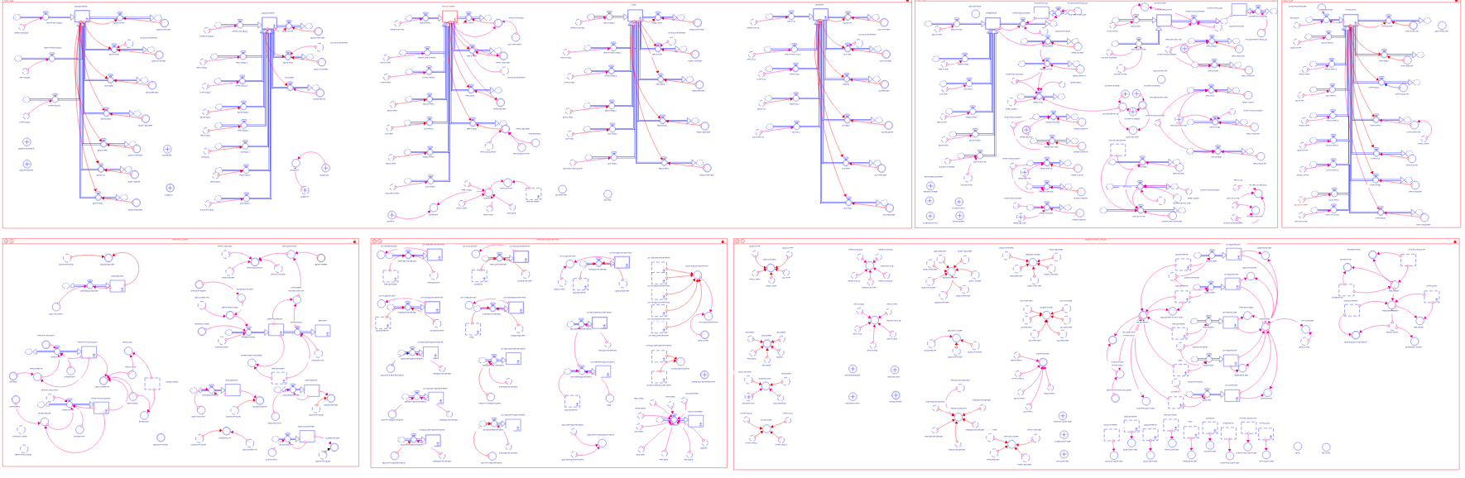
60 second self introduction
Done in public: There’s a model behind this CLD. But equally important,
reconstructing this CLD in a Legislative hearing with an
audience of 200+ was the pivot to the Law that 30 years later, still governs
hospital finance in New York.
Done in private: In contrast, you’ll never see the details or results of this model of New York’s nursing home finance system. It convinced the client he was wrong, spared him some embarrassment. And, it showed him an alternative path
How? Ask me afterwards. You may get a fun story as a bonus.

Slide 4

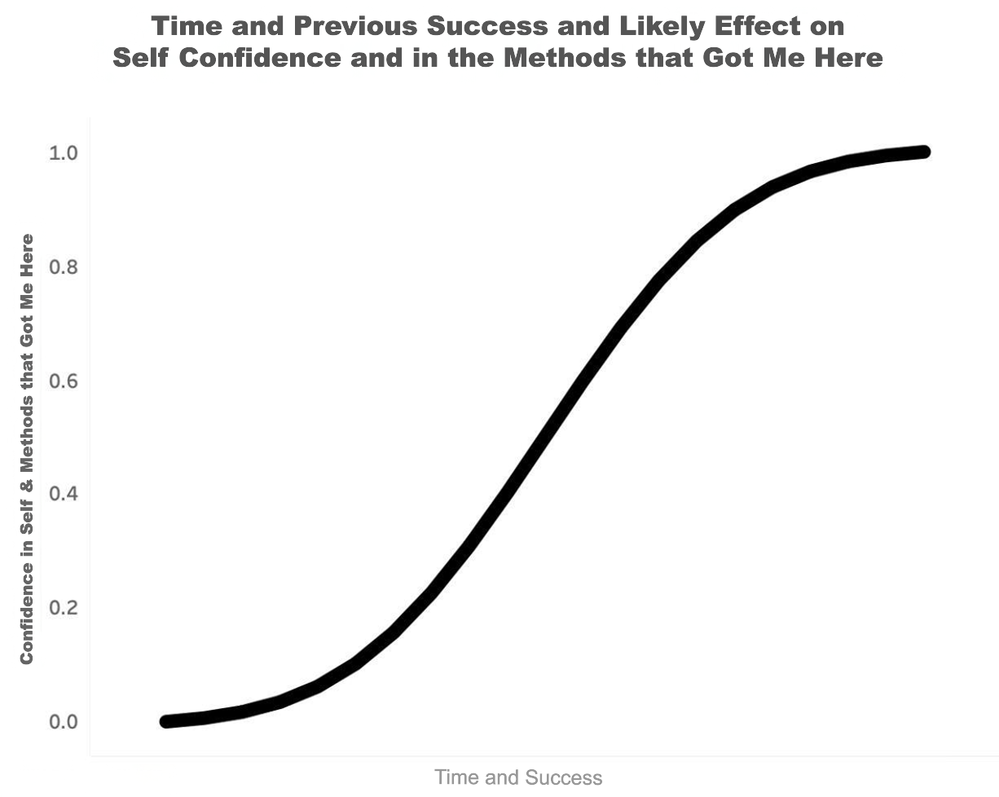
It’s an individual ceo problem
Formally & informally, today’s leaders were trained in and succeeded with linear, unidirectional, static thinking –
Some hypotheses:
The higher they’ve climbed, the more successful they’ve become, the more confident of not only of themselves, but of what they’ve learned
They’ve not only learned methods, they’ve developed habits of mind

Slide 5
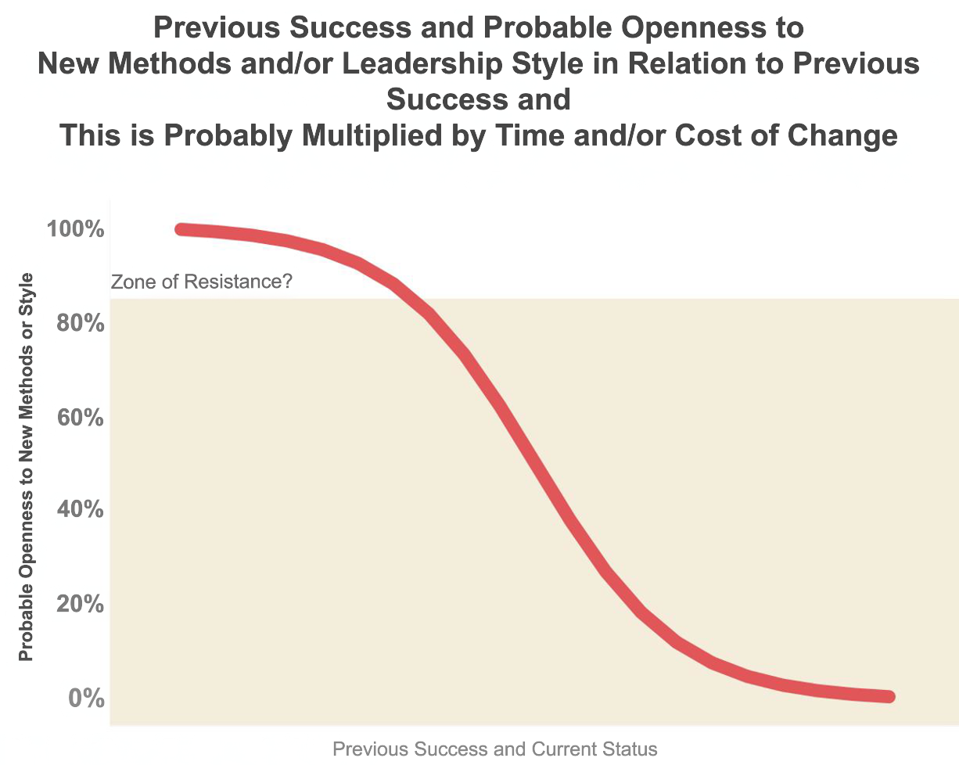
It’s an individual ceo problem
Success and status that appear to come from linear, unidirectional thinking are not going to make change easy. Quite the opposite
The higher they’ve climbed, the more successful they’ve become, the more confident of not only of themselves, but of what they’ve learned
On their way to being successful, they’ve developed ”habits of mind and practice,” in which they’ve grown increasingly confident … and less open to alternatives
Moreover, the higher they’ve climbed, the more complex the challenges they face
The higher they’ve climbed, the less they have of that most precious of stocks, TIME
And, we in the SD community know how much time is required to really learn the discipline and a different way to see the world
Notes:
We DO need new leaders and new types of leaders
Business problems are broken down into measurable parts and solved rationally. Value is the result of shareholder return, & financial metrics
With notable exceptions, MBA and Economics programs tend to be reductionist, linear, and unidirectional.
Even those not formally trained thus swim in the same pool (and they do learn Excel™, (the quintessential linear tool).
Approach (or attack) from the side or rear. Engage in metaphorical, intellectual guerrilla warfare.
Recall Kuhn’s The Structure of Scientific Revolutions. When they do happen, it’s through a network, not at a constant speed. And, for the old order to be replaced, the old theories, theorists and practitioners must be replaced

Slide 6
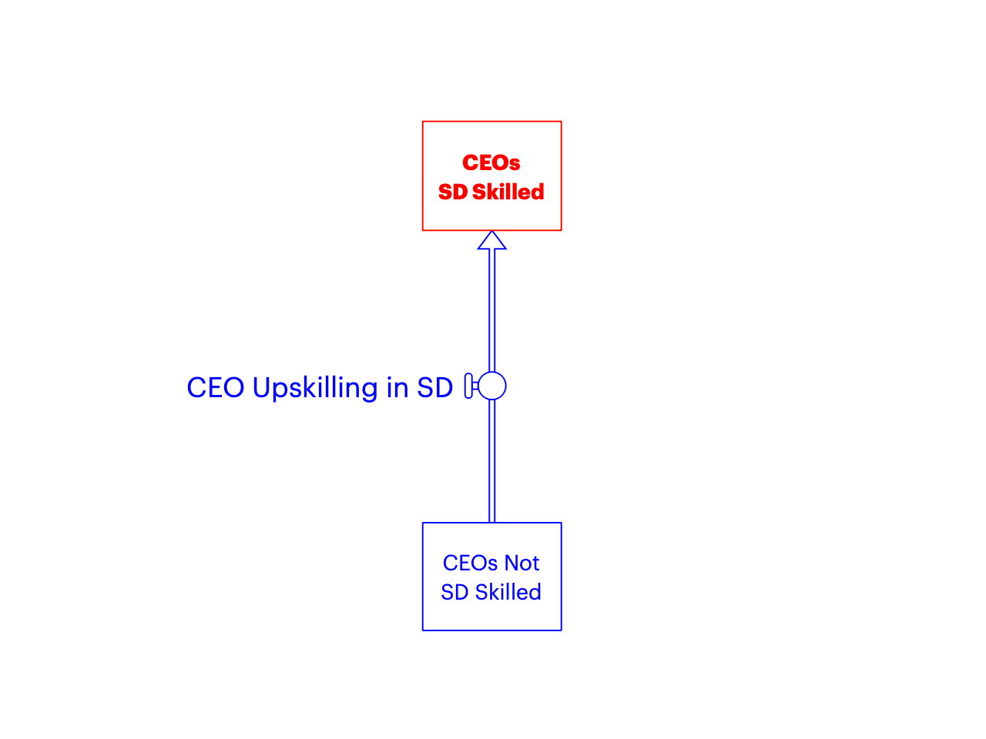
Ceo Upskilling: the topic & goal
It’s not just an individual ceo problem
It’s a system problem!

Slide 7
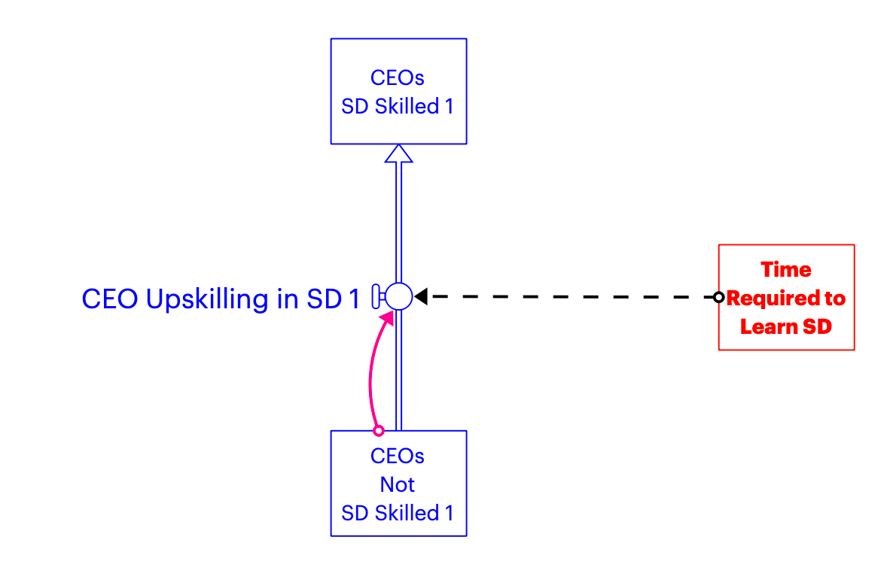
a challenge that we in the sd community have embedded in our thinking?
Time and delays

Slide 8
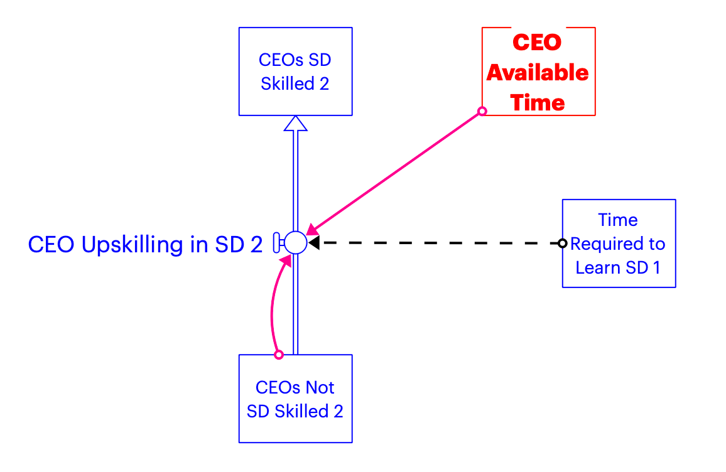
And available time is what ceos have very little of, if any

Slide 9
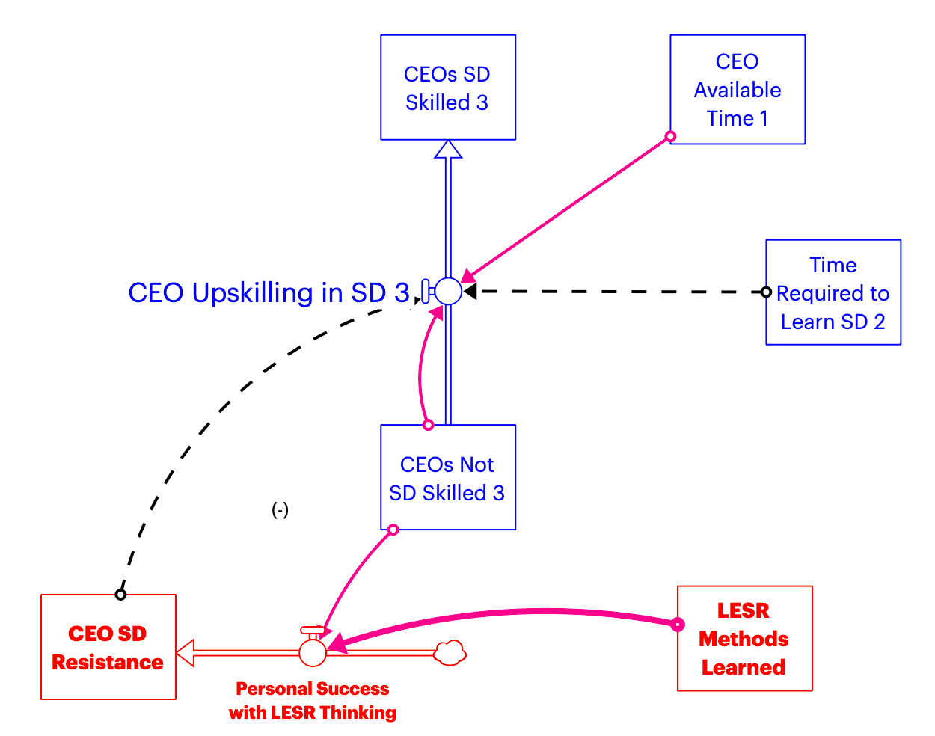
Moreover, they’ve been very successful with lesr thinking, making them especially resistant

Slide 10
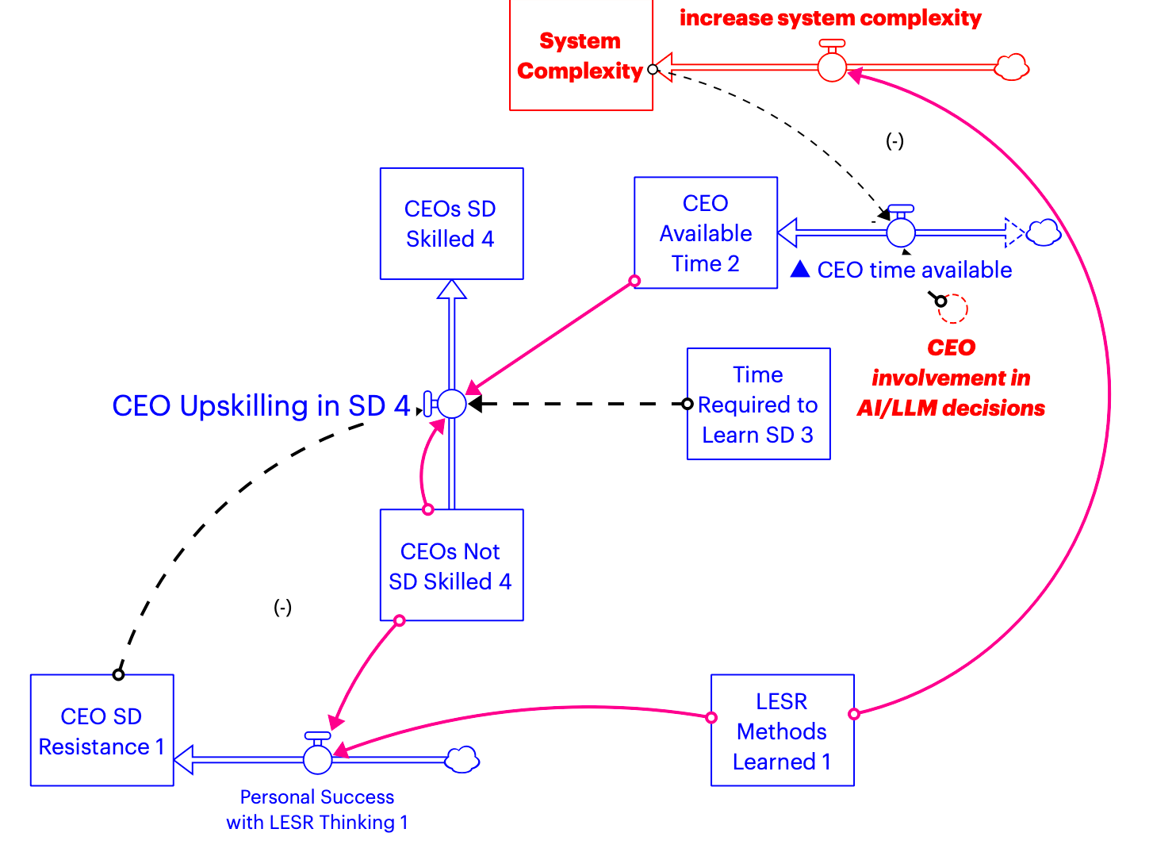
And, lesr based decisions made over a half century have contributed to their internal organizations & the world in which they operate being much more complex. (Structures adding complexity not shown)

Slide 11
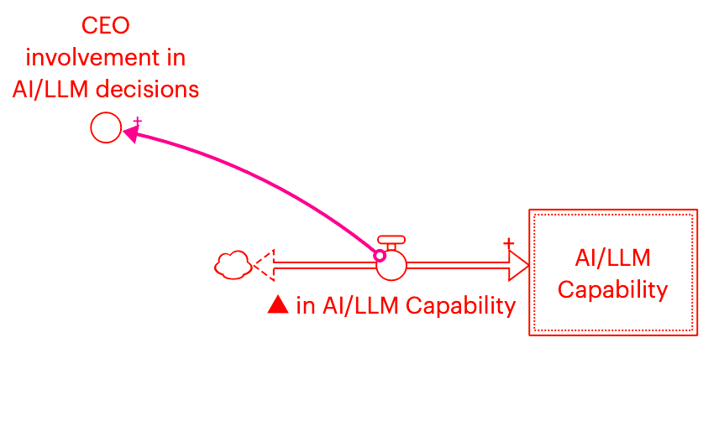
Piling on to already complex CEO jobs - AI

Slide 12
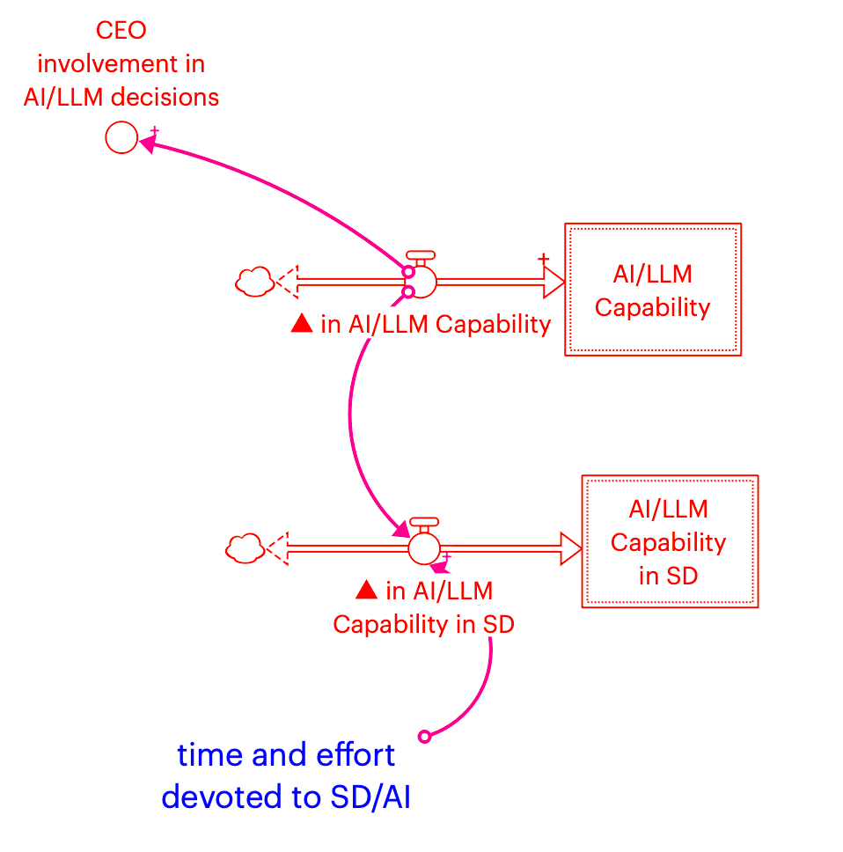
So it’s on us. The sd community can and must take advantage of increasing capability to reach much larger audiences and help solve much bigger and more complex problems
Notes:
AI can be used not only to accelerate model building, but to accelerate SD learning
AI:
Compresses cycle-times
Multiplies abstraction layers which may force second and n-order thinking, one of the pillars of SD. This new multi-level thinking may not even be conscious and it may not all lead to closed loops, but it will still be different
It may tend to routinize execution
It may save time on execution – which may leave more time for the even harder stuff: judgement. Judgement tends to come from experience. Can SD based simulators effectively substitute for real-world experience in developing judgement?

Slide 13
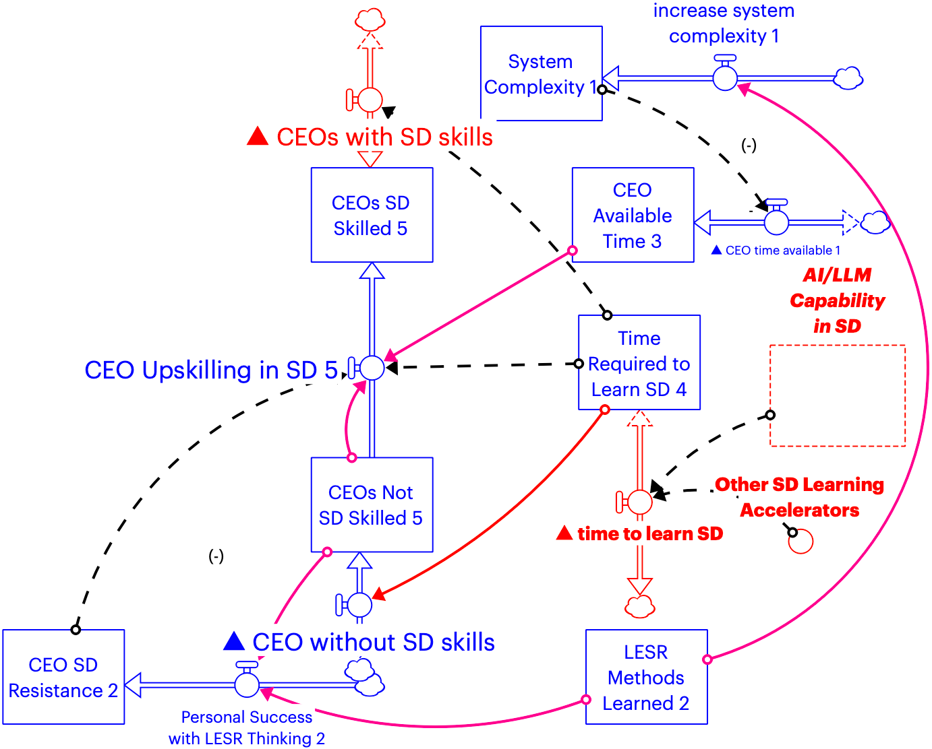
System perspective: the key lever is not directly with ceos. It’s reducing the time required to learn, absorb & adopt Sd, both for current & especially with future ceos & other leaders

Slide 14
Some suggestions and thanks
Everyone in the SD Community Must be Engaged in Reaching Many and Any Other Audiences
Use AI/LLMs to Accelerate SD Learning as Well as to “Solve” Particular, Big Problems
Everyone in the SD Community Should Develop the Habit of Asking “What Happens Then?” Repeatedly!
Find future leaders, including middle managers, minor political office holders, etc., and engage them
Find the frustrated and wary and engage them
Notes:
Acknowledge Sara Metcalf and BEAMS, Billy Schoenberg and Alton Alexander
However small, we all have networks. Engage them. Be like Kuhn’s scientists with ideas that will upend the old orders and paradigms. Repeatedly. The Society should add a criterion to evaluate future ISDC proposals: “How will this work expand the reach of SD, and did they include financial consequences?” Find organizations that have benefited from ST/SD. New aids for community participatory ST/SD projects should be developed. New pathways to bridge the intellectual gap between Causal Loop Diagrams and functional SD models should be developed.
AI tools in SD are rapidly advancing. This needs to be accelerated. AI tools and methods must also help explain to lay audiences and people new to the field why models behaving as they do.
When the medical community recognized that it had a problem with errors, it learned to ask “Five Whys?” to get to the causal roots. That practice was very useful, but was limited to reviewing the past. When a proposal to “solve” any problem is offered, we should all develop the habit of asking five times, “What might happen then?”
Forrester was right about getting to kids early. But we do not have enough time to wait for them or their education systems. A legitimate question is what approach will have the widest and fastest success, reaching and upskilling current leaders or reaching and upskilling future leaders? (We need a model here!)
Those who are frustrated sense (or know) that something is wrong. But they may not yet have the tools to understand why. Engage them. Encourage them to expect more system thinking & communicating from leaders. ENGAGE IN INTELLECTUAL GUERILLA WARFARE!!!
Caution: asking “and then” of one’s spouse or partner may be ill-advised

Slide 15
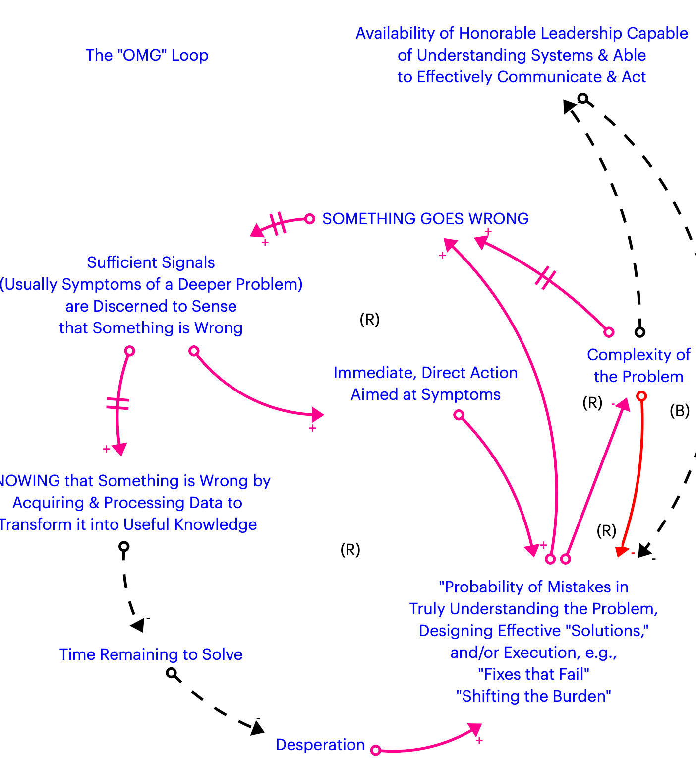
With a respectful nod to Col. John Boyd, USAF and his OODA Loop, a first draft of the "OMG" loop

Slide 16
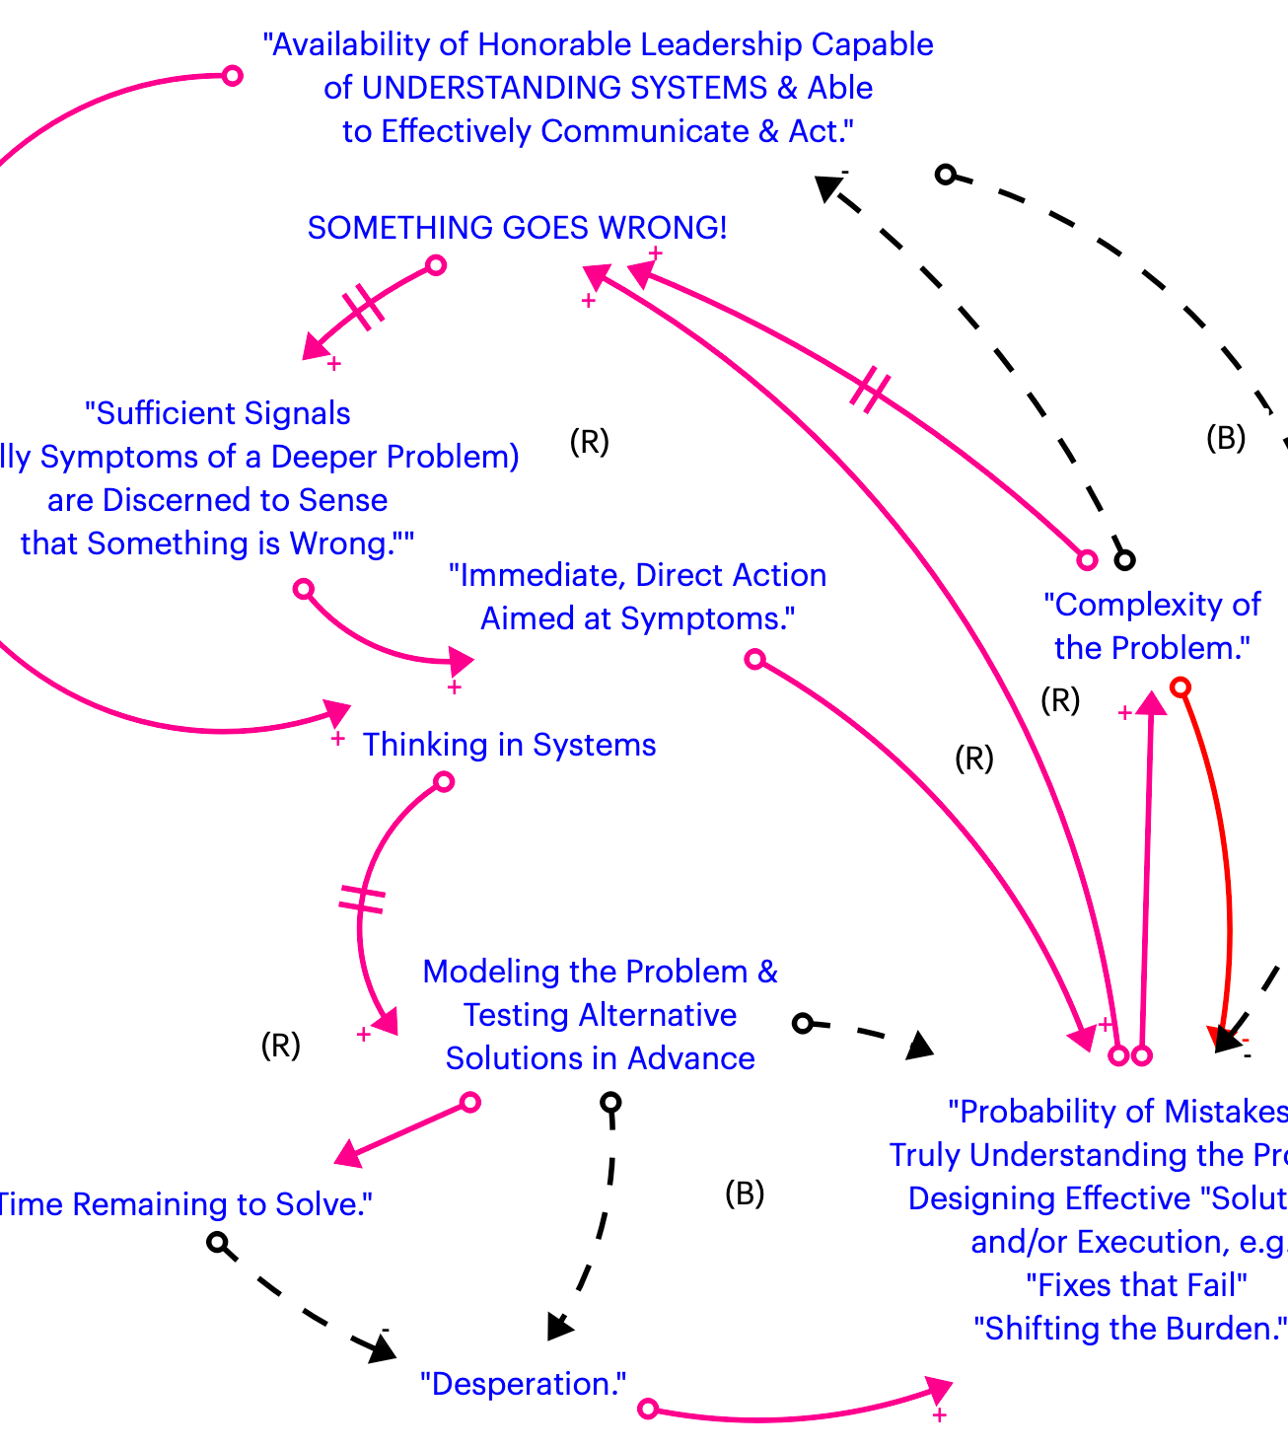
System dynamics rides to the rescue?
Add System Thinking/System Dynamics to the Mix and get some balancing loops
We need to increase the stock of honorable leaders capable of understanding systems and capable of effectively communicating and acting. This takes TIME and effort
But, usually, without the ground being prepared in advance, this is difficult, especially in a crisis
So ask the question, “why do pilots fly simulators as well as airplanes?”

