Slide 1





Designing investment strategies for a regionally self-sufficient healthcare system in South Korea:
An agent-based modeling and simulation approach
Online Poster Presentation
Moo Hyuk Lee^{1,¶}, Jungwoo Kim^{2,¶}, Ji-Su Lee³, Taesik Lee^{2,3}, and Young Kyung Do^{4,5}
1 Department of Biomedical Sciences, Seoul National University College of Medicine
2 Department of Industrial & Systems Engineering, Korea Advanced Institute of Science and Technology
3 Graduate School of Data Science, Korea Advanced Institute of Science and Technology
4 Department of Health Policy and Management, Seoul National University College of Medicine
5 Institute of Health Policy and Management, Seoul National University Medical Research Center
¶ The two authors contributed equally.
0:00-0:30
@systemdynamics_
THE 44TH INTERNATIONAL SYSTEM DYNAMICS CONFERENCE
Delft, Netherlands and Virtually
#isdc2026
Notes:
Title page: Change title to submission name. Bold the name of the presenter and display your name as you want it read by the moderator (eg Bob instead of Robert). Note the suggested timing in the bottom right. Slide timing may be adjusted, but not the number of slides.

Slide 2

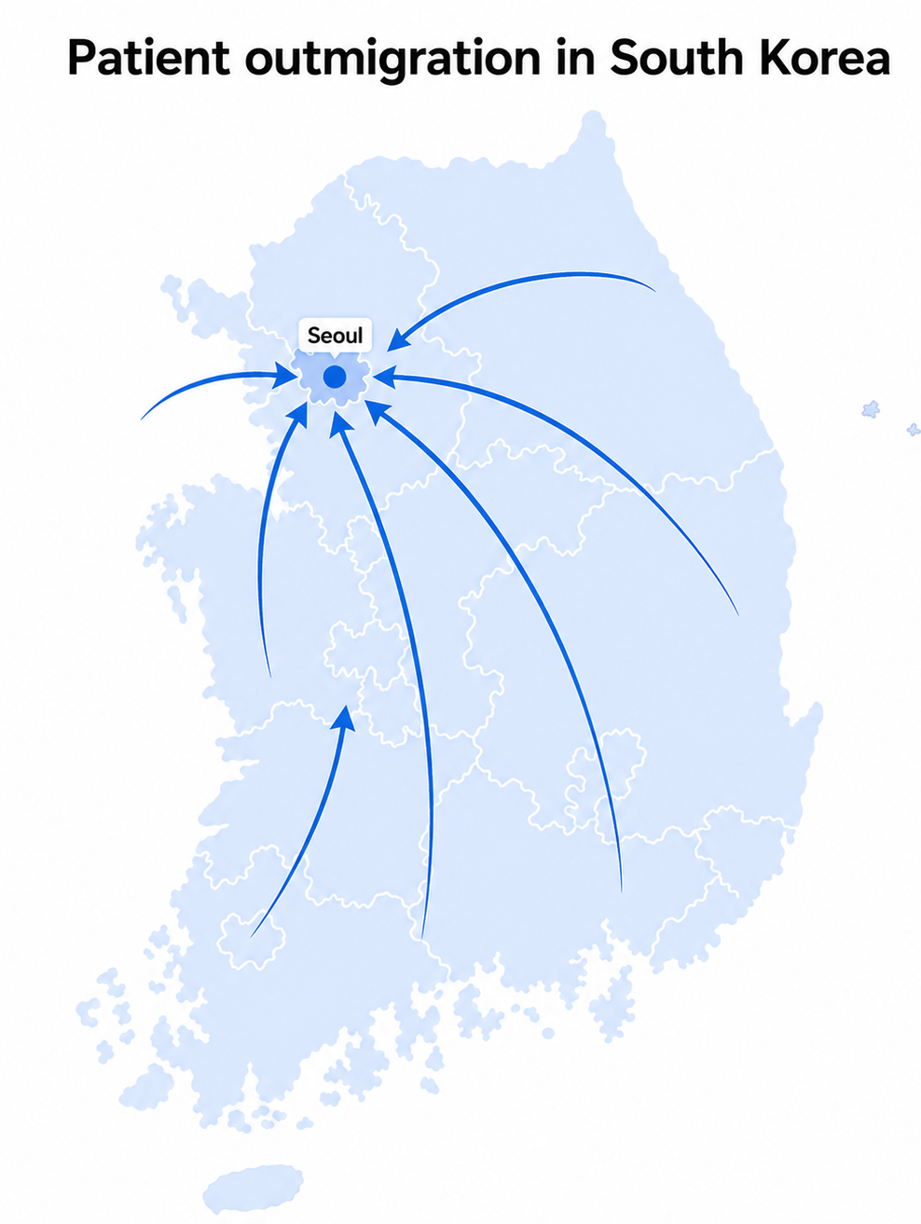
Problem Statement
South Korea faces substantial patient outmigration from local regions toward the capital city Seoul.
The government has introduced an investment policy to develop a “regionally self-sufficient healthcare system,” which aims to strengthen local healthcare systems.
However, the inherent complexity of the healthcare system (i.e., time delay, bidirectional feedback, nonlinearity) hinders the effectiveness of such investments in reducing outmigration.
0:30-2:00
@systemdynamics_
THE 44TH INTERNATIONAL SYSTEM DYNAMICS CONFERENCE
Delft, Netherlands and Virtually
#isdc2022
THE 40TH INTERNATIONAL SYSTEM DYNAMICS CONFERENCE
Virtually everywhere!
#isdc2026
Notes:
Keep fonts big (24 pt or bigger). Note suggested timing in the bottom right.

Slide 3
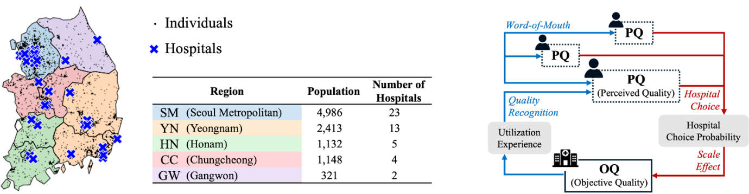
Approach
Agent-based modeling and simulation
  Incorporation of quality dynamics
  Multiple investment scenarios varying in target hospitals, timing, and magnitude
  Leaders strategy vs. Prospective strategy
2:00-3:30
@systemdynamics_
THE 44TH INTERNATIONAL SYSTEM DYNAMICS CONFERENCE
Delft, Netherlands and Virtually
#isdc2022
THE 40TH INTERNATIONAL SYSTEM DYNAMICS CONFERENCE
Virtually everywhere!
#isdc2026
Notes:
Keep fonts big (24 pt or bigger). Note suggested timing in the bottom right.

Slide 4
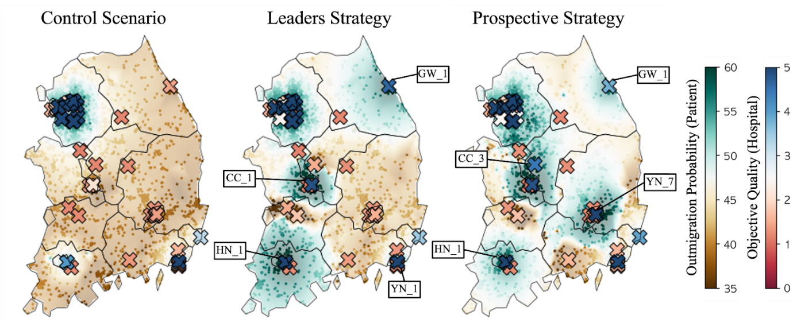
Results
Investments were effective when:
  Target hospital: not confined to existing regional leaders
  Timing: early investments
  Magnitude: moderate-scale investments
3:30-5:30
@systemdynamics_
THE 44TH INTERNATIONAL SYSTEM DYNAMICS CONFERENCE
Delft, Netherlands and Virtually
#isdc2022
THE 40TH INTERNATIONAL SYSTEM DYNAMICS CONFERENCE
Virtually everywhere!
#isdc2026
Notes:
Keep the text short and fonts big. Some flexibility on font for images. Note suggested timing in the bottom right.

Slide 5
Conclusions
The effects of hospital investment on mitigating patient outmigration depend critically on where, when, and at what scale quality enhancements are implemented.
Policies aimed at constructing a regionally self-sufficient healthcare system must take into account the dynamic nature of healthcare systems.
5:30-7:00
@systemdynamics_
THE 44TH INTERNATIONAL SYSTEM DYNAMICS CONFERENCE
Delft, Netherlands and Virtually
#isdc2022
THE 40TH INTERNATIONAL SYSTEM DYNAMICS CONFERENCE
Virtually everywhere!
#isdc2026
Notes:
Keep the text short and fonts big. Any questions you want to pose to the audience can go here. Note suggested timing in the bottom right.

Slide 6
INTERNATIONAL SYSTEM DYNAMICS CONFERENCE
Instructions: Please do this!!!
1) Prepare your Online Poster presentation using a copy of this template.
  Change the presentation title and author information to match your submission.
  Do NOT change the number of slides with content.
  Change the body of the slides to present your work, following the instructions in the slide notes.
2) Submit your Online Poster presentation slides at https://webportal.systemdynamics.org by the Conference Material Submission Deadline
  Click on the title of your submission
  Select “Upload new or updated paper files”
  Upload the Powerpoint presentation file for your Online Poster slides
3) Follow the format and timing listed below:
  You have exactly 7:00 minutes to present, followed by up to 8:00 minutes of discussion.
4) You may record your presentation in advance
  If you are not able to attend the session, the recording will be used instead
  If you do attend, you can ask the chair to play the recording, or present live
  Add the YouTube Video ID to the Web Portal under “Review or update paper information”
5) If you make updates or change plans after the Conference Material Submission Deadline, send the session chair a note
  Use the contact information at https://isdc.systemdynamics.org
Notes:
This slide will be hidden from presentation. You may delete this instruction slide once your slides are ready.

