Slide 1
Operationalizing RE-AIM as a Dynamic System
John Pastor Ansah
Jansi Patel

Slide 2
What is RE-AIM
RE-AIM stands for Reach, Effectiveness, Adoption, Implementation, and Maintenance.
Together, these dimensions examine not only whether an intervention works, but also who participates, which organizations adopt it, how consistently it is delivered, and whether its effects are sustained over time.

Slide 3
What is RE-AIM
RE-AIM was developed in the late 1990s by Russell Glasgow and colleagues and
Formally introduced in 1999.
It emerged in response to concerns that many effective interventions produced
  limited population-level impact because they were tested under highly controlled conditions,
  reached only selected groups,
  were difficult to implement and sustain in routine settings.

Slide 4
The Problem:
We know what works…But it does not reach people
Only 17% of evidence-based practices are implemented
Average delay: 17 years
Massive waste of research investment
Persistent disparities despite effective interventions
The problem is not knowledge---its implementation

Slide 5
Why Interventions Fails
Health systems are complex, not linear
  Feedback loops
  Resource constraints
  Workforce dynamics
  Context variability
  Policy and incentives
  Interventions interact with systems—not operate in isolation

Slide 6
RE-AIM Framework
Reach – who is affected?
Effectiveness –does it work?
Adoption—who delivers it?
Implementation –how well is it delivered?
Maintenance –is it sustained?
Typically used as measurement, not theory

Slide 7
Motivation
Implementation is a dynamic process
  Implementation evolves over time
  Outcomes depends on feedback, delays, and capacity
  Static evaluation misses' system behavior

Slide 8
Key Limitation
RE-AIM does not explain:
Why adoption stalls
Why fidelity declines
Why programs collapse

Slide 9
Study Aims
Develop implementation dynamics model based on RE-AIM framework
Examine implementation trajectories
Create learning laboratory

Slide 10
RE-AIM Model Overview
Population engagement
Site adoption
Workforce capacity
Outcomes & effectiveness

Slide 11
Population Engagement Sub-Model

Slide 12
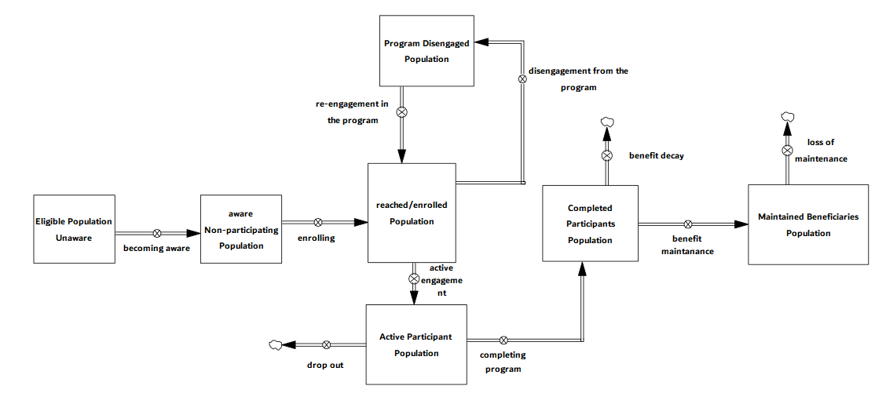

Slide 13
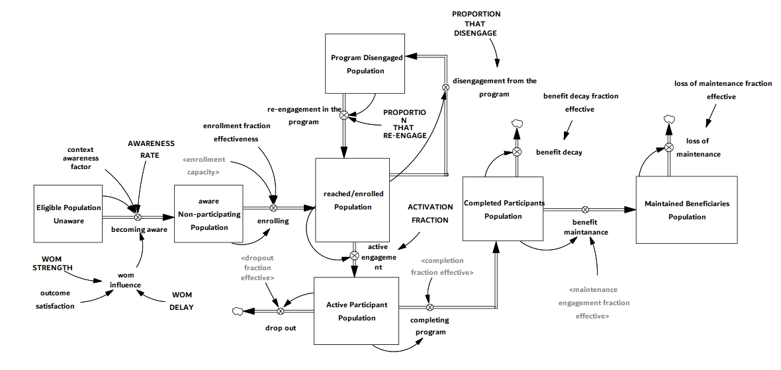
Completed participants tell you how many people you served; maintained beneficiaries tell you how many people actually benefited over time. Example DPP: Completed participants are Individuals who finish the 16-week lifestyle program. Maintained beneficiaries are individuals who: (a) continue healthy eating, (b) maintain weight loss, (c) sustain physical activity, and (d) avoid progression to diabetes
Benefit decay is the rate at which the effectiveness or impact of an intervention diminishes over time in the absence of sustained reinforcement or continued engagement. Most interventions do not produce permanent effects—their impact fades unless maintained.
Context Awareness Factor: How well does the intervention ‘fit’ the real-world environment it is being implemented in? This includes awareness of: (a) patient population needs, (b) cultural norms, (c) workflow realities, (d) resource constraints, and (e) policy and organizational environment
Maintenance Engagement Fraction Effectiveness is the proportion of ongoing engagement efforts that result in sustained, meaningful, and adherent participation during the maintenance phase.
Enrollment Fraction Effectiveness is the proportion of enrollment efforts that result in meaningful, appropriate, and high-quality participation in the intervention.
Enrollment Capacity is the upper limit on how many participants can be enrolled per unit time, determined by staffing, infrastructure, processes, and operational constraints.
EFFECTIVENESS represents the realized average impact per active participant, given the current system maturity and context. It is a system-adjusted effectiveness, not biological efficacy.

Slide 14
Site Adoption Sub-Model

Slide 15
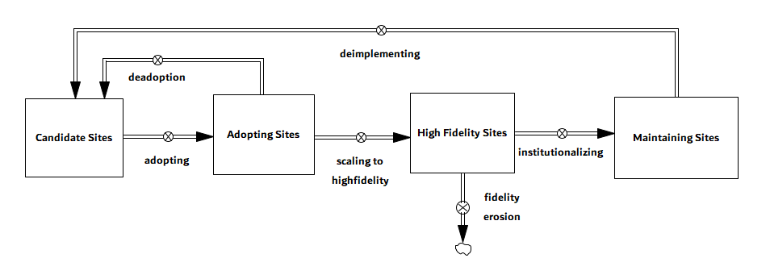
Maintaining sites means organizations have institutionalized and retained the operational capability to deliver the intervention. Maintaining sites continues to contribute to service capacity even when demand fluctuates, reflecting retained infrastructure and workforce capability.
Adopting sites represent organizations that have initiated implementation but have not yet achieved high structural fidelity. The transition from adoption to high-fidelity status is governed by the scale-up process. Scaling to high fidelity depends on the scale-up rate, training adequacy, implementation support, and capacity pressure.
High-fidelity sites are organizations that deliver the intervention according to protocol and maintain adequate structural integrity.
Candidate sites represent organizations that have not yet initiated implementation.

Slide 16
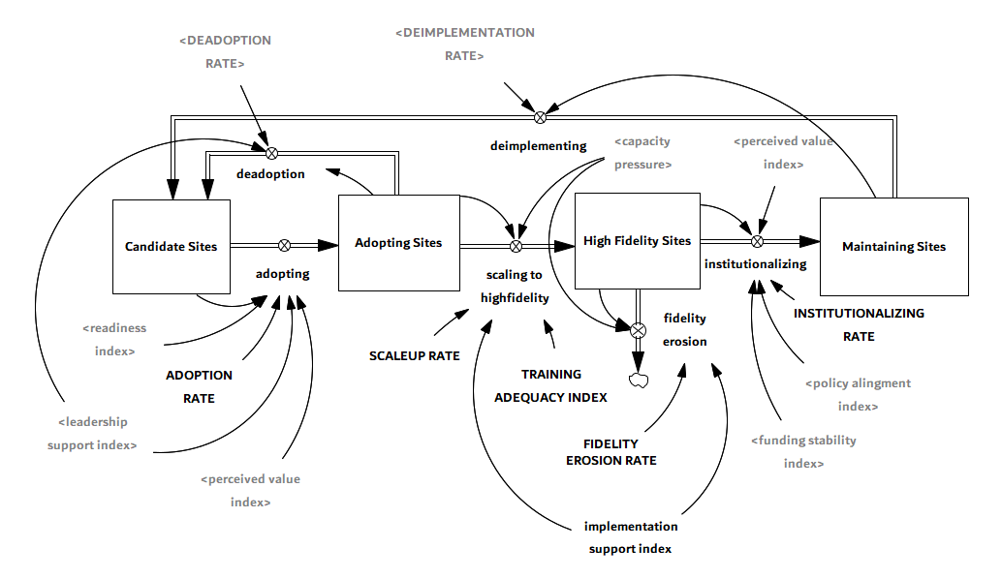
Implementation Support Index is a bounded composite measure (0–1) of the active support mechanisms in place to enable effective implementation, combining facilitation, audit & feedback, and reminder systems.
Readiness Index is a bounded composite measure of an organization’s practical preparedness to implement an intervention, reflecting baseline readiness enhanced by internal champions and facilitation support, and reduced by competing priorities.
Leadership Support Index is a bounded measure, ranging from 0 to 1, that represents the effective level of leadership commitment available to support implementation after accounting for organizational distractions and leadership instability.
Policy Alignment is a bounded, time-varying measure (0–1) of how well the policy environment supports and reinforces the implementation of an intervention, incorporating both baseline alignment and discrete policy changes over time.

Slide 17
Workforce and Capacity Sub-Model

Slide 18
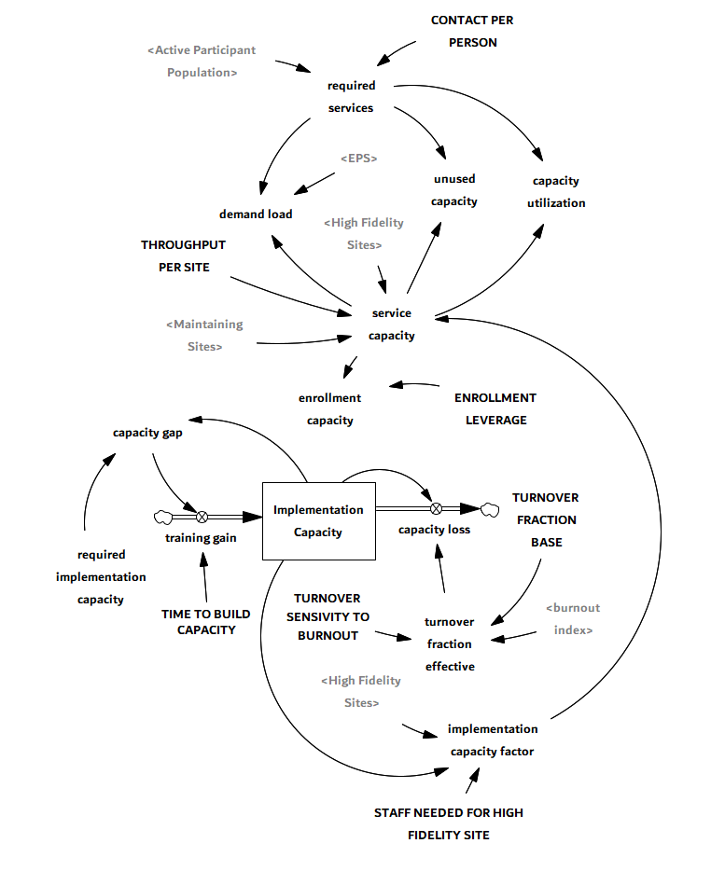
Assumption: Maintaining sites still have delivery capacity, but maintaining/completed participants require little or no ongoing service contacts.
Required Implementation Capacity is the total resource demand needed to support all sites currently adopting, delivering at high fidelity, or maintaining the intervention, based on the requirement per high-fidelity site.
Implementation Capacity Factor is a bounded ratio (0–1) that represents the extent to which available implementation capacity is sufficient to support the staffing requirements of high-fidelity sites.
Implementation capacity is the available resources, infrastructure, and capability required to deliver an intervention at scale and with fidelity. It is not a single thing—it’s a composite of multiple system elements

Slide 19
Effectiveness Sub-Model

Slide 20
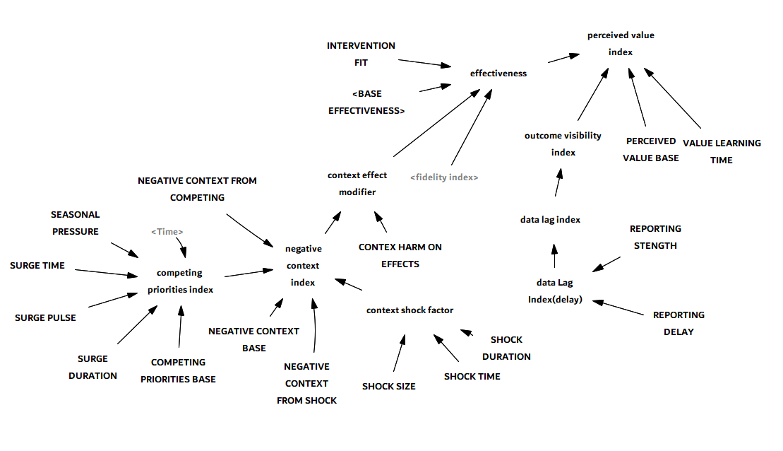
Intervention Fit is the extent to which an intervention matches the needs, capacities, workflows, and values of the setting and population, thereby enabling effective adoption, implementation, and sustainment.

Slide 21
Reach
Reach represents the proportion of the total eligible population that has engaged with the intervention, including individuals who are currently active participants, have completed the program, or are sustaining benefits over time.

Slide 22
Effectiveness
Effectiveness: The realized, system-level average impact of the intervention per active participant at a given point in time, after accounting for implementation maturity, contextual conditions, and intervention fit.
Intervention Fit is the extent to which an intervention matches the needs, capacities, workflows, and values of the setting and population, thereby enabling effective adoption, implementation, and sustainment.
Context Effect Modifier accounts for competing pressures, Policy shocks, and Environmental constraints

Slide 23
Adoption
Adoption: The proportion of eligible sites that have begun or sustained implementation of the intervention. It reflects organizational uptake at the system level.

Slide 24
Implementation
Implementation: Implementation represents the structural maturity of intervention delivery across adopting sites. This reflects the proportion of implementing sites that are operating at high fidelity or have institutionalized the intervention.

Slide 25
Maintenance - Organization
Maintenance – Organization: Maintenance (organization) is the proportion of eligible sites that have institutionalized and sustained the intervention's delivery over time.

Slide 26
Maintenance – Individual
Maintenance – Individual: Maintenance (individual) represents the proportion of participants who sustain intervention benefits after completing the program.

Slide 27
Experiments
Experiment 1: Perfect Implementation
We conducted a best-case counterfactual simulation to establish the upper bound of achievable implementation performance and outcomes under ideal conditions.
Experiment 2: Good Implementation Initially, Then Collapse
We simulated a two-phase trajectory reflecting common real-world implementation patterns:
strong early implementation supported by funding and leadership
followed by abrupt collapse at month 60 due to simultaneous funding cuts and leadership turnover.

Slide 28
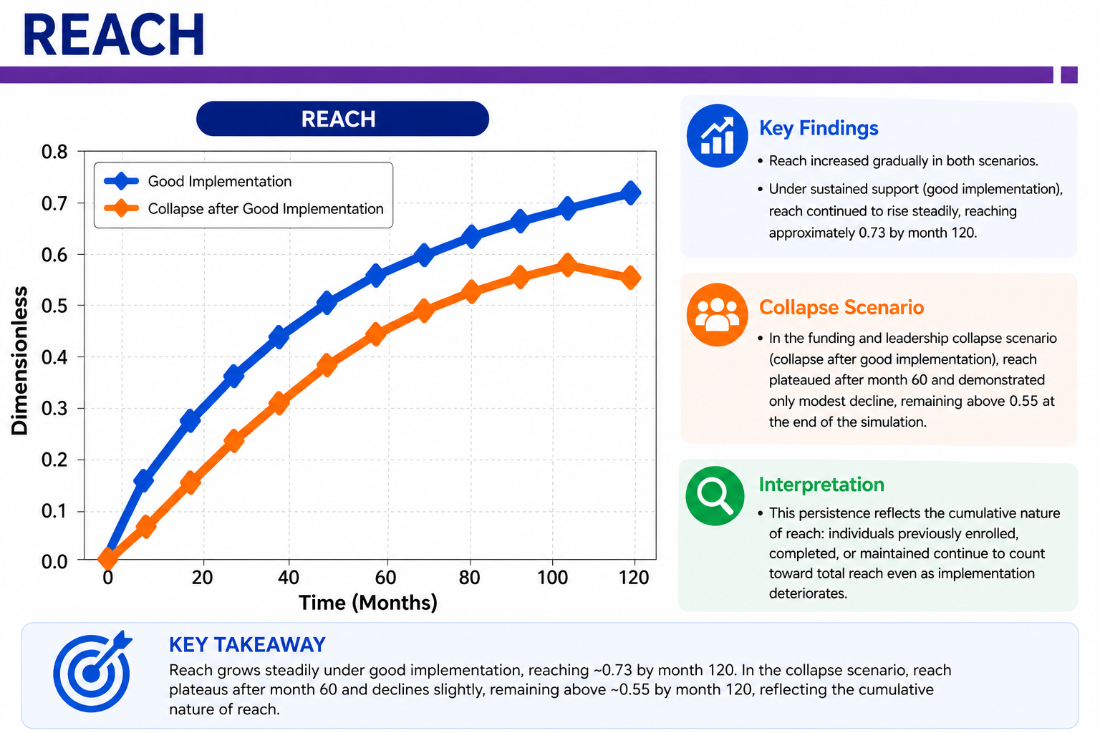

Slide 29
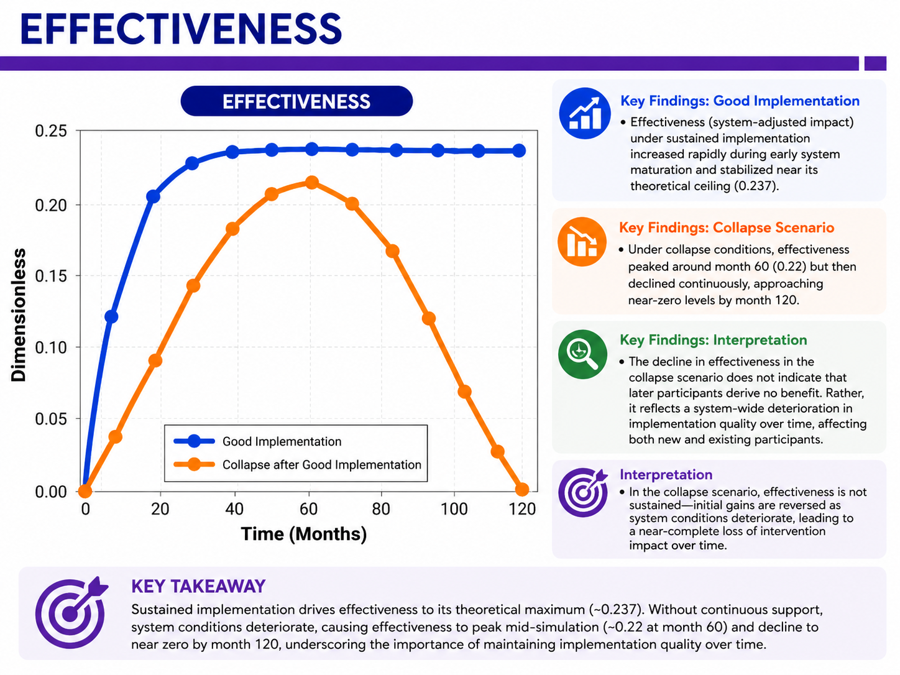

Slide 30
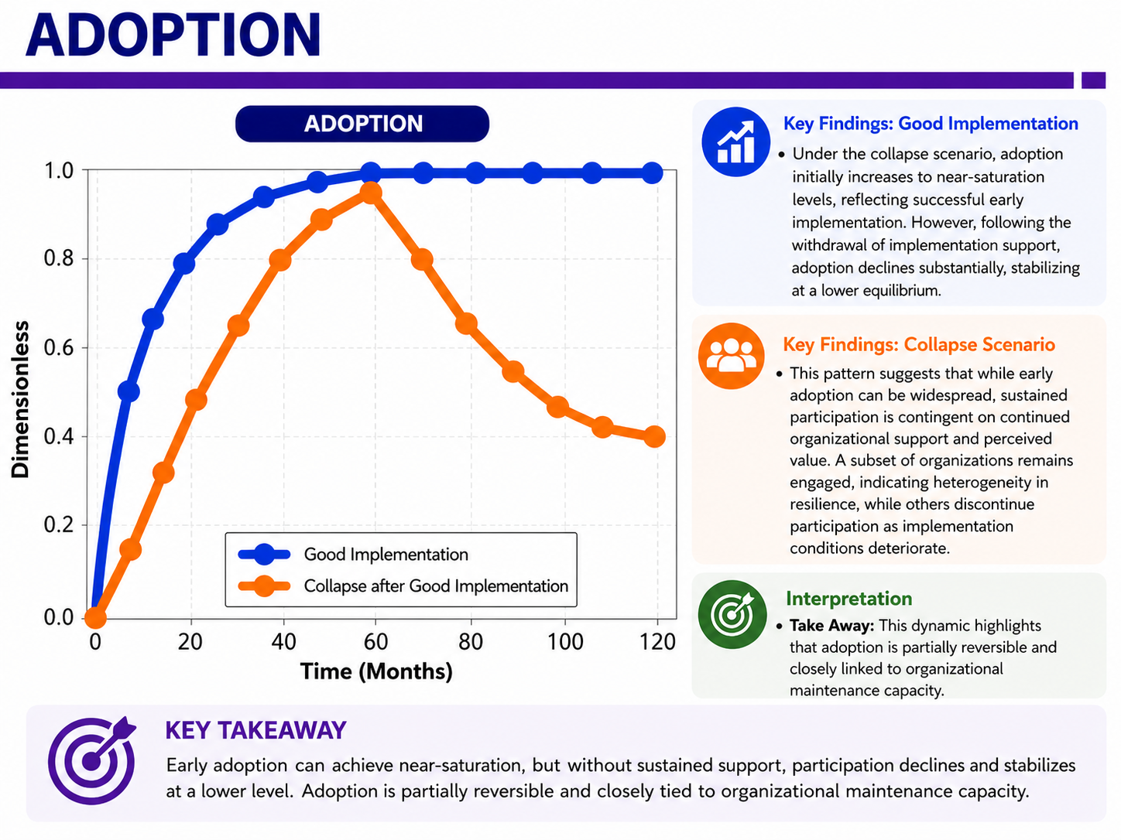

Slide 31
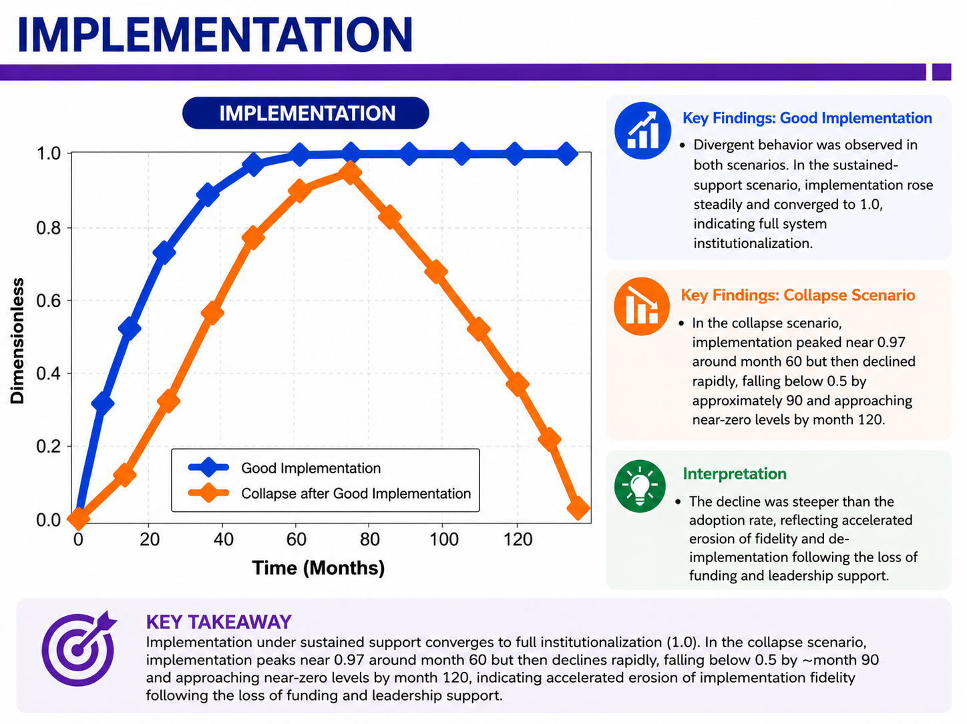

Slide 32
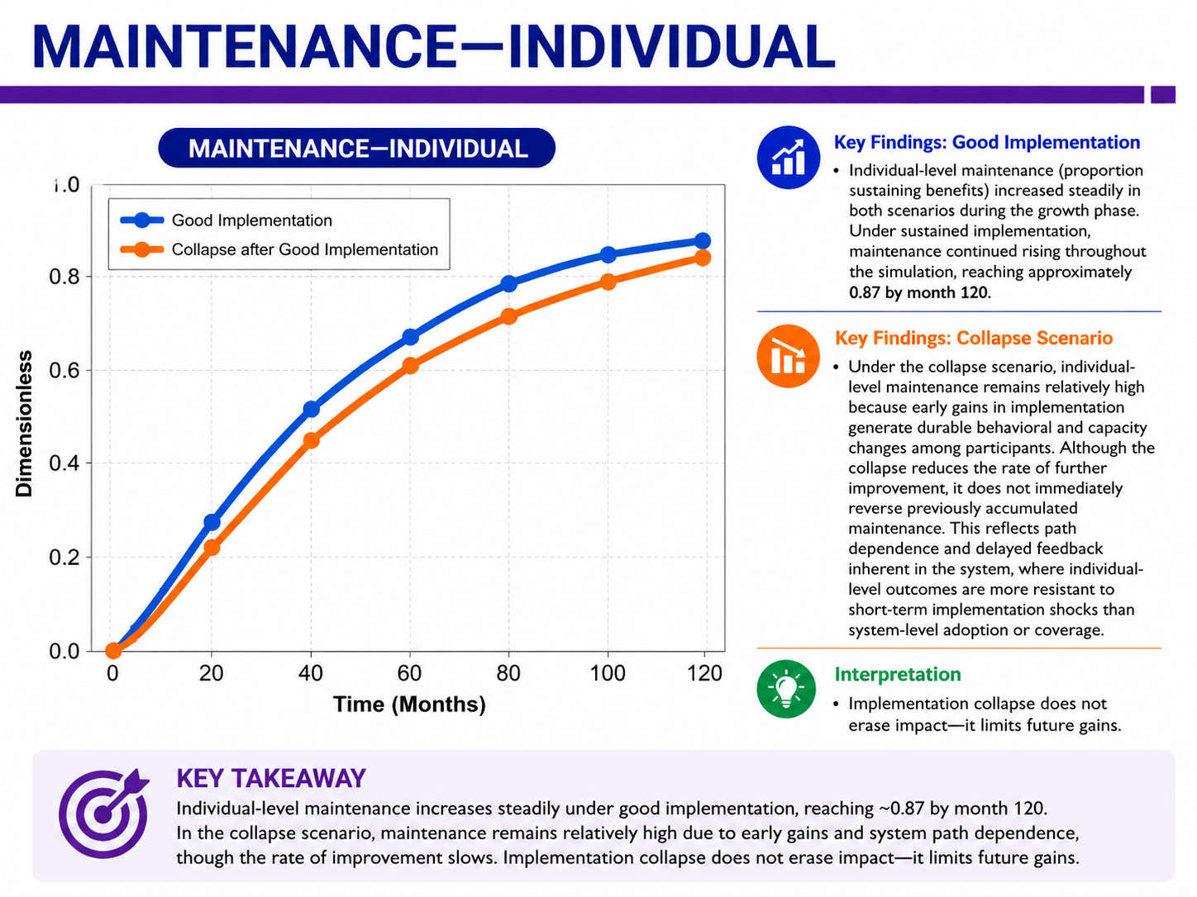

Slide 33
