Slide 1
Reducing Urban Cardiovascular Disparities Through Community Health Worker–Led Risk Management: A Simulation Study of ACHIEVE-GreatER
John P. Ansah, PhD
Assistant Professor
Center for Community Health Integration
Case Western Reserve University

Slide 2

Disclosures Relevant to this Presentation: P50 Center NIMH

Slide 3

ACHIEVE GREATER Team
Community Stake Holders
Fonda McClain,
CCHW
Kim Nicholson, CCHW
Delores Gray,
CMHA Liason
Research Team
Heidi Osborne,
Supervisor
Audrey Kwun Research Coordinator
Shawn Campbell, Research Assistant
Yuvraj Narang, Research Assistant
Clinical Research Team
Sanjay Rajagopalan, Principal Investigator
Jackson T. Wright Jr., Co- Investigator
John Ansah
Co- Investigator
Kyia Mountain,
Clinical Lead
Santosh Sirasapalli,
Data Analyst

Slide 4
Background (AchieveGreater)
A focused response to cardiometabolic inequities in Cleveland and Detroit.
Persistent Burden
  Cardiovascular and metabolic diseases remain major drivers of premature illness, death, and reduced quality of life.
Place Matter
  Poverty, housing instability, transportation barriers, pollution, food access, and care access cluster geographically and shape risk.
  Risk factors accumulate across the life course and contribute to downstream Black–White lifespan inequality.

Slide 5
Project Aim
Early Prevention
  The project intervenes before advanced disease develops, linking clinical, community, and implementation strategies.
  Core rationale: reduce preventable cardiometabolic disease by acting earlier, across multiple domains of influence, with partners who can translate evidence into practice.

Slide 6
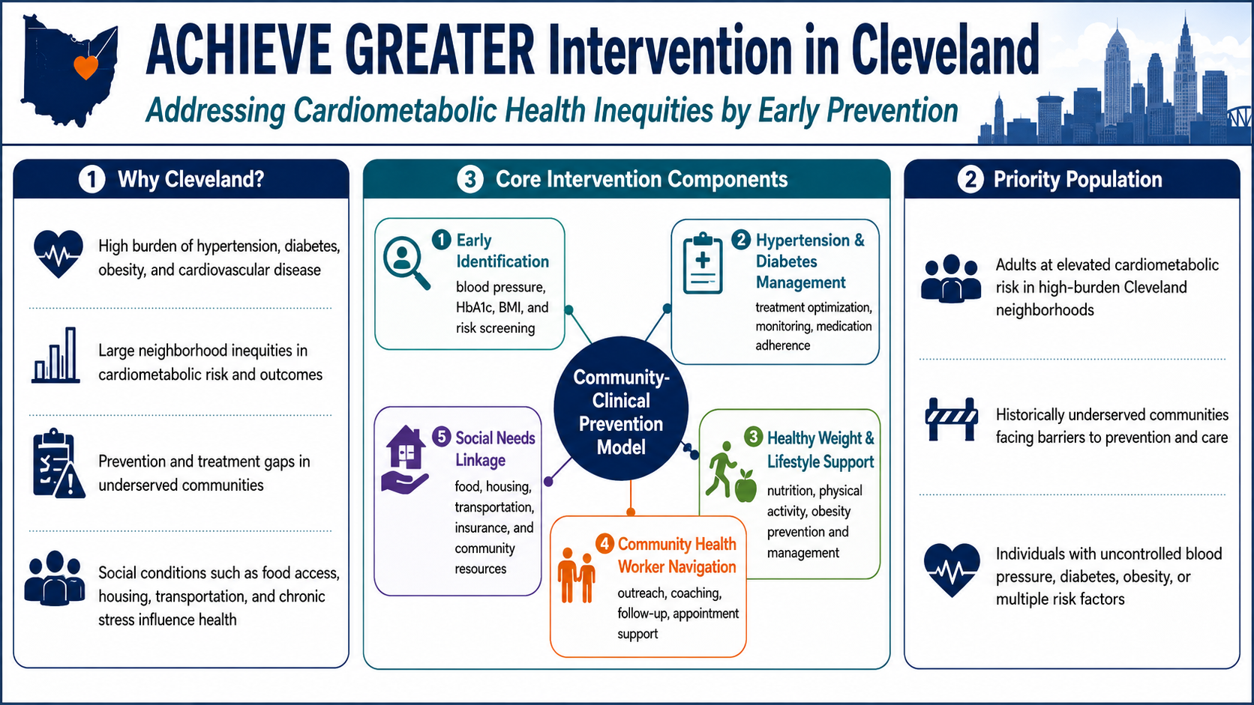

Slide 7
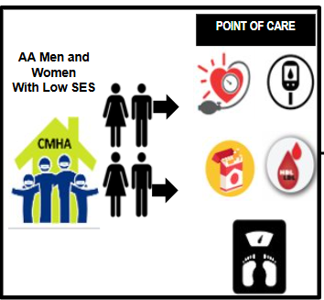
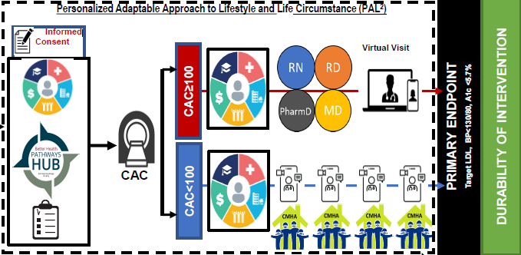
Patient Journey
Timeline 0h 24h 48h 2w 16w 32w 48w 52w 104w

Slide 8
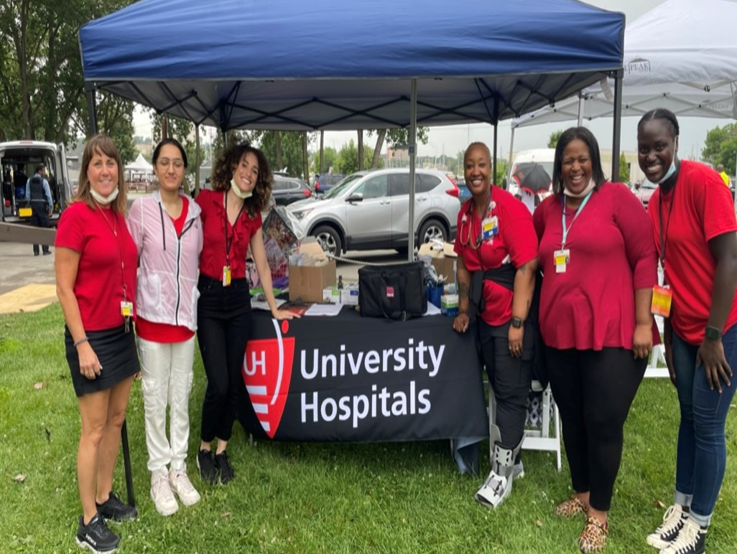
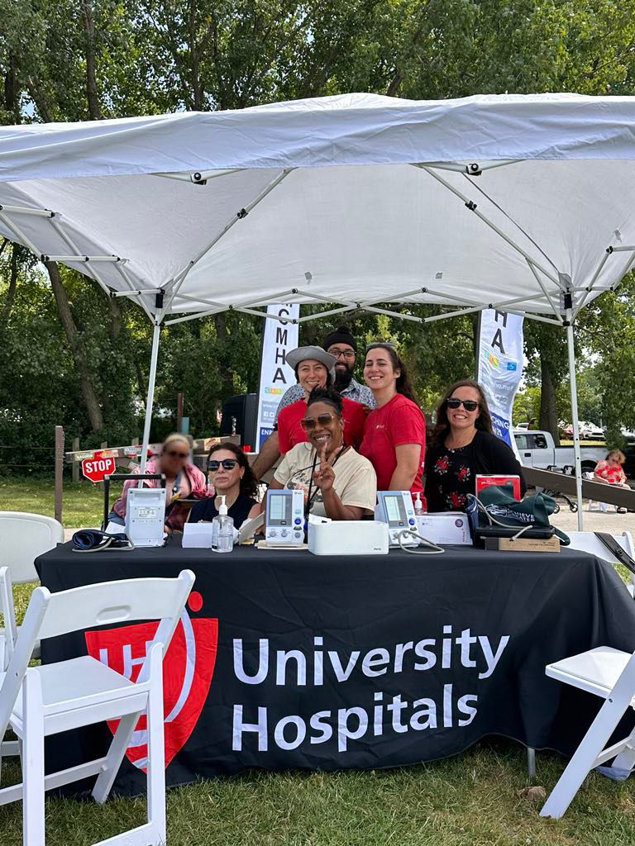
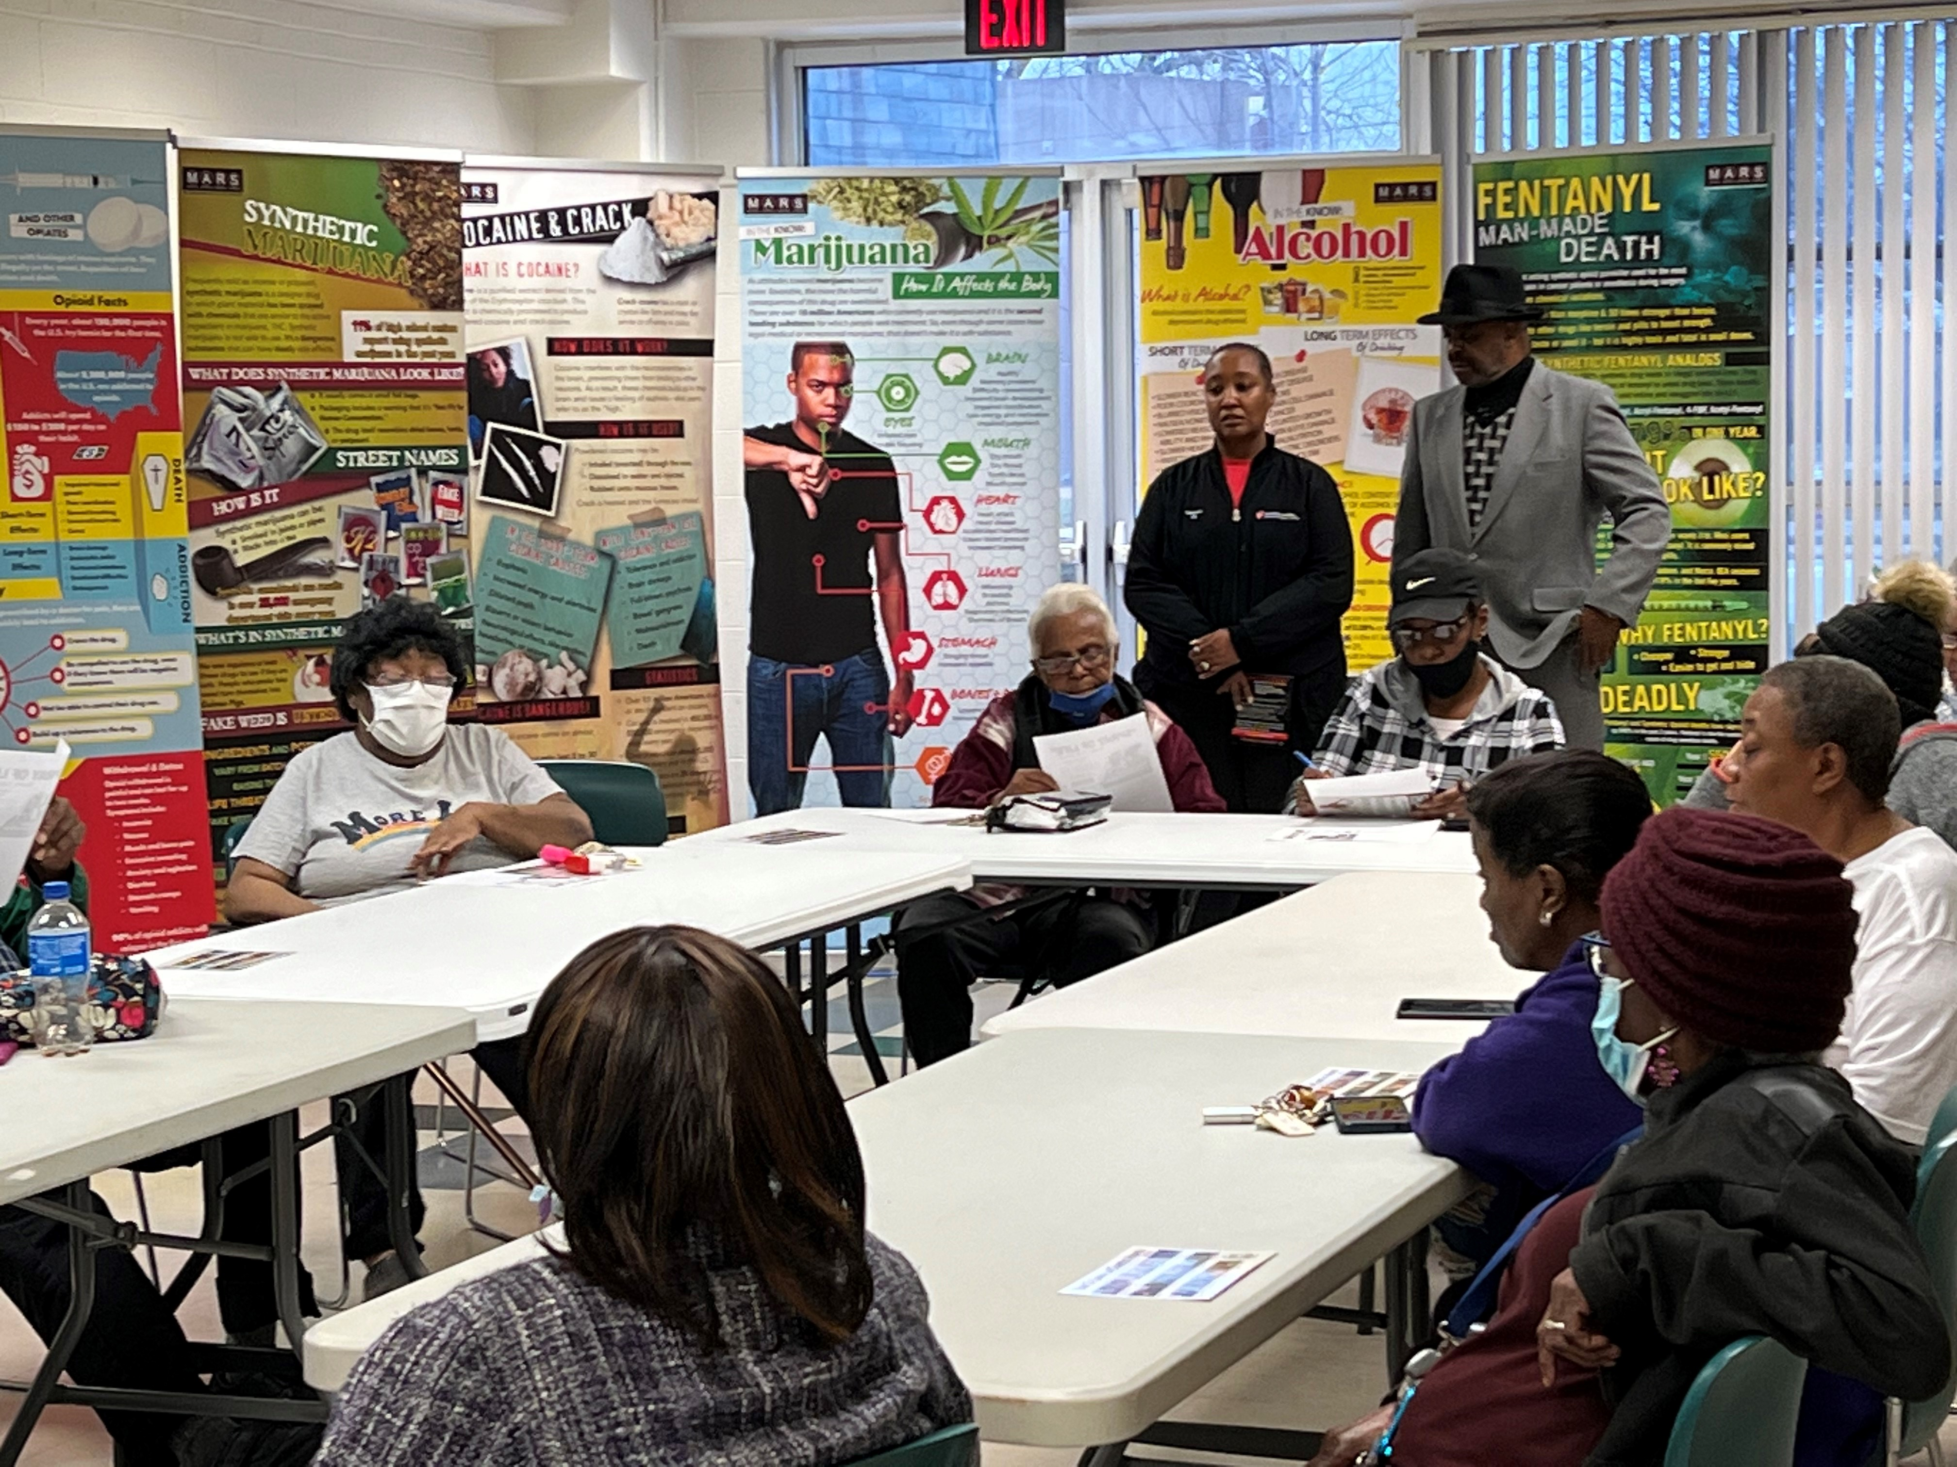
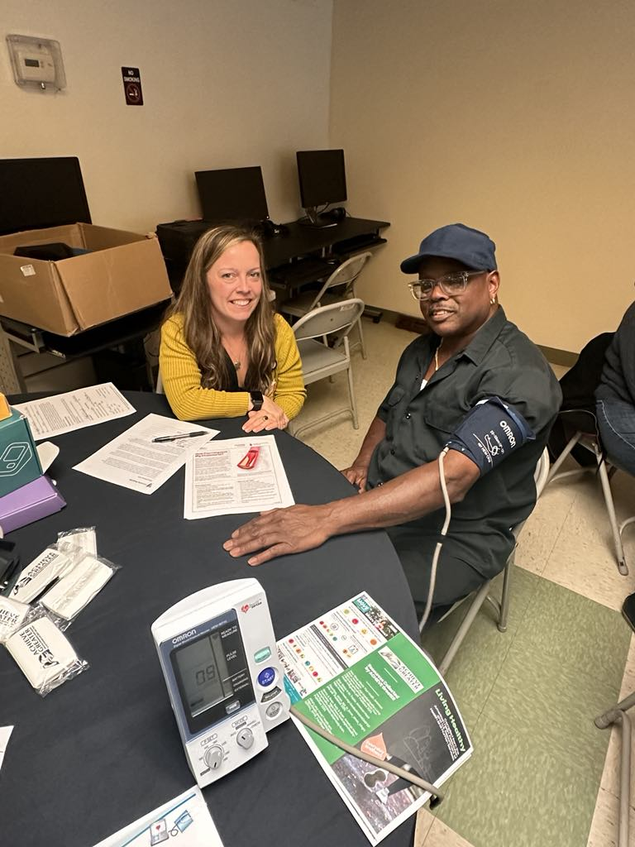

Building Trust and Serving the Community
2022
2023
2024
2025
31 Community Events
306 Screened
20 Enrolled
10 Community Events
63 Screened
10 Enrolled
Community Programming begins in June
16 Community Events
60 Screened
EMR Screening Begins
32 Community Events
119 Screened
79 Enrolled

Slide 9
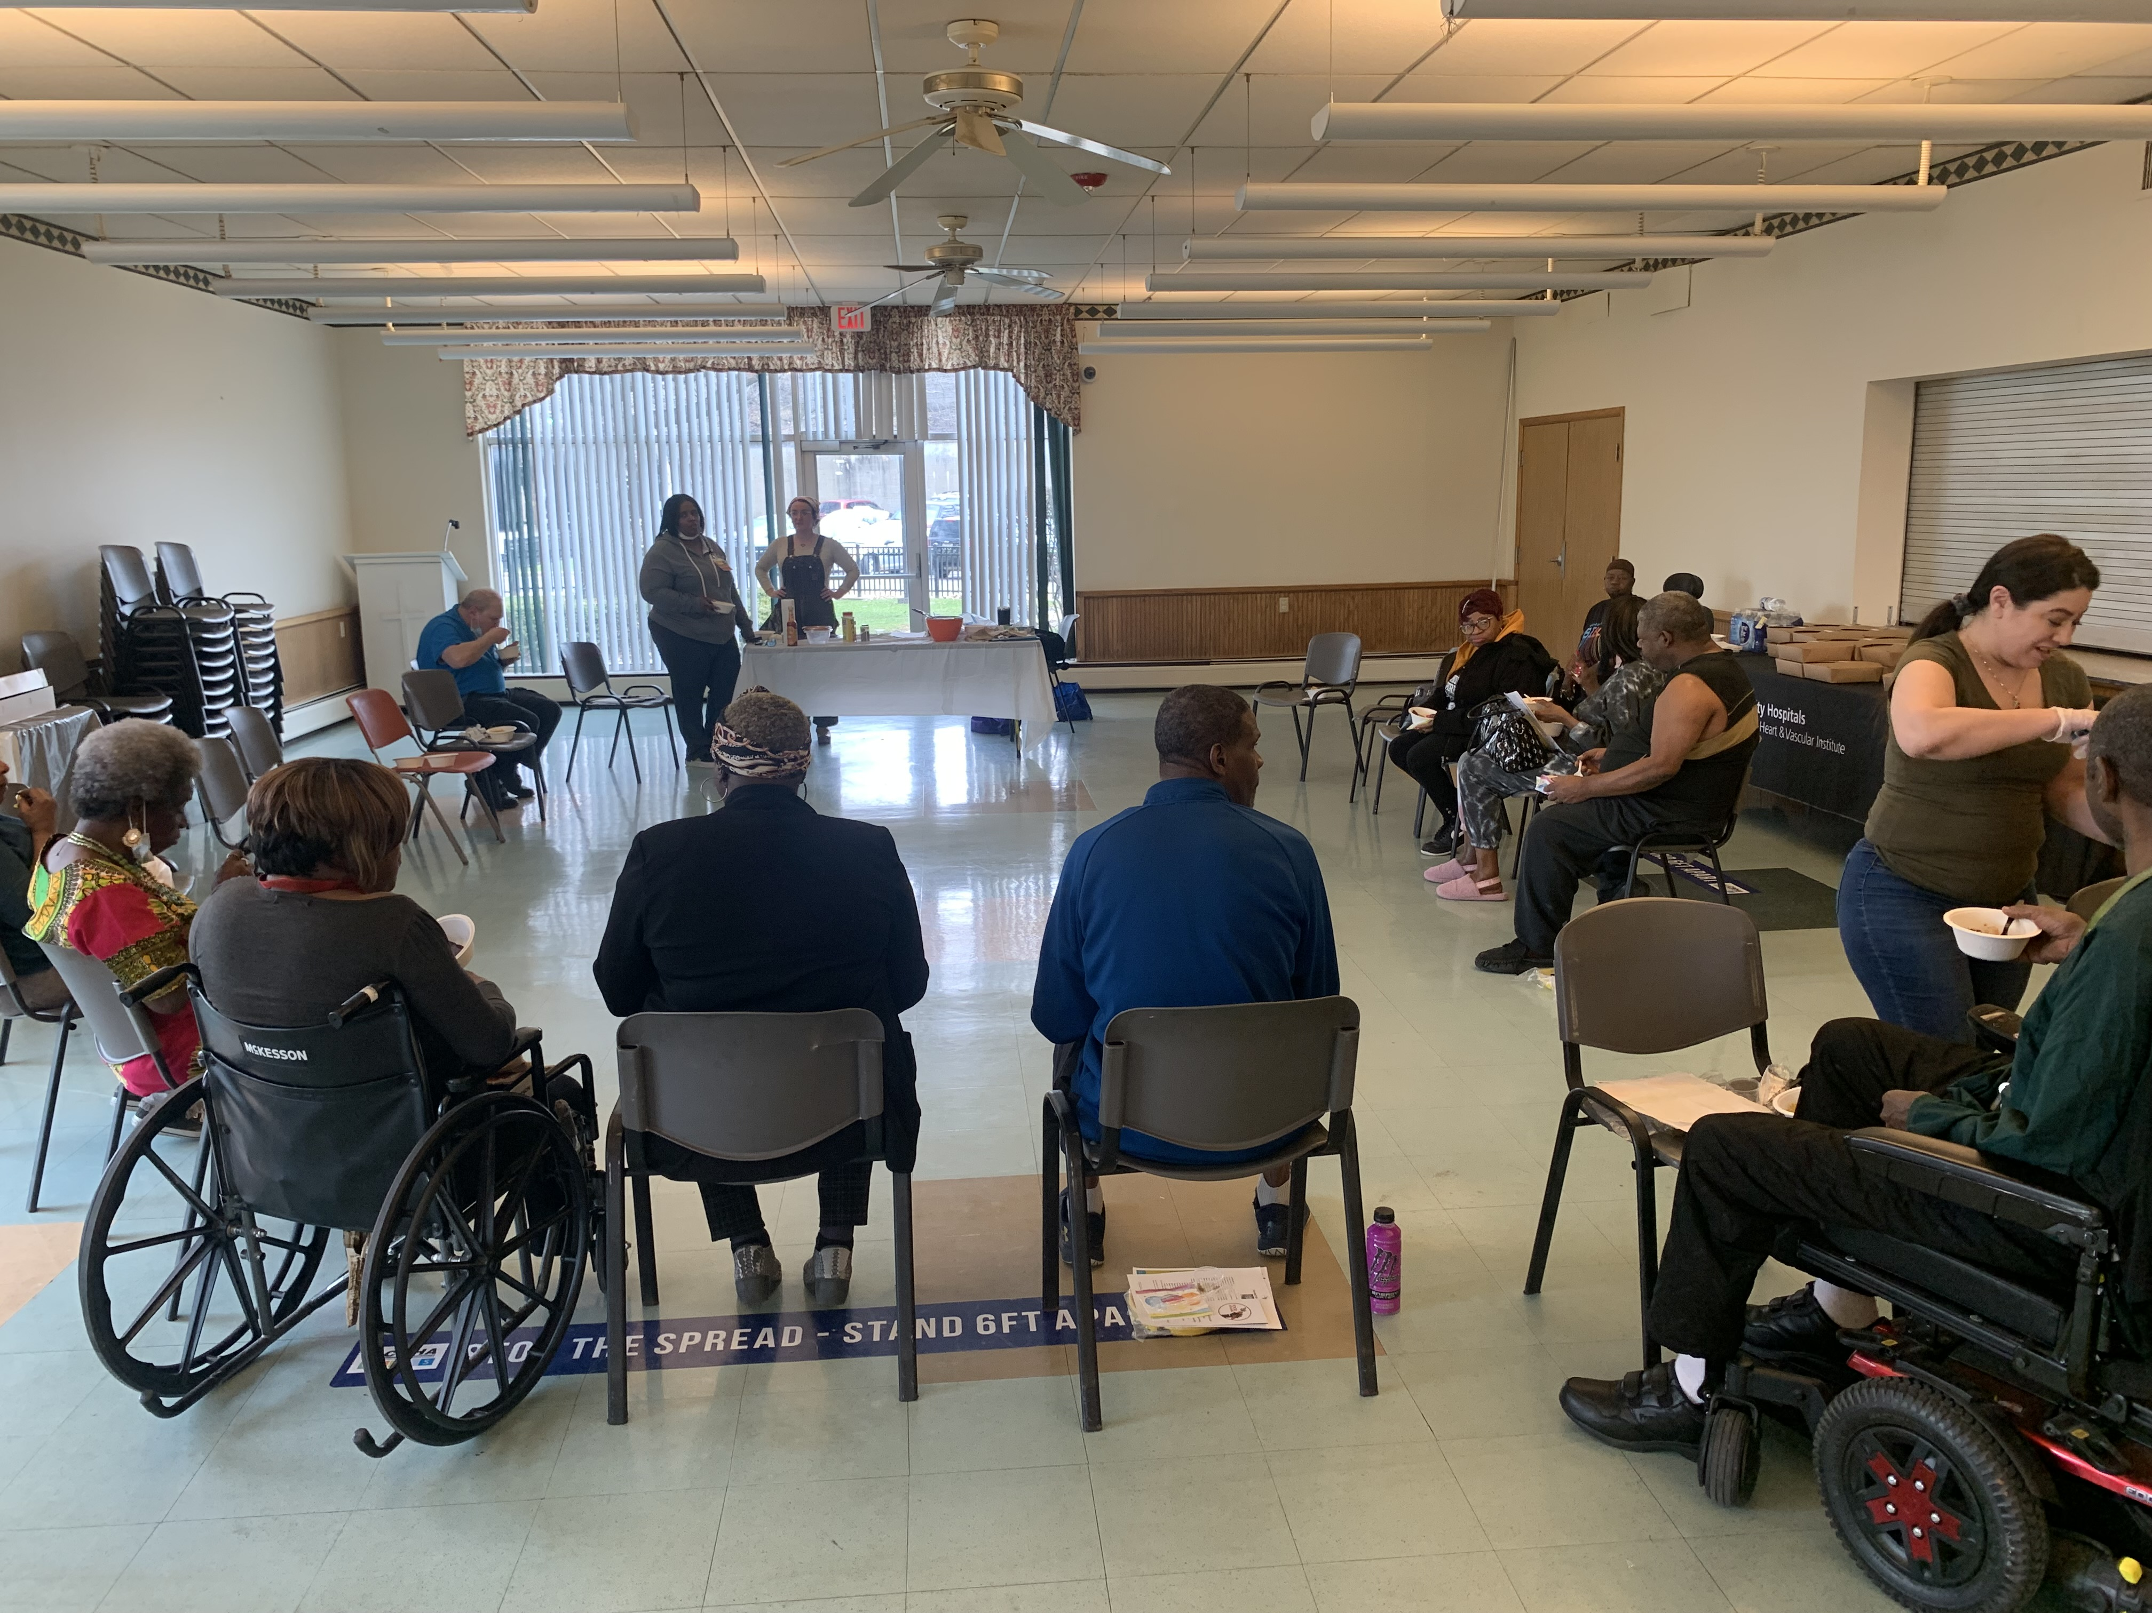
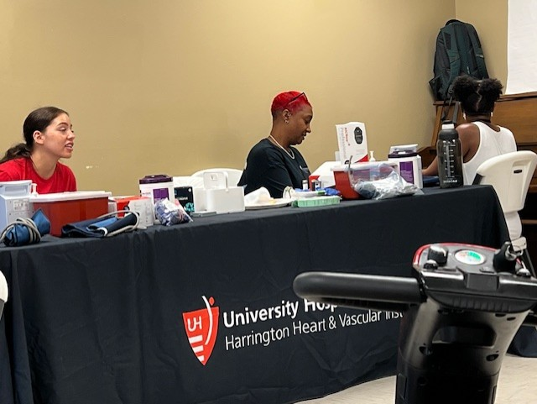
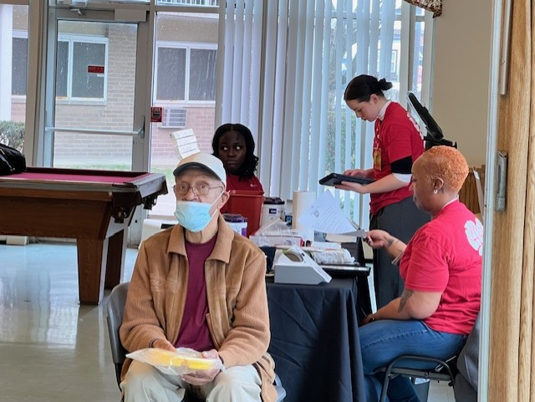
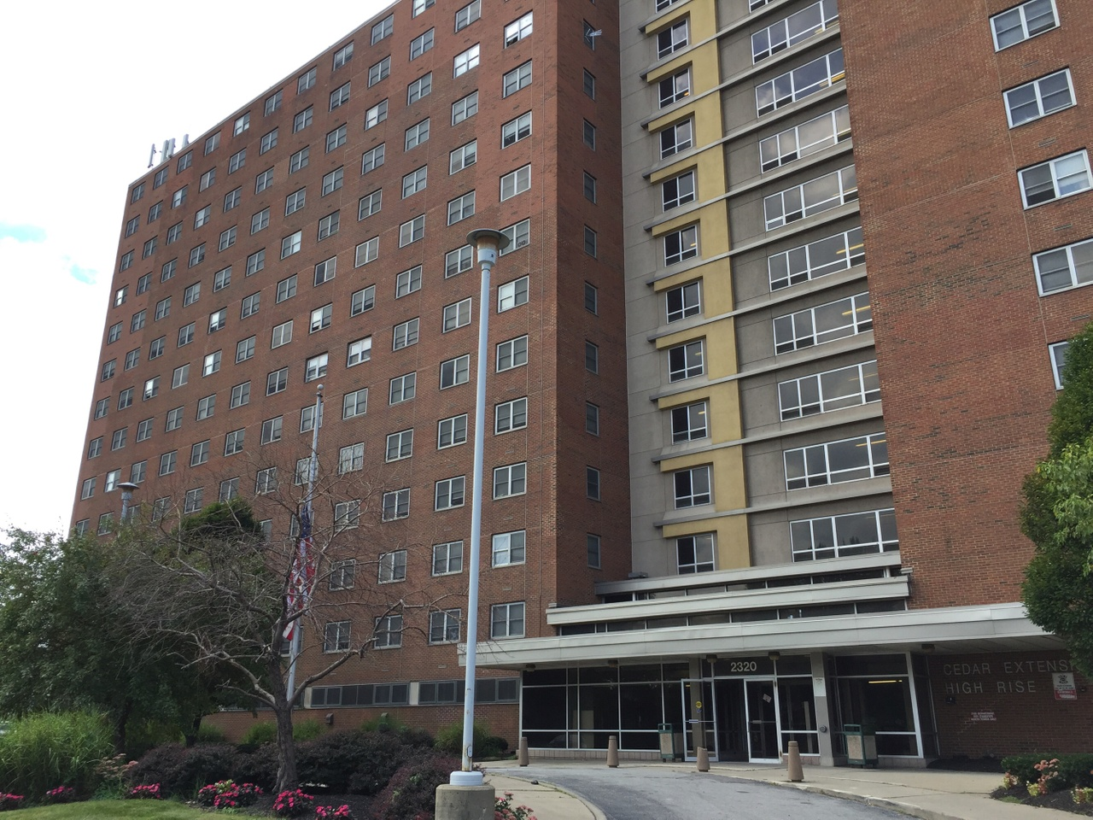
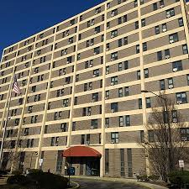
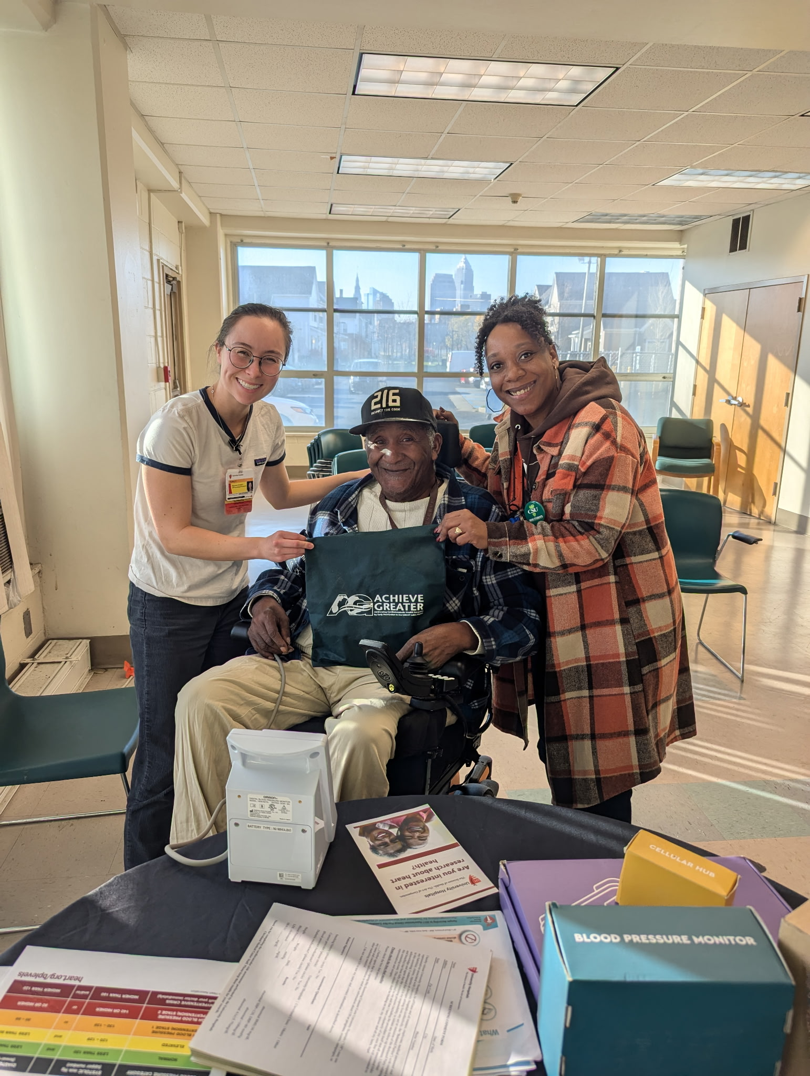
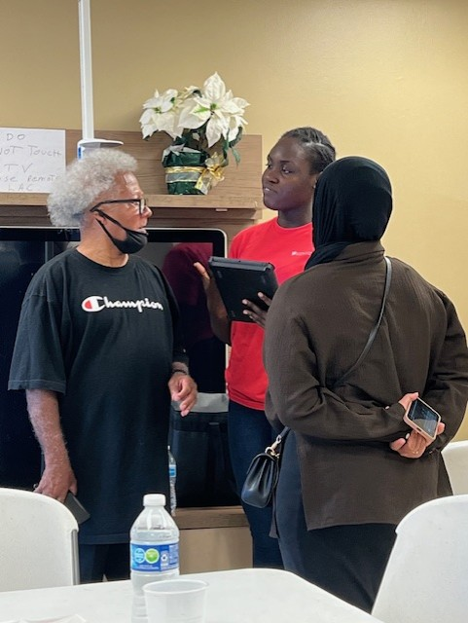
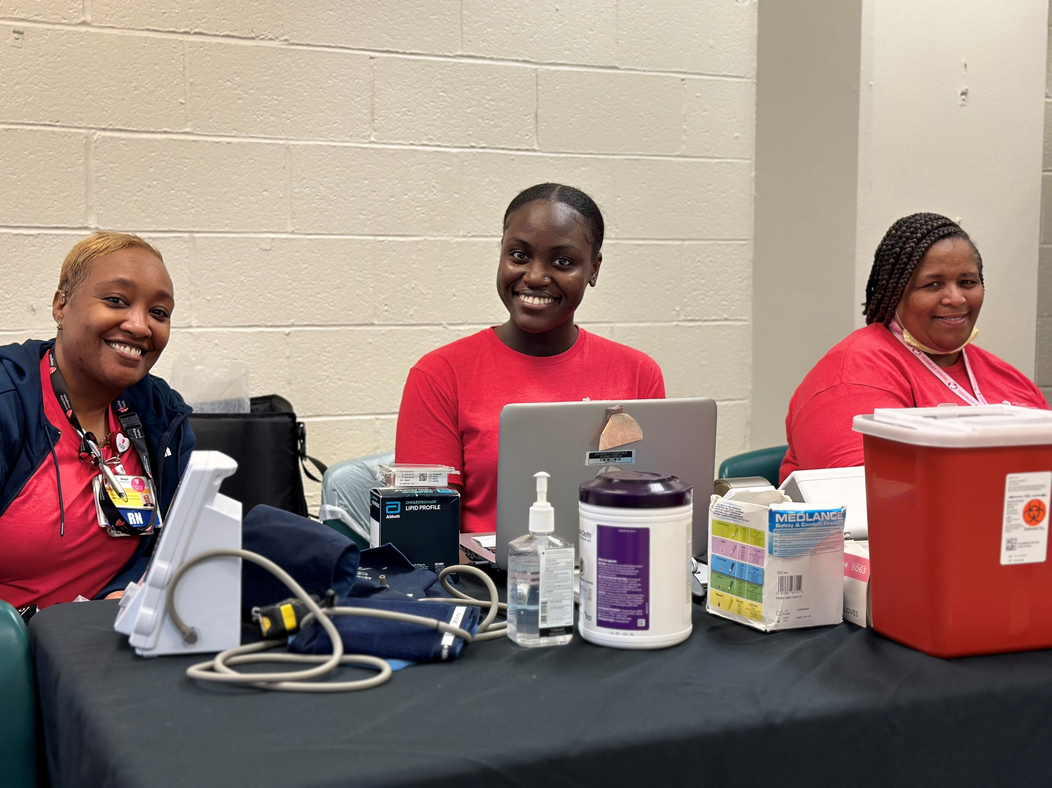
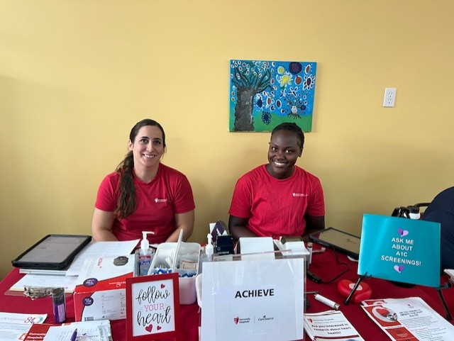

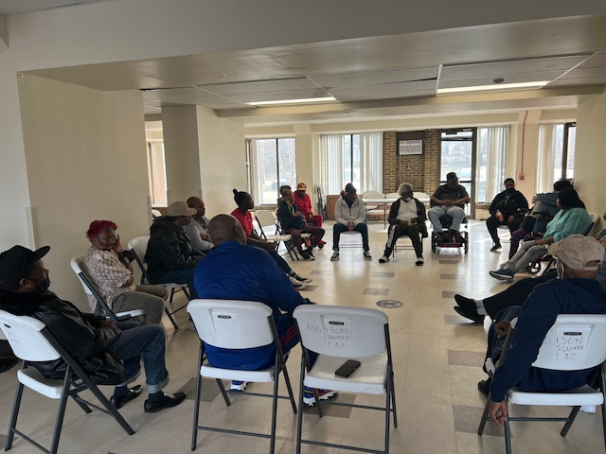

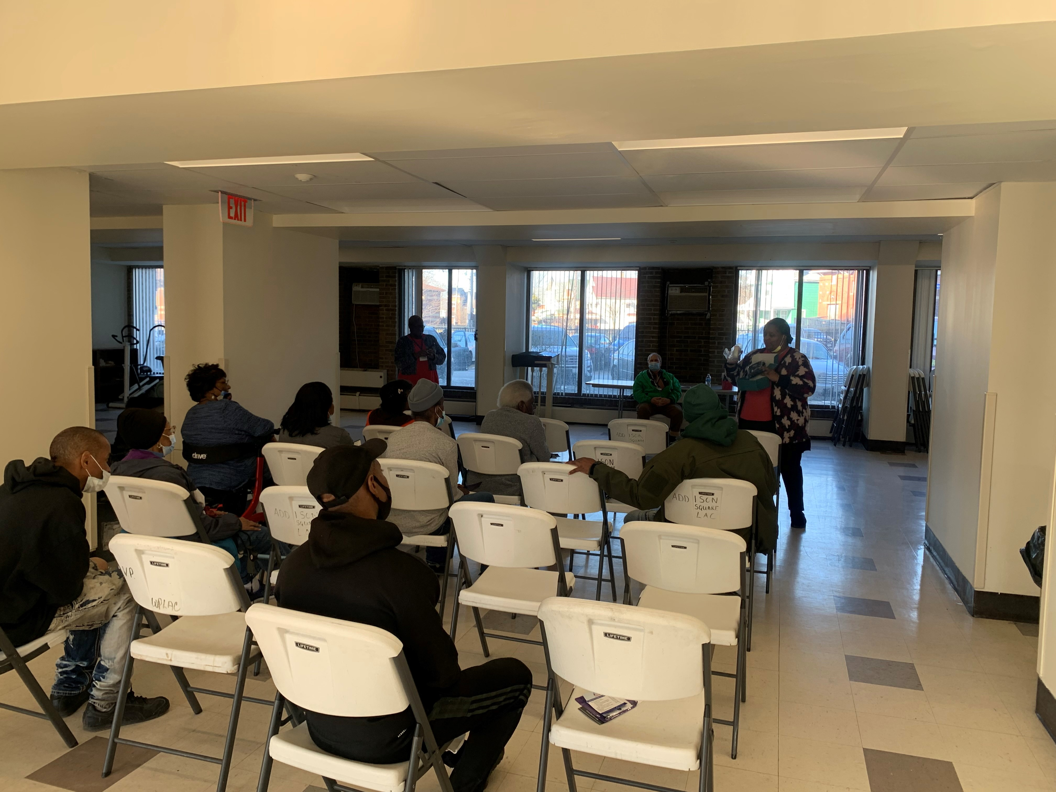
Community Screening Events

Slide 10
Collaborating with Community Partners
Urban Minority Alcoholism and Drug Abuse Outreach Programs
Food For Life
Food Strong
Western Reserve Area Agency for Aging
Northern Ohio Recovery Association
National Alliance on Mental Illness

Slide 11
Screening/Enrollment
Inclusion Criteria
•40-75 years of age
•Identify as African American
•Reside in Cleveland Metro Area
•Have at least 2 CVD risk factors
•BMI 30 kg/m²
•History of smoking
•Elevated blood pressure defined as SBP >140 or DBP >80 mmHg
•HbA1c ≥5.7 mg/dL
•LDL ≥130 mg/dL
Exclusion Criteria
Established CVD disease (CAD, PAD, CVA)
•SBP ≥180 mmHg or DBP ≥110 mmHg
•Lung disease requiring supplemental oxygen therapy
•Receiving treatment for cancer-related disease
•Pregnant or nursing mothers

Slide 12
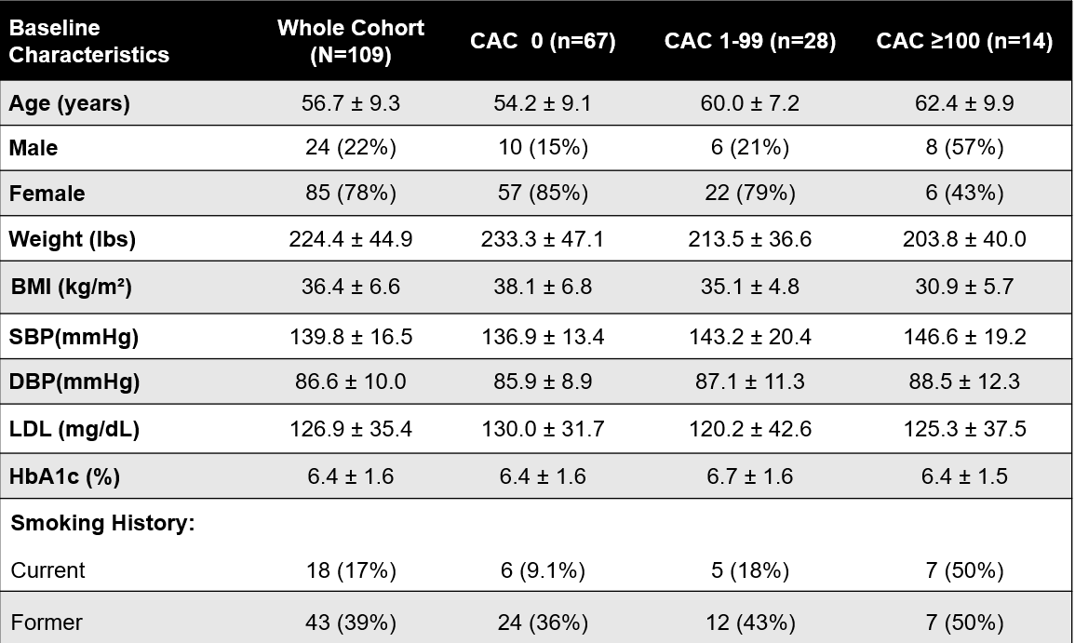
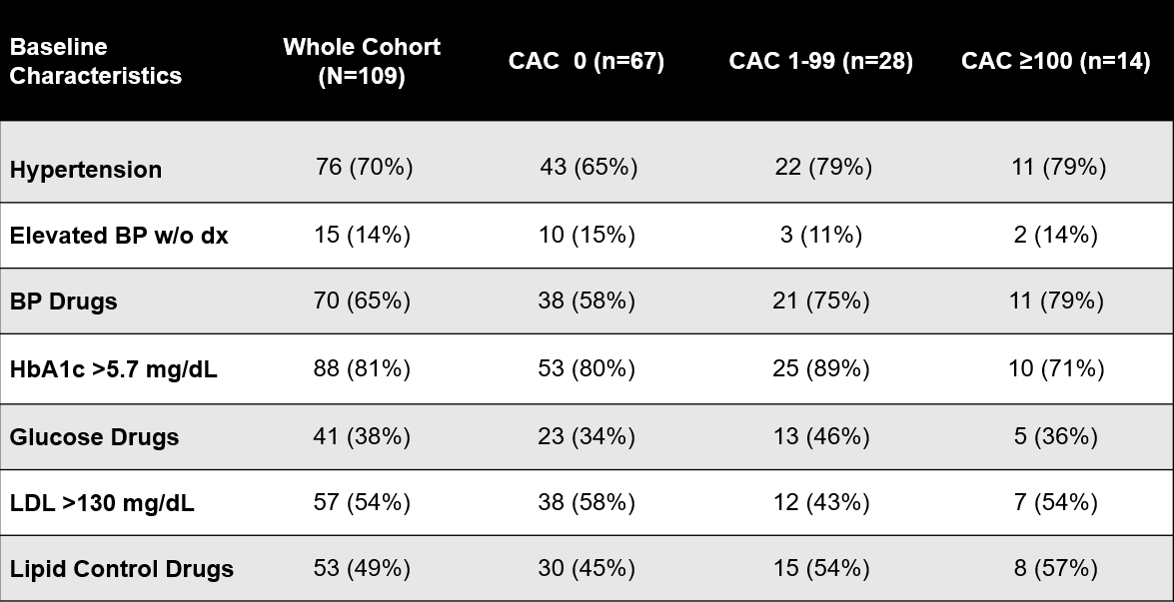
Baseline Demographics

Slide 13
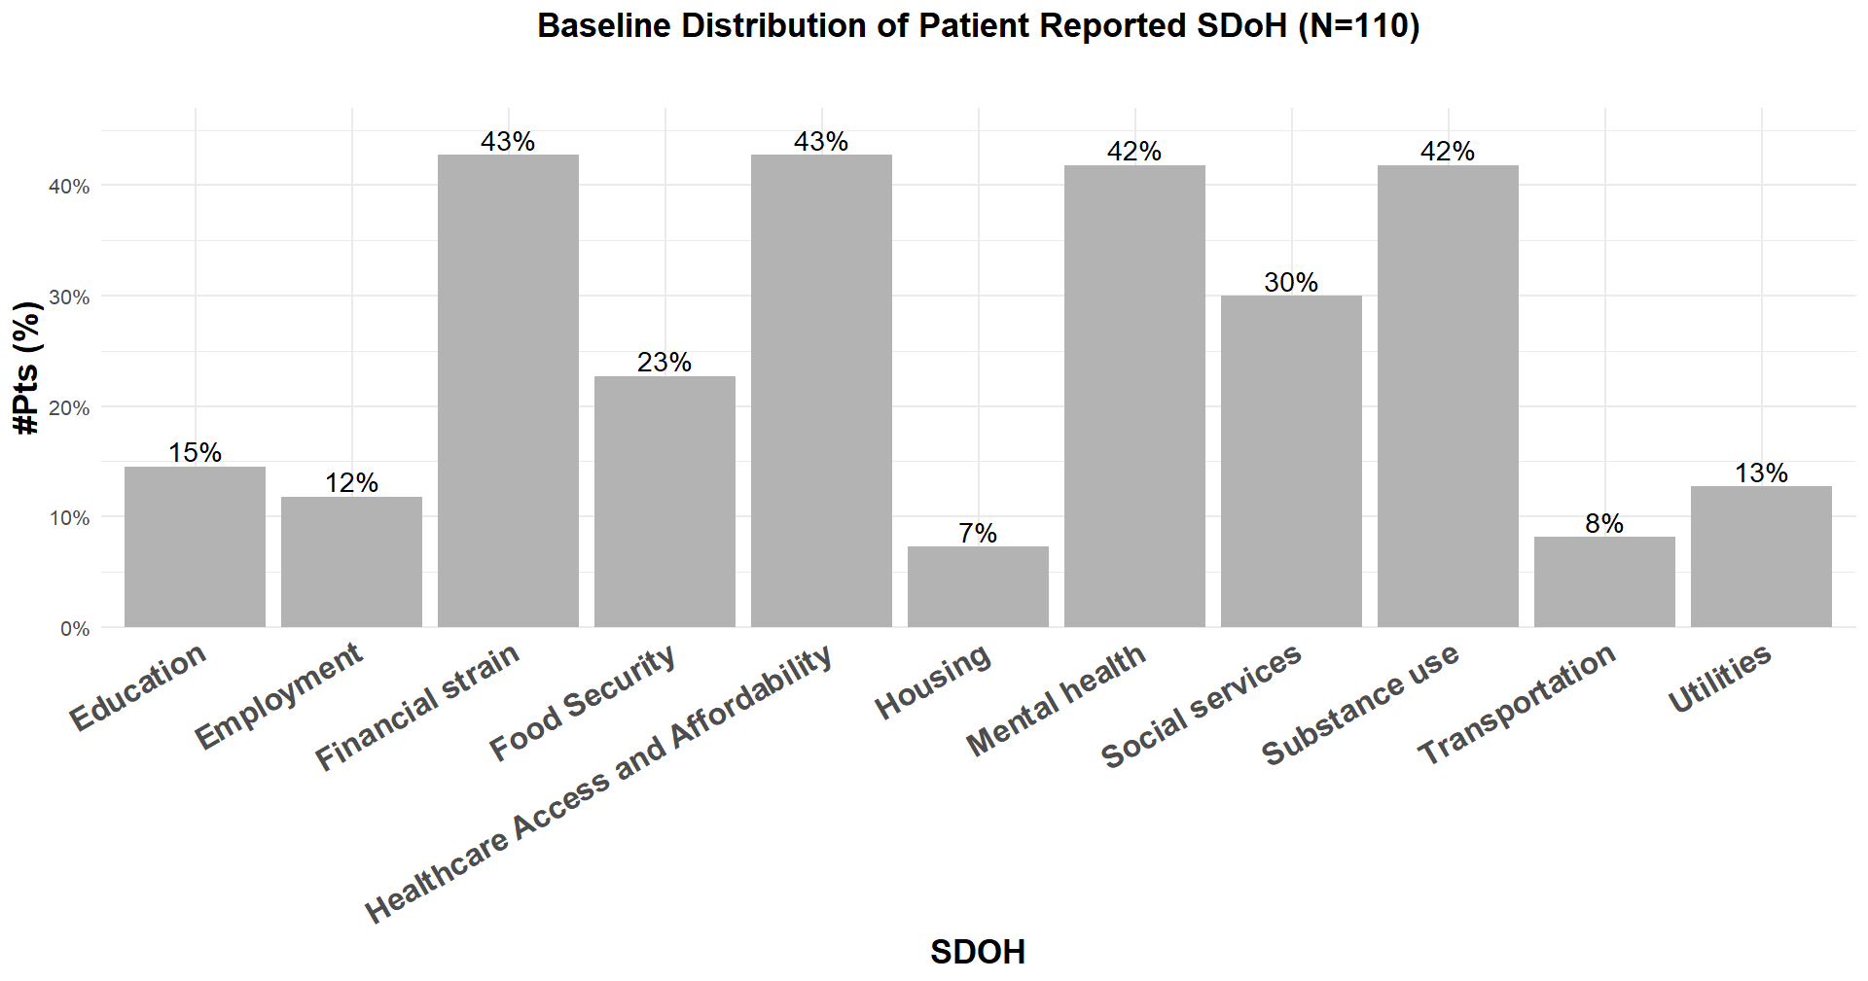











Self-reported SDoH Needs

Slide 14
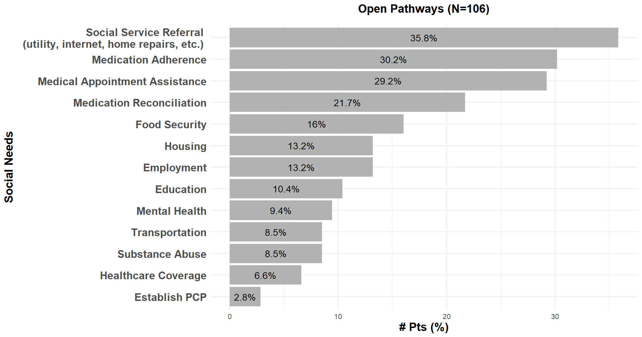





Open “Pathways” Addressing SDoH

Slide 15
Preliminary Results: Risk Factor Changes

Slide 16
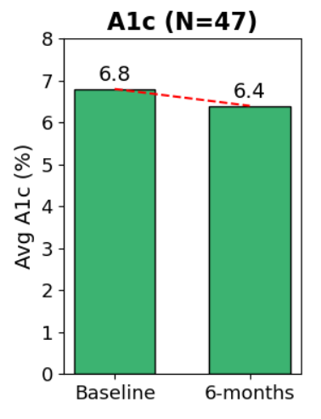
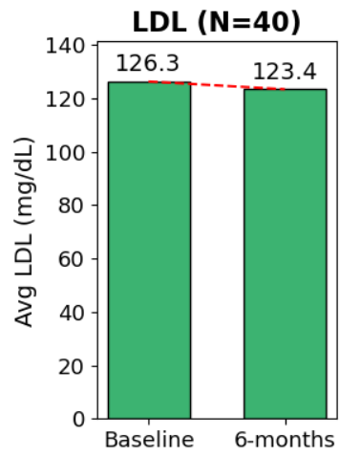
Metabolic Risk Factors- 6 months
Metrics | Time Points | N | Avg Value(s) | Delta Change
HbA1c | Baseline → 6-month | 47 | Baseline: 6.8 → 6-month: 6.4 | −0.4%
LDL | Baseline → 6-month | 40 | Baseline: 126.3 → 6-month: 123.4 | −2.9 mg/dL

Slide 17
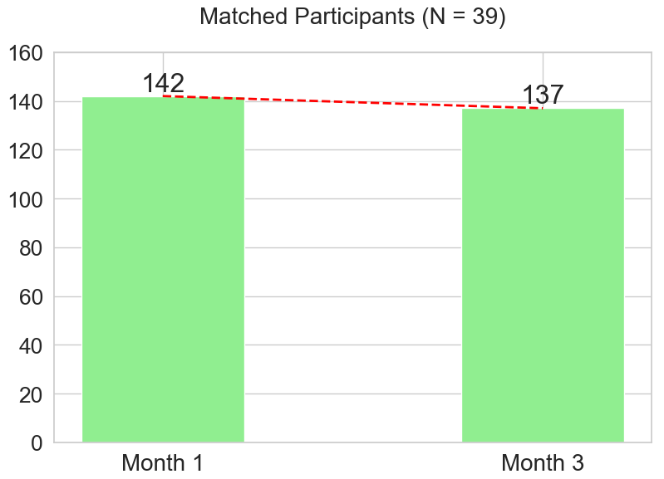
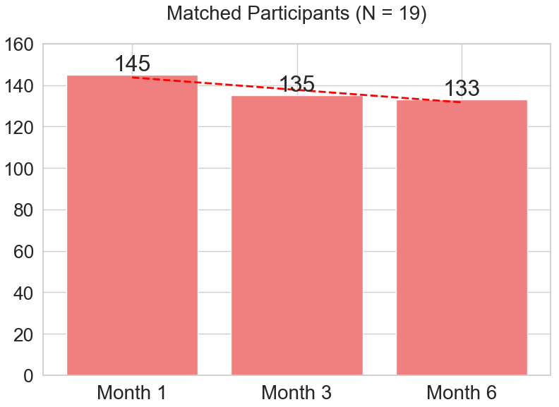
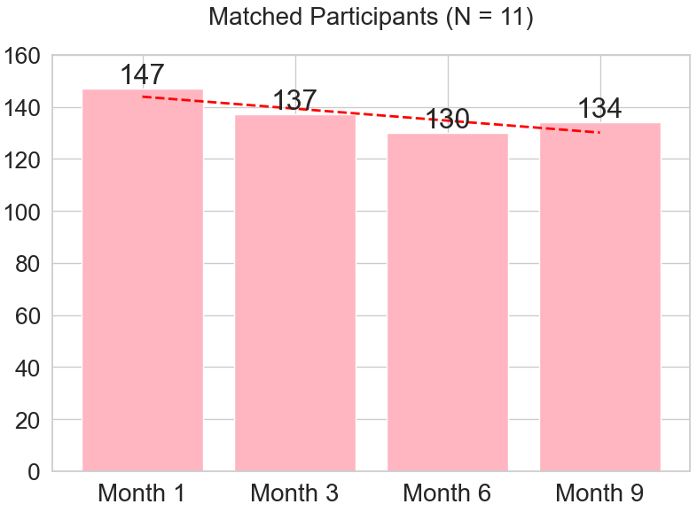
Blood Pressure Trends
Time Points | Baseline → 3-months | Baseline → 6-months | Baseline → 9-months
Δ SBP(mmHg) | -5 mmHg | -12 mmHg | -7 mmHg

Slide 18
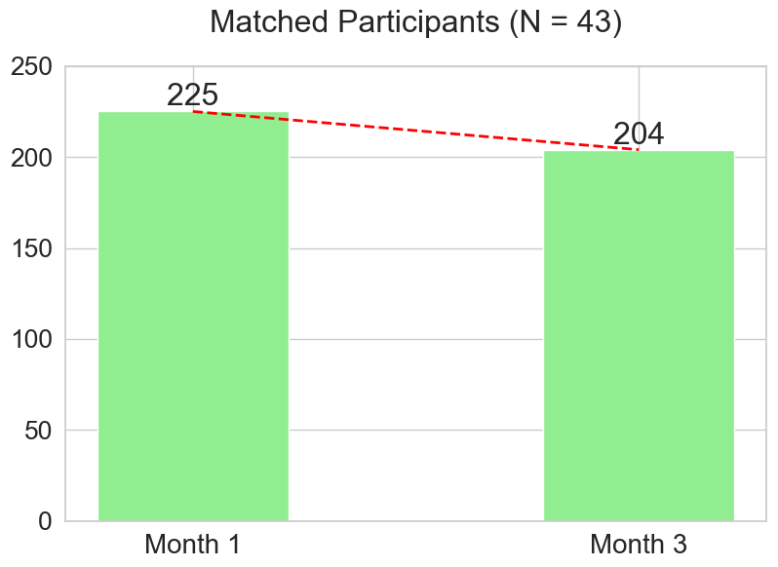
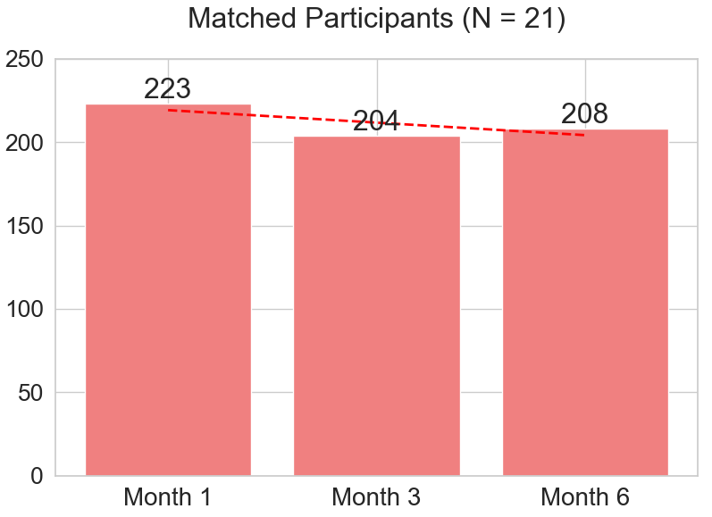
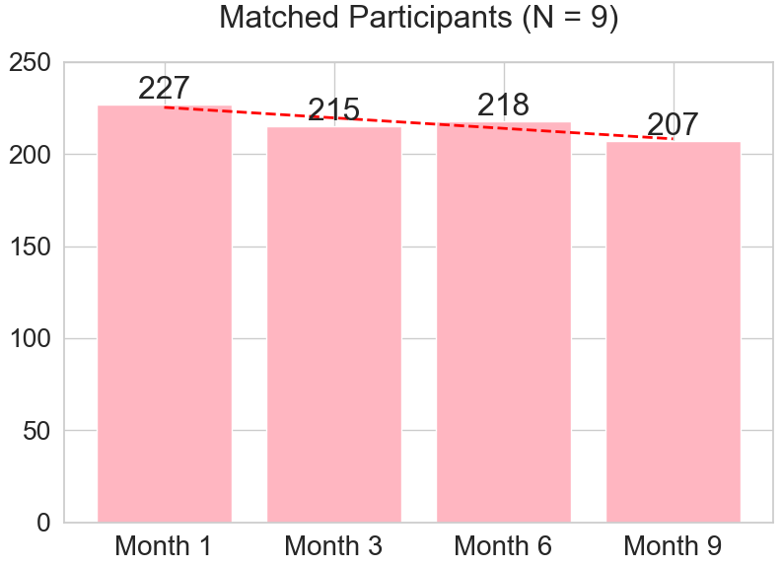
Weight Trends
Time Points | Baseline → 3-months | Baseline → 6-months | Baseline → 9-months
Δ Weight(lbs) | -21 lbs | -15 lbs | -19 lbs

Slide 19
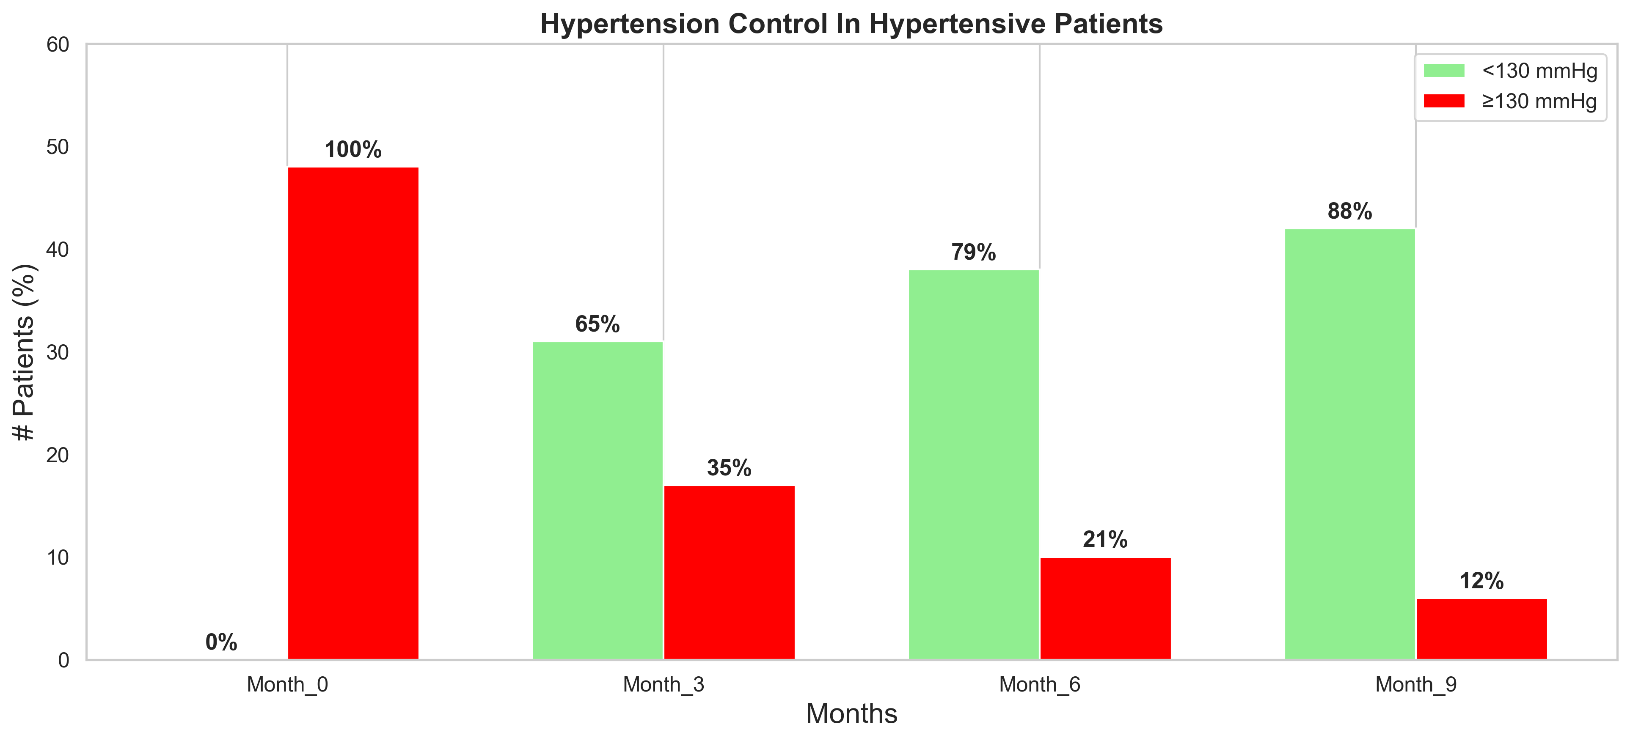
Preliminary Findings
BP Control Status | Month 0 | Month 3 | Month 6 | Month 9 | Δ (Month 0 → Month 9)
Uncontrolled (Red) | 100% | 35% | 21% | 12% | −88%
Controlled (Green) | 0% | 65% | 79% | 88% | +88%

Slide 20
Achieve-Greater (AG-SIM) Simulation Model

Slide 21
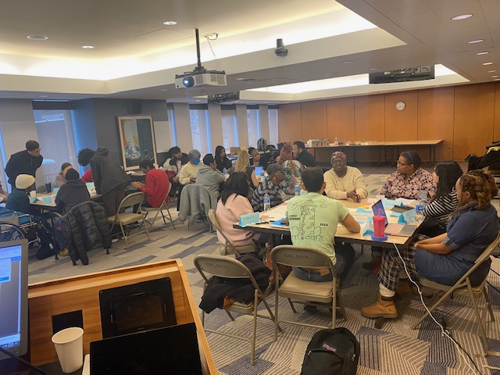
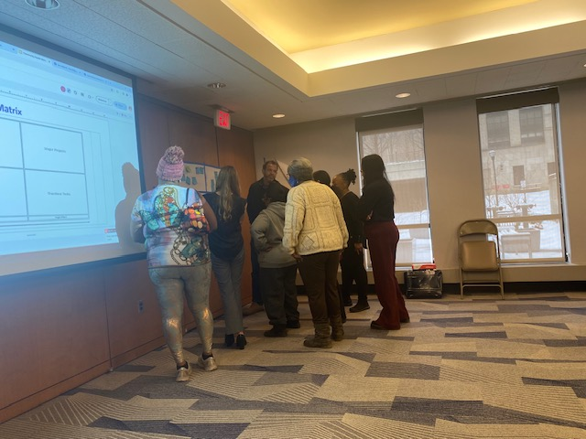
Group Model Building
1
Outcome Elicitation
What outcomes do you want to track to determine the success/failure of a CVD risk factors management and prevention program?.
2
Variable Elicitation
What variables can directly or indirectly influence the success and failure of a CVD risk factor management and prevention program and its outcomes?.
3
Structure Elicitation
Backbone model (Healthy population, Undiagnosed pre-CVD population, Diagnosed pre-CVD population, Managed pre-CVD population, Undiagnosed CVD population, Diagnosed CVD population, Managed CVD population).
4
Model Review
Stakeholders reviewed and refined the preliminary model structure in the second GMB session.
21
5
Action Ideas
Stakeholders listed current and future interventions CHWs could implement to improve the prevention and management of CVD risk factors.

Slide 23

AG-SIM Model Sectors
Population
Food Access
Economy
Housing
Pollution
Health care access and use
Diabetes
Hypertension
BMI
Risk Engine (Prevent Risk Engine)

Slide 24
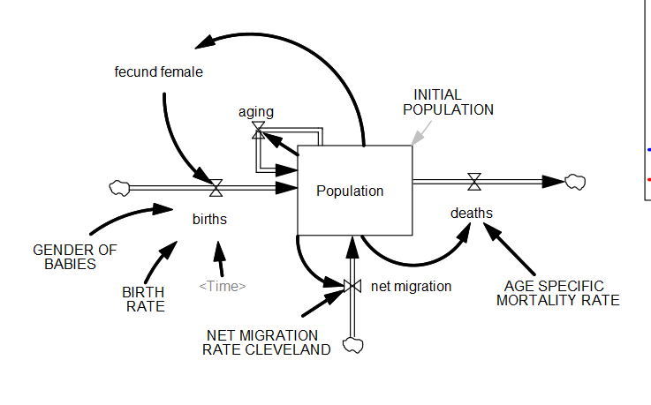
Population Model

Slide 25
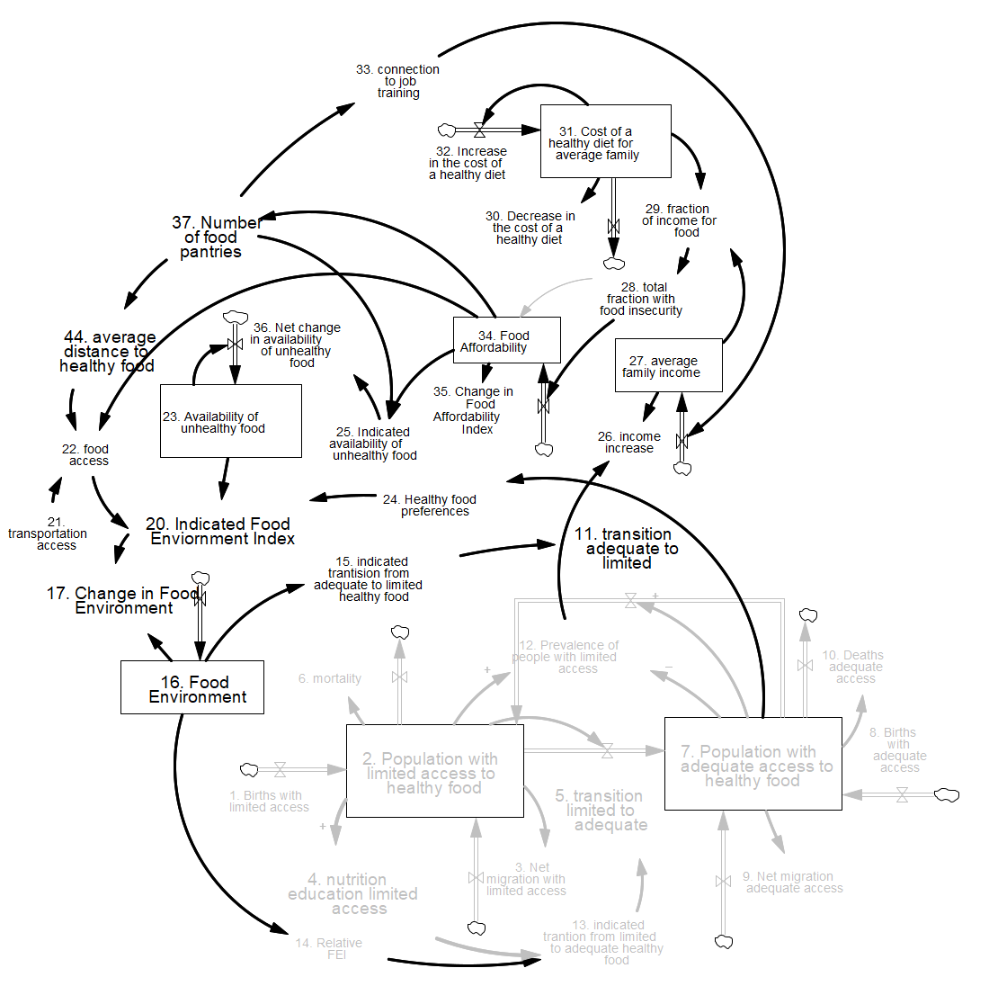
Food Environment

Slide 26
Diabetes Sub-Model

Slide 27
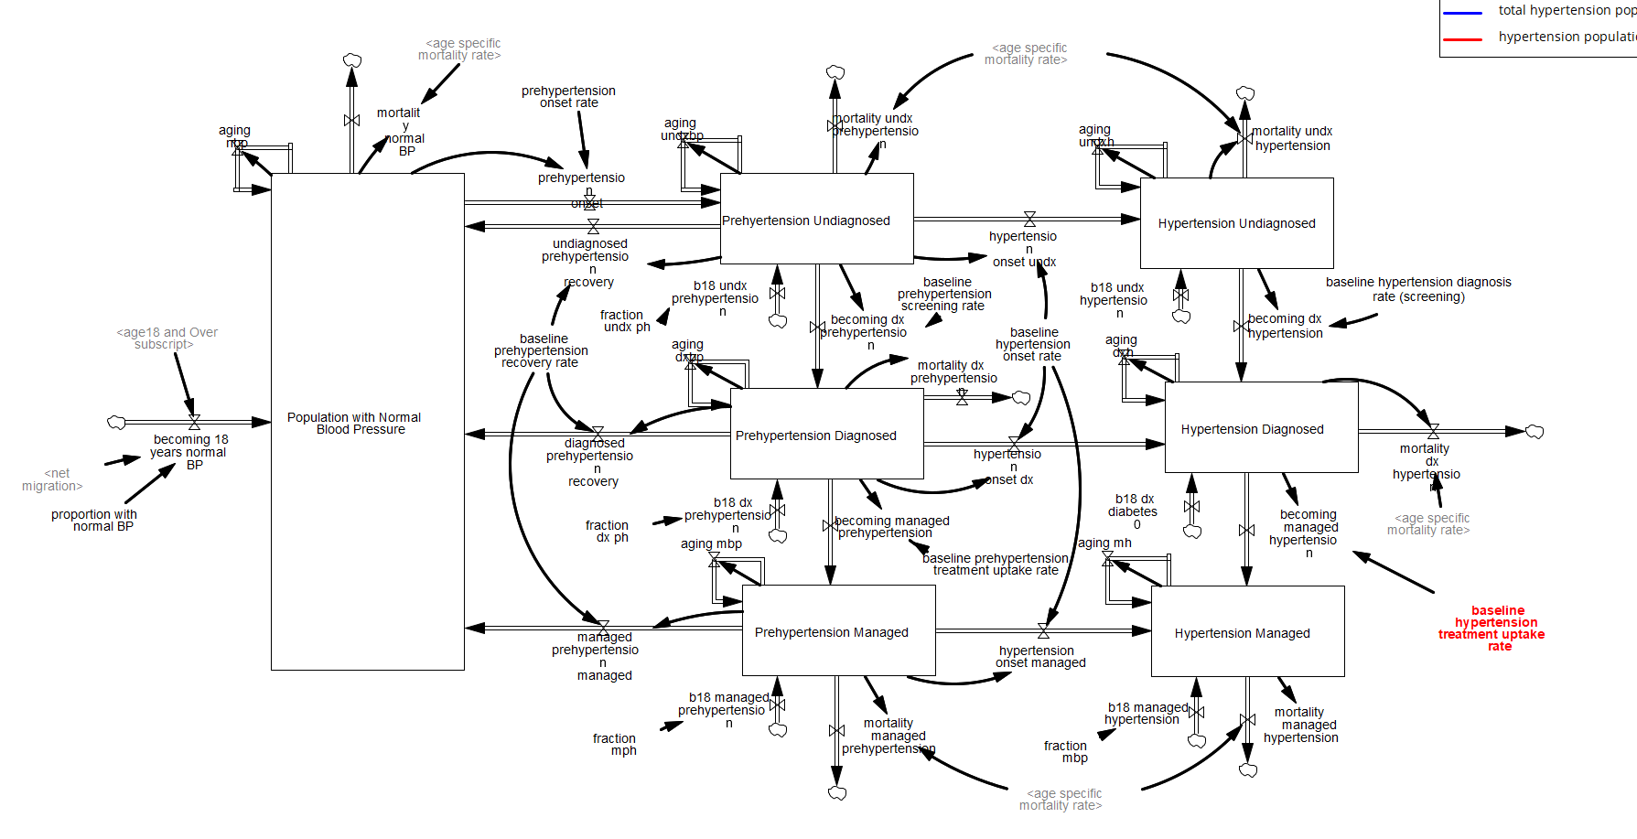
Hypertension Model

Slide 28
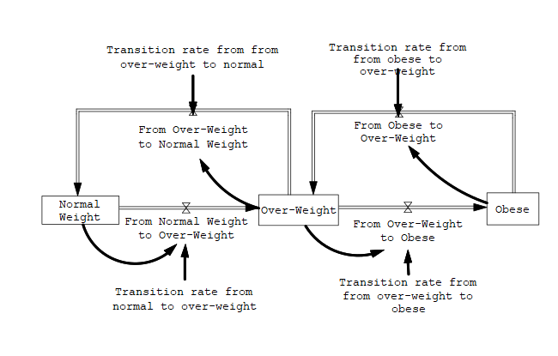
Weight Model

Slide 29
Risk Engine Sub-Model

Slide 30
CVD Risk Engine
Calculate the risk of CVD using three risk factors:
Diabetes
Hypertension
BMI
The CVD risk engine calculates the risk of CVD for eight population segments:
No Risk
Diabetes only
Hypertension only
BMI only
Diabetes and Hypertension
Diabetes and BMI
Hypertension and BMI
Diabetes, hypertension and BMI

Slide 31
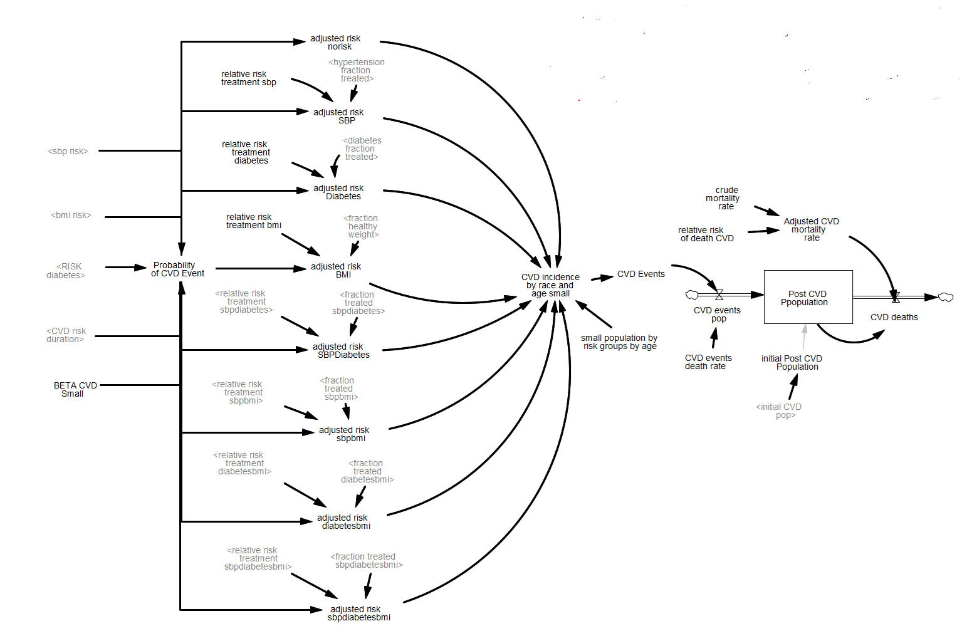
Risk Engine Model

Slide 32
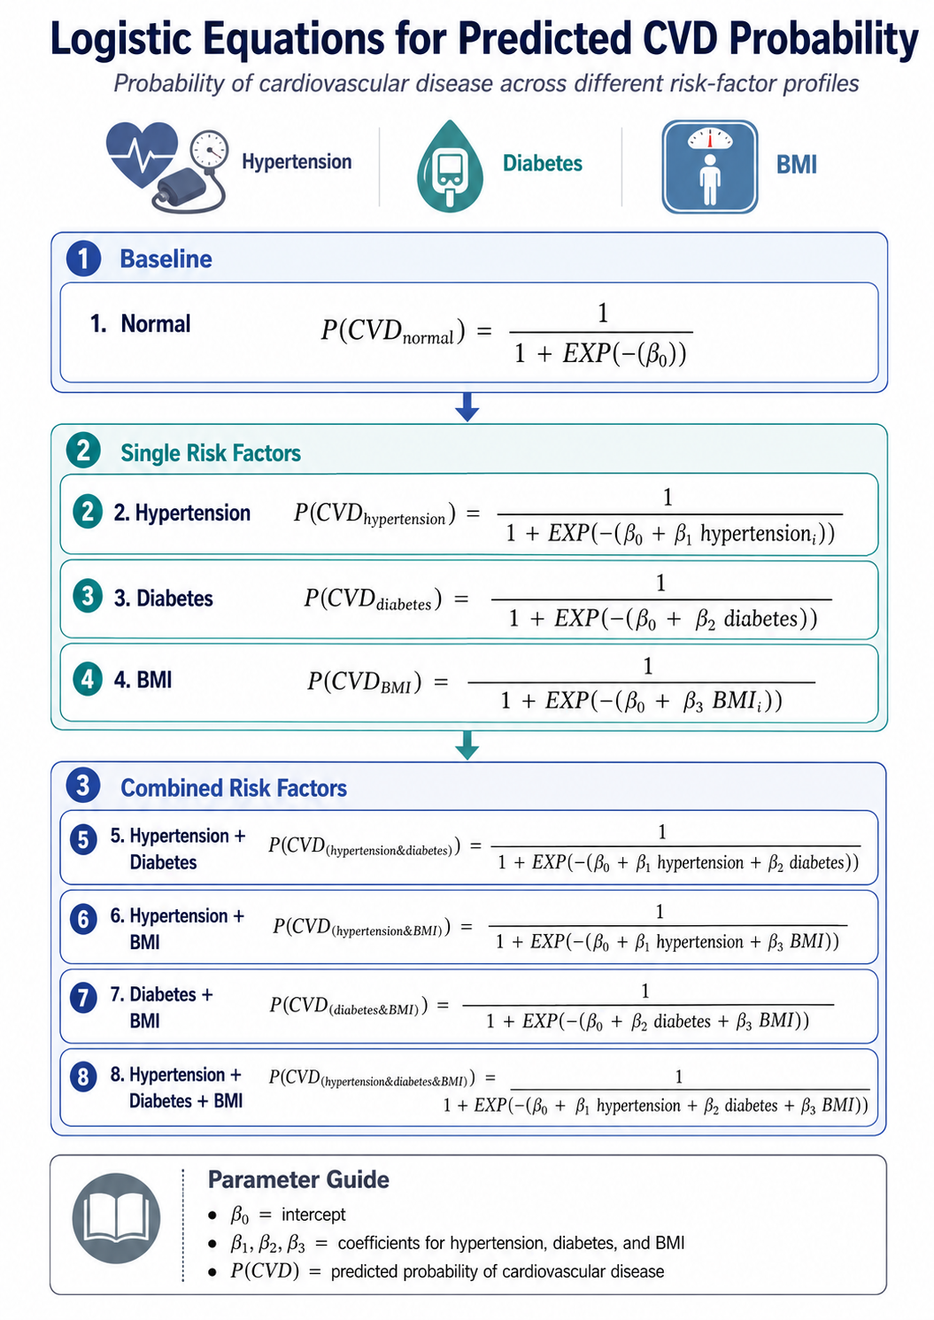

Slide 33
Data Sources
U.S. Census Bureau
County Health Rankings and Roadmaps.
U.S. Department of Agriculture (USDA).
Ohio state portal.
University Hospital Electronic Medical Records
Achieve Greater Study
Prevent Risk Engine
Estimate when data is not available.

Slide 34
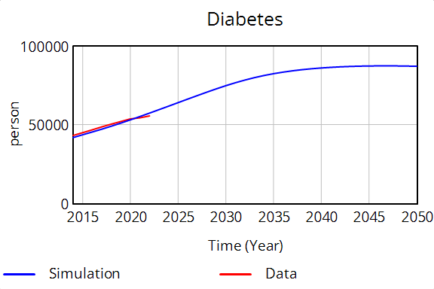
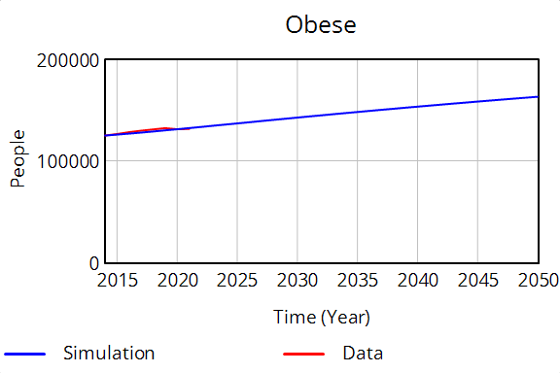
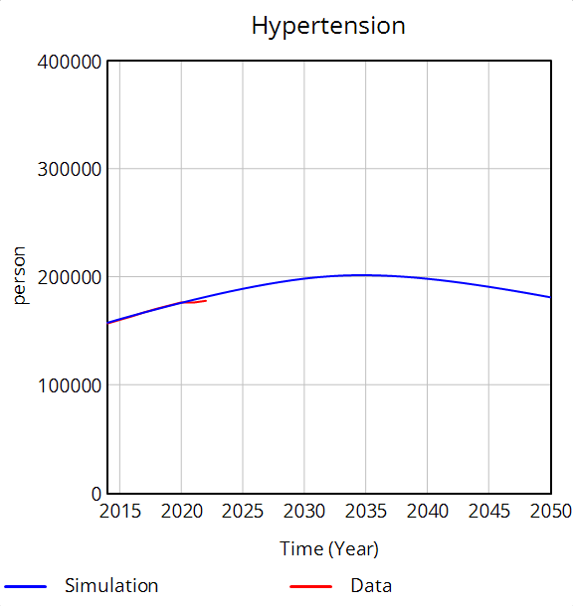
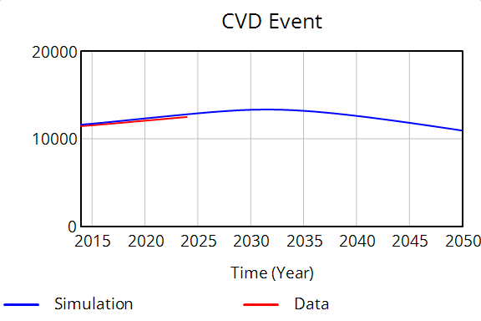

Slide 35
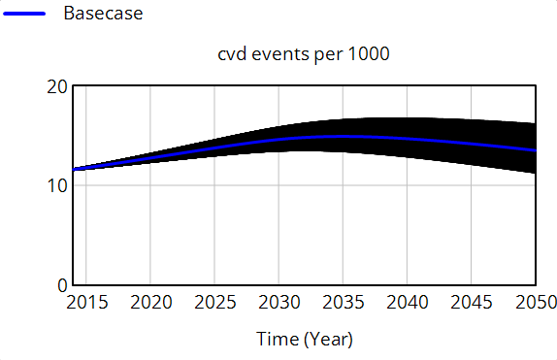
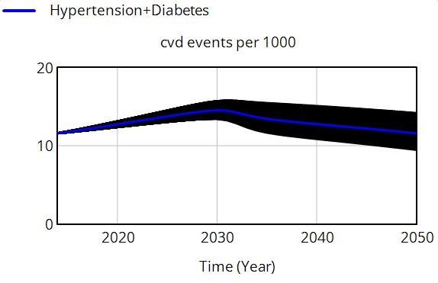
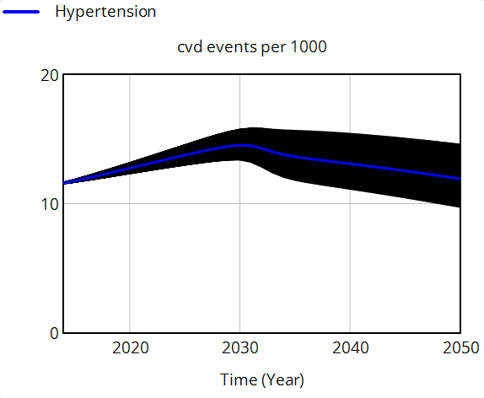
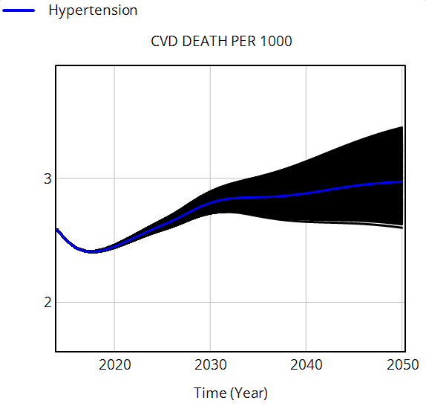
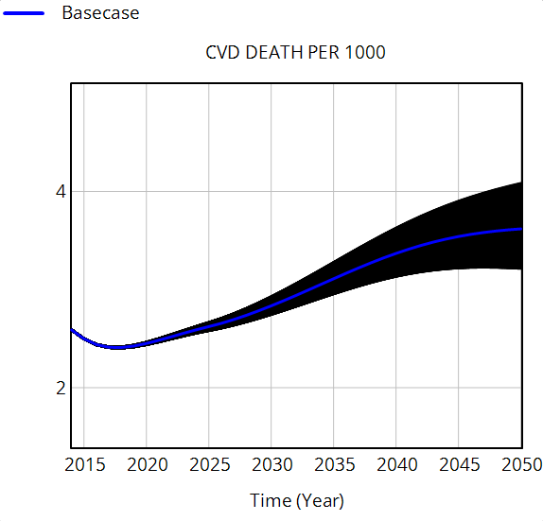
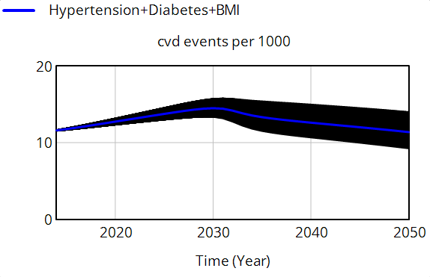

Slide 36
Scenarios
BASE-CASE
Hypertension Intervention
HYPERTENSION AND DIABETES INTERVENTION
HYPERTENSION, DIABETES AND WEIGHT MANAGEMENT
OTHERS
The current approach to managing risk factors remains unchanged.
.
Focus on increasing management of hypertension and improving SBP.
Focus on increasing management of hypertension and Diabetes and improving SBP and HbA1C.
Focus on increasing management of hypertension and Diabetes and improving SBP and HbA1C. Also supports weight management.

Slide 37
Outcome | 2020 | 2035 | 2050
CVD Events per 1000
BAU | 12.75 (12.41—13.11) | 14.92 (13.57—16.45) | 13.53 (11.47—15.97)
Hypertension | 12.75 (12.41—13.11) | 13.66 (12.24—15.29) | 11.97 (10.10—14.16)
Hypertension Diabetes | 12.75 (12.41—13.11) | 13.48 (12.05—15.11) | 11.63 (9.80—13.78)
Hypertension Diabetes Obesity | 12.75 (12.41—13.11) | 13.36 (11.93—14.99) | 11.42 (9.61—13.54)
CVD Mortality per 1000
BAU | 2.45 (2.44—2.46) | 3.11 (2.97—3.27) | 3.62 (3.24—4.06)
Hypertension | 2.45 (2.44—2.46) | 2.85 (2.72—2.99) | 2.98 (2.66—3.34)
Hypertension Diabetes | 2.45 (2.44—2.46) | 2.77 (2.64—2.91) | 2.80 (2.50—3.14)
Hypertension Diabetes Obesity | 2.45 (2.44—2.46) | 2.66 (2.54—2.80) | 2.59 (2.32—2.90)

Slide 38
Insights

Slide 39
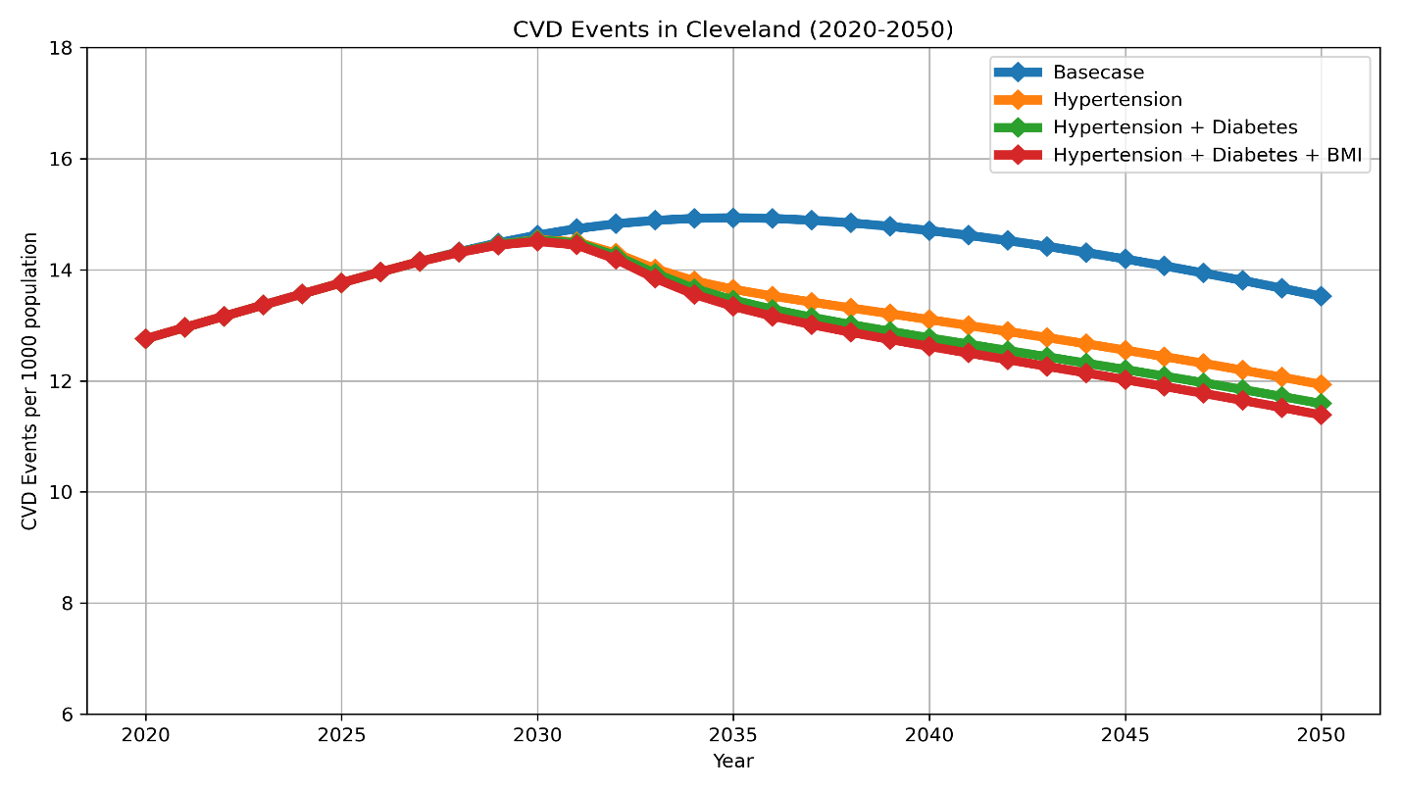

Projected CVD Events
11.06%
14.12%
15.59%

Slide 40

Projected CVD Deaths
17.68%
22.93%
28.45%

Slide 41
Avoidable CVD Events and Deaths (2027-2050)

Slide 42
Key Findings
Status quo leaves a high CVD burden, with mortality rising from 2.45 to 3.62 per 1,000 by 2050.
Hypertension management is the largest single first-step intervention, preventing about 27,335 events and 8,774 deaths between 2027-2050.
The comprehensive strategy produces the greatest mortality benefit: 28.45% lower mortality than baseline.
Diabetes and obesity management add incremental gains, supporting integrated cardiometabolic prevention rather than isolated disease programs.

