Slide 1

Exploring Loop and Parameters Influence using Sensitivity Analysis with Explanatory Model Analysis
Jim Duggan¹, Enda Howley¹, Martina Curran², and Hamda Ajmal³
¹ School of Computer Science, University of Galway, Ireland
² Technological University of the Shannon, Athlone, Ireland
³ Central Statistics Office, Dublin, Ireland
https://github.com/JimDuggan/ISDC-2026-EMA

Slide 2
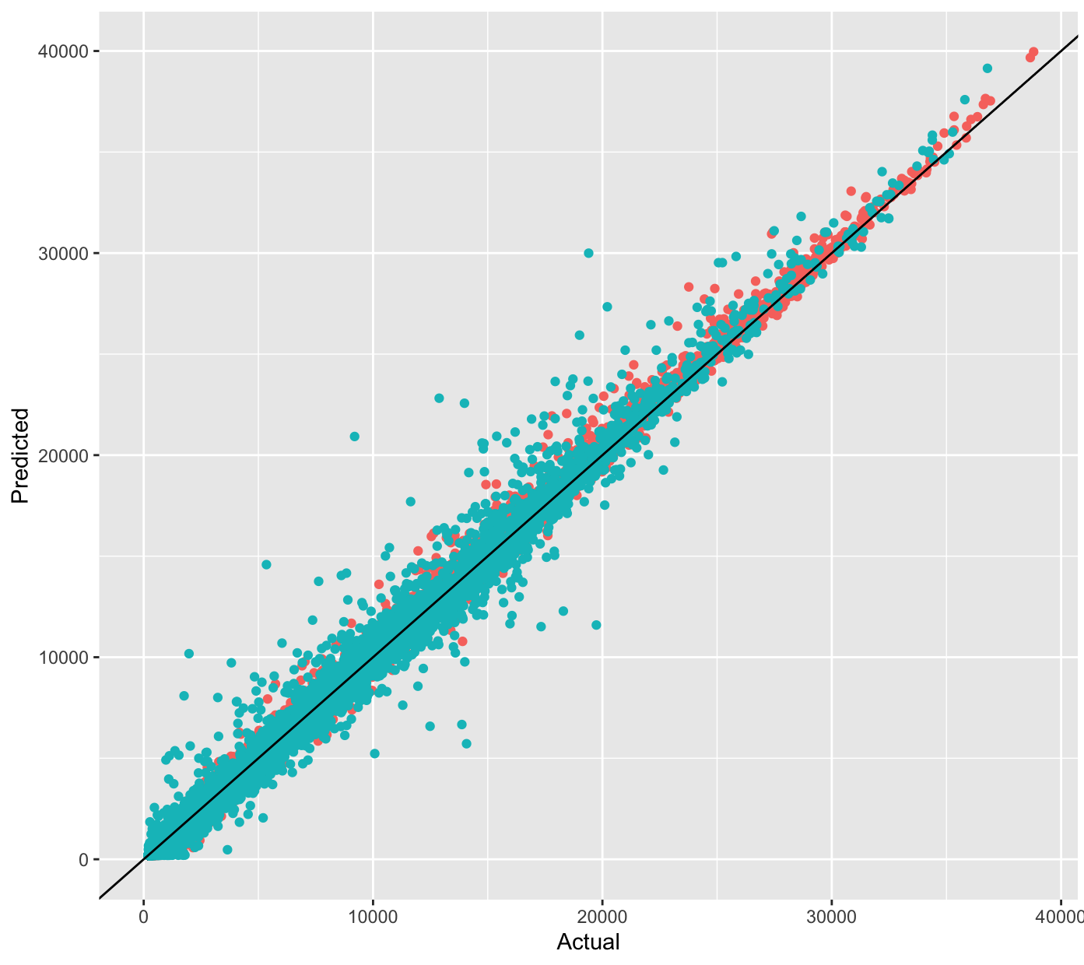
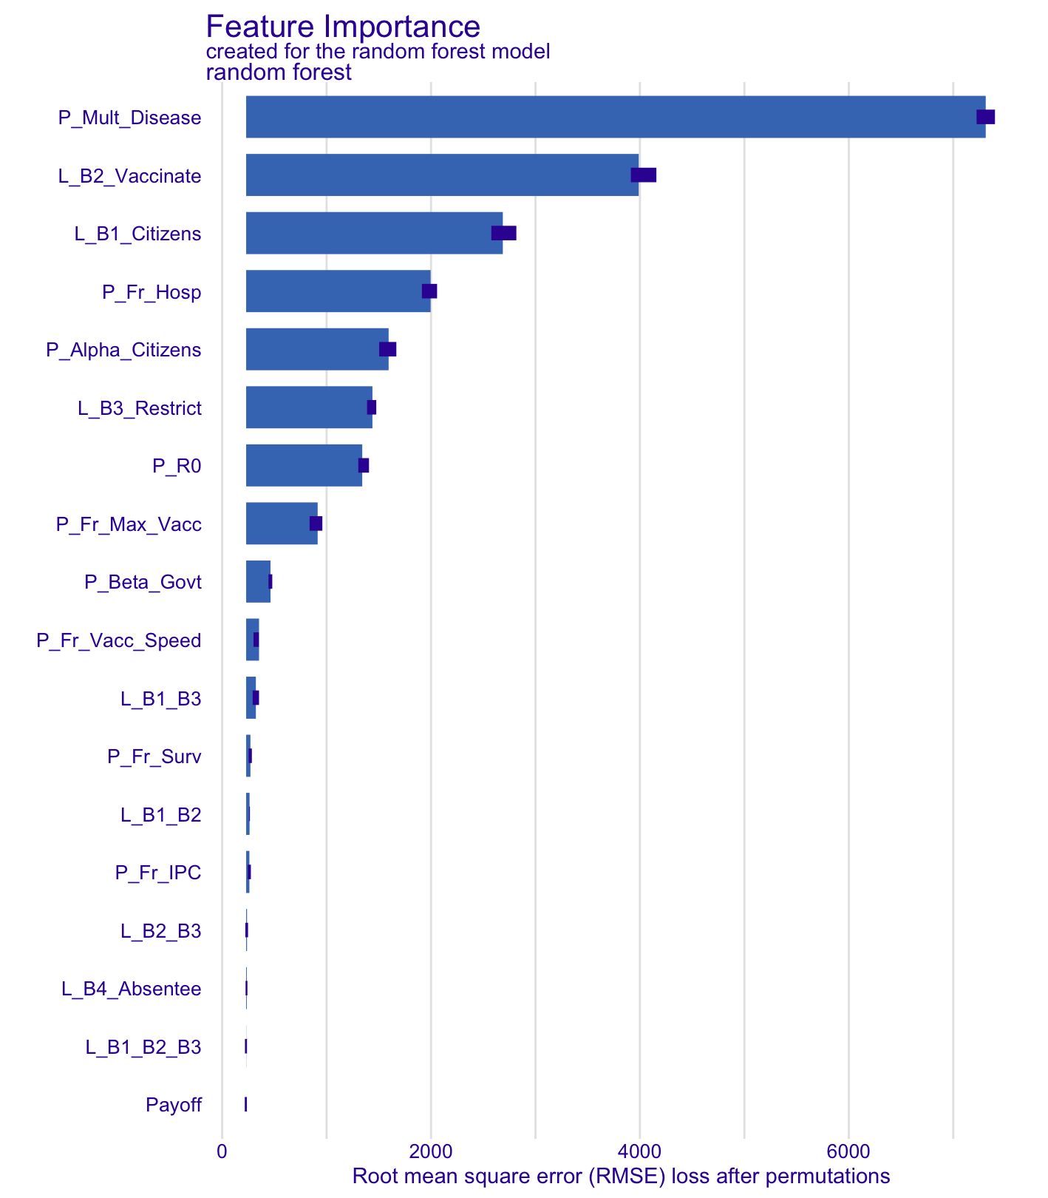
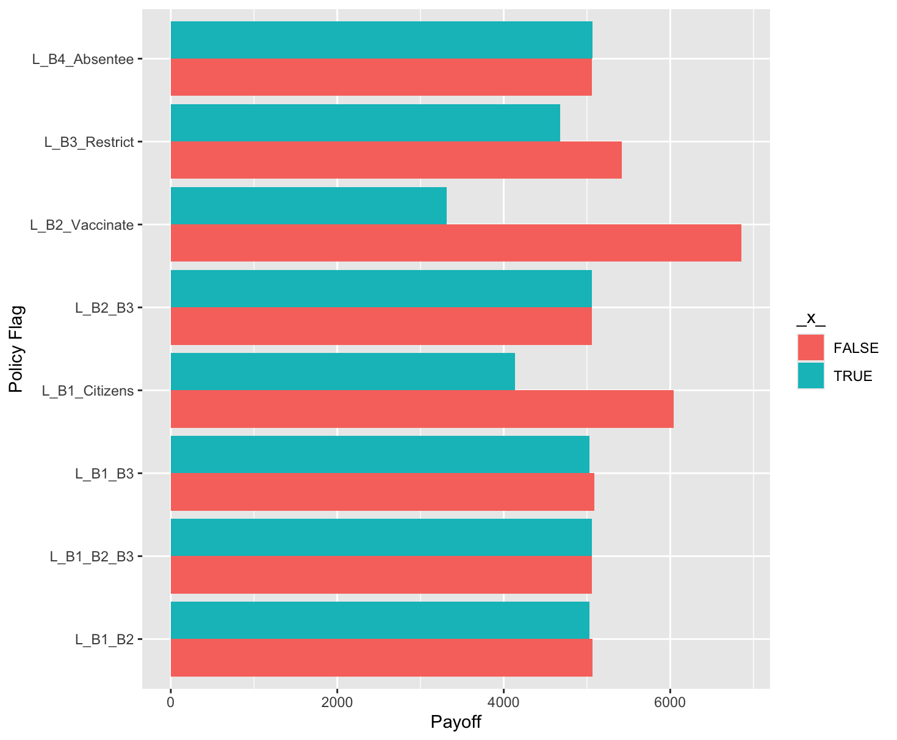
Overall Goal – Generate SD Model Insights
1: Sensitivity Analysis (with Payoff)
2: Regression model – Supervised learning Y = f(X) +⍷
Sim Data_{N}
:
Y X_{1.} X₂ X_{M}
Sim Data₁
:
Sim Data₁
3: Explanatory Model Analysis (Dataset & Instance)
4: Modelling Insights and Validation Information

Slide 3

Supply Chain Model Example (BD, p688)

Slide 4
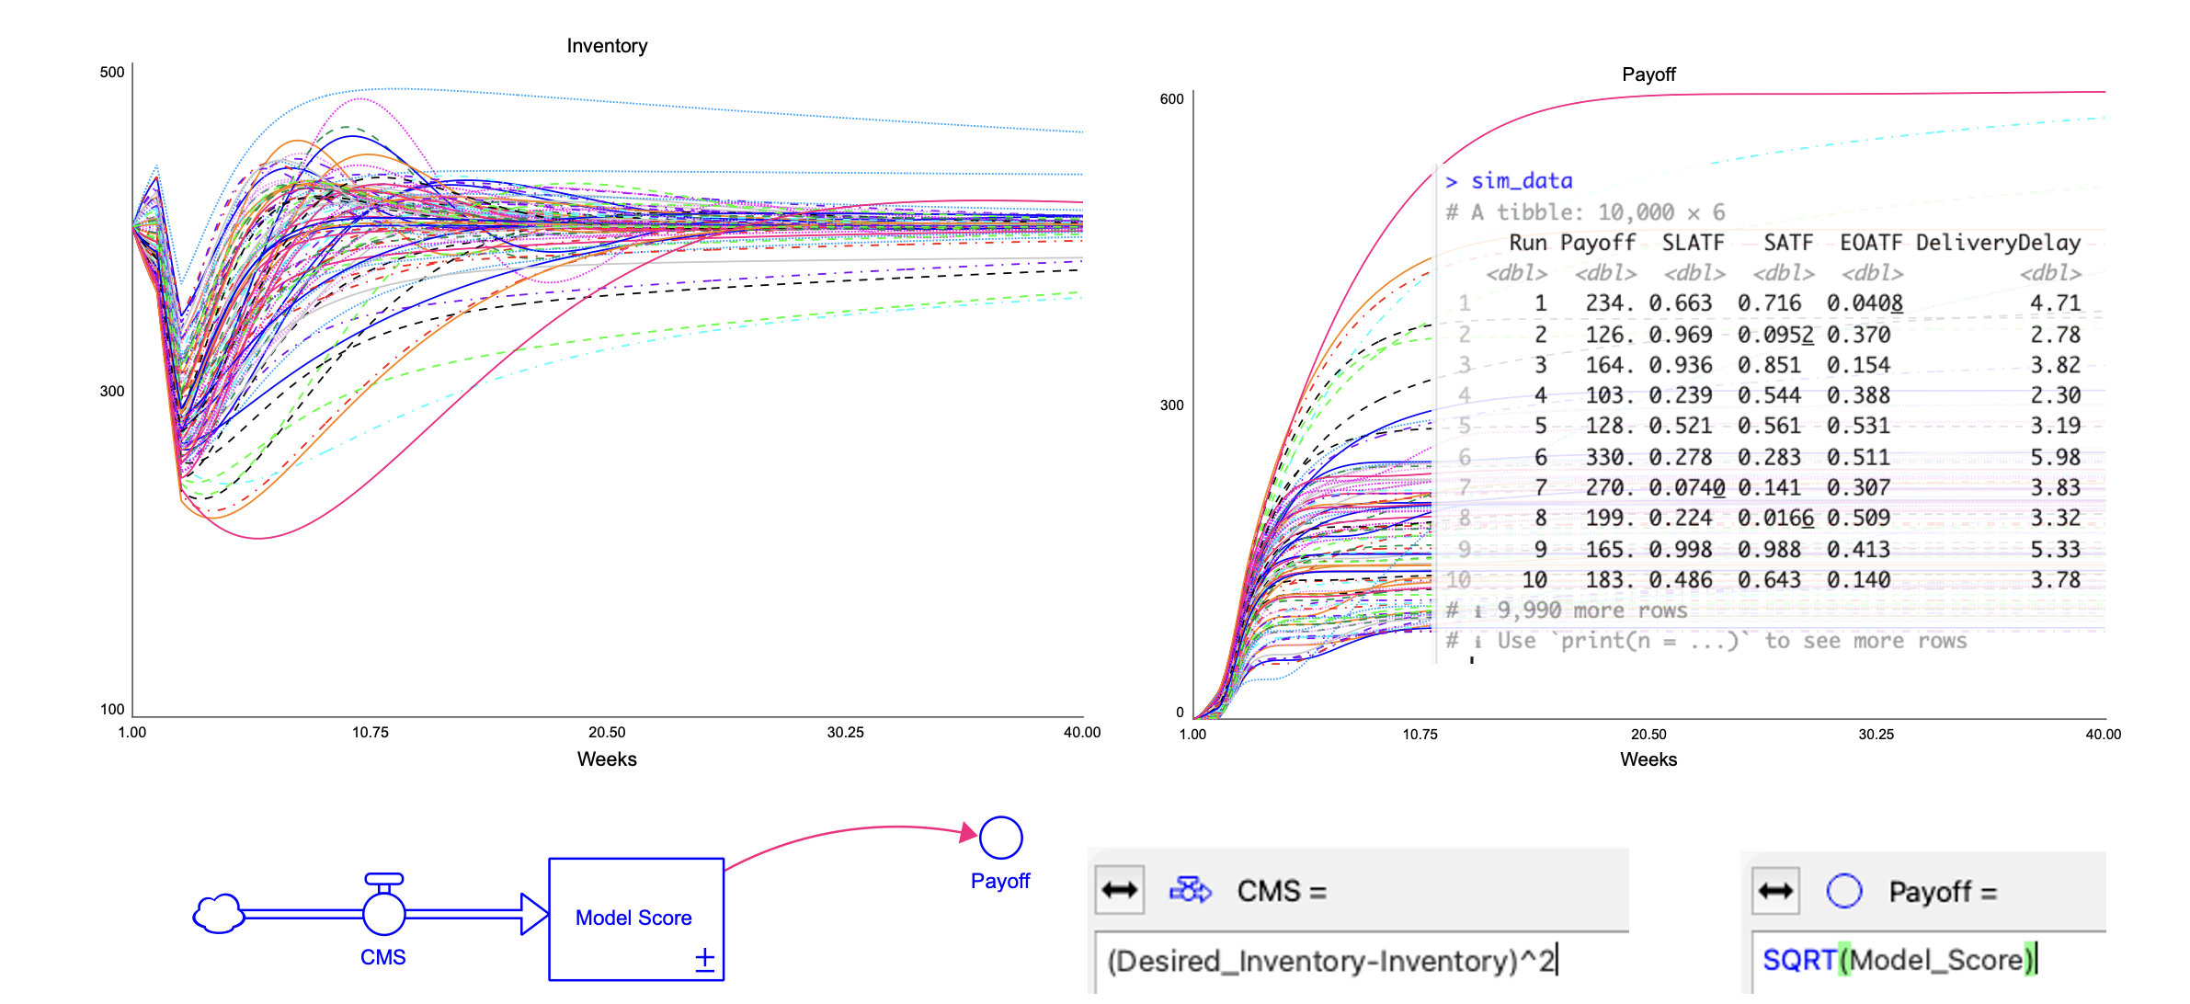
Sensitivity Analysis

Slide 5
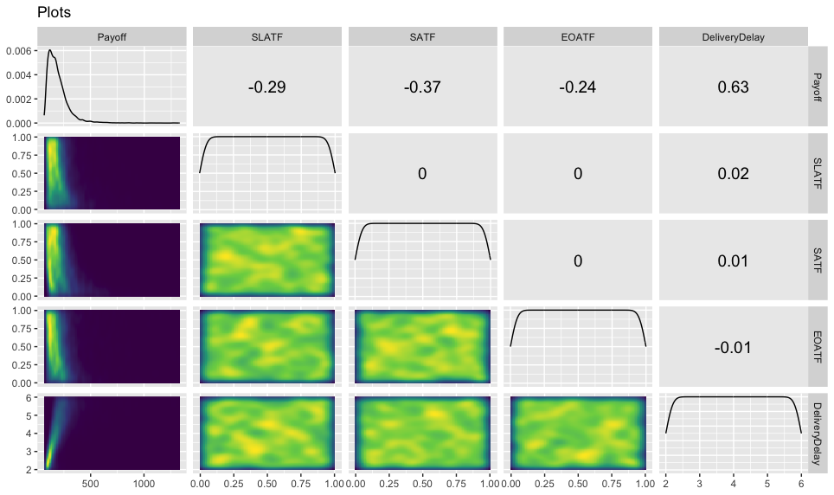
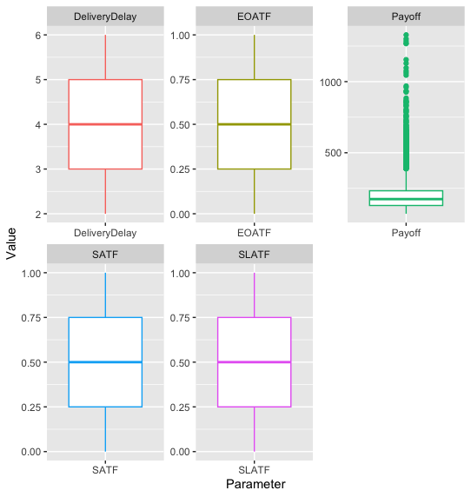
Exploratory Analysis – Sensitivity Data

Slide 6

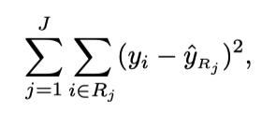
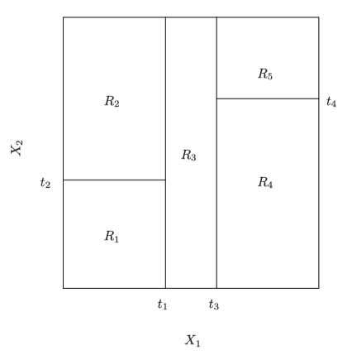
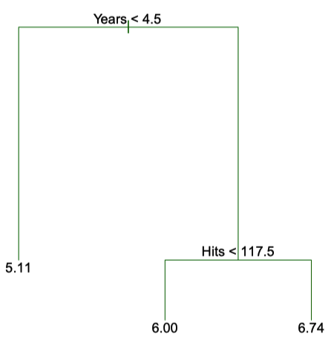
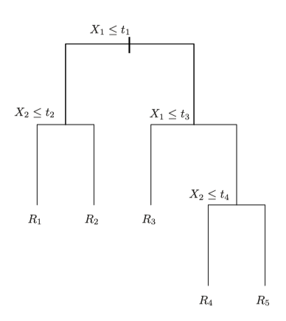
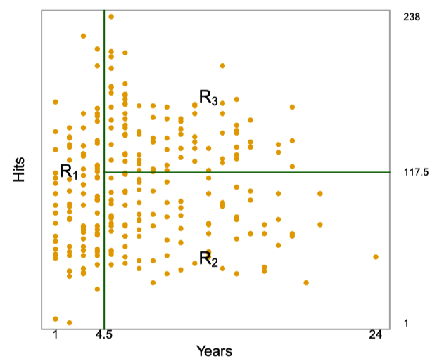
Random Forest Regression
Minimise Residual Sum
Of Squares for J Regions
Tree-based methods segment the predictor space into a number of simple regions
Prediction based on the mean/mode response for the region to which the observation belongs
Ensemble-based methods (with multiple trees) improves accuracy
Random Forest Regression is an ensemble-based method

Slide 7
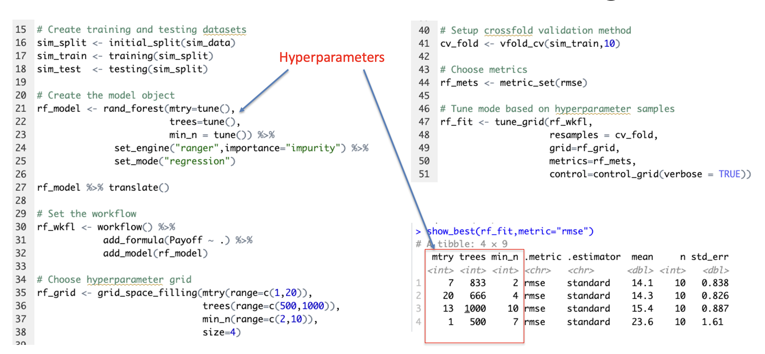
Random Forest Model Building
Hyperparameters

Slide 8
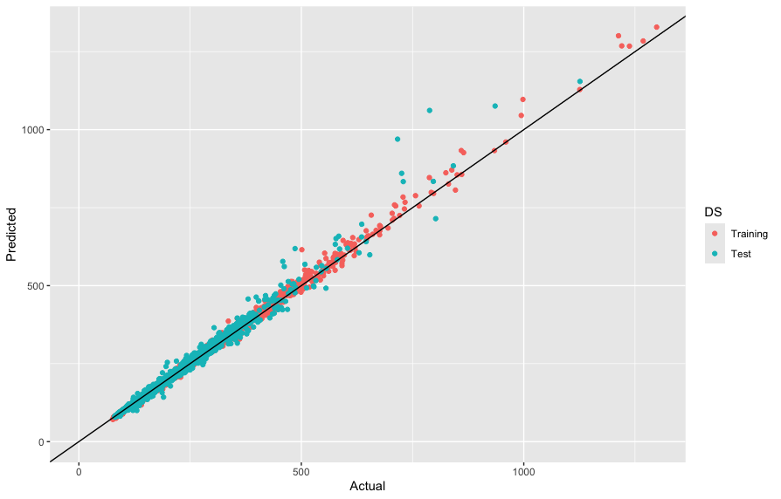
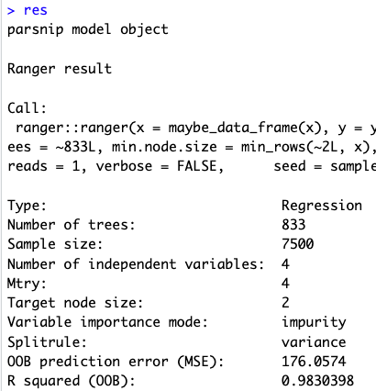
Model Fitting

Slide 9
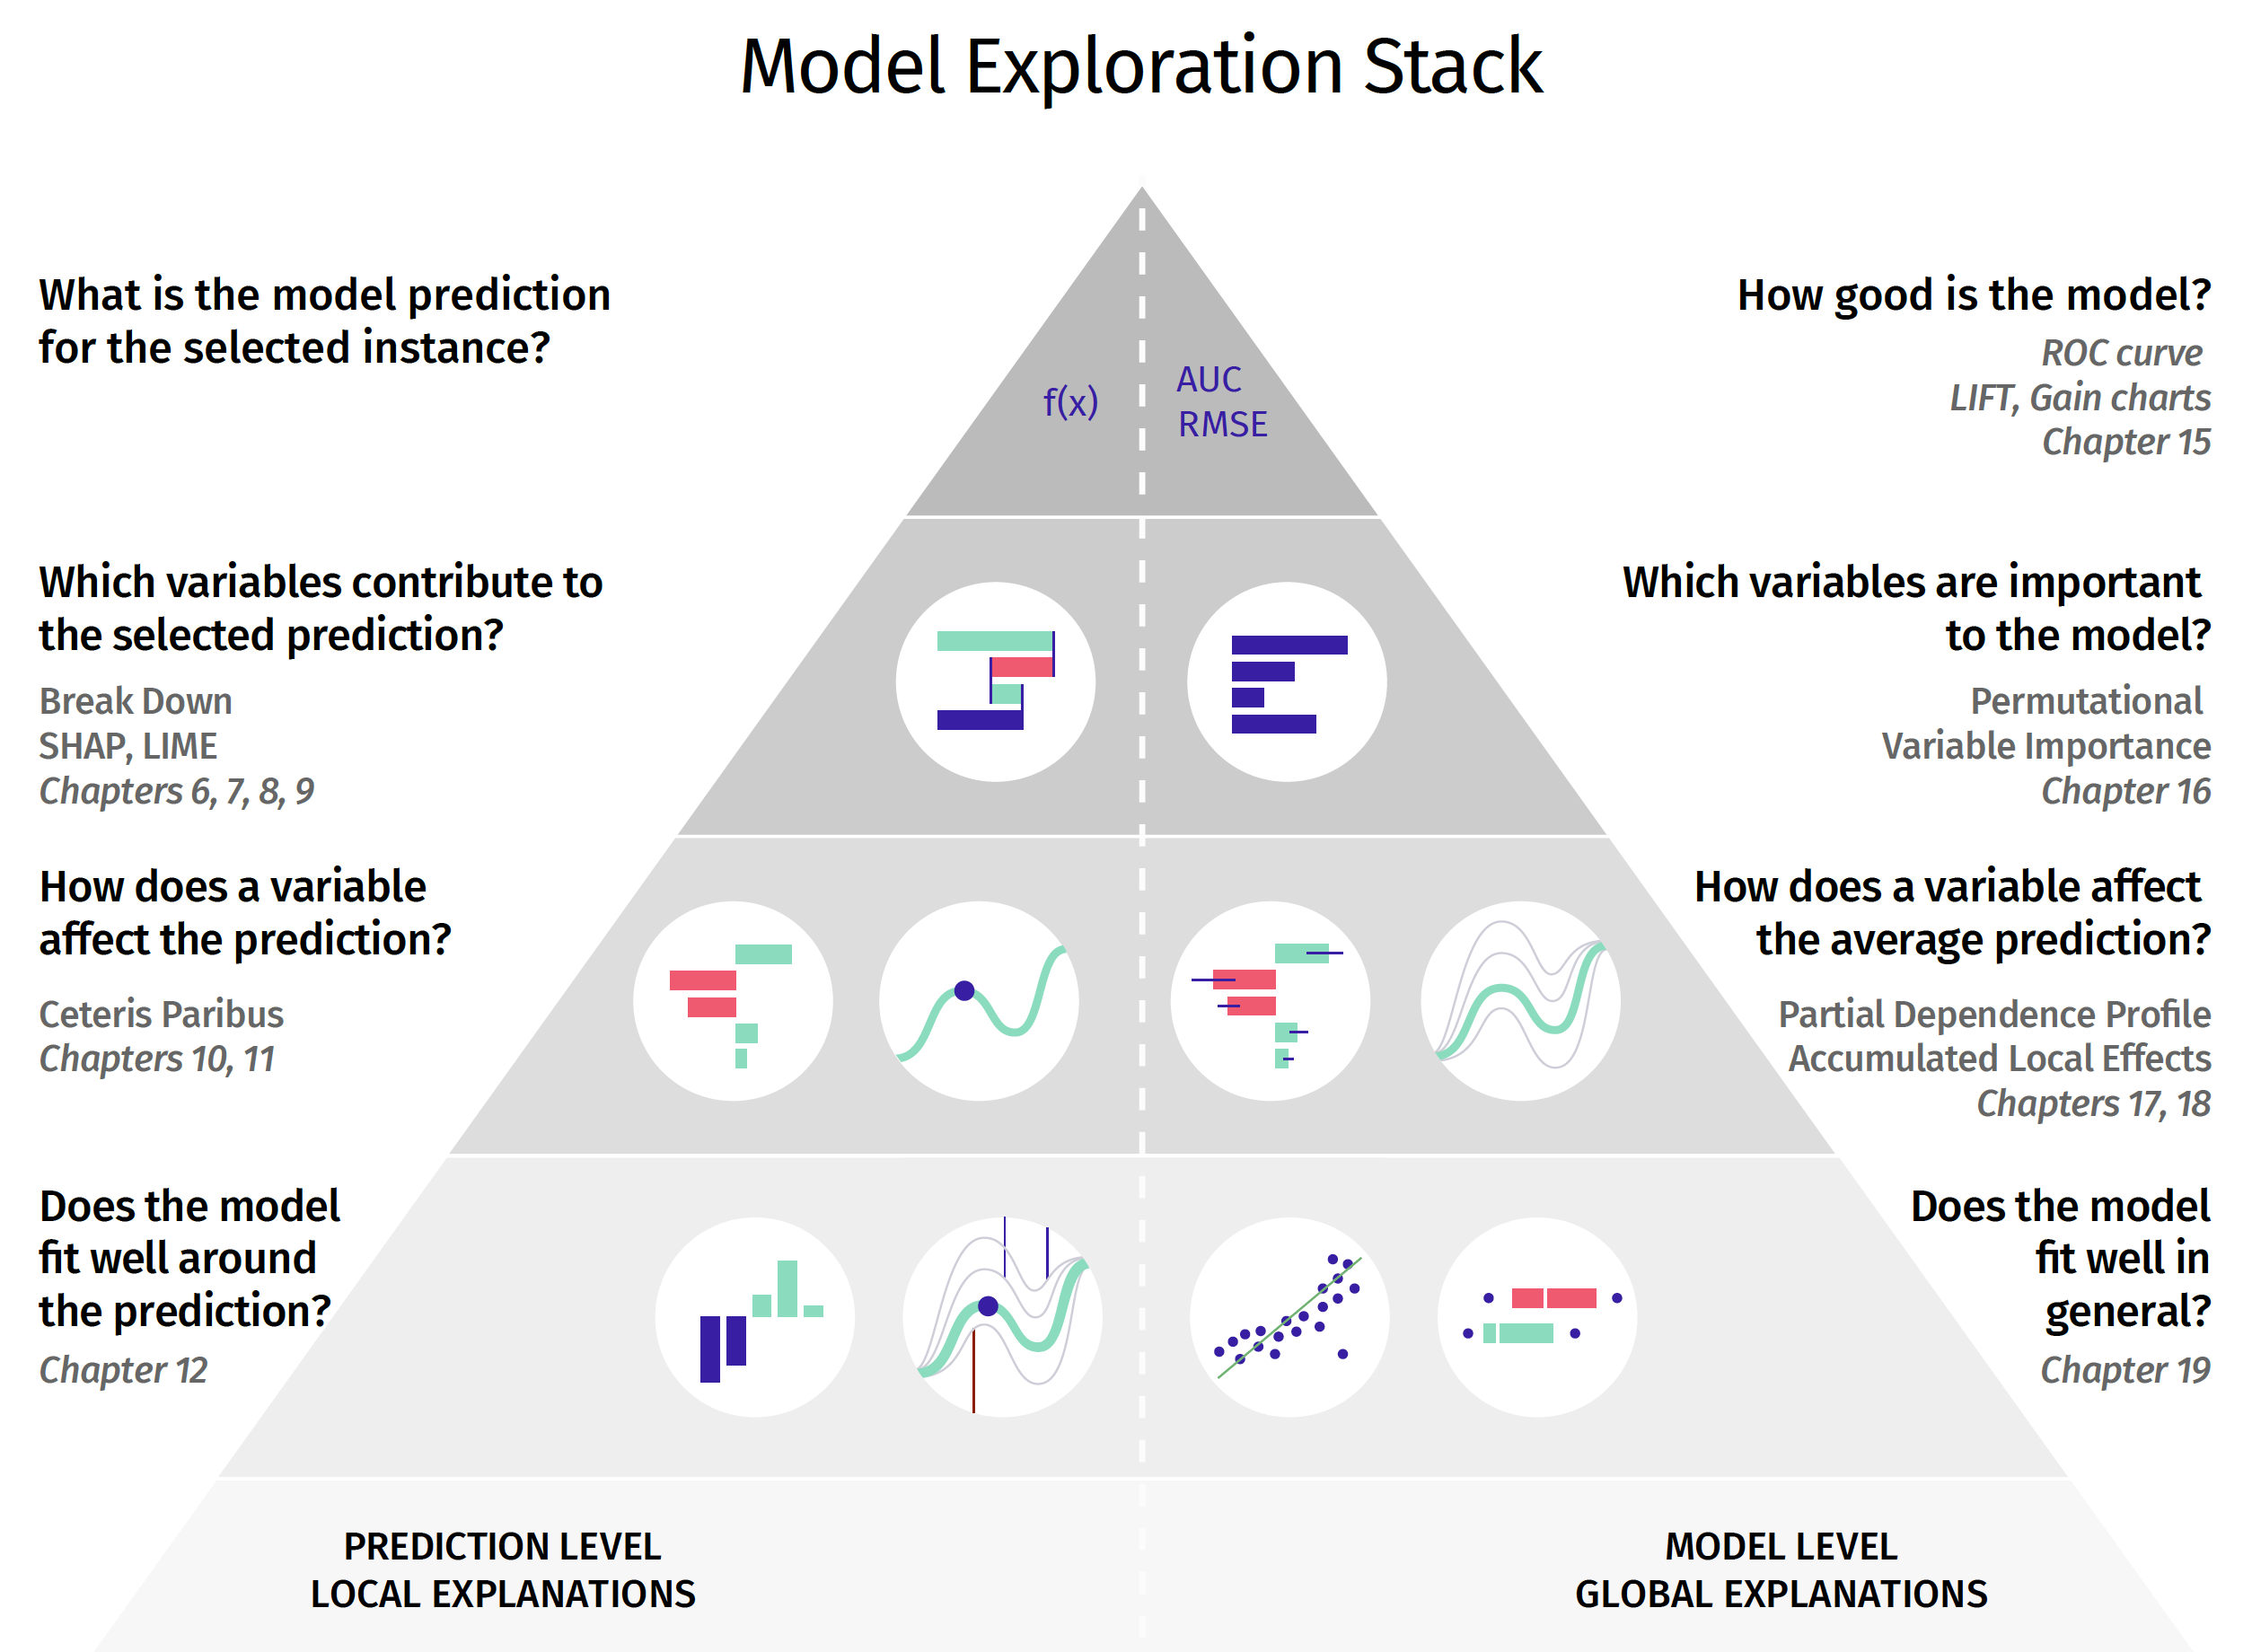
Explanatory Model Analysis
Variable-importance purposes:
Model simplification
Model exploration
Domain-knowledge-based model validation
Knowledge generation
https://ema.drwhy.ai

Slide 10
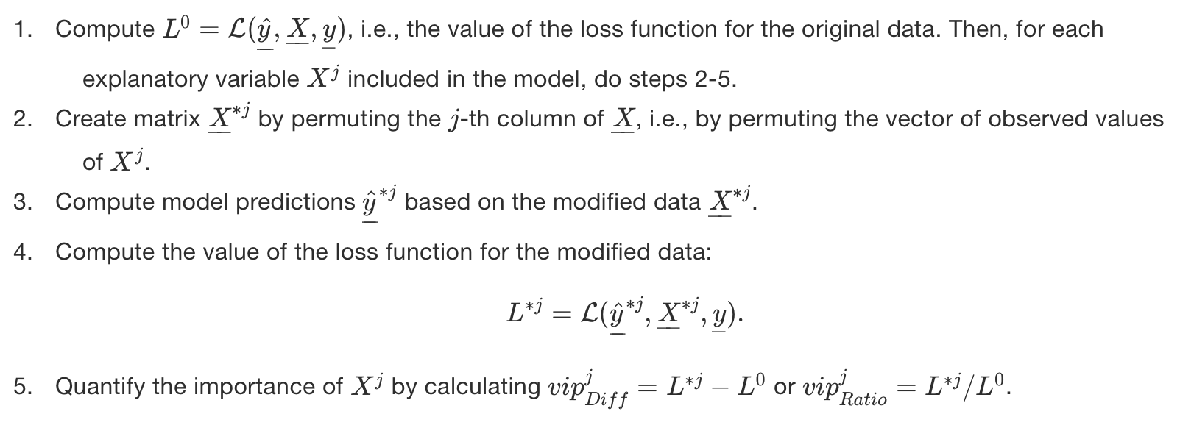
The VoI Method (Biecek and Burzykowski 2021, p194)
(SD model parameter)
(resampling)
RESAMPLE
https://ema.drwhy.ai/featureImportance.html

Slide 11
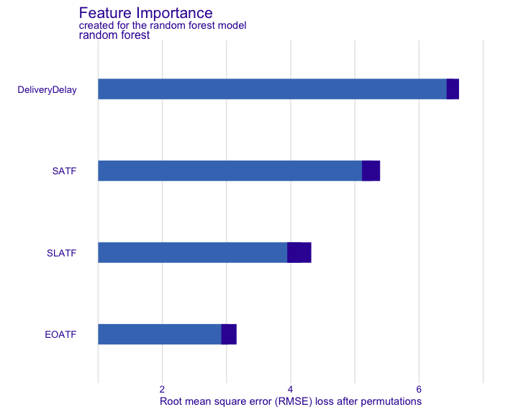


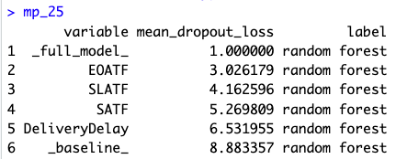
VOI Results

Slide 14
SD-EMA Process
Augment a system dynamics model
  Identify a model payoff variable, which captures a value that indicates the overall result of the simulation output – a form of key performance indicator for the model.
  Add flags (variables that can be 0 or 1) to activate/deactivate prioritised feedback loops, a process that is similar in intent to loop knockout analysis (Sterman, 2000).
  Identify sensitivity parameters, their ranges, and the statistical distributions to sample from (e.g. uniform, normal, etc).
Generate a single sensitivity dataset that samples from the flags (0 or 1) and the range of sensitivity parameters, and output the final result based on the payoff variable.
Using the sensitivity dataset, build a supervised statistical learning regression model (e.g. random forest regression). Test this across a range of model hyperparameters, and, following cross validation, select a model with the lowest root mean squared error.
Perform explanatory model analysis, which can include instance and dataset level computations (e.g. VOI, PDP, SHAP, Ceteris Paribus)
Communicate insights as part of the model building process, and refine/update system dynamics model as appropriate.

Slide 15
Conclusion
Advantages
Disadvantages
Integrates SD/ML modelling
Open source tools (R and Python) with well-defined APIs
Model agnostic (can be any type of regression model)
Ease of integration with existing SD Software (that supports sensitivity analysis)
No evidence yet on how this approach would enhance the SD model building process
Needs an agreed-on and well-defined payoff variable(s)
ML model focused on the SD final output (does not consider behaviour over time).
Reliant on a well-tested/calibrated model with plausible parameter ranges.
Requires skills in R/Python, although tidy modelling package in R has a nice supporting workflow

Slide 16
Conference Workshop (08.30 24/7/2026)
https://github.com/JimDuggan/ISDC-2026-EMA

Slide 17
















RAPIDE
Thank you
Any questions?
Funded by the European Union. Views and opinions expressed are however those of the author(s) only and do not necessarily reflect those of the European Union or the Health and Digital Executive Agency. Neither the European Union nor the granting authority can be held responsible for them.

