Slide 1





Leveraging System Dynamics to Bridge the Indicator Trap in Cali, Colombia
Online Poster Presentation
Jorge Andrick Parra Valencia (Presenter), Universidad Autónoma de Bucaramanga
Ivan Taylor, Policy Dynamics Inc.
Saroj Koul, Jindal Global Business School
Beatriz Marin, Universidad Autónoma de Bucaramanga
0:00-0:30
@systemdynamics_
THE 44TH INTERNATIONAL SYSTEM DYNAMICS CONFERENCE
Delft, Netherlands and Virtually
#isdc2026
Notes:
Title page: Change title to submission name. Bold the name of the presenter and display your name as you want it read by the moderator (eg Bob instead of Robert). Note the suggested timing in the bottom right. Slide timing may be adjusted, but not the number of slides.

Slide 2

Problem Statement
Key Problem
  Sustainability investments continue increasing.
  Socio-ecological degradation continues worsening.
  Administrative success does not necessarily imply territorial improvement.
  Governance systems optimize indicators rather than underlying realities.
Core Condition
λ > τ
Administrative reporting delay > Territorial response time
Consequence
"Zone of False Security"
Reported success while real vulnerability continues growing.
0:30-2:00
@systemdynamics_
THE 44TH INTERNATIONAL SYSTEM DYNAMICS CONFERENCE
Delft, Netherlands and Virtually
#isdc2022
THE 40TH INTERNATIONAL SYSTEM DYNAMICS CONFERENCE
Virtually everywhere!
#isdc2026
Notes:
Keep fonts big (24 pt or bigger). Note suggested timing in the bottom right.

Slide 3
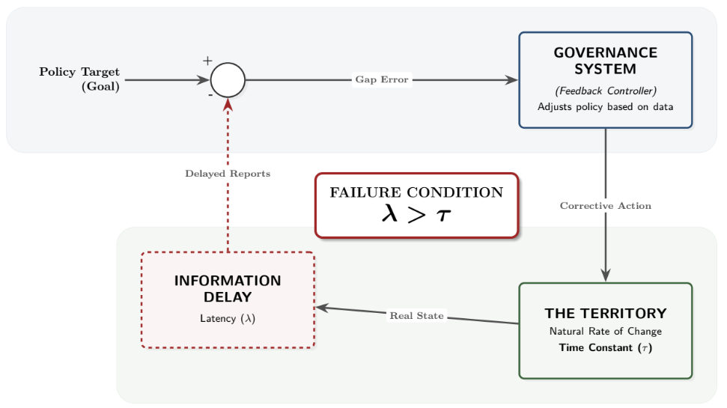
Problem Statement
0:30-2:00
@systemdynamics_
THE 44TH INTERNATIONAL SYSTEM DYNAMICS CONFERENCE
Delft, Netherlands and Virtually
#isdc2022
THE 40TH INTERNATIONAL SYSTEM DYNAMICS CONFERENCE
Virtually everywhere!
#isdc2026
Notes:
Keep fonts big (24 pt or bigger). Note suggested timing in the bottom right.

Slide 4
Approach or Dynamic Hypothesis
Dynamic Hypothesis
Governance operates on the Map
Indicators
Reports
KPIs
Administrative cycles
Territories operate on the Territory
Vulnerability
Informality
Violence
Social resilience
Structural Hypothesis
High-stakes indicators trigger archetypal behaviors:
Administrative Rationality | Archetype
Velocity | Fixes That Fail
Stability | Shifting the Burden
Efficiency | Success to the Successful
Self-interest | Tragedy of the Commons
2:00-3:30
@systemdynamics_
THE 44TH INTERNATIONAL SYSTEM DYNAMICS CONFERENCE
Delft, Netherlands and Virtually
#isdc2022
THE 40TH INTERNATIONAL SYSTEM DYNAMICS CONFERENCE
Virtually everywhere!
#isdc2026
Notes:
Keep fonts big (24 pt or bigger). Note suggested timing in the bottom right.

Slide 5
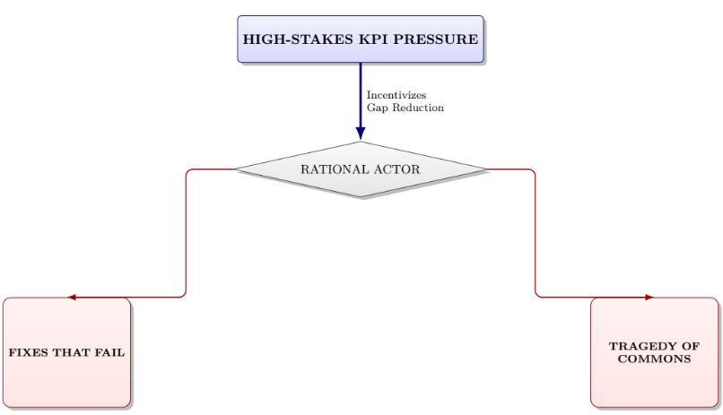
Approach or Dynamic Hypothesis
Indicator Trap
Goodhart's Law
+
System Archetypes
+
Control Failure (λ > τ)
2:00-3:30
@systemdynamics_
THE 44TH INTERNATIONAL SYSTEM DYNAMICS CONFERENCE
Delft, Netherlands and Virtually
#isdc2022
THE 40TH INTERNATIONAL SYSTEM DYNAMICS CONFERENCE
Virtually everywhere!
#isdc2026
Notes:
Keep fonts big (24 pt or bigger). Note suggested timing in the bottom right.

Slide 6
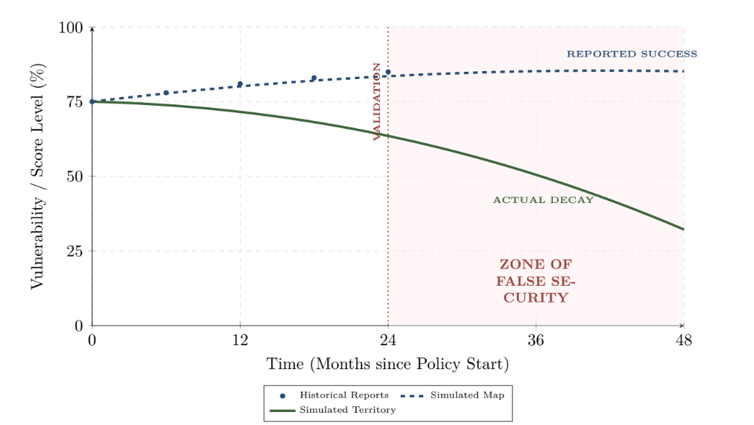
Results
Administrative Map (λ)
Survey coverage
Classification accuracy
Quarterly reporting
Resource focalization
Territorial Reality (τ)
Informal labor (>45%)
Violence
Mental health issues
Structural vulnerability
Simulation Findings
Administrative indicators improve.
Territorial vulnerability remains high.
False security emerges.
Policy resistance increases.
Dynamic Structure
B1 Fundamental Solution
Structural remediation
B2 Symptomatic Solution
Indicator optimization
Result:Shifting the Burden
3:30-5:30
@systemdynamics_
THE 44TH INTERNATIONAL SYSTEM DYNAMICS CONFERENCE
Delft, Netherlands and Virtually
#isdc2022
THE 40TH INTERNATIONAL SYSTEM DYNAMICS CONFERENCE
Virtually everywhere!
#isdc2026
Notes:
Keep the text short and fonts big. Some flexibility on font for images. Note suggested timing in the bottom right.

Slide 7
Conclusions
Main Findings
✓ The Indicator Trap is a structural governance failure.
✓ Information delays suppress territorial feedback.
✓ Traditional indicators create false security.
✓ Sisbén Científico provides a simulation-based alternative.
Policy Design Principles
Dual-Clock Reporting
Administrative Clock (λ)
Territorial Clock (τ)
Shadow Auditing
Independent stock verification
Simulation-Based Due Diligence
Test policies before implementation
5:30-7:00
@systemdynamics_
THE 44TH INTERNATIONAL SYSTEM DYNAMICS CONFERENCE
Delft, Netherlands and Virtually
#isdc2022
THE 40TH INTERNATIONAL SYSTEM DYNAMICS CONFERENCE
Virtually everywhere!
#isdc2026
Notes:
Keep the text short and fonts big. Any questions you want to pose to the audience can go here. Note suggested timing in the bottom right.

Slide 8
INTERNATIONAL SYSTEM DYNAMICS CONFERENCE
Instructions: Please do this!!!
1) Prepare your Online Poster presentation using a copy of this template.
  Change the presentation title and author information to match your submission.
  Do NOT change the number of slides with content.
  Change the body of the slides to present your work, following the instructions in the slide notes.
2) Submit your Online Poster presentation slides at https://webportal.systemdynamics.org by the Conference Material Submission Deadline
  Click on the title of your submission
  Select “Upload new or updated paper files”
  Upload the Powerpoint presentation file for your Online Poster slides
3) Follow the format and timing listed below:
  You have exactly 7:00 minutes to present, followed by up to 8:00 minutes of discussion.
4) You may record your presentation in advance
  If you are not able to attend the session, the recording will be used instead
  If you do attend, you can ask the chair to play the recording, or present live
  Add the YouTube Video ID to the Web Portal under “Review or update paper information”
5) If you make updates or change plans after the Conference Material Submission Deadline, send the session chair a note
  Use the contact information at https://isdc.systemdynamics.org
Notes:
This slide will be hidden from presentation. You may delete this instruction slide once your slides are ready.

