Slide 1





Digital Health Design for Leverage:
Transitioning to Proactive Health Ecosystems through Systems Thinking
Online Poster Presentation
Jorge Andrick Parra Valencia (Presenter), Universidad Autónoma de Bucaramanga (Colombia)
Vinaytosh Mishra, Gulf Medical University (UAE)
0:00-0:30
@systemdynamics_
THE 44TH INTERNATIONAL SYSTEM DYNAMICS CONFERENCE
Delft, Netherlands and Virtually
#isdc2026
Notes:
Title page: Change title to submission name. Bold the name of the presenter and display your name as you want it read by the moderator (eg Bob instead of Robert). Note the suggested timing in the bottom right. Slide timing may be adjusted, but not the number of slides.

Slide 2

Problem Statement
Core Finding
Despite thousands of digital health applications:
Short-term engagement improves.
Long-term adherence collapses.
Clinician burnout increases.
Sustainable remission remains rare.
The Leverage Gap
Evidence from 48 studies (2017–2026)
85% of interventions focus on:
Notifications
Reminders
Interface optimization
Data collection
Only 15% target:
Information flows
Institutional rules
Health system goals
0:30-2:00
@systemdynamics_
THE 44TH INTERNATIONAL SYSTEM DYNAMICS CONFERENCE
Delft, Netherlands and Virtually
#isdc2022
THE 40TH INTERNATIONAL SYSTEM DYNAMICS CONFERENCE
Virtually everywhere!
#isdc2026
Notes:
Keep fonts big (24 pt or bigger). Note suggested timing in the bottom right.

Slide 3
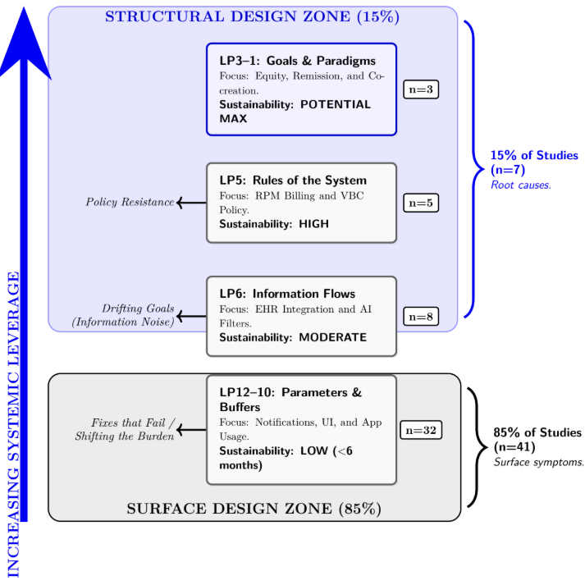
Problem Statement
This creates a:70-point Leverage Gap
between technological effort and systemic impact
0:30-2:00
@systemdynamics_
THE 44TH INTERNATIONAL SYSTEM DYNAMICS CONFERENCE
Delft, Netherlands and Virtually
#isdc2022
THE 40TH INTERNATIONAL SYSTEM DYNAMICS CONFERENCE
Virtually everywhere!
#isdc2026
Notes:
Keep fonts big (24 pt or bigger). Note suggested timing in the bottom right.

Slide 4
Approach or Dynamic Hypothesis
Surface Design
More Users
↓
More Data
↓
More Cognitive Load
↓
Less Responsiveness
↓
More Attrition
↓
Fewer Users
Dominant Loop
B1 – Sustainability Trap
Growth generates overload.
Overload generates abandonment.
Abandonment destroys sustainability.
Structural Intervention
LP6 → AI Clinical Filtering
LP5 → Value-Based Incentives
LP3 → Equitable Remission Goals
LP2 → Proactive Health Paradigm
These leverage points neutralize the trap.
2:00-3:30
@systemdynamics_
THE 44TH INTERNATIONAL SYSTEM DYNAMICS CONFERENCE
Delft, Netherlands and Virtually
#isdc2022
THE 40TH INTERNATIONAL SYSTEM DYNAMICS CONFERENCE
Virtually everywhere!
#isdc2026
Notes:
Keep fonts big (24 pt or bigger). Note suggested timing in the bottom right.

Slide 5
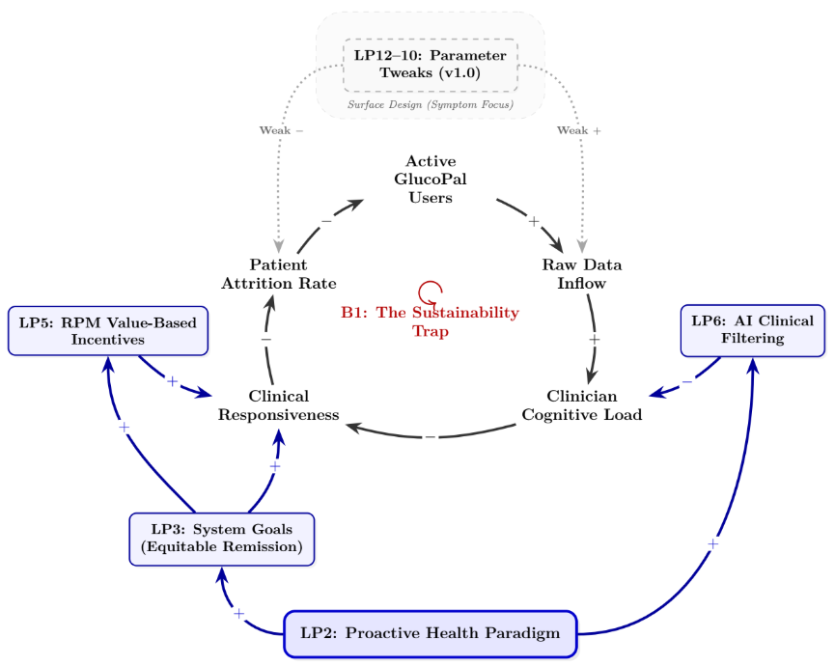
Approach or Dynamic Hypothesis
2:00-3:30
@systemdynamics_
THE 44TH INTERNATIONAL SYSTEM DYNAMICS CONFERENCE
Delft, Netherlands and Virtually
#isdc2022
THE 40TH INTERNATIONAL SYSTEM DYNAMICS CONFERENCE
Virtually everywhere!
#isdc2026
Notes:
Keep fonts big (24 pt or bigger). Note suggested timing in the bottom right.

Slide 6
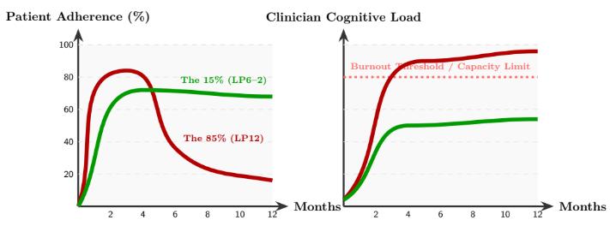
Results
Scenario A
Surface Design (85%)
LP12–10
Rapid adoption
Data overload
Burnout
Attrition
Structural Design (15%)
LP6–2
AI-filtered signals
Expanded clinical capacity
Sustained responsiveness
Long-term adherence
Behavior:
Growth and Sustainable Plateau
Behavior:
Overshoot and Collapse
3:30-5:30
@systemdynamics_
THE 44TH INTERNATIONAL SYSTEM DYNAMICS CONFERENCE
Delft, Netherlands and Virtually
#isdc2022
THE 40TH INTERNATIONAL SYSTEM DYNAMICS CONFERENCE
Virtually everywhere!
#isdc2026
Notes:
Keep the text short and fonts big. Some flexibility on font for images. Note suggested timing in the bottom right.

Slide 7
Conclusions
Systemic Redesign Pathway
LP6 Improve Information Flows
↓
LP5 Align Rules and Incentives
↓
LP3 Redefine System Goals
↓
LP2 Shift Healthcare Paradigms
From Digital Tools to Health Ecosystems
Main Findings
✓ 85% of digital health research targets low-leverage points.
✓ Sustainable remission requires structural redesign.
✓ AI becomes valuable when improving information flows.
✓ Incentives determine adoption as much as technology.
✓ Equity must become a system goal rather than an afterthought.
5:30-7:00
@systemdynamics_
THE 44TH INTERNATIONAL SYSTEM DYNAMICS CONFERENCE
Delft, Netherlands and Virtually
#isdc2022
THE 40TH INTERNATIONAL SYSTEM DYNAMICS CONFERENCE
Virtually everywhere!
#isdc2026
Notes:
Keep the text short and fonts big. Any questions you want to pose to the audience can go here. Note suggested timing in the bottom right.

Slide 8
INTERNATIONAL SYSTEM DYNAMICS CONFERENCE
Instructions: Please do this!!!
1) Prepare your Online Poster presentation using a copy of this template.
  Change the presentation title and author information to match your submission.
  Do NOT change the number of slides with content.
  Change the body of the slides to present your work, following the instructions in the slide notes.
2) Submit your Online Poster presentation slides at https://webportal.systemdynamics.org by the Conference Material Submission Deadline
  Click on the title of your submission
  Select “Upload new or updated paper files”
  Upload the Powerpoint presentation file for your Online Poster slides
3) Follow the format and timing listed below:
  You have exactly 7:00 minutes to present, followed by up to 8:00 minutes of discussion.
4) You may record your presentation in advance
  If you are not able to attend the session, the recording will be used instead
  If you do attend, you can ask the chair to play the recording, or present live
  Add the YouTube Video ID to the Web Portal under “Review or update paper information”
5) If you make updates or change plans after the Conference Material Submission Deadline, send the session chair a note
  Use the contact information at https://isdc.systemdynamics.org
Notes:
This slide will be hidden from presentation. You may delete this instruction slide once your slides are ready.

