Slide 1

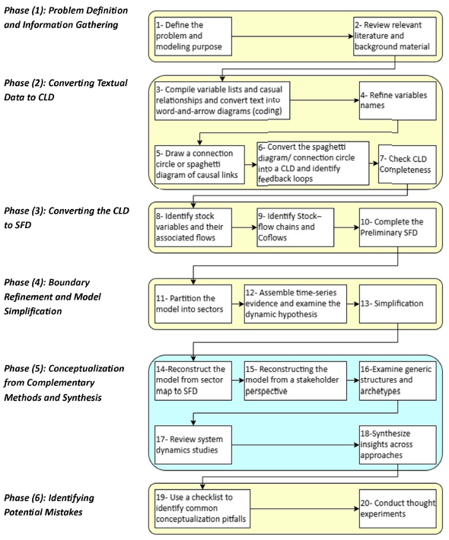
Operationalizing Model Conceptualization: From Tacit Expertise to Structured Practice
Mehdi Moghadam Manesh, Washington State University
Leonard Malczynski, Mindseye Computing
2026 International Conference of the System Dynamics Society
20 to 24 July 2026 Delft, The Netherlands

Slide 2
Problem definition, Model conceptualization, model construction
Translating qualitative problem descriptions into coherent model structures remains less proceduralized than other stages of the modeling process; e.g. problem definition and construction
We propose a structured procedural framework that organizes insights from SD literature into an explicit sequence of reasoning steps for model conceptualization
The core process combines grounded theory with a divergent–convergent reasoning approach and is complemented by perspectives such as stakeholder analysis, sector-based reasoning, generic structures and archetypes, and insights from prior SD studies

Slide 3
Motivation and references
No existing comprehensive collection of cradle-to-grave, birth-to-earth processes for system dynamics modeling writ large *
72 references encompassing:
  Steps in system dynamics modeling
  Causal loop diagram (CLD) design
  Stock and flow diagram (SFD) design
  Personal experiences in qualitative and quantitative modeling
  Archetypes
  Model review processes
  Model construction processes
* Models never die; they continue to enlighten, inspire, and excite us.

Slide 4
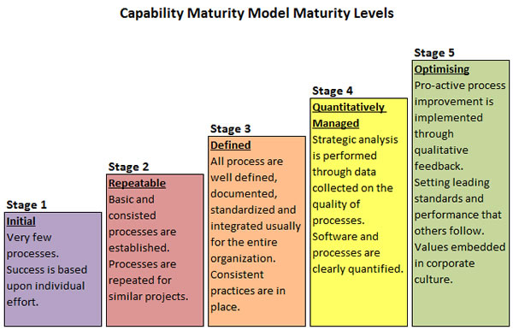
What other professions do: How software engineering organizations look at capability, i.e. quality assurance
They key word is ‘process’.
Do you have a process that you, your course, your organization, your company, your university uses when building models?
Notes:
There was a time that contracts were assumed by these process levels

Slide 5
We propose five major phases comprising 20 steps in total. The five major phases are:
Phase (1) Problem Definition and Information Gathering
Phase (2) Converting Textual Data to CLD
Phase (3) Converting the CLD to SFD
Phase (4) Boundary Refinement and Model Simplification
Phase (5) Conceptualization from Complementary Methods and Synthesis
Phase (6) Identifying Potential Mistakes

Slide 6
Process, procedure, algorithm = good practices
This study addresses a persistent challenge in system dynamics (SD) modeling: the difficulty of learning and practicing model conceptualization
It proposes a structured procedural framework that organizes insights from the system dynamics literature into an explicit sequence of reasoning steps for model conceptualization
A central feature of the framework is its emphasis on progressive formalization
The primary contribution of this study is therefore to translate high-level guidance on model conceptualization into a more operational procedural workflow that can be more readily applied by novice modelers
Some would say that a best practices guide just stifles creativity. We say that it liberates creativity in that it simplifies mundane modeling tasks, makes models done by other modelers more accessible, and prolongs the useful life of models.

Slide 7
QUESTIONS and comments
REFERENCES
DISAGREE
AGREE
SUGGESTIONS

