Slide 1

1

Slide 2


2
System dynamics modeling of energy storage systems diffusion in grid-connected photovoltaic
systems in Colombia
Amaya de Miguel Mediavilla
Veronica Valencia Hernandez
Santiago Arango-Aramburo
Facultad de Minas
Sede Medellin
International System Dynamics Conference
July 23th, TU Delft, Netherlands

Slide 3
3
Agenda
SIX PARTS, FROM MOTIVATION TO POLICY IMPLICATIONS
  Introduction & Context
  Model Structure
  Theoretical Framework & Objective
  Results & Scenarios
  Methodology
  Conclusions
Facultad de Minas
Sede Medellin

Slide 4
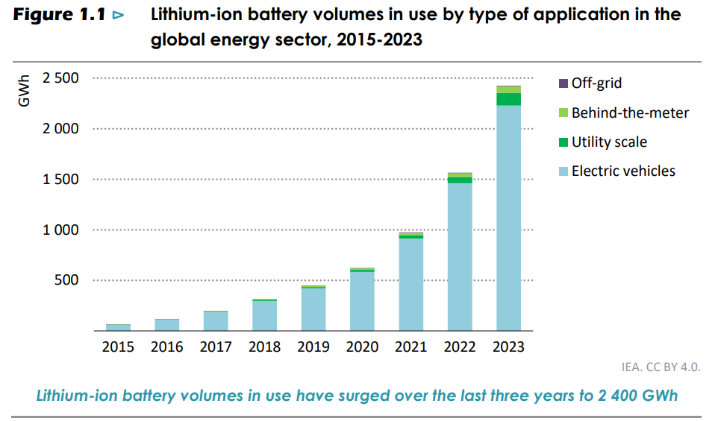
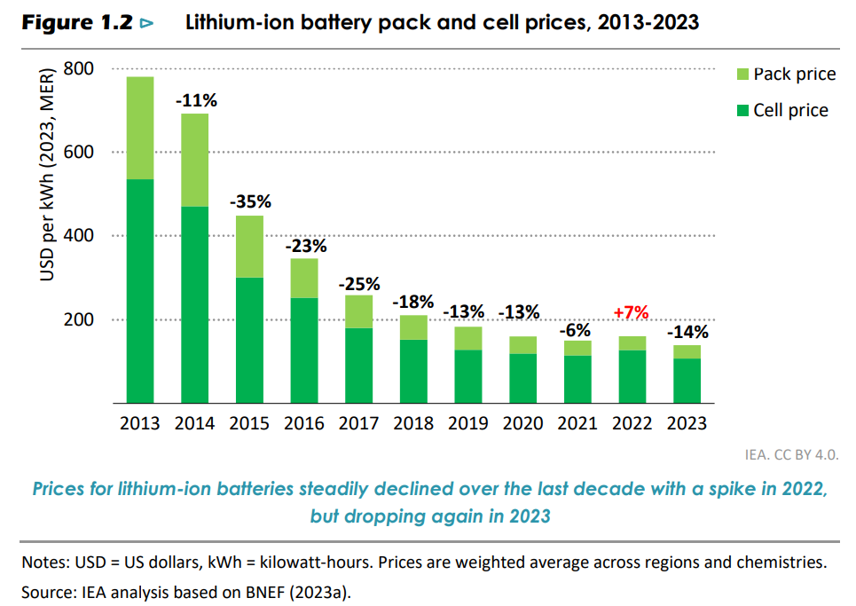
4
The Global Rise of Energy Storage
SOLAR'S GROWTH DEMANDS AN EQUALLY FAST FLEXIBILITY RESPONSE
(IEA, 2024)
Facultad de Minas
Sede Medellin

Slide 5
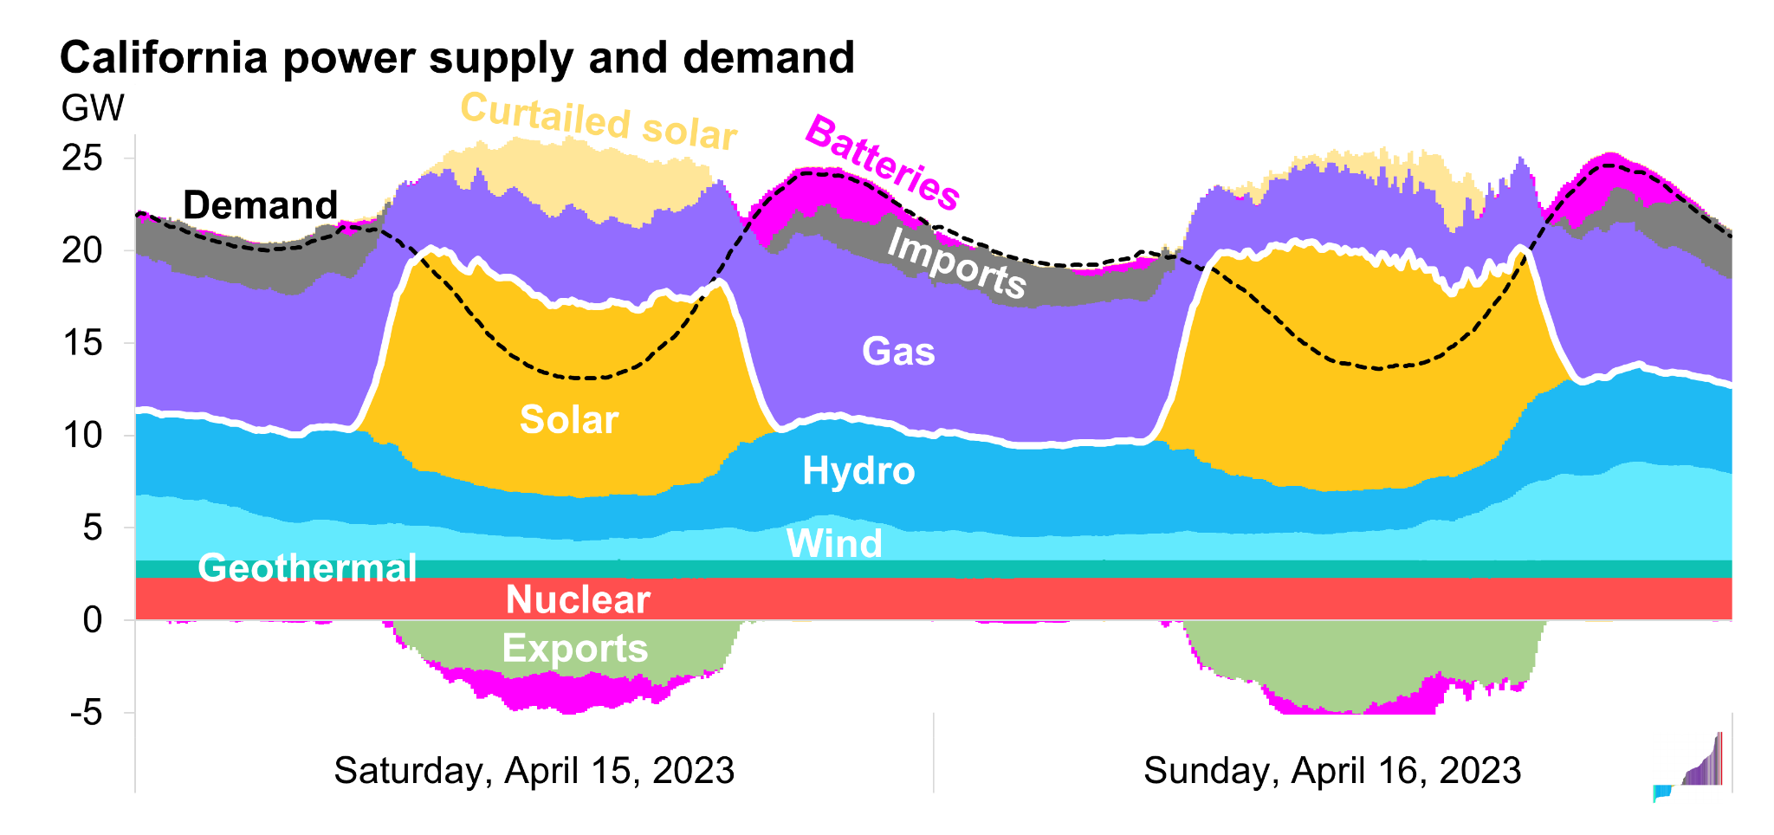
4
What for?
Energy transition with a lot of Solar PV
Facultad de Minas
Sede Medellin

Slide 6
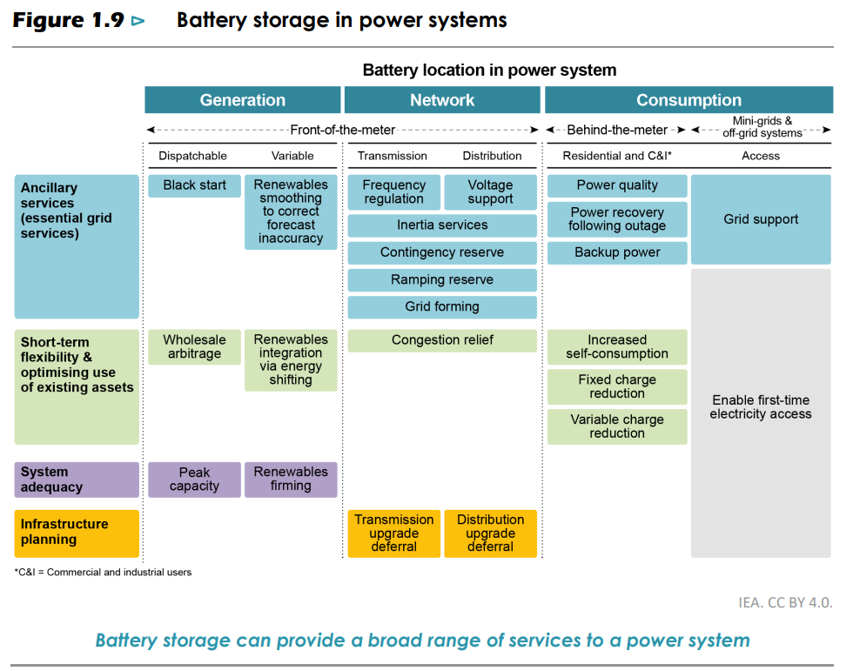
What for?
Other services
4

Slide 7
5
The Colombian Challenge: Hydropower-Dominated, Storage Still Incipient
  The National Interconnected System relies on hydropower, exposed to climate variability (e. g. El Niño).
  Increase of Solar PV, expected rapid growth.
  No large-scale BESS projects are currently operating in the SIN; the first utility-scale initiative awarded in 2021 failed to materialize due to financial and regulatory barriers.
  CHILE
  Surpassed aprox. 1.7 GW by 2025, with a project pipeline of ≈ 4 GW
  "BESS del Desierto" (2025) 200 MW (aprox. 800 MWh)
  Appropriate regulatory framework
15–20 MW
0.1% of Colombia's installed capacity
Most relevant operating projects.
  Termozipa (Enel) — 3.9 MWh
  Celsia Palmira 2 — 2 MWh
  La Martina (Erco Energía) — 6.9 MWh
Regulatory milestones
  Resolution 098 of 2019 — formally recognized storage as a system resource
  CREG Draft Resolution 701 103 of 2025, and Decree 0393 of 2026 — define stand-alone BESS market participation
Facultad de Minas
Sede Medellin

Slide 8



7
Literature Review: Three Research Threads on BESS
TECHNOLOGY, TECHNO-ECONOMICS, AND SYSTEM PLANNING
Technology Development
Techno-Economic Viability
Planning & Market Integration
  Focus on hardware components and power-tracking/control methods that balance supply and demand
  Battery lifetime hinges on thermal control and degradation-aware operation
  BESS flexibility enables participation in multiple services — not just arbitrage
  Most utility-scale projects are more viable in ancillary-service markets than through arbitrage alone
  Reviews assess economic and grid performance of battery-connected hybrid systems
  Hybrid renewable + BESS systems excel in remote or unreliable-grid regions
Facultad de Minas
Sede Medellin

Slide 9
8
System Dynamics Applications to BESS Diffusion
  Queensland, Australia (Agnew et al. 2018): Causal loop modeling of residential solar-plus-battery adoption; shows how cost/adoption/grid-independence feedback can challenge incumbent utilities
  Hungary (Hartvig & Szabó 2025): Regional Bass diffusion approach integrating financial and non-financial factors under alternative subsidy schemes
  Latvia (Gravelsins et al. 2023): Household-level SD model showing how subsidies and price trajectories influence PV-battery penetration
  China (Liu et al. 2024): Innovation diffusion theory applied to the "utility death spiral" mechanism under different tariff structures
Facultad de Minas
Sede Medellin

Slide 10
9
Research Gap & Study Objective
CLOSING THE LOOP BETWEEN BESS DIFFUSION THEORY AND COLOMBIA'S ENERGY TRANSITION
The Gap
The Objective
  SD and diffusion models have effectively captured BESS adoption elsewhere — Australia, Hungary, Latvia, China
  Colombian studies have addressed renewable diffusion, but no BESS penetration
  Develop an SD model of BESS–PV co-diffusion in Colombia through 2050
  Integrate Bass-type diffusion with techno-economic learning and profitability dynamics
  Assess how subsidies and revenue-based mechanisms shape BESS deployment
Facultad de Minas
Sede Medellin

Slide 11
10
Methodological Approach: Why System Dynamics
CAPTURING FEEDBACK-DRIVEN DIFFUSION WHERE STATIC METHODS FALL SHORT
The Problem
The SD Approach
  BESS diffusion depends on feedback linking costs, revenues, and investment decisions — plus delays in learning and policy implementation
  Static optimization or econometric regressions aren't built to capture these non-linear interactions and path dependencies
  Explicitly represents feedback-driven systems evolving over time
  Integrates stocks (e.g., installed BESS capacity), flows (installations/retirements), and feedback mechanisms (learning, profitability-driven adoption)
  Well suited to emerging technologies with limited historical data — emphasizes causal structure and pattern reproduction over short-term statistical fit
Facultad de Minas
Sede Medellin

Slide 12
11
Model Scope & Boundaries
POLICY-RELEVANT STRUCTURE — NOT A FULL ELECTRICITY-SYSTEM MODEL
In Scope
Out of Scope
  Horizon 2023 to 2050 with a monthly time step
  Key endogenous variables: installed BESS capacity, adoption/retirement flows, cumulative experience driving cost reductions, arbitrage revenue streams
  Exogenous inputs: PV deployment trajectories, price spreads between charging/discharging periods, policy/regulatory parameters
  Detailed operational constraints and network-level dispatch
  Full representation of the entire electricity system
  The model prioritizes economic and technological dynamics over grid-operation detail
Rather than modeling the whole power system, the framework isolates the dominant drivers of BESS diffusion, enabling exploration of alternative regulatory and economic scenarios.
Facultad de Minas
Sede Medellin

Slide 13
12
Projecting Photovoltaic Capacity
PV EXPANSION IS THE EXOGENOUS DRIVER THAT SETS THE CEILING FOR BESS POTENTIAL
20%
Of total PV capacity is assumed as the maximum installable BESS potential (informed by IRENA's ~11% storage-to-renewable ratio for the 2030 tripling target, adjusted upward for storage's growing flexibility role)
Near term (2023–2030)
Long term (2030–2050)
  Based on the portfolio of projects with confirmed entry into the SIN, as reported by XM (Colombia's system operator)
  Reflects projects in advanced development stages, realistic under current market conditions
  Based on solar targets from Colombia's National Energy Plan 2020–2050: 24–32 GW of installed solar capacity by 2050
  Temporal evolution follows growth trajectories from Parra-Rodas et al. (2025), an SD-based framework for Colombia's electricity sector
Two-phase Projection
Facultad de Minas
Sede Medellin

Slide 14
13
Calculating Arbitrage Revenues
A STYLIZED DAILY CYCLE, GROUNDED IN THREE YEARS OF COLOMBIAN PRICE DATA
Methodology
Key result
  Uses historical hourly price data (2021–2023), spanning both La Niña (2021-22) and El Niño (late 2023) phases
  Stylized cycle: charge 12:00–14:00 (peak solar) → discharge 18:00–20:00 (demand peak) — one full cycle/day
  0.40 USD/kW/month (average)
  0.15 USD/kW in April (min) to 0.98 USD/kW in October (max)
  Strong seasonal variability across the Colombian market
Table 1 simplified, monthly margin (USD per kW per month)
JAN | FEB | DEC | NOV | MAR | APR | SEP | JUN | MAY | OCT | AUG | JUL
0.21 | 0.21 | 0.26 | 0.96 | 0.31 | 0.15 | 0.33 | 0.22 | 0.19 | 0.98 | 0.64 | 0.31
Facultad de Minas
Sede Medellin

Slide 15
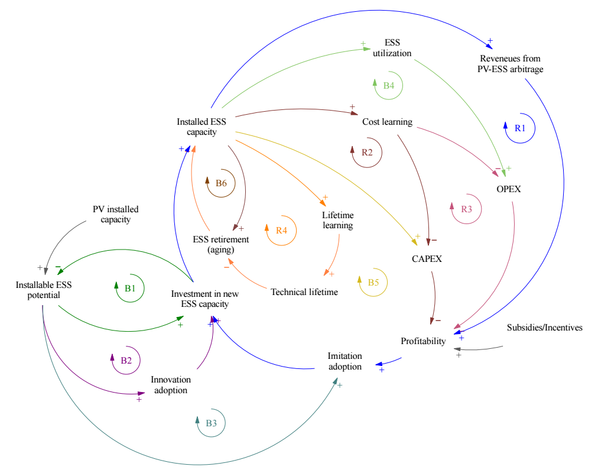
Causal Loop Diagram: The Feedback Mechanisms Driving Diffusion

Slide 16
Stock-Flow Structure of the BESS Diffusion Model
TWO CORE STOCKS, ONE INFLOW, ONE OUTFLOW — FORMALIZING THE DYNAMIC HYPOTHESIS

Slide 17
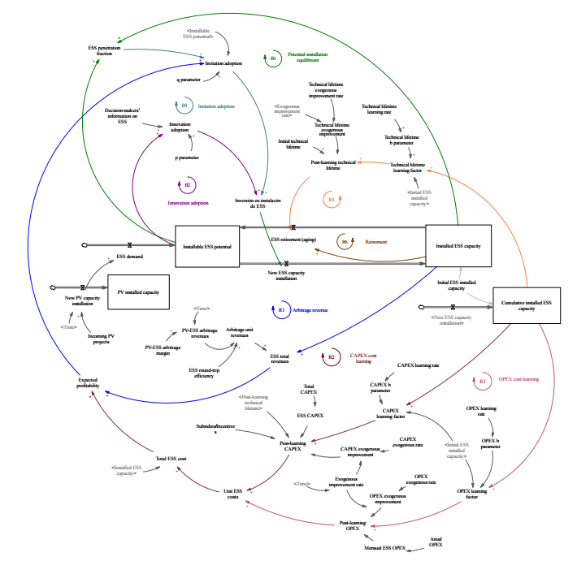
Stock-Flow Structure
BESS Diffusion Model

Slide 18
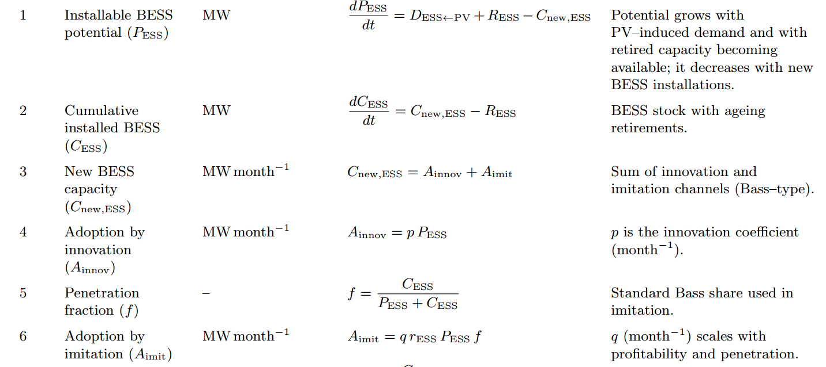
16
Selected Model Equations
STOCKS
FLOWS
ARBITRAGE
Facultad de Minas
Sede Medellin

Slide 19
15
Stock-Flow Structure of the BESS Diffusion Model
TWO CORE STOCKS, ONE INFLOW, ONE OUTFLOW — FORMALIZING THE DYNAMIC HYPOTHESIS
The Stocks
The Flows
  Installable BESS potential: remaining capacity available for deployment (shrinks as capacity is installed)
  Installed BESS capacity: cumulative adoption (the model's central output)
  These two stocks directly implement the B1 balancing loop from the CLD: as installed capacity grows, remaining potential declines
  Inflow — New BESS capacity installations: combined effect of innovation and imitation adoption (Bass-type structure)
  Outflow — ESS retirements: asset turnover dynamics (B6), driven by technical lifetime
The arbitrage revenue loop (R1) links installed capacity, utilization, and revenues to profitability, which then drives adoption via imitation — closing the model's main reinforcing loop.
Facultad de Minas
Sede Medellin

Slide 20
17
Model Validation
STRUCTURAL AND BEHAVIORAL TESTS, FOLLOWING ESTABLISHED SD PROTOCOLS
Structural tests
Behavioral tests
  Grounded in established formulations (Bass model, learning curves)
  Dimensional consistency checks
  Extreme-condition and numerical-sensitivity tests confirm stable, plausible behavior
  No historical BESS data for Colombia — validation focuses on plausibility, not point-prediction
  Baseline shows a gradual take-off (early S-curve);
  Sensitivity analysis
BESS diffusion in Colombia has no historical precedent, we focus validation on the system structure.
Facultad de Minas
Sede Medellin

Slide 21
18
Sensitivity Analysis
TESTING THE MODEL'S NON-OBSERVABLE PARAMETERS UNDER ±50% VARIATION
Why this matters
Table 3 — summary of results
  Innovation (p) and imitation (q) coefficients, plus CAPEX/OPEX/lifetime learning rates, are not directly observable
  No historical BESS diffusion data exists in Colombia to calibrate them empirically
  Each parameter was varied independently by ±50% around its baseline value
P95 | VARIABLE | Mean | P05
11.74 - 12.43 | Installed BEES capacity | 9.98 - 10.13 | 8.37 - 9.95
0.023 - 0.046 | Immitation adoption | 0.020-0.023 | 0.015 - 0.020
0.0166 - 0.0116 | Innovation adoption | 0.0113 - 0.0115 | 0.0064 - 0.0115
0.143 - 0.153 | Expected profitability | 0.126 - 0.141 | 0.126 - 0.129
Facultad de Minas
Sede Medellin

Slide 22
19
Scenario & Policy Design
THREE MARKET SCENARIOS × FOUR POLICY CONFIGURATIONS
Three scenarios
Four policy configurations
  BAU (Business-as-usual): Baseline PV projections (Parra-Rodas et al. 2025), central diffusion parameters (p, q) and learning rates
  Optimistic: Higher PV penetration, aggressive diffusion parameters, faster cost reductions, gradually widening arbitrage margins
  Pessimistic: Lower PV expansion, more conservative diffusion parameters, slower learning rates
  No policy applied — baseline conditions
  Investment subsidy: 15% reduction in upfront CAPEX
  Reliability/ancillary services charge: 10% increase in arbitrage revenues
  Combined: both instruments applied together
This 3×4 design (3 scenarios × 4 policy cases) produces 12 simulation paths
for installed BESS capacity in 2030 and 2050
Facultad de Minas
Sede Medellin

Slide 23
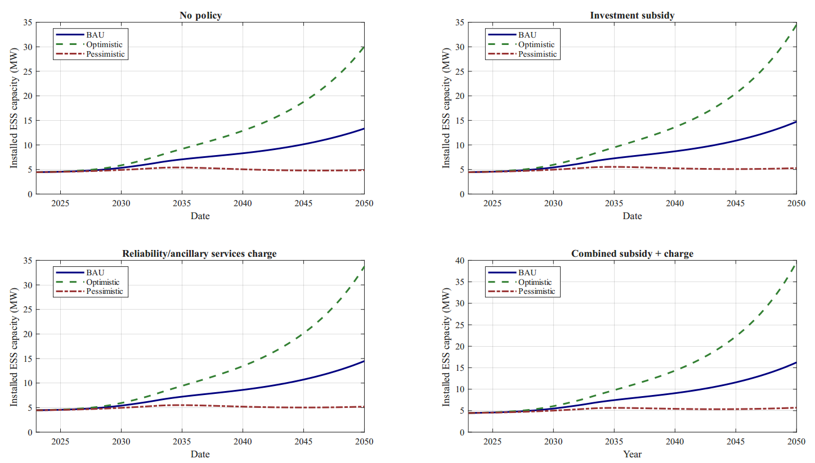
22
Diffusion Trajectories by Scenario
Facultad de Minas
Sede Medellin

Slide 24
21
Installed BESS Capacity: 2030 vs. 2050
MODEST EARLY GAINS, SHARPLY DIVERGING LONG-TERM TRAJECTORIES
By 2030: All scenarios remain closely clustered at 5–6 MW
  The market is still too young for significant scenario or policy differences to emerge
By 2050: Scenario differences become substantial
  Optimistic + combined policies: 39.6 MW
  Pessimistic + combined policies: 5.7 MW
  Nearly a 7-fold difference
Policy effects compound over time, with limited short-term impact but significant long-term effects.
Facultad de Minas
Sede Medellin

Slide 25
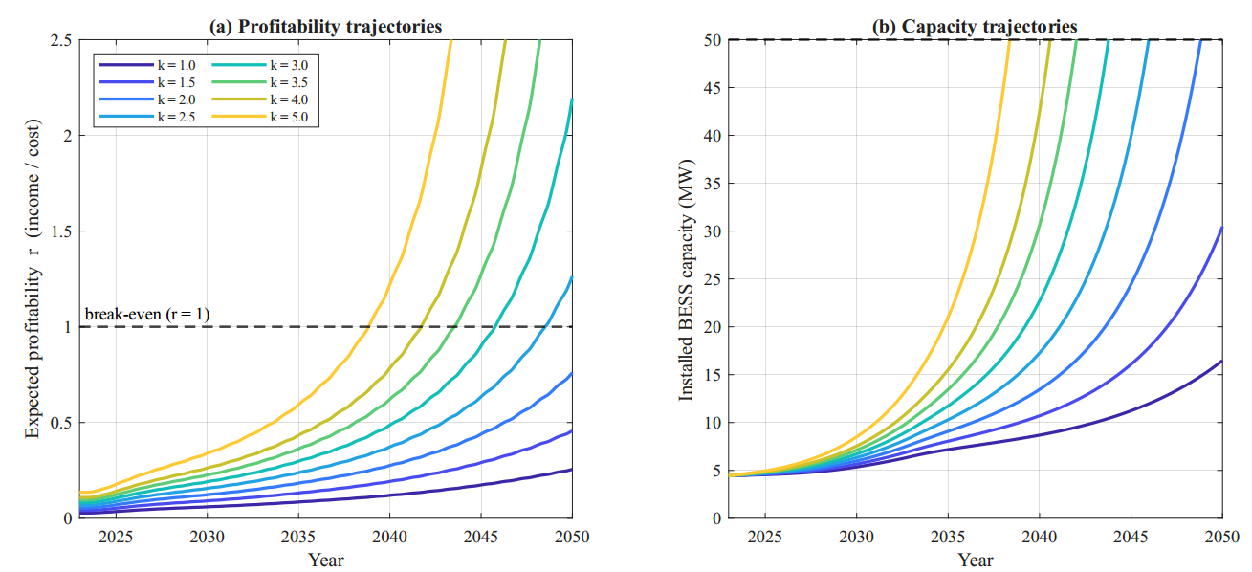
22
Dynamics of the arbitrage experiment (BAU, no policy, spread widening 50% by 2050).
(a) Expected profitability r for each arbitrage multiplier k, (r = 1 break-even) (b) Installed capacity
Facultad de Minas
Sede Medellin

Slide 26
25
Conclusions & Key Findings
WHAT THE MODEL TELLS US ABOUT BESS DIFFUSION IN COLOMBIA
Limited BAU diffusion
The profitability–imitation loop dominates
BESS diffusion remains at an early stage even by 2050 (13.4 MW) — well below the system's potential.
Adoption accelerates when returns improve — but the cycle weakens if profitability gains fall short and retirements catch up.
Learning helps, but isn't enough
Two interchangeable levers
Cost learning alone can not unlock large-scale diffusion without explicit remuneration for system services.
Cost reduction and revenue growth work through the same channel: closing the gap needs a 2–3x improvement in income-to-cost ratio.
Facultad de Minas
Sede Medellin

Slide 27
26
Policy Implications, Limitations & Future Research
FROM SHORT-TERM INCENTIVES TO LONG-TERM MARKET DESIGN
Policy implications
Limitations & future research
  Short term: targeted subsidies help trigger early adoption
  Medium/long term: priority shifts to rewarding flexibility and ancillary services
  Consistent with revenue stacking: storage needs multiple income streams beyond arbitrage
  No historical BESS data in Colombia limits empirical calibration
  Future work: stochastic prices, endogenous PV, multiple revenue streams, technology portfolios (e.g., long-duration storage)
Unlocking large-scale BESS deployment in Colombia requires both targeted policy support and robust market frameworks that ensure access to reliable, diversified revenue streams.
Facultad de Minas
Sede Medellin

Slide 28

6
27
Gracias
Santiago Arango-Aramburo
saarango@unal.edu.co
This presentation was partially supported by the RESET Network, an international non-profit research network coordinated by the Environmental Defense Fund (EDF), and by the project “Advancing Energy Storage for a Just and Flexible Energy Transition in Colombia,” funded by the Pooled Fund on International Energy (PIE).
We gratefully acknowledge their support and contribution to advancing research on a just and flexible energy transition in Colombia.

Slide 29
2
System dynamics modeling of energy storage systems diffusion in grid-connected photovoltaic
systems in Colombia
Amaya de Miguel Mediavilla
Veronica Valencia Hernandez
Santiago Arango-Aramburo
Facultad de Minas
Sede Medellin

Slide 30
23
Profitability Threshold: The Arbitrage Experiment
HOW MUCH HIGHER WOULD ARBITRAGE REVENUES NEED TO BE FOR STORAGE TO PAY OFF?
Setup
Table 6 — key values of k
  BAU scenario, no policy, so the effect of arbitrage level can be isolated
  Arbitrage margin multiplied by a factor k, ranging from 1 (current level) to 5
  All dynamics stay active: cost learning, gradual "duck curve" widening, diffusion feedbacks
  Two indicators tracked: break-even (year rESS first reaches 1) and take-off (year capacity first exceeds 50 MW)
k | Capacity 2050(MW) | Break-even | Take-off(>50MW)
1.0 | 16 | >2050 | >2050
2.0 | 67 | >2050 | 2049
2.5 | 185 | 2048 | 2046
3.0 | 704 | 2046 | 2044
5.0 | 8117 | 2039 | 2038
Facultad de Minas
Sede Medellin

Slide 31
24
Profitability Threshold: The Cost-Reduction Experiment
THE SAME QUESTION, FROM THE COST SIDE — AND WHY THE TWO LEVERS ARE MIRROR IMAGES
Setup
Table 7 — key values
  Same BAU scenario, no policy; arbitrage held at current level, duck-curve assumption unchanged
  Unit BESS cost multiplied by a factor below 1 (i.e., cost reduction), instead of raising revenues
  Same two indicators: break-even (rESS ≥ 1) and take-off (capacity ≥ 50 MW)
Cost Reduction | Capacity 2050(MW) | Break-even | Take-off(>50MW)
0% | 16 | >2050 | >2050
40% | 39 | >2050 | >2050
50% | 67 | >2050 | 2049
60% | 185 | 2048 | 2046
80% | 8117 | 2039 | 2038
Facultad de Minas
Sede Medellin

Slide 32
6
Regional Benchmark: The Gap with Chile
A MATURE REGULATORY FRAMEWORK MAKES THE DIFFERENCE IN DEPLOYMENT SPEED
Colombia
Chile
  15–20 MW installed (≈0.1% of the SIN)
  No large-scale BESS project currently in operation
  Regulatory framework still under development (draft resolutions)
  Remuneration for arbitrage and ancillary services not yet clearly defined
  Surpassed aprox. 1.7 GW by 2025, with a project pipeline of ≈ 4 GW across various stages of development
  "BESS del Desierto" (2025) 200 MW (aprox. 800 MWh): largest stand-alone storage system in the region
  Regulatory framework allows independent systems to earn revenue from arbitrage and reserve capacity
  Undisputed regional leader in energy storage solutions
Facultad de Minas
Sede Medellin

Slide 33
14
Causal Loop Diagram: The Feedback Mechanisms Driving Diffusion
Reinforcing loops (R)
Balancing loops (B)
  R1 — Arbitrage revenue: Higher installed capacity increases utilization and arbitrage revenue, improving profitability and stimulating further adoption
  R2 — CAPEX learning: Cumulative installed capacity drives learning-by-doing, lowering CAPEX and improving project economics
  R3 — OPEX learning: Cumulative installed capacity reduces OPEX through the same learning mechanism
  R4 — Lifetime learning: Cumulative capacity extends technical lifetime, further enhancing economic performance
  B1 — Potential-installation equilibrium: As installed capacity rises, remaining installable potential shrinks
  B2 / B3 — Innovation / imitation adoption: Classic Bass-model saturation dynamics
  B4 / B5 — CAPEX / OPEX drag: Higher costs reduce expected returns, dampening investment
  B6 — Retirement (aging): Aging infrastructure exits the system, partially offsetting new installations
FOUR REINFORCING LOOPS ACCELERATE ADOPTION; SIX BALANCING LOOPS KEEP IT BOUNDED
Facultad de Minas
Sede Medellin

