Slide 1

The Kissing Fishes Diagram:
A Structured Approach to Fostering Operational Thinking in Model Conceptualization
Mehdi Moghadam Manesh, Washington State University
Leonard Malczynski, Mindseye Computing
2026 International Conference of the System Dynamics Society
20 to 24 July 2026 Delft, The Netherlands

Slide 2
introduction
Operational thinking is widely recognized as foundational to system dynamics (SD) modeling, yet it is often treated as an implicit competency expected to emerge from general guidance rather than structured instruction.
Consequently, many conceptual models—particularly those developed by less experienced practitioners—exhibit structural deficiencies that undermine credibility and become apparent only during formulation or validation.
Despite its importance, systematic approaches for cultivating operational thinking during conceptualization remain limited.

Slide 3
Approach
This study introduces the Kissing Fishes Diagram (KFD), a structured adaptation of the Fishbone Diagram that embeds operational reasoning within the conceptualization phase of system dynamics modeling.
The KFD promotes quantitative thinking in qualitative model construction, making explicit and teachable a reasoning process experts apply implicitly.
Grounded in equation-based articulation and structured “how” questions, the framework guides functional specification of causal relationships and strengthens structural validity for improved model performance.

Slide 4
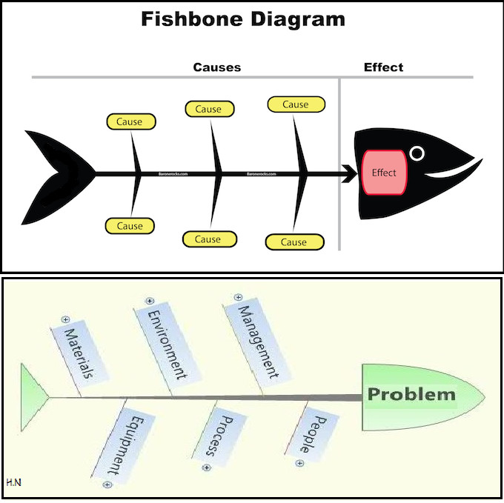
Ishikawa aka fishbone diagram
The fish head represents the problem
The bones represent major cause categories

Slide 5
How is it accomplished?
Step 1: Extracting Problem-Relevant Variables and Causal Relationships from Text
Step 2: Constructing the Kissing Fishes Diagram
  Choose the problem variable
  Add the flows that alter it
Step 3: Expanding the Model Through Chains of “How” Questions

Slide 6
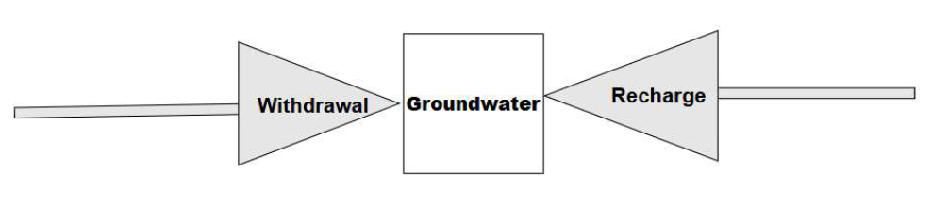
An example* groundwater resources and large-scale agriculture
If someone asked you to estimate X, how would you calculate it?
  How is the amount of groundwater withdrawal calculated?
  How is groundwater recharge estimated?
Each answer introduces new variables that are subsequently added to the model.
* Akhavan, A., & Gonçalves, P. (2021). Managing the trade-off between groundwater resources and large-scale agriculture: The case of pistachio production in Iran. System Dynamics Review, 37(2–3), 155–196. https://doi.org/10.1002/sdr.1689

Slide 7
Following through to conclusion
Notes:
Zoom and move through the diagram

Slide 8
results
The Kissing Fishes Diagram (KFD) functions as a “training wheel” for operational thinking—a temporary scaffold that supports early-stage rigor while fostering durable modeling judgment.
By making causal relationships explicit and equation-consistent, the framework improves conceptual clarity, reduces structural ambiguity, and supports more systematic development of model structure during conceptualization.

Slide 9
discussion
By providing a structured mechanism for operational reasoning, the KFD advances conceptual rigor and methodological practice in system dynamics.
The approach supports the development and internalization of mechanistic thinking, particularly for novice modelers, while clarifying causal structure.
Its pedagogical and methodological implications suggest opportunities for improving model quality and strengthening SD modeling practice.

Slide 10
questions

