Slide 1
Open Source Tools for AI Supported System Dynamics Modeling & Analysis
An overview of what tools and capabilities are available in the sd-ai platform
By: Billy Schoenberg & Sara Metcalf

Slide 2
Potential for AI in SD…
Benefits
Risks
Lower the barriers to entry
Automate model formulation
Support iterative development
Explain model behavior in natural language
Critique models for scope, realism, and applicability
Identify limitations of models
Assist with policy design and scenario ideation
Shift human effort to “higher-value” work
Erosion of system thinking skills
Loss of methodological rigor
Superficial learning
Opacity of reasoning
Non-determinism & reproducibility problems
Overconfidence
Misinterpretation
Educational misuse
Failure blindness
Blinding to bias

Slide 3
What is the sd-ai project?
Open-source platform for AI-powered system dynamics modeling
Modular engine architecture for collaborative innovation
REST-based API for universal accessibility
Automated generation of causal loop diagrams, stock-flow diagrams and model explanations
Built-in evaluation framework for measuring performance of these tools

Slide 4
Overview of today’s talk…

Slide 5
What is an Engine?

Slide 6
Why Engines Matter?
What is an engine?
A specialized component that connects sd-ai to external AI tools (e.g. LLMs)
Generates system dynamics model content by interacting with those AI services
The core innovation of the sd-ai platform
Lets researchers build custom AI-powered modeling tools within a shared, open-source framework
Why do engines matter?
The main way researchers contribute to the SD community
The platform handles the generic infrastructure (e.g. request handler), so contributors can:
  Focus on innovation instead of rebuilding core components
  Experiment freely with prompts, LLMs, and modeling methods
  Reach users instantly across sd-ai tools (Stella & CoModel)
  Build modular engines that are self-contained and use any AI tool
  Stay open and community-driven in prompts, design, and implementation

Slide 7
Table of All Engines in sd-ai
Engine Name | Type | Model Type | Primary Use | Author
Quantitative | Core | SFD | SFD Model Building | Billy Schoenberg
Qualitative | Core | CLD | CLD Model Building | Billy Schoenberg
Quantitative-Experimental | Variant | SFD | SFD Model Building AI Research | Billy Schoenberg
Qualitative-Experimental | Variant | CLD | CLD Model Building AI Research | Billy Schoenberg
Recursive Causal | Advanced | CLD | CLD Model Building | Aritra Majumdar
Causal Chains | Advanced | CLD | CLD Model Building | Bobby Powers
Seldon | Discussion | SFD/CLD | Model analysis | Billy Schoenberg
Seldon-Mentor | Variant | SFD | Guided learning | Billy Schoenberg
Seldon-Experimental | Variant | SFD/CLD | AI Research | Billy Schoenberg
Quantitative-Mentor | Variant | SFD | SFD Model Building Guided learning | Billy Schoenberg
LTM Narrative | Utility | SFD | Loop stories | Billy Schoenberg
Generate Documentation | Utility | SFD/CLD | Variable docs | Billy Schoenberg
Causal Decoder | Exploratory | CLD | CLD Model Building Local LLM | Aritra Majumdar

Slide 8
Seldon Discussion Engine
Author: Billy Schoenberg
Purpose: Interactive discussion engine to learn about and analyze both quantitative and qualitative models.
How It Works
Uses Loops That Matter metrics to explain model behavior
Feedback loops (critical to understanding dynamics)
Delays and stocks (sources of system delays)
Unit consistency validation
Structural validity alongside behavioral validity
Model scope and completeness

Slide 9
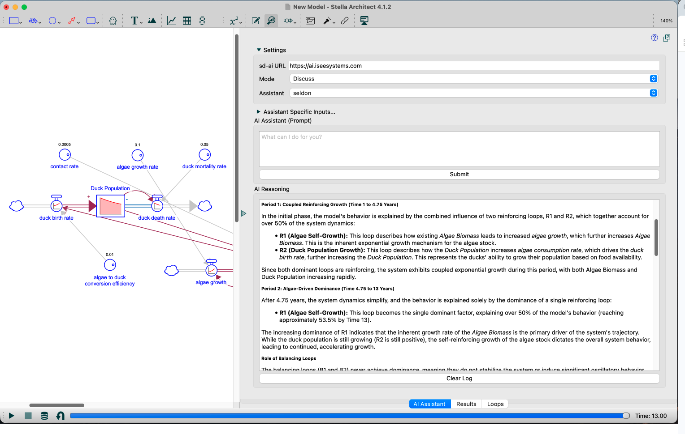
Example of Seldon Discussion Engine

Slide 10
Quantitative Engine
Author: Billy Schoenberg
Purpose: Generates Simulating Stock‑Flow Diagrams (SFDs) — the platform’s quantitative modeling engine.
How It Works
Identify system variables
Define causal relationships
Assign variable types (stock / flow / auxiliary)
Generate XMILE equations for each variable
Based on background information and problem statement
Supports iterative model development
Supports modules & arrays!

Slide 11
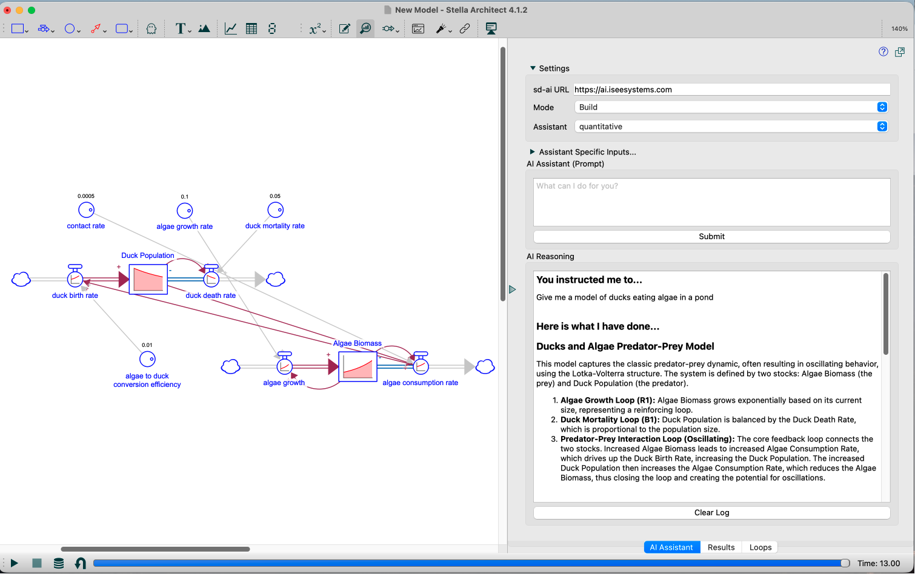
Example of the Quantitative Engine

Slide 12
Qualitative Engine
Author: Billy Schoenberg
Purpose: Generates Causal Loop Diagrams (CLDs) - high-level qualitative relationships showing cause-and-effect chains. This is sd-ai’s original engine for qualitative modeling
How It Works
Identify variables with cause-and-effect relationships
Assign polarity to each relationship (+/- representing correlation direction)
Provides detailed examples of polarity logic and relationship reasoning
Converts identified relationships to variables (extracting unique from/to values)
Based on background information and problem statement
Supports iterative model development

Slide 13
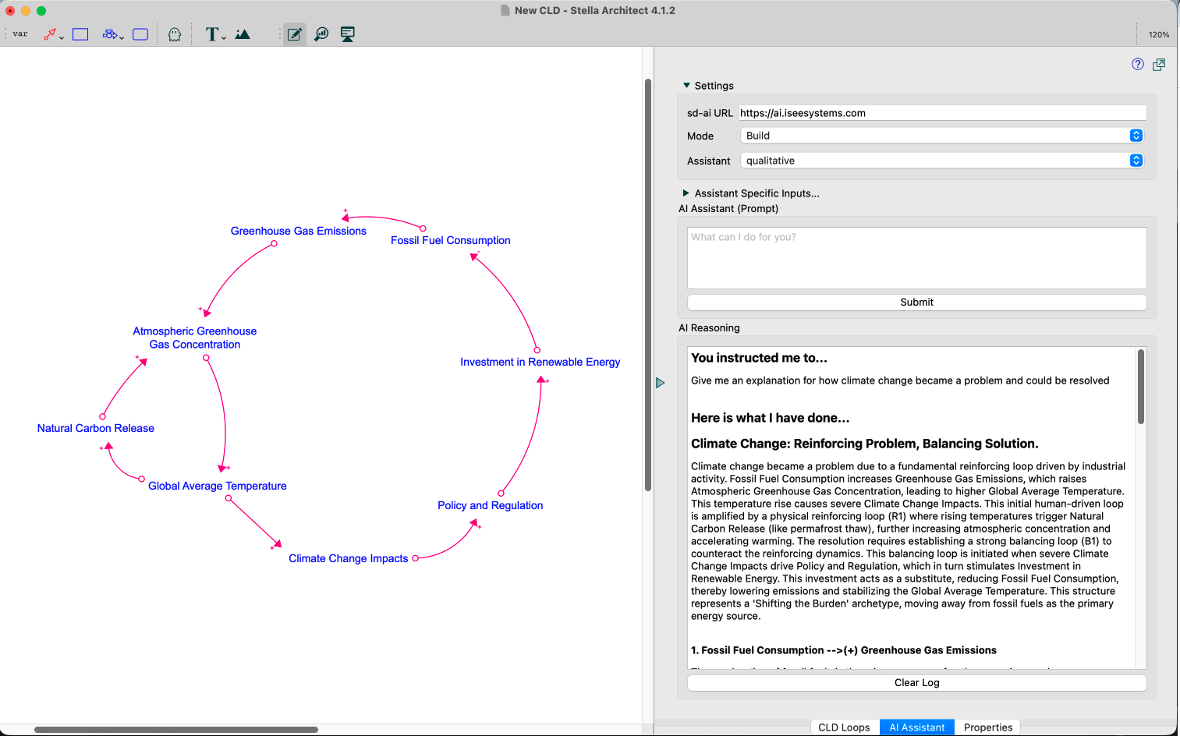
Example of the Qualitative Engine

Slide 14
Causal Decoder Engine
Author: Aritra Majumdar
Purpose: Generate CLDs without using external LLM.
How it Works
Fine-tuned small language model for causal relationship extraction. Uses Qwen2.5-1.5B (1.5 billion parameters) fine-tuned via PyTorch. Alternative to cloud LLMs - runs locally with minimal resources.
Works best with structured input like "more x leads to more y"
Supports iterative model development

Slide 15
From Engines to Agents

Slide 16
Single-Shot Engines to Agentic Workflows
Engines operate by generating content (a model/analysis) from a prompt, leaving workflow control to users.
Agentic systems plan and execute iterative actions like simulation, analysis, and revision autonomously.
Key idea: the SD method of modeling is embedded in the AI
  Result: lower barrier to entry
  More people can explore complex systems
But still transparent:
  All results come from clear, inspectable models
Impact: focus shifts from “how to model” → “what we learn”

Slide 17
How do the Agents work?
Agent = LLM + tools + control loop
  Repeatedly decides: call a tool or respond, then uses results to continue
Tool calling is the core mechanism
  generate_quantitative_model or generate_qualitative_model - Quantitative engine or Qualitative engine
  discuss_with_seldon - Seldon - Discussion engine
    Interprets results and explains behavior using feedback loops & LTM™
Iterative loop = build → simulate → explain → revise
  Agent keeps improving the model until it makes sense

Slide 18
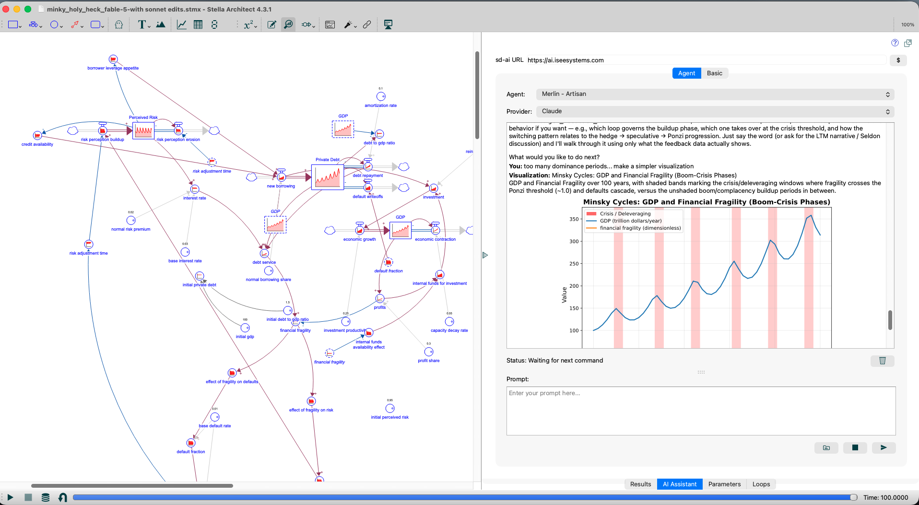
Example Agent Output

Slide 19
Conclusions
sd-ai enabled modeling tools mark the start of a “third age” of System Dynamics implementation.
  These tools represent the dawn of a new era where humans focus on framing, validation, and interpretation, while AI handles technical implementation and explanation. Similar to shift from DYNAMO -> STELLA
AI can accelerate modeling but cannot replace SD thinking.
  These tools replicate core SD phases (problem definition, formulation, explanation, policy design) much faster, yet still require human judgment to ensure structural and behavioral validity.
There are serious risks to rigor and learning.
  Over-automation may erode systems thinking, propagate biased or fabricated content from training data, and encourage superficial or uncritical model use.
Opacity and non-determinism must be managed.
  Because LLMs are stochastic and not transparent in their reasoning, users must expect variability, audit results carefully, and avoid treating AI outputs as authoritative.
Future work must define guardrails and evaluation standards.
  Systematic benchmarking, workflow design, and educational scaffolds (e.g., through initiatives like BEAMS) are needed to ensure AI augments, rather than weakens, causal understanding and model quality.

Slide 20
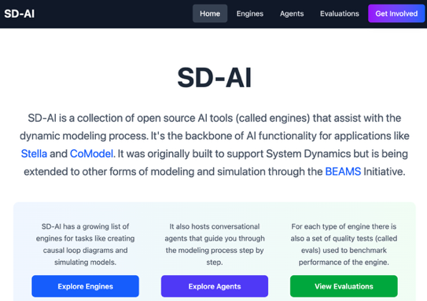
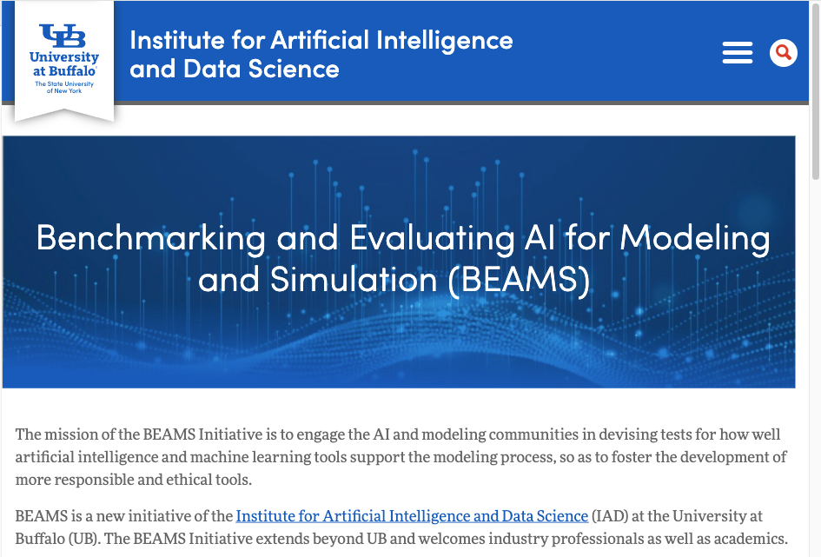
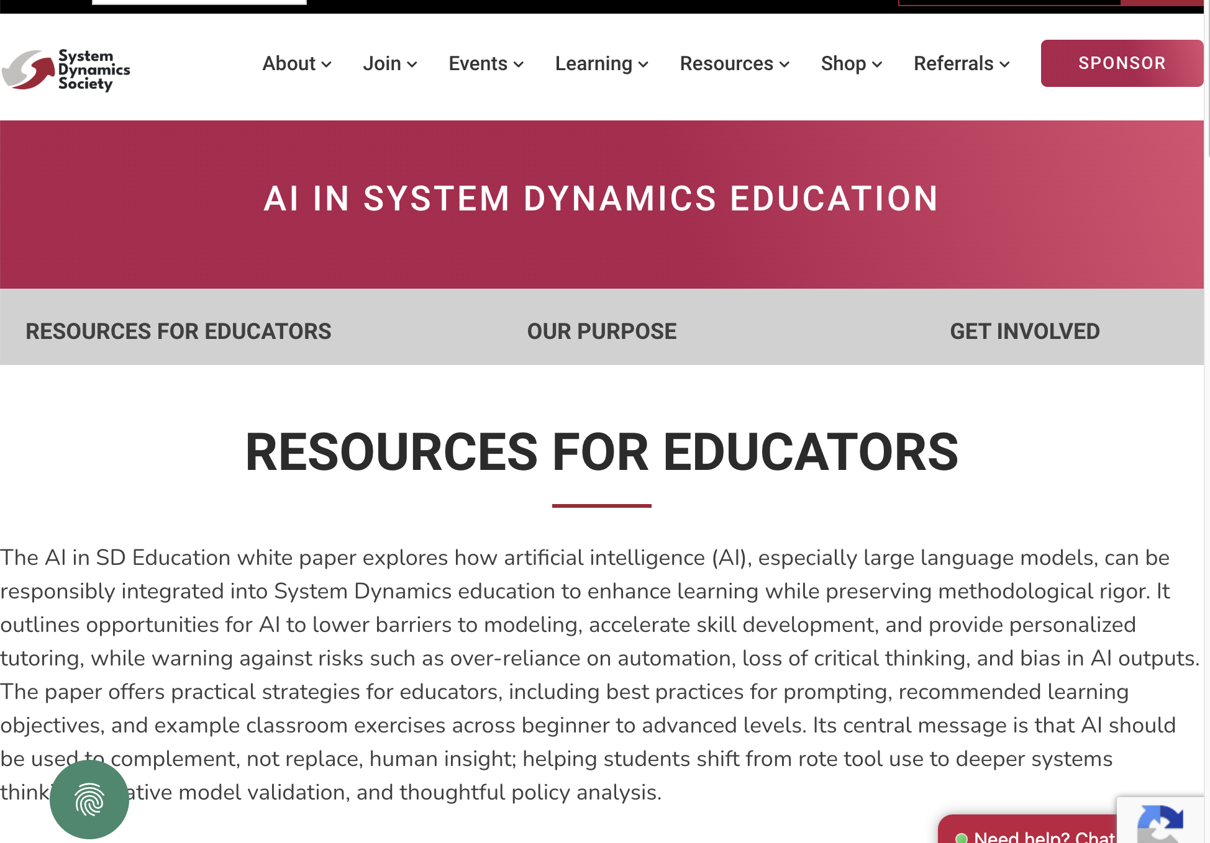



Questions & Useful Resources…
sd-ai Open-Source Project
The BEAMS Initiative
AI in SD Education Task Force
https://ub-iad.github.io/sd-ai/
https://bit.ly/BEAMSinitiative
https://systemdynamics.org/ai-in-sd-education

Slide 21
“-Experimental” Engines
Purpose: Experimental versions of Quantitative and Quantitative engines with full customization capabilities. Designed for users who want to experiment with LLM prompts and underlying model selection.
Engines with Experimental capabilities
Quantitative
Qualitative
Seldon
How It Works
Exposes all prompts for end users to modify
Exposes underlying LLM for end users to modify

