Slide 1
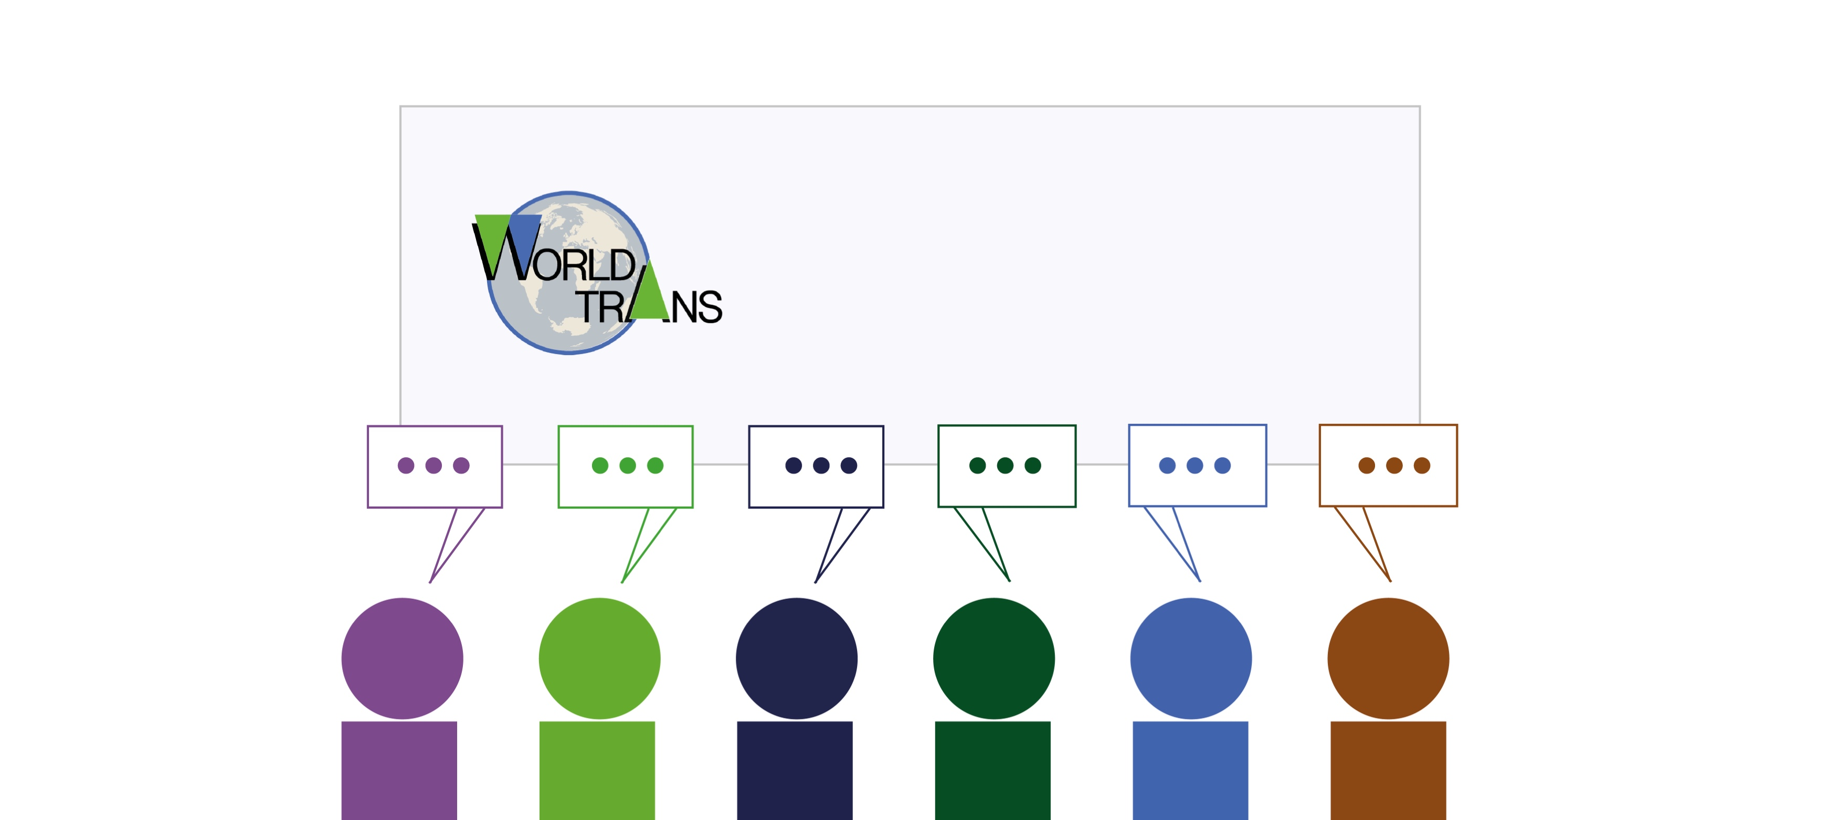
Billy Schoenberg, Jefferson K. Rajah, Chris Wells, David Collste, Beniamino
Callegari, Benjamin Blanz, Andreas Nicolaidis, Alex Koberle, Birgit Kopainsky
From Accelerating Growth to Biophysical Brakes: Feedback Dominance in the Human–Earth System
Notes:
Goal is to mention that I am a part of the WorldTransTeam

Slide 2
Our goal for today…
Illuminate the feedback mechanisms shaping planetary limits
and methods for understanding them

Slide 3
Feedback-based knowledge Repository for IntegrateD Assessment
But first, let’s talk about…
FRIDA

Slide 4

We believe that…
Informed climate policy discussions must consider
  Delays
  Feedback
  Complex interlinkages between the physical climate and human activities
  Rigorously validated models
Hard coupling existing IAMs and ESMs produces models that are prohibitively expensive to run, and opaque!
Dynamic Connectivity
ESMs
&
IAMs
Detail Complexity

Slide 5
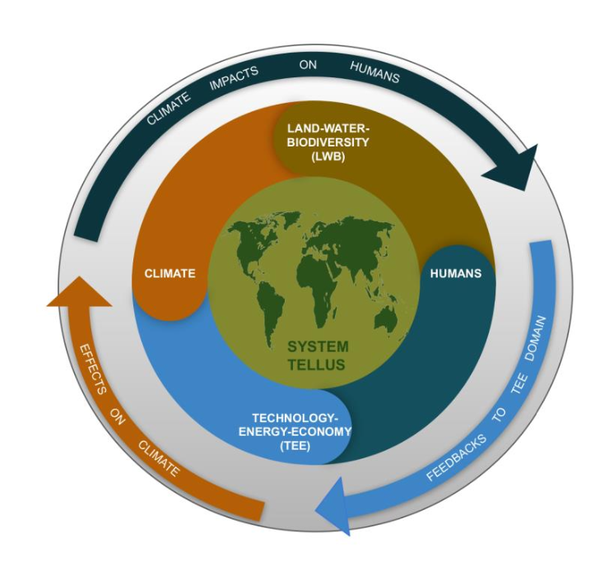
With FRIDA we want to break down silos and close the big feedback loops!
Represent the two-way causal connections between people and planet
Inform sustainable climate action
Bridge across academic and decision maker communities
Our goal is an accessible and a more easily interpretable model

Slide 6

Why existing approaches fall short?
Limitations of Current Frameworks
  Existing frameworks often exclude climate impacts on socioeconomic development, preventing feedback loops that reflect real-world dynamics.
Challenges in Damage Estimation
  Statistical approaches estimate aggregate climate damage but lack process-based insight into impacts across interconnected systems.
Interpretability of Complex Models
  Fully Earth System + Integrated Assessment models generate plausible outcomes but require feedback analysis to explain system behavior and policy relevance.
Innovative Analytical Approach
  Combining coupled models with loop dominance analysis enables causal explanations of long-term climate-human interactions.

Slide 7
The FRIDA Ensemble & Analytical Approach…

Slide 8
100,000 Futures and Representative Runs
Endogenous Model Dynamics
  FRIDA v2.1 models long-term futures internally through feedback among demographics, energy, land, economics, and climate.
Large Ensemble Simulation
  The model was run 100,000 times, generating diverse plausible futures spanning temperature and economic paths consistent with historical observations.
Representative Runs Selection
  Eleven representative runs were chosen to capture a wide range of temperature outcomes for detailed analysis.
Insights from Diversity
  This approach reveals recurring feedback patterns across scenarios, avoiding focus on a single projection.

Slide 9
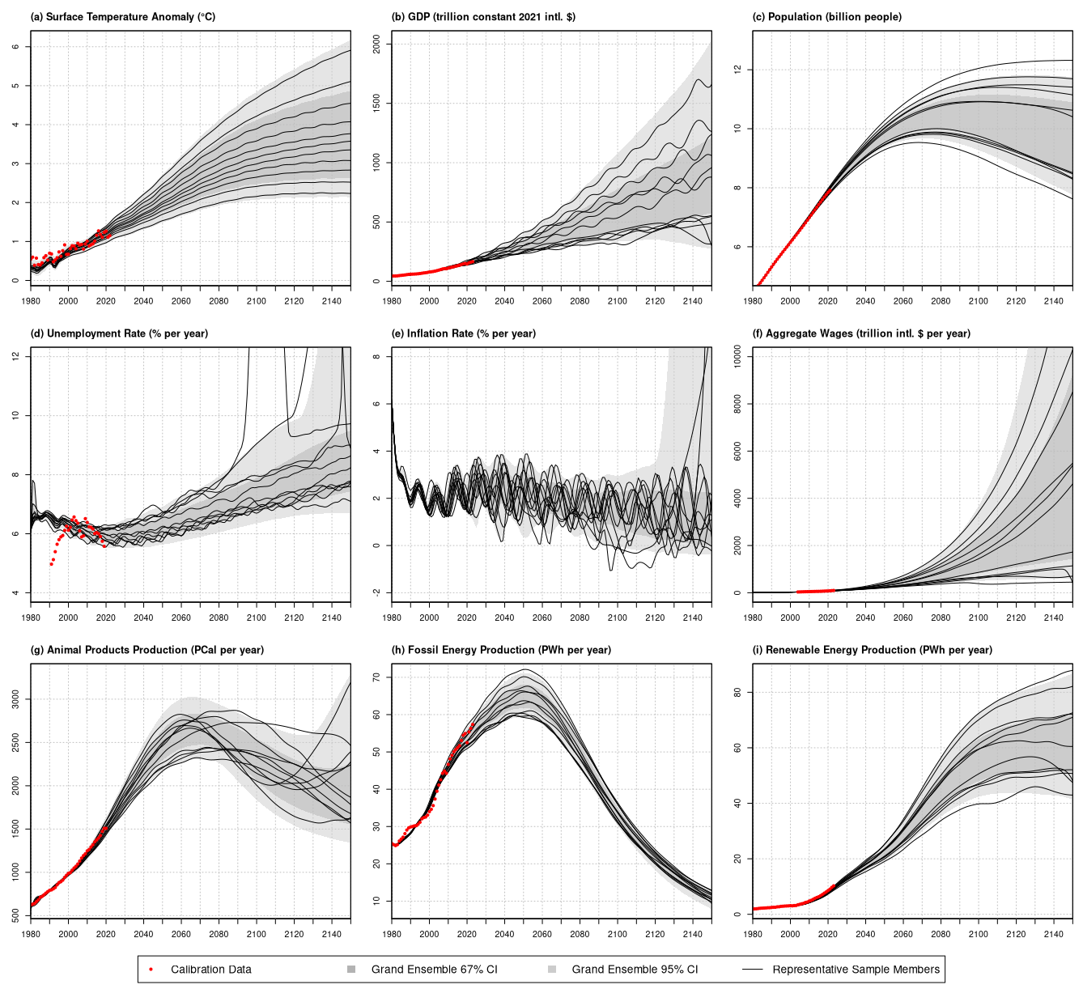
FRIDA’s Endogenous Model Behavior

Slide 10
Model to Explanation: Loops That Matter
Loops That Matter Method
  LTM analyzes feedback loop dominance by computing link and loop scores to identify influential causal relationships over time.
Strongest Path Algorithm
  The Strongest Path Algorithm efficiently finds high-impact loops in massive models with billions of potential loops for focused analysis.
AI-Assisted Narrative Synthesis
  AI transforms structured LTM outputs into coherent feedback narratives, improving interpretability and auditability of the model.
Dynamic Loop Dominance Tracking
  LTM tracks when and how dominance shifts occur in feedback loops, revealing dynamic causal changes during simulations.

Slide 11
The Feedback Story of the 21st Century…

Slide 12
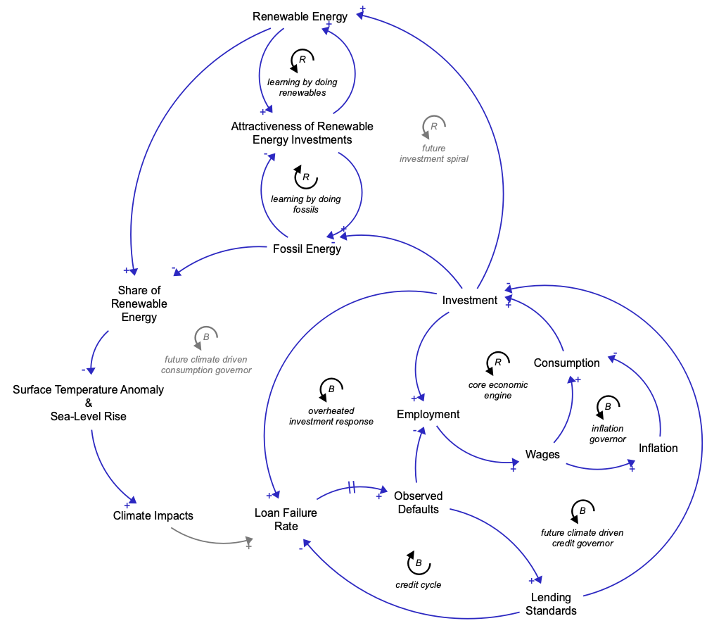
Late 20th Century – Mid 21st Century: Reinforcing Growth Dominates
Core Economic Engine
  Investment, employment, wages, and consumption form a reinforcing loop driving sustained economic growth.
Macroeconomic Balancing
  Inflation and credit adjustments moderate growth pace without imposing hard biophysical limits.
Fossil Fuel Path Dependence
  Learning-by-doing and sunk capital reinforce fossil fuel dominance, delaying renewable energy adoption.
Climate Change as Latent Stock
  Surface temperature rises steadily, but economic and social impacts remain limited and uncertain initially.

Slide 13
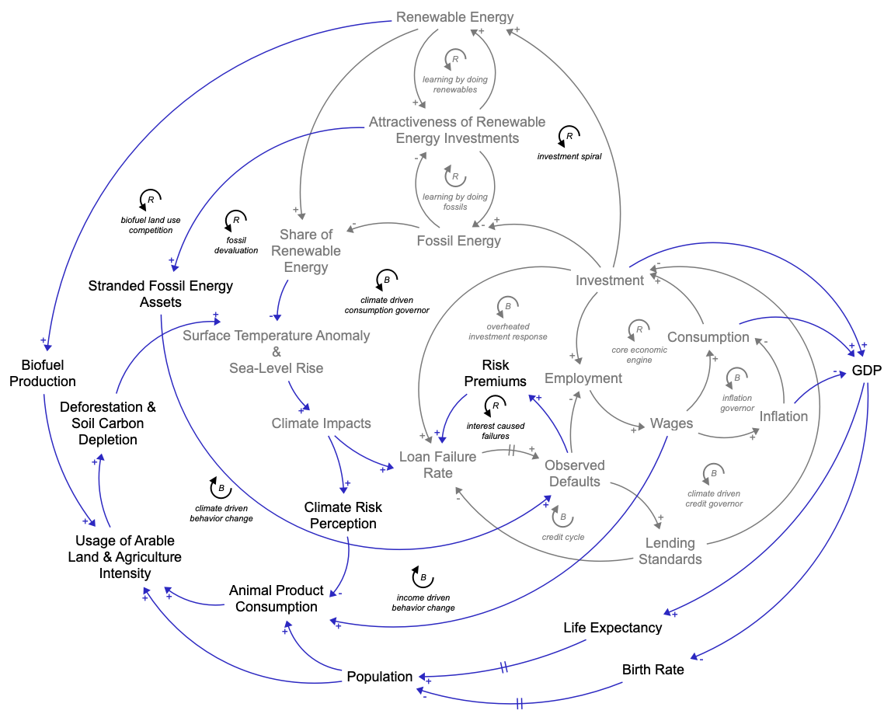
Mid 21st Century: The Great Transition and Emerging Constraints
Climate Impacts on Economy
  Climate change reduces labor productivity, harms agriculture, infrastructure, and financial stability by mid-21st century.
Land-Use and Inflation Pressures
  Competition for land between food, biofuels, and ecosystems causes inflationary pressures and market volatility.
Renewable Energy Transition
  Renewable energy adoption accelerates but is uneven due to economic stress and weakened learning effects.
Finance as Climate Impact Channel
  Rising financial risks tighten lending, suppressing investments in energy, adaptation, and infrastructure renewal.

Slide 14
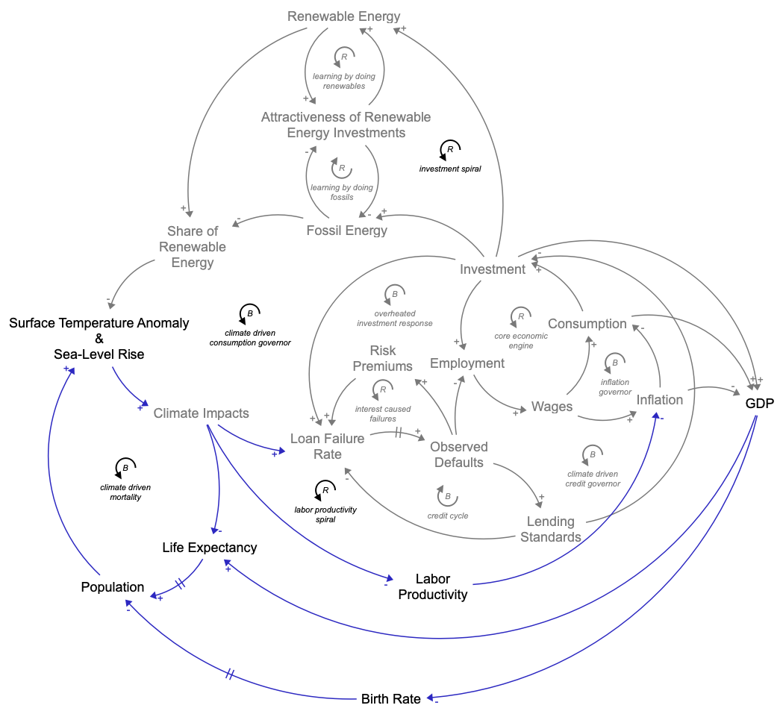
Late 21st Century – Mid 22nd Century: Biophysical Brakes Take Over
  Balancing Feedbacks Dominate
  Financial disruptions from failing loans, sea level rise damages, climate-driven increases in mortality and productivity losses dominate in this period.
Economic Outcomes Settle into a new Regime
  Growth is significantly reduced, with more pronounced boom and bust cycles caused by climate impacts on the socio-economic system.
Shift in Governing Dynamics
  The late-century regime shows fundamentally different dynamics dominated by biophysical limits.

Slide 15
Implications and Takeaways

Slide 16
Policy by Design or by Disaster
Early vs Late Responses
  Society must respond early through anticipatory policies to avoid costly reactive adjustments caused by climate damages.
  Our human behavior representation shows without policy, adaptions happen too late.
Impact of Biophysical Feedbacks
  Dominance of biophysical feedbacks leads to financial stress and reduces capacity for effective mitigation and adaptation.
Targeting Key Feedbacks
  Policies should focus on key systems like finance, energy transition, and demand to influence climate outcomes positively.
Feedback-Aware Policy Design
  Designing policies that consider feedback loops is essential for stable, equitable and sustainable human-Earth futures.

Slide 17
Modern SD Methods are Key
Challenges of Large Models
  Modern system dynamics methods handle complexity beyond manual reasoning and traditional causal loop diagrams.
Quantitative Loop Dominance
  Loop dominance analysis identifies key feedbacks and their interactions over time in complex systems.
AI-Assisted Narrative Synthesis
  AI transforms structured outputs into clear explanations without generating new information.
Advancing System Dynamics Practice
  Combining methodological rigor with feedback loop dominance analysis makes complex policy models understandable.

Slide 18


FRIDA is still being built…
Join us on Github
https://github.com/metno/WorldTransFRIDA

