Slide 1





Leveraging AI within System Dynamics to Transform Governance and Leadership in South African Municipalities
Online Poster Presentation
Fanyana Ntuli
Durban University of Technology, South Africa
0:00-0:30
@systemdynamics_
THE 43RD INTERNATIONAL SYSTEM DYNAMICS CONFERENCE
Boston, Massachusetts, USA and Virtually
#isdc2025
Notes:
Title page: Change title to submission name. Bold the name of the presenter and display your name as you want it read by the moderator (eg Bob instead of Robert). Note the suggested timing in the bottom right. Slide timing may be adjusted, but not the number of slides.

Slide 2

Problem Statement
South African municipalities suffer from compounding challenges persistent service delivery failures, erosion of institutional trust, and a vacuum of effective leadership. In many cases, artificial intelligence is introduced as a rapid-response tool automating billing or data collection without real structural reform. These AI deployments become symptomatic fixes that displace more fundamental interventions.
Model-based insights are frequently produced, yet rarely acted upon. This failure stems from a lack of attention, poor understandability, limited believability, and absence of empathetic narrative. Using concepts from narrative theory plot, characterization, verisimilitude we see that system models, like stories, must resonate with decision-makers emotionally and cognitively to effect change.
Thus, our challenge is not only one of modeling accuracy but also communicative power. We must ask: how do we tell better stories with models? And how can AI serve not just as an analytical engine, but a narrative ally in making systemic feedback visible, credible, and actionable?
0:30-2:00
@systemdynamics_
THE 43RD INTERNATIONAL SYSTEM DYNAMICS CONFERENCE
Boston, Massachusetts, USA and Virtually
#isdc2022
THE 40TH INTERNATIONAL SYSTEM DYNAMICS CONFERENCE
Virtually everywhere!
#isdc2025
Notes:
Keep fonts big (24 pt or bigger). Note suggested timing in the bottom right.

Slide 3
Research Approach
This study adopts a qualitative, interpretive methodology rooted in system dynamics modeling.
Data is derived from critical municipal policy documents including Integrated Development Plans (IDPs), Municipal Finance Management Act (MFMA) reports, national AI strategy papers, and governance white papers.
Using system dynamics, recurring loops, leverage points, and archetypes (e.g., 'Shifting the Burden') were extracted, coded, and simulated to better understand how AI is positioned either as a systemic enabler or symptomatic patch.
Document analysis was chosen to capture institutional narratives and identify structural feedback patterns that are often embedded in planning frameworks but overlooked in implementation.
2:00-3:30
@systemdynamics_
THE 43RD INTERNATIONAL SYSTEM DYNAMICS CONFERENCE
Boston, Massachusetts, USA and Virtually
#isdc2022
THE 40TH INTERNATIONAL SYSTEM DYNAMICS CONFERENCE
Virtually everywhere!
#isdc2025
Notes:
Keep fonts big (24 pt or bigger). Note suggested timing in the bottom right.

Slide 4
Dynamic Hypothesis
The central hypothesis of this study is that short-term AI deployments while addressing visible inefficiencies ultimately reinforce governance dependency cycles. These symptomatic interventions displace long-term leadership and institutional learning efforts.
However, when embedded into feedback-aware governance architectures, AI has the potential to enhance public trust, improve adaptive policy responses, and catalyze governance resilience.
System dynamics modeling illustrates two distinct pathways: a short feedback loop of immediate gains that fades over time, and a long feedback loop of structural improvement via participatory AI integration, institutional ethics, and adaptive leadership.
2:00-3:30
@systemdynamics_
THE 43RD INTERNATIONAL SYSTEM DYNAMICS CONFERENCE
Boston, Massachusetts, USA and Virtually
#isdc2022
THE 40TH INTERNATIONAL SYSTEM DYNAMICS CONFERENCE
Virtually everywhere!
#isdc2025
Notes:
Keep fonts big (24 pt or bigger). Note suggested timing in the bottom right.

Slide 5
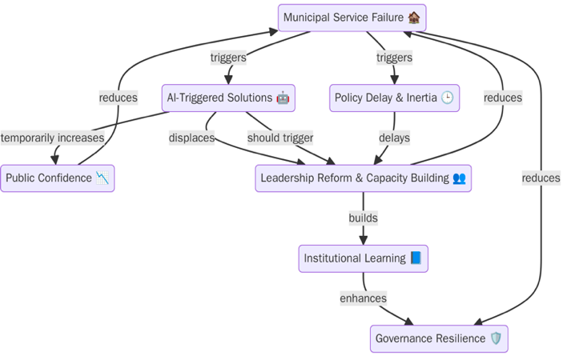
Model- Shifting the Burden via AI in Municipal Governance
2:00-3:30
@systemdynamics_
THE 43RD INTERNATIONAL SYSTEM DYNAMICS CONFERENCE
Boston, Massachusetts, USA and Virtually
#isdc2022
THE 40TH INTERNATIONAL SYSTEM DYNAMICS CONFERENCE
Virtually everywhere!
#isdc2025
Notes:
Keep fonts big (24 pt or bigger). Note suggested timing in the bottom right.

Slide 6
Key Results – Insights from Feedback Models
The simulations reveal that AI solutions are not inherently transformative—they function as amplifiers within feedback structures.
1. Trust in AI is dynamic, not static. It grows through transparency, public participation, and ethical alignment.
2. Ethics cannot be post-factum add-ons. They must be embedded into AI governance loops at design and policy levels.
3. Resilience is a function of institutional learning, which is activated only when leadership reform precedes or complements digital intervention.
The 'Inclusive AI-Governance Loop' model shows that reinforcing feedbacks between transparency, participation, and adaptive policy can create a governance flywheel accelerating public value creation rather than merely automating broken systems.
2:00-3:30
@systemdynamics_
THE 43RD INTERNATIONAL SYSTEM DYNAMICS CONFERENCE
Boston, Massachusetts, USA and Virtually
#isdc2022
THE 40TH INTERNATIONAL SYSTEM DYNAMICS CONFERENCE
Virtually everywhere!
#isdc2025
Notes:
Keep fonts big (24 pt or bigger). Note suggested timing in the bottom right.

Slide 7
Conclusion
This study illustrates that AI, when embedded within system dynamics-informed governance, holds the potential to transform municipal leadership.
Yet transformation is conditional:
- It demands strategic foresight, not technological enthusiasm.
- It requires long-term thinking over quick wins.
- It thrives on feedback fluency leaders must learn to govern delays, loops, and nonlinearity.
For African municipalities, this is not just a technical revolution it is a political and narrative renaissance. We must reframe AI not as magic, but as a participatory, ethical, and adaptive institution-building tool.
5:30-7:00
@systemdynamics_
THE 43RD INTERNATIONAL SYSTEM DYNAMICS CONFERENCE
Boston, Massachusetts, USA and Virtually
#isdc2022
THE 40TH INTERNATIONAL SYSTEM DYNAMICS CONFERENCE
Virtually everywhere!
#isdc2025
Notes:
Keep the text short and fonts big. Any questions you want to pose to the audience can go here. Note suggested timing in the bottom right.

Slide 8

Q&A
5:30-7:00
@systemdynamics_
THE 43RD INTERNATIONAL SYSTEM DYNAMICS CONFERENCE
Boston, Massachusetts, USA and Virtually
#isdc2022
THE 40TH INTERNATIONAL SYSTEM DYNAMICS CONFERENCE
Virtually everywhere!
#isdc2025
Notes:
Keep the text short and fonts big. Any questions you want to pose to the audience can go here. Note suggested timing in the bottom right.

