Slide 1
Understanding contingencies of Say’s law of markets
Khalid Saeed
Professor of System Dynamics and Economics
Worcester Polytechnic Institute
Worcester MA 01609
2025 International System Dynamics conference, Boston, MA: August 2025
Notes:
Motivation: Revision of models of the thought process of classical economists.
Say was of classical vintage, but in my observation modern in terms of thought process. Abstract with many underlying assumptions.
His proposal of supply fueling demand especially stands out as an abstract concept among the magnificent (Baumol’s term) classical models of economic growth and limits that discussed in detail how everyday behavior of producers and consumers sets an invisible hand into motion. There indeed are many contingencies underlying the so-called Say’s law which are often ignored by the controversies. This short paper attempts to understand those contingencies and their relevance to economic policy using parsimonious system dynamics models and computer simulation. In particular, the concepts of gain is found helpful in understanding the diverse results of supply-side stimulation policies.

Slide 2
workers = ∫(change in workers) * dt
change in workers = (desired workers-workers)/worker adjustment time
desired workers = demand/productivity
demand = income
income = workers*wage rate
production = workers*productivity
Notes:
Simplest model. One sector, one factor Closed economy, produced only with labor that can be hired from and fired into an unlimited pool without affecting wage rate. Capital adjusts instantaneously to maintain productivity at an optimal level. What is produced can always be bought by households who receive enough income from production. There is no surplus of supply or demand. All Say’s assumptions that he stated between lines.

Slide 3
Both Demand and supply side stimulants work
One-time exogenous change in demand
One-time exogenous change in workers
Notes:
First of all, I added a pulse of 10 units fist to demand, then to workers. Both pulled income up by 10 units as shown. Hence the controversy about which intervention is effective is moot.

Slide 4
Debate is on unstated contingencies
Keynes was critical of Say’s law arguing that demand does not increase as much as the production, which is possible under certain contingencies.
Some of these contingencies can be identified if we are able to recognize the drivers of growth in income, which can be done easily when we calculate the gain of the growth loop (OLSSG).
Others can be identified by extending the model.
Notes:
This very simple model does not include the unstated contingencies under which different results are obtained.
Some also refer to Keynes famous words: Long run is a misleading guide to current affairs. In the long run we are all dead.
Indeed, Say’s law refers to long run correction, and that might happen in our lifetime.

Slide 5
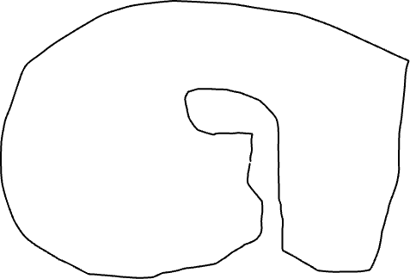
Gain of the growth process (OLSSG)
Io = workers*wage rate
=desired workers*wage rate
= (demand/productivity)*wage rate
= Ii*wage rate/productivity
Io/Ii = wage rate/productivity
= OLSSG
Ii
Io
Notes:
If Say is referring to this growth process, it can indeed be driven by a supply side intervention. Steady state is of course a ling run outcome..

Slide 6
An explanation and a question
Note the gain does not include a term depending on either demand side or supply side. Hence autonomous change in either has same effect on income.
The ratio wage rate/productivity defines the gain, meaning underpaid workforce will inhibit growth. Explains the failure of supply side interventions in poor countries.
Some also argue that Keynes talked about short run, while Say referred to long run. His infamous words: Long run is a misleading guide to current affairs. In the long run we are all dead.
Question: Can short run imbalances of supply and demand affect gain?

Slide 7
Adding market dynamics to the model

Slide 8
Variable | Equation
inventory(t) | ∫ (production - sale) * dt
price(t) | ∫ (change in price) * dt
workers(t) | ∫ (change in workers) * dt
change in price | price*f3(inventory/inventory goal); f3’<0, f3”>0
Inventory goal | sale * inventory coverage
change in workers | (desired workers-workers)/worker adjustment time
production | workers*productivity
sale | demand
demand | income*f2; f2’<0, f2”>0
desired workers | (demand/productivity)*f1; f1’>0, f1”<0
income | workers*wage rate

Slide 9
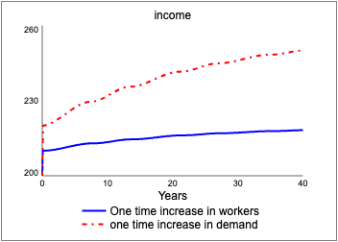
Comparing performance of supply and demand driven stimuli with market dynamics
Notes:
1. price changes and their impact on supply and demand create growth in both cases, albeit with oscillations signifying presence of underemployment of resources when supply is reduced following over-production.
2. the impact of demand increase is higher than the supply increase. The autonomous supply increase would at first raise inventory that would suppress price and production in the subsequent rounds, while the autonomous increase in demand would at first deplete inventory that would raise price - increasing production in the subsequent rounds. The multiplier effects of autonomous increases in supply and demand therefore differ, although both cause growth.

Slide 10
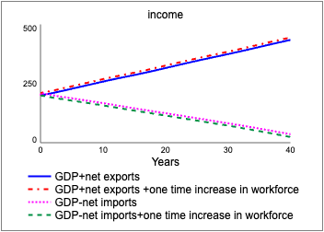
Performance of Say’s law in an open economic system with net exports or imports
Notes:
Impact of adding net imposts to GDP gives a boost to income while maintaining the multiplier from one time

Slide 11
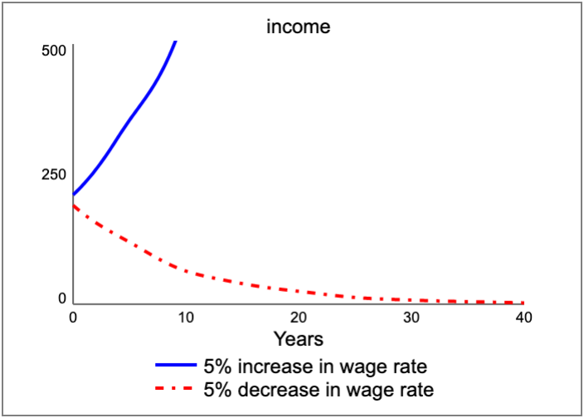
Impact of wage rate on the gain of the growth process

Slide 12
Adding government spending to GDP calculation
When government deficit spending is also added to the calculation of GDP, and it may further stimulate economy by increasing demand, but this would also cause money inflation as I have explored elsewhere [1] with a larger model.
If govt spending has a large component of goods and services that households supplying inputs to production cannot consume, it may cause further price inflation.
I am not sure if adding G to GDP calculation is correct. A good subject for further research.
1. Saeed, Khalid. 2022. "Taxation of Fiat Money Using Dynamic Control" Systems 10, no. 3: 84. https://doi.org/10.3390/systems10030084

Slide 13
Conclusion
The value of Say’s law to economic development policy lies in understanding its contingencies (5).
Using the principle of gain in * fb allows understanding of contingencies.
Supply side interventions in the face of low wages and widespread poverty may not stimulate the economy.
Indiscriminate hiring by governments for income support may only reduce the production capacity by excluding so hired personnel from productive workforce.
Defensive expenditures might likewise curtail production capacity while expanding demand, both creating inflation.
Hence, Say’s law may not give carte blanche to supply side interventions nor refute demand side policy but should caution against their indiscriminate use.

