Slide 1

Building and Learning from Models Using AI
Presented by Billy Schoenberg | August 6, 2025
isee systems inc | (603) 448-4990 | www.iseesystems.com
24 Hanover St, Suite 8A | Lebanon, NH 03766 | USA

Slide 2
The Opportunity for System Dynamics
Overcoming Barriers: A major hurdle in SD has been the extensive time and effort required to learn model building, analysis, and application.
LLMs Have Demonstrated Proficiency: Large Language Models (LLMs) have shown proficiency in similar complex tasks in domains like software engineering and education.
Quantum Leap: The current surge in AI investment and tools can dramatically increase the number of SD students and practitioners, while simultaneously enhancing work quality and modeler productivity.
Redefining Productivity: Publicly available LLMs, such as Google's Gemini-2.5 and Open AI's models, offer the potential to fundamentally change how System Dynamicists work, without altering core methodologies.

Slide 3
How LLMs Function for SD
Predicting the Next Word: At their core, LLMs predict the next word in a sequence based on prior words.
Data-Driven Predictions: These predictions are informed by the vast amounts of data the LLM was trained on, minimizing error between predicted and actual text.
Neural Network Architecture: LLMs utilize neural network architectures adept at processing text sequences as numerical vectors.
Information Transformers: We should view LLMs as tools for organizing, transforming, and presenting information, not as knowledge progenitors.
Structured Outputs (JSON): LLMs excel at summarizing dense information and can generate structured outputs like JSON, which is ideal for interoperability with external software. This "contractual guarantee" of parsable JSON eliminates syntax errors, a common problem with traditional model formats like XMILE.

Slide 4
The sd-ai Project: A Collaborative Platform
Open Source Initiative: The sd-ai project is an open-source platform fostering collaboration in the SD community for AI-driven modeling tools.
Natural Language Interaction: It acts as an intermediary, enabling users to generate and interact with SD models using natural language.
Automated Translation: Essentially, sd-ai automates the translation between user intent and model-based system representations.

Slide 5
The sd-ai Project: A Collaborative Platform

Slide 6
Two Key Engines: Quantitative & Seldon
Quantitative Engine
Generates quantitative System Dynamics models, including equations, units, and documentation.
Relies on a well-designed scheme for encoding model structure information, specifically the sd-json format.
Seldon
An LLM-based modeling companion.
Transforms dense model structure and behavior information into more understandable prose.
Designed as a learning aid for ideation, implementation, and model analysis, accessible via natural language conversation.
Differs from general conversational agents by taking verifiable model facts as input to avoid knowledge creation by the LLM.

Slide 7
sd-json Format: Encoding Model Structure
Efficient Information Delivery: Documentation for each element in the schema is provided to the LLM via the structured outputs feature, using the Zod library, ensuring efficient information organization.
Variables: An array of nodes, each representing a computed concept.
Relationships: An array of edges connecting variables.
Specs: Object for model time dimension information (startTime, stopTime, dt, timeUnits).

Slide 8
Prompting Scheme: Guiding LLM Behavior
Quantitative Engine
System
Background Knowledge
User
Close Feedback
Problem Statement
Model
Assistant
Seldon
System
Problem Statement
User
Background Knowledge
Model
Structure
Behavior
LTM Feedback

Slide 9
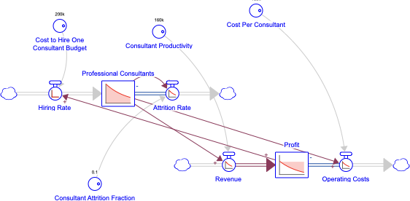
Applying the Methodology: A Business Case Study
Demonstration Context: Using Seldon and the quantitative engine with gemini-2.5-flash.
Problem Statement: A consulting business struggles with profit due to insufficient highly skilled professional consultants, aiming to increase their number.
Initial Model (Quantitative Engine):
Professional Consultants, Hiring Rate, Attrition Rate, Revenue, Operating Costs, and Profit.
Establishes a reinforcing loop for hiring, but with parameters set to create a "vicious cycle" where costs exceed productivity.
Includes a balancing loop from consultant attrition.

Slide 10
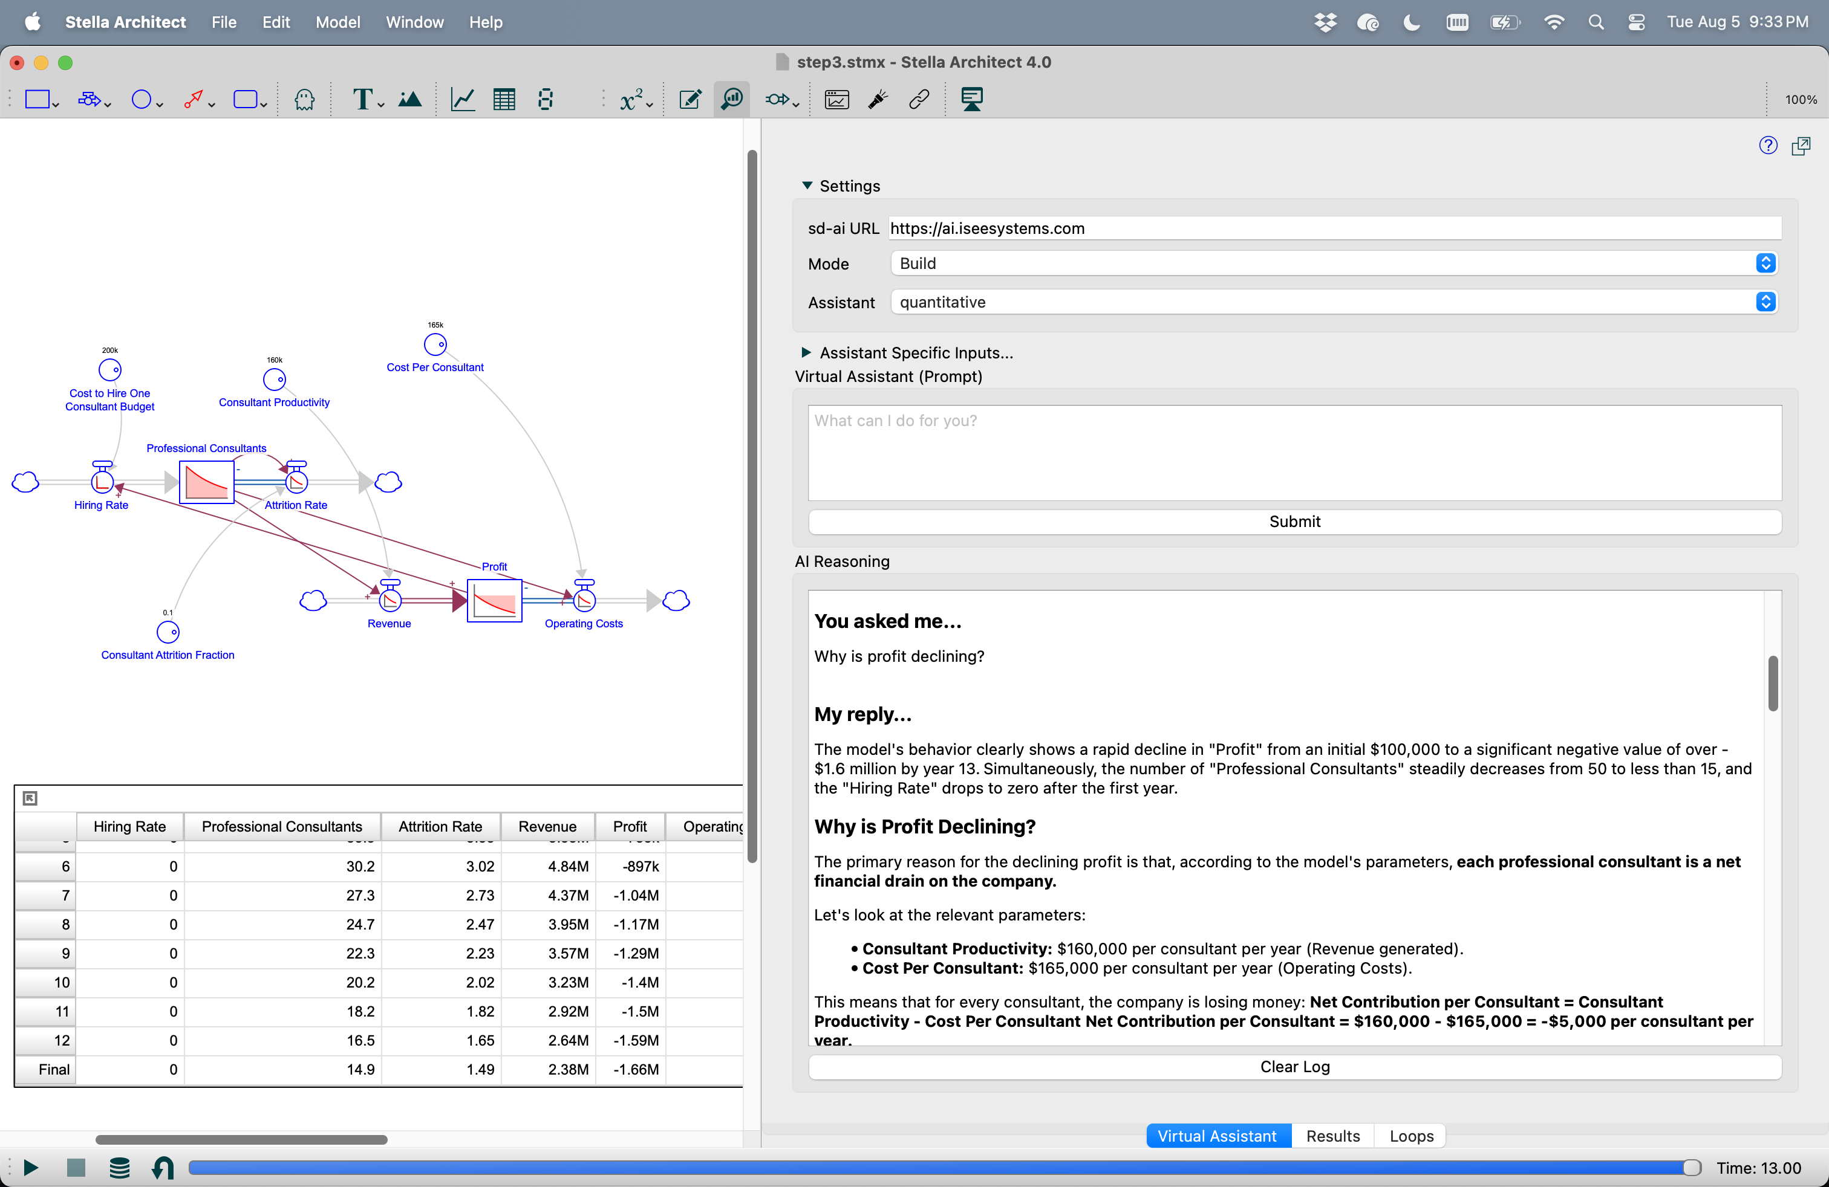
Talking with Seldon

Slide 11
Seldon's Insight: Why Profit is Declining (Initial Model)
Model Behavior: Rapid and continuous decline in Profit and Professional Consultants.
Seldon's Breakdown:
Initial Unprofitability
Cost Per Consultant ($165,000) exceeds Consultant Productivity ($160,000) by $5,000 per year per consultant.
Immediate Loss
Initial annual loss of $250,000 (50 consultants * -$5,000), quickly depleting starting profit.
Hiring Halted
Profit quickly turns negative, stopping all Hiring Rate activity by year 1.75.
Consultant Base Erodes
With no new hires, Attrition Rate steadily reduces Professional Consultants.
Downward Spiral
Decreasing consultants lead to decreased revenue, but the per-consultant loss persists, driving profit further negative.
Summary: Business is fundamentally unprofitable per consultant, leading to fund depletion, halted hiring, and consultant decline

Slide 12
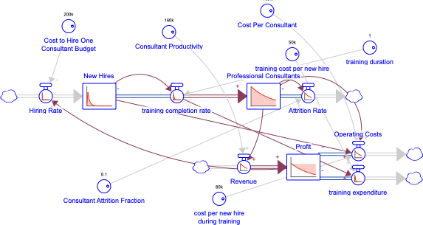
Iterative Model Development: Adding a Training Pipeline
Addressing the Problem: Based on Seldon's insights, the next step is to add a "Consultant Skill Development/Training Pipeline".
Quantitative Engine's Response:
Introduces a New Hires stock (consultants undergoing training).
Hiring Rate now flows into New Hires.
Training Completion Rate flow moves consultants from New Hires to Professional Consultants after a Training Time delay.

Slide 13
Seldon's Analysis on the Enhanced Model
Re-evaluating Profit Decline
Seldon again explains the profit decline, confirming the core issue: Operating Costs Per Professional Consultant are higher than the Revenue they generate.
Reinforced Findings
Consultant Productivity ($160,000) vs. Cost Per Consultant ($165,000) leads to a $5,000 loss per consultant.
This fundamental imbalance rapidly depletes Profit, halting Hiring Rate.
No new New Hires or Training Completion Rate means attrition continues unchecked.
The system lacks the positive feedback mechanism (R1) to counteract attrition, leading to a financial spiral.

Slide 14
Seldon's Solution: Fixing the Problem
Addressing the Imbalance: To fix declining profit and enable growth, the fundamental financial imbalance (loss per consultant) must be addressed.
Increase Consultant Productivity:
Action: Increase the value of Consultant Productivity (currently $160,000).
Reasoning: More revenue per consultant (e.g., higher billing rates, improved efficiency, focus on high-value work) leads to increased total Revenue. If productivity exceeds cost, the business becomes profitable per consultant.
Decrease Cost Per Consultant:
Action: Decrease the value of Cost Per Consultant.
Reasoning: Reducing costs per consultant (e.g., lower salaries, benefits, overhead) makes the business profitable per consultant if it falls below Consultant Productivity.
Seldon's Value: Seldon provides clear, precise, and understandable explanations for model behavior and offers effective strategies for dealing with problems, with minimal human input.

Slide 15
Conclusions: The Future of System Dynamics
SD Could Flourish With AI
The traditional methods of System Dynamics are not dying, but evolving. AI tools are enabling them to be wielded with impressive competence.
Enhanced Analysis Skills
While perhaps not yet on par with the most experienced human modelers in raw modeling skill, LLMs, as used by Seldon, are remarkably skilled in model analysis and understanding.
Increased Accessibility
This integration of AI makes System Dynamics more accessible, reducing the barriers to entry and enabling more people to build and understand complex systems.
Focus on Verification
LLMs' "superhuman stamina" in model construction and understanding allows human modelers to focus more on validation and verification.
A New Era
We are entering a new era where AI empowers System Dynamicists to dramatically increase their productivity and the quality of their work.

Slide 16
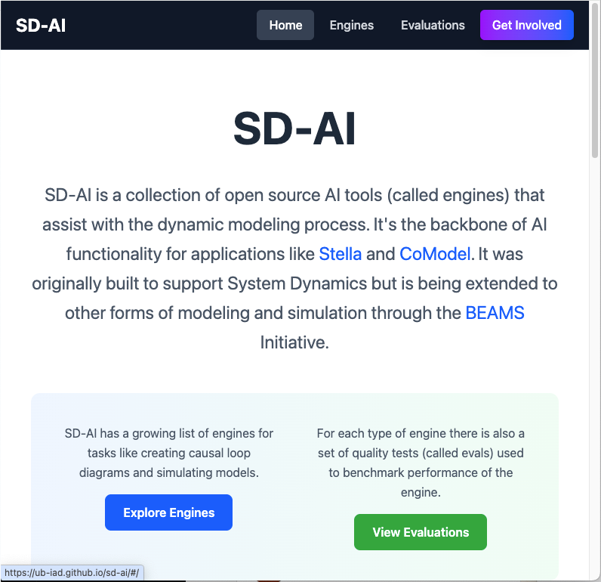

Questions?
Billy Schoenberg
bschoenberg@iseesystems.com
If you want to get involved go to the sd-ai website!

