Slide 1




Health Insurance at a Crossroads: Market Failures, Financial Protection, and Private Sector Dynamics
Online Poster Presentation
Aakriti Gupta, IIM Calcutta, Incoming MIT Sloan
Nachiket Mor, Banyan Academy of Leadership in Mental Health
Prof. Rahul Roy, IIM Calcutta
@SystemsDrinker
THE 43RD INTERNATIONAL SYSTEM DYNAMICS CONFERENCE
Boston, Massachusetts, USA and Virtually
Notes:
Title page: Change title to submission name. Bold the name of the presenter and display your name as you want it read by the moderator (eg Bob instead of Robert). Note the suggested timing in the bottom right. Slide timing may be adjusted, but not the number of slides.

Slide 2

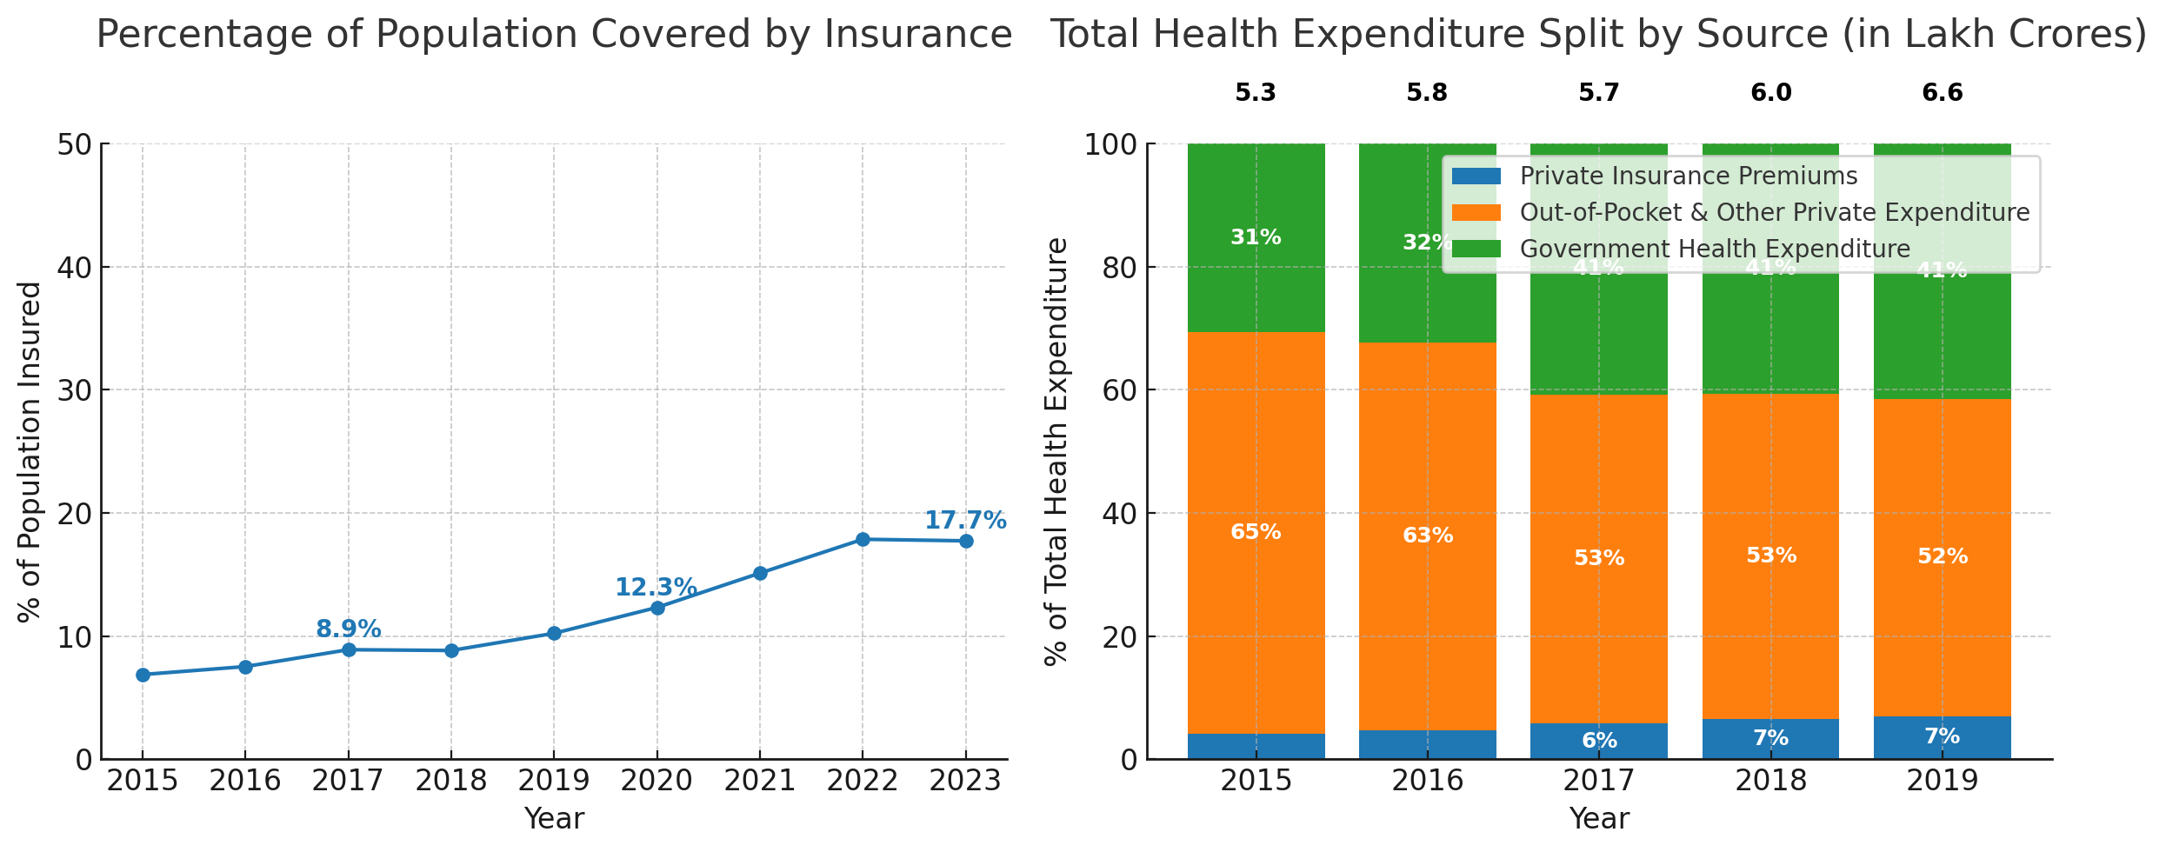

India’s road to Universal Health Coverage (UHC) needs commercial health insurance for enhancing financial protection…
// PROBLEM STATEMENT
Aakriti Gupta, Nachiket Mor, Rahul Roy
@SystemsDrinker
THE 43RD INTERNATIONAL SYSTEM DYNAMICS CONFERENCE
Boston, Massachusetts, USA and Virtually
#isdc2022
THE 40TH INTERNATIONAL SYSTEM DYNAMICS CONFERENCE
Virtually everywhere!
Notes:
Keep fonts big (24 pt or bigger). Note suggested timing in the bottom right.

Slide 3
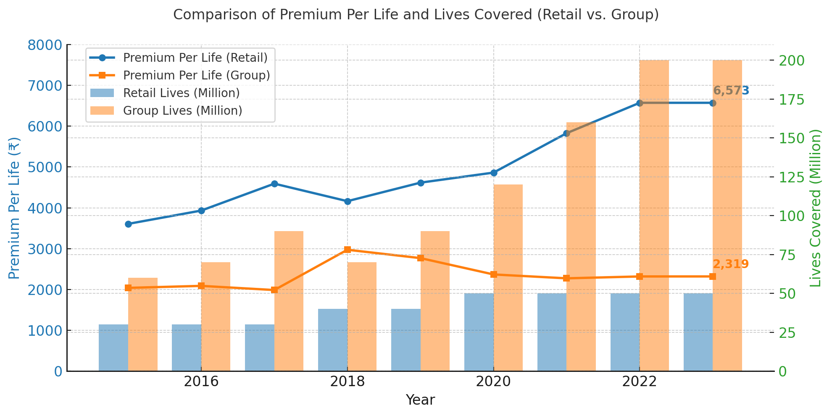
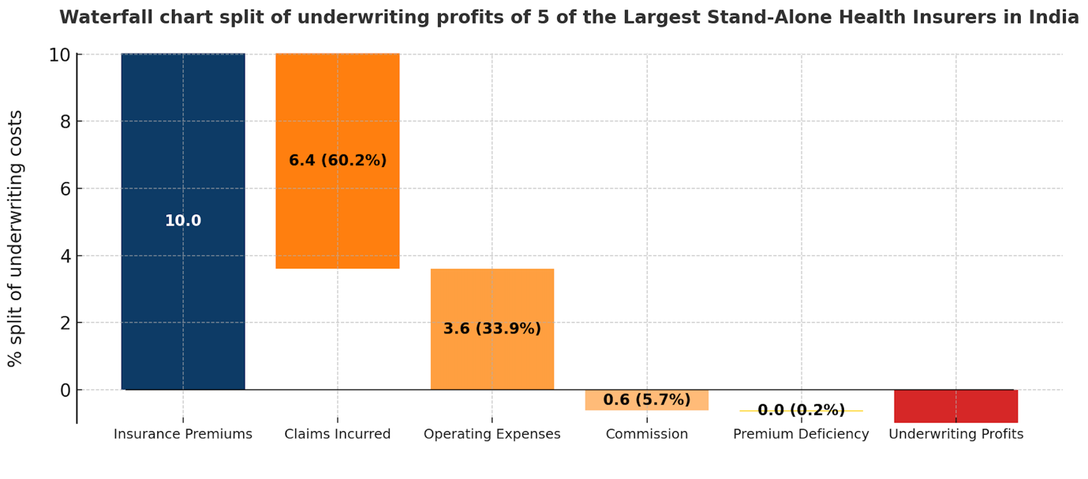
…However, private players face challenges in offering a commercial insurance product profitably
// PROBLEM STATEMENT
Aakriti Gupta, Nachiket Mor, Rahul Roy
@SystemsDrinker
THE 43RD INTERNATIONAL SYSTEM DYNAMICS CONFERENCE
Boston, Massachusetts, USA and Virtually
#isdc2022
THE 40TH INTERNATIONAL SYSTEM DYNAMICS CONFERENCE
Virtually everywhere!
Notes:
Keep fonts big (24 pt or bigger). Note suggested timing in the bottom right.

Slide 4
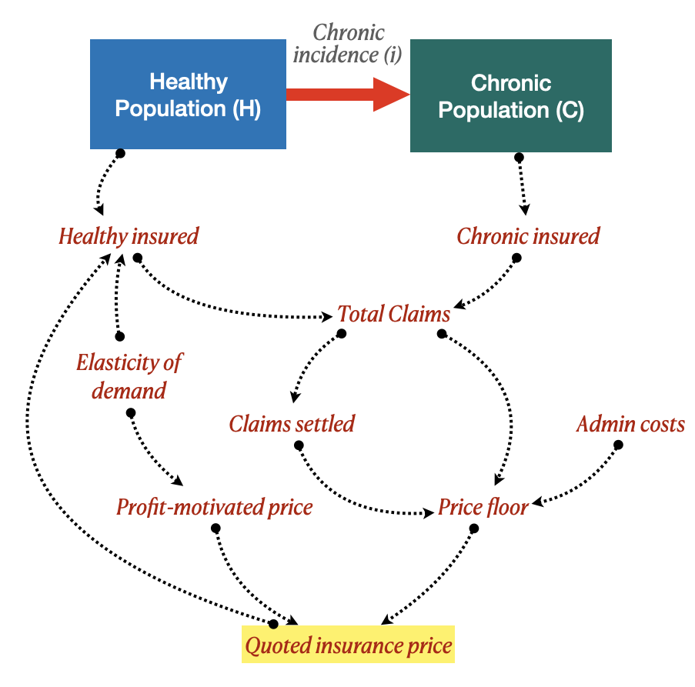
Our health financing model has simplified population health dynamics, insurance market, claims, and stakeholder strategies
// APPROACH & MODEL
This work integrates a stakeholder lens and decision theory to model system interactions
We are interested in the interaction of 4 key stakeholders – Insurance buyers (Healthy, Chronic), Insurer, Regulator.
Goals & Leverage Points of each:
Insurer :Maximize profits (revenue – cost).
Levers: premiums, risk selection, claims settled.
Population: Affordable, dependable coverage.
Levers: join/drop, disclose health status if chronic.
Regulator: Coverage & sustainability.
Levers: price regulation, permitting risk selection.
Aakriti Gupta, Nachiket Mor, Rahul Roy
@SystemsDrinker
THE 43RD INTERNATIONAL SYSTEM DYNAMICS CONFERENCE
Boston, Massachusetts, USA and Virtually
#isdc2022
THE 40TH INTERNATIONAL SYSTEM DYNAMICS CONFERENCE
Virtually everywhere!
Notes:
Keep fonts big (24 pt or bigger). Note suggested timing in the bottom right.

Slide 5
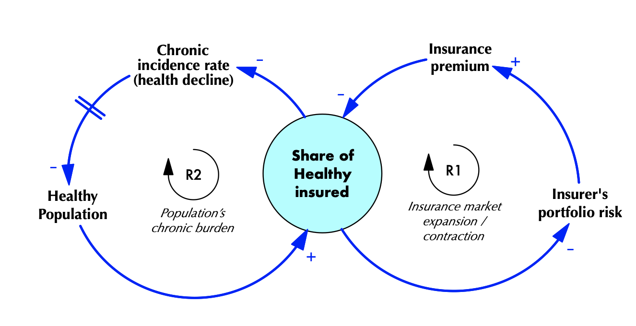
The base scenario shows the link between population health (chronic burden) and the insurance market – it is stuck in a low energy state
// DYNAMIC HYPOTHESIS
Base Scenario
“Over 60% of India’s population — approximately 90 crore people — remain outside the health insurance system, highlighting the massive gap in financial protection”
IRDAI data, reported by Express Healthcare, 2024
Aakriti Gupta, Nachiket Mor, Rahul Roy
@SystemsDrinker
THE 43RD INTERNATIONAL SYSTEM DYNAMICS CONFERENCE
Boston, Massachusetts, USA and Virtually
#isdc2022
THE 40TH INTERNATIONAL SYSTEM DYNAMICS CONFERENCE
Virtually everywhere!
Notes:
Keep fonts big (24 pt or bigger). Note suggested timing in the bottom right.

Slide 6
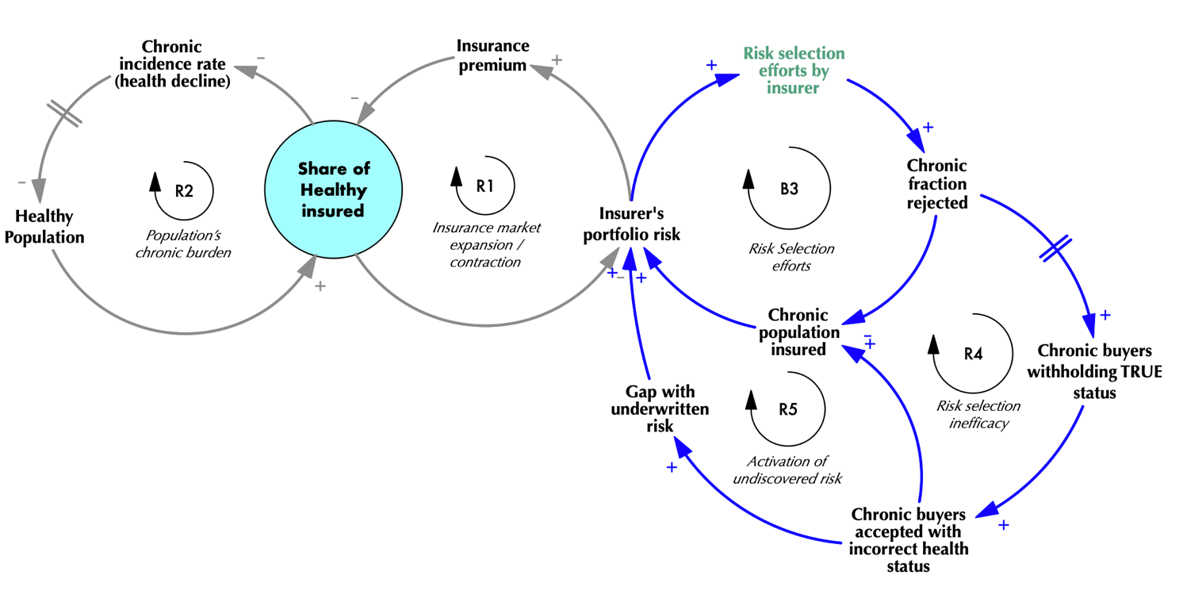
Private players are allowed to “risk select” to improve their portfolio, leading to adverse selection as true health status is undiscovered
// DYNAMIC HYPOTHESIS
“About 60 per cent of Indian insurance companies are seeing a rapid increase in fraud, especially in the life and health insurance space”
Deloitte’s Insurance Fraud Survey, 2023
Risk Selection Scenario
Aakriti Gupta, Nachiket Mor, Rahul Roy
@SystemsDrinker
THE 43RD INTERNATIONAL SYSTEM DYNAMICS CONFERENCE
Boston, Massachusetts, USA and Virtually
#isdc2022
THE 40TH INTERNATIONAL SYSTEM DYNAMICS CONFERENCE
Virtually everywhere!
Notes:
Keep fonts big (24 pt or bigger). Note suggested timing in the bottom right.

Slide 7
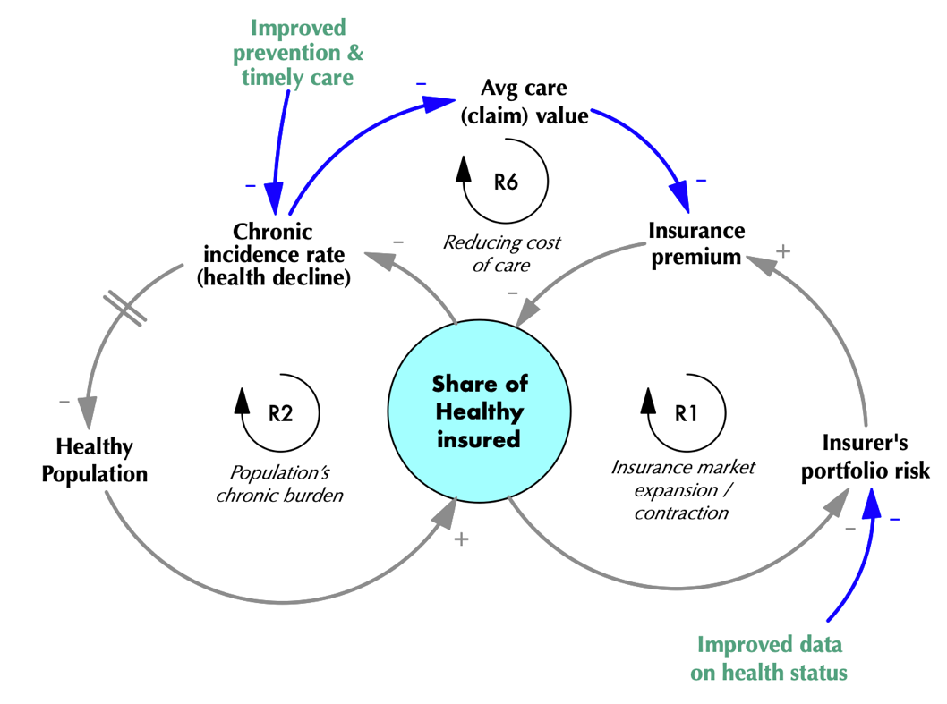
We propose a Managed Care scenario to address goals of all stakeholders
// DYNAMIC HYPOTHESIS
Managed Care Scenario
@SystemsDrinker
THE 43RD INTERNATIONAL SYSTEM DYNAMICS CONFERENCE
Boston, Massachusetts, USA and Virtually
#isdc2022
THE 40TH INTERNATIONAL SYSTEM DYNAMICS CONFERENCE
Virtually everywhere!
Notes:
Keep fonts big (24 pt or bigger). Note suggested timing in the bottom right.

Slide 8
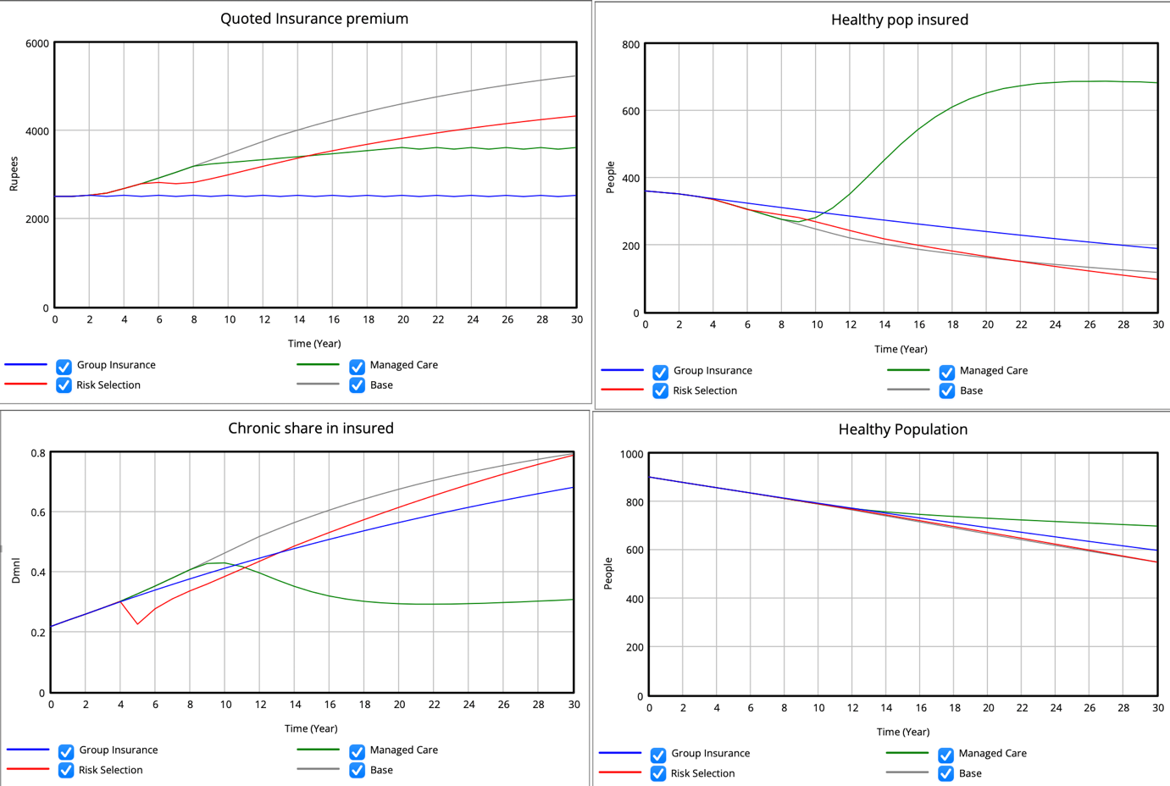
We propose a Managed Care scenario to address goals of all stakeholders
// RESULTS
Overall health dynamics improve with the managed care scenario
@SystemsDrinker
THE 43RD INTERNATIONAL SYSTEM DYNAMICS CONFERENCE
Boston, Massachusetts, USA and Virtually
#isdc2022
THE 40TH INTERNATIONAL SYSTEM DYNAMICS CONFERENCE
Virtually everywhere!
Notes:
Keep fonts big (24 pt or bigger). Note suggested timing in the bottom right.

Slide 9
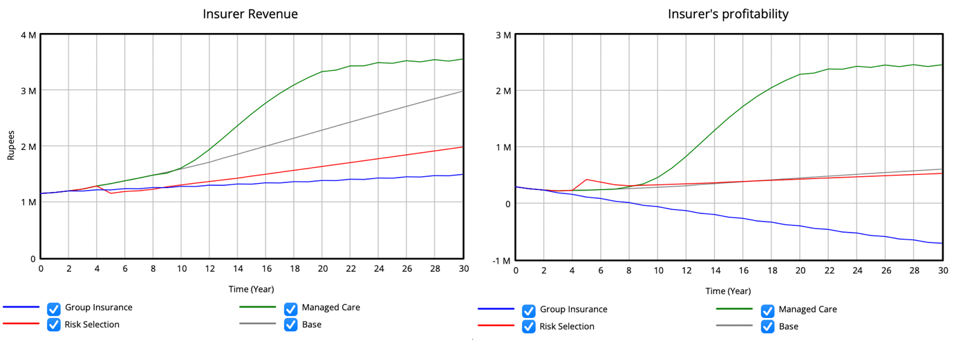
We propose a Managed Care scenario to address goals of all stakeholders
// RESULTS
The insurer’s profitability is also highest in the managed care model as the new model enables diagnosis to be early and thus, cost of care reduces
In addition, health status information is more updated
@SystemsDrinker
THE 43RD INTERNATIONAL SYSTEM DYNAMICS CONFERENCE
Boston, Massachusetts, USA and Virtually
#isdc2022
THE 40TH INTERNATIONAL SYSTEM DYNAMICS CONFERENCE
Virtually everywhere!
Notes:
Keep fonts big (24 pt or bigger). Note suggested timing in the bottom right.

Slide 10
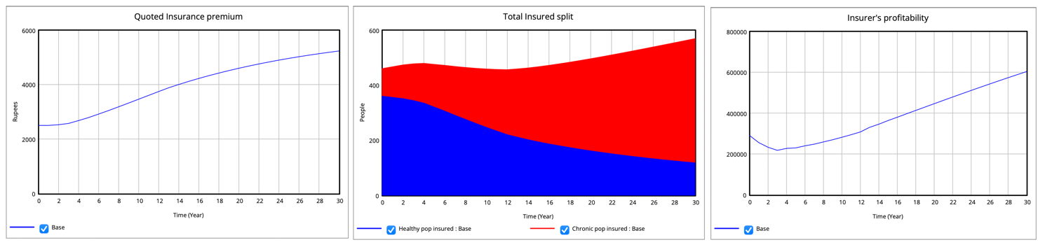
Base case | Scenario results (1/5)
// RESULTS
@SystemsDrinker
THE 43RD INTERNATIONAL SYSTEM DYNAMICS CONFERENCE
Boston, Massachusetts, USA and Virtually
#isdc2022
THE 40TH INTERNATIONAL SYSTEM DYNAMICS CONFERENCE
Virtually everywhere!
Notes:
Keep fonts big (24 pt or bigger). Note suggested timing in the bottom right.

Slide 11
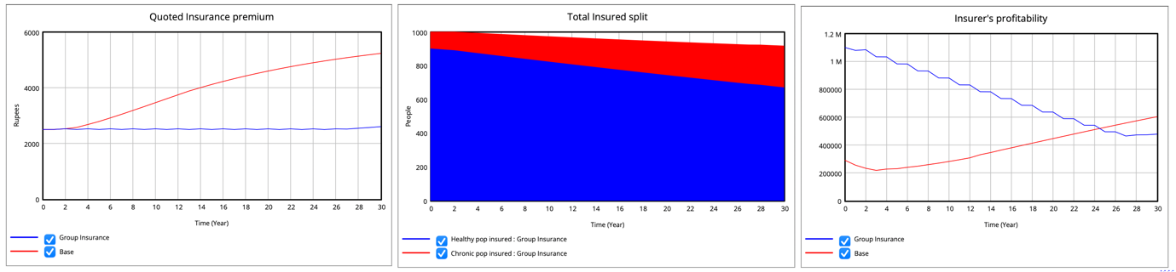
Base Case with 100% UHC (Idealised) | Scenario results (2/5)
// RESULTS
@SystemsDrinker
THE 43RD INTERNATIONAL SYSTEM DYNAMICS CONFERENCE
Boston, Massachusetts, USA and Virtually
#isdc2022
THE 40TH INTERNATIONAL SYSTEM DYNAMICS CONFERENCE
Virtually everywhere!
Notes:
Keep fonts big (24 pt or bigger). Note suggested timing in the bottom right.

Slide 12
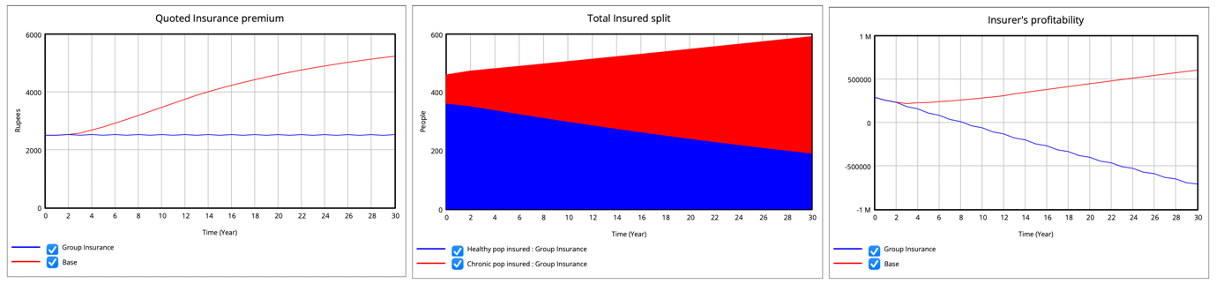
Group Insurance (Low elasticity) | Scenario results (3/5)
// RESULTS
@SystemsDrinker
THE 43RD INTERNATIONAL SYSTEM DYNAMICS CONFERENCE
Boston, Massachusetts, USA and Virtually
#isdc2022
THE 40TH INTERNATIONAL SYSTEM DYNAMICS CONFERENCE
Virtually everywhere!
Notes:
Keep fonts big (24 pt or bigger). Note suggested timing in the bottom right.

Slide 13
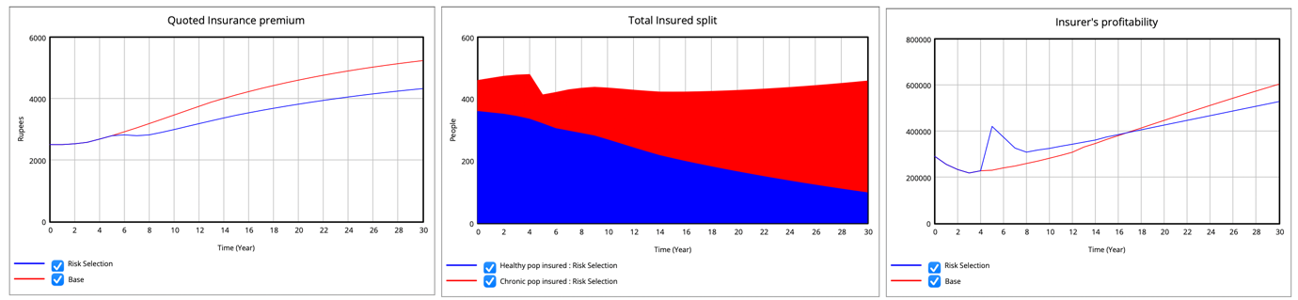
Risk Selection (Insurer strategy) | Scenario results (4/5)
// RESULTS
@SystemsDrinker
THE 43RD INTERNATIONAL SYSTEM DYNAMICS CONFERENCE
Boston, Massachusetts, USA and Virtually
#isdc2022
THE 40TH INTERNATIONAL SYSTEM DYNAMICS CONFERENCE
Virtually everywhere!
Notes:
Keep fonts big (24 pt or bigger). Note suggested timing in the bottom right.

Slide 14
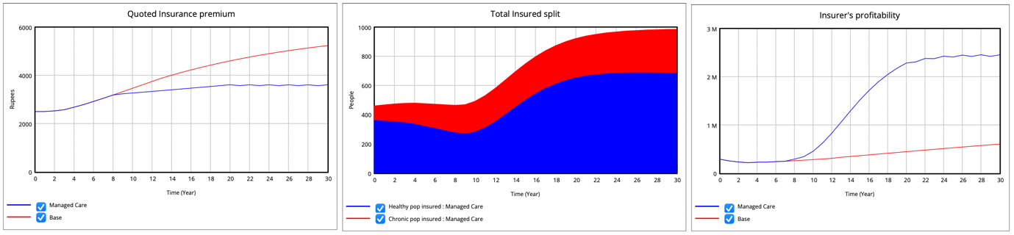
Managed Care (Proposed policy) | Scenario results (5/5)
// RESULTS
@SystemsDrinker
THE 43RD INTERNATIONAL SYSTEM DYNAMICS CONFERENCE
Boston, Massachusetts, USA and Virtually
#isdc2022
THE 40TH INTERNATIONAL SYSTEM DYNAMICS CONFERENCE
Virtually everywhere!
Notes:
Keep fonts big (24 pt or bigger). Note suggested timing in the bottom right.

Slide 15
Our insights from this work and a few questions…
// CONCLUSIONS
Health policy
Indian insurance regulator’s current “risk selection” policy harms the industry in the long term, and needs to be reviewed
Managed care, if introduced well, can be useful to unlock the positive linkage between health financing via pooling and population health
Methodology
Integrating decision science using a stakeholder view in interconnected systems can reveal deeper layers of interactions and system evolution
Single-insurer market assumption is a key limitation of this work, and balancing complexity vs insight is a fine edged sword (which I’m still learning how to tackle!)
Our questions
What are the best ways to get this work published and which journals is it best placed for?
As an incoming researcher at the MIT Sloan PhD program, I invite connections— from SD practitioners, policymakers, and academics—interested in joint modeling, data, or UHC policy.
Please reach me at aakritii@mit.edu or X.com/SystemsDrinker for any feedback!
@SystemsDrinker
THE 43RD INTERNATIONAL SYSTEM DYNAMICS CONFERENCE
Boston, Massachusetts, USA and Virtually
#isdc2022
THE 40TH INTERNATIONAL SYSTEM DYNAMICS CONFERENCE
Virtually everywhere!
Notes:
Keep fonts big (24 pt or bigger). Note suggested timing in the bottom right.

