Slide 1

Towards an Internally Consistent Representation of All Planetary Boundaries - Using the World-Earth Model FRIDA
Axel E. Eriksson, Jannes Breier, David Collste, Dieter Gerten, Lars J. Nilsson and William A. Schoenberg
WorldTrans –
TRANSPARENT ASSESSMENTS FOR REAL PEOPLE
https://www.worldtrans-horizon.eu
This project has received funding from the European Union’s Horizon 2.5 – Climate Energy and Mobility programme under grant agreement No. 101081661.
The contents of this document are the sole responsibility of the authors and do not reflect the opinion of the European Commission. The European Commission is not responsible for any use that may be made of the information contained in this document.

Slide 2
Outline
Introduction to planetary boundaries
Research questions
Results
Discussion
Conclusion
Notes:
Common document for expectations: https://docs.google.com/document/d/1Ofe8zA26Gvnd5y_RL91w59xzXbf0XSs9lG_SRLari1o/edit?tab=t.0

Slide 3
Imagine that you are walking up a hill…

Slide 4
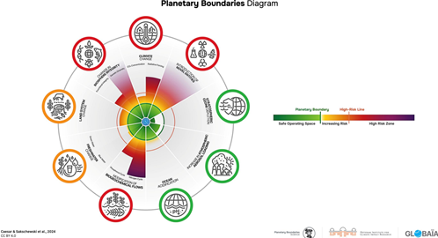
Planetary boundaries
9 boundaries
Life-supporting functions of the planet
Strongly influenced by humans
Beyond: Risk irreversible consequences
Notes:
Common document for expectations: https://docs.google.com/document/d/1Ofe8zA26Gvnd5y_RL91w59xzXbf0XSs9lG_SRLari1o/edit?tab=t.0

Slide 5
Example: Climate change
Influenced by human emissions of greenhouse gases
Control variable: Atmospheric CO2 concentration
Safe operating space: Up to 350 ppm
Zone of increasing risk: 350-450 ppm
High risk zone: Over 450 ppm
Notes:
Common document for expectations: https://docs.google.com/document/d/1Ofe8zA26Gvnd5y_RL91w59xzXbf0XSs9lG_SRLari1o/edit?tab=t.0

Slide 6
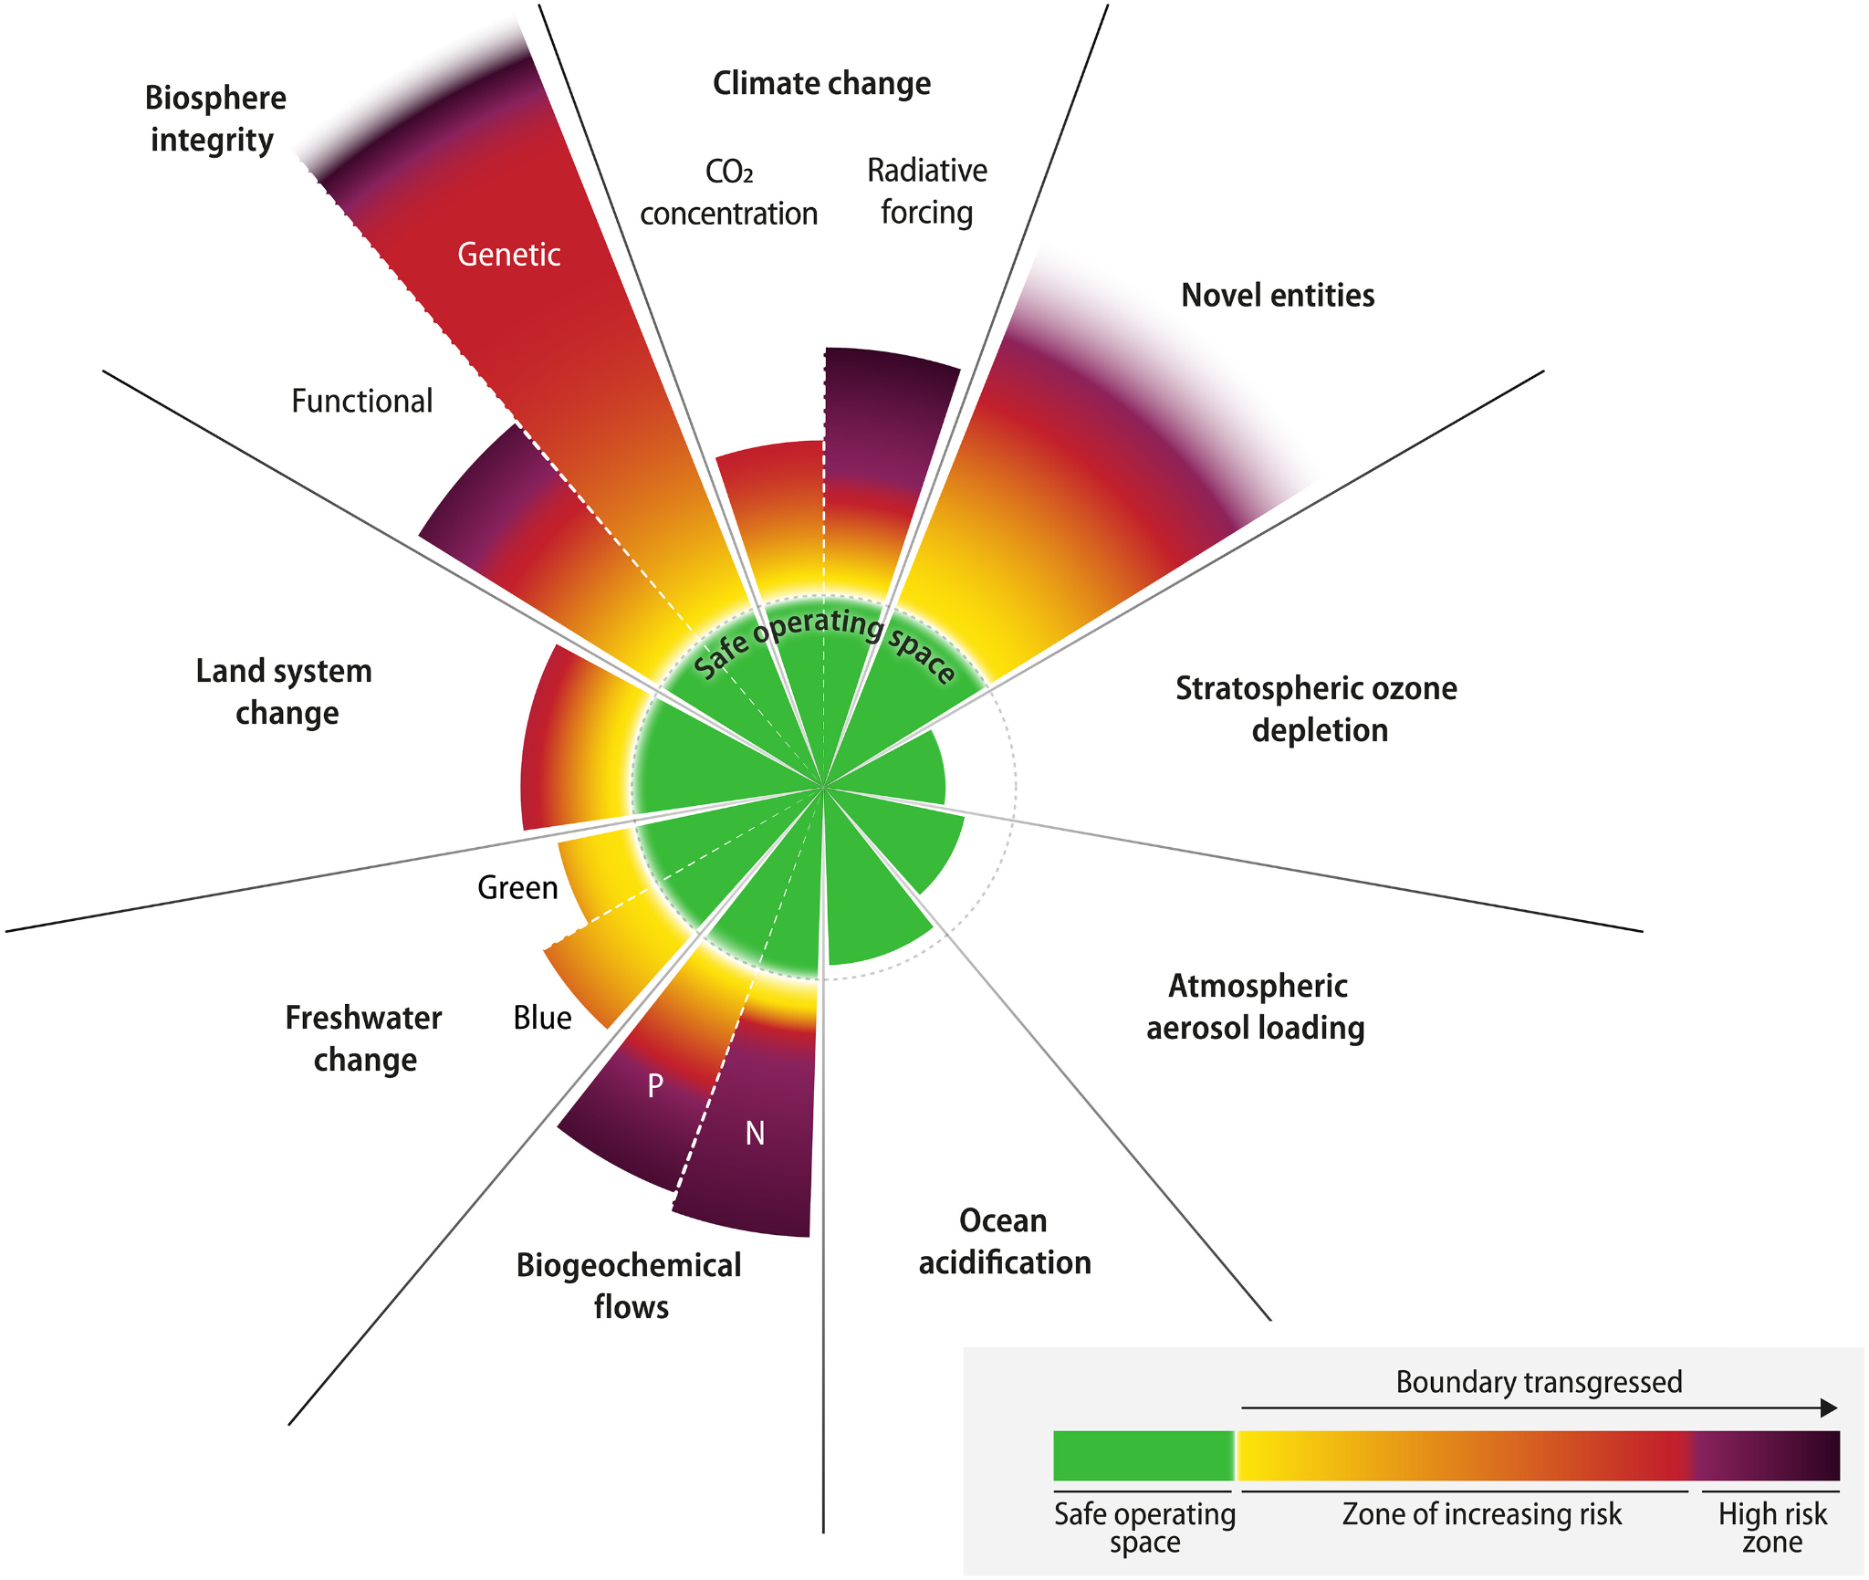
The planetary boundaries (PBs) framework
Status using control variables
Zones
Safe operating space
Zone of increasing risk
High risk zone
Notes:
Common document for expectations: https://docs.google.com/document/d/1Ofe8zA26Gvnd5y_RL91w59xzXbf0XSs9lG_SRLari1o/edit?tab=t.0

Slide 7


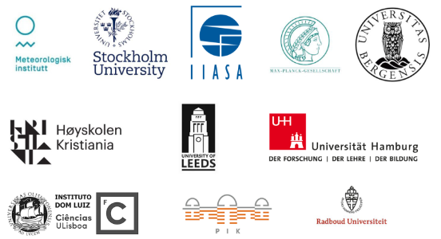
FRIDA and WorldTrans
FRIDA: Simulation model
Global
Balances society and Earth system
Feedback between variables
WorldTrans - Transparent Assessments for Real People
Notes:
Common document for expectations: https://docs.google.com/document/d/1Ofe8zA26Gvnd5y_RL91w59xzXbf0XSs9lG_SRLari1o/edit?tab=t.0

Slide 8
Research question 1: Representation
How can control variables for PBs be accurately implemented in the FRIDA model, in particular for the terrestrial PBs of biosphere integrity, land system change, freshwater change and biogeochemical flows, and for climate change?
Notes:
Common document for expectations: https://docs.google.com/document/d/1Ofe8zA26Gvnd5y_RL91w59xzXbf0XSs9lG_SRLari1o/edit?tab=t.0

Slide 9
Research question 2: Drivers
How can the main dietary and agricultural drivers for transgression of these four terrestrial PBs be represented in FRIDA? To what extent can the representations of these drivers explain potential differences in values of PBs compared to previous studies?
Notes:
Common document for expectations: https://docs.google.com/document/d/1Ofe8zA26Gvnd5y_RL91w59xzXbf0XSs9lG_SRLari1o/edit?tab=t.0

Slide 10
Research question 3: Interactions
How does the FRIDA model currently represent interactions among the four terrestrial PBs, in particular the cascading effect they have on each other and on their drivers? What additions can be made to more accurately represent these interactions?
Notes:
Common document for expectations: https://docs.google.com/document/d/1Ofe8zA26Gvnd5y_RL91w59xzXbf0XSs9lG_SRLari1o/edit?tab=t.0

Slide 11
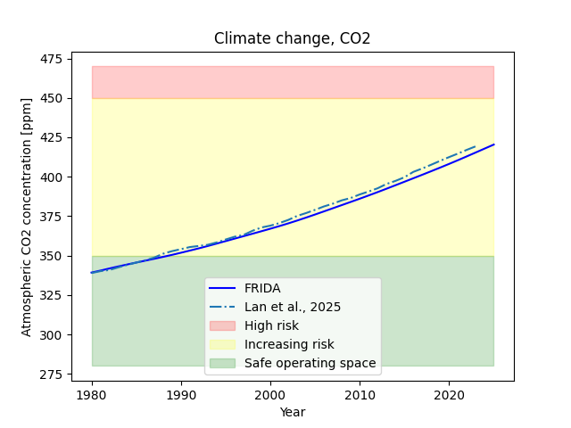
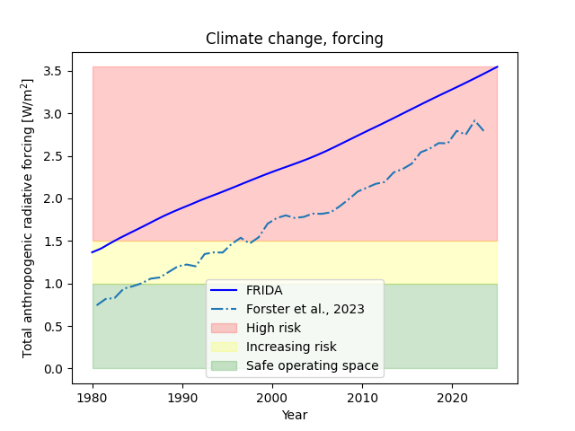
Results: Climate change PB

Slide 12
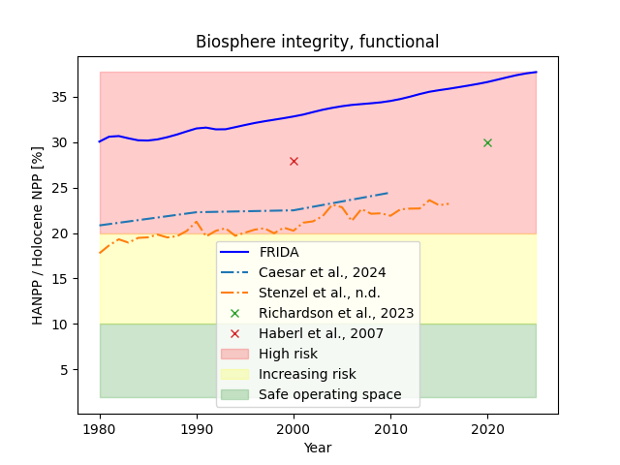
Results: Biosphere integrity PB

Slide 13
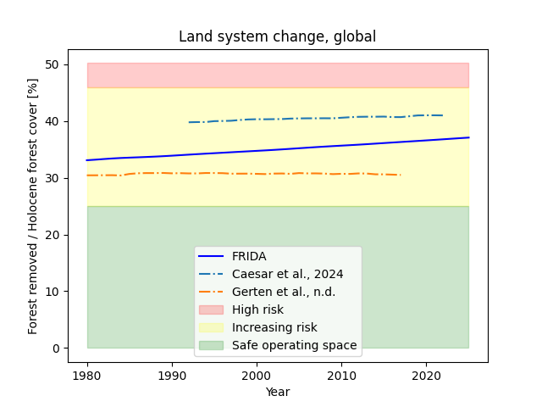
Results: Land system change PB

Slide 14
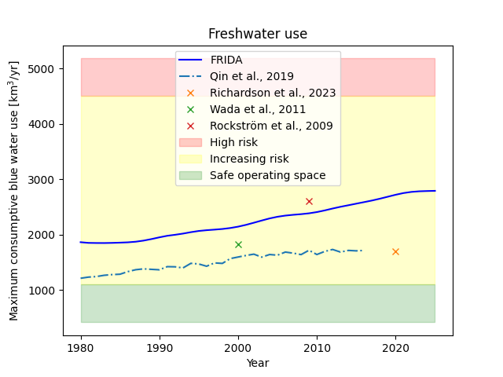
Results: Freshwater use PB

Slide 15
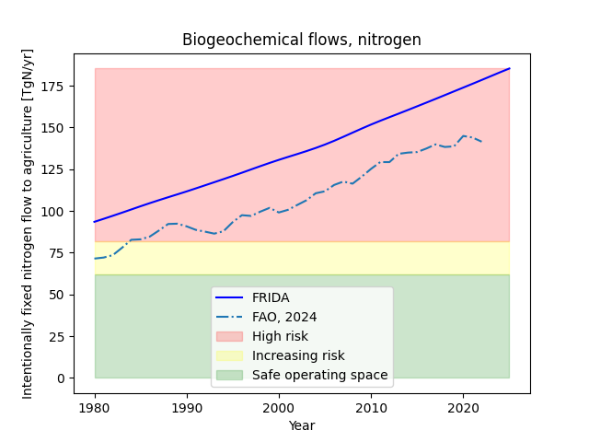
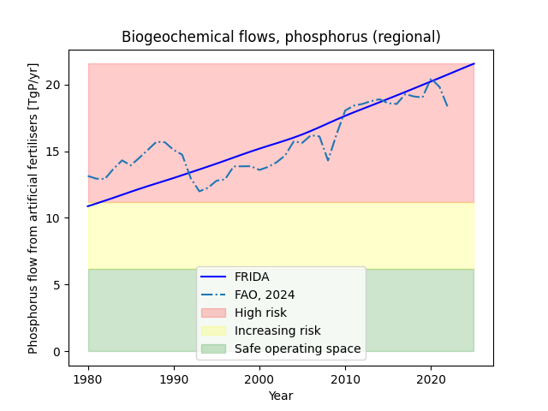
Results: Biogeochemical flows PB

Slide 16
Discussion – Representation of PBs
Relatively aligned with references, especially on the zone
Testing of FRIDA
Some control variable representations not possible or accurate
Notes:
Common document for expectations: https://docs.google.com/document/d/1Ofe8zA26Gvnd5y_RL91w59xzXbf0XSs9lG_SRLari1o/edit?tab=t.0

Slide 17
Outlook
Increase accuracy of PB representations
Represent all 9 PBs
Could address gaps
One model - all PBs
PB drivers and interactions
Notes:
Common document for expectations: https://docs.google.com/document/d/1Ofe8zA26Gvnd5y_RL91w59xzXbf0XSs9lG_SRLari1o/edit?tab=t.0

Slide 18
Conclusion
PB representation aligning with literature
Potential to analyse both PB drivers and interactions
PBs could support FRIDA as a policy-relevant tool
Notes:
Common document for expectations: https://docs.google.com/document/d/1Ofe8zA26Gvnd5y_RL91w59xzXbf0XSs9lG_SRLari1o/edit?tab=t.0

Slide 19
Thank you for your attention!
Contact: axel.eriksson@su.se
https://www.worldtrans-horizon.eu – European Commission Horizon
(Grant no. 101081661)
WorldTrans –
TRANSPARENT ASSESSMENTS FOR REAL PEOPLE
https://www.worldtrans-horizon.eu
This project has received funding from the European Union’s Horizon 2.5 – Climate Energy and Mobility programme under grant agreement No. 101081661.
The contents of this document are the sole responsibility of the authors and do not reflect the opinion of the European Commission. The European Commission is not responsible for any use that may be made of the information contained in this document.

