Slide 1

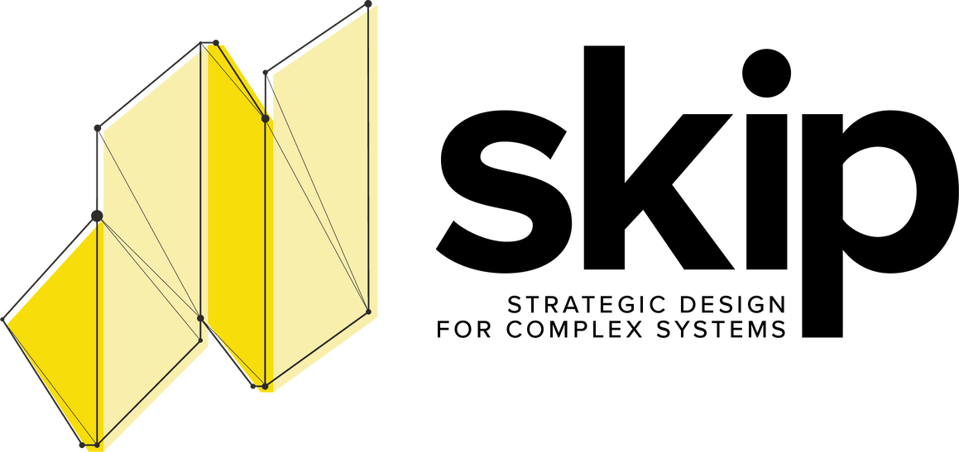
Webs of Influence:
Exploring Links Between Social Media & Anxiety from a Teen Perspective
Community Based System Dynamics Workshop
Prepared for August 4, 2025
International System Dynamics Conference
Notes:
Hello, everyone.
My name is ellen o'neill, and today I’m pleased to share a project titled “Webs of Influence: Exploring Links Between Social Media & Anxiety from a Teen Perspective.”
This presentation highlights a Community Based System Dynamics workshop conducted with teenagers in partnership with The Soulard School in St. Louis, Missouri.
Over the next fifteen minutes, I’ll walk you through our approach, key insights, and the causal structures teens identified linking social media use to anxiety.

Slide 2
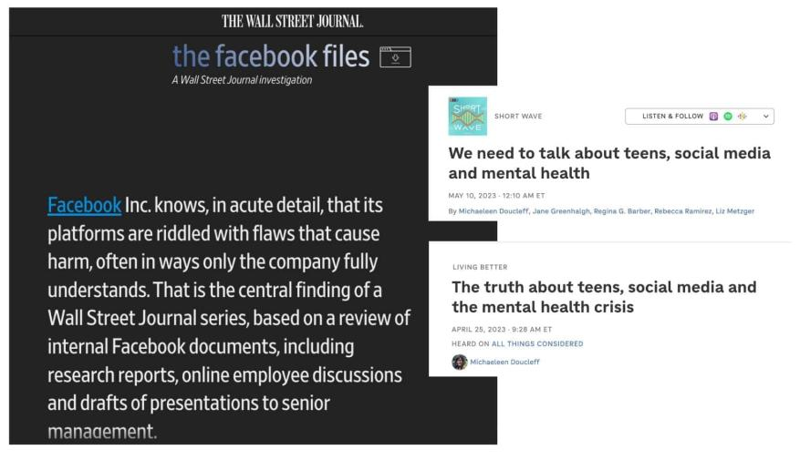

Notes:
So, a bit of background to set up this work.
In the spring of 2023, the U.S. Surgeon General released a report titled Social Media and Youth Mental Health, highlighting increasing evidence of social media's negative effects on the mental health of young people.
To quote this report:
“Nearly every teenager in America uses social media, and yet we do not have enough evidence to conclude that it is sufficiently safe for them. Our children have become unknowing participants in a decades-long experiment. It is critical that independent researchers and technology companies work together to rapidly advance our understanding of the impact of social media on children and adolescents.”
Shortly thereafter, the American Psychological Association (APA) also issued a health advisory on the topic.
This flurry of headlines got our attention, so we turned to the literature to see what researchers had to say.

Slide 3
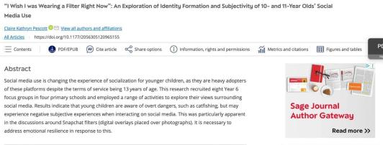
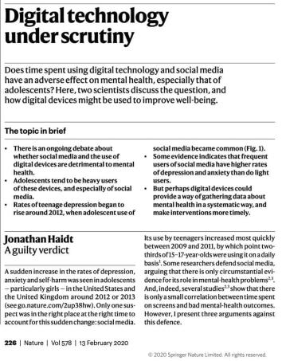
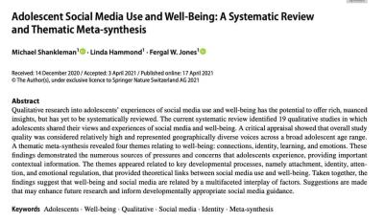
Pescott, C. K. (2020)
Haidt, J., & Allen, N. (2020)
Shankleman et al. (2021)
Notes:
I want to briefly highlight three peer-reviewed articles that informed this project:
1. a qualitative meta-synthesis of teens’ experiences,
2. a study of 10–11-year-olds on identity and filters, and
3. a Nature forum debate on whether social media drives recent increases in teen distress. Together they show both promise and pressure—and where our evidence still falls short.

Slide 4
Study‑specific limitations
Pescott (2020): Year‑6 focus groups (N=40; 4 schools, South Wales); small, non‑random sample & group dynamics. Limited generalizability; ethics limited discussion to general views rather than personal use.
Shankleman et al. (2021): Meta‑synthesis of 19 qualitative studies; relies on self‑report & broad age bands; limited author reflexivity; qualitative richness but no causal inference; inconsistent outcome definitions.
Haidt & Allen (2020): *Nature* forum (commentary) rather than primary data; evidence base noted as mixed/variable quality; proposed school‑level policies remain untested.
Notes:
So briefly, here's some of our takeaways:
Teens describe four recurring themes when they consider social media and mental health: connections, identity, learning and emotions as both supports and stressors. Feeling pressure to respond instantly, fear of missing out, and sleep disruption are common threads; at the same time, connections and support can help.
Additionally, in 10–11-year-olds, kids are savvy about dangers, but filters and curated images can generate negative subjective experiences and appearance concerns which prompt calls to build emotional resilience early.

Slide 5
Cross‑cutting gaps & next steps
Stronger causal designs: longitudinal, experimental & natural‑experiment studies; analyze specific features (e.g., algorithmic feeds, filters) rather than generic 'screen time'.
Developmental precision & diversity: separate tweens (8–12), early/late adolescence; ensure adequate power across gender, culture & SES.
Real‑time, ecologically valid data: ecological momentary assessment + passive sensing to capture sleep, ‘always‑on’ pressure & context of use.
Under‑13 cohort work: expand research and build emotional‑risk education (comparison, imagined audiences) alongside physical‑safety curricula.
Notes:
And we noted a few gaps:
This work is mostly correlational, not causal. The meta-synthesis relies on interviews/focus groups; it powerfully captures teens’ voices but can’t establish causality. The authors themselves call for longitudinal and, where ethical, experimental designs to sort causes from correlates.
Additionally, studies lump wide age bands like 11–18 to year olds. Plus, teens sometimes struggle to define “mental health,” making nuance hard to capture. Future work should stratify by age, gender, culture/ethnicity and tailor questions to teens’ language.
Under-13 voices are still under-studied, as well. Pescott’s work helps fill that gap but is mostly useful for depth, not breadth.
Scholars in this field generally agree that we need larger, multi-site samples and careful designs that still protect children.
So, this challenges is real, especially as it relates to identity pressures and girls, but closing these gaps will take developmentally targeted, real-time, and causal studies to inform policy.

Slide 6
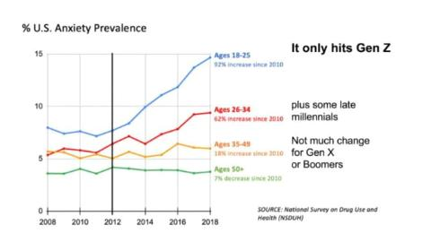
Our problem definition & reference mode:
Anxiety among Generation Z (10-23) has risen by 92% since 2010, coinciding with the advent of social media. Anxiety rates for other generations remain comparatively stable despite their use of social media.
For example, Millennials (24-43) experienced a 62% increase in anxiety rates, Gen X experienced an 18% rise while Boomers experienced a 7% decline.
Source: U.S. National Survey on Drug Use & Health
Notes:
Which brings us to our CBSD workshop. We chose a problem scope that focused on the sharp increase in anxiety among youth age 14-16.
Since 2010, anxiety in this group has increased by 92%, coinciding with the rise of social media.
In contrast, older generations experienced much smaller changes in anxiety levels. For example, Millennials saw a 62% increase, while Gen X and Boomers saw much smaller increases or even a decline.

Slide 7
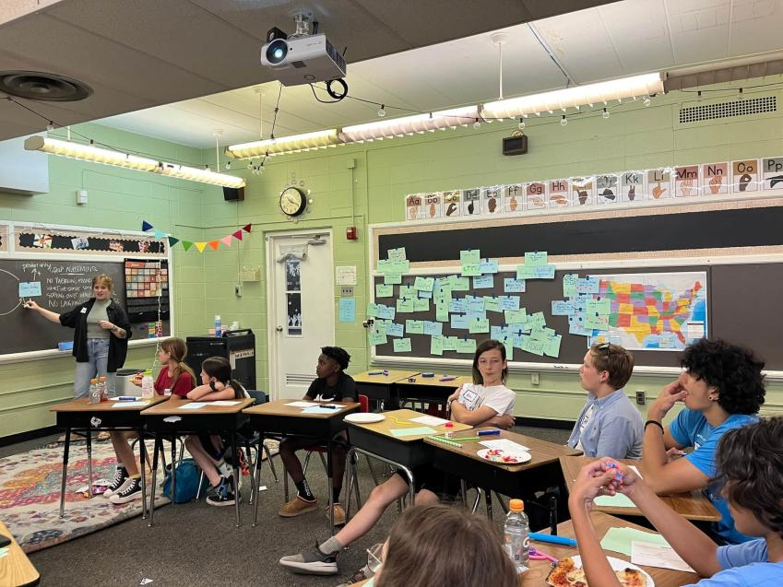
This project maps the causal loops between social media usage and anxiety
from the perspective of teenagers.
We seek answers to the following questions:
What do teens perceive as the drivers of social media usage and its connection to anxiety?
What are the feedback loops that link social media and anxiety from a teen's perspective?
What would solve this problem, according to participants?
Notes:
Our project focused on three guiding questions:
First: What do teens perceive as the main drivers of social media use and its connection to anxiety?
Second: What feedback loops do teens identify?
And third: What actions do teens believe would help mitigate anxiety generated by social media?

Slide 8
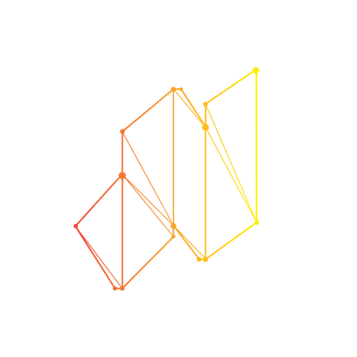
APPROACH
Community-based system dynamics (CBSD) is a participatory method for involving communities in the process of understanding and changing systems from the endogenous or feedback perspective of system dynamics.
In system dynamics, informal causal maps and formal models are used to uncover and understand endogenous sources of system behavior with the goal of solving problems by improving the mental models we use to perceive the system and act (Hovmand 2014).
Notes:
We used Community Based System Dynamics as our methodological framework.
CBSD is a participatory modeling approach that engages stakeholders in understanding systems from a feedback perspective.
As articulated by Hovmand (2014), the goal is to improve mental models and identify endogenous drivers of system behavior through informal maps and formal models.
This method was well-suited for capturing teens’ lived experiences and their understanding of complex social influences.

Slide 9
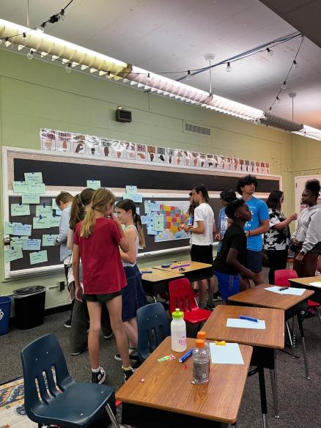

APPROACH
Once the problem was defined, we designed a two-hour workshop with 13 teenagers, ages 14-16. There were 5 males and 8 females.
Participants were recruited through The Soulard School, an elementary school in St. Louis, Missouri. The Soulard School runs a summer camp and invites alumni to become camp counselors. SKIP recruited participants from the 2024 cohort of camp counselors.
Participants were compensated with a $40 Visa gift card.
Notes:
We designed a two-hour workshop involving 13 teenagers between the ages of 14 and 16.
Participants were recruited through The Soulard School, which operates a summer program for alumni serving as camp counselors.
The group included five boys and eight girls, and each participant received a $40 Visa gift card in appreciation of their time.

Slide 10
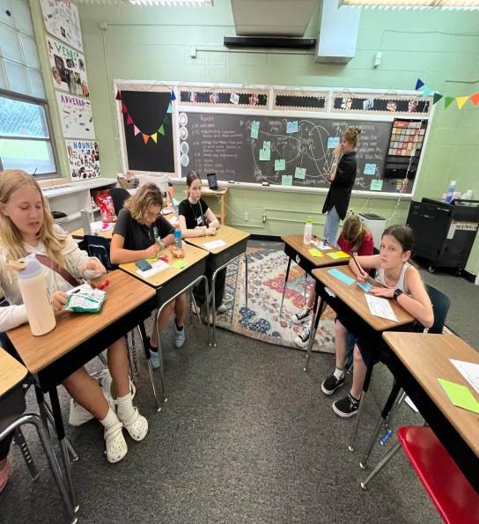
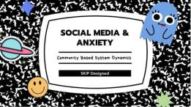
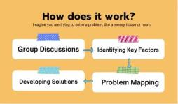
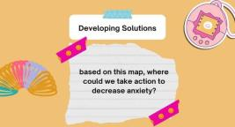
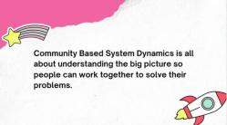
APPROACH
The Community Based System Dynamics workshop included:
Variable elicitation
Causal loop diagramming
Action ideas
Source: Scriptapedia
Notes:
The workshop consisted of three core activities:
Variable elicitation, causal loop diagramming, and action idea generation.
This structure followed CBSD practice as outlined in Scriptapedia, and was designed to guide teens through increasingly deep engagement with the problem as they identified causal connections.

Slide 11
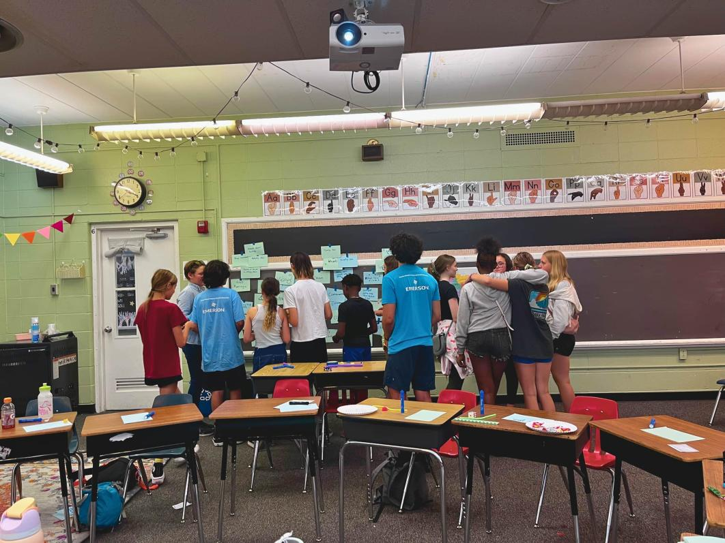
RESULTS
Notes:
and here is what we found:

Slide 12
RESULTS - VARIABLES
Participants identified 44 variables associated with social media that contribute to an increase OR decrease in anxiety.
Variables were sorted into the following themes:
Validation from followers (e.g. posting, views, only sharing your best moments)
Negativity & hate (e.g. hate comments, accepting hate, body image concerns)
Content consumption habits (e.g. doom scrolling, cat videos, listening to music)
Self expression through content (e.g. making things you enjoy)
Notes:
In the first activity, teens identified 44 unique variables that they believed contribute to either increased or decreased anxiety in relation to social media.
These variables were grouped into four major themes:
Validation from followers,
Negativity and hate,
Content consumption habits,
And self-expression through content.

Slide 13
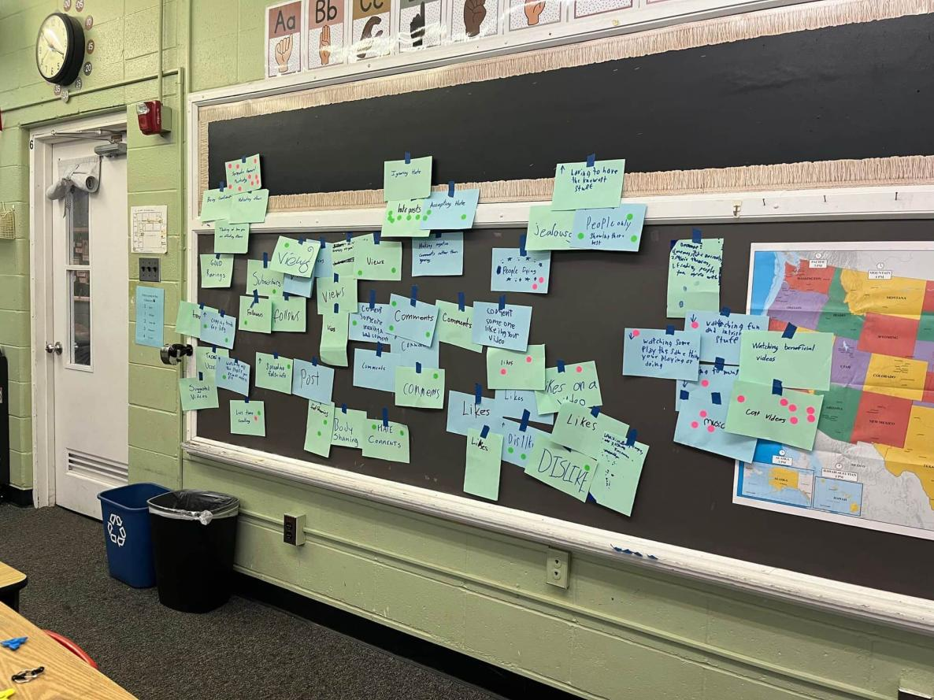
RESULTS - VARIABLES
Notes:
here you can see a few artifacts from the session

Slide 14
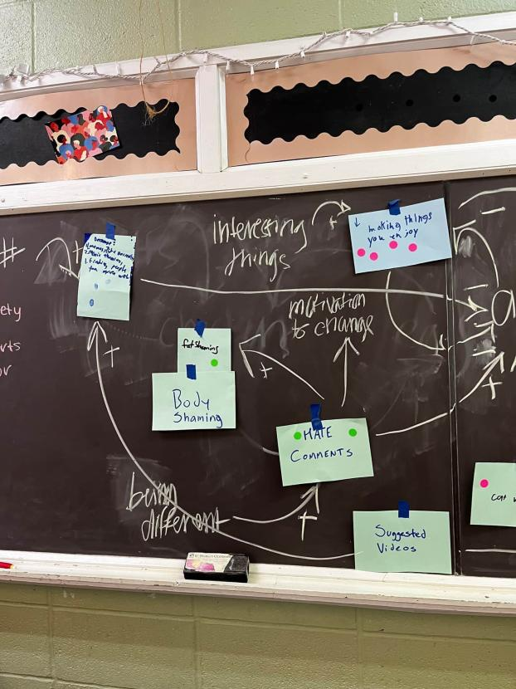
RESULTS - CLD
After we identified important variables, we began drawing causal connections.
Teens were asked to draw arrows between variables that cause a change in another variable. This is a causal loop diagram, a qualitative map capturing their mental models.
Notes:
After variable elicitation, teens worked to connect these variables using causal arrows, identifying how one factor influences another.
This process generated a causal loop diagram — a qualitative map that represents the mental models of our participants.

Slide 15
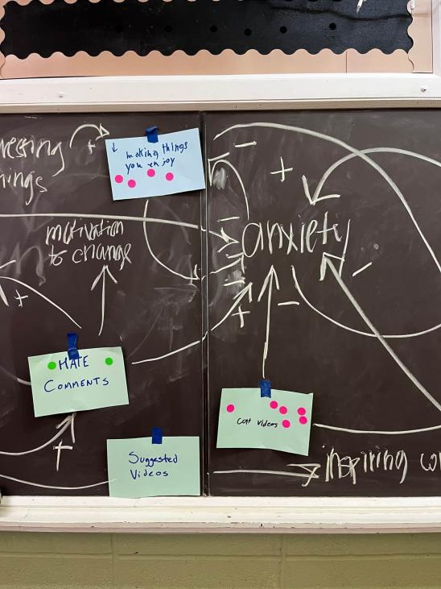
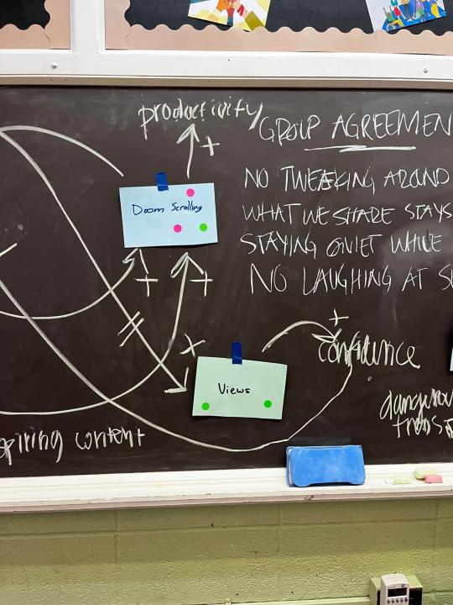
RESULTS - CLD
Notes:
Here you can see a stitched together artifact from the session.

Slide 16
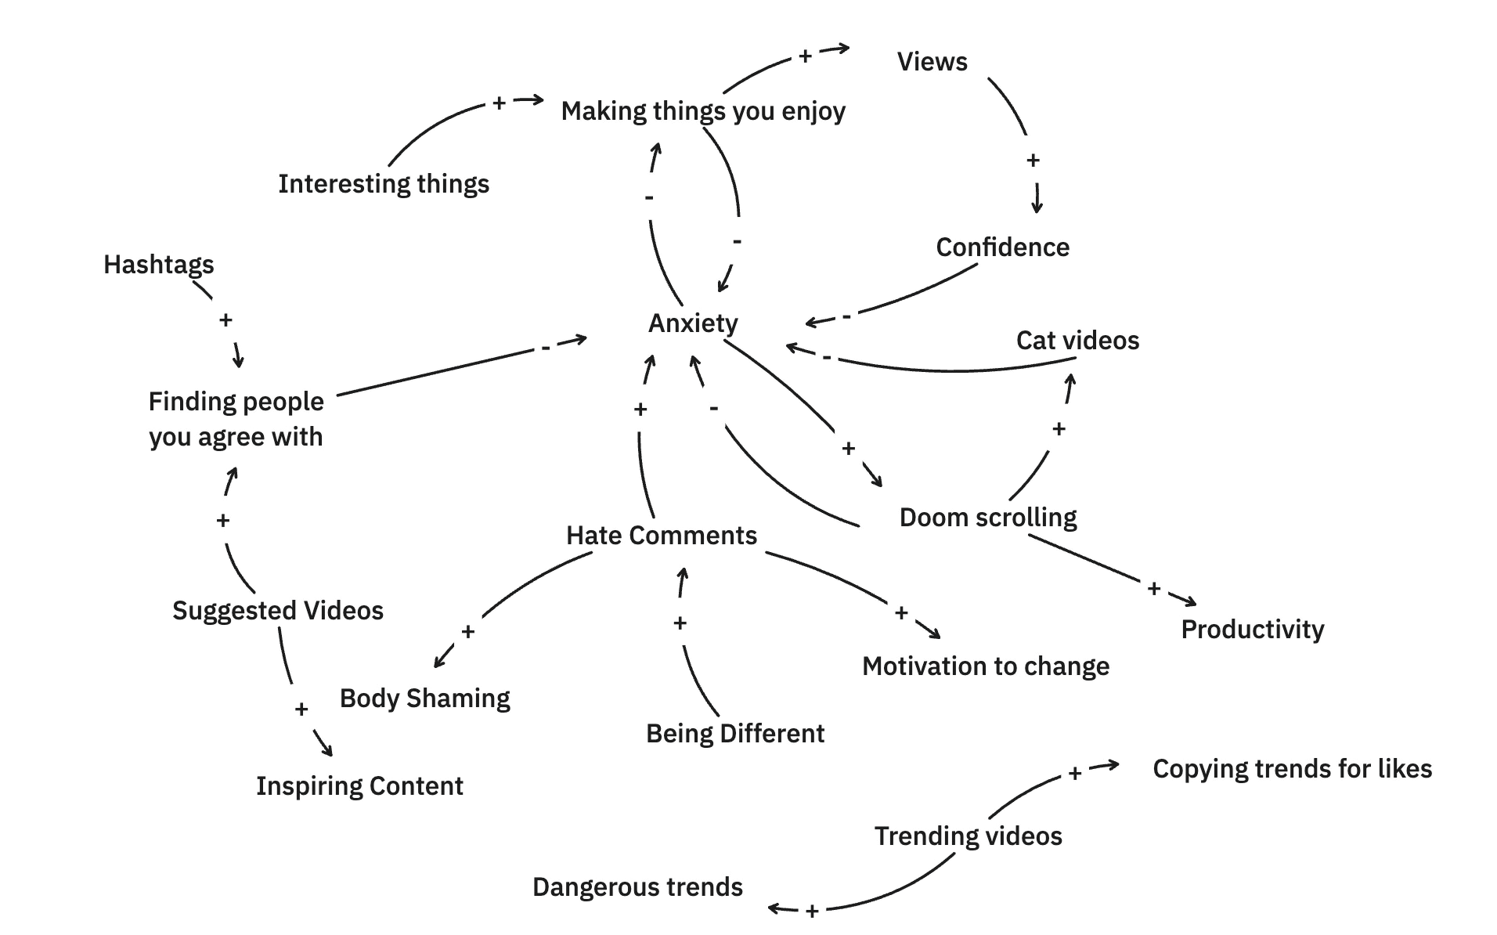
Teens produced this causal loop diagram (CLD) during the workshop:
Notes:
And here is the replicated CLD in CoModel which is a free, online qualitative mapping software.
You should check it out.
It includes at least one reinforcing and balancing feedback loops, which we’ll now explore in more detail.

Slide 17
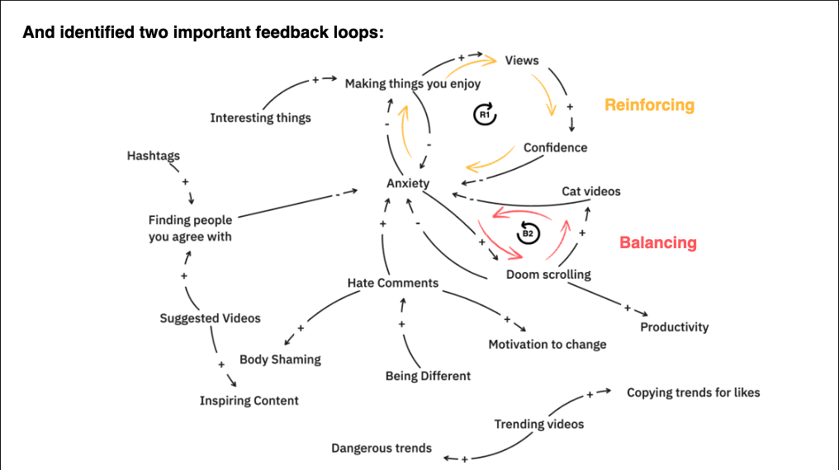
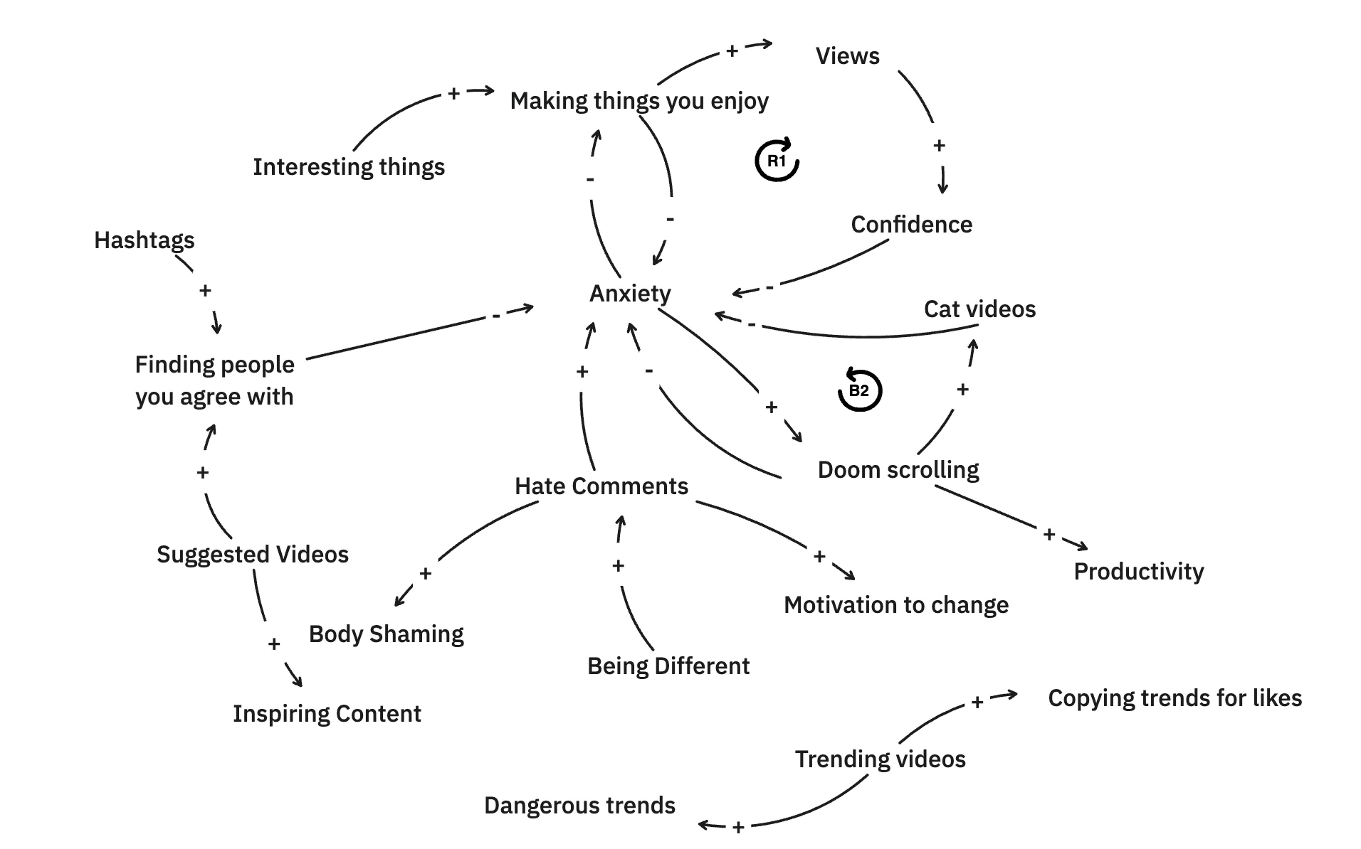


And identified two important feedback loops:
Reinforcing
Balancing
Caption
Notes:
Here, you can see r1: the more you make/post things you enjoy, the more views you get, which leads to more confidence, and decreases anxiety, which leads to making more things you enjoy.
Participants also identified a balancing loop: the more anxiety, the more doom scrolling. More doom scrolling, more cat videos, more cat videos, less anxiety.
Since this was only a two hour session and there were causal connections that we didn't have time to map with the teenagers, the research team spent the next few days refining the CLD based on artifacts and notes from the workshop.

Slide 18
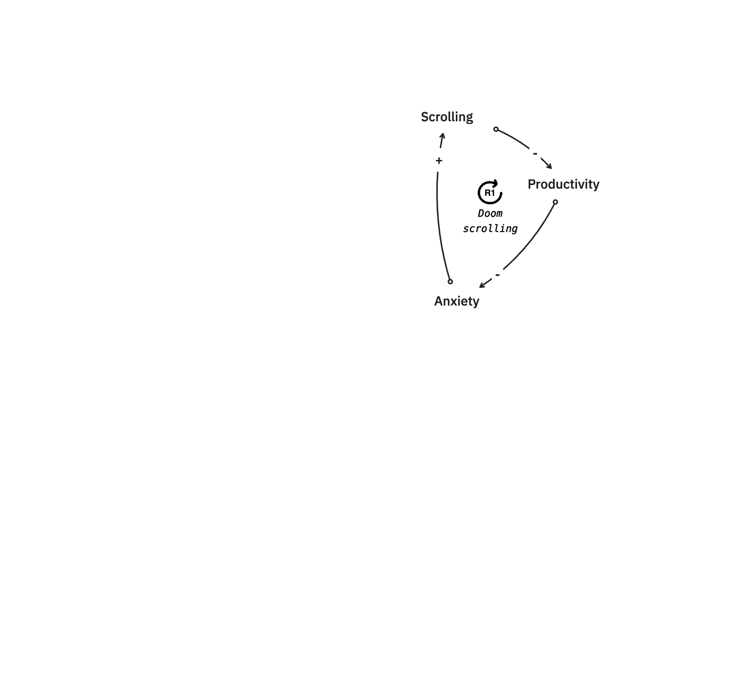
R1: DOOM SCROLLING
We began with the reinforcing loop: increasing anxiety leads to more social media scrolling, which reduces productivity. Low productivity, like incomplete chores or homework - all examples we heard from teens, increases levels of anxiety*.
Teens referred to this cycle as ‘Doom scrolling.’
*Keep in mind that this loop works in the opposite direction too. Low anxiety leads to less scrolling. Less scrolling, more productivity. More productivity, less anxiety.
Notes:
The first loop we’ll highlight in this refined model is one teens labeled Doom Scrolling.
In this reinforcing loop, anxiety leads to more social media scrolling. But excessive scrolling reduces productivity, which further increases anxiety.
Teens noted this cycle particularly in relation to things like skipped chores or unfinished homework, common stressors that intensify anxiety for teens.

Slide 19
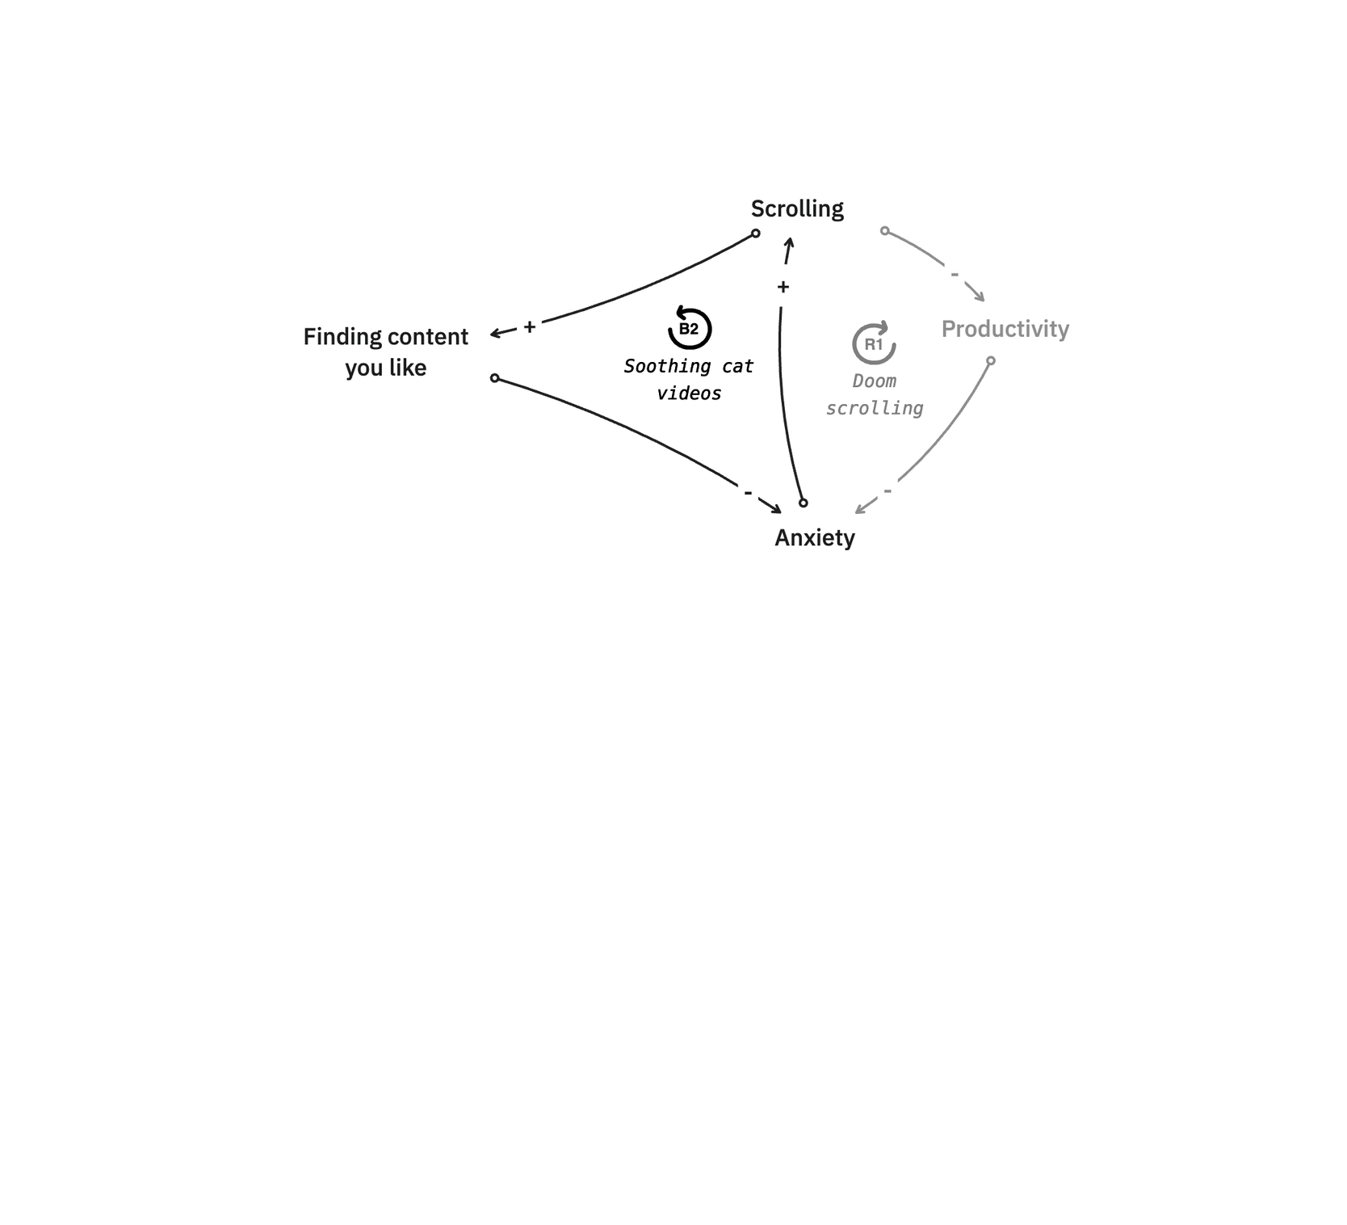
B2: SOOTHING CAT VIDEOS
Teens told us that finding the content they enjoy, although it might take a lot of scrolling and time away from other things, helps to reduce their anxiety.
This creates a balancing loop: increasing anxiety leads to more scrolling. More scrolling eventually leads to finding content you like. A frequently cited example is funny cat videos. The more you see content you like, the less anxious you become.
=
Notes:
In contrast, B2, titled Soothing Cat Videos describes a balancing loop.
Anxiety leads to more scrolling, but eventually teens find content that they enjoy — like humorous videos or music.
This enjoyable content helps reduce anxiety.
Our teenaged participants also noted that this process includes a delay, it takes time and effort to find calming content on the web.

Slide 20
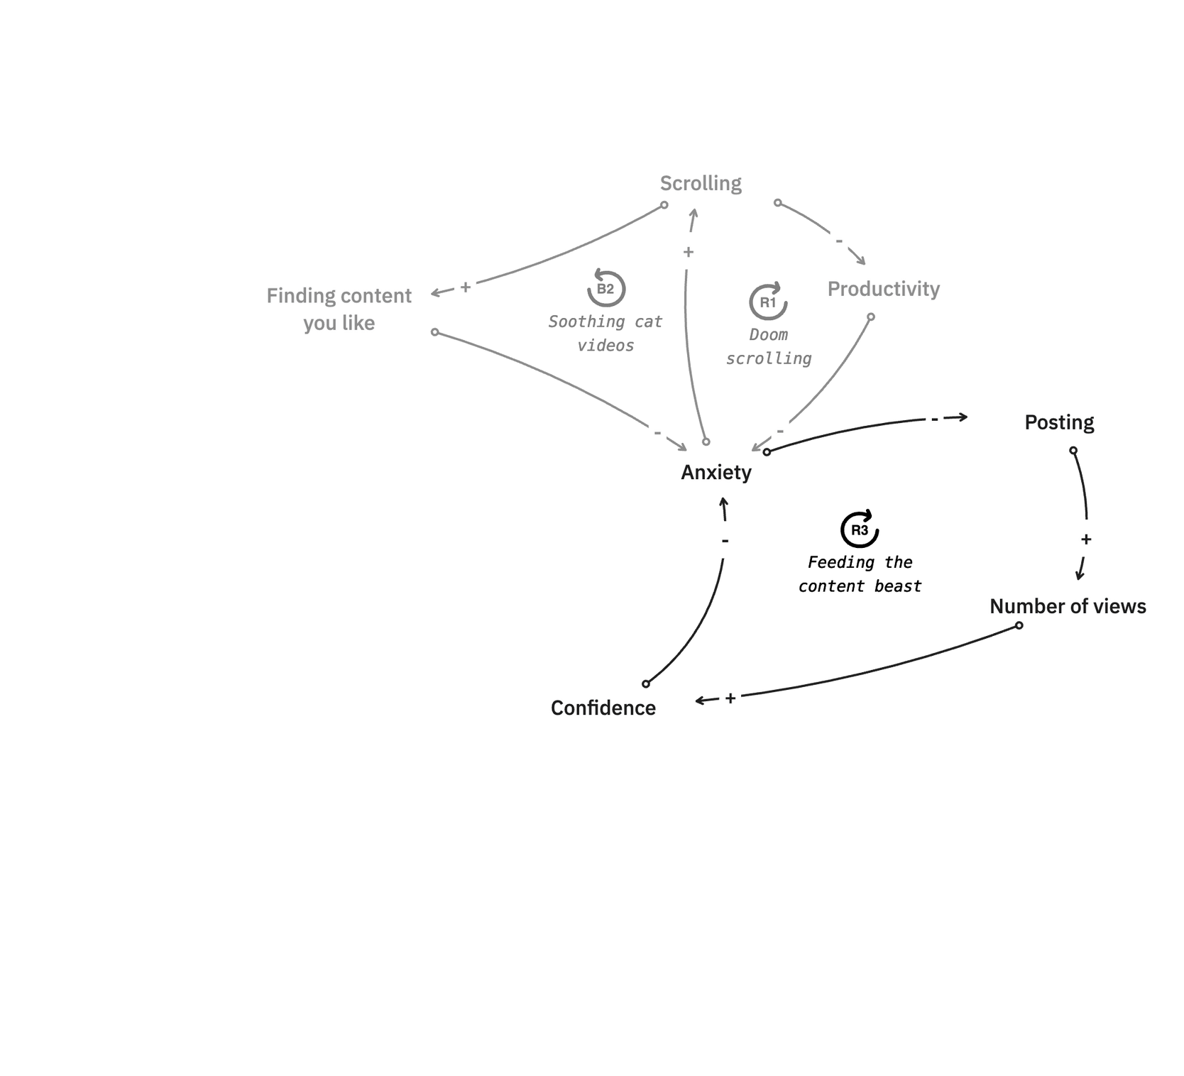
R3: FEEDING THE CONTENT BEAST
A big topic of conversation was content creation and the possible repercussions that come with it.
When anxiety decreases, posting increases. As posting increases, so does number of views. As views increase, so does the poster’s confidence. As confidence increases, anxiety decreases.
Teens did note that increasing views does not always cause an increase in confidence under certain circumstances.
=
Notes:
Another reinforcing loop emerged around content creation.
Teens noted that when anxiety is low, they feel more inclined to post. Posting leads to more views, which can boost confidence and reduce anxiety.
However, this loop only functions under certain conditions: teens were quick to point out that more views do not always lead to more confidence.

Slide 21
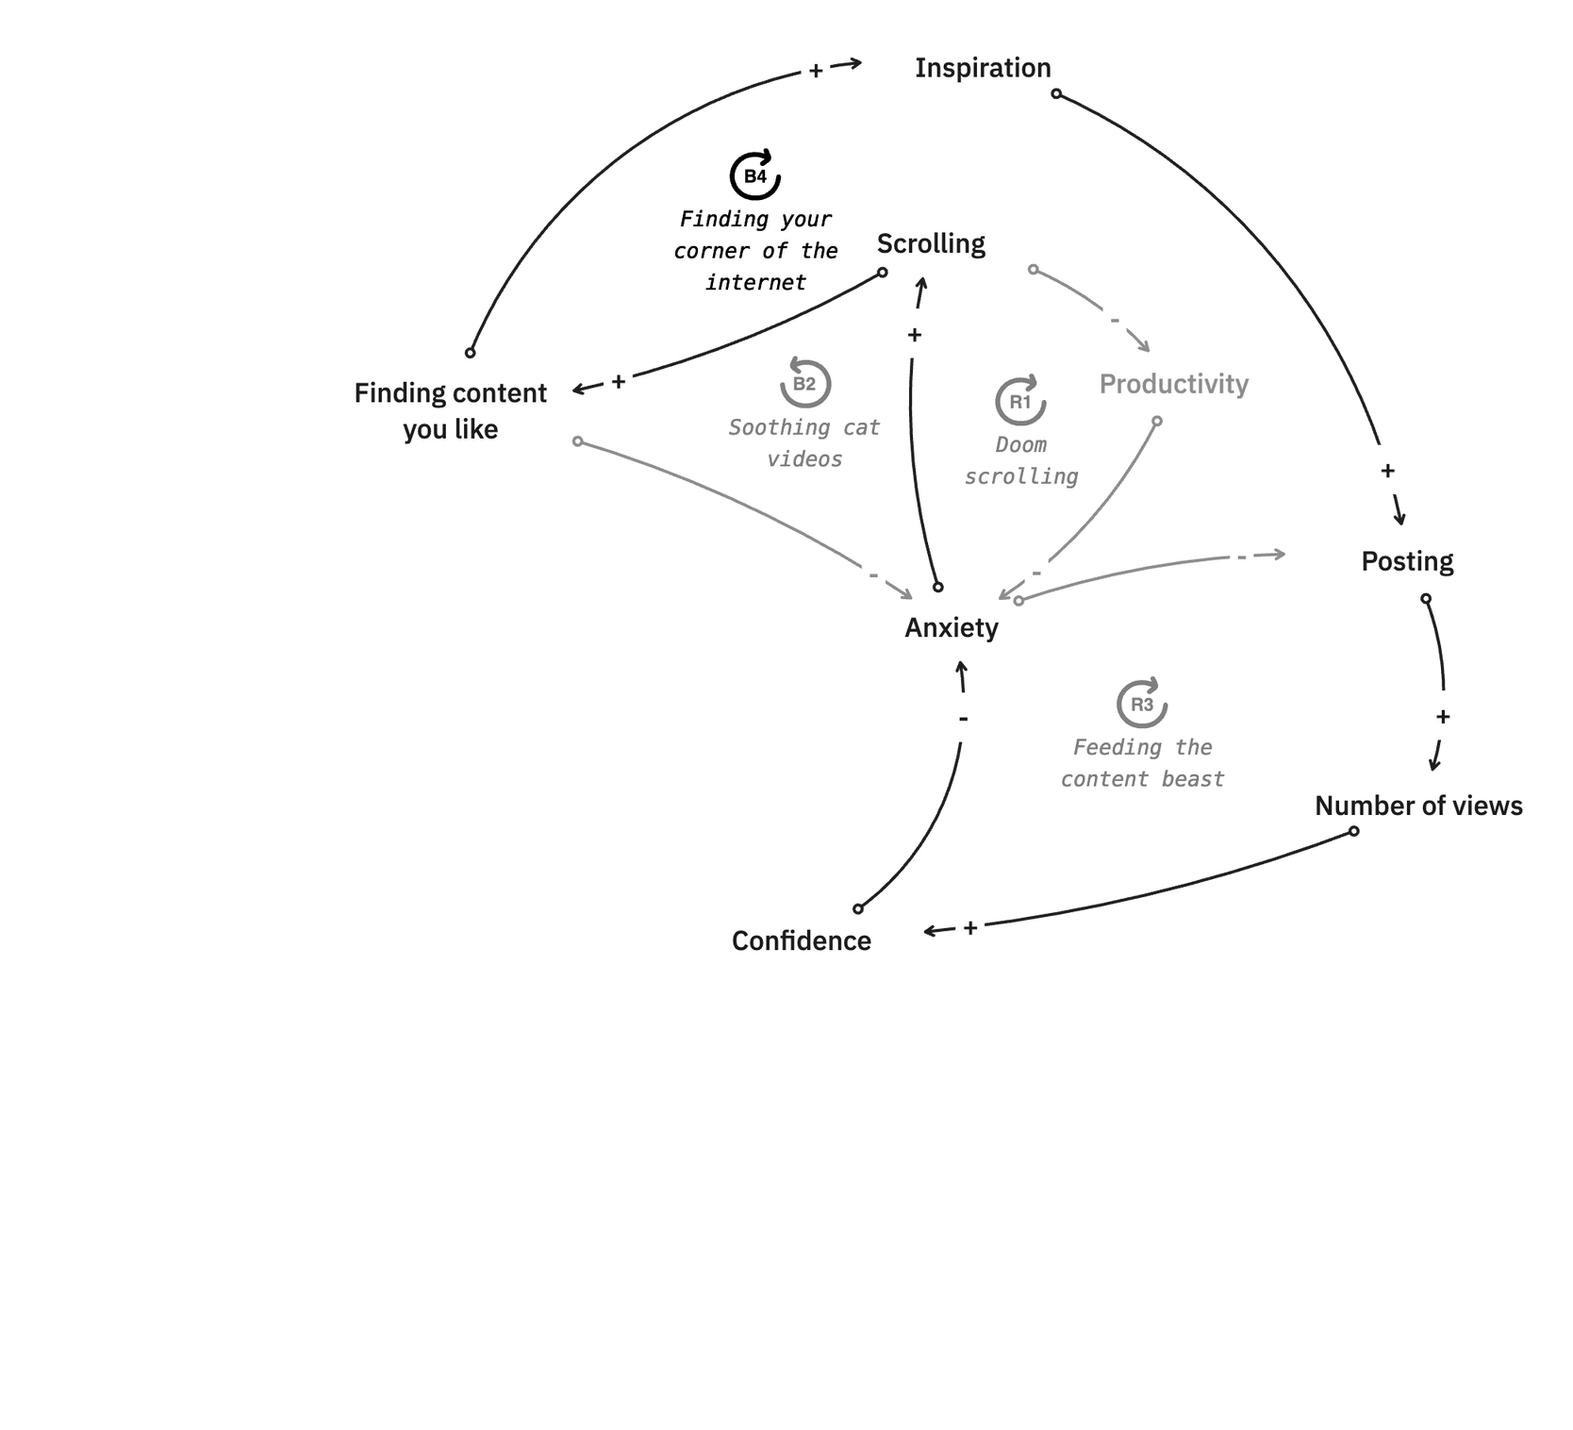
B4: FINDING YOUR CORNER OF THE INTERNET
Teens also talked about finding communities of like-minded people on social media. We called this balancing loop, “Finding your corner of the internet”:
The more a teen finds content they like, the more inspired they become. The more inspiration, the more they post. More posting leads to more views which also increases confidence. As confidence rises, anxiety decreases. Decreasing anxiety decreases scrolling which eventually leads to finding less likeable content.
=
Notes:
In this balancing loop, teens shared how discovering like-minded communities inspires them to create content and post.
More content leads to more views, which increases confidence and reduces anxiety.
As anxiety decreases, scrolling also decreases which means you're less likely to find online communities you enjoy participating in.

Slide 22
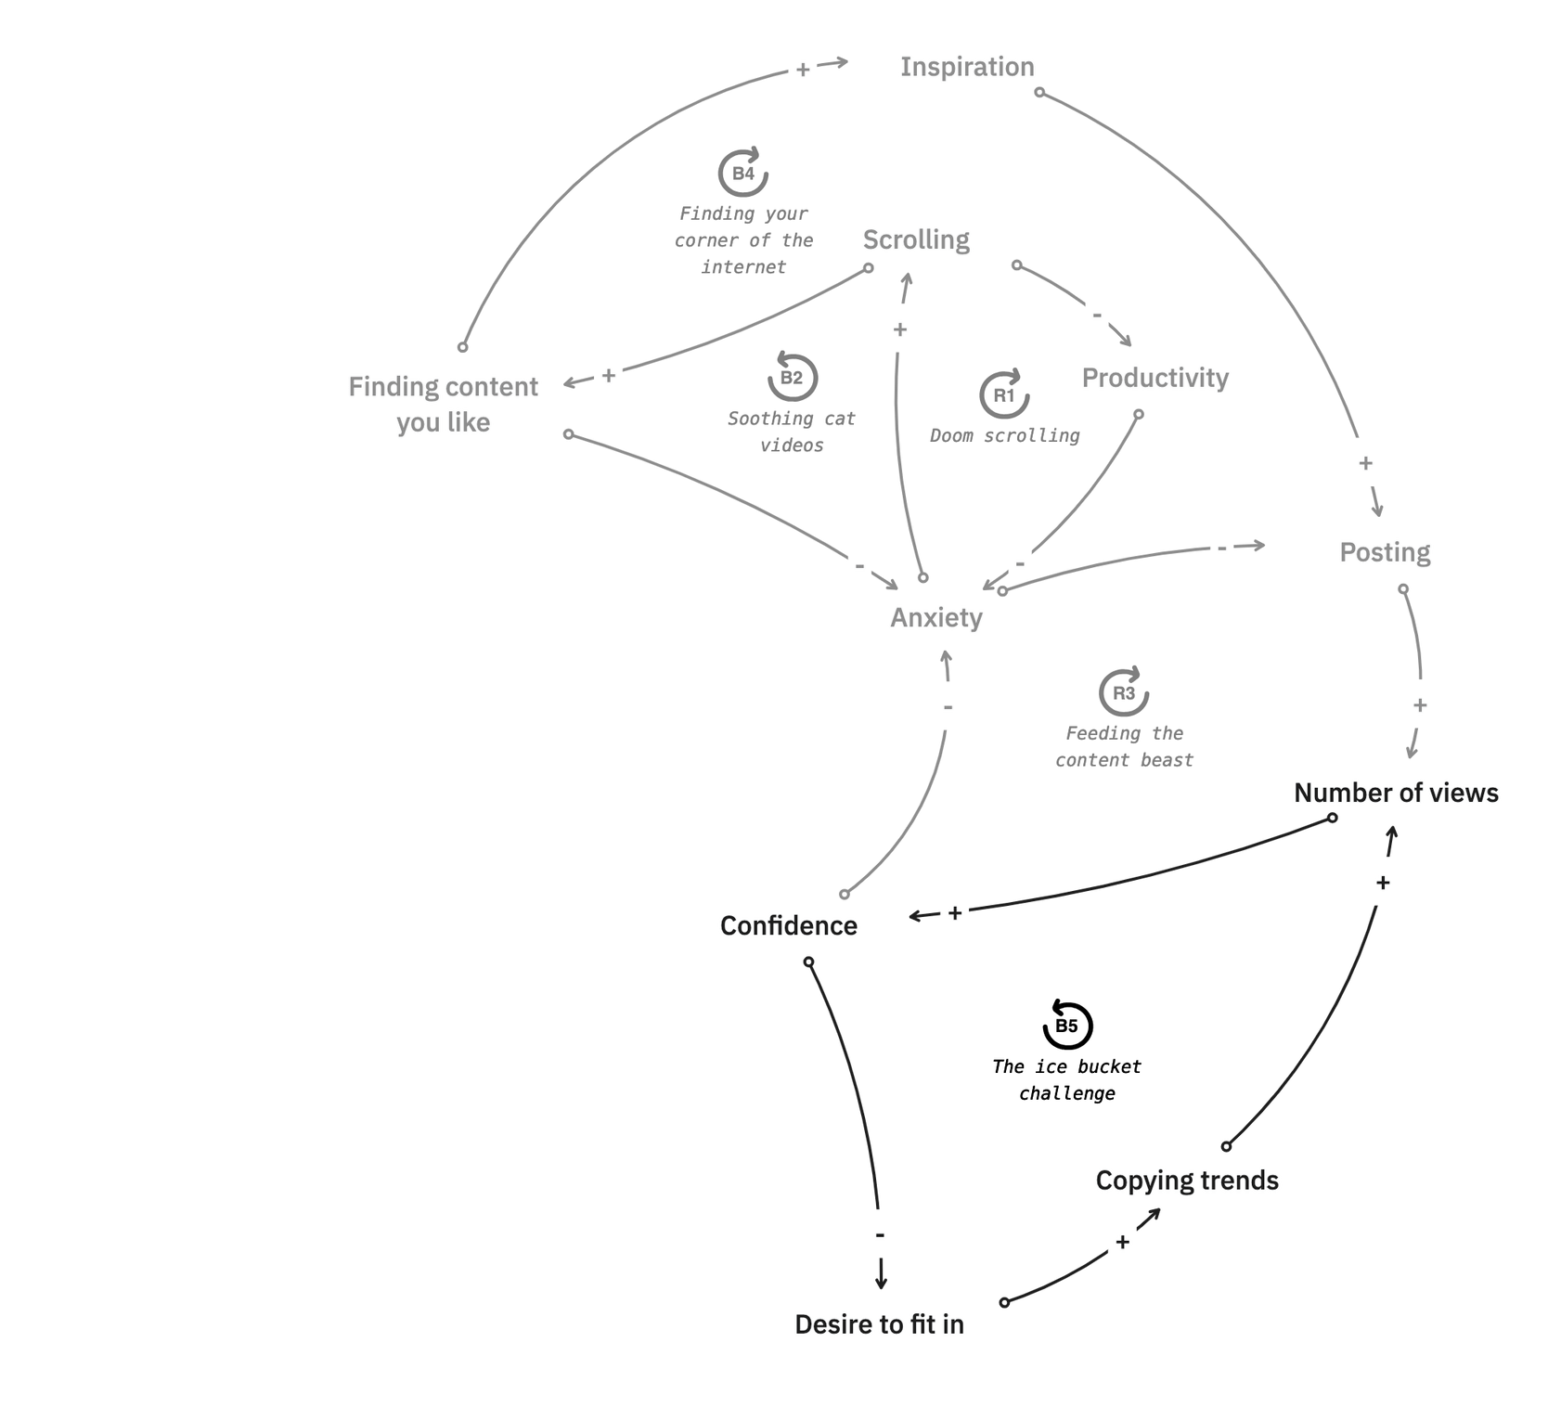
B5: ICE BUCKET CHALLENGE
As a teen’s desire to fit in increases, the more they copy social media trends. The more trends copied, the more views. The more views, the more confidence. The more confidence, the less desire to fit in.
We called this loop, “The ice bucket challenge”.
=
Notes:
A big topic of discussion during the workshop was the idea of copying trends for social validation.
This loop, named The Ice Bucket Challenge, captures the dynamic of copying trends to gain validation.
As teens strive to fit in, they mimic popular trends, which can lead to increased views and confidence.
But as confidence grows, the need to fit in decreases, helping to balance the initial motivation.

Slide 23
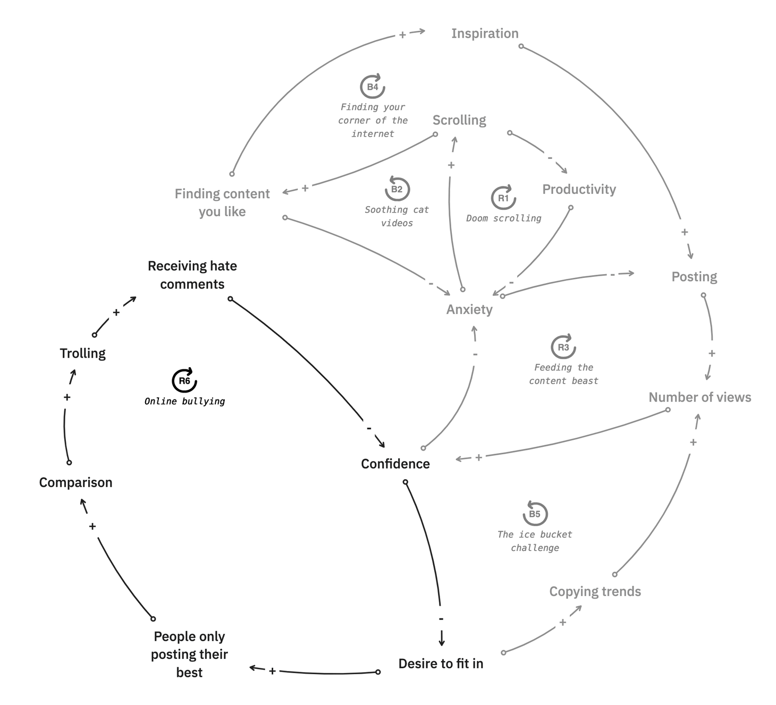
R6: ONLINE BULLY
The less confident a teen is, the more they desire to fit in. As their desire to fit in increases, the more they post their “best” which leads to more comparison. As comparison increases, so does trolling. The more trolling, the more hate comments. The more hate comments, the less confident teens become.
=
Notes:
Number of views isn’t the only influence on a teen’s confidence. Receiving hate comments and the dynamic of online bullying came up in the stories and variables they shared.
Here, we see a reinforcing loop centered on online bullying.
When teens receive hate comments, confidence drops. Lower confidence increases the desire to fit in, leading to curated posts and more comparisons.
These comparisons often fuel trolling behavior, which results in more hate comments, a damaging reinforcing cycle.

Slide 24
R7: INFLUENCERS GONNA INFLUENCE
=
The more people post their “best”, the more others compare themselves. The more comparison, the more desire to fit in. An increasing desire to fit in leads to an increase in people only posting their best.
Notes:
“Only posting your best” was something the girls in the workshop spoke to several times. It is the idea that everyone on social media only posts highlights without sharing any of their low points or struggles.
When teens see others doing this, it drives comparison and a stronger desire to fit in, leading them to post only their own highlights.
This cycle reinforces unrealistic portrayals and social pressure online.

Slide 25
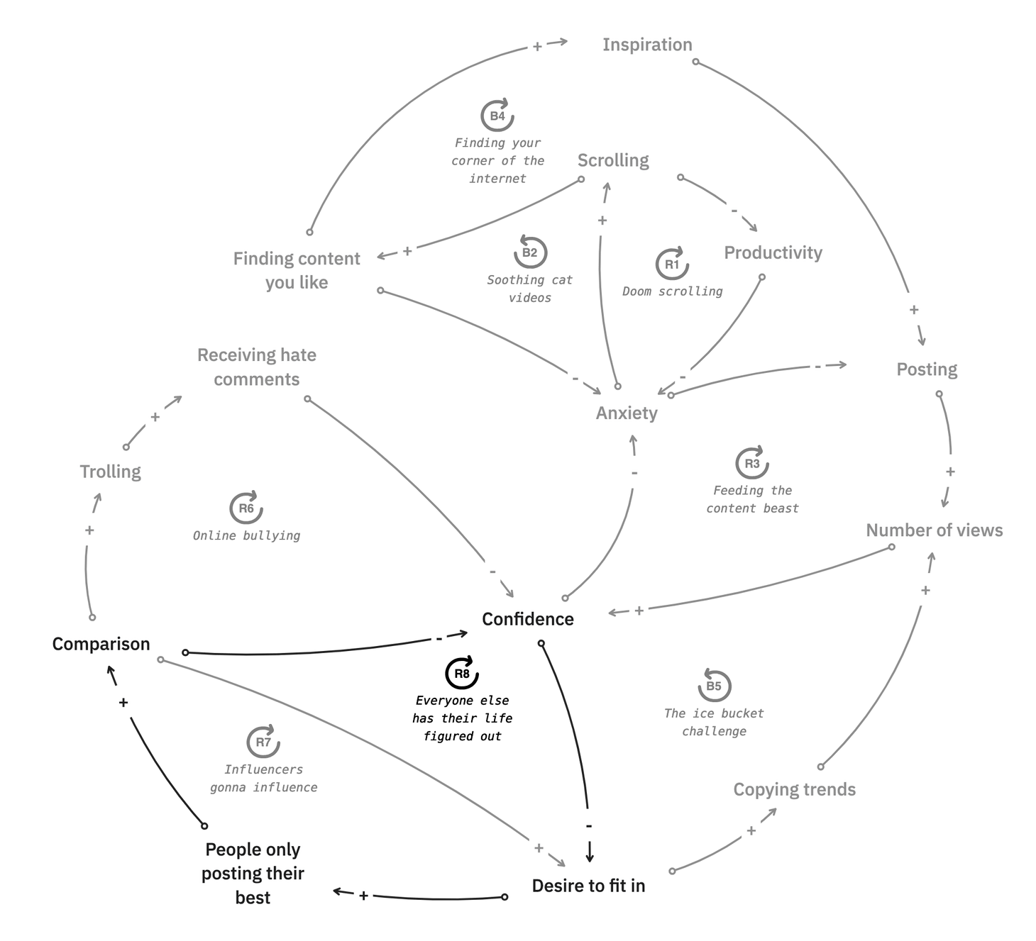
R8: EVERYONE ELSE HAS THEIR LIFE FIGURED OUT
The more you view everyone else’s “best” on social media, the more you compare yourself to that standard. The more you compare, the less confident you become. As confidence declines, desire to fit in increases. As desire to fit in increases, so too does the inclination to only post your best.
=
Notes:
In addition to the influencer dynamic described in R7, teens shared that the influx of people’s “best” on social media can affect their confidence levels.
In this final loop, teens described the feeling that everyone else has it all together, a perception driven by curated posts.
As comparison increases, confidence declines, and the desire to fit in grows, fueling more curated content and continuing the loop.

Slide 26
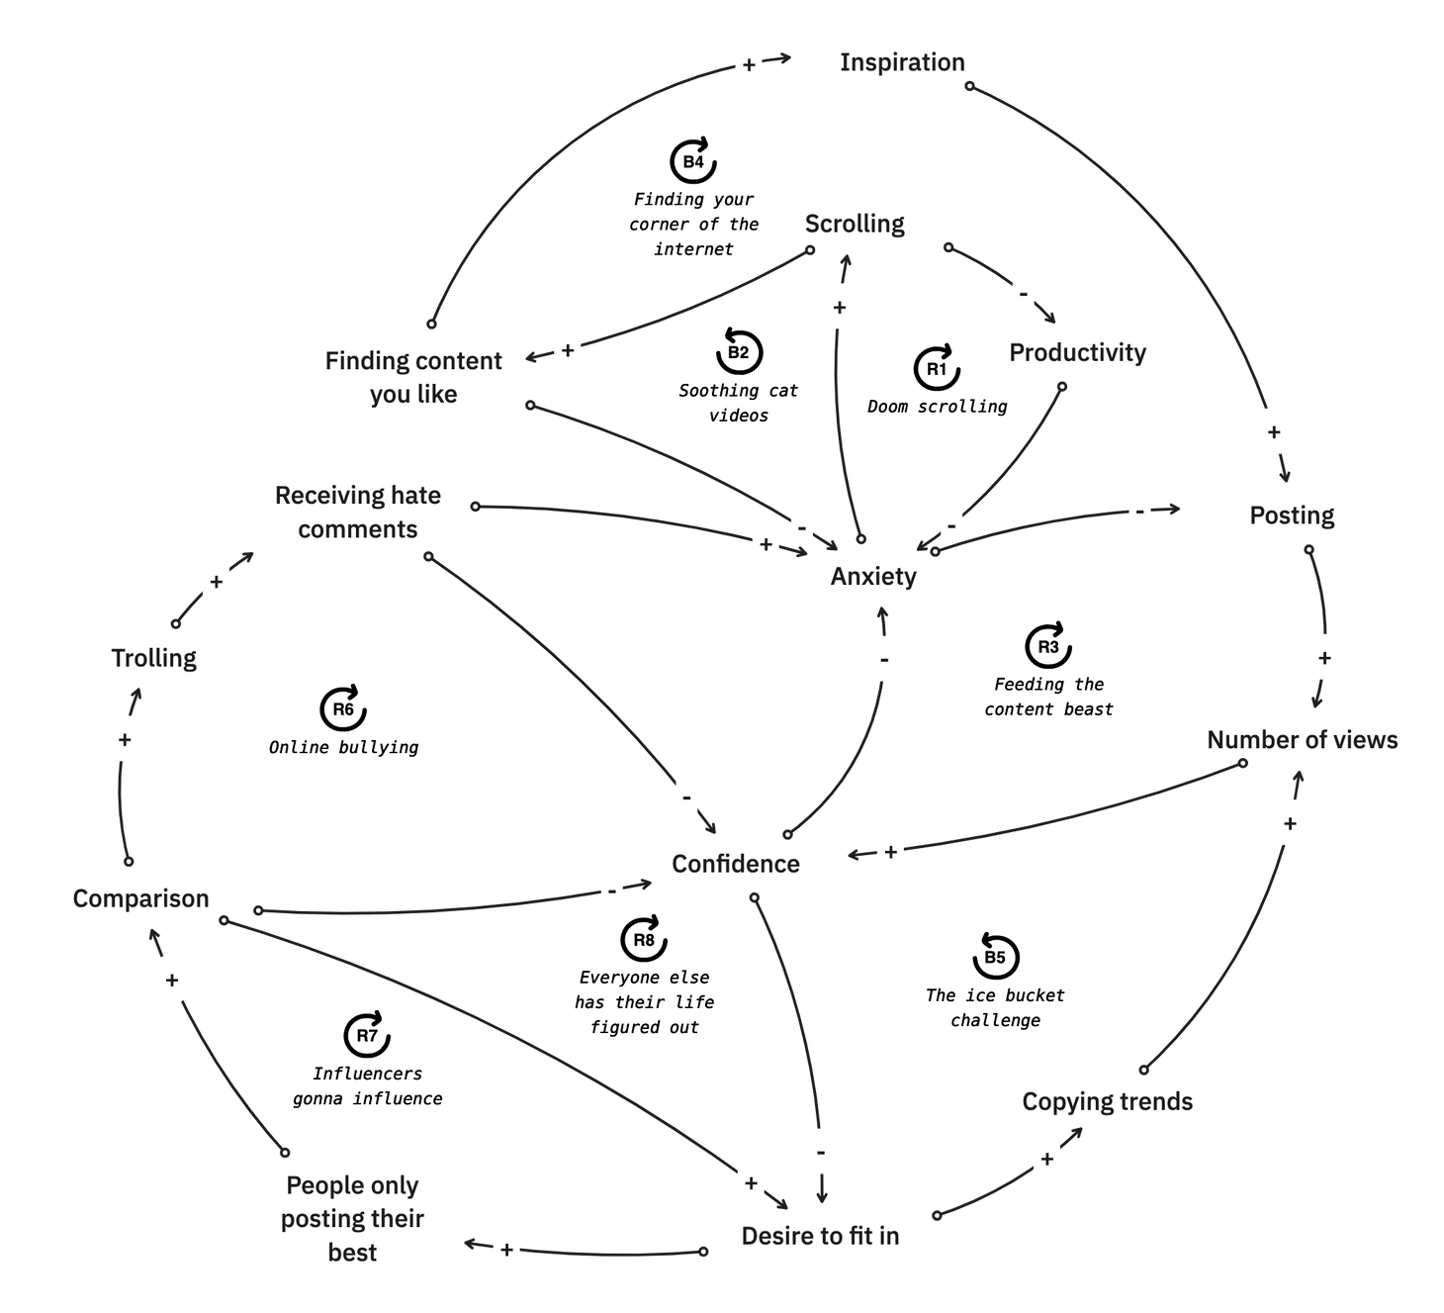
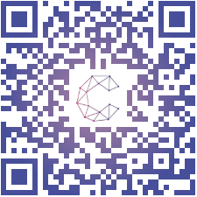
So, what do teens think we can do about these dynamics?
=
Notes:
So, what do teens believe could improve these dynamics?
In the final part of the workshop, teens brainstormed action ideas aimed at reducing anxiety and promoting healthier engagement with social media.

Slide 27
ACTION IDEAS

Slide 28
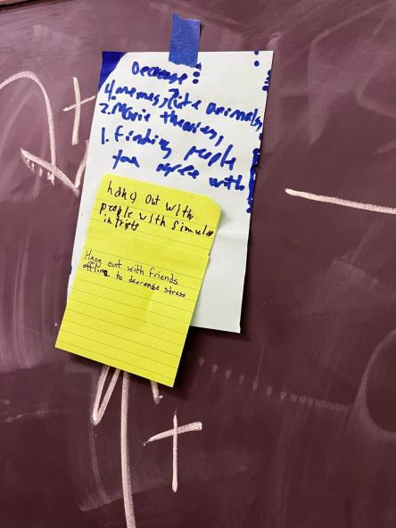
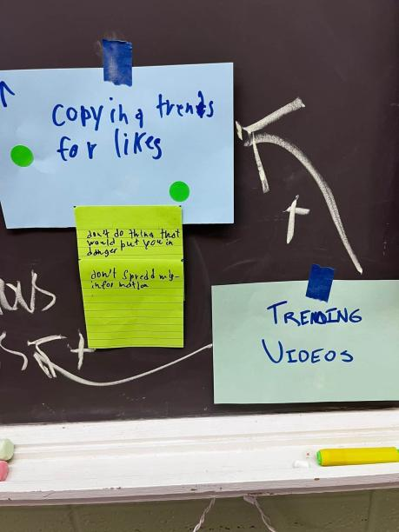
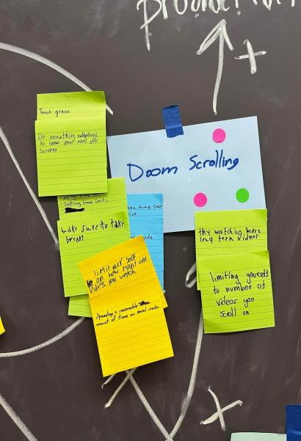

Slide 29
Teens identified several strategies to manage their social media experiences and reduce anxiety. They focused on self-regulation and personal mental well-being strategies.
Those action ideas include:
Limiting screen time and setting device usage limits
Creating positive content; setting boundaries for negative comments
Shifting mindset: social media is curated information, use it intentionally
Prioritizing offline interactions to reduce stress
Using social media for self-expression and to connect with a supportive community
Notes:
The proposed strategies include:
Limiting screen time,
Creating positive content,
Being mindful that social media is curated and using it intentionally,
Prioritizing offline interactions,
And using social media as a tool for self-expression and community-building.
These ideas reflect teens’ desire for agency, rather than restriction, in how they use technology.

Slide 30
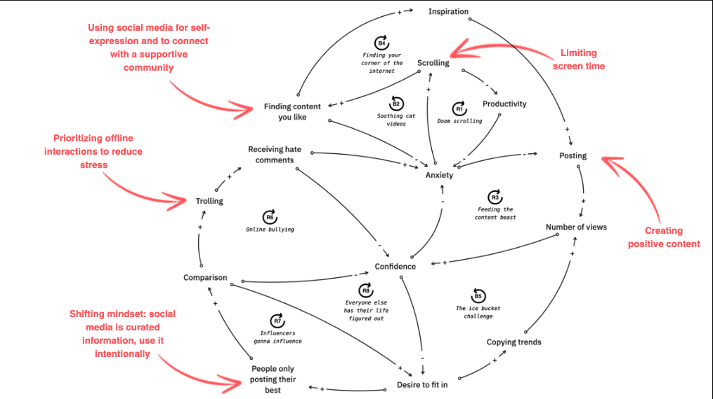
Using social media for self-expression and to connect with a supportive community
Limiting
screen time
Prioritizing offline interactions to reduce stress
Creating
positive content
Shifting mindset: social media is curated information, use it intentionally
Caption

Slide 31

TAKEAWAYS
Rather than keeping teens away from social media, it is crucial to recognize that some teens view social media positively and often use it as a means to alleviate anxiety or find community.
Teens can benefit from increased positive content and better access to mental health resources, enabling them to turn to these resources rather than misinformation.
Notes:
So, a couple takeaways:
Rather than portraying social media as inherently harmful, teens acknowledged its dual nature.
They recognized its potential to soothe anxiety but only when used with care.
Teens called for more positive content that displayed the the spectrum of human experience, both good and bad.
They also discussed the need for improved access to mental health resources, so they can rely on real support rather than misinformation.

Slide 32
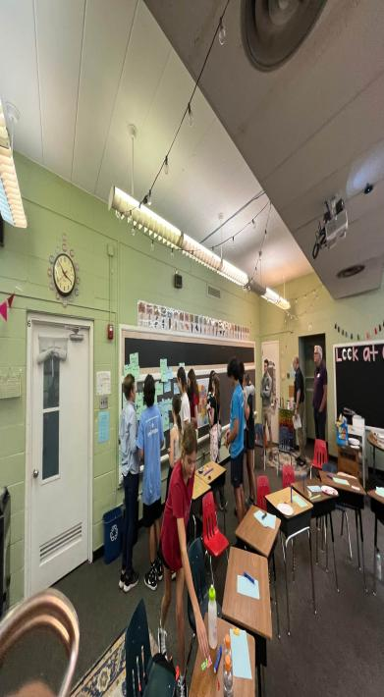
LIMITATIONS
Several limitations are present.
Small sample size
Limited time to dive deeper into modeling.
It is customary for modelers to share the revised CLD with participants post-workshop to check for correctness. Back to school schedules of the students limited deeper participation.
Notes:
Of course, this work has limitations.
We had a small sample size and limited time to dive deeper into model revision.
Due to the school calendar, we weren’t able to reconvene for a validation session with participants — a typical CBSD practice that i wish we had be able to execute.
I also wish that we had spent more time understanding how our participants define anxiety itself.
Nonetheless, this pilot offered valuable insight into teen perspectives and the feedback loops that shape their digital lives.

Slide 33


One teen told us,
“THERE IS NO ONE SOLUTION, BESIDES A PERFECT SYSTEM AND PEOPLE. I THINK WE SHOULD TAKE IT ONE STEP AT A TIME, MAYBE STARTING WITH BLOCKING SAD VIDEOS??”
Notes:
I’ll close with a response one of our participants wrote on a follow-up survey:
“There is no one solution, besides a perfect system and people. I think we should take it one step at a time — maybe starting with blocking sad videos?”
A poignant reminder that the solutions to complex social challenges, like anxiety and technology, are themselves complex — and best understood from the perspectives of those most affected.

