Slide 1


Integrating SD, VSM, and DPG to Address Health Financing & Governance Challenges in Singapore
2025 International System Dynamics Conference, Boston MA, USA
Presenters: Prof. David Bruce Matchar (Duke-NUS Medical School, Singapore)
Prof. Enzo Bivona (University of Palermo, Italy)
Zhenghua (Steve) Yang (University of Palermo, Italy)

Slide 2


Introduction & Context
Healthier SG
Healthcare clusters (?)
A pre-determined budget based on the age bands of each geographical resident under their charge every year
A new annual service fee* for each enrolled Healthier SG resident (*applicable ONLY to limited health services and age groups)
Family doctors
3
4
1
Transition from service-based (i.e., fee-for-service or FFS) to capitation (CAP) payment
2
Enrolling a significant proportion of the population with a designated primary care provider
Increased community involvement in health management focusing on healthy behaviors
Building greater capacity for home-based services, especially those that aim to meet the needs of individuals who might otherwise require residential care
Source: WHITE PAPER ON HEALTHIER SG (Ministry of Health, 2022a).
Image credit: https://www.gowhere.gov.sg/healthiersg/files/infobox-image.png.

Slide 3
Systems Thinking on Payment Reform
A view on FFS
1. no undersupply of services (Cinchon et al., 1999);
2. manageable financial risks for care providers.
1. inherent incentives for increasing service volume regardless of the outcome or cost of care;
2. constraints on preventive or promotive services without an associated billing code.
(Cinchon et al., 1999; James & Poulsen, 2016; Wieck, 2021)
FFS payment model

Slide 4

Systems Thinking on Payment Reform
What about CAP?
Unintended
consequences?!
Risks and incentives
Financial risks for providers
Financial incentives for underservice
© Cartoon Bank
CAP places financial responsibility on providers in hopes of improving patient management and decreasing unnecessary expenditures, but it is not perfect too☹️

Slide 5
Systems Thinking on Payment Reform
Financial risks for providers
Healthcare clusters
Each cluster gets paid funding rates from MOH for managing the regional health systems. By contrast, they have not capitated the budgets of individual healthcare institutions, including hospitals, polyclinics or community hospitals so far (Ministry of Health, 2022b).
Medical clinics
Many GPs worry that the new annual service fee could not be commensurate with the expanded scope of primary care work (i.e., the dual responsibility of encouraging preventive care among residents while managing chronic diseases of patients) (Foo et al., 2023). As a result, the enrollment rate into Healthier SG was only ~40% (712 out of 1800 GP clinics) as of April 2023 (Abdullah, 2023).

Slide 6
Systems Thinking on Payment Reform
Financial incentives for underservice
The new payment model has raised public fears of lower service intensity with longer waiting time or compromised service quality when seeking medical care during Parliamentary QA (Ministry of Health, 2023).
A recent study warns that care providers could be incentivized to reduce the supply of medical services under the CAP payment model and to deny ﻿high-value services simply because of high costs (Matchar et al., 2023).
Therefore, the potential impacts of payment reform on care delivery to patients and on financial performance of providers merit policymakers’ attention.

Slide 7
Health Financing Model
Modeling objective
Risk analysis and policy tests through dynamic modelling:
  to quantify/simulate the possible changes in population health outcomes and in health services utilization over time in Singapore;
  to evaluate the potentially financial risks for providers (e.g., public healthcare clusters and private medical clinics) and long-term health financing sustainability under the current CAP funding model at the time of aging population;
  to design and test alternative and innovative payment models (e.g., Comprehensive Capitation Payment or Value-based Payment, VBP) that would encourage risk sharing, risk pooling, and care integration in the local healthcare system.

Slide 8
Health Financing Model
Model structure
An integrated SD model includes:
  Population: Aging chain with changing health states;
  Provider: Physician Supply & Service Delivery;
  Payer: Budget allocation.

Slide 9
Health Financing Model
Model behavior (preliminary results, for reference only!)

Slide 10
System Governance
Beyond health financing
Viable governance structure for risk management and care coordination:
  The transition is not merely a shift in payment mechanism. Rather, it requires excellence in governance that promotes accountable health services and care integration across multiple stakeholders within the complex healthcare system;
System governance
Risk management
Care coordination

Slide 11
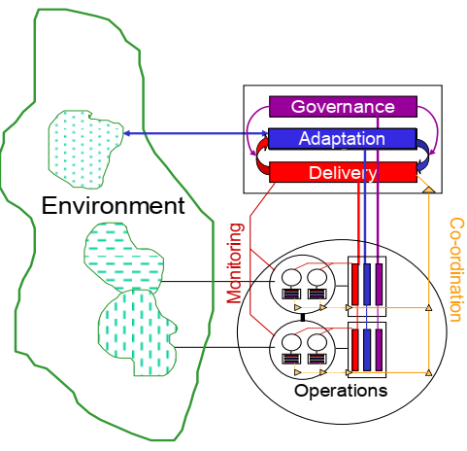
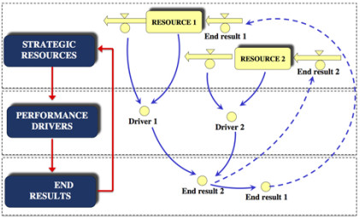
System Governance
Applied method
A combination of complex system analytical frameworks – VSM & DPG:
  VSM: a systems model and the cybernetic framework to ensure organizations remain viable and flexible in their business strategies and operational structures (Beer, 1984; Hoverstadt, 2010);
  DPG: a conceptual framework that ﻿adopts a feedback view to frame dynamic complexity in interinstitutional contexts to achieve sustainable outcomes through consistent policy design and implementation (Bianchi, 2021; Bianchi et al., 2019).
© Fractal consulting
© CED4, UNIPA

Slide 12
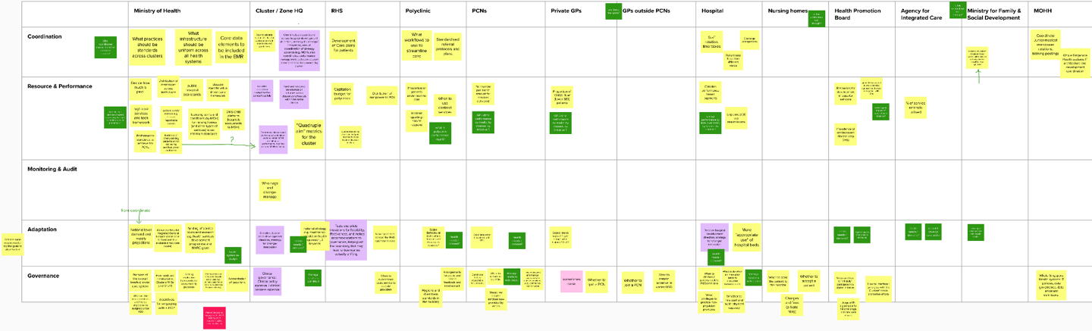
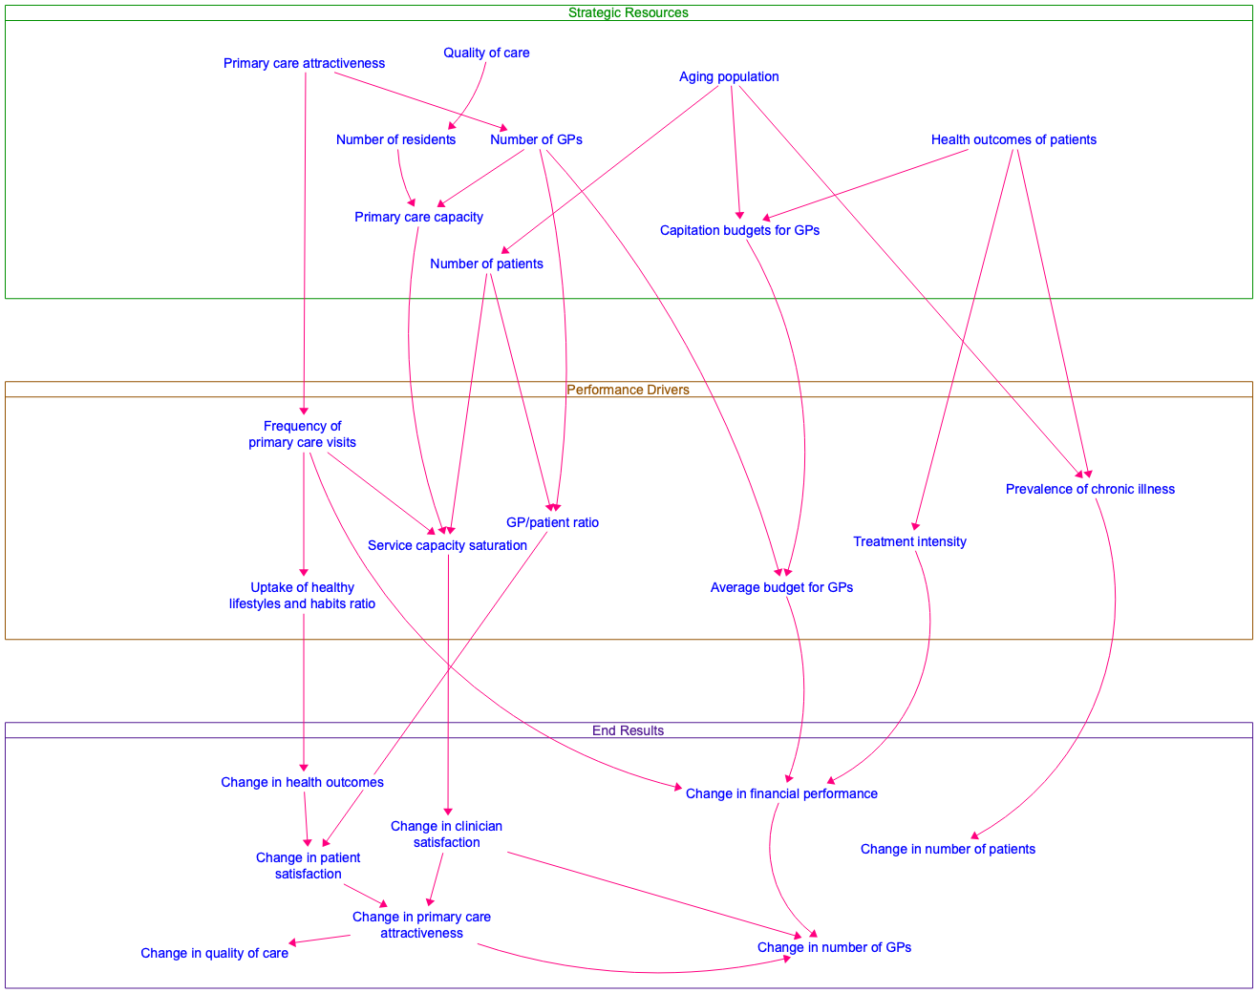
System Governance
Proof of concept
A integrated workflow of VSM , DPG, & SD:
VSM
map key stakeholders and identify enablers/barriers in current CAP payment reform using VSM exercise
DPG
link strategic resources to key performance indicators (KPIs) and long-term outcomes using DPG framework
SD
simulate governance decisions/policies to ensure long-term financial sustainability and system viability using SD model

Slide 13
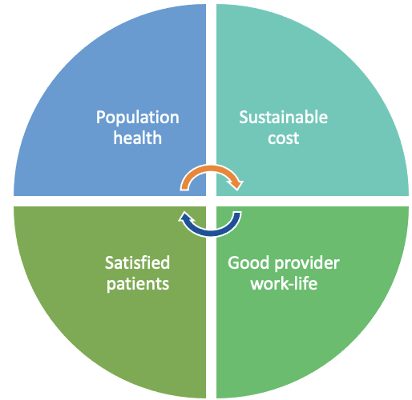
Wrap up
Conclusion and challenges
Conclusion
The successful payment reform is essential for the achievement of “Quadruple Aim” under the “Healthier SG” initiative (Ruth, 2023).
This study builds a decision support tool (i.e., an integrated SD model) for alternative payment model design.
Challenges
Data limitation
Model calibration
Detail complexity
In addition, with the aid of complex system frameworks (i.e., VSM and DPG), it draws attention to viable governance structure design.

Slide 14
Source Information
Reference list
Abdullah, Z. (2023). 712 GP clinics have joined Healthier SG so far: Health Minister Ong Ye Kung. https://www.straitstimes.com/singapore/health/712-gp-clinics-have-joined-healthier-sg-so-far-ong-ye-kung
Beer, S. (1984). The Viable System Model: Its Provenance, Development, Methodology and Pathology. The Journal of the Operational Research Society, 35(1). https://doi.org/10.2307/2581927
Bianchi, C. (2021). Fostering sustainable community outcomes through policy networks: a dynamic performance governance approach. In Handbook of Collaborative Public Management. https://doi.org/10.4337/9781789901917.00036
Bianchi, C., Bereciartua, P., Vignieri, V., & Cohen, A. (2019). Enhancing Urban Brownfield Regeneration to Pursue Sustainable Community Outcomes through Dynamic Performance Governance. International Journal of Public Administration, 44(2), 100-114. https://doi.org/10.1080/01900692.2019.1669180
Cinchon, M., Newbrander, W., Yamabana, H., Weber, A., Normand, C., Dror, D., & Preker, A. (1999). Modelling in health care finance: a compendium of quantitative techniques for health care financing. International Labour Office (ILO) and the International Social Security Association (ISSA). https://www.ilo.org/sites/default/files/wcmsp5/groups/public/@ed_protect/@soc_sec/documents/publication/wcms_209903.pdf
Foo, C. D., Chia, H. X., Teo, K. W., Farwin, A., Hashim, J., Choon-Huat Koh, G., Matchar, D. B., Legido-Quigley, H., & Yap, J. C. H. (2023). Healthier SG: Singapore’s multi-year strategy to transform primary healthcare. The Lancet Regional Health - Western Pacific, 37. https://doi.org/10.1016/j.lanwpc.2023.100861
Hoverstadt, P. (2010). The Viable System Model. In Systems Approaches to Managing Change: A Practical Guide (pp. 87-133). https://doi.org/10.1007/978-1-84882-809-4_3
James, B. C., & Poulsen, G. P. (2016). The Case for Capitation. Harvard Business Review, (July–August 2016), pp.102–111.
Matchar, D. B., Lai, W. X., Kumar, A., Ansah, J. P., & Ng, Y. F. (2023). A Causal View of the Role and Potential Limitations of Capitation in Promoting Whole Health System Performance. International Journal of Environmental Research and Public Health, 20(5). https://doi.org/10.3390/ijerph20054581
Ministry of Health. (2022a). WHITE PAPER ON HEALTHIER SG. https://file.go.gov.sg/healthiersg-whitepaper-pdf.pdf
Ministry of Health. (2022b, 5 October). CLOSING SPEECH BY MR ONG YE KUNG, MINISTER FOR HEALTH, AT THE HEALTHIER SG WHITE PAPER DEBATE 2022, ON WEDNESDAY, 5 OCTOBER 2022. Ministry of Health. https://www.moh.gov.sg/newsroom/closing-speech-by-mr-ong-ye-kung-minister-for-health-at-the-healthier-sg-white-paper-debate-2022-on-wednesday-5-october-2022
Ministry of Health. (2023). Capitation. Ministry of Health. https://www.moh.gov.sg/newsroom/capitation
Ruth, L. (2023). What is Healthier SG (HSG) about? , 49. https://www.cfps.org.sg/publications/the-college-mirror/article/1957
Wieck, M. R. (2021). Profitably Risky: A Study of Medicare Capitation Contracts for Primary Care Medical Practices (Publication Number 28652749) [D.B.A., University of Missouri - Saint Louis]. ProQuest Dissertations & Theses Global. Missouri, United States.
Notes:
So much for my speech, thanks for your attention.

