Slide 1

THE SUBHEADING IS HERE
Uptake of Sustainable Aviation Fuels (SAFs) in the context of policies, mandates and industry targets: A comparison of potential production capacity across different world regions by 2030
Chetan Talwar, Andres Filipe Guzman
Transportation & Infrastructure Team
KAPSARC
ISDC 2025 Conference 04.08.2025

Slide 2
Table of Contents
01
Introduction and Motivation
06
Appendix 1 – Research robustness
02
SAF types: Emissions Reduction Potential and Price Comparison
03
Air Transport System Model Extensions
04
Outlook Design & Results
05
Future outlook: potential SAF availability & challenges

Slide 3
01
Introduction and Motivation

Slide 4

Introduction: Initiatives taken by institutions
IATA’s strategy towards net-zero 2050
IATA‘s strategy toward net-zero by 2050
At the 77th IATA meeting a resolution was passed
IATA member airlines decided to agree on achieving net-zero carbon emissions from their operations by 2050
This brings air transport in line with the Paris agreement to limit global warming below 2°C
ATAG global emissions reduction goals
To reach net-zero carbon emissions by 2050
Improve fuel efficiency by an average of 2 %
Compared to the base year 2005 emission value
Emissions
Years
IATA : International Air Transport Association ; ATAG: Air transport action group : SAF: Sustainable aviation fuels

Slide 5


Introduction: Initiatives taken by institutions
IATA’s strategy towards net-zero 2050
IATA‘s strategy toward net-zero by 2050
At the 77th IATA meeting a resolution was passed
IATA member airlines decided to agree on achieving net-zero carbon emissions from their operations by 2050
This brings air transport in line with the Paris agreement to limit global warming below 2°C
ATAG global emissions reduction goals
Sustainable aviation fuels (SAFs)
To reach net-zero carbon emissions by 2050
Improve fuel efficiency by an average of 2 %
Compared to the base year 2005 emission value
4 pathways to produce SAFs – HEFA, ATJ, PTL and FT synthesis
Can be blended up to 50 % as drop-in fuels
Currently has 0.1 % share in total fuel used
Potentially 38 – 99 % GHG emissions reduction*
Emissions
Years
HEFA: Hydroprocessed fatty acid esters and fatty acids ; FT synthesis: Fischer-Tropsch synthesis ; ATJ: Alcohol-to-jet ; PTL: Power-to-liquids *: when compared to jet fuel over life cycle
IATA : International Air Transport Association ; ATAG: Air transport action group : SAF: Sustainable aviation fuels

Slide 6
Introduction: Initiatives taken by institutions
IATA’s strategy towards net-zero 2050
IATA‘s strategy toward net-zero by 2050
At the 77th IATA meeting a resolution was passed
IATA member airlines decided to agree on achieving net-zero carbon emissions from their operations by 2050
This brings air transport in line with the Paris agreement to limit global warming below 2°C
Challenge:
It would be impossible to achieve these goals using current technology
To realize these goals, using policies and incentives, the strategic introduction of SAF in the system is necessary.
ATAG global emissions reduction goals
Sustainable aviation fuels (SAFs)
To reach net-zero carbon emissions by 2050
Improve fuel efficiency by an average of 2 %
Compared to the base year 2005 emission value
4 pathways to produce SAFs – HEFA, ATJ, PTL and FT synthesis
Can be blended up to 50 % as drop-in fuels
Currently has 0.1 % share in total fuel used
Potentially 38 – 99 % GHG emissions reduction*
Emissions
Years
HEFA: Hydroprocessed fatty acid esters and fatty acids ; FT synthesis: Fischer-Tropsch synthesis ; ATJ: Alcohol-to-jet ; PTL: Power-to-liquids *: when compared to jet fuel over life cycle
IATA : International Air Transport Association ; ATAG: Air transport action group : SAF: Sustainable aviation fuels

Slide 7
02
SAF types: Emissions Reduction Potential and Price Comparison

Slide 8
SAF types: Emissions Reduction Potential & Price Comparison
SAF types
SAF type Current Share as of 2022**
SAF Production Pathway | Feedstock | GHG Emission Reduction Potential Compared to Jet Fuel in %* | Certified Blending Limit
Hydroprocessed Esters and Fatty Acids (HEFA) | Used cooking oil vegetable oil Animal fats Algae | 38 – 70 % | 50 % D7566 Annex 2 2011
Fischer-Tropsch synthesis (FT – Syn) | Municipal solid waste (MSW) Forestry residue Agriculture residue Energy crops | 85 – 93 % | 50 % D7566 Annex 1 2009
Alcohol to Jet (ATJ) | Methanol Ethanol Butanol | 38 – 71 % | 50 % D7566 Annex 5 2016
Power to Liquid (PtL) | Clean hydrogen Captured CO₂ | Up to 99 % | 50 % D7566 Annex 1
Jet Fuel
355 billion liters
HEFA share: 95 %
FT synthesis share: 3 %
ATJ share: 2 %
PtL share: 0.01 %
99.9%
Total Consumption
355 billion liters
SAF
0.355 billion liters
0.1%
Sources: IATA, 2022; Waypoint ATAG, 2021; Fuel cells and Hydrogen JU, 2020; Ng et al. 2021; and Shahriar and Khanal, 2022
* Life Cycle based Assessment; ** Based on research reports of aviation institutions and action groups; MMBD: Million barrels per day

Slide 9
SAF types: Emissions Reduction Potential & Price Comparison
SAF types
SAF type Current Share as of 2022**
SAF Production Pathway | Feedstock | GHG Emission Reduction Potential Compared to Jet Fuel in %* | Certified Blending Limit
Hydroprocessed Esters and Fatty Acids (HEFA) | Used cooking oil vegetable oil Animal fats Algae | 38 – 70 % | 50 % D7566 Annex 2 2011
Fischer-Tropsch synthesis (FT – Syn) | Municipal solid waste (MSW) Forestry residue Agriculture residue Energy crops | 85 – 93 % | 50 % D7566 Annex 1 2009
Alcohol to Jet (ATJ) | Methanol Ethanol Butanol | 38 – 71 % | 50 % D7566 Annex 5 2016
Power to Liquid (PtL) | Clean hydrogen Captured CO₂ | Up to 99 % | 50 % D7566 Annex 1
Jet Fuel
355 billion liters
HEFA share: 95 %
FT synthesis share: 3 %
ATJ share: 2 %
PtL share: 0.01 %
99.9%
Total Consumption
355 billion liters
SAF
0.355 billion liters
0.1%
SAF Price Comparison to Jet Fuel 2022
66 – 370 % higher price
Sources: IATA, 2022; Waypoint ATAG, 2021; Fuel cells and Hydrogen JU, 2020; Ng et al. 2021; and Shahriar and Khanal, 2022
* Life Cycle based Assessment; ** Based on research reports of aviation institutions and action groups; MMBD: Million barrels per day

Slide 10
SAF types: Emissions Reduction Potential & Price Comparison
SAF types
SAF type Current Share as of 2022**
SAF Production Pathway | Feedstock | GHG Emission Reduction Potential Compared to Jet Fuel in %* | Certified Blending Limit
Hydroprocessed Esters and Fatty Acids (HEFA) | Used cooking oil vegetable oil Animal fats Algae | 38 – 70 % | 50 % D7566 Annex 2 2011
Fischer-Tropsch synthesis (FT – Syn) | Municipal solid waste (MSW) Forestry residue Agriculture residue Energy crops | 85 – 93 % | 50 % D7566 Annex 1 2009
Alcohol to Jet (ATJ) | Methanol Ethanol Butanol | 38 – 71 % | 50 % D7566 Annex 5 2016
Power to Liquid (PtL) | Clean hydrogen Captured CO₂ | Up to 99 % | 50 % D7566 Annex 1
Jet Fuel
355 billion liters
HEFA share: 95 %
FT synthesis share: 3 %
ATJ share: 2 %
PtL share: 0.01 %
99.9%
Total Consumption
355 billion liters
SAF
0.355 billion liters
Challenge:
Keeping in mind the higher price of SAF, it is impossible for the alternative fuels to be adopted without the support of policy measures.
0.1%
SAF Price Comparison to Jet Fuel 2022
66 – 370 % higher price
Sources: IATA, 2022; Waypoint ATAG, 2021; Fuel cells and Hydrogen JU, 2020; Ng et al. 2021; and Shahriar and Khanal, 2022
* Life Cycle based Assessment; ** Based on research reports of aviation institutions and action groups; MMBD: Million barrels per day

Slide 11
03
Air Transport System Model Extensions

Slide 12
The air transport system model and its components
Air travel demand
Population
Effect of GDP
Effect of airline fares Effect of system congestion
Demanded seat kilometers
Airline industry
Aircraft on order & in storage
Air travel demand by world regions
Fleet planning
Demand by world regions
Fleet operation
Demand by world regions
Aircraft in use
Direct operating costs
Adoption Assessment variables:
Share of SAF in total fuel mix
Share of SAF in each World region
Policy input
SAF blending mandate
Industry targets for SAF
Operating margin
Effect of operating margin
Airline fares
Competitors
competition
Price Setting
Costs and time delay parameters:
Target load factor
Thresholds for profitability & margin
Improvement rates
Sensitivities
Time constants e.g., delivery time
Aircraft orders/
cancellations
Aircraft deliveries
Airline fuel orders/cancellations
Total fuel production
Aircraft manufacturers
Fuel producers
Aircraft orders/
cancellations
Sustainable aviation fuel
Legend:
: extensions done in the model
: model boundary
: exogenous parameters
Time delay, initial level, and scaling effects parameters
Time delay, initial level green electricity, and scaling effects parameters
Source: Airbus, 2021 ; Kieckhafer et al. 2018. Pierson and Sterrman, 2013 ; Joormann et al. 2024
Notes:
You have to adjust the diagram to you theme and topic

Slide 13
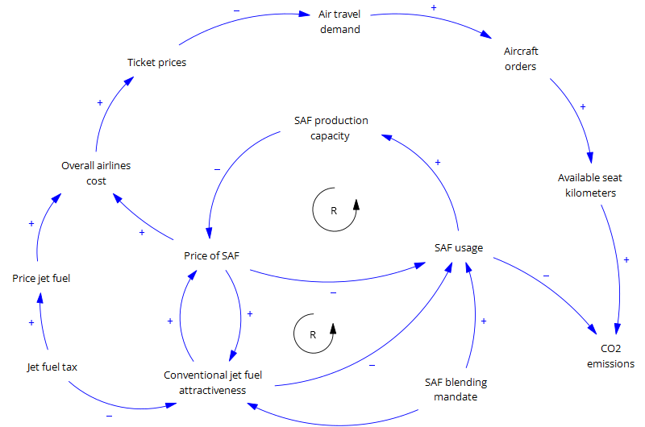
Air Transport System Model – Causal Loop Diagram (CLD)
Causal Loop Diagram policy mechanism
Effect of blending mandate
This reinforcing mechanism is represented by R and an anticlockwise circle
$$↑Blending mandate → ↑SAF usage→ ↑Production capacities$$
$$↑Production capacities→ ↓Price SAF→ ↑SAF usage$$
Substitution effect
Low jet fuel attractiveness prompts an increase in SAF usage due to the substitution effect
$$↑Blending mandate → ↑SAF usage→ ↑Production capacities$$
$$↑Production capacities→ ↓Price SAF→ ↓Jet fuel attratctiveness$$
$$↓Jet fuel attratctiveness→↑SAF usage$$

Slide 14
04
Outlook Design & Results

Slide 15





Key Drivers for the Future Consumption of SAF
Mandates: Government regulations requiring a minimum percentage of SAF in aviation fuel.
Penalties for Non-compliance: Fines imposed on airlines and/or fuel producers for failing to meet SAF obligation targets.
Taxation: Increased taxes on conventional jet fuel to encourage SAF adoption.
Subsidy: The government provides financial support, such as tax credits, to promote SAF production and use.
Carbon offsetting: Airlines use SAF to reduce or offset their carbon footprint.

Slide 16
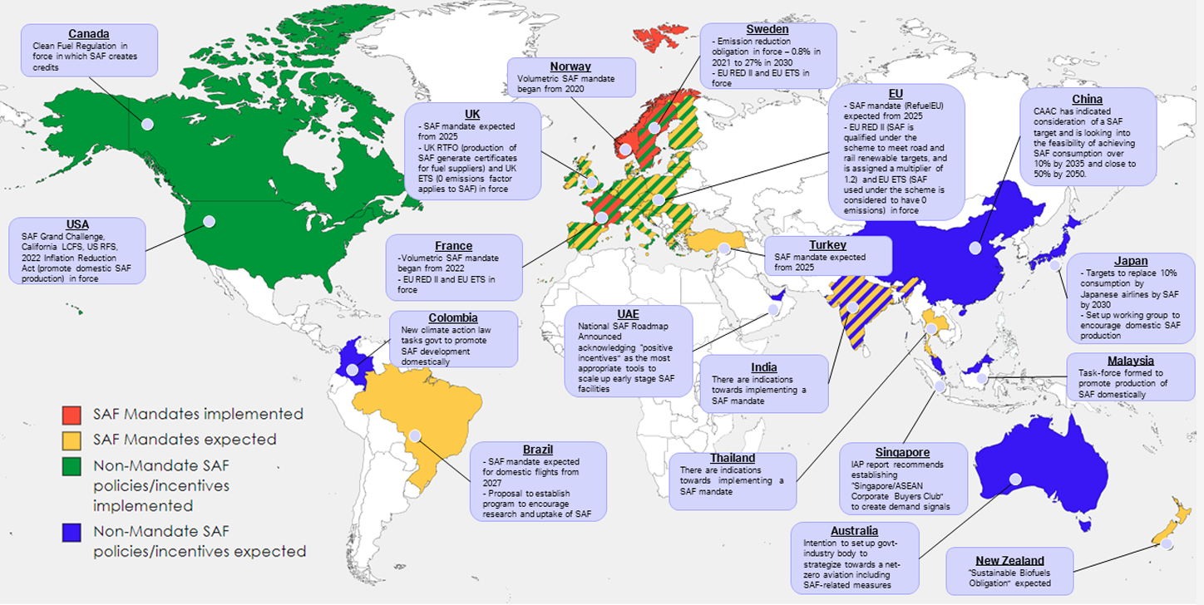
Global Overview of Policy Landscape
Source: The figure is directly taken from IATA, Nov 2023

Slide 17
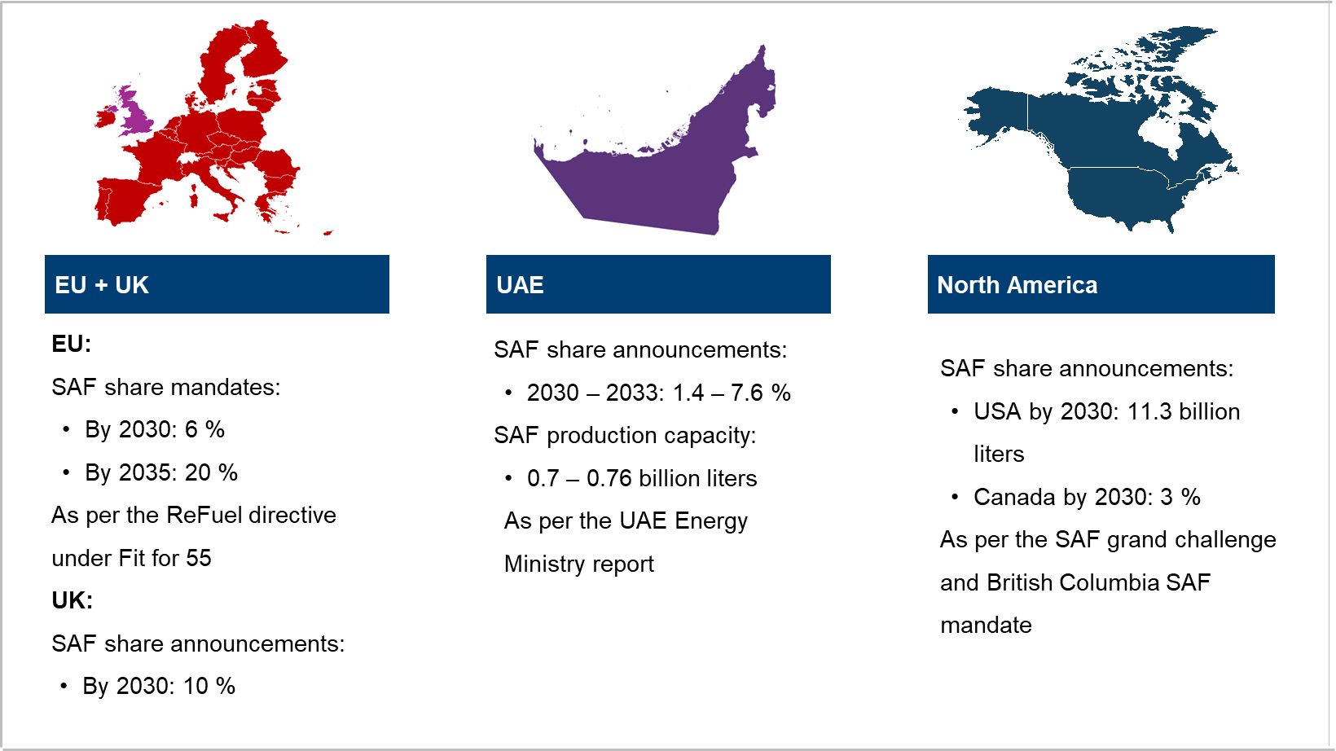
Existing National Mandates and Announcements
Source: MOEI 2023; IATA ReFuelEU Handbook 2024; CSIRO 2023; and NREL 2024. More details can be found in Appendix

Slide 18

Outlook Design – National Mandates and Announcements Achievement
The EU Mandates
The European mandates are fully realized
EU reaches 6 % share of SAF by 2030
North America mandates and announcements fully realized: 16 % SAF share in North America region by 2030
USA Grand Challenge and Canadian regional policies are realized.
North American SAF capacity increases 35 times the current global value to reach 11.66 billion liters per year in 2030.
The UAE Roadmap fully realized: 3.8 % SAF share in MENA region by 2030
Roadmap 2030 is fully realized
7.6 % SAF share in the UAE
0.7 billion liters per year of SAF production by 2030-33 in UAE.
Description | National Mandates and Announcements Achievement
Planned SAF share by 2030 | MENA: 3.8 % EU: 2030: 6 % North America: 16 %
Key assumptions by 2030 | Europe’s mandates are implemented and realized SAF Grand challenge, UAE Roadmap, and Canada’s regional mandate are fully realized

Slide 19
Outlook Design – KAPSARC SAF Outlook
The EU Mandates
The European mandates are fully realized
EU reaches 6 % share of SAF by 2030
The UAE and North America partially reach targets
The announcements from UAE and North America are only partially realized.
Expected Mandates and Industry Targets in Asia Pacific
Japan by 2030: 10 % for Japanese airlines
Singapore by 2030: 3 - 5 % SAF Mandate potential introduction in 2026
Australia by 2030: 20 – 40 % SAF share Industry target
Expected mandate in Rest of the World
Brazil by 2027: 1 % SAF Mandate reaching to 10 % by 2037 to be potentially announced in 2025
Description | KAPSARC SAF Outlook
Planned SAF share by 2030 | MENA 0.7 % EU: 2030: 6 % North America: 3 % Asia pacific: 2 % Rest of the World: 1 %
Key assumptions by 2030 | EU achieves mandates UAE, North America achieve partial fulfillment Expected mandates and industry targets in Singapore, Brazil, Australia, and Japan are partially realized

Slide 20
Scenario Results
Variable | KAPSARC SAF Outlook | National Mandates and Announcements Achievement | IATA Net zero Goals by 2030
SAF Share by 2030 | 1.42 % | 2.34 % | 2 – 10 %
SAF Consumption by 2030 | 6.24 billion liters | 10.3 billion liters | 23 billion liters
Brief Description | EU and UK mandates are met. US Grand Challenge, UAE targets, and expected targets elsewhere are partially realized. | The EU+ UK mandates, US Grand Challenge, and UAE’s targets are fully realized. | IATA Net zero 2050: sustainable aviation fuels expectations globally

Slide 21
Scenario Results
Variable | KAPSARC SAF Outlook |  | National Mandates and Announcements Achievement |  | IEA STEPS 2024* | IEA APS 2024*
Jet Fuel Consumption by 2030 | 433 billion liters | Total = 439 billion liters | 429 billion liters | Total = 439 billion liters | 8.99 MMBD ≈ 524.2 billion liters | 8.51 MMBD ≈ 496.3 billion liters
SAF Share by 2030 | 1.42 % |  | 2.34 % |  | 2 % | 5 %
SAF Consumption by 2030 | 6.24 billion liters |  | 10.3 billion liters |  | 0.18 MMBD ≈ 10.49 billion liters | 0.44 MMBD ≈ 25.65 billion liters
Brief Description | EU and UK mandates are met. US Grand Challenge, UAE targets, and expected targets elsewhere are partially realized. |  | The EU+ UK mandates, US Grand Challenge, and UAE’s targets are fully realized. |  | EU implements SAF mandates. North America and the rest of the World take initiative to produce SAF | EU + UK implement SAF mandates. North America & Asia Pacific take strong initiatives to produce SAF
MMBD: Million barrels per day; STEPS: Stated Policies Scenarios; APS: Announced Pledges Scenario
* IEA World Energy Outlook 2024 Dataset A.2 – World Total Final Consumption

Slide 22
05
Future outlook: potential SAF availability & challenges

Slide 23



Future outlook: potential SAF availability & challenges
Share of SAF
Bottlenecks
IATA projections
The results of modeling show that:
Share of SAF globally can be between 1.4 – 2.3 % by 2030
EU and North American regions can have the most contributions
Main bottlenecks of SAF adoption:
Increase in production capacities can take longer
Prices of SAF are unattractive for both airlines as well as producers alike
HEFA alone cannot support jet fuel demand due to the inability of feedstock scaling
IATA projections of 15 -17 % global SAF share by 2035 are highly optimistic
The methodology of projections is unclear
Production delays are not taken into consideration

Slide 24

Thank You!
Question?
King Abdullah Petroleum Studies and Research Center
Airport Road
P.O. Box 88550
Riyadh 11672
Saudi Arabia
/kapsarc
info@kapsarc.org
/kapsarc
kapsarc.org

Slide 25
06
Appendix 1 – Research robustness

Slide 26
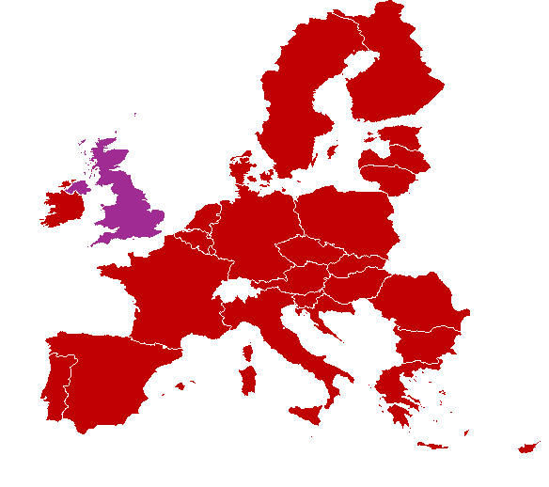
EU + UK
Asia
MENA
North America
Oceania
EU:
SAF share mandates:
By 2030: 6 %
By 2035: 20 %
SAF production capacity:
By 2030: 4.2 – 6.5 billion liters
By 2050: 40 billion liters
As per the ReFuel directive under Fit for 55
UK:
SAF share announcements:
By 2030: 10 %
By 2035: 15 %
SAF share announcements:
India by 2030: 5 - 10 %
China by 2025: 4.5 %
Japan by 2030: 10 %
Indonesia: by 2025: 5 %
Singapore by 2030: 3-5 %
SAF production capacity:
India: 0.45 billion liters
China: 0.05 billion liters
SAF share announcements in UAE:
2030 – 2033: 2 – 8 %
SAF production capacity:
UAE: 0.7 – 0.76 billion liters
As per the UAE energy ministry reports
SAF share announcements:
USA by 2030: 11.3 billion liters
Canada by 2030: 3 %
As per the SAF grand challenge and British Columbia SAF mandate
SAF share announcements:
Australia by 2030: 20 – 40 %
Australia by 2035: 25 – 45 %
New Zealand by 2030: 10 – 15%
SAF production capacity:
Australia: 6 – 9 billion liters

Slide 27
Existing mandates
Comparison between jet fuel usage and SAF production capacity
400
366
355
300
SAF has increase 3.5 times since 2019.
Even with this increase it is merely 0.01 % of the jet fuel as of 2022 equal to 0.355 billion liters.
Expected to increase 21 times by 2025 to reach 7.5 billion liters capacity.
Expected to increase 3.3 times further to reach 25 billion liters by 2030.
Finally to reach ambitious aim of 90 billion liters by 2035
200
100
Amount of fuel in billions of liters
x 3.3 times increase
x 3.6 times increase
x 3.5 times increase
x 21 times increase
:Change in scale

Slide 28
Air Transport System Model – Causal Loop Diagram (CLD)
Causal Loop Diagram policy mechanism
SAF price, demand and production relationship assumptions
It is assumed that the reduction in price of SAF will in general lead to an increase in the production of SAF
The above happens due to economies of scale and increase in production efficiencies
It is assumed that a reduction in SAF price will not reach jet fuel prices due to constant changes in SAF production pathways
It is assumed that an increase in SAF usage would prompt an increase in SAF production capacity as airlines and fuel producers enter into forward contracts for SAF

Slide 29




Research robustness
Literature review
Methodology
To conduct research on the existing mandates, policies, SAF types, and future potentials, a literature review with:
20+ research reports
10 journal and research articles
5 press release by IATA
For more than 70 countries across 5 regions was done.
The review was processed to find out region wise:
Mandates
Official Announcements
Potential % share of SAF
Potential SAF production amount
System dynamics air transport system (ATS) model was utilized. The model is:
State of the art aviation system model
Includes 4 major components of airline industry
Air travel demand
Airline industry
Aircraft manufacturers
Fuel producers
Some characteristics of the model are:
Feedback loop based simulation model
More than 300 differential and linear equations
Developed in 4 years during Phd. research

Slide 30
Bibliography
Advanced Biofuels Canada. (2023). British Columbia makes history with first North American aviation fuel mandate, formalizes new LCFS Regulation - Advanced Biofuels Canada. https://advancedbiofuels.ca/british-columbia-makes-history-with-first-north-american-aviation-fuel-mandate-formalizes-new-lcfs-regulation/
Agroicone. (2013). Flightpath to Aviation Biofuels in Brazil: Action Plan. https://agroicone.com.br/uploads/2015/02/flightpath-to-aviation-biofuels-brazil-action-plan.pdf
Air Transport Action Group (ATAG). (2020). Waypoint 2050. https://aviationbenefits.org/media/167187/w2050_full.pdf
Airbus. (2021). Global Market Forecast. https://www.airbus.com/sites/g/files/jlcbta136/files/2021-11/Airbus-Global-Market-Forecast-2021-2040.pdf
Barke, A., Bley, T., Thies, C., Weckenborg, C., & Spengler, T. S. (2022). Are Sustainable Aviation Fuels a Viable Option for Decarbonizing Air Transport in Europe? An Environmental and Economic Sustainability Assessment. Applied Sciences, 12(2), 597. https://doi.org/10.3390/APP12020597
Bauen, A., Bitossi, N., German, L., Harris, A., & Leow, K. (2020). Sustainable Aviation Fuels : Status, challenges and prospects of drop-in liquid fuels, hydrogen and electrification in aviation. Johnson Matthey Technology Review, 64(3), 263–278. https://doi.org/10.1595/205651320X15816756012040
Boeing, Embraer, FAPESP, & UNICAMP. (2013). Flightpath to aviation biofuels in Brazil: Action Plan. https://agroicone.com.br/uploads/2015/02/flightpath-to-aviation-biofuels-brazil-action-plan.pdf
C-SAF. (2023). The C-SAF roadmap. https://transitionaccelerator.ca/reports/the-c-saf-roadmap/
Cabrera, E., & Melo de Sousa, J. M. (2022). Use of Sustainable Fuels in Aviation - A Review. Energies, 15(7), 2440. https://doi.org/10.3390/EN15072440
Chiaramonti, D., Talluri, G., Vourliotakis, G., Testa, L., Prussi, M., & Scarlat, N. (2021). Can Lower Carbon Aviation Fuels (LCAF) Really Complement Sustainable Aviation Fuel (SAF) towards EU Aviation Decarbonization? Energies, 14(19), 6430. https://doi.org/10.3390/EN14196430
Commonwealth Scientific and Industrial Research Organisation (CSIRO). (2023). Sustainable Aviation Fuel Roadmap. https://publications.csiro.au/publications/publication/PIcsiro:EP2023-2251
De Jong, S., Antonissen, K., Hoefnagels, R., Lonza, L., Wang, M., Faaij, A., & Junginger, M. (2017). Life-cycle analysis of greenhouse gas emissions from renewable jet fuel production. Biotechnology for Biofuels, 10(1), 1–18. https://doi.org/10.1186/S13068-017-0739-7/TABLES/4

Slide 31
Bibliography
Department of Energy. (2021). Sustainable Aviation Fuel Grand Challenge. https://www.energy.gov/eere/bioenergy/sustainable-aviation-fuel-grand-challenge
Department of Transport (DOT). (2023). Pathway to net zero aviation: Developing the UK sustainable aviation fuel mandate. https://assets.publishing.service.gov.uk/media/66cf1f76a7256f1cd83a89c0/pathway-to-net-zero-aviation-developing-the-uk-sustainable-aviation-fuel-mandate.pdf
Ding, Y., Zheng, P., Yang, L., Wang, Q., & Han, Q. (2024). The Present and Future of Sustainable Aviation Fuels in China. 333–356. https://doi.org/10.1007/978-981-99-7289-0_19
EPRS. (2021). Review of the Energy Taxation Directive. https://www.europarl.europa.eu/RegData/etudes/BRIE/2021/662636/EPRS_BRI(2021)662636_EN.pdf
European Commission. (2002). Liquid hydrogen fuelled aircraft - system analysis (CRYOPLANE). https://cordis.europa.eu/project/id/G4RD-CT-2000-00192
Fuel Cells and Hydrogen Joint Undertaking. (2020). Hydrogen-powered aviation: a fact-based study of hydrogen technology, economics, and climate impact by 2050. Publications Office. https://doi.org/https://data.europa.eu/doi/10.2843/471510
International Air Transport Association (IATA). (2019). Fuel fact sheet. https://www.iata.org/contentassets/25e5377cf53c4e48bbaa49d252f3ab03/fact-sheet-fuel.pdf
International Air Transport Association (IATA). (2021a). Fact Sheet 6: Examples of ground transport biofuel mandates around the world. https://www.iata.org/contentassets/d13875e9ed784f75bac90f000760e998/biofuel-mandates_fact-sheet6-biofuel.pdf
International Air Transport Association (IATA). (2021b). Net zero 2050: sustainable aviation fuels. https://www.iata.org/en/iata-repository/pressroom/fact-sheets/fact-sheet---alternative-fuels/
International Air Transport Association (IATA). (2022a). Fact Sheet 2 - Sustainable Aviation Fuel: Technical Certification. https://www.iata.org/contentassets/d13875e9ed784f75bac90f000760e998/saf-technical-certifications.pdf
International Air Transport Association (IATA). (2022b). Net-Zero Carbon Emissions by 2050. https://www.iata.org/flynetzero/
International Air Transport Association (IATA). (2023). The US Approach and Policy Outline to Stimulate SAF Characteristics and distinctions against the EU and other regions. https://www.iscc-system.org/wp-content/uploads/2023/11/2.5_TCNA141123_The-US-Approach-and-Policy-Outline-to-Stimulate-SAF_IATA_Azim-Norazmi.pdf
International Air Transport Association (IATA). (2024a). Aviation Net-Zero CO2 Transition Pathways: Comparative Review. https://www.iata.org/en/pressroom/2024-releases/2024-04-17-01/

Slide 32
Bibliography
International Air Transport Association (IATA). (2024b). ReFuelEU Aviation Handbook. https://www.iata.org/contentassets/d13875e9ed784f75bac90f000760e998/refuel-eu-aviation-handbook.pdf
International Council on Clean Transportation (ICCT). (2021a). Alternative Transport Fuels elments of the European Union’s “Fit-for-55” Package (Issue September 2021).
International Council on Clean Transportation (ICCT). (2021b). An assessment of the policy options for driving sustainable aviation fuels in the European Union. https://theicct.org/publication/an-assessment-of-the-policy-options-for-driving-sustainable-aviation-fuels-in-the-european-union/
International Council on Clean Transportation (ICCT). (2021c). Assessing the sustainability implications of alternative aviation fuels. https://theicct.org/wp-content/uploads/2021/06/Alt-aviation-fuel-sustainability-mar2021.pdf
International Council on Clean Transportation (ICCT). (2021d). Estimating sustainable aviation fuel feedstock availability to meet growing European Union demand - International Council on Clean Transportation. https://theicct.org/publication/estimating-sustainable-aviation-fuel-feedstock-availability-to-meet-growing-european-union-demand/
International Energy Agency (IEA). (2024). World Energy Outlook 2024. https://www.iea.org/reports/world-energy-outlook-2024
Joormann, I., Talwar, C., & Spengler, Thomas, S. (2024). Shaping the future air transport system: Transition pathways assessment of SAF, hydrogen-electric and hydrogen combustion with a system dynamics simulation model. https://doi.org/10.24355/dbbs.084-202404150946-0
Kieckhäfer, K., Quante, G., Müller, C., Spengler, T., Lossau, M., & Jonas, W. (2018). Simulation-Based Analysis of the Potential of Alternative Fuels towards Reducing CO2 Emissions from Aviation. Energies, 11(1), 186. https://doi.org/10.3390/en11010186
MOEI. (2023). National Sustainable Aviation Fuel Roadmap of the United Arab Emirates. https://u.ae/-/media/Documents-2024/UAE_National_SAF_Roadmap-(2).pdf
National Renewable Energy Laboratory (NREL). (2024). Sustainable Aviation Fuel (SAF) State-of-Industry Report: State of SAF Production Process. /https://www.nrel.gov/docs/fy24osti/87802.pdf
Ng, K. S., Farooq, D., & Yang, A. (2021). Global biorenewable development strategies for sustainable aviation fuel production. Renewable and Sustainable Energy Reviews, 150, 111502. https://doi.org/10.1016/J.RSER.2021.111502
Norden. (2016). Sustainable jet fuel for aviation: Nordic perpectives on the use of advanced sustainable jet fuel for aviation. /www.nordicenergy.org/wp-content/uploads/2016/09/FULLTEXT_Sustainable_Jet_Fuel_for_Aviation.pdf

Slide 33
Bibliography
Pierson, K., & Sterman, J. D. (2013). Cyclical dynamics of airline industry earnings. System Dynamics Review, 29(3), 129–156. https://doi.org/10.1002/sdr.1501
Shahriar, M. F., & Khanal, A. (2022). The current techno-economic, environmental, policy status and perspectives of sustainable aviation fuel (SAF). Fuel, 325, 124905. https://doi.org/10.1016/J.FUEL.2022.124905
Shell. (2021). Decarbonizing Aviation. https://www.shell.com/sustainability/our-climate-target/reducing-emissions-from-transport-and-industry/decarbonising-aviation.html#vanity-aHR0cHM6Ly93d3cuc2hlbGwuY29tL0RlY2FyYm9uaXNpbmdBdmlhdGlvbi5odG1s
SkyNRG. (2021). A summary of the proposed Sustainable Aviation Fuel mandate. https://skynrg.com/news-and-inspiration/expert-opinions/a-summary-of-the-proposed-sustainable-aviation-fuel-mandate/
Tanzil, A. H., Brandt, K., Wolcott, M., Zhang, X., & Garcia-Perez, M. (2021). Strategic assessment of sustainable aviation fuel production technologies: Yield improvement and cost reduction opportunities. Biomass and Bioenergy, 145, 105942. https://doi.org/10.1016/J.BIOMBIOE.2020.105942
World Economic forum. (2021). Guidelines for a Sustainable Aviation Fuel Blending Mandate in Europe. https://www3.weforum.org/docs/WEF_CST_EU_Policy_2021.pdf
World Economic Forum. (2020). Joint Policy Proposal to Accelerate the Deployment of Sustainable Aviation Fuels in Europe - Energy Transitions Commission. https://www.energy-transitions.org/publications/policy-proposal-sustainable-aviation-fuels-europe/
World Economic Forum, & McKinsey & Company. (2020). Clean Skies for Tomorrow - Sustainable Aviation Fuels as a Pathway to Net-Zero Aviation Terms of use and disclaimer. November, 1–43.
World Eocnomic Forum. (2021). Deploying Sustainable Aviation Fuels at Scale in India: A Clean Skies for Tomorrow Publication. https://www.weforum.org/publications/deploying-sustainable-aviation-fuels-at-scale-in-india-a-clean-skies-for-tomorrow-publication/
World Eocnomic Forum. (2022). Power-to-Liquids Roadmap: Fuelling the Aviation Energy Transition in the United Arab Emirates. https://www.weforum.org/publications/power-to-liquids-roadmap-fuelling-the-aviation-energy-transition-in-the-united-arab-emirates/
Zhang, L., Butler, T. L., & Yang*, B. (2020). Recent Trends, Opportunities and Challenges of Sustainable Aviation Fuel. In Green Energy to Sustainability (pp. 85–110). Wiley. https://doi.org/10.1002/9781119152057.ch5

