Slide 1
Modeling the Dynamics of Access to Healthy Food. The Case of Cleveland, Ohio
John Pastor Ansah, PhD
Assistant Professor at CWRU
Robinson Salazar Rua, PhD
Research Associate at CWRU
Dr. Sanjay Rajagopalan
Chief of Cardiovascular Medicine at UH Hospitals

Slide 2
Background
Over 40% of Cleveland residents experience food insecurity.
The USDA reports that approximately 10.2% of U.S. households experienced food insecurity in 2021, with rates significantly higher among Black and Hispanic households.
Root causes:
Systemic disinvestment
Segregation
Low income: The median household income in Cleveland is approximately $39,187. but the income share disparities highlight that many earn well below this threshold, while a small minority earn disproportionately more.
Consequences: poor nutrition → chronic illness.

Slide 3
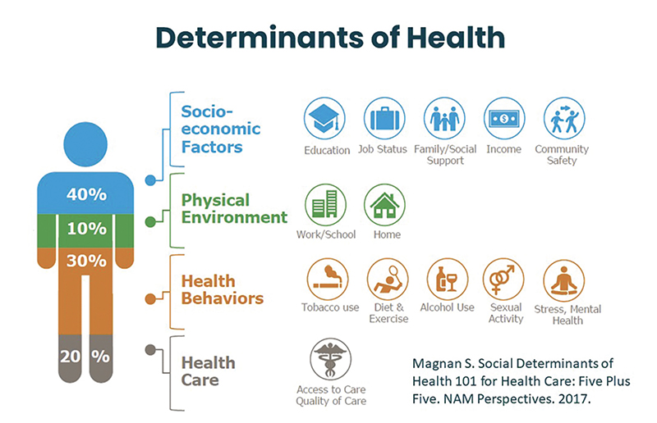

Slide 4
Why System Dynamics
Food Insecurity is a complex dynamic problem.
The interplay of social determinants of health—income, environment, and transportation—creates feedback loops that perpetuate food deserts and poor dietary habits.
System dynamics modeling provides a framework to capture these feedbacks and test interventions.
Goal: Understand the factors driving access to healthy food in Cleveland and test interventions that could improve food access and health.

Slide 5
Method

Slide 6
Study Context
The research team from Case Western Reserve University and University Hospitals conducted two-day workshops in Cleveland on November 18th, 2023, and February 17th, 2024.
Twenty Stakeholders participated in the workshop, representing:
Community Leaders,
Healthcare Providers,
Patients,
Residents,
Community Health Workers,
Community-Based Organizations, and
Researchers.
The food access model was built from a large qualitative model co-developed with the stakeholders to examine cardiovascular disease (CVD) risk factors.

Slide 7
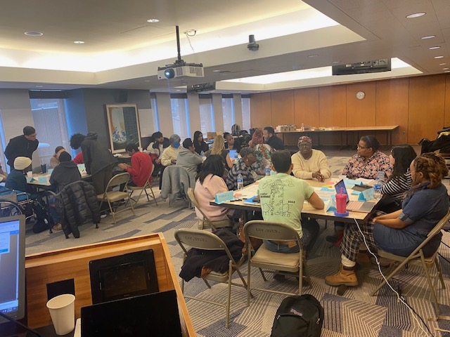
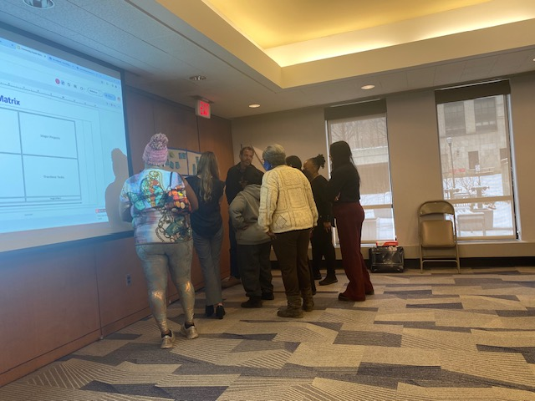
Group Model Building
1
Outcome Elicitation
What outcomes do you want to track to determine the success/failure of a CVD risk factors management and prevention program?.
2
Variable Elicitation
What variables can directly or indirectly influence the success and failure of a CVD risk factor management and prevention program and its outcomes?.
3
Structure Elicitation
Backbone model (Healthy population, Undiagnosed pre-CVD population, Diagnosed pre-CVD population, Managed pre-CVD population, Undiagnosed CVD population, Diagnosed CVD population, Managed CVD population).
4
Model Review
Stakeholders reviewed and refined the preliminary model structure in the second GMB session.
7
5
Action Ideas
Stakeholders listed current and future interventions CHWs could implement to improve the prevention and management of CVD risk factors.

Slide 8
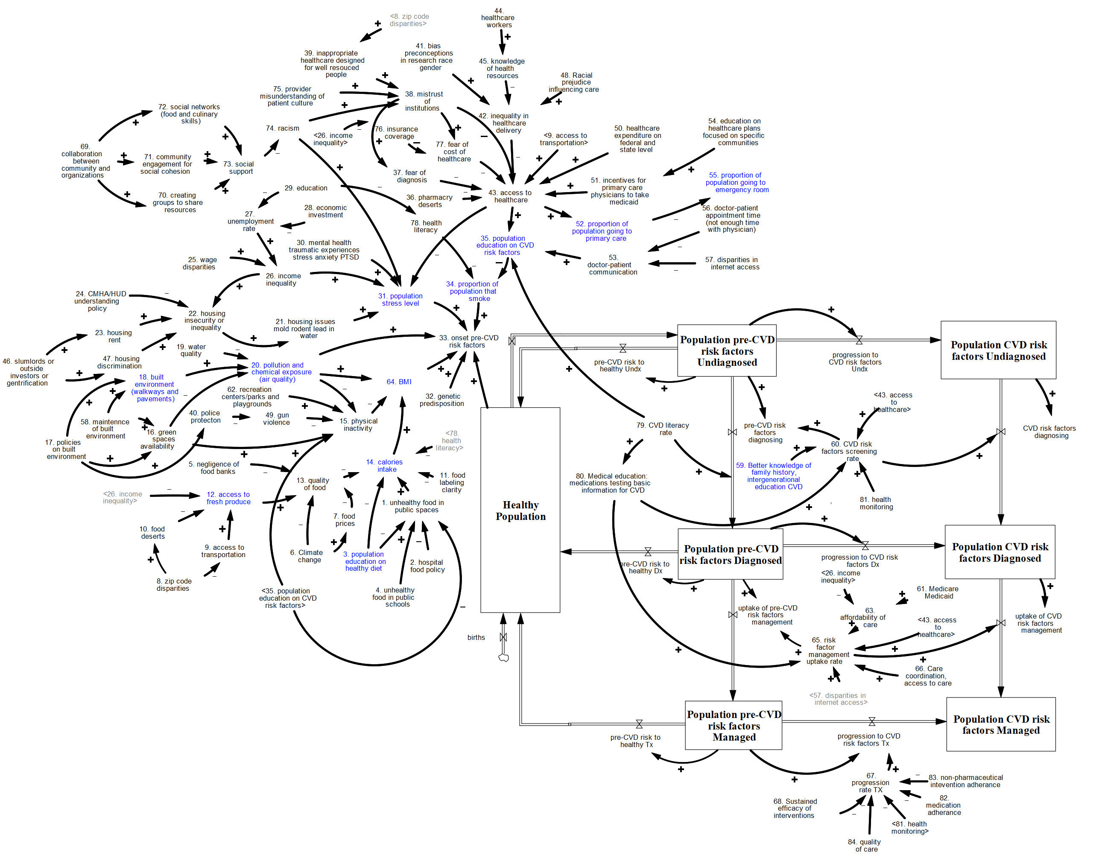
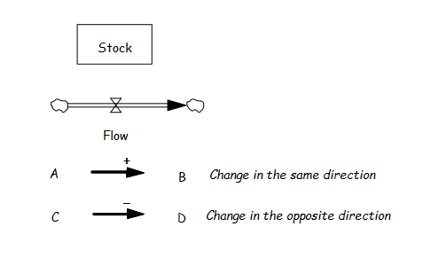
SDOH Impact on CVD Risk Factors
CVD INTERVENTIONS
Community Engagement
Healthcare System
Assistance and Information Agents (Group A)
A1. Food assistance
A2. Facilitate transport to health services
A3. Accessing BP devices from Medicaid
A4. Rent, utilities, and legal assistance
A5. Mental illness support
A6. Help veterans navigate the VA system
Screening and Health Education (Group S)
S1. Teach screening machine use
S2. Medication and proper dosage
S3. Connecting people to screening services in the community
S4. Advocate for high school athletics
S5. Educate on healthy diets, exercise, salt intake, sleep, rest, and stress
S6. Empower people to empower others
S7. Partner with churches and faith communities to promote healthy habits
S8. Expand partnerships with elementary, middle, and high schools regarding health
S9. Promote success stories
S10. Digital literacy (e.g., my chart, medical devices, telehealth)
Community Organizer (Group C)
C1. Work with social networks
C2. Presence of CHWs at community events
C3. Have a seat at the table of local government
S4, S5, S6, S7, S8, S9, C1, C2, C3
A2, A3, A5, A6, C3, S10
LEGEND
Economic
A4
Screening
A3, S1, S3, S8
Neighborhood
C1, C2
Treatment Uptake
Food
A1, S5, S7
Management
S2, S5, S10

Slide 9
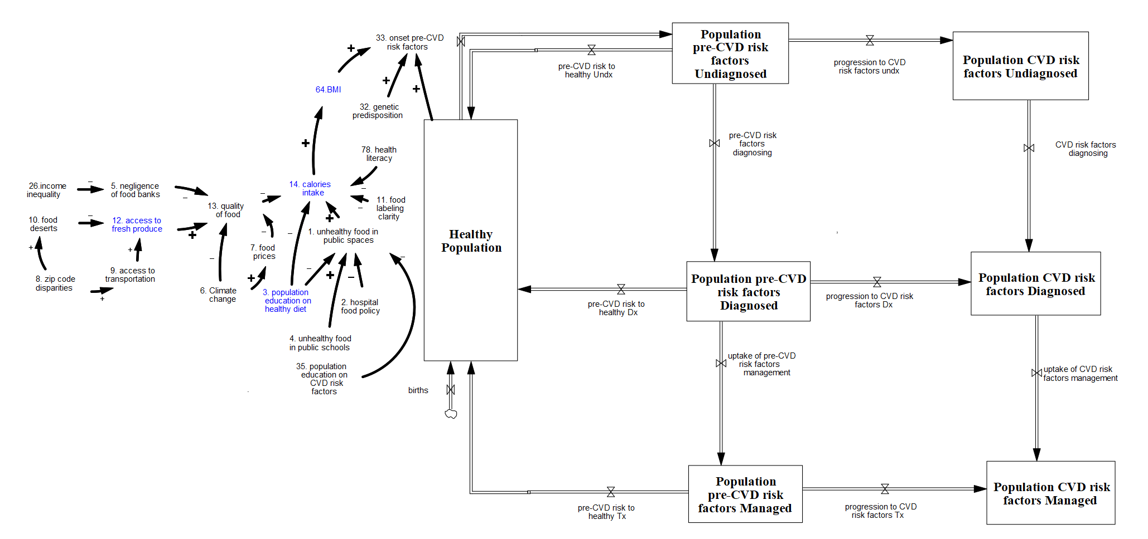
Food and CVD Risk Factors Onset
Food
A1, S5, S7
9

Slide 10
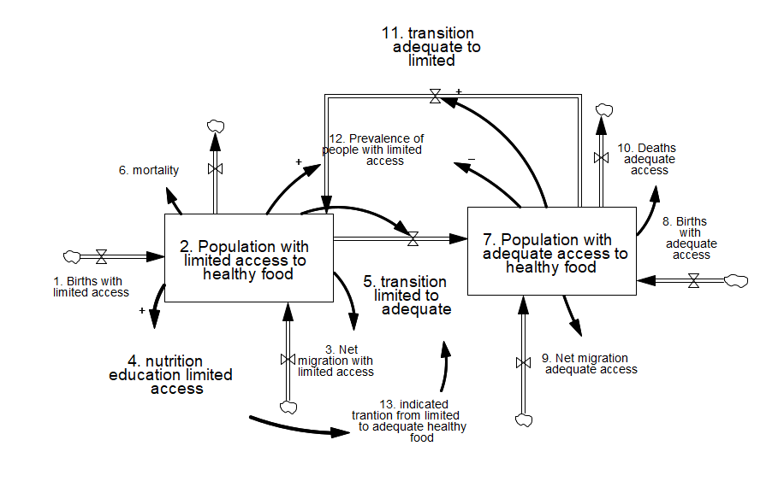
Population with access to healthy food

Slide 11
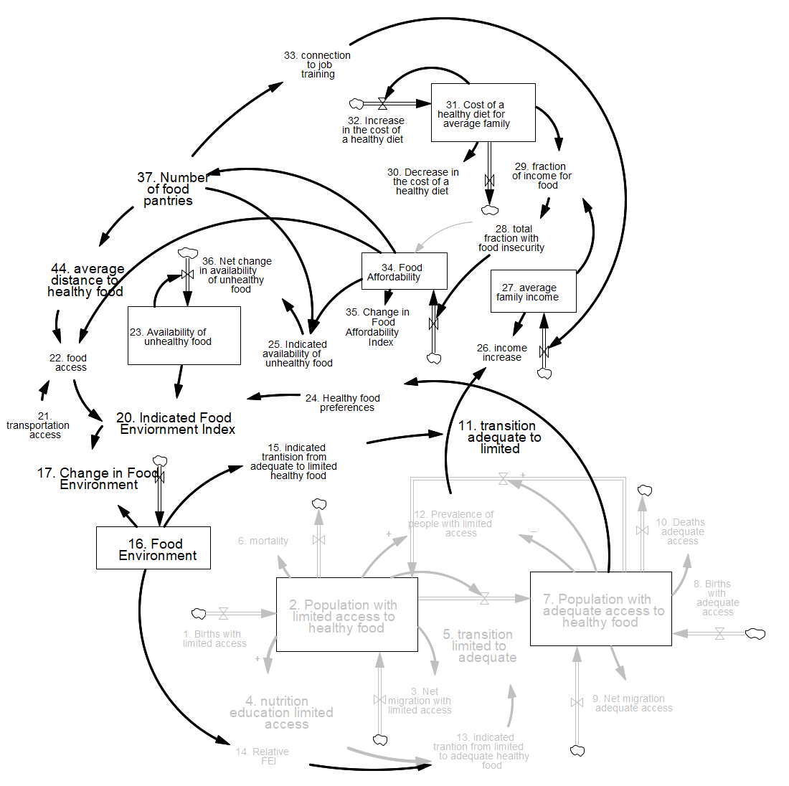
Impact of Food Environment

Slide 12
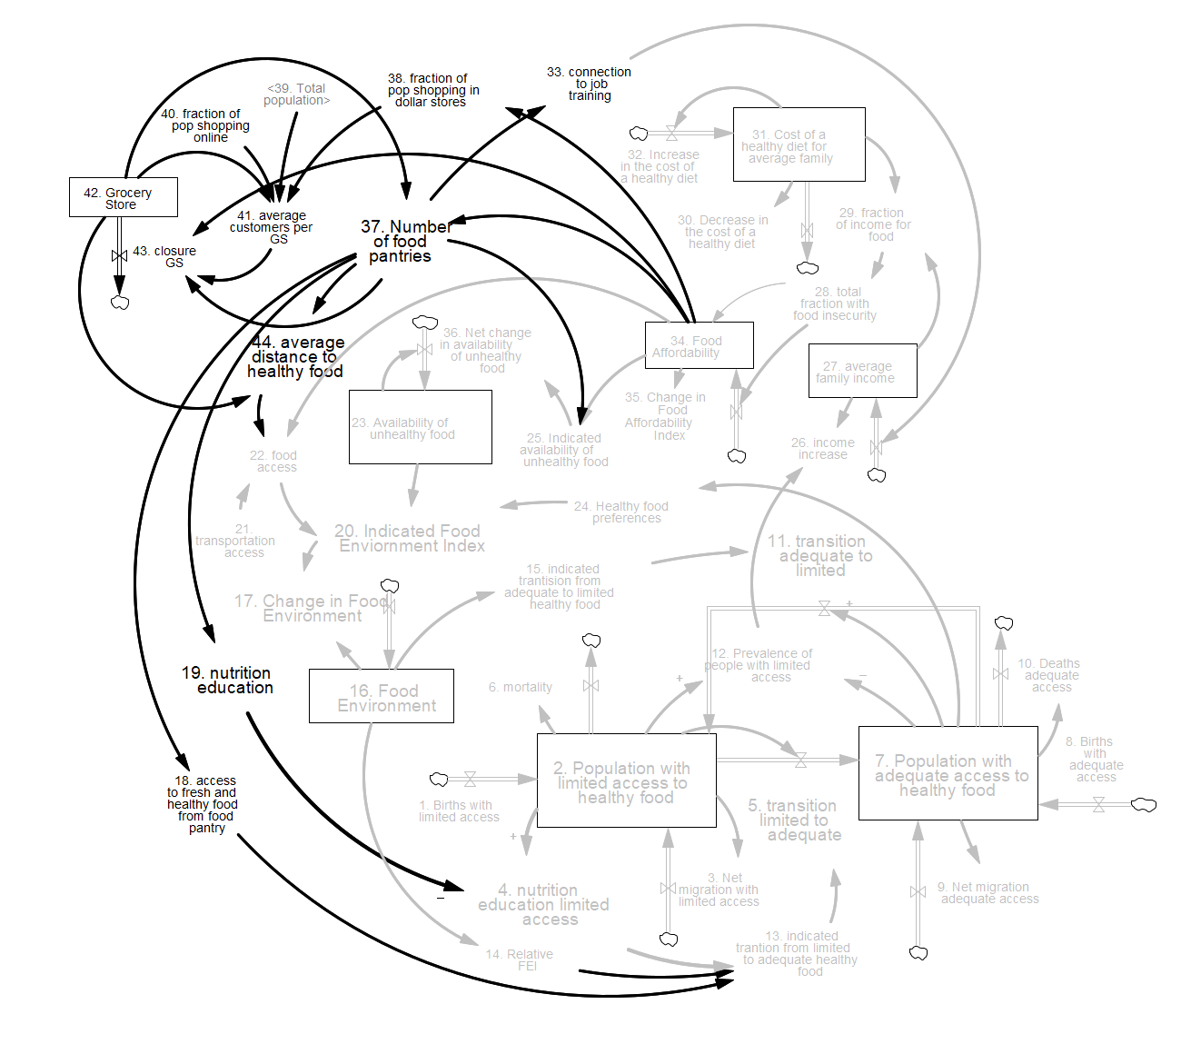
Impact of Food Pantries on Grocery Stores
1. Reduce the customer base of the local grocery shops.
2. Price sensitivity and competition with free.
3. Shifting purchasing pattern (customers buy non-perishable items, spend less per visit, which affects store margins).
4. Food pantries are subsidized while grocery stores are not.

Slide 13
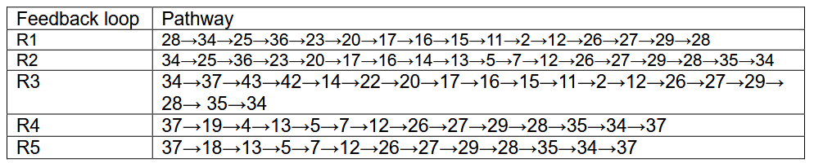
Feedback Loops

Slide 14
Data Sources
The demographic data were obtained from the U.S. Census Bureau
Data on the food environment, food insecurity, and proportion of the population with limited access to healthy food were obtained from County Health Rankings and Roadmaps.
The availability of unhealthy food data and the cost of healthy food data were derived from the U.S. Department of Agriculture (USDA).
Data on income distribution and SNAP beneficiaries were obtained from the Ohio state portal.
When data were not available, an estimate was used.

Slide 15
Interventions
Six interventions were simulated. These interventions represent different approaches to addressing food insecurity in Cleveland, each with distinct assumptions and goals:
Business-as-usual: Assumes no significant change in current policies or conditions. Trends such as declining food affordability, growing food deserts, and grocery store closures continue unchecked.
Income-focused interventions: Explore the effects of raising average family income through structural economic improvements. These include policies that improve wages, employment, and financial support, which are expected to enhance food affordability and reduce reliance on emergency food sources.

Slide 16
Interventions
SNAP Double-up: Simulates expanded benefits for low-income households to purchase fresh fruits and vegetables. While this increases purchasing power for healthy food, its impact is constrained by the low base income of most recipients.
Grocery Store Incentives: Includes grants and low-interest loans to keep grocery stores operating in underserved areas. Aims to prevent closures and improve the physical availability of healthy food.

Slide 17
Interventions
Food Bank/Pantry Funding: Models the effects of increasing funding for emergency food sources.
Comprehensive Intervention: Combines all of the above strategies into a unified policy response. This holistic approach addresses both structural income inequality and food access infrastructure.

Slide 19
Insights
Food insecurity is fundamentally economic
Food insecurity is not about the lack of food, but the lack of access to food. This access is determined by a person’s income, purchasing power, and economic stability. The food system produces more than enough food to feed everyone, yet people are hungry because they can not afford nutritious food consistently.
Food insecurity is closely tied to low-wage jobs, part-time or informal work, and unstable employment. These conditions leave people with insufficient income to meet basic needs.
Income-focused interventions break negative loops and reinforce recovery loops
Notes:
hun

Slide 20
Insights
A comprehensive approach is most effective—but requires coordination
Most interventions, such as SNAP, food pantries, food deserts programs (grocery shop), are short-term relief mechanisms. They temporarily reduce hunger but do not alter the economic reality that causes it.
Policies and interventions rarely address income inequality, job quality, and housing insecurity, all of which underpin chronic food insecurity.
Reliance on charitable food distribution can unintentionally normalize food insecurity.
Insufficient policy integration: food insecurity must not be treated in isolation. Policies and interventions must be cross-sectoral and economically focused to address the complex, interrelated drivers.
Policymakers must balance short-term relief with long-term structural change

