Slide 1
MacroLab Lite for Introductory Macroeconomics
I. David Wheat, PhD, MPP
Professor Emeritus, University of Bergen
david.wheat@uib.no
41st International System Dynamics Conference
Chicago, July 25, 2023
Professor, Economic Dynamics
National University of Kyiv-Mohyla Academy, Ukraine
Professor, Economics
Virginia Western Community College, USA
System Dynamics Group

Slide 2
MacroLab Lite: a Work in Progress
Motivation: recover original motivation to study system dynamics & build MacroLab.
Over time, MacroLab grew like topsy — • used for advanced instruction & policy analysis • detailed structure (financial structure, multiple industries, multiple households)
It’s time to put a macro model back in the hands of young students.
Emphasis on simple equations, with just a few basic SD structures applied throughout.
Current version of MacroLab Lite Well-developed Supply Side and a highly aggregated Demand Side. Almost entirely endogenous. Only exogenous inputs: - SS: growth rates of the civilian adult population & labor force participation - DS growth rate in total debt, both private and public.
Next upgrades: more sub-models • Financial sector -- including monetary policy. • Households, Firms, Government, and the Rest-of-the-World.

Slide 3
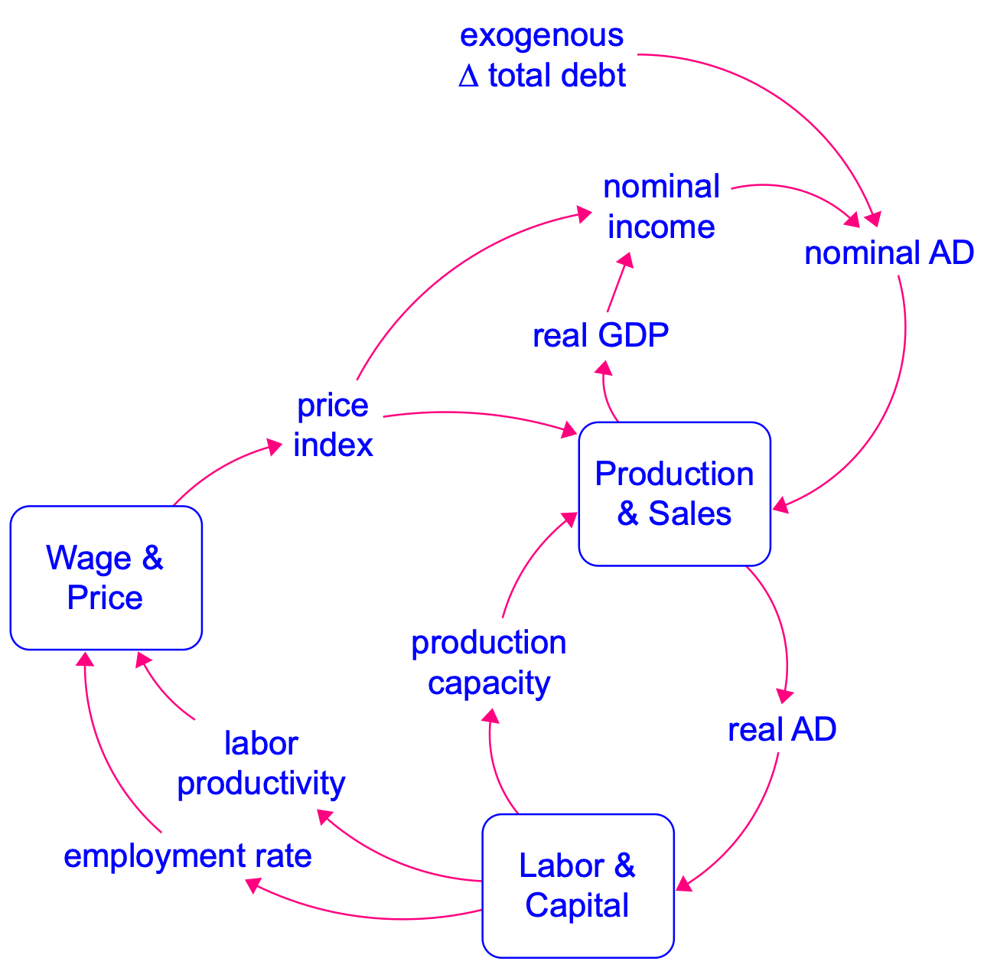
Overview of MacroLab Lite
Demand Side
Supply Side

Slide 4
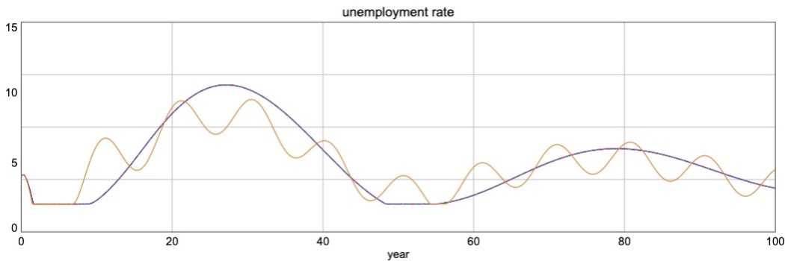
Simulation Results with Exogenous Growth in Debt
dark curve: constant growth rate
light curve: fluctuating growth rate

Slide 5
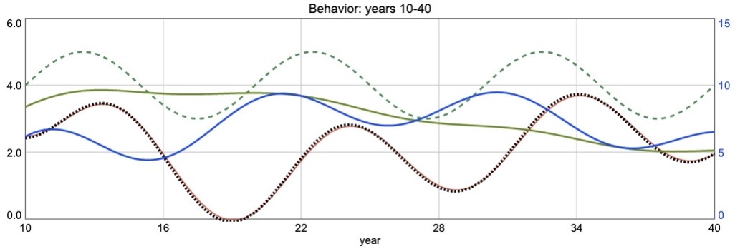
Simulation Results with Exogenous Growth in Debt
fluctuating growth rate
%∆
UR
∆ debt
Inflation
unemployment
rate
real AD growth rate
_______
real GDP growth rate ……………

Slide 6
Online Version of MacroLab Lite
https://exchange.iseesystems.com/public/david-wheat/litesdc

Slide 7
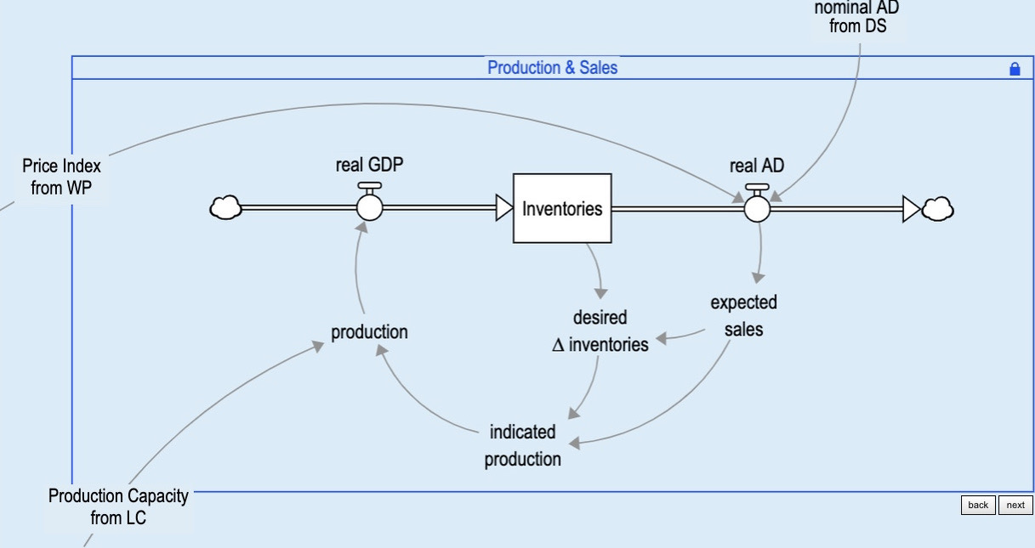
Production & Sales (PS) Sub-Model

Slide 8
Labor & Capital (LC) Sub-Model
Unemployment Rate
& Employment Rate
Employed Labor
& Productivity
Capital

Slide 9
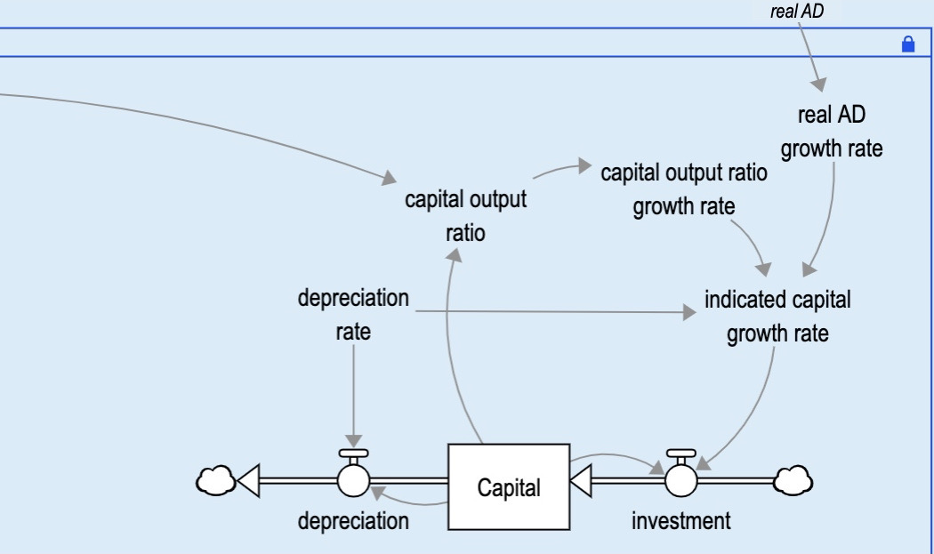
Capital Sector within LC Sub-Model
from PS
production
capacity

Slide 10
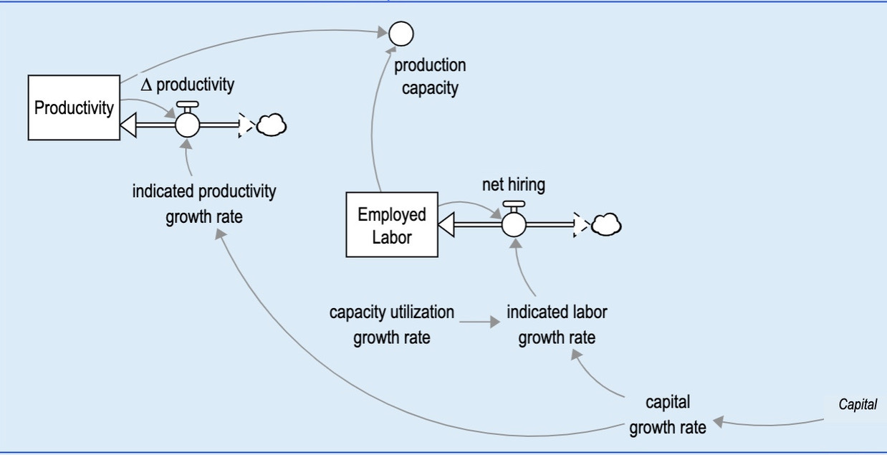
Employment & Productivity Sector within LC Sub-Model

Slide 11
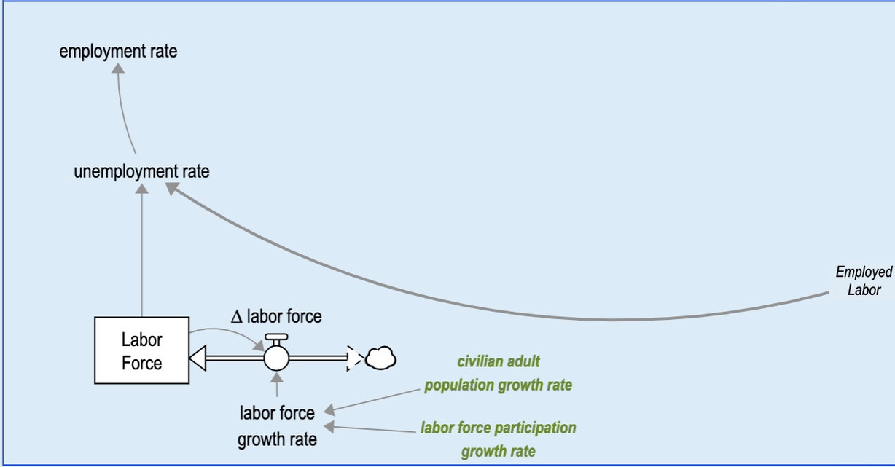
Unemployment Rate & Employment Rate within LC Sub-Model

Slide 12
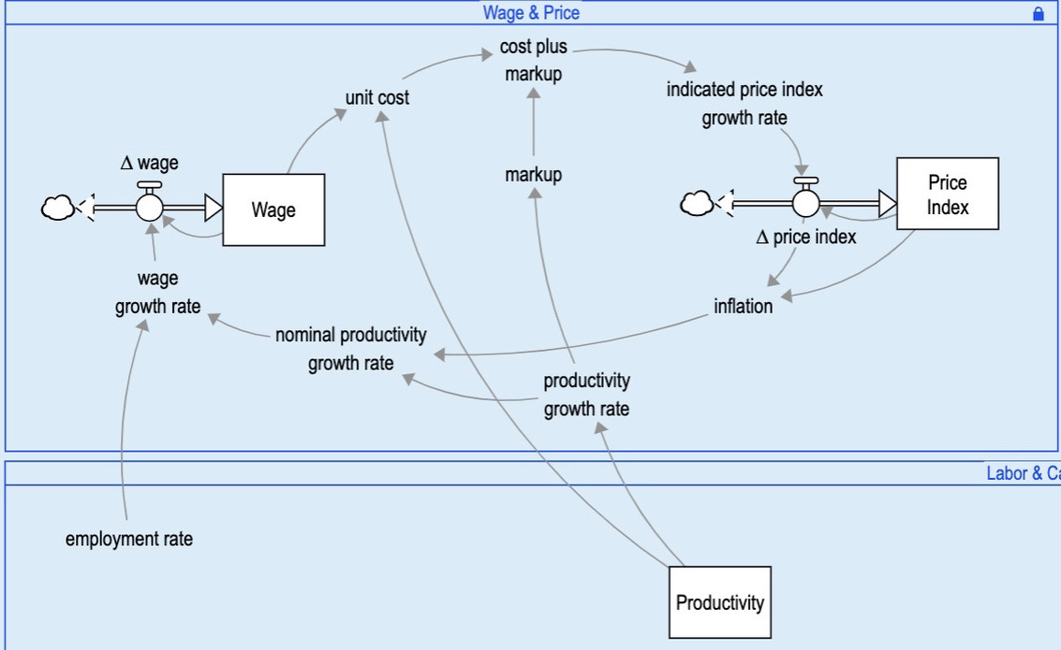
Wage & Price (WP) Sub-Model

Slide 13
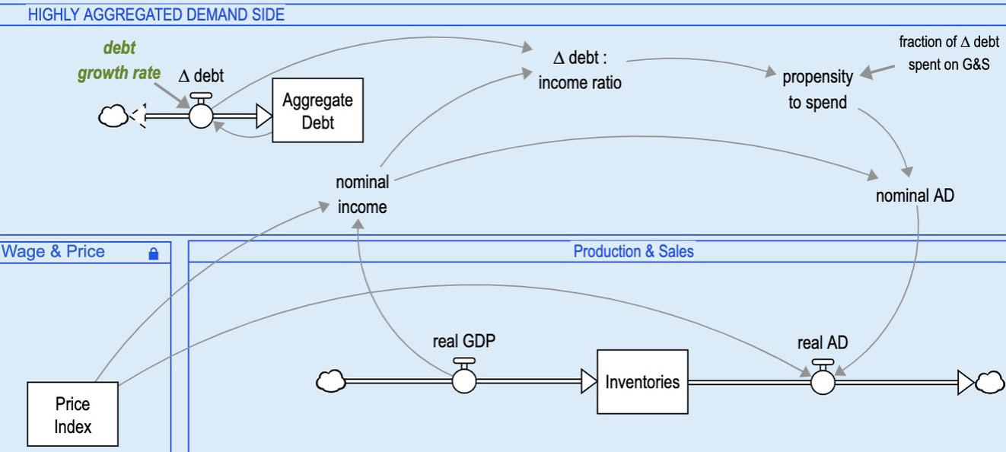
Highly Aggregated Demand Side

Slide 14
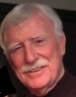
I. David Wheat Emeritus Professor of System Dynamics, University of Bergen, Norway Professor of Economics, Virginia Western Community College, United States Professor of Economic Dynamics, National University of Kyiv-Mohyla Academy, Ukraine Retired Professor, Financial Economics, ISM University of Management & Economics, Lithuania
Professor Wheat studies economic systems. His research specialty is simulation modeling of macroeconomic structure, behavior, and policy. He is particularly interested in the economies of Ukraine, the Euro Area, and the United States.
He teaches macroeconomic dynamics and policy to graduate students in Norway and Ukraine, and to undergraduates in the United States. In Norway, he taught the system dynamics modeling process for many years, as well as a course in policy design & implementation. In Lithuania, he taught monetary policy for many years. His research projects include collaboration with Ukrainian economists to build dynamic modeling capacity at national universities in Kyiv and Lviv, a system dynamics version of the central bank’s monetary policy model, and an economic recovery policy model for post-war Ukraine. He also worked with economists at Lithuania’s central bank to develop a multi-industry system dynamics model of price dynamics in Europe.
For more than twenty years, his system dynamics-based MacroLab model has been used by macroeconomics students in the United States. That model is available online, and students can use it without special software. He is currently writing a textbook to supplement student use of MacroLab. His latest economics journal article is Teaching Endogenous Money with Systems Thinking and Simulation Tools, and the most recent conference paper was Limits to Entrepreneurial Growth: Impact on Firm Demographics and Employment. He is co-editor of Feedback Dynamics (Springer 2021), which includes ‘Get Started with Macro Modeling’ (with M. Oliskevych and A. Novik).
Wheat is past-president of the economics chapter of the International System Dynamics Society. He served as Associate Editor of the System Dynamics Review and on the Advisory Board of the International Journal of Pluralism and Economics Education. He has given guest lectures in more than twenty countries. For three decades, he was president of Wheat Resources Inc, a consulting firm serving business and government clients. His current firm, Praktika LLC, specializes in coaching others to build useful models (https://www.usefulmodels.net). He received his PhD in system dynamics at the University of Bergen, his master’s degree in public policy at Harvard University, and his bachelor’s degree in government and mathematics at Texas Tech University. During the 1970s, he served at the White House as staff assistant to the President of the United States.
In a previous life, he and his young family lived in the Blue Ridge Mountains of Virginia, where they built a barn and raised goats and chickens, and he was Coach of the Year twice after winning back-to-back state championships in high school girls’ basketball. Recently, after two decades in Norway, he and his wife returned to Virginia and settled in Charlottesville, near Washington, D.C. He still works in Europe about two months each year.
7

