Slide 1
Equation is not Causation
Using stock-flow diagrams to show causality in physics lessons
Practitioner Application for
Online Poster Presentation
Sena Yıldız Değirmenci, Systems Thinking Association
Emre Göktepe,Systems Thinking Association
THE 41ST INTERNATIONAL SYSTEM DYNAMICS CONFERENCE
Chicago, USA and Virtually

Slide 2

Introduction
Guided learning is needed
    Not only is unguided instruction normally less effective; there is also evidence that it may have negative results when students acquire misconceptions or incomplete or disorganized knowledge. (Kirschner, 2006)
but...
Guided learining may also cause misconceptions
    ...teachers could have played a role in the formation of misconceptions held by their student... Another factor that contributes occurrence of misconceptions by students is textbooks, which include many errors and incorrect information. (Tekkaya, 2002)
THE 41ST INTERNATIONAL SYSTEM DYNAMICS CONFERENCE
Chicago, USA and Virtually
#isdc2022
THE 40TH INTERNATIONAL SYSTEM DYNAMICS CONFERENCE
Virtually everywhere!

Slide 3
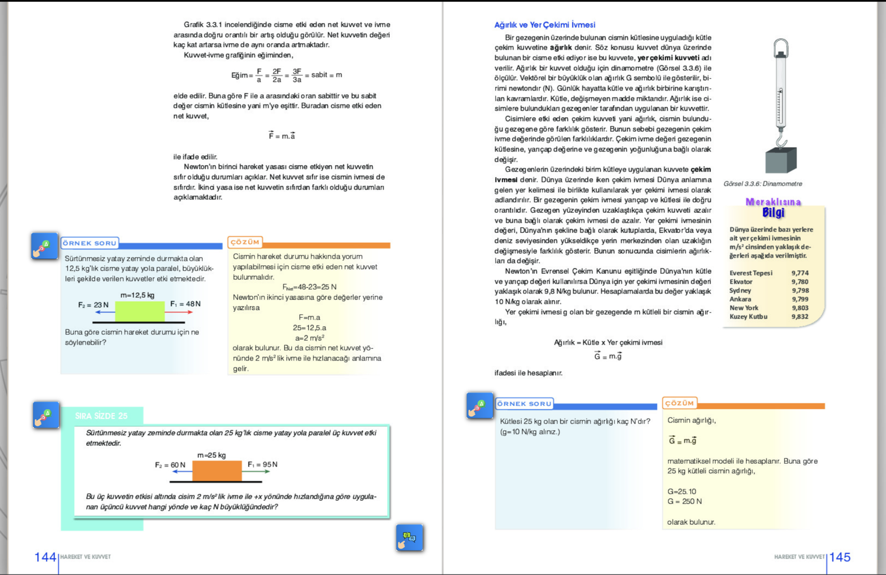
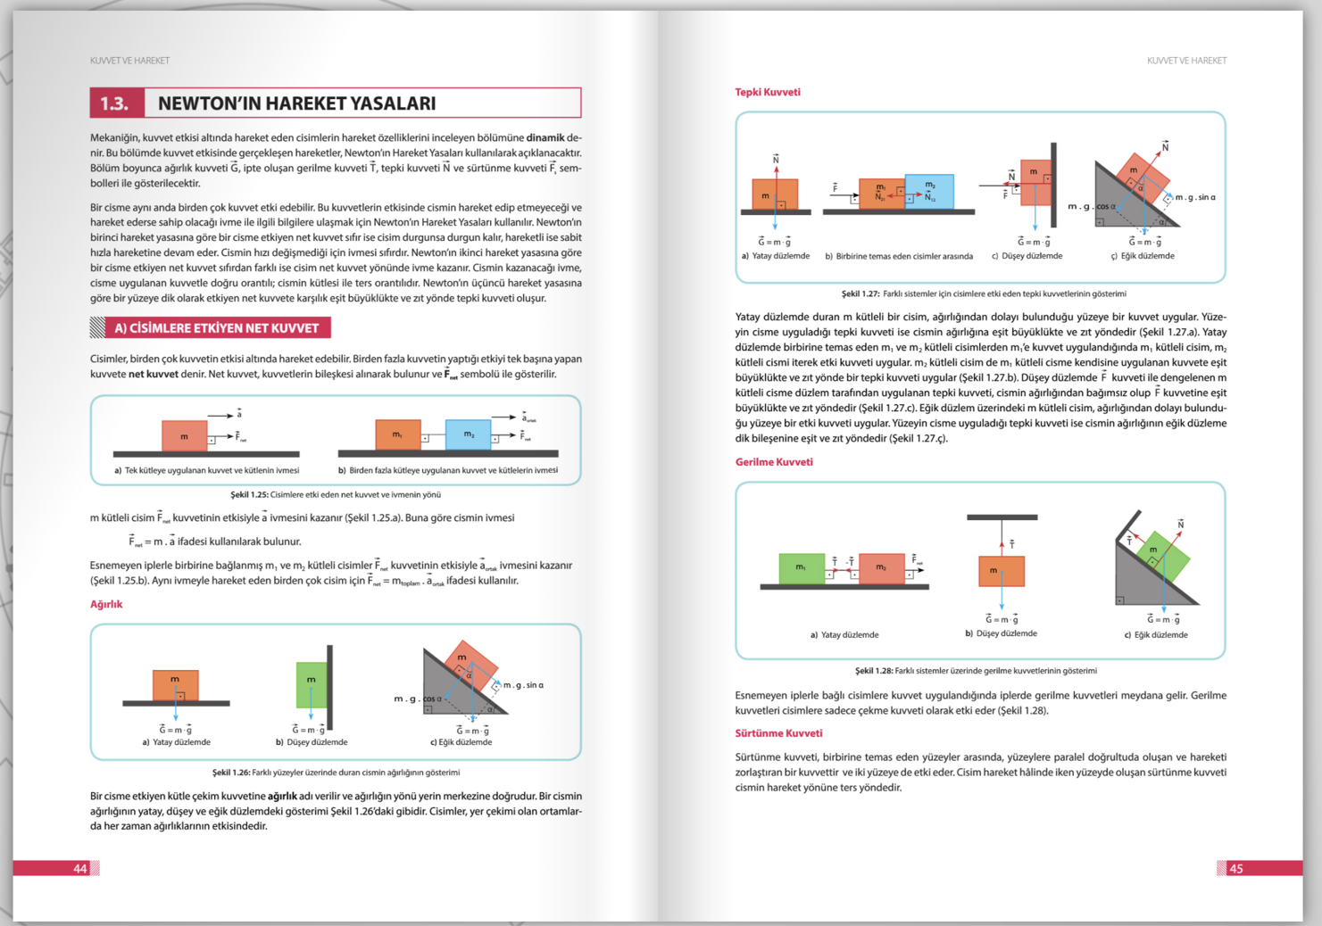
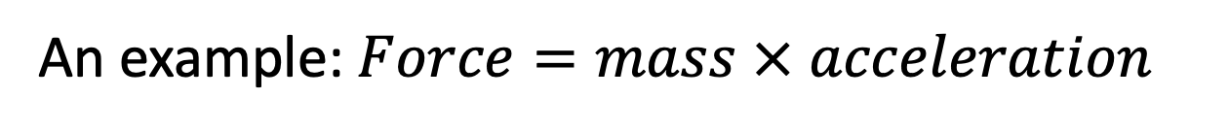
An example: $Force=mass × acceleration$
Some pages from a science textbook from K-12 education
9th Grade Science course textbook (MoNE, n.d.a)
11th Grade Physics course textbook (MoNE, n.d.b)
THE 41ST INTERNATIONAL SYSTEM DYNAMICS CONFERENCE
Chicago, USA and Virtually
#isdc2022
THE 40TH INTERNATIONAL SYSTEM DYNAMICS CONFERENCE
Virtually everywhere!

Slide 4
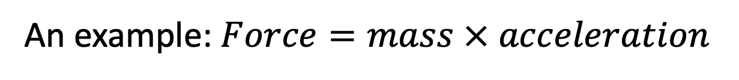
An example: $Force=mass × acceleration$
Number fo entries for Google search results for
“a = F / m” 6,210,000 entries
“F = m * a” 18,670,000,000 entries
(Google, 2023)
THE 41ST INTERNATIONAL SYSTEM DYNAMICS CONFERENCE
Chicago, USA and Virtually
#isdc2022
THE 40TH INTERNATIONAL SYSTEM DYNAMICS CONFERENCE
Virtually everywhere!

Slide 5
from Principia Mathematica (Newton, 1687)
p.83 - LAW II. The alteration of motion is ever proportional to the motive force impressed; and is made in the direction of the right line in which that force is impressed.
(p.73 - DEFINITION II. The quantity of motion is the measure of the same, arising from the velocity and quantity of matter corjunctly.)
THE 41ST INTERNATIONAL SYSTEM DYNAMICS CONFERENCE
Chicago, USA and Virtually
#isdc2022
THE 40TH INTERNATIONAL SYSTEM DYNAMICS CONFERENCE
Virtually everywhere!

Slide 6

Problem Statement
These equations are mathematically equivelant:
But only one of them depict causality
  Force is not a result of mass and acceleration
  Mass is not a result of force and acceleration
  Acceleration is a result of force and mass
It is not possible to see the causality in an equation
This ambiguity may easily cause misconceptions
$$F=ma$$ | $$m=\frac{F}{a}$$ | $$a=\frac{F}{m}$$
THE 41ST INTERNATIONAL SYSTEM DYNAMICS CONFERENCE
Chicago, USA and Virtually
#isdc2022
THE 40TH INTERNATIONAL SYSTEM DYNAMICS CONFERENCE
Virtually everywhere!

Slide 7

Approach or Dynamic Hypothesis
$$=\frac{force}{mass}$$
A simple stock-flow diagram clearly shows the nature of relations
  Acceleration is a result of force and mass
THE 41ST INTERNATIONAL SYSTEM DYNAMICS CONFERENCE
Chicago, USA and Virtually
#isdc2022
THE 40TH INTERNATIONAL SYSTEM DYNAMICS CONFERENCE
Virtually everywhere!

Slide 8
An implemantation example
from a lesson plan for 8th grade Science lesson
all unis in seconds
THE 41ST INTERNATIONAL SYSTEM DYNAMICS CONFERENCE
Chicago, USA and Virtually
#isdc2022
THE 40TH INTERNATIONAL SYSTEM DYNAMICS CONFERENCE
Virtually everywhere!

Slide 9

Another example
Ohm’s Law
$$V =I × R$$
Ohm’s Law with related stocks
THE 41ST INTERNATIONAL SYSTEM DYNAMICS CONFERENCE
Chicago, USA and Virtually
#isdc2022
THE 40TH INTERNATIONAL SYSTEM DYNAMICS CONFERENCE
Virtually everywhere!

Slide 10
A major reason for lack of applications so far
System dynamics is mostly deals with endogenous behaviour of social systems
    The System Dynamics Approach
    ...
    It uses simulation modeling based on feedback systems theory that complements systems thinking approaches. It applies to dynamic problems arising in complex social, managerial, economic, or ecological systems. It can be applied to social, managerial, economic, ecological, and physiological systems. System Dynamics Society (n.d.)
THE 41ST INTERNATIONAL SYSTEM DYNAMICS CONFERENCE
Chicago, USA and Virtually
#isdc2022
THE 40TH INTERNATIONAL SYSTEM DYNAMICS CONFERENCE
Virtually everywhere!

Slide 11
Possible applications with feedback
A horizontal spring-mass system
A system with a graviational force
THE 41ST INTERNATIONAL SYSTEM DYNAMICS CONFERENCE
Chicago, USA and Virtually
#isdc2022
THE 40TH INTERNATIONAL SYSTEM DYNAMICS CONFERENCE
Virtually everywhere!

Slide 12
Results
Stock-flow diagrams
  can be used in K-12 education
  to construct correct mental models
  about causal relations in physical phenomenon
THE 41ST INTERNATIONAL SYSTEM DYNAMICS CONFERENCE
Chicago, USA and Virtually
#isdc2022
THE 40TH INTERNATIONAL SYSTEM DYNAMICS CONFERENCE
Virtually everywhere!

Slide 13
References
Google. (2023). Google search result for "a=F/m" Retrieved March 12, 2023, from https://www.google.com/search?q=“a=F/m”
Google. (2023). Google search result for "F=m*a" Retrieved March 12, 2023, from https://www.google.com/search?q=“F=m*a”
Hirsch, G. B. (2002). Using Dynamic Simulation to Teach Physics in a Real-World Context.
Kirschner, P. A., Sweller, J., & Clark, R. E. (2006). Why minimal guidance during instruction does not work: An analysis of the failure of constructivist, discovery, problem-based, experiential, and inquiry-based teaching. Educational psychologist, 41(2), 75-86.
MoNE (n.d.a). Etkileşimli Ktaplar: Fizik 9. Eğitim Bilişim Ağı Sitesi Ortaöğretim Genel Müdürlüğü. Milli Eğitim Bakanlığı – Ministry of National Education (MEB - MoNE) https://ogmmateryal.eba.gov.tr/panel/panel/EKitapUniteOnizle.aspx?Id=155&sayfa=144 (Accessed: March 3, 2023)
MoNE (n.d.b). Etkileşimli Ktaplar: Fizik 11. Eğitim Bilişim Ağı Sitesi Ortaöğretim Genel Müdürlüğü. Milli Eğitim Bakanlığı – Ministry of National Education (MEB - MoNE) https://ogmmateryal.eba.gov.tr/panel/upload/etkilesimli/kitap/fizik/11/unite1/index.html#p=32 (Accessed: March 3, 2023)
Newton, Isaac. "Principia mathematica (1687)." Trans. Andrew Motte. On line: https://ia802706.us.archive.org/0/items/newtonspmathema00newtrich/newtonspmathema00newtrich.pdf
Schecker, H. P. (1996). Modeling Physics System Dynamics IN Physics Education. Published in the “Creative Learning Exchange” Newsletter.
System Dynamics Society (n.d.). What is System Dynamics? System Dynamics Society. https://systemdynamics.org/what-is-system-dynamics/ (Accessed: March 13, 2023)
Tekkaya, C. (2002). Misconceptions as barrier to understanding biology. Hacettepe Üniversitesi Eğitim Fakültesi Dergisi, 23(23).
THE 41ST INTERNATIONAL SYSTEM DYNAMICS CONFERENCE
Chicago, USA and Virtually
#isdc2022
THE 40TH INTERNATIONAL SYSTEM DYNAMICS CONFERENCE
Virtually everywhere!

