Slide 1
Understanding Limits to Success in Equitable Investment Approaches for Black-led Community Based Organizations
41st International System Dynamics Conference
Parallel (121): Use of system archetypes to improve
diversity, equity, and inclusion
7/25/2023
Irene Headen, Melanie Houston, and Christine Delfino
Notes:
Goals of this:
-Last year, Inge mentioned that a goal-gap structure might be interesting to explore because the goals of organizations may be different than the goals of white-led investors
-Also, people wanted to know about other organizations, like latinx or native organizations; this was also brought up here, that comparing to other organizations (both poc and white led) to see if structures are similar would ”improve the work”
-We will need to make a stronger argument about why not centering whiteness is important

Slide 2
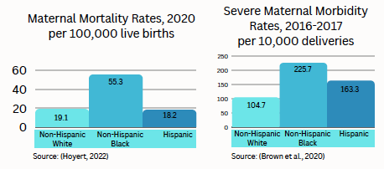
Background-General
A multipronged approach to improving maternal health has jointly focused on
Racial inequities that disproportionately impact Black birthing people
Improving the quality of care received through developing a more holistic system of care
Both conventional and community-based care models are a focus of improvement
Community-based organizations providing maternal health services across the continuum of care during the childbearing period are both critical to success and an area of underinvestment
Brown, C. C., Adams, C., George, K., & Moore, J. A. (2020). Associations Between Comorbidities and Severe Maternal Morbidity. Obstetrics & Gynecology, 136(5), 892 901. https://doi.org/10.1097/aog.0000000000004057; Hoyert DL. Maternal mortality rates in the United States, 2020. NCHS Health E-Stats. 2022. DOI: https://dx.doi.org/10.15620/cdc:113967. Taylor, J., Novoa, C., Hamm, K., & Phadke, S. (2019). Eliminating racial disparities in maternal and infant mortality: a comprehensive policy blueprint. Center for American Progress, 1(1), 1-93.

Slide 3
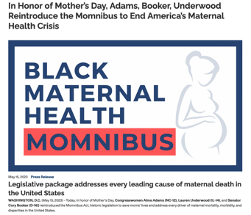
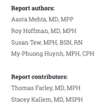
Background-General
Both national and local initiatives to foster investment in CBOs have emerged
Supporting these initiatives requires (1) better understanding of investment overall and (2) better understanding of how to achieve sustainable investment
Past investment has often had unintended consequences leading to short term growth but long term failure
The persistence of these unintended consequences suggest that dynamic feedback may be impacting this process
https://adams.house.gov/media-center/press-releases/honor-mothers-day-adams-booker-underwood-reintroduce-momnibus-end
Notes:
[READ ARTICLES THAT YOU SENT TO SID FOR THIS PART; MAY HAVE THIS ON A SEPARATE SLIDE WITH REFERENCE MODE]
In Philadelphia, a city-wide Community Investment team housed in the OVA multi-sector action initiative led by the MCFH division of PDPH has been leading this work
https://adams.house.gov/media-center/press-releases/honor-mothers-day-adams-booker-underwood-reintroduce-momnibus-end

Slide 4
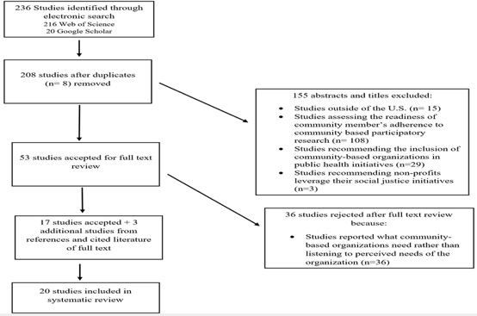
Background-Review
To better understand investment, we conducted a comprehensive literature review to identify factors driving or preventing sustainable investment from the perspective of Black-led organizations
Identified 21 relevant factors
Many narratives described feedback processes, but this feedback wasn’t well captured in explicit models and action steps
Structural racism, as a dynamic process, was a thread throughout
We used system dynamics to better illustrate this feedback in anticipation of developing a concept model to inform a local engagement process
Notes:
Use this to create a goal-gap structure (?): Black-led CBOs largely defined success
as receiving investment, whether in the form of financial funding or access to other resources, that
allowed them to remain in alignment with their mission and values-driven work. This core definition of
success from their perspective seemed to misalign with the current funding structure (relating to
financial investment), which mostly aligned with being “profitable” as the top priority, over mission or
values-driven approaches that may lead to less income/profit.
Define racialization and racism

Slide 5
Problem Statement
How can considering the structure interconnecting factors that facilitate or constrain organizational success enhance our understanding of how structural racism shapes experiences of success for Black-led CBOs?
Objective: To explore the application of qualitative system dynamics methods to illustrate how structural racism impacts successful investment in Black-led CBOs
Use the limits to growth/success archetype as a “building block” from which to understand narratives encountered in literature
Notes:
In the long run, this would allow us to develop a dynamic hypotheses to better inform interventions to reduce racism in Black leaders’ experiences at the helm of Black-serving CBOs.
How structural racism informs (or interferes with) the sustainable functioning of Black-led CBOs (Powell, 2008; Stroh, 2015).

Slide 6
Archetypes—Overview
Explored the “limits to growth/success” archetype specifically because
Focuses on growth and decline cycles
Framework for extrapolating impact of internal and external factors driving a limit to growth
Gives insight for why some actions businesses take may not lead to desired outcome
Could be useful when processes of racialization are part of the constraining action or limit to growth/success because these factors are not often explicit
Notes:
Systems archetypes are generic templates to represent the structural and behavioral insights in dynamic systems.
Limit can be a resource constraint or an external or internal response to growth
If in experiencing a decline, a system ramps up the reinforcing loop it has relied on for growth, this will only exacerbate its progression towards the limits – it will not overcome or overpower the limits (Senge, 2006; Stroh, 2015).
The problem then shifts from being the perceived underperformance of the reinforcing loop or growth process, to the unattended to or unmanaged limits to the growth process (Senge, 2006).
Racialization:

Slide 7
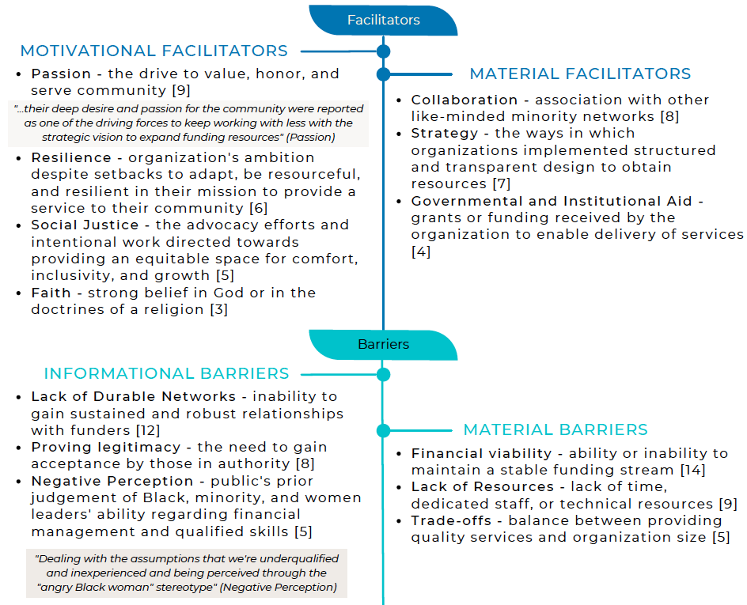
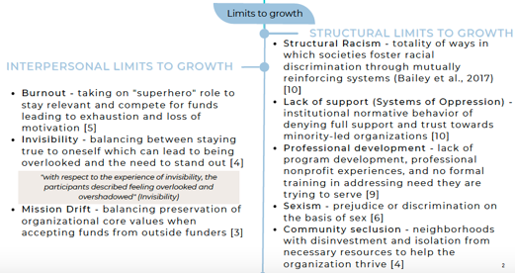
Archetypes—Application to Black-led CBO Limits to Success
Method: Obtained variables from previous literature review
We focused on two mechanisms from these narratives that could be better understood using the limits to success framework
Notes:
Variable types: Facilitators, Barriers, and potential limits to growth (but we hadn’t put them in this framework)
Include appendix table in extra slides
Resources encompassed intangible resources (such as relationships, support, knowledge, skills) and tangible resources (buildings, funds, infrastructure). Funds included all sources that provide money for the CBO to use.
Supporting this motivation to translate insight into action, many Black leaders described a strong influence of passion, faith, and resilience.
The themes outlined in the previous comprehensive review relating to patterns of decline included financial viability, lack of access to resources, proving legitimacy, negative perceptions, and burnout.
These negative perceptions set the tone for why and how Black CBO leaders had to do more to prove themselves as legitimate or trustworthy to their peers or funders compared to their white counterparts, even though Black leaders had ample credentials, experience, and training.
[THE GOAL GAP STRUCTURE!] The trade-offs and mission drift exist when the goals of the CBO are not aligned with the goals of the external funders. Many of the CBOs reported explicitly needing to decenter Black cultural practices in order to be seen as legitimate by mostly white funders.

Slide 8
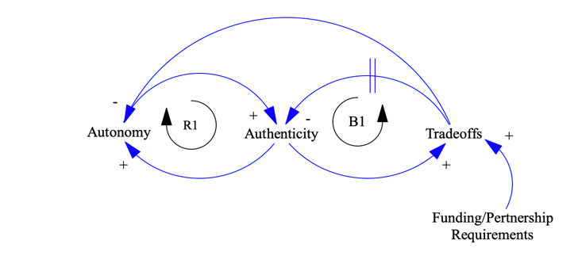
Archetypes—Application to Black-led CBO Limits to Success
Mission Drift: The tension of wanting to preserve authentic organizational core values but having to make concessions in order to meet funders’ expectations.
Adhering to these expectations often comes at the expense of autonomy
R1: When Black CBO leaders have more ability to act on their own visions for change in their community, this leads to authenticity in organizations’ operations. Centering the values that matter most to the community strengthens their ability to commit to their vision for change
B1: As CBO leaders make decisions aligned with their values, operating in a landscape with different values requires leaders to make trade-offs to gain access to resources. These trade-offs may result in decreased authenticity.
Partnership

Slide 9
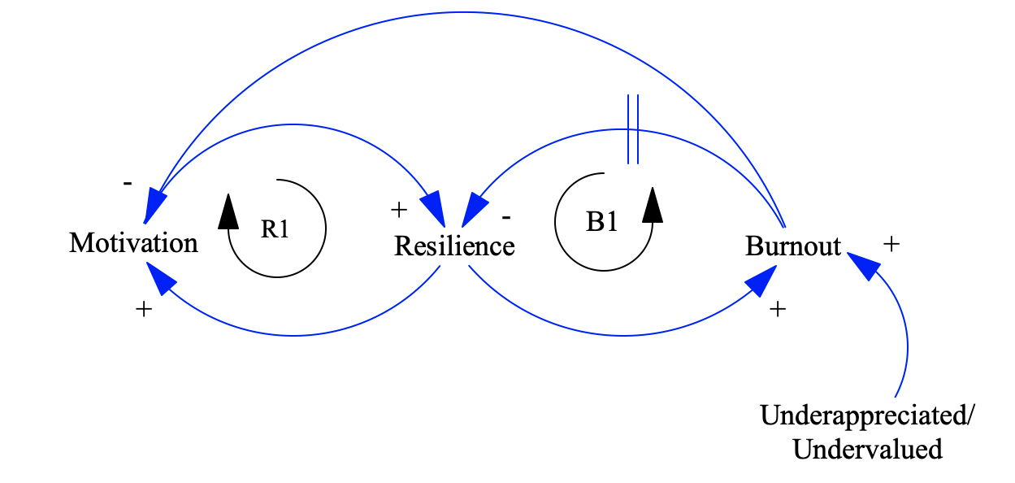
Archetypes—Application to Black-led CBO Limits to Success
Burnout from Systems of Oppression: Taking on more than CBO leaders can handle out of necessity, which then takes a toll on the whole organization due to unsustainable performance
Undervaluation ends up depleting motivation needed to increase resilience
R1: Motivation drives Black leaders’ commitment to community. With more motivation, Black leaders develop the resilience to overcome obstacles or barriers. In turn, this resilience strengthens the motivating factors driving Black CBO leaders.
B1: As CBO leaders overcome more obstacles through their resilience, they can experience more overwhelm leading to burnout. The burnout, over time, depletes resilience.

Slide 10
Insights
Applying the limits to success archetype uncovered important insight for action:
Many Black-led CBOs double down on building resilience and/or increasing authenticity in the face of declining growth
This may not lead to desired outcomes given the behavior implied by the limits to success archetype
Equal focus on disrupting the limits (i.e. funders’ requirements and underappreciation) are needed to successfully get out of (and not accelerate) cycles of decline
Notes:
[From paper: Specifically, in the case of Black-led CBOs experiences of structural racism through forms of undervaluation and underappreciation as well as requirements of external funders as a limit to their organization’s growth, the solution is not for Black leaders to better predict or internally manage experiences of structural racism.]
Some benefits for using archetypes in this case is not only to work towards insights about how certain parts of the system function, but also can be useful in facilitating stakeholder engagement. Makes concrete the value add of using system dynamics to understand this problem overall because in our case it 1) aligns with an established narrative, 2) provides simple straightforward anchor to understand feedback loops, delays, and unintended consequences, 3) links to anticipated action (as described in the archetypes cannon) that makes clear how this method can lead to action and not just another manuscript on the shelf. This last point is incredibly important in accumulating buyin because so many collective impact and other processes have ended in no clear action forward, action that does not align with insight, or action that norms back to the lowest hanging fruit that (in the end) do not achieve the desired outcomes.

Slide 11
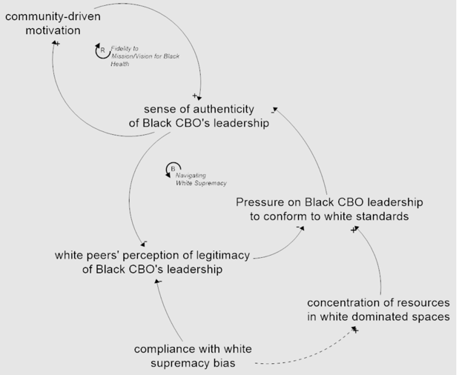
Insights (cont’d)
Support that is conditional on reinforcing ideals rooted in Whiteness, whether intentionally or not, limits the ability for Black-led CBOs to operate to effectively deliver services for the communities they serve
Addressing the embeddedness of these ideals requires white leaders/organizations/funders also become aware of the limits they (unintentionally) place on the leadership of Black CBOs
Notes:
Black leaders cannot opt out of these white-led spaces because of the degree to which key resources are concentrated within these spaces.

Slide 12
Implications and Next Steps:
Use of an archetype was effective in representing Black-led CBO leaders’ narratives of key processes limiting their ability to sustainably function
We will explore whether these archetypes paired with their vignettes can function as an effective “on ramp” for engagement of local orgs
Maternal health orgs in Philadelphia, PA
Currently developing an engagement clinic to get more region and topic specific insights about these processes
Inform potential action towards a city wide goal to invest in BIPOC CBOs
Notes:
The limits to success archetype was particularly relevant in this context because it specifically emphasized the need to anticipate or plan for the limit rather than relying on just the reinforcing or growth process to generate the right course of growth in order to effectively manage success.

Slide 13
Thank You! Questions?

