Slide 1
Dynamic Modelling of Circadian Rhythm Disorder and its Connections to Autism in Fetus
WIP Presentation
Ekin Yurdakul, Bogazici University
Prof. Kutlu Ulgen, Bogazici University
Prof. Yaman Barlas, Bogazici University
@systemdynamics_
THE 41st INTERNATIONAL SYSTEM DYNAMICS CONFERENCE
Chicago, USA and Virtually
#isdc2023

Slide 2
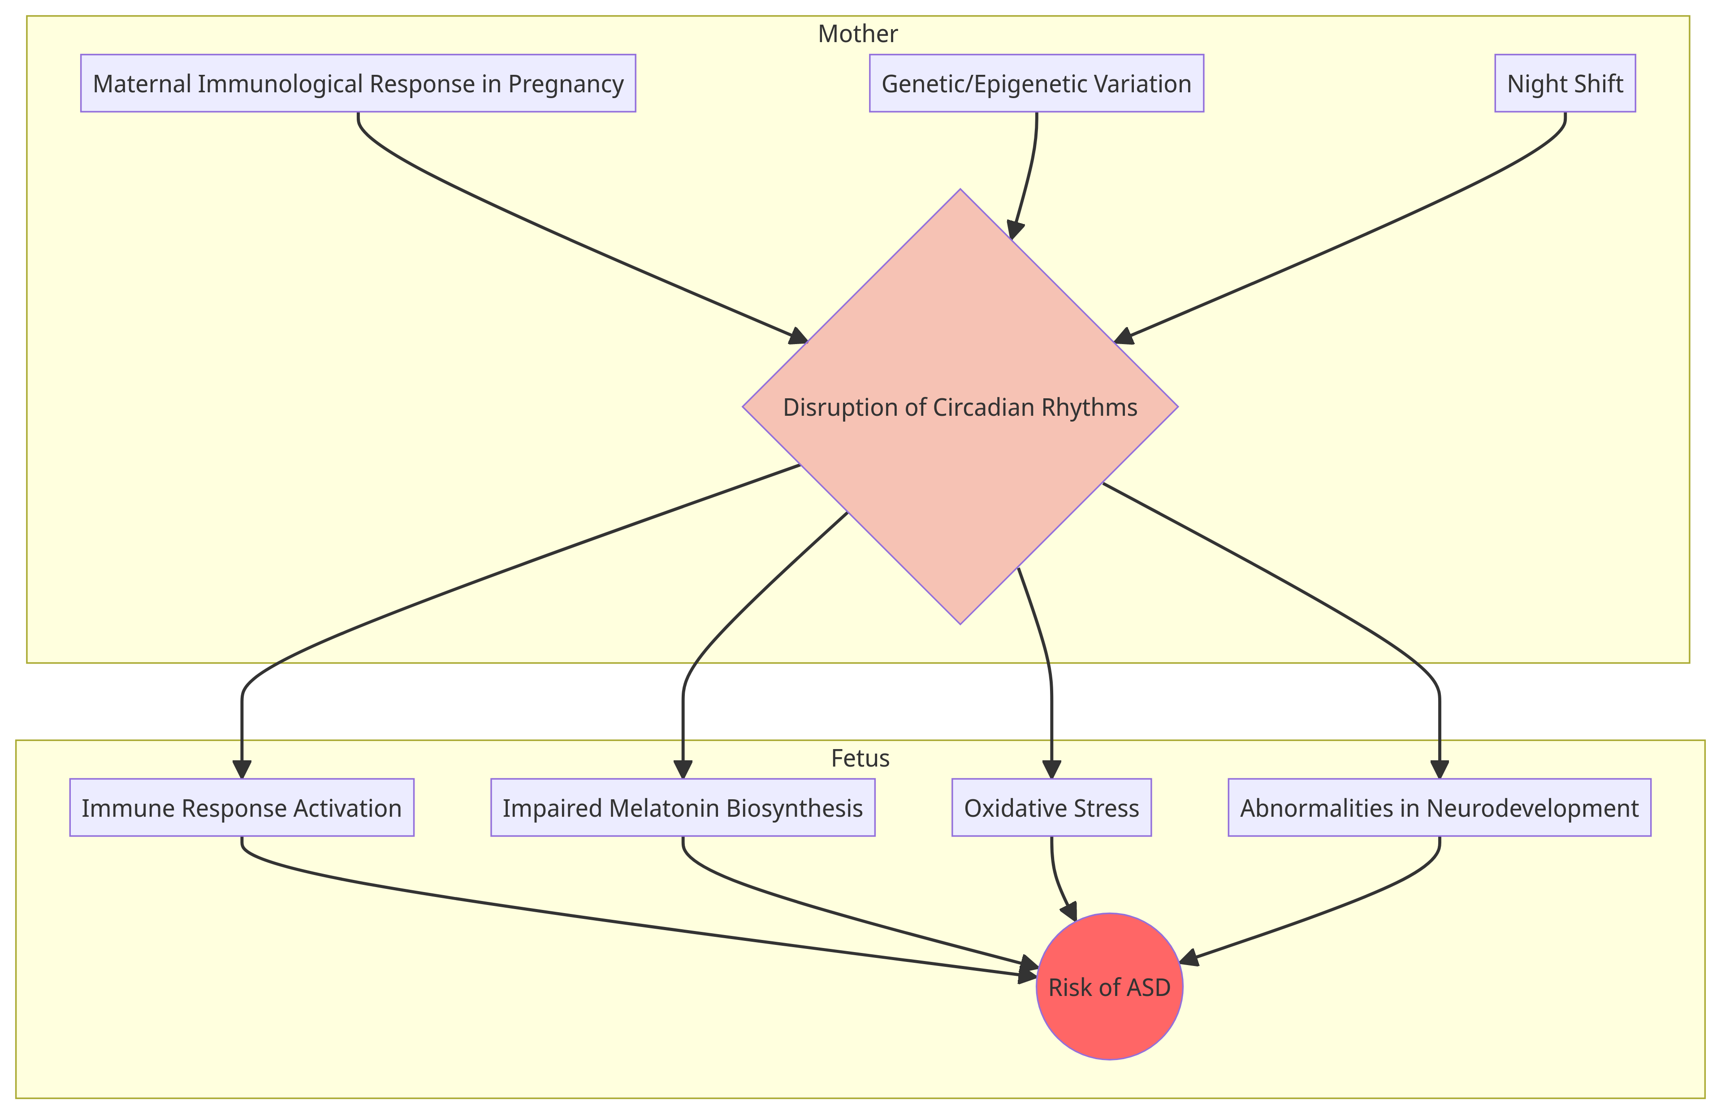
Problem Statement
Circadian rhythm disruption causes an increase in the risk of neuropsychiatric disorders during pregnancy in the fetus
Autism
Endocrine, nervous, and immune systems
Shift work
The mechanisms have not yet been fully resolved to identify potential early diagnosis
@systemdynamics_
THE 41st INTERNATIONAL SYSTEM DYNAMICS CONFERENCE
Chicago, USA and Virtually
#isdc2022
THE 40TH INTERNATIONAL SYSTEM DYNAMICS CONFERENCE
Virtually everywhere!
#isdc2023

Slide 3
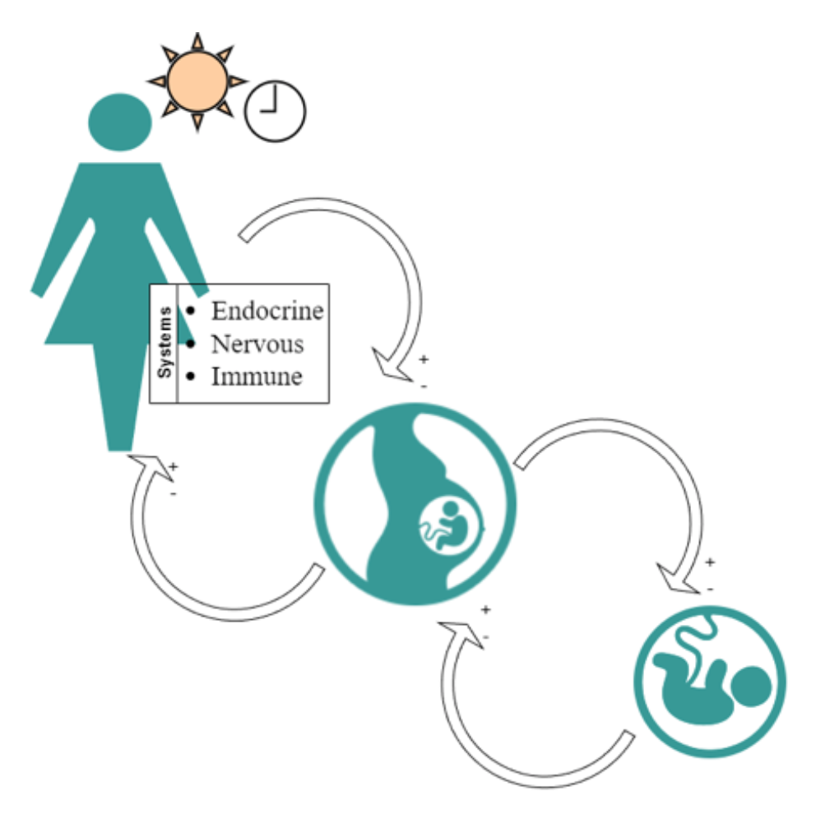
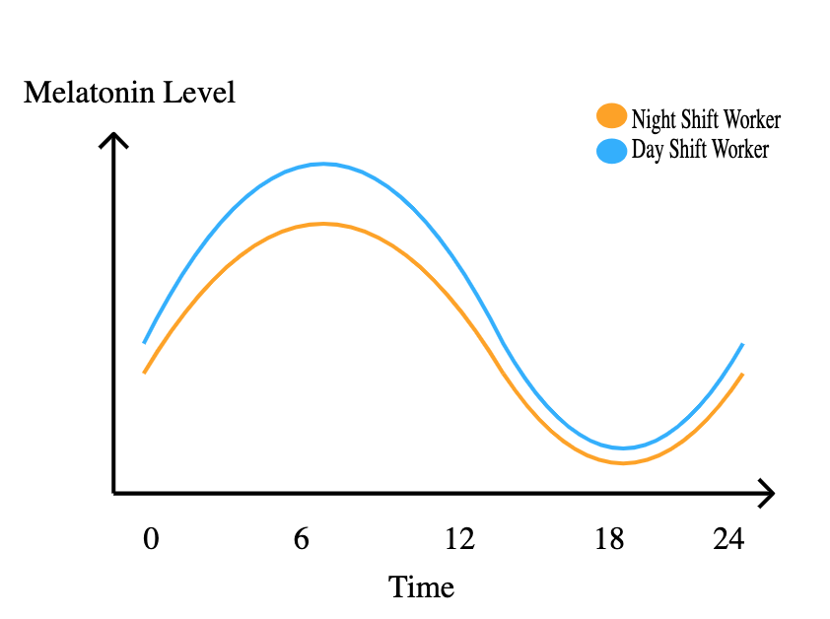
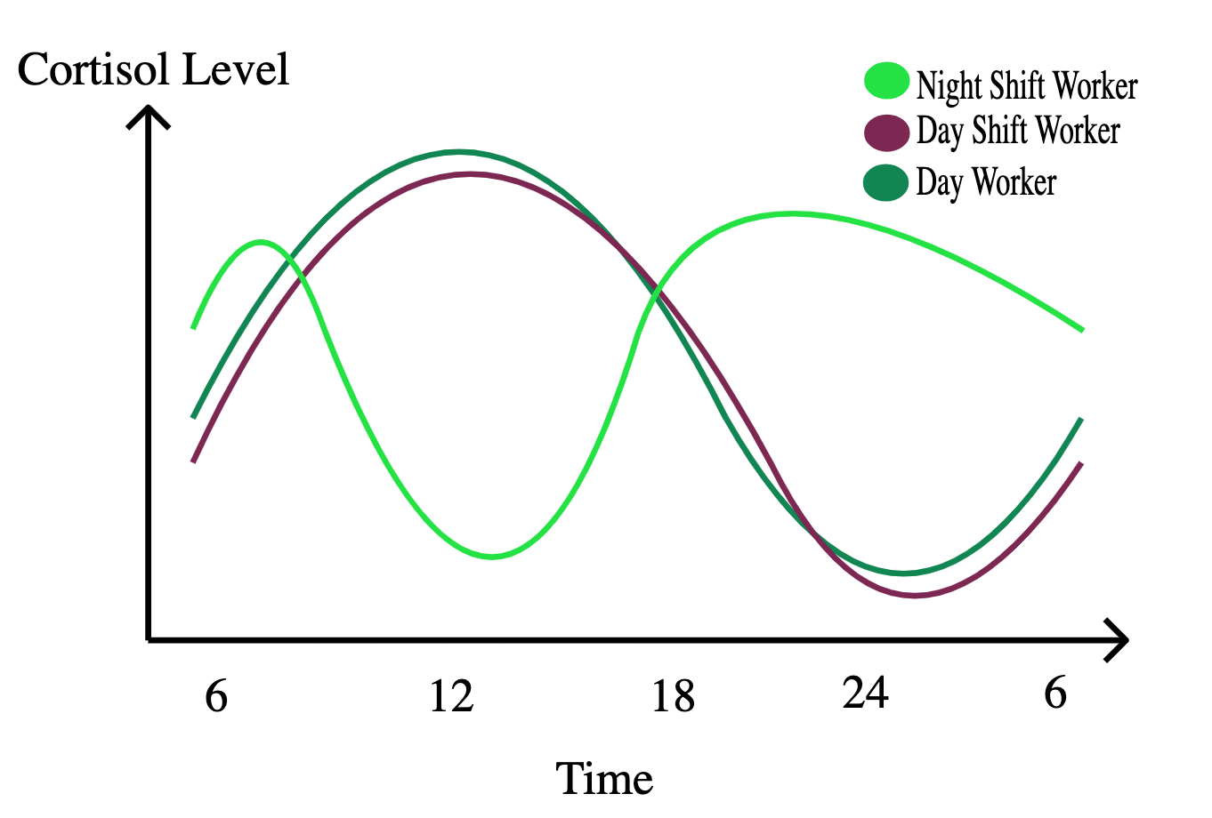
Approach or Dynamic Hypothesis
Two Systems:
Mother and fetus
Three Subsystems:
Endocrine, nervous, and immune
Main stock variables:
Circadian Stress, Cortisol, Melatonin, ACTH, Interleukin 6 (Inflammatory Cytokine), Oxidative Stress
Time unit: hour
Pregnancy second trimester: brain development
@systemdynamics_
THE 41st INTERNATIONAL SYSTEM DYNAMICS CONFERENCE
Chicago, USA and Virtually
#isdc2022
THE 40TH INTERNATIONAL SYSTEM DYNAMICS CONFERENCE
Virtually everywhere!
#isdc2023

Slide 4
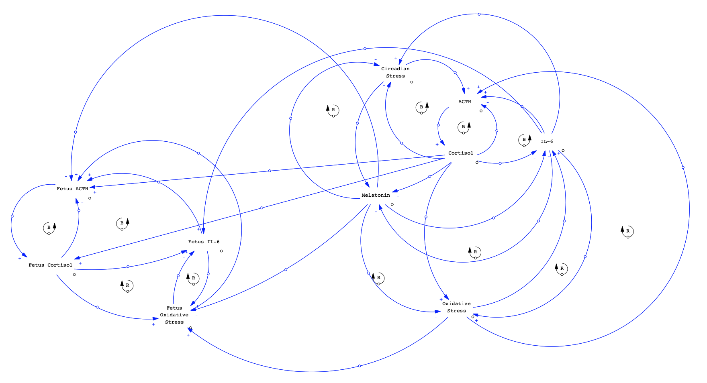
Progress, Insights, and Questions
Causal Loop Diagram:
Thoughts, feedback, and questions welcome
@systemdynamics_
THE 41st INTERNATIONAL SYSTEM DYNAMICS CONFERENCE
Chicago, USA and Virtually
#isdc2022
THE 40TH INTERNATIONAL SYSTEM DYNAMICS CONFERENCE
Virtually everywhere!
#isdc2023

