Slide 1
HHMI BioInteractive Model Builder: An Online Application to Teach Conceptual and Stock & Flow Modeling with Automated Feedback biointeractive.org/classroom-resources/model-builder
Online Poster Presentation
Jon Darkow
Seneca East Local Schools
Attica, Ohio
0:00-0:30
@systemdynamics_
THE 41ST INTERNATIONAL SYSTEM DYNAMICS CONFERENCE
Chicago, USA and Virtually
#isdc2023
Notes:
Title page: Jon teaches high school and introductory college Biology, Anatomy & Physiology, and Physics courses. He has used a number of object-based computational modeling tools with his students over the past 15 years, including Stella, Insight Maker, Simulink, and Vensim. The Model Builder website includes the free online tool, a User Guide, a Pedagogy Guide, and a Catalog of BioInteractive Models for Educators (https://www.biointeractive.org/classroom-resources/model-builder).

Slide 2
Problem Statement
How can more teachers and students learn how to build diagrams of conceptual and stock and flow models?
0:30-1:00
@ systemdynamics_
THE 41ST INTERNATIONAL SYSTEM DYNAMICS CONFERENCE
Chicago, USA and Virtually
#isdc2022
THE 40TH INTERNATIONAL SYSTEM DYNAMICS CONFERENCE
Virtually everywhere!
#isdc2023
Notes:
Problem Statement: The goal of Model Builder is to be useful to beginning modelers to understand the language (symbology) of conceptual and stock and flow diagrams and be an on-ramp to more sophisticated modeling platforms. Model Builder provides teachers and students an opportunity to practice modeling with automated feedback so students can learn how systems are represented and interpreted.

Slide 3
Approach or Dynamic Hypothesis
Free online tool that allows users to build Conceptual and Stock and Flow models.
Checks users’ models against a reference model to generate automated feedback.
A bank of curated models
1:00-3:30
@systemdynamics_
THE 41ST INTERNATIONAL SYSTEM DYNAMICS CONFERENCE
Chicago, USA and Virtually
#isdc2022
THE 40TH INTERNATIONAL SYSTEM DYNAMICS CONFERENCE
Virtually everywhere!
#isdc2023
Notes:
Approach or Dynamic Hypothesis: 1) a. Allow users to OPEN pre-existing reference models, self-check models, and assessment models.
b. Users can create and edit reference models and then save a zip file to generate self-check and assessment models files.
c. Teachers can receive assessment files from students and auto-grade them using the Grading Tool and a reference model.
2) Using BioInteractive models or self-check files, students can build models and check their models iteratively for automated feedback.
3) A growing bank of curated models are on the main Model Builder page that allow students to build models with automated feedback to easily get started using Model Builder.

Slide 4
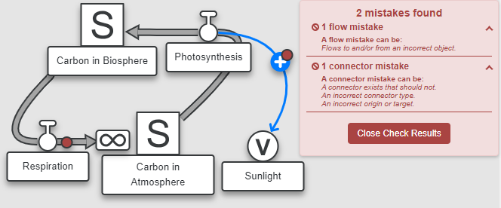
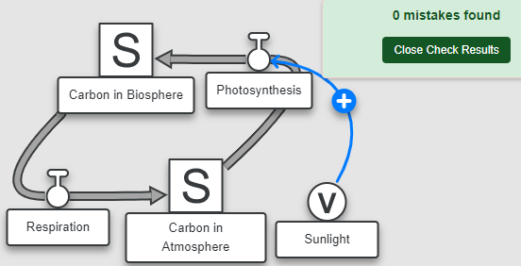
Results
Model Builder checks for, Object type, Objects linked with Connectors, and Flow connections
When asked Anatomy students (n=26) “…how helpful was Model Builder in helping you understand the course content?”, 73% said it was helpful or very helpful (on a scale of 1-5, x̄=4.16).
3:30-5:00
@systemdynamics_
THE 41ST INTERNATIONAL SYSTEM DYNAMICS CONFERENCE
Chicago, USA and Virtually
#isdc2022
THE 40TH INTERNATIONAL SYSTEM DYNAMICS CONFERENCE
Virtually everywhere!
#isdc2023
Notes:
Results:
Model Builder currently allows users to create two types of models: Conceptual models and Stock and Flow models.
Conceptual models check for how the objects are linked: the presence of connectors between objects, and the direction and polarity of the connectors.
Stock and Flow models check for how objects are named (stock, flow, or variables), how flows are linked to stocks, and connectors.
My Anatomy students (n=26) used MB throughout the school year. When asked “…how helpful was Model Builder in helping you understand the course content?”, 73% said it was helpful or very helpful (on a scale of 1-5, x̄=4.16). Only one student said it was not helpful.
Here are some students’ comments: Comment 1: “Model builder helped in every section to see how the flow of eveyrhting worked. It allowed me to know the terms better, and how everything functions at a better knowledge. Everrthing with model builder was good.” Comment 2: “I thought Model Builder was helpful in understanding how systems work and fit together.”
Comment 3: “I found it helpful that we had to figure out how to put all the pieces together on our own and see how the setup looks laid out in a way that is easy to read and understand.”

