Slide 1
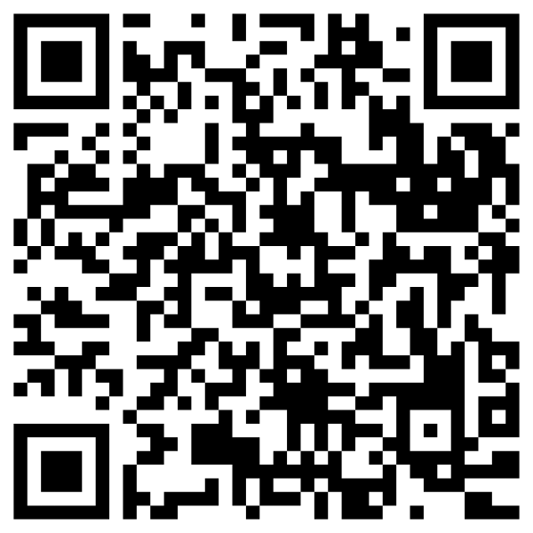
For your convenience, please go to website.
https://bit.ly/KoreanPollakModel
or QR code as below

