Slide 1
Facilitating Scenario Analysis of System Dynamics Models with Bayesian Network
Wang Zhao (PhD Student)
Susan Howick (Professor in Management Science)
John Quigley (Professor in Management Science)

Slide 2
Contents
Introduction
  Scenarios and Monte Carlo method
Research questions
Method
  Bayesian Network as sampler
  A framework for scenario analysis
Case study
Summary
Q & A

Slide 3
Introduction
Scenarios
How to Generate Them?
A description of how things might happen in the future (oxford dictionary)
Consisting of:
  Factors that can be controlled (policy inputs)
  Factors that are out of control (environmental factors)
Why analysing scenarios?
  Identify factors for favourable behaviour
  Make sure they are robust to rely on
Simulation models have input variables
Varying input variables creates scenarios
Monte Carlo simulation

Slide 4
Research Questions
Literature
Research Question
Samplers to generate scenarios for SD model
  Grid sampler
  Latin Hypercube Sampler (Ford & Flynn, 2005)
  Output-oriented sampler (Pruyt & Islam, 2016)
Gap in the literature
  Situations when input variables are interrelated is not sufficiently studied
What sampler can handle the interrelations between input factors?
How to use this sampler for scenario analysis?

Slide 5
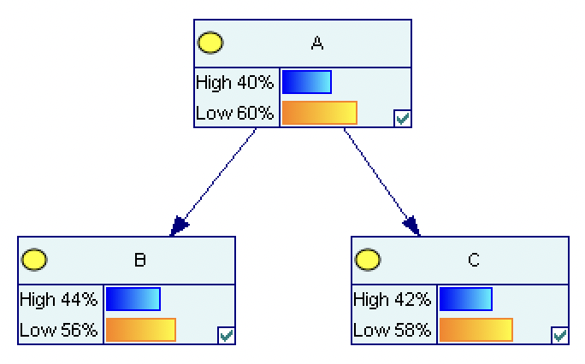
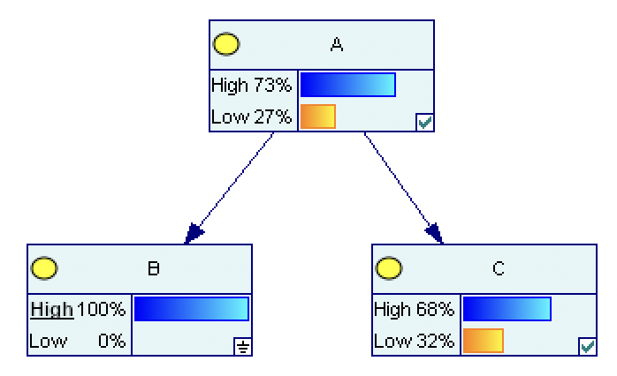
Bayesian Network
Before setting evidence for B
After setting evidence for B
B and C are interdependent

Slide 6
Method: Setup of the Hybrid Model
Inputs: BX₁, BX₂, …, BX_{n}
Scenario Bayesian Network
Outputs: BY₁, BY₂, …, BY_{n}
Inputs: SX₁, SX₂, …, SX_{n}
System Dynamics Model
Outputs: SY₁, SY₂, …, SY_{n}
Hybrid System Dynamics and Bayesian Network model for scenario analysis

Slide 7
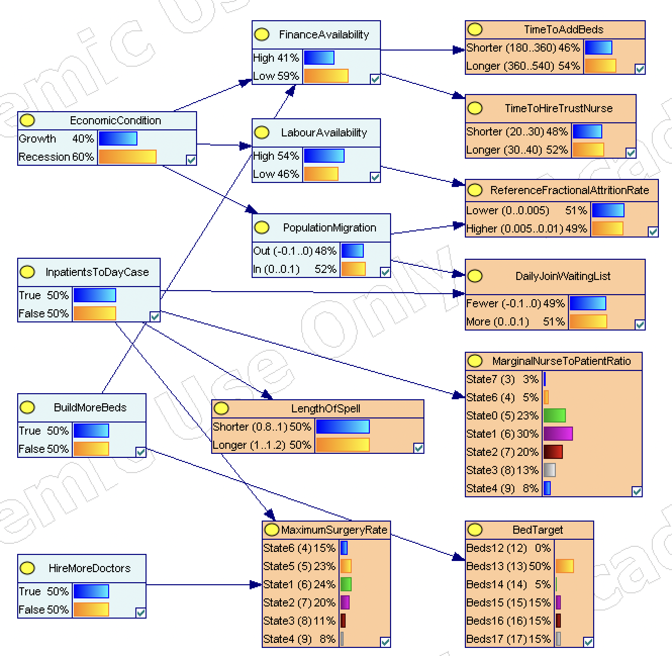
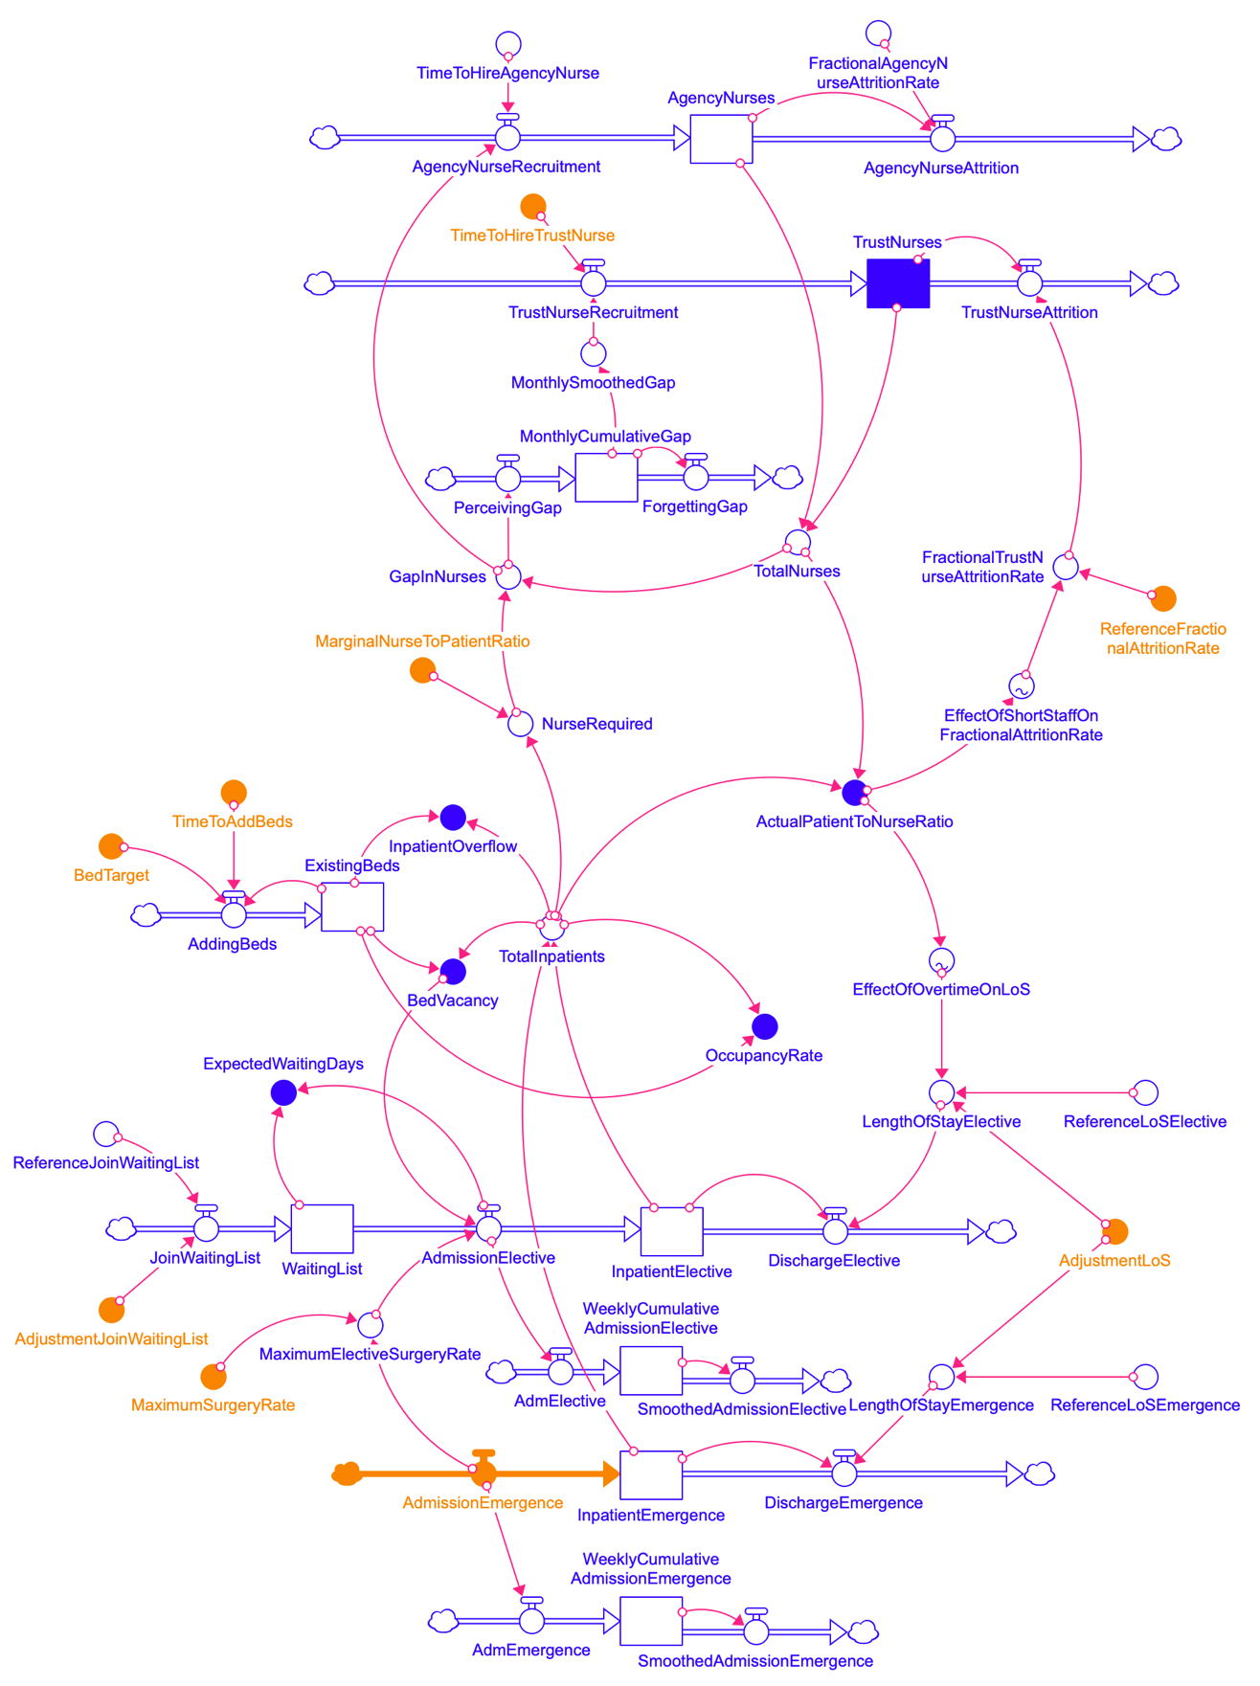
Method: Setup of the Hybrid Model
Bayesian Network
System Dynamics Model
Inputs

Slide 8
Method: Steps for Scenario Analysis
Screening
Which simulation runs are favourable?
Sensitivity Analysis
Which inputs result in the favourable runs?
Robustness Analysis
How much can we rely on the identified inputs to generate favourable runs?
Simulating
What possible behaviours can the model generate?

Slide 9
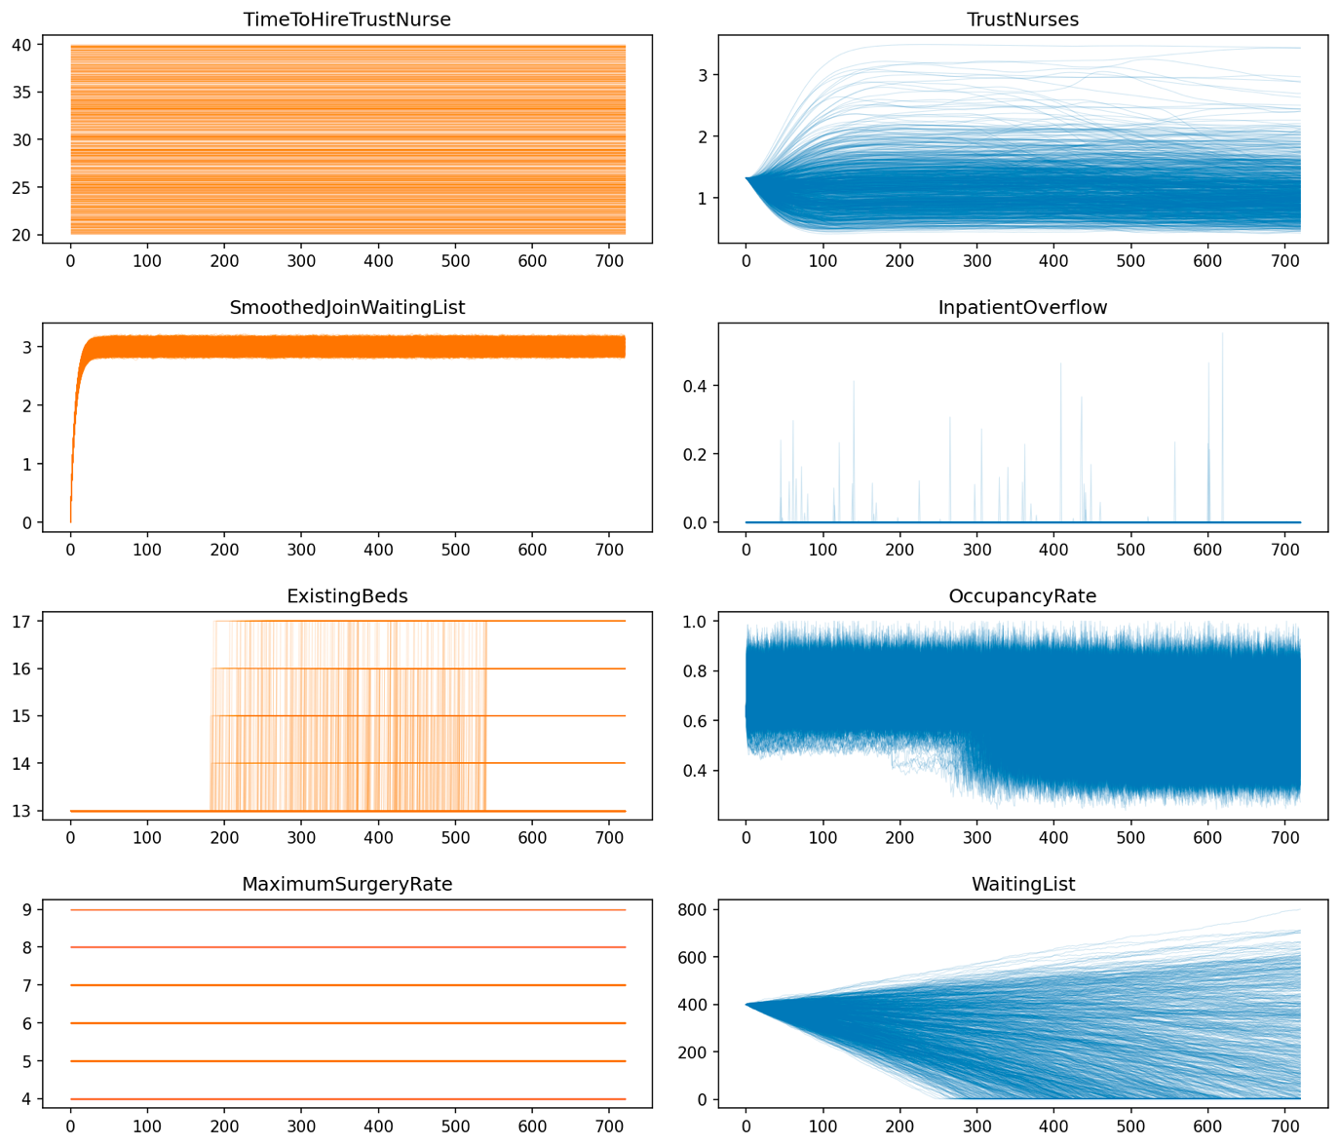
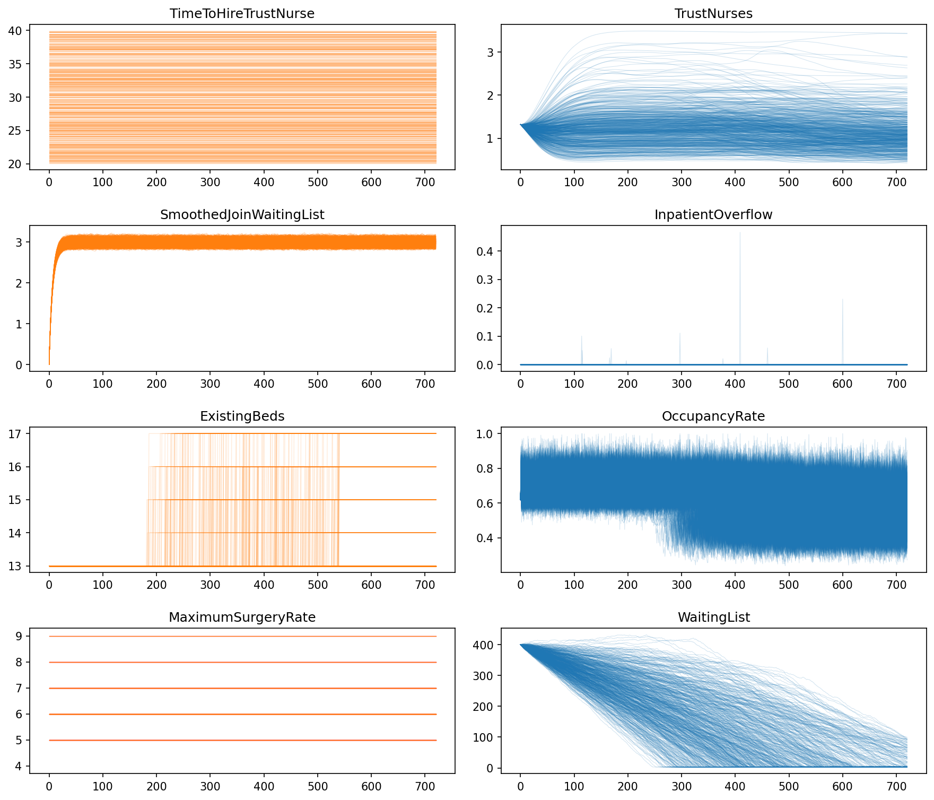
Result-1: Screening of Scenarios
Simulation runs before screening
Simulation runs after screening

Slide 10
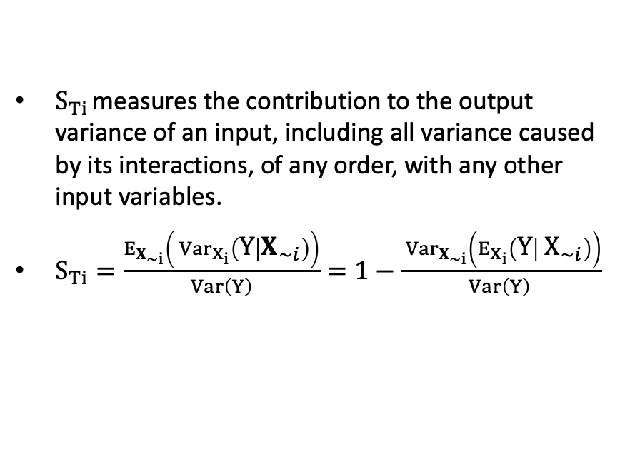
Result-2: Sensitivity Analysis of Inputs
Calculation of total-effect index $S_{Ti}$
Total-effect index of inputs
$S_{Ti}$ measures the contribution to the output variance of an input, including all variance caused by its interactions, of any order, with any other input variables.
$S_{Ti}=\frac{E_{X_{∼i}}\left( Var_{X_{i}}\left(Y | X_{∼i}\right)\right)}{Var\left(Y\right)}=1−\frac{ Var_{X_{∼i}}\left(E_{X_{i}}\left(Y | X_{∼i}\right)\right)}{Var\left(Y\right) }$
Variable | Total-effect index | Effect direction
Hire more doctors | 0.267 | Desirable
Build more beds | 0.493 | Desirable
Inpatients to day case | 0.622 | Undesirable
Economic condition | 0.335 | Neutral

Slide 11
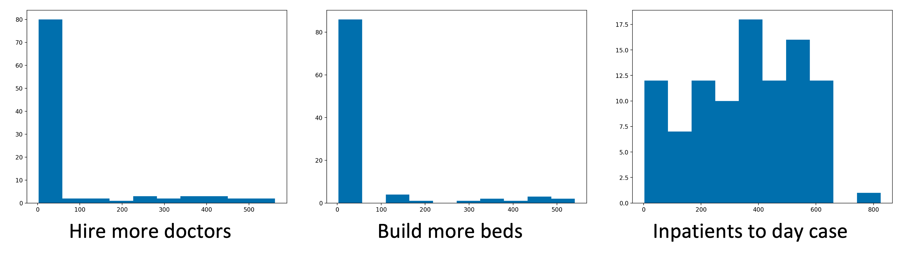
Result-3: Robustness Analysis of Inputs
Steps to calculate of robustness
Robustness of inputs
Identify an input in the BN for testing
Set the input to the desired state
Draw samples from the BN
Run Monte Carlo simulation
Assess the percentage of runs with favourable behaviour

Slide 12
Summary
We use Bayesian Network as a sampler to generate scenarios for simulating the System Dynamics model. Bayesian Network allows us to model the interactions between the input factors.
We follow a four-step [Simulation, Screening, Sensitivity, and Robustness] approach to carry out scenario analysis, identifying policy inputs that are both effective to solve the problem and robust to uncertainties.
We use Total effect index for sensitivity analysis of input factors.
By updating the Bayesian Network, we create situations for testing the robustness of input factors.

Slide 13
Thank you for your attention!
Q & A

