Slide 1
What attitudes, behaviours and beliefs are associated with systems thinking competency?
WIP Presentation
Miriam Spano, Monash University
Nici Zimmermann, University College London
Stefan Kaufman, Monash University
Denise Goodwin, Monash University
0:00-0:30
@systemdynamics_
THE 41st INTERNATIONAL SYSTEM DYNAMICS CONFERENCE
Chicago, USA and Virtually
#isdc2023
Notes:
Hello Chicago, this is Miriam and I am coming to you from Melbourne, Australia.
I am presenting early thoughts on answering the questions: what attitudes, behaviours and beliefs are associated with systems thinking competency.
This work is still in its infancy and forms part of my PhD. Naturally, any constructive feedback is more than welcome.

Slide 2
Problem Statement
Public Sector organisations* are increasingly looking for systems thinking (ST) competency as part of their ongoing organisational capability to better respond to the ever increasing complexity and design effective systems change
Yet, it is unclear what exactly ST competency is as part of a general skill set; what it looks like in practice and how it can be developed and embedded as part of BAU
In order to increase ST capacity in Public Sector organisations, we need to understand who needs to hold what level of competency, and how can it be effectively embedded and demonstrated to allow for evaluation and development
*While the focus of this is the public sector in Australia we think this can be generalised
0:30-2:00
@systemdynamics_
THE 41st INTERNATIONAL SYSTEM DYNAMICS CONFERENCE
Chicago, USA and Virtually
#isdc2022
THE 40TH INTERNATIONAL SYSTEM DYNAMICS CONFERENCE
Virtually everywhere!
#isdc2023
Notes:
Systems thinking is increasingly a skill organisations, especially governments - including the public sector here in Victoria, Australia - are looking for, to form part of the ongoing organisational capability. This is in response to an ever increasing request from researchers for systems thinking competence and systemic approaches to address large scale, complex change.
Competencies in an organisational context are qualities that form a capacity within the organisation to perform certain global things, for example conduct systems change. They are made up of a combination of knowledge and skill and a capacity to bring this knowledge and skill to a given situation that would class it as “effective”.
Yet, this request for systems thinking competency is mighty unspecific.
Does it need more internal experts, and if not, what does systems thinking competency look like when it forms part of a general skill set of a public servant.
There is little guidance for recruiters, organisational developers and designers, and leaders in general as to what exactly to look out for, who should have it, how can they foster and support this ominous and potentially omnipotent competence, and what else might be helping or hindering.
However, this is exactly the detail that is required when systems thinking is supposed to be embedded in BAU to be readily deployed when a complex problem arises.
In an attempt to remedy this gap, I am planning to look at systems thinking through a behavioural science lens to understand what is actually observable, measurable and what needs to change in order for it to flourish.

Slide 3
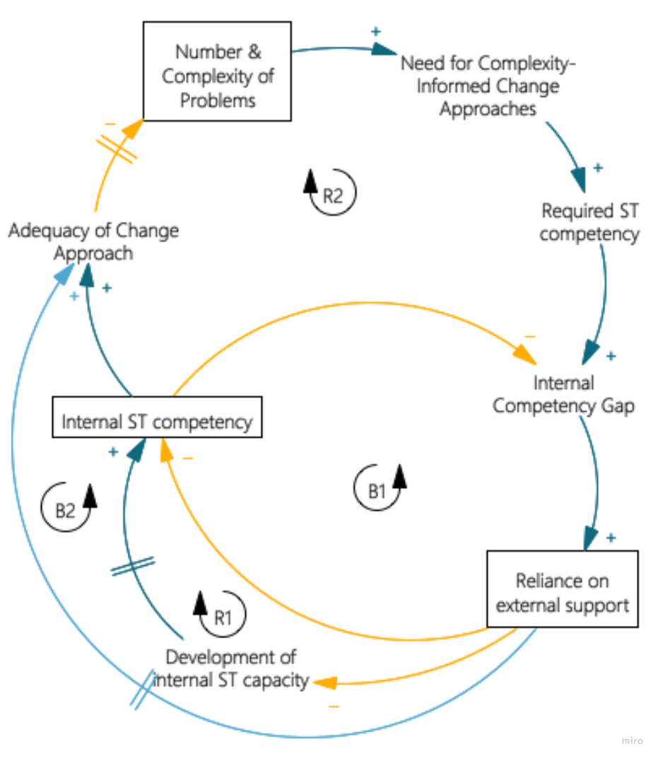
Approach or Dynamic Hypothesis
Foundation:
Systems thinking competency:
Generalisable or context dependent?
Clustered or stand-alone?
In which way is it linked to system change?
Apply a behavioural science lens:
What does look like at what level?
Identify attitudes, behaviours & beliefs
Identify enabling context, e.g. organisational settings
2:00-3:30
@systemdynamics_
THE 41st INTERNATIONAL SYSTEM DYNAMICS CONFERENCE
Chicago, USA and Virtually
#isdc2022
THE 40TH INTERNATIONAL SYSTEM DYNAMICS CONFERENCE
Virtually everywhere!
#isdc2023
Notes:
My hypothesis on the left highlights that the increased number and complexity of today’s problems drive the need for complexity-informed change approaches which in turn are said to require systems thinking competency.
There are two sources for this competence – internal and external.
As an underdeveloped field, there is often none or not sufficient internal competence so organisations rely on external consultants like me.
This in turn hampers the development of internal competencies and might even drive internal systems thinkers to consulting. While external consultants might still get the job done, it might take longer, due to complex procurement processes in government as well as budget limitations, which are set to increase in the future. This in turn impacts the adequacy of the change approach and in turn the quality of the solution to the number and level of complexity of our issues today.
In summary, if we want our governments to be agile and respond better in future, a certain threshold of internal systems thinking capacity is highly desirable. And be it only to understand what kind of expertise is actually required.
To help, we will look at what forms the foundation of a systems thinking competency in BAU – is it generalisable or context dependent, is it clustered or standalone and how exactly does it link to systems change. Applying the behaviroual lense, we will look at what does systems thinking competence ‘look like’ at different levels of organisational hierarchy and processes and identify enabling contexts and settings.

Slide 4
Progress, Insights, and Questions
Practice Review:
Semi-structured interviews/ survey, grey literature review
ST experts, educators & students + OD/ HR specialists, VPS staff
Literature Review:
Systemised narrative review
Key academic works, bibliography search
Analysis:
Inductive: Description of ST competency
Deductive: Ecological approach/ COM-B
Questions:
Any thoughts on the approach we are taking ?
Are you aware of similar approaches/ research ?
Any suggestions in terms of definition, literature or people ? Would you be interested to be interviewed ?
Get in touch : miriam.spano@monash.edu
Legend:
BAU: business as usual; OD: organisational development; HR: human resources; VPS: Victorian Public Sector (Australia); COM-B: Capability, Opportunity, Motivation - Behaviour (model)
3:30-5:00
@systemdynamics_
THE 41st INTERNATIONAL SYSTEM DYNAMICS CONFERENCE
Chicago, USA and Virtually
#isdc2022
THE 40TH INTERNATIONAL SYSTEM DYNAMICS CONFERENCE
Virtually everywhere!
#isdc2023
Notes:
My plan it to do both a practice review and literature review as I believe the gap is in the translation of theory into practice.
We plan to interview ST practitioners, professional development educators and their organization-based students as well as OD and HR specialists looking for definitions, descriptions, applications and expectations.
Similarly, the literature review looks at descriptions and expected benefits of systems thinking in context of systems change, who should do it and what might have been barriers in the past in which context. The recent publication about expert competency skills by Sondoss et al 2023 will provide much guidance here.
The findings will be analysed, deriving a rich description of ST as competency and enticing more details along the ecological apporach and COM-B which is a behaviour change tool. This will provide input into the question of what needs to change, including behaviour, if we want to embed systems thinking as part of business as usual.
Questions I have:
Any thoughts on scope and the approach we are taking?
Do you know anyone I could approach about this who might do something similar?

Slide 5
THE INTERNATIONAL SYSTEM DYNAMICS CONFERENCE
Instructions: Please do this!!!
1) Prepare your Work in Progress (WIP) presentation using a copy of this template.
Change the presentation title and author information to match your submission.
Do NOT change the titles of the other slides. Do NOT change the number of slides with content.
Change the body of the slides to present your work, following the instructions in the slide notes.
2) Submit your WIP presentation slides at https://webportal.systemdynamics.org by June 20
Click on the title of your submission
Select “Upload new or updated paper files”
Upload the Powerpoint presentation file for your WIP slides
3) Follow the format and timing listed below:
You have exactly 5:00 minutes to present, followed by up to 5:00 minutes of discussion.
Keep within the time limits noted at the lower right of each slide.
The session chair will combine your slides with other presentations and will control the screen.
4) You may record your presentation in advance
If you are not able to attend the session, the recording will be used instead
If you do attend, you can ask the chair to play the recording, or present live
Add the YouTube Video ID to the Web Portal under “Review or update paper information”
5) If you make updates or change plans after June 20, send the session chair a note
Use the contact information at https://isdc.systemdynamics.org
Notes:
This slide will be hidden from presentation. You may delete this instruction slide once your slides are ready.

