Slide 1
Flood Risk Assessment of Urban Systems Understanding the Response Behavior of Communities at Risk
WIP Presentation
MTOV Peiris (Vishva),
Department of Town & Country Planning, University of Moratuwa, Sri Lanka
0:00-0:30
@systemdynamics_
THE 41st INTERNATIONAL SYSTEM DYNAMICS CONFERENCE
Chicago, USA and Virtually
#isdc2023
Notes:
Title page: Change title to submission name. Bold the name of the presenter and display your name as you want it read by the moderator (eg Bob instead of Robert). Note the suggested timing in the bottom right. Slide timing may be adjusted, but not the number of slides. The session chair will change slide following the timing indicated, or earlier if requested.

Slide 2
Problem Statement
Flood risk involves multiple interactions at the urban scale
Interdependency of multiple players (natural, physical, and social)
Accumulation of risk factors over short to long-time horizons
Multiple system failures (rainfall, communication delays)
Population at risk is more important than the infrastructure
Disparities in socio-economic and natural factors in cities
Recovery of the population may take longer than the infrastructure
Risk is not static and dynamic before, during, and after a flood event
How does the population risk of urban floods vary in disaster-prone cities?
0:30-2:00
@systemdynamics_
THE 41st INTERNATIONAL SYSTEM DYNAMICS CONFERENCE
Chicago, USA and Virtually
#isdc2022
THE 40TH INTERNATIONAL SYSTEM DYNAMICS CONFERENCE
Virtually everywhere!
#isdc2023
Notes:
Problem Statement: Do not change the slide title. Keep fonts big (24 pt or bigger). Indicate why the problem is important. Note the timing in the bottom right.

Slide 3
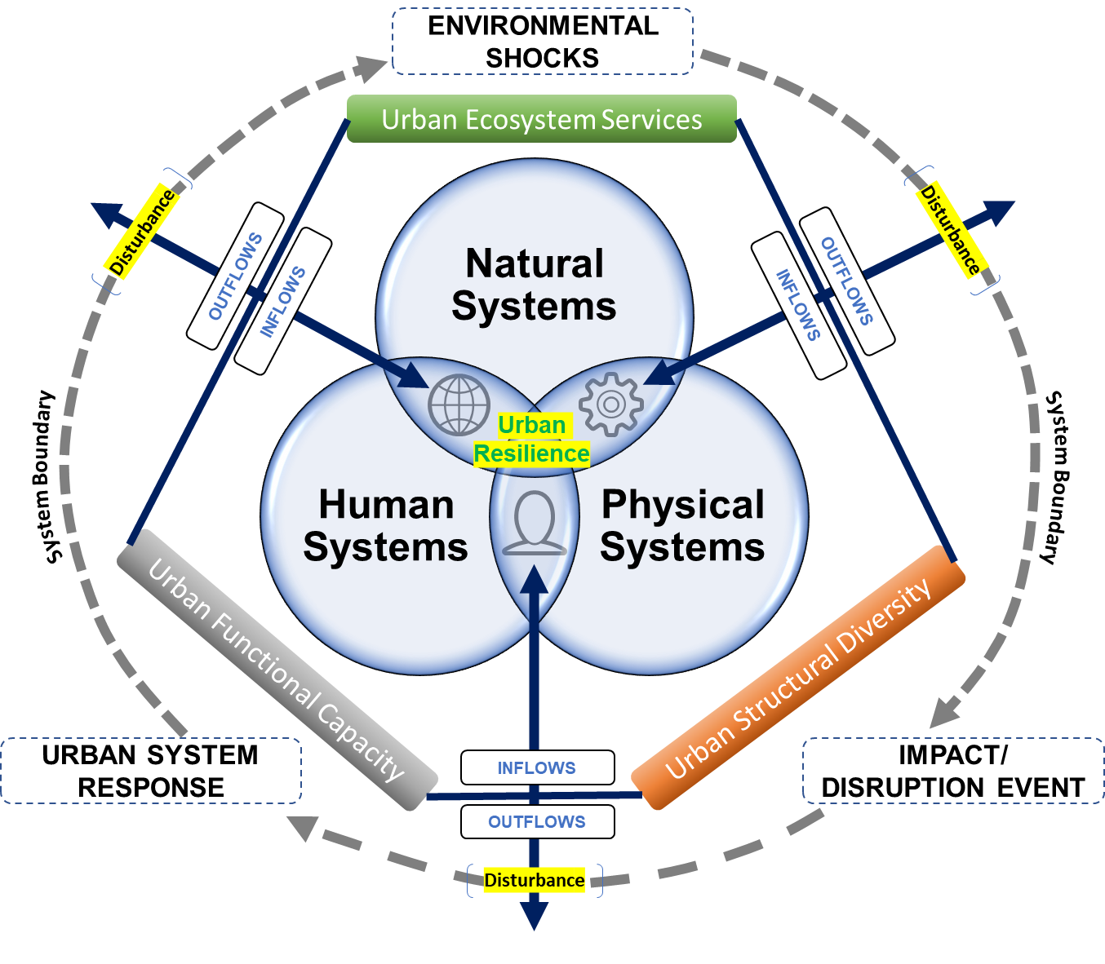
Approach or Dynamic Hypothesis
Flood risk of urban population emerged with interactions among natural, physical, and human subsystems.
Flood event disrupts the balance through:
Exceeding water retention capacity
Damage to physical components
Recovery by the human functional response
Floods increase the risk of damage
Flood vulnerability increases with a flood event, and the recovery rate after the disaster decreases the risk levels of people for future disasters
2:00-3:30
@systemdynamics_
THE 41st INTERNATIONAL SYSTEM DYNAMICS CONFERENCE
Chicago, USA and Virtually
#isdc2022
THE 40TH INTERNATIONAL SYSTEM DYNAMICS CONFERENCE
Virtually everywhere!
#isdc2023
Notes:
Approach or Dynamic Hypothesis: Do not change the slide title. Keep fonts big (24 pt or bigger). Note the timing in the bottom right.

Slide 4
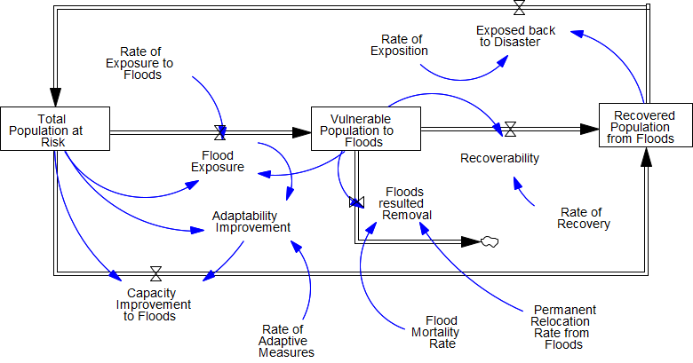
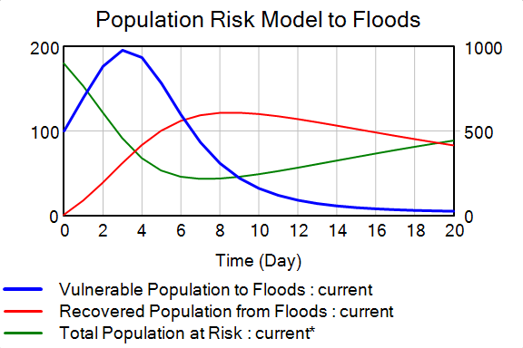
Progress, Insights, and Questions
Vulnerability and Risk model
Exposure, recovery, Adaptability, & Expose rates
Consideration of socio-economic risks before a flood event
Integration of mitigation and adaptation into the model
Thoughts, feedback, and questions welcome
3:30-5:00
@systemdynamics_
THE 41st INTERNATIONAL SYSTEM DYNAMICS CONFERENCE
Chicago, USA and Virtually
#isdc2022
THE 40TH INTERNATIONAL SYSTEM DYNAMICS CONFERENCE
Virtually everywhere!
#isdc2023
Notes:
Progress, Insights, and Questions: Do not change the slide title. Again, keep the text short and fonts big. Show structure or behavior – may not be room for both (some flexibility on font for images). No need to conclude, there is always more to be done. Any questions you want to pose to the audience can go here. Note the timing in the bottom right.

Slide 5
THE INTERNATIONAL SYSTEM DYNAMICS CONFERENCE
Instructions: Please do this!!!
1) Prepare your Work in Progress (WIP) presentation using a copy of this template.
Change the presentation title and author information to match your submission.
Do NOT change the titles of the other slides. Do NOT change the number of slides with content.
Change the body of the slides to present your work, following the instructions in the slide notes.
2) Submit your WIP presentation slides at https://webportal.systemdynamics.org by June 20
Click on the title of your submission
Select “Upload new or updated paper files”
Upload the Powerpoint presentation file for your WIP slides
3) Follow the format and timing listed below:
You have exactly 5:00 minutes to present, followed by up to 5:00 minutes of discussion.
Keep within the time limits noted at the lower right of each slide.
The session chair will combine your slides with other presentations and will control the screen.
4) You may record your presentation in advance
If you are not able to attend the session, the recording will be used instead
If you do attend, you can ask the chair to play the recording, or present live
Add the YouTube Video ID to the Web Portal under “Review or update paper information”
5) If you make updates or change plans after June 20, send the session chair a note
Use the contact information at https://isdc.systemdynamics.org
Notes:
This slide will be hidden from presentation. You may delete this instruction slide once your slides are ready.

