Slide 1
Investigating food insecurity using a qualitative system dynamics model: The case of remote northern communities of Canada
WIP Presentation
Arnoosh Golestanian, Department of Mechanical and Industrial Engineering University of Toronto
Tracey Galloway, Department of Anthropology University of Toronto
J. Christopher Beck, Department of Mechanical and Industrial Engineering University of Toronto
0:00-0:30
@systemdynamics_
THE 41st INTERNATIONAL SYSTEM DYNAMICS CONFERENCE
Chicago, USA and Virtually
#isdc2023
Notes:
Hello everyone, thanks for joining me. In this presentation I would like to talk about how to investigate FI in remote northern communities of Canada using QSD model
This is a joint work with my advisors, Tracey Galloway from Anthropology department and Chris Beck from Mechanical and Industrial Eng dep.

Slide 2
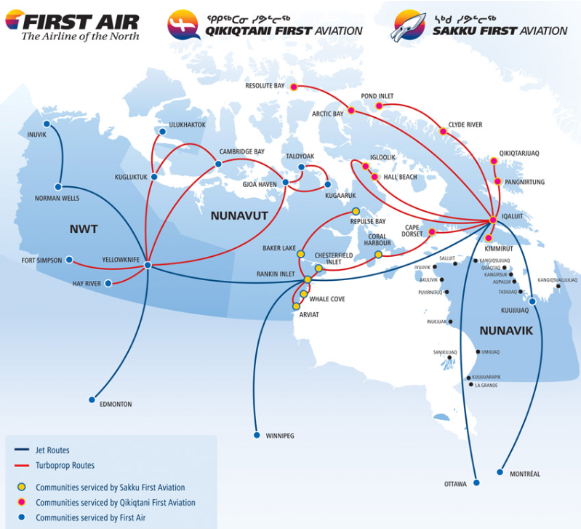
Problem Statement
Food insecurity is very high among Indigenous peoples in remote northern communities of Canada [1]
Can we use system dynamics to understand the complex interactions among traditional and market food, government programs, economics, and local cultural practices?
First Air Route Map
[1] Council of Canadian Academies (2014). Aboriginal food security in northern Canada: An assessment of the state of knowledge. The Expert Panel on the State of Knowledge of Food Security in Northern Canada, Council of Canadian Academies.
2000 km
0:30-2:00
@systemdynamics_
THE 41st INTERNATIONAL SYSTEM DYNAMICS CONFERENCE
Chicago, USA and Virtually
#isdc2022
THE 40TH INTERNATIONAL SYSTEM DYNAMICS CONFERENCE
Virtually everywhere!
#isdc2023
Notes:
food security exists when all people, at all times, have physical and economic access to sufficient, and nutritious food
Here is the map of first air, one of the airline operating mostly in northern Canada
Iqaluit is the capital of Nunavut and it’s not the northernmost

Slide 3
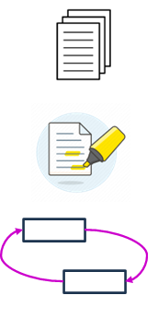
Approach or Dynamic Hypothesis
Finding a collection of relevant papers
Scoping review
Found 27 relevant papers out of 534
Identifying key variables and causal relationships
Identifying causality paragraphs using Grounded Theory
Using open coding and axial coding
Building causal loop diagram
CLD model with 91 relationships and 45 variables
15 balancing loops and reinforcing 13 loops
2:00-3:30
@systemdynamics_
THE 41st INTERNATIONAL SYSTEM DYNAMICS CONFERENCE
Chicago, USA and Virtually
#isdc2022
THE 40TH INTERNATIONAL SYSTEM DYNAMICS CONFERENCE
Virtually everywhere!
#isdc2023
Notes:
Grounded theory is a qualitative research technique that is frequently used to construct a theory from data
Used open coding to break down texts into causality paragraphs. Then we extracted key variables and relationships from these paragraphs. (400 causal relationships and 500 variables)
Then we used axial coding to categorize key variables into 45 categories. By using these categories we mapped the 500 relationships into 92.
Then we generalized these variables and removed some of the irrelevant relationships. At the end we had 80 rels and 45 vars

Slide 4
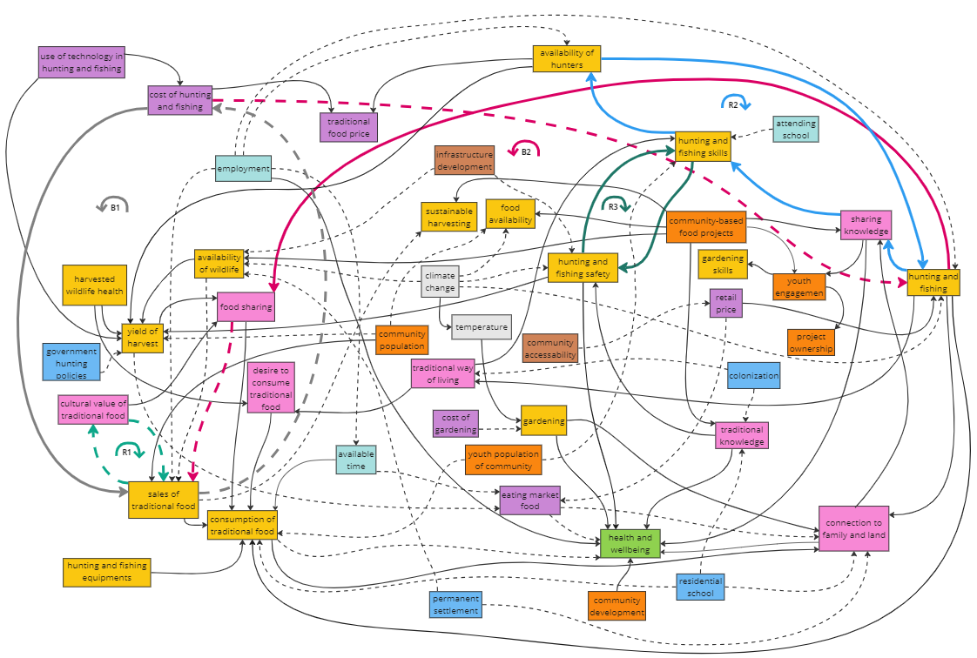
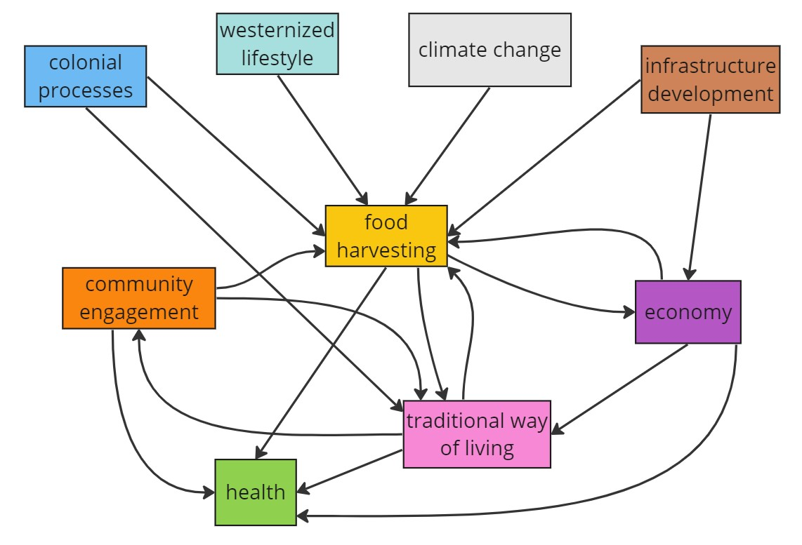
Progress, Insights, and Questions
3:30-5:00
@systemdynamics_
THE 41st INTERNATIONAL SYSTEM DYNAMICS CONFERENCE
Chicago, USA and Virtually
#isdc2022
THE 40TH INTERNATIONAL SYSTEM DYNAMICS CONFERENCE
Virtually everywhere!
#isdc2023
Notes:
This causal loop diagram has 15 balancing loop and 13 reinforcing loops. Here we showed 2 balancing loops and 3 reinforcing loops
As selling increases their cultural value decreases as some hunters believe that if you sell them you won’t get them
Also there is a negative relationship between cultural value of TF and sales of traditional food as many people prefer to share it rather than selling it
Therefore, according to the LR there is a reinforcing loop which shows that the sales of TF will be less and less
As the cost of hunting and fishing increases (for example through high price of gas and hunting equipment’s), people have more desire to sell traditional food rather than sharing it, and as they sell it more they get compensated for their hunting and therefore, their actual expense will be less. We should note that in this context people do not hunt to make a profit, it’s a way of living and getting food
Here is the summarized model of CLD. It is not a SD model, it’s just a causal map to show the relationship between the categories.
As we can see food harvesting is the key category here and all other categories are linked to it. As a limitation of this study we believe that some relationships are missing in the LR.
For example we think that some studies could show that as people are healthier the conduct more hunting and fishing activities or they’re engaged more in community activities.
"We are analyzing this CLD in order to identify leverage points that policymakers can use to improve northern food insecurity.
Currently we are preparing a publication aimed at an international journal on Northern topics, called Arctic. Thank you for your attention."

Slide 5
THE INTERNATIONAL SYSTEM DYNAMICS CONFERENCE
Instructions: Please do this!!!
1) Prepare your Work in Progress (WIP) presentation using a copy of this template.
Change the presentation title and author information to match your submission.
Do NOT change the titles of the other slides. Do NOT change the number of slides with content.
Change the body of the slides to present your work, following the instructions in the slide notes.
2) Submit your WIP presentation slides at https://webportal.systemdynamics.org by June 20
Click on the title of your submission
Select “Upload new or updated paper files”
Upload the Powerpoint presentation file for your WIP slides
3) Follow the format and timing listed below:
You have exactly 5:00 minutes to present, followed by up to 5:00 minutes of discussion.
Keep within the time limits noted at the lower right of each slide.
The session chair will combine your slides with other presentations and will control the screen.
4) You may record your presentation in advance
If you are not able to attend the session, the recording will be used instead
If you do attend, you can ask the chair to play the recording, or present live
Add the YouTube Video ID to the Web Portal under “Review or update paper information”
5) If you make updates or change plans after June 20, send the session chair a note
Use the contact information at https://isdc.systemdynamics.org
Notes:
This slide will be hidden from presentation. You may delete this instruction slide once your slides are ready.

