Slide 1
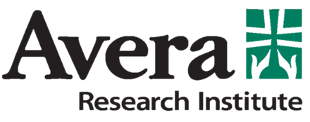
Reduce alcohol consumption, increase birth control use, or both? Simulating the long-term efficacy of preconceptual alcohol-exposed pregnancy prevention programs
Arielle Deutsch, Ali Akhavan, Tianna Herman, Mohammad Jalali
ISDC, July 26th, 2023

Slide 2
Alcohol Use During Pregnancy
Alcohol-exposed pregnancy (AEP) is a leading preventable cause of negative birth outcomes, birth defects and neurodevelopmental abnormalities in the United States
Current guidelines state that no drinking during pregnancy is safe
~10% of birthing people report any drinking during pregnancy, ~4% report binge drinking (4+ drinks per episode)
Likely under-reported: high rates of drinking before pregnancy is realized + rates of unintended pregnancy (lots of overlap here).
Most exposure happens in first trimester after which people stop drinking (e.g., after pregnancy realization)
Small proportion continue drinking throughout pregnancy

Slide 3
Preconceptual AEP-Reduction Strategies
Preconceptual AEP-prevention programs are popular strategies to reduce AEP rates
Addresses critical window of risk and vulnerability
Dual focus on increasing birth control use and decreasing alcohol use (focus on heavy/binge)
Typically consists of 1 – 8 brief sessions for intervention via behavioral change/health promotion methods
Low implementation burden, useful in variety of settings and in high-risk, resource-poor communities,
Barrier-addressing: can be culturally tailored for specific communities (e.g., Indigenous), can be provided in person or online to address physical accessibility.

Slide 4
Preconceptual AEP-Reduction Strategies: Do they work?
Evidence that programs are effective “at reducing AEP risk” for at least a year
“AEP risk” = collapsing alcohol and BC outcomes into one category
Programs more effective at increasing BC use than they are at reducing alcohol use
In other words, such programs are more effective at reducing the rates of pregnancy for people who drink, but less so at preventing AEP for people who get pregnant

Slide 5
Preconceptual AEP-Reduction Strategies: Do they work?
Other concerns:
Continued risky drinking may reduce longevity of increased BC use
Chosen BC strategies are commonly hormonal methods (pill) or condoms, which have higher failure rates than other methods
Programs focus on people who drink at certain “risk” levels (binge or almost binge levels), ignoring the larger proportion of non-risky drinkers (who are also at risk for AEP)
Little overall understanding of program efficacy within people or populations, over longer periods of time

Slide 6
Current Study
Simulate a model of community-level AEP
Based on larger project; model calibrated to specific small metro (~75K population) community in the Northern Plains for women ages 15-44
Questions for simulation/policy testing:
How much do preconceptual AEP-prevention programs reduce rates of AEP?
Does changing birth control or alcohol use matter more?
How much do programs need to be effective at changing both behaviors?
Historical data from 2016-2019, simulation for 10 years

Slide 7
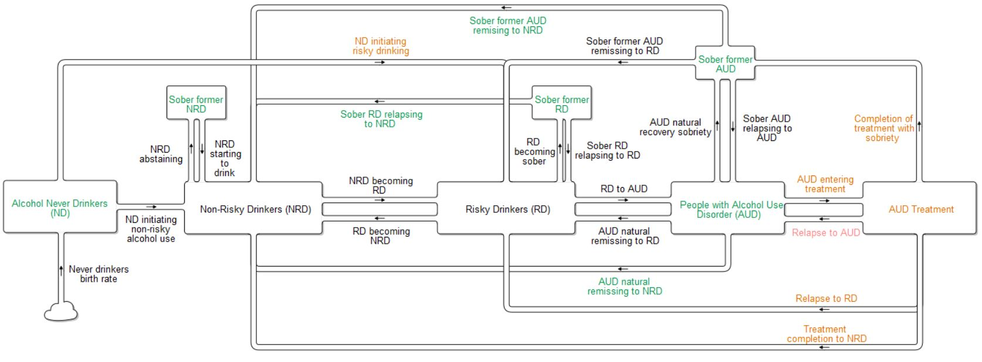
Model grounded in theoretical and empirical alcohol use literature
Represents different alcohol use stages (stocks):
Stages differ in AEP patterns, risk, and program eligibility
Represents broad continuum of alcohol use patterns (flows):
Wide variety in peoples’ patterns of use over time

Slide 8
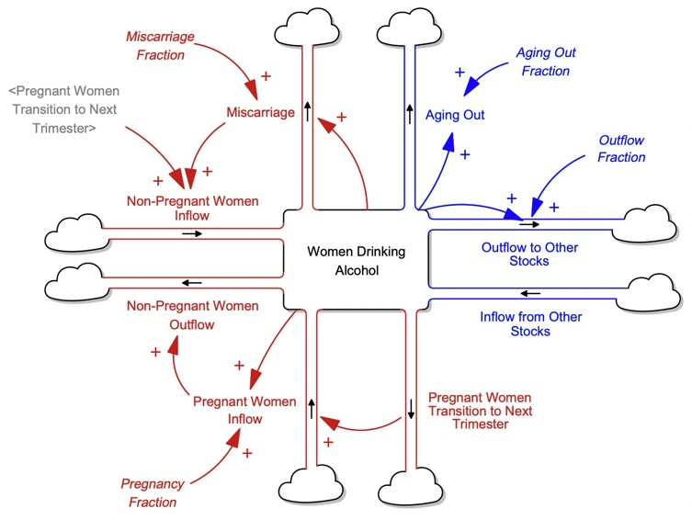
Alcohol Exposed Pregnancy Structure
All stocks have corresponding pregnancy stocks that the population can move to and from
Distinction between 1st trimester and 2nd-3rd trimester
Biggest shift in drinking to sobriety that occurs in first trimester
Allows for future tests of intervention strategies during pregnancy

Slide 9
Model Parameterization
Models represent 15-44 year old women (census based) within a Northern Plains community over 2016 – 2019.
Dataset created by integrating datasets (specifying women aged 15-44), informed by academic literature
Base Population: U.S. Census (city), CDC WONDER (county)
Alcohol Use: Restricted NSDUH (regional/national), PRAMS (state), Treatment Episode Dataset (MSA)
Birth Control: Adult and Youth BRFSS (state)
Main approach:
Apply known population to data-derived / lit informed behavioral category proportions (alcohol use stages, AEP, BC use) for stocks and (some) flows
Use literature to get ranges for other flows
Optimize when no information is available

Slide 10
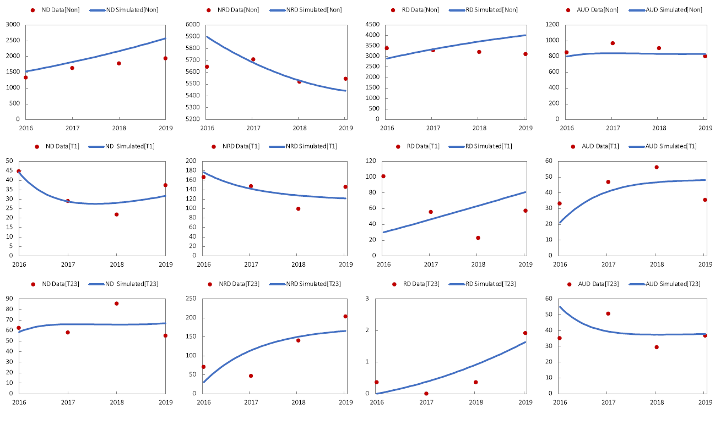
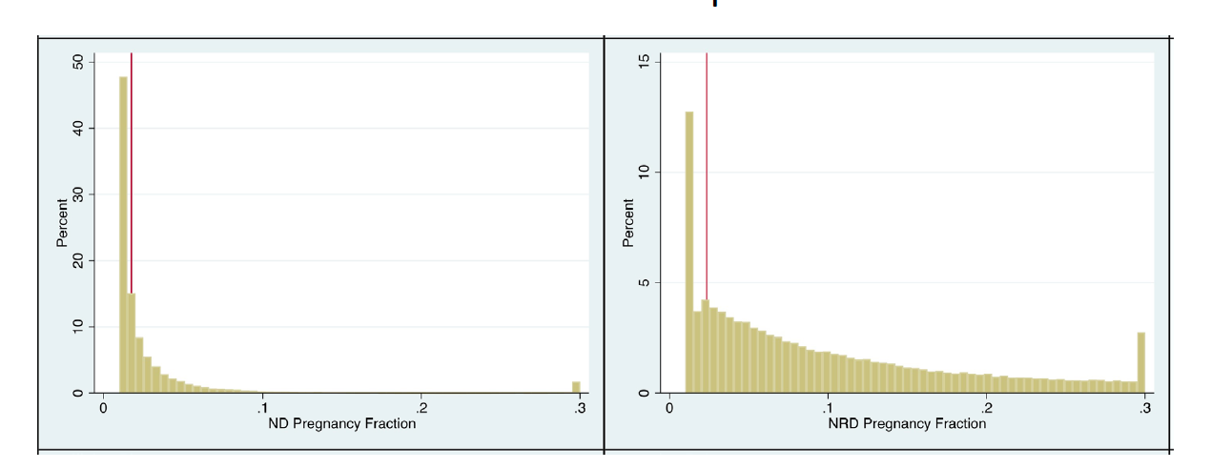
Model Calibration
Simulated Vs Observed Data
21 time-series data
Estimated 92 parameters
Powell’s method for calibration
Objective: Min ((model-data)/weights)^2
Weights: standard deviation of data
Markov chain Monte Carlo (MCMC) for estimating 95% confidence intervals
Summary statistics shows goodness of fit and relatively low systematic errors
MCMC Sampling and Confidence Intervals

Slide 11
Policy Testing
Questions:
Do programs change AEP rates for heavier “at risk” drinkers (target population)?
Do programs change community-level rates of any AEP?
Two program aspects:
Effect size (% of people who changed behavior)
Changing BC: New Pregnancy Rate = Initial Pregnancy Rate × (1- BC Use)
Changing Alcohol use: Increase or decrease RD or AUD outflows to sobriety stocks or NRD
Behavior change type (% of people who changed BC only, Alc use only, or both)
BC only: change pregnancy rates in RD and AUD stocks
BC and alc : Add change to pregnancy rate in NRD and RD/AUD sober stocks based on % of additional (program-facilitated) BC-changing people who flow into these stocks
Alc only: held constant

Slide 12
Policy Testing
Effect Size
 | ↓ Alcohol | ↑ Birth Control
1 (low-low) | 15% | 20%
2 (low-high) | 15% | 60%
3 (high-low) | 45% | 20%
4 (high-high) | 45% | 60%
Policy testing based on 9 AEP-prevention program evaluations
20 combinations
High vs low effect size (% changed behavior)
Proportional shifts between behavior change categories
Assumed “single” implementation of program in 2019
Factored in decay of BC effect based on failure rates for different types of BC
Change Category Proportions
 | % ↑ BC only | % ↓Alc + ↑BC | % of Alc Flow w/ BC
1 (Baseline) | 50% | 30% | 60%
2 (10% ↓ BC) | 40% | 40% | 67%
3 (10% ↓ Alc/BC) | 60% | 20% | 50%
4 (20% ↓ BC) | 30% | 50% | 71%
5 (20% ↓ Alc + BC) | 70% | 10% | 33%

Slide 13
Policy Testing: Effect Sizes only
Effect size strategies align with expectations
High-High efficacy provides strongest change
Higher BC more effective than higher alc for overall rates of AEP
Higher BC less effective in long-term for preventing AEP in higher risk drinking stocks (given single implementation)
Low Alc – Low BC Low Alc – High BC High Alc – Low BC High Alc - High BC

Slide 14
Policy Testing: Only/Both behavior change
Currently checking if policy test approach accurately reflects what we want to test
If we are accurate, then current proportions are optimal
Best results when a small (10%) amount of people shift from alc+bc to bc only
Worst results when a larger (20%) amount of people shift from BC only to Alc + BC
Optimal proportions depend on program effect sizes for larger shifts
Most stable impact over time regardless of shifts is high alc-low bc effects

Slide 15
Future Directions/Things to Figure Out
How to better test proportional shifts?
How to account for long-term impact?
Accounting for relapse with maintaining BC use
Testing continued program implementation
Current policy tests dependent in part on initial stock numbers – how do we create feedback loops that can inform policy testing parameters?
Nest models in broader systems with feedback loops and variables that have known impacts on program efficacy
Availability/accessibility of birth control; recovery/sobriety promotion services; social alcohol use environments; polysubstance use/comorbidity of mental health; violent and/or coercive relationships
Evaluate program impact within racial/ethnic groups with known differences in AEP patterns
Regionally: overall AEP most common for white, older birthing people but shorter-term binge drinking AEP more common for younger Indigenous birthing people

Slide 16
Thank you!
Questions? Comments? Feedback?
Arielle.Deutsch@avera.org
PS: We are actively recruiting a postdoctoral researcher for a new 7-year project – especially interested in people with strong quantitative backgrounds in simulation and modeling with interests in expanding to community-based approaches.

