Slide 1
Design Structure Matrices in System Dynamics: Modeling Community Disaster Recovery
International System Dynamics Conference, 2023
^{Chicago}
July 25, 2023
Rameez R Qureshi, PhD, Freese and Nichols, Inc
David N Ford, PhD, PE, Virginia Tech
Charles M Wolf, D.Eng, PE, Freese and Nichols, Inc

Slide 2
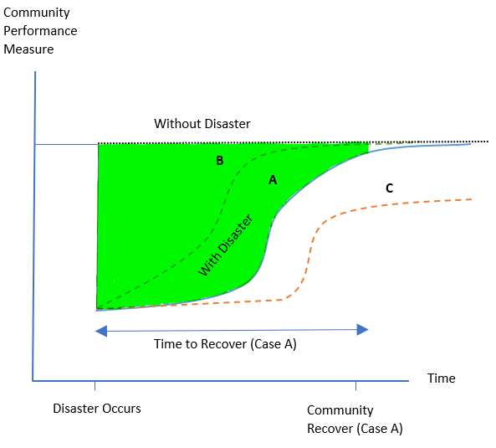
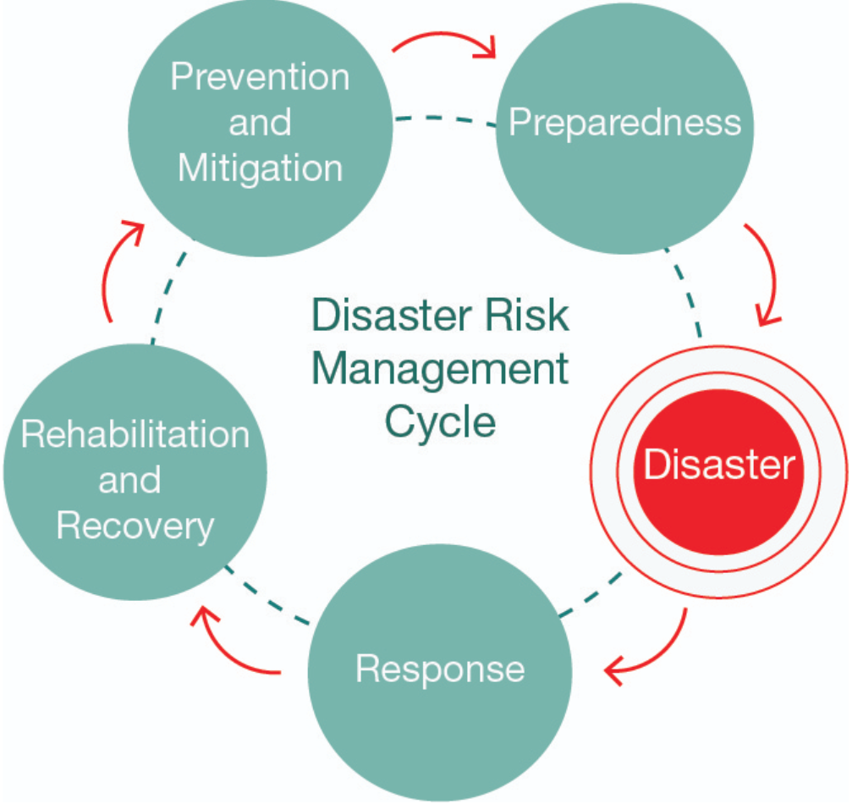
Community Natural Disaster Recovery
Restoration of normal patterns of household, business, and government activities
FEMA 2011
Schematic Disaster Recovery (Miles and Chang 2006)
Determining optimal resource sequencing, amounts, and timing to improve recovery is challenging
Introduction
Conceptualization
Methodology
Validation
Application
Notes:
Recovery is defined as the restoration of patterns of activity to pre-disaster levels. Figure on the right shows the behavior mode of recovery systems. When a disaster hits a community, there is a drop in the total performance of the system. Lines A,B,C show the recovery behavior, while the shaded areas shows loss in performance. A successful recovery is one that recovers quickly to its pre-disaster levels with minimum loss in functionality. However, limited resources and multiple competing factors make it difficult to allocate resources.

Slide 3
The Practitioner’s Problems
Widespread damage, limited resources, infrastructure interdependencies, and competing sectoral priorities make resource allocation challenging
Invest in public health vs infrastructure? Invest in manufacturing vs agriculture?
How should disaster managers allocate limited resources for improved recovery?
What recovery resourcing strategies can improve community disaster recovery performance?
Introduction
Conceptualization
Methodology
Validation
Application
Notes:
From the practitioner's perspective, there are multiple interacting sectors that drive each other in the recovery phase. E.g. Loop R1 here is a housing growth loop, while R2 is the public health growth loop. Comparing loop R1 & R2, even when there is adequate housing, lack of public health infrastructure may constrain population recovery.
Practitioners face a difficult challenge in deciding how to sequence resourcing efforts for recovery. Should they first invest in infrastructure, or public health, or manufacturing sectors, or agriculture.

Slide 4
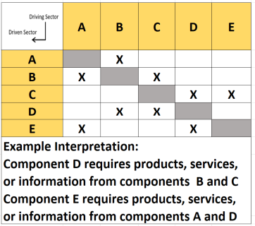
System Dynamics and Design Structure Matrix
Supplying Sectors
Compact format, visual representation, powerful analytical tools make DSM useful for modeling tightly coupled systems
DSMs are not useful in modeling delays, feedback, and the impact of decision-making
DSM was used in an SD model to simulate the requisite interdependent feedback interactions in community recovery
Receiving Sectors
Typical Design Structure Matrix
Introduction
Conceptualization
Methodology
Validation
Application
Notes:
DSM is a useful tool to capture the interaction among the elements of the system. Its is a useful way to model the location and strength of feedback loops when there are many, and many differently loop among system elements.
However, DSMs are not particularly useful in model decision making and delays in the system. Therefore, we combined SD and DSM methods to simulate the community recovery model.
The model was validated and used to test the impact of resourcing strategies based on the structure of the community system.

Slide 5
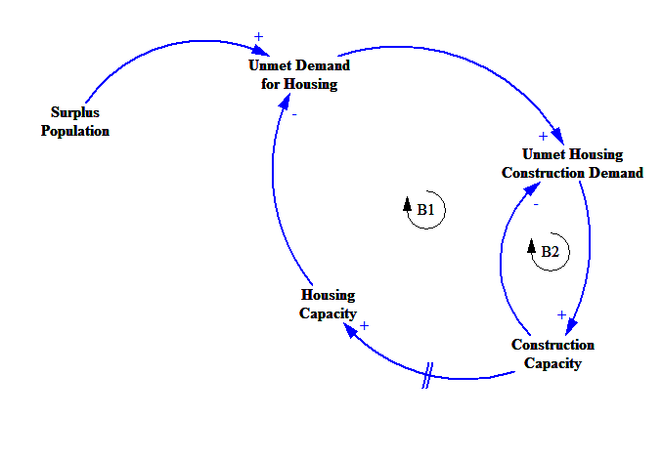
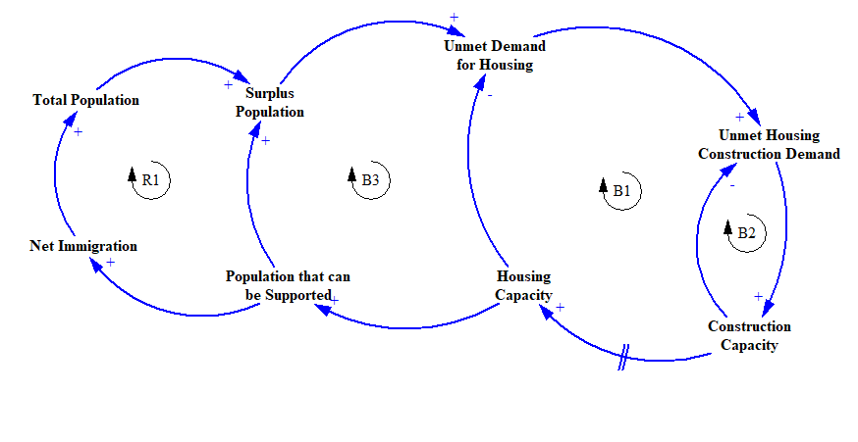
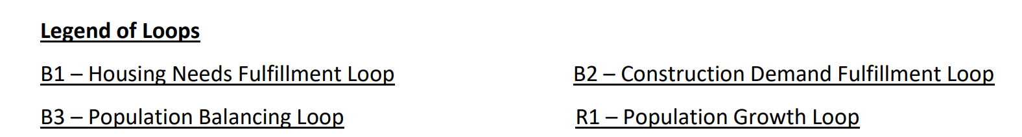
Feedback Theory of Community Recovery
Restoration activities continue to restore the damaged infrastructure until adequate physical infrastructure is made available to meet the population needs.
-
Natural Disaster
-
-
*For simplification purposes, CLD shows the interaction only between Housing and Construction sector
Introduction
Conceptualization
Methodology
Validation
Application
Notes:
Our hypothesis is based on the demand for restoration generated by the population in the post disaster period. eg. loop B1 here is housing restoration loop. After residential housing is impacted due to a disaster, the demand for providing the housing services grows in the post-disaster period. This demand surge is met by an increase in the construction activity that increases the number of houses after a delay.
As more housing is made available, it increases attractiveness of the community that increases net population that further increases the demand for housing, and therefore attracts more people to move in. Loop R1 is the population growth loop.
But here is the catch, adequacy housing infrastructure also depends on their usability. Unless houses are not provided with basic utility services, access to markets, etc. they are not habitable. We used a design structure matrix to capture these dependencies of a sector on other sector services for its regular operation.

Slide 6
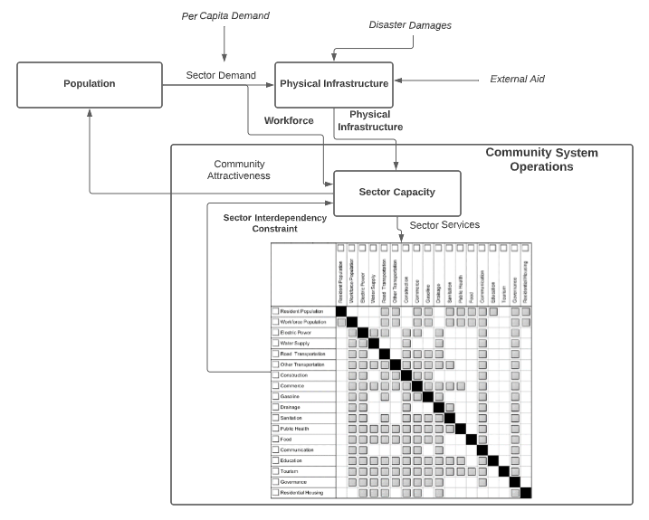
Simulation Model Subsystem Diagram
Community recovery efforts are driven by the local demand for infrastructure services
Population that can be supported depend on the available infrastructure services
Community Recovery System Model Schematics
Introduction
Conceptualization
Methodology
Validation
Application
Notes:
The figure shows the model schematics. The population sub-system provides information about the demand for community sectors. The demand for community sectors is met by providing adequate physical infrastructure and workforce to
meet the sector needs. In addition, the services provided by a sector depend on the availability of other
community sectors for regular operations. In the current model, a DSM is used to quantify the
dependencies among the system elements. The final sector supply is a function of the available workforce,
physical infrastructure, and sector dependencies.
The community sectors provide information about the available services to the population. This
information impacts the community's attractiveness, which affects the immigration and emigration rates
of the community.

Slide 7
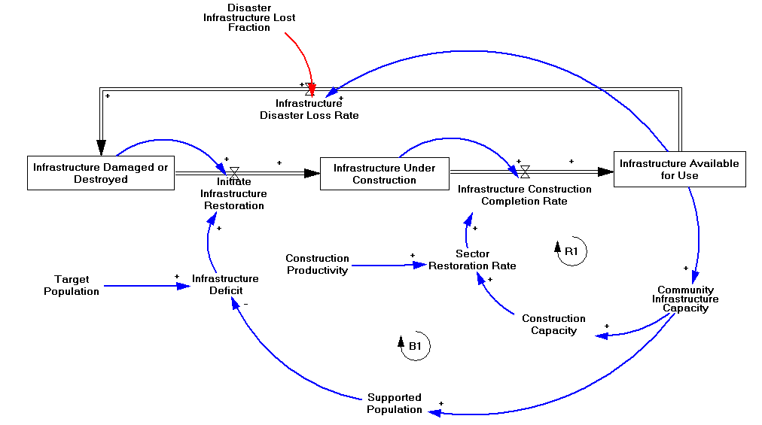
System Structure Diagram
The damaging and restoration of physical infrastructures are modeled using a three-stock aging chain with a single return flow to simulate the infrastructure damage
In the formal model there is a copy of the structure shown below for all the sixteen community sectors
Legend of Loops (partial):
R1: Restoration Capacity Growth Loop
B1: Population Goal Seeking Loop
Feedback Structure of Community Infrastructure Restoration
Introduction
Conceptualization
Methodology
Validation
Application

Slide 8
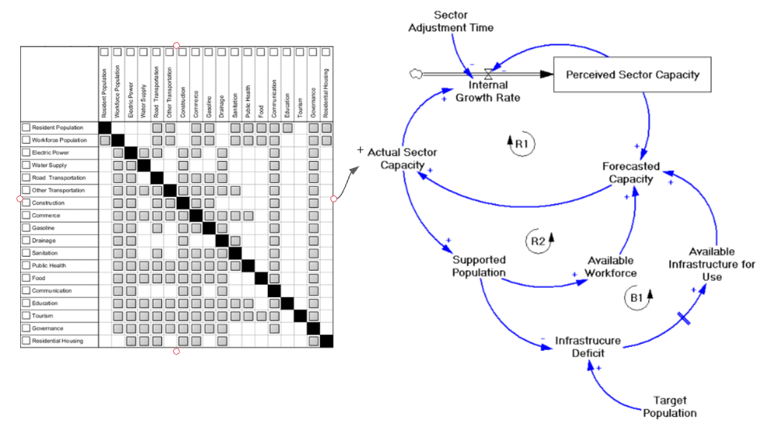
Integration of DSM and SD Models
Capacity of an infrastructure at any time is a function of
  Dependencies among infrastructure systems (Loop R1)
  Available workforce (Loop R2)
  Available physical infrastructure (Loop B1)
Legend of Loops:
R1: Sector Operations Growth Loop
R2: Workforce Growth Loop
B1: Population Goal Seeking Loop
Feedback Structure of Community Growth
Introduction
Conceptualization
Methodology
Validation
Application

Slide 9
Model Calibration
Example Model Calibration - Initial Infrastructure Capacity Parameter
Sector | Metric to Measure Capacity | UoM | Value | Source
Electric Power | Electric power Generation and Transmission Capacity | Mwh/Week | 1250 | New Orleans Energy Department
Commercial | Economic Output | M$/Week | 354 | United States Bureau of Economic Analysis
Construction | Installed Value of Construction Industry | M$/Week | 83 | United States Bureau of Economic Analysis
Water Supply & Wastewater Treatment | Water Production & Treatment Capacity | Million Gallons/Week | 250 | Sewerage & Water Board of New Orleans
Drainage | Drainage Capacity | Million Gallons/Week | 29000 | Sewerage & Water Board of New Orleans
Sanitation | Total Waste Collection Capacity | Garbage Tons/Week | 3000 | City of New Orleans
Public Health | Number of Available Hospital Beds | Hospital Beds/Week | 2269 | City of New Orleans
Road Transportation | Total Functional Lane Mileage | Lane Miles/Week | 1547 | City of New Orleans
Other Modes of Transportation | Cargo Capacity | Passengers/Week | 222000 | City of New Orleans
Fuel Distribution | Total Gasoline Sales/Deliveries | Thousand Gallons/Week | 25830 | United States Energy Information Administration
Food & Agriculture | Total Food Distribution Capacity | Ksqft/Week | 320400 | City of New Orleans
Tourism | Number of Functional Hotel Beds | Hotel Beds/Week | 40000 | City of New Orleans
ICT | Reachability | Customer Base/Week | 400 | City of New Orleans
Governance | Operating Administrative Budget | K$/Week | 722 | City of New Orleans
Education | Total number of enrollments | Student Enrollments/Week | 172219 | City of New Orleans
Housing | Total Housing Built Area | Ksqft/Week | 769095 | City of New Orleans
Data Collected for Recovery of Orleans Parish after Hurricane Katrina in 2005
Example Data Types
Community Characteristics: Population, Per Capita Demand, Migration Duration
Hazard Characteristics: Type, Duration, Extent of Damage
Community Sector-Specific Characteristics: Sector Capacity, Time to Issue Permits, Rate of Restoration, Resource Allocation
Introduction
Conceptualization
Methodology
Validation
Application

Slide 10
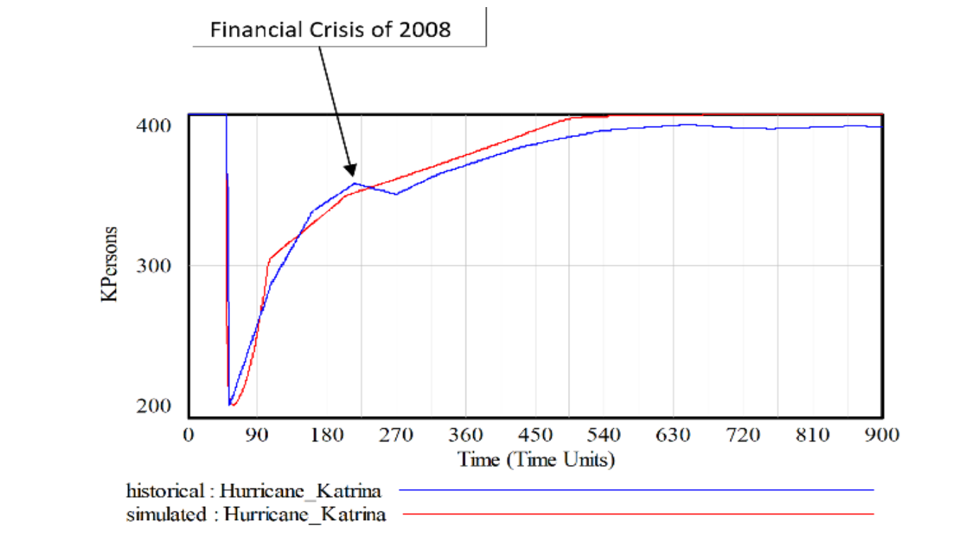
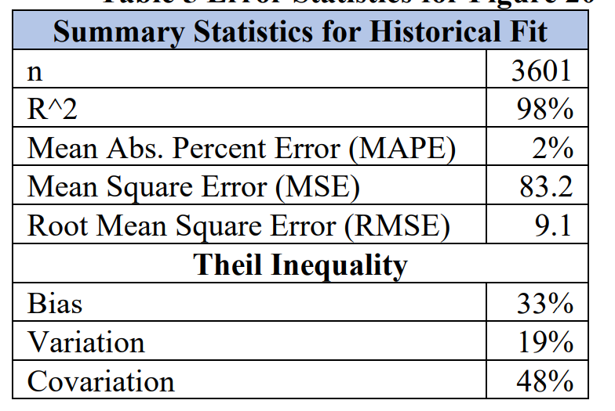
Model Behavior Assessment
In combination with other validation tests, the results support the model’s usefulness for simulating community recovery from shock events
Community Recovery System Behavior Reproduction Test Based on Orleans Parish Population Data
Introduction
Conceptualization
Methodology
Validation
Application

Slide 11
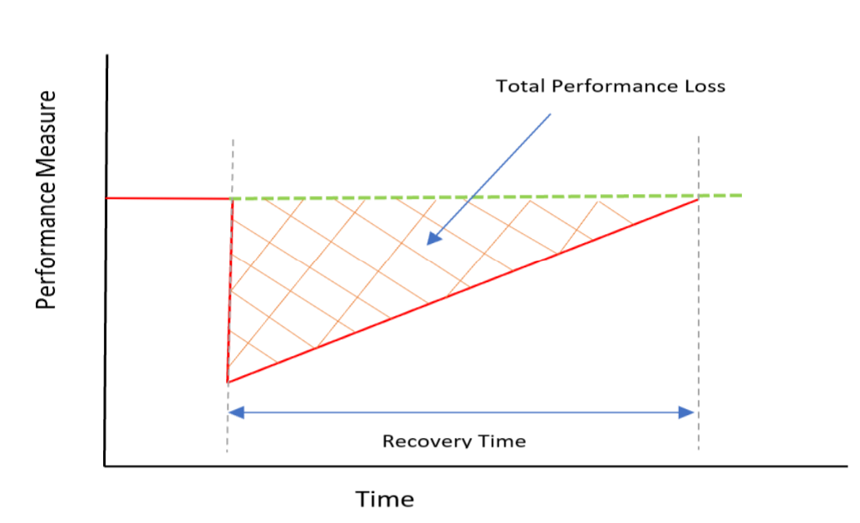
Model Use for Policy Design and Testing
How should disaster mangers allocate limited resources across community sectors?
What criteria-based resource allocation strategy design yields improved recovery performance and why?
Recovery Performance Metrics
Recovery Duration – Time for Population to Recover to 95% of Pre-Disaster
Performance Loss – Average Lost Capacity in %Pre-Disaster Capacity
Introduction
Conceptualization
Methodology
Validation
Application

Slide 12
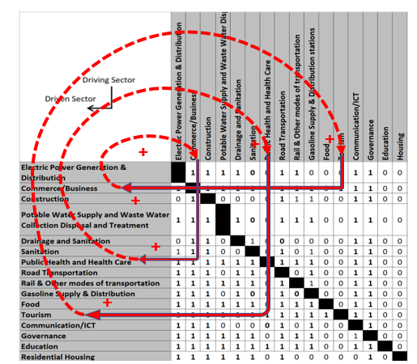
Base Case Simulation
Initial Conditions:
Time of Disaster @50th week
Equal damage to all sectors@50% of initial capacity
External Aid of $25billion allocated equally (6.25%) to all sectors
Numerical Community Recovery DDSM
Recovery Performance Metrics
Average Lost Performance 14%
Recovery Duration 441 weeks
Recovery Behavior of Interdependent Community Sectors
Introduction
Conceptualization
Methodology
Validation
Application
Notes:
There are sixteen infrastructure sectors in the community that interact with each other to drive and constrain each other's recovery. The column elements drive the row elements, whereas the interacting cells show whether an interaction exists (1) or not (0). The relationships in Figure and model calibration are based on community data collected from New Orleans, Louisiana. At each iteration through the DSM the model simulates the capacity of the downstream sector (rows) based on the minimum capacity of its upstream sectors (columns). Restoration of infrastructure increases the sector capacity after a delay, which increases the 74 constrained upstream sector supply and supports the downstream sector services. The capacity calculation passes through the DSM in each iteration to determine the sectors' available capacity (output from row elements) based on the minimum of the available ‘upstream’ sector capacity that are required for its regular operations.

Slide 13
Comparison of Resource Allocation Strategies
The result suggests that both restoration speed and sector dependencies are important guides to improved recovery resource allocation
Comparison of Recovery Resourcing Strategies
Disaster Recovery Resourcing Strategy Performance Summary
Resource Funding Policy | Recovery Performance |  | %Improvement Over Base Case
 | Recovery Duration (Weeks) | Performance Loss | Recovery Duration | Performance Loss
Base Case | 441 | 14% | 0% | 0%
P1 Sector Restoration Rate | 102 | 4% | +77% | +69%
P2 Resilience Improvement | 416 | 13% | +6% | +9%
P3 World Bank Recovery Framework | 417 | 12% | +6% | +14%
P4 In-Degree Centrality | 305 | 13% | +31% | +10%
P5 Out-Degree Centrality | 940 | 52% | -113% | -272%
Introduction
Conceptualization
Methodology
Validation
Application

Slide 14
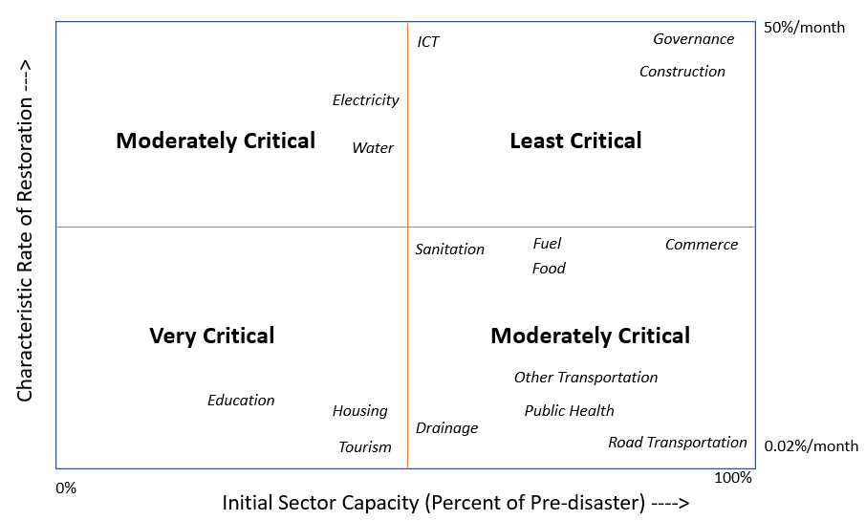
Improved Recovery Resourcing Strategy
The most important community resourcing features driving recovery are the extent of damage, infrastructure restoration speeds, and infrastructure interdependencies.
Recovery Performance Metrics
Lost Performance = 53% Improvement over base-case
Recovery Duration = 55% Improvement over base-case
Introduction
Conceptualization
Methodology
Validation
Application

Slide 15
Improved Recovery Resourcing Strategy
The most important community resourcing features driving recovery are the extent of damage, infrastructure restoration speeds, and infrastructure interdependencies.
The extent of damage can be impacted by mitigation projects
Infrastructure restoration speed can be impacted by emergency public policies (e.g. permitting speed)
Infrastructure interdependencies can be improved through increased robustness
Introduction
Conceptualization
Methodology
Validation
Application

Slide 16
Conclusions
Contributions to Research
Integration of System Dynamics and Design Structure Matrix modeling approach
Development of a feedback theory of community recovery consisting of many interacting sectors
Simulated the behavior of complex interdependent community sectors with different rates of restoration
Tested and compared impacts of resourcing heuristics on community recovery duration and lost performance
Contributions to Practice
Developed a simulation model that be can be calibrated to communities with specific characteristics for community-specific recovery resourcing strategy
Designed a cross-sector resource allocation prioritization criteria for a faster community recovery with reduced loss in functionality
Introduction
Conceptualization
Methodology
Validation
Application
Notes:
We have successfully integrated SD and DSM for simulate the long-term recovery behavior of community systems. We have also tested the impacts of varying qty of resources on community recovery performance. Model results show that some sectors are more critical than others based on their structure of the system and resource allocation needs to identify the criticality of sectors for improved recovery.

Slide 17
Thank you!
“It’s your reaction to adversity, not adversity itself that determines how your life’s story will develop.”
- Dieter F. Uchtdorf

Slide 18
References
https://www.undrr.org/
FEMA (2011). “National Disaster Recovery Framework”
Hallegatte, Stephane; Rentschler, Jun; Rozenberg, Julie. (2019). Lifelines: The Resilient Infrastructure Opportunity. Sustainable Infrastructure; Washington, DC: World Bank. © World Bank. https://openknowledge.worldbank.org/handle/10986/31805 License: CC BY 3.0 IGO
Miles, S. Chang, S. 2006. "Modelling Community Recovery from Earthquakes". Earthquake Engineering Research Institute. Vol. 22 (2) 439-458
Rinaldi, S., J. Peerenboom, and T. Kelly. 2001. “Identifying, Understanding, and Analyzing Critical Infrastructure Interdependencies.” IEEE Control Systems Magazine 11-25.

