Slide 1
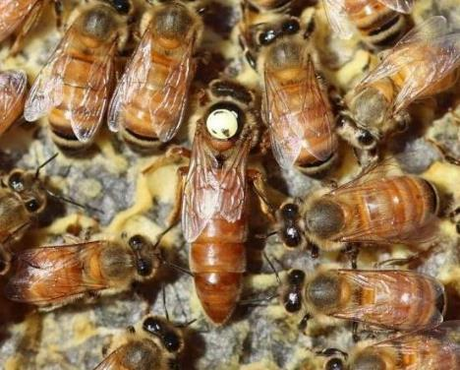
Optimizing Beekeeping Production: A Case Study on Forecasting Bee Queen Rearing Capacity
Agnese SMILGA-SPALVINA*^{1,2}, Kriss SPALVINS², Ivars VEIDENBERGS²
¹LLC SMILGA SPALVINA, Sigulda district., Incukalna parish, Incukalns, Plānupes street 11A, LV-2141, Latvia
²Institute of Energy Systems and Environment, Riga Technical University, Azenes street 12/1, Riga, LV-1048, Latvia
* Corresponding author. E-mail address: smilga.agnese@gmail.com

Slide 2
Why is system dynamics modeling applied in beekeeping?
Corresponding author Agnese Smilga-Spalvina:
a beekeeper and manager at SMILGA SPALVINA LLC (Latvia),
specialization in beekeeping: queen rearing and breeding work,
PhD student at Institute of Energy Systems and Environment, Riga Technical University.
Why system dynamics modeling?
«Last year, I encountered a practical problem in beekeeping.
I had created a queen rearing system and in the middle of the season I realized that there was not enough time for inspecting bee colonies, there was also not enough time for rearing queens and many other tasks related to beekeeping started to pile up. Working every day 16+ hours did not help to catch up with all the tasks. I knew I had to understand what my mistakes were and find a solution.
Luckily in the fall I had to take professor Andra Blumberga’s system dynamic modeling course in my doctoral studies. It helped me to look at the problem differently and find a solution through modeling.»

Slide 3
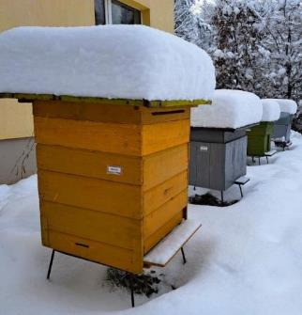
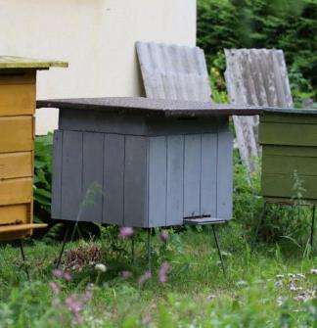
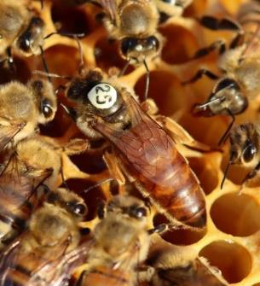
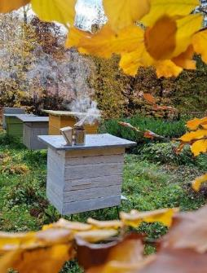
Situation description (1/8)
The beekeeper wants to produce naturally mated honey bee queens.
To raise queens, 2 types of bee units must be established and maintained during the active beekeeping season (in Latvia – 16 weeks from May 1 to August 31).

Slide 4
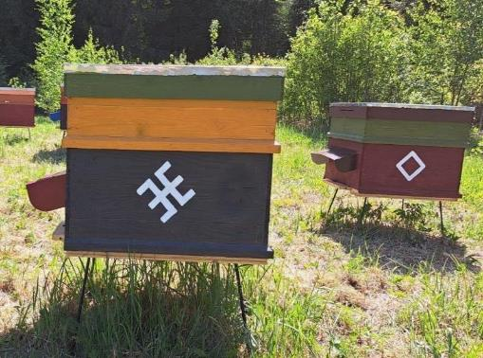
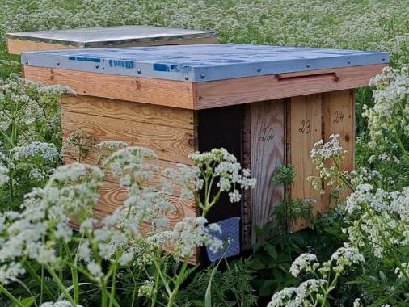
Situation description (2/8)
No more than 20 bee colonies and 100 nucs (small queen mating units) may be located in one apiary.

Slide 5
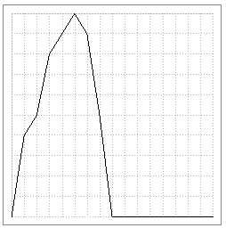
Situation description (3/8)
New nucs can be created by taking honey and egg/larva combs with bees from other bee colonies. No more than 5 new nucs per season can be gradually created from one bee colony.
1
Creation factor for nucs
0
4
8
12
16
Time (weeks)

Slide 6
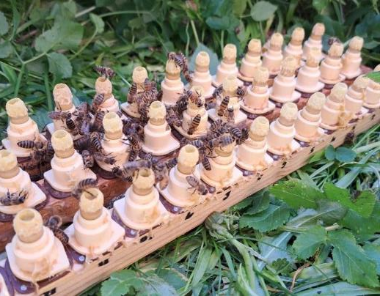
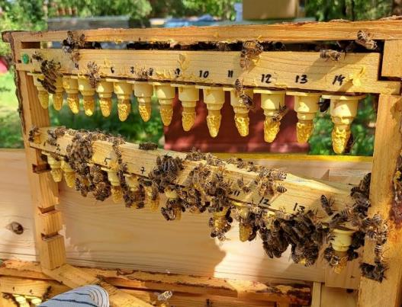
Situation description (4/8)
Nurse or rearing colonies (large queen rearing units) are used for rearing virgin queens. It is possible to rear 40 new virgin queens from one rearing colony per week.

Slide 7
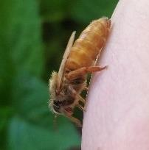
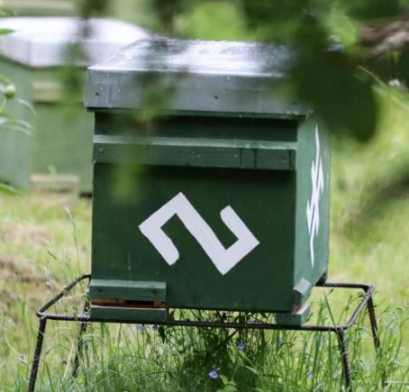
Situation description (5/8)
After that beekeeper introduce virgin queens to nucs (small queen mating units), which take care of the queens. Only one virgin queen may be added to one nuc. Virgin losses of 20% are usually observed after queen addition to nucs.

Slide 8
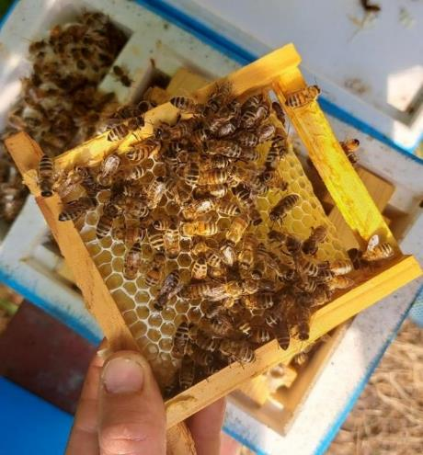
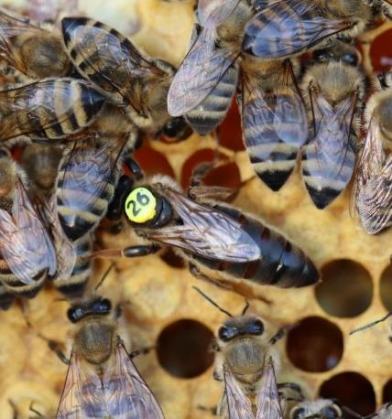
Situation description (6/8)
Then virgins go on a nuptial flight and upon return become naturally mated, laying queens.

Slide 9
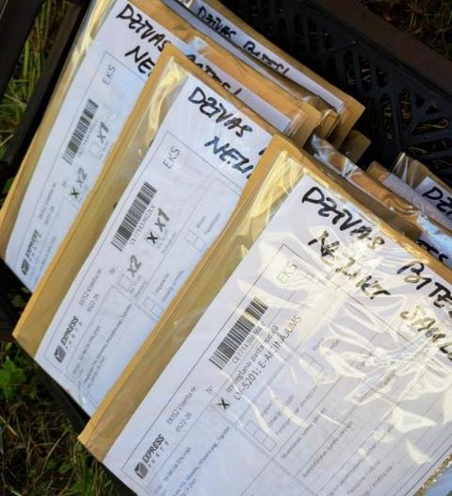
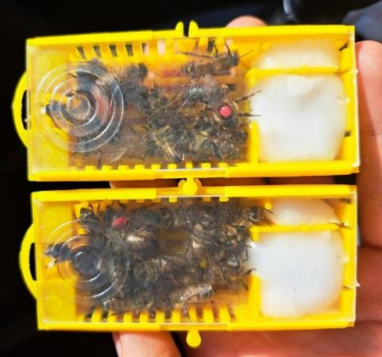
Situation description (7/8)
Naturally mated, laying queens and surplus of virgin queens are packaged and sold to other beekeepers.

Slide 10
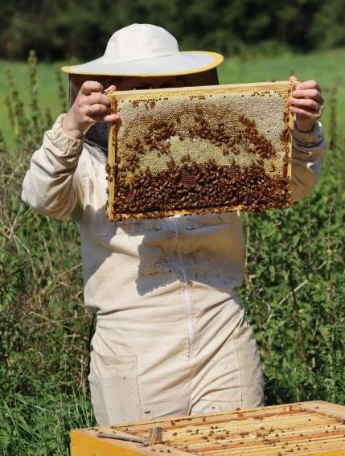
Situation description (8/8)
In order to maintain the entire system, 1 beekeeper must invest work in rearing queen bees, inspecting bee colonies and nucs, packing queen bees. Maintenance of the system should not require more than 40 hours per week, as the rest of the time is for other beekeeping tasks, communication with customers, etc. Exceeding 40 hours hinders other beekeeping activities.
Knowing the bee colonies, nucs and labor costs, it is necessary to find out the optimal size of the production system (number of nurse colonies and nucs) so that it is operational and profitable (without losses).

Slide 11
Problem statement
What is the optimal number of rearing colonies and nucs that a beekeeper should establish for 16 weeks for rearing and selling naturally mated queens so that the production system can be kept functional and profitable with 40 working hours per week?

Slide 12
Description of model (1/4)

Slide 13
Description of model (2/4)
Negative feedback loop No. 1 (stock of virgin queens):
*) The fewer virgins are added to the nucs, the greater the virgin surplus,
*) The greater the virgin surplus, the more virgins are sold,
*) The more virgins are sold, the fewer virgins remain in stock,
*) The fewer virgins are in stock, the less virgins are added to the nucs.
Negative feedback loop No. 2 (adding of virgin queens to nucs):
*) The more virgins are added to nucs, the smaller the virgin surplus,
*) The smaller the virgin surplus, the less virgins are sold,
*) The less virgins are sold, the more virgins are in stock,
*) The more virgins are in stock, the more virgins are added to the nucs.

Slide 14
Description of model (3/4)
Negative feedback loop No. 3 (sale of naturally mated queens):
*) The more naturally mated queens are in stock, the more naturally mated queens are sold,
*) The more naturally mated queens are sold, the less naturally mated queens are in stock.
Negative feedback loop No. 4 (mortality/loss of naturally mated queens):
*) The more naturally mated queens disappear or die, the less naturally mated queens are in stock,
*) The less naturally mated queens are in stock, the less naturally mated queens disappear or die.

Slide 15
Description of model (4/4)
Negative feedback loop No. 5 (overtime-queen rearing):
*) As overtime increases, the effect of overtime on queen rearing decreases (from 1 to 0),
*) As the overtime effect decreases, queen rearing decreases,
*) As the queen rearing decreases, the labor consumed in queen rearing decreases,
*) As labor decreases, overtime decreases,
*) As overtime decreases, the effect of overtime on queen rearing increases (from 0 to 1).
There are other loops that run briefly depending on the initial values of variables.

Slide 16
Full model (supporting material)

Slide 17
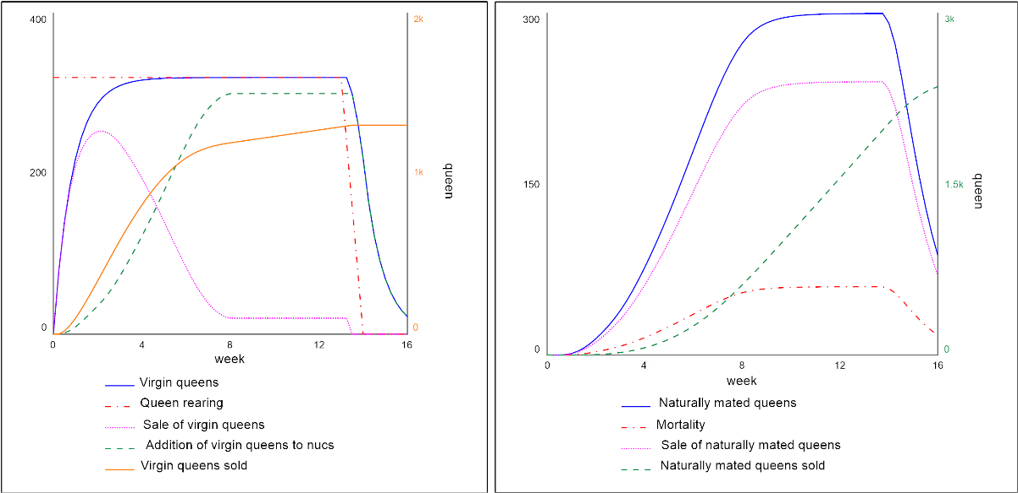
Result #1: system resources and labor has been used effectively (3 apiaries (300 nucs), 8 rearing colonies (320 queens/wk)

Slide 18
Result #2: system resources and labor has not been used effectively (4 apiaries (400 nucs), 10 rearing colonies (400 queens/wk)

Slide 19
Discussion of the conclusions
Verification and validation of the model has been carried out with several tests.
Key policies included in the model:
*) #1 - constants, parameters, numbers. More specifically, the parameters «Apiaries» and «Rearing colonies» will be changed, which affect the flow «Formation of nucs» and «Queen rearing».
*) #2 – the size of buffers and other stabilizing stocks relative to their flows. The stabilizing stock is «Production overtime», if the stock becomes > 0 the parameter «Overtime effect on queen rearing» immediately affects the flow «Queen rearing».
*) #3 - system rules. The limitation of the system is the parameter «Expected time for production». In the given model, it is 40 h, when it is exceeded, production overtime begins to accumulate, which immediately regulates or temporarily stops the flow «Queen rearing».

Slide 20
Discussion of the conclusions and recommendations
By setting rules for the system (estimated time for production 40 h), introducing limiting parameters («Overtime effect on queen rearing») and changing parameters of production capacity («Apiaries», which affect the number of nucs for queen mating, and «Rearing colonies», which affect the number of virgin queens per week), it is possible to predict how long it is possible to keep the selected production capacity functional and the system itself profitable with a time limit of 40 h.
The optimal number of production units with a production time of 40 h is 3 apiaries (300 nucs) and 8 rearing colonies (320 queen bees/week).
The model fulfills the purpose of prediction for system capacity.

Slide 21
References
This is a case study based on the practical experience of a beekeeping company.
Data for model validation and verification are used from practical experience.
A detailed description of the model will be available in a upcoming publication in the journal Environmental and Climate Technologies.

Slide 22
Thank you for your attention!

