Slide 1
THE HUMAN ORGANISM RESPONSE TO STRESS How violence exposure affects cortisol levels and its implications.
WIP Presentation
Eduardo de la Vega Taboada
Florida International University
0:00-0:30
@systemdynamics_
THE 41st INTERNATIONAL SYSTEM DYNAMICS CONFERENCE
Chicago, USA and Virtually
#isdc2023
Notes:
Title page: Change title to submission name. Bold the name of the presenter and display your name as you want it read by the moderator (eg Bob instead of Robert). Note the suggested timing in the bottom right. Slide timing may be adjusted, but not the number of slides. The session chair will change slide following the timing indicated, or earlier if requested.

Slide 2
Problem Statement
The environment turns adverse.
The nervous system activates a goal directed mechanism to release cortisol.
The release stops when the body is more stressed than the perceived requirements of the environment.
The frequent activation of the system dysregulate the activation sensor (HPA axis).
How is the exposure to different levels and types of stress affecting children’s health and future behaviors?
0:30-2:00
@systemdynamics_
THE 41st INTERNATIONAL SYSTEM DYNAMICS CONFERENCE
Chicago, USA and Virtually
#isdc2022
THE 40TH INTERNATIONAL SYSTEM DYNAMICS CONFERENCE
Virtually everywhere!
#isdc2023
Notes:
Problem Statement: Do not change the slide title. Keep fonts big (24 pt or bigger). Indicate why the problem is important. Note the timing in the bottom right.
The human organism is in a constant calculated interaction with the environment. When the environment turns adverse or perceived as adverse, the nervous system activates a survival mechanism, the “adaptive stress response” (Kirschnaum & Hellhammer, 1994). This activated system prepares the body to either fight against the treat or flight from the adverse situation. The control piece of this system lays in the brain, specifically in the hypothalamic-pituitary-adrenal axis (HPA), which evaluate the change in the environment and if the change is considered threaten it activates the release of the cortisol hormone which prepares the body for fight-or-flight. This mechanism functions as a goal directed feedback

Slide 3
Approach or Dynamic Hypothesis
Cortisol levels is the main quantified element in the simulation.
The element that is flowing thru the system.
The dysregulation is an endogenous response.
We are building a model based on empirical papers and experts’ interviews.
The model can simulate the way in which the organism response to changes in their environment.
The cortisol levels is something that can be measured by the saliva and/or the hair.
2:00-3:30
@systemdynamics_
THE 41st INTERNATIONAL SYSTEM DYNAMICS CONFERENCE
Chicago, USA and Virtually
#isdc2022
THE 40TH INTERNATIONAL SYSTEM DYNAMICS CONFERENCE
Virtually everywhere!
#isdc2023
Notes:
Approach or Dynamic Hypothesis: Do not change the slide title. Keep fonts big (24 pt or bigger). Note the timing in the bottom right.

Slide 4
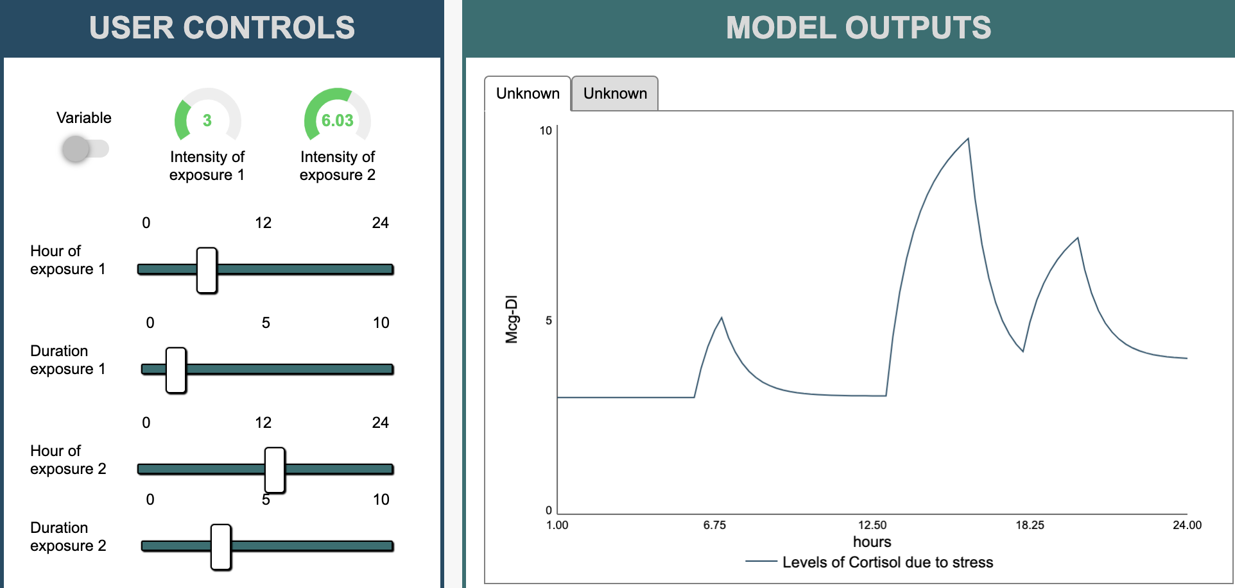
Progress, Insights, and Questions
The child response to stress
The user can introduce different stressful events happening on a typical day of a child (time, intensity, and duration).
We are working in a weeklong one, that includes therapeutical moments.
3:30-5:00
@systemdynamics_
THE 41st INTERNATIONAL SYSTEM DYNAMICS CONFERENCE
Chicago, USA and Virtually
#isdc2022
THE 40TH INTERNATIONAL SYSTEM DYNAMICS CONFERENCE
Virtually everywhere!
#isdc2023
Notes:
Progress, Insights, and Questions: Do not change the slide title. Again, keep the text short and fonts big. Show structure or behavior – may not be room for both (some flexibility on font for images). No need to conclude, there is always more to be done. Any questions you want to pose to the audience can go here. Note the timing in the bottom right.

Slide 5
THE INTERNATIONAL SYSTEM DYNAMICS CONFERENCE
Instructions: Please do this!!!
1) Prepare your Work in Progress (WIP) presentation using a copy of this template.
Change the presentation title and author information to match your submission.
Do NOT change the titles of the other slides. Do NOT change the number of slides with content.
Change the body of the slides to present your work, following the instructions in the slide notes.
2) Submit your WIP presentation slides at https://webportal.systemdynamics.org by June 20
Click on the title of your submission
Select “Upload new or updated paper files”
Upload the Powerpoint presentation file for your WIP slides
3) Follow the format and timing listed below:
You have exactly 5:00 minutes to present, followed by up to 5:00 minutes of discussion.
Keep within the time limits noted at the lower right of each slide.
The session chair will combine your slides with other presentations and will control the screen.
4) You may record your presentation in advance
If you are not able to attend the session, the recording will be used instead
If you do attend, you can ask the chair to play the recording, or present live
Add the YouTube Video ID to the Web Portal under “Review or update paper information”
5) If you make updates or change plans after June 20, send the session chair a note
Use the contact information at https://isdc.systemdynamics.org
Notes:
This slide will be hidden from presentation. You may delete this instruction slide once your slides are ready.

