Slide 1
Bridging South Africa’s supply-demand mismatch in the electricity transitions
Online Poster Presentation
Josephine Musango, University of Cape Town
0:00-0:30
@systemdynamics_
THE 41ST INTERNATIONAL SYSTEM DYNAMICS CONFERENCE
Chicago, USA and Virtually
#isdc2023

Slide 2
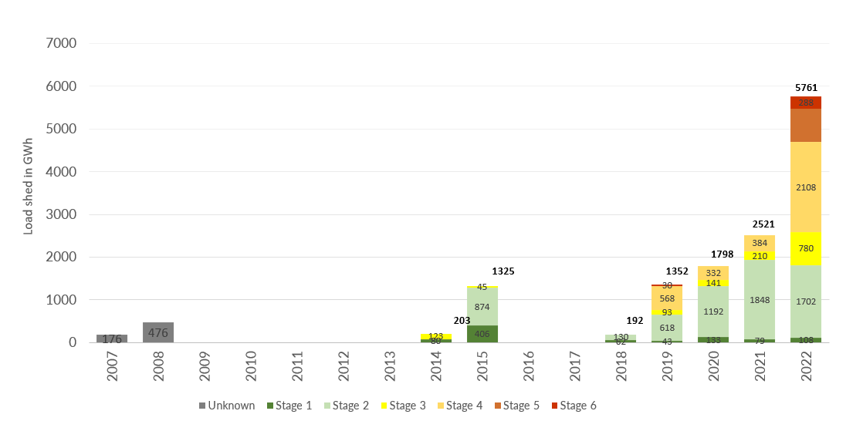
Problem Statement
Electricity transitions ignore a holistic approach
Investment requirements
Supply chain delays
Socio-political dynamics
0:30-2:00
@ systemdynamics_
THE 41ST INTERNATIONAL SYSTEM DYNAMICS CONFERENCE
Chicago, USA and Virtually
#isdc2022
THE 40TH INTERNATIONAL SYSTEM DYNAMICS CONFERENCE
Virtually everywhere!
#isdc2023

Slide 3
Approach or Dynamic Hypothesis
Demand-supply gap influences:
Coal capacity investment requirements (R1)
Renewable energy investment requirements (B1)
Electricity demand through GDP effect (R2)
Electricity demand through price effect (B2)
2:00-3:30
@systemdynamics_
THE 41ST INTERNATIONAL SYSTEM DYNAMICS CONFERENCE
Chicago, USA and Virtually
#isdc2022
THE 40TH INTERNATIONAL SYSTEM DYNAMICS CONFERENCE
Virtually everywhere!
#isdc2023

Slide 4
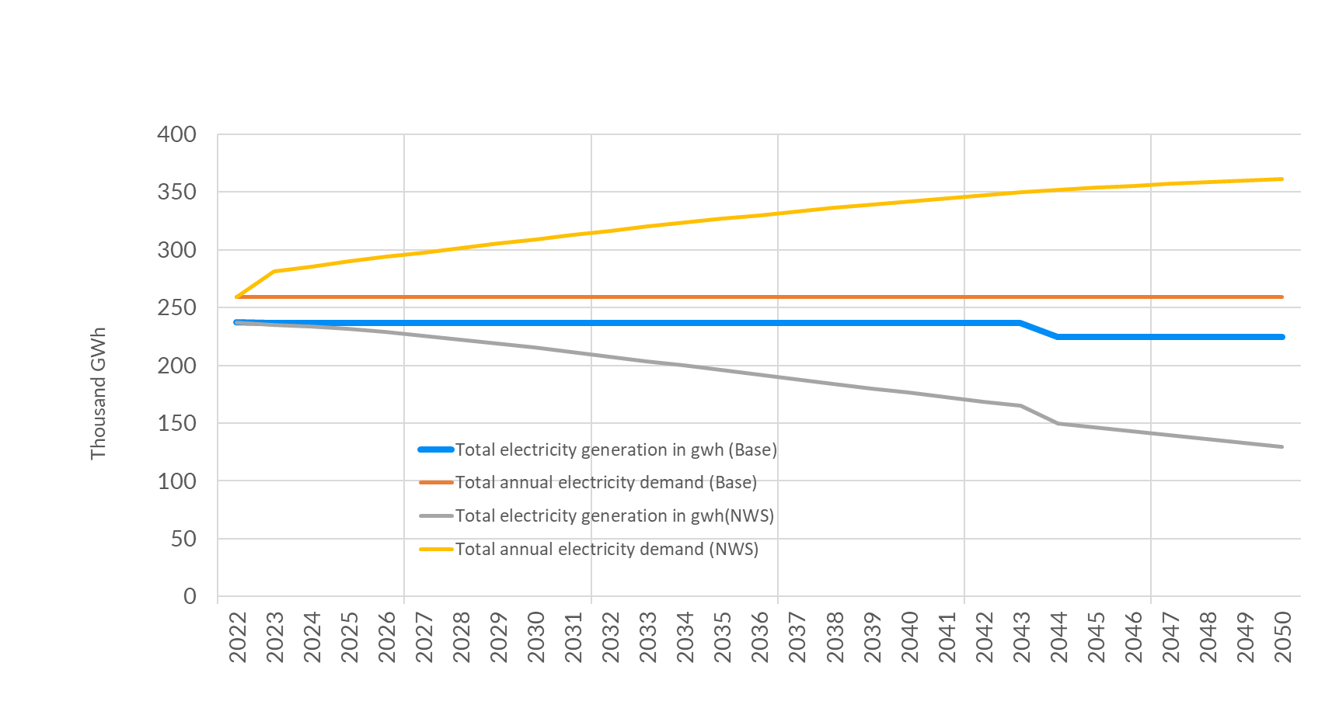
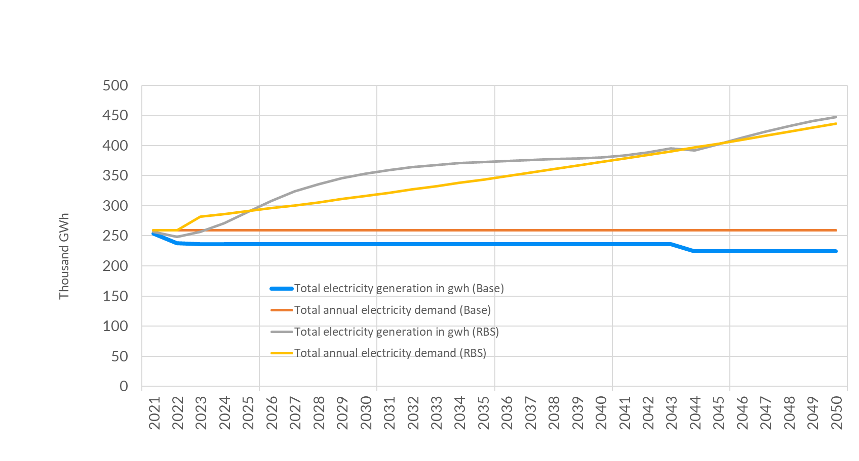
Results
Behavior resulting from structure
Widening gap without investment
Investment improves energy security
Double renewable capacity relative to coal
Consider emerging decentralised market
3:30-5:00
@systemdynamics_
THE 41ST INTERNATIONAL SYSTEM DYNAMICS CONFERENCE
Chicago, USA and Virtually
#isdc2022
THE 40TH INTERNATIONAL SYSTEM DYNAMICS CONFERENCE
Virtually everywhere!
#isdc2023

