Slide 1



Fatigue dynamics in safety-critical monitoring roles: evidence from the Belgian railway network
Georgia (Ning-Yuan) Liu¹, Navid Ghaffarzadeganª,Hesam Mahmoudi¹, Konstantinos Triantis¹, Bart Roets²
¹ Virginia Polytechnic Institute and State University, Grado Department of Industrial and Systems Engineering, Virginia, USA
²INFRABEL and Ghent University, Brussels, Belgium
41st International System Dynamics Conference July 23-27, 2023
This research is in part supported by National Science Foundation (NSF) grant #2051685.
The findings and conclusions of this research are the sole responsibility of the authors and not of the NSF

Slide 2
Overview
Research Background and Motivation
Research Question
Theory: Suboptimality of Workload Theory
Data: Task Workload and Human Errors
Model: The Fatigue-Dynamics SD Model
Result: Model testing, validation, scenario testing
Conclusion

Slide 3


Research Background and Motivation
As automation takes a growing role in a wide range of tasks over the past decades, the nature of human workload has shifted noticeably to monitoring roles.
Modern technological systems are shifting the operator’s task burden to a psychological level, rather than a physical one. (Strauch, 2018).
This require more cognitive demands compare to physical demands upon operators in complex safety-critical system.
The construct of “Mental Workload (MWL)” is proposed to understand how cognitive demands effect an operator’s overall performance.
Notes:
Exploratory research, primarily conceptual, mix methods
Modern technology can enhance systems performance, but also increases the systems’ complexity, introducing new safety issues (Strauch, 2018).
This have require ever more cognitive demands compare to physical demands upon operators in complex safety-critical systems (e.g., transport, process control).

Slide 4
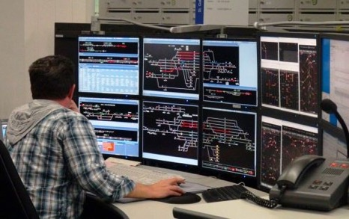
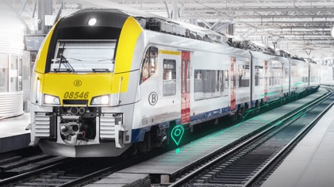

Research Question
Research question: “How does workload affect operator’s mental fatigue through an 8-hour shift?”
We propose a dynamic model of workload and its interaction with mental fatigue through time for safety-critical monitoring roles.
Automated Decision Aid System (ADAS)
Traffic Controller (TC)

Slide 5
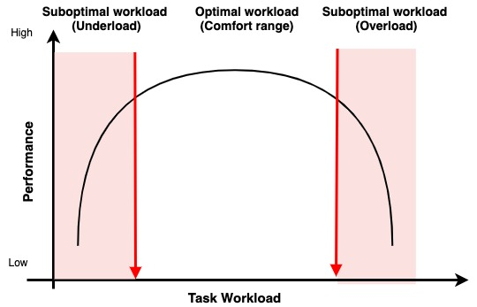

Theory: Suboptimality of Workload
Underload
Comfort range
Overload
Fig 1. Performance in overload, underload and comfort range (M. S. Young et al., 2015).
Notes:
Suboptimal workload can means either overload or underload.
. Overload occurs, for instance, when the operator is faced with more stimuli than (s)he is able to handle while maintaining their own standards of performance. Excessive load can affect selective attention, leading to narrowed or inefficient sampling (Easterbrook 1959). Conversely, too little stimulation can lead to underload, as resources are either allocated elsewhere or otherwise shrink through underuse (cf. Young and Stanton 2002).
In the present authors’ view, there has to be some engagement in the task, but such engagement is exceptionally low.
In comparison with MWL, suboptimality of workload has drawn considerably less attention in the literature. However, suboptimality of workload is by far a less vague concept and greatly simpler to quantify, estimate and model.

Slide 6
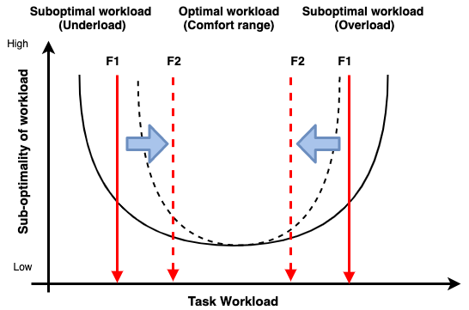
Theory: The dynamics of Suboptimality of Workload
Underload and overload thresholds change as fatigue is accumulated and rises through the work shift.
The thresholds move towards each other for growing fatigue levels (F2>F1), decreasing the comfort range.
“One’s level of mental fatigue influences his/her available resources and thus, performance over time, representing a dynamic relationship.” (Grech, Michelle R., et al, 2009)
Underload
Comfort range
Overload
Human Errors
Notes:
Grech, Michelle R., et al. "An examination of the relationship between workload and fatigue within and across consecutive days of work: Is the relationship static or dynamic?." Journal of occupational health psychology 14.3 (2009): 231.
“One’s level of mental fatigue influences his/her available resources and thus, performance over time, representing a dynamic relationship.” (Grech, Michelle R., et al, 2009)

Slide 7
Data
Model setup:
  Time frame: A 8hr shift, with 15 mins time interval. [1, 32]
  Subscripted and calibrated on 37,719 data points.
  The model is run on 4000 shifts in total.
Table 1. Variable definition and it’s Descriptive Statistics

Slide 8
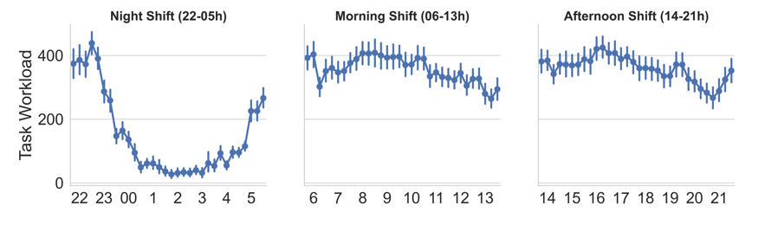
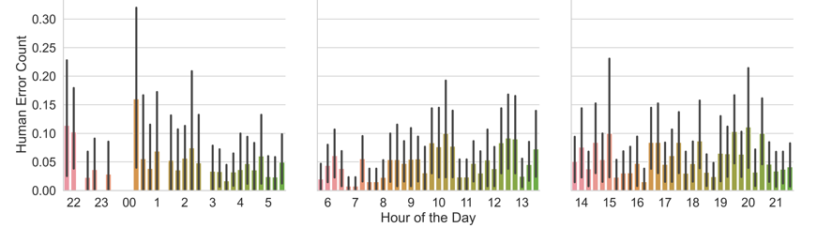
Data: Task workload and Human errors
Fig 2. Average workstation Task Workload and Human Error Count over 24 hours
Notes:
Overload: an excessive amount of task demand in a short time (e.g. during the rush hours)
Underload: low levels of task demand for a long time (e.g. during midnight hours).

Slide 9
Model: The Fatigue-Dynamics SD Model
Fig 3. A simplified system dynamics model structure depicting two major reinforcing feedback loops of Stress out and Bore out. Note: give the time boundary of analysis (8 hours) environmental feedbacks from human error to task workload and organizational factors are negligible.

Slide 10
Result: Model Testing
Model 1: Without Feedback Loop
Model 2: With Feedback Loop
We calibrated the model and the compare with real-world data.
We test our hypothesis that there is a feedback loops of strain and boredom effect the overload and underload threshold by running two models.
Model 1 does not include the feedback loop, i.e., the Stress Out and Bore Out Loop is disactivated.
Model 2 includes the feedback loop.
Fig 4. Sum of all human error simulated results plotted against real data
Fig 5. The Cumulative Error Comparing Real and simulate data
Notes:
In the next step, the system dynamics model is run using Vensim for the purpose of calibration. We calibrated the model and the compare with real-world data. Even though the underload and overload thresholds vary from one TC to another depending on personal attributes such as work experience, for the purpose of this model, the thresholds are estimated for an average TC. We test our hypothesis that there is a feedback loops of strain and boredom effect the overload and underload threshold by running two models. Model 1 does not include the feedback loop, i.e., the Stress Out and Bore Out Loop is disactivated. Model 2 includes the feedback loop.

Slide 11
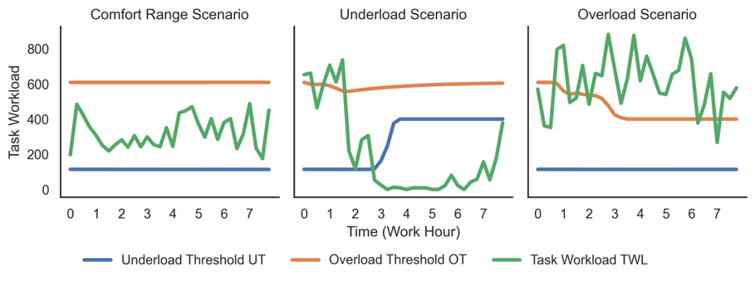
Result: Scenario Testing
Fig 6. Expected non safety-critical human error simulated results plotted against real data (Counts/Hour).

Slide 12
Conclusions
We presented a dynamic model of task workload’s interaction with stress, boredom, mental fatigue, and performance in safety-critical monitoring roles.
Our SD model builds on the suboptimality of workload theory, and extends it by incorporating the dynamic characteristic of operator’s mental fatigue affect by overload and underload.
The model is developed for Traffic Controllers in the Belgian railway network, INFRABEL, and is tested and calibrated with the detailed data provided by INFRABEL.
The calibration results of the SD model tested the hypothesis that whether there is a feedback loop in strain and boredom that decreases the comfort range.
The simulation results present some evidence supporting the structure of the model, however, there is considerable room for improvement in the model, calibration, and simulation.
Notes:
The average comfort range falls during the span of the work shift, and most rapidly in the night shift where suboptimality of workload is higher and fatigue is accumulating faster. Furthermore, night shift contains a larger confidence interval than the other two shifts, suggesting a higher variability of task workload during the shift.
Similar model structures can be used to predict dynamics of workload and errors in other similar settings. In safety critical systems

Slide 13
Thank you!
Georgia (Ning-Yuan) Liu
Email: ningyuan@vt.edu

Slide 14
Bibliography
Boksem, M. A. S., Meijman, T. F., & Lorist, M. M. (2006). Mental fatigue, motivation and action monitoring. Biological Psychology, 72(2), 123–132.
Charles, R. L., & Nixon, J. (2019). Measuring mental workload using physiological measures: A systematic review. Applied Ergonomics, 74, 221–232.
Folkard, S., Lombardi, D. A., & Spencer, M. B. (2006). Estimating the circadian rhythm in the risk of occupational injuries and accidents. Chronobiology International, 23(6), 1181–1192.
Hancock, P. A. (1989). The effect of performance failure and task demand on the perception of mental workload. Applied Ergonomics, 20(3), 197–205.
Hancock, P., & Warm, J. (2003). A dynamic model of stress and sustained attention. Journal of Human Performance in Extreme Environments, 7(1), 4.
Hancock, Peter A, & Desmond, P. A. (2001). Stress, workload, and fatigue. Lawrence Erlbaum Associates Publishers.
Hancock, Peter A, & Meshkati, N. (1988). Human mental workload. North-Holland Amsterdam.
O’Donnel, C., & Eggmeier, F. (1986). Workload assessment methodology: Chapter 42. Handbook of Perception and Human Performance. II, 1–49.
Rouse, W. B., Edwards, S. L., & Hammer, J. M. (1993). Modeling the dynamics of mental workload and human performance in complex systems. IEEE Transactions on Systems, Man, and Cybernetics, 23(6), 1662–1671
Strauch, B. (2017). Investigating human error: Incidents, accidents, and complex systems. CRC Press.
Tao, D., Tan, H., Wang, H., Zhang, X., Qu, X., & Zhang, T. (2019). A Systematic Review of Physiological Measures of Mental Workload. International Journal of Environmental Research and Public Health, 16(15), E2716
Wickens, C. D. (2008). Multiple Resources and Mental Workload. Human Factors, 50(3), 449–455.
Young, M. S., Brookhuis, K. A., Wickens, C. D., & Hancock, P. A. (2015). State of science: Mental workload in ergonomics. Ergonomics, 58(1), 1–17.

