Slide 1
A conceptual model of Social Determinants of Health (SDOH) an Intervention Impact on Population Health
John Ansah
Assistant Professor, CHI
Robinson Salazar Rua, PhD
Research Associates, CHI

Slide 2
Background
The U.S. healthcare cost is growing while disparities in health and healthcare persist.
Policymakers and diverse stakeholders are exploring interventions with the dual aim of slowing healthcare expenditure and reducing health inequality and population health.
Evidence shows that addressing social determinants of health (SDoH) advances population health and equity and reduces healthcare costs.
SDoH are the conditions in which people are born, grow, work, live, and age. They also refer to the forces and systems shaping daily life, such as education, physical environment, economic stability, access to food, community engagement, and the healthcare system.

Slide 4
Aim
To develop a conceptual model of social determinants of health (SDOH),
to the feedback loops that drive population health outcomes within the context of determinants of health and
simulate the short-term and long-term effectiveness of hypothesized SDOH interventions on population health.

Slide 5
METHOD
A system dynamics model was developed based on the following:
an extensive literature review and
engagement with community health experts with significant experience in population health.
The model simulated the hypothesized interventions' short-term and long-term effects on population health (with CVD as a proxy).

Slide 6
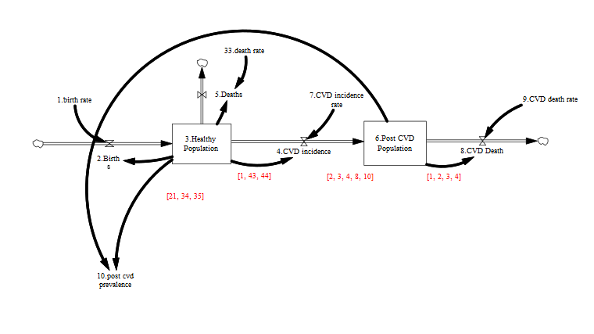
Conceptual Model of SDOH:
Health States

Slide 7
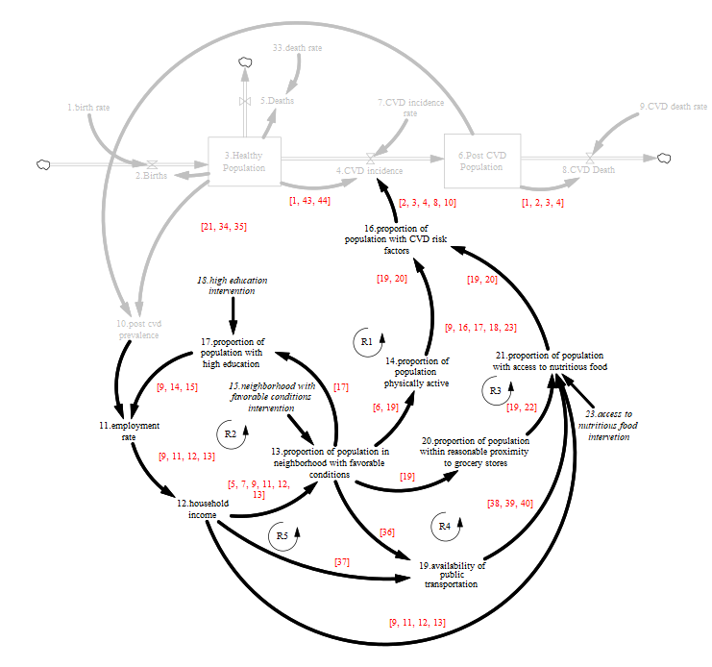
Adding Income, Education, neighborhood and food access relationships

Slide 8
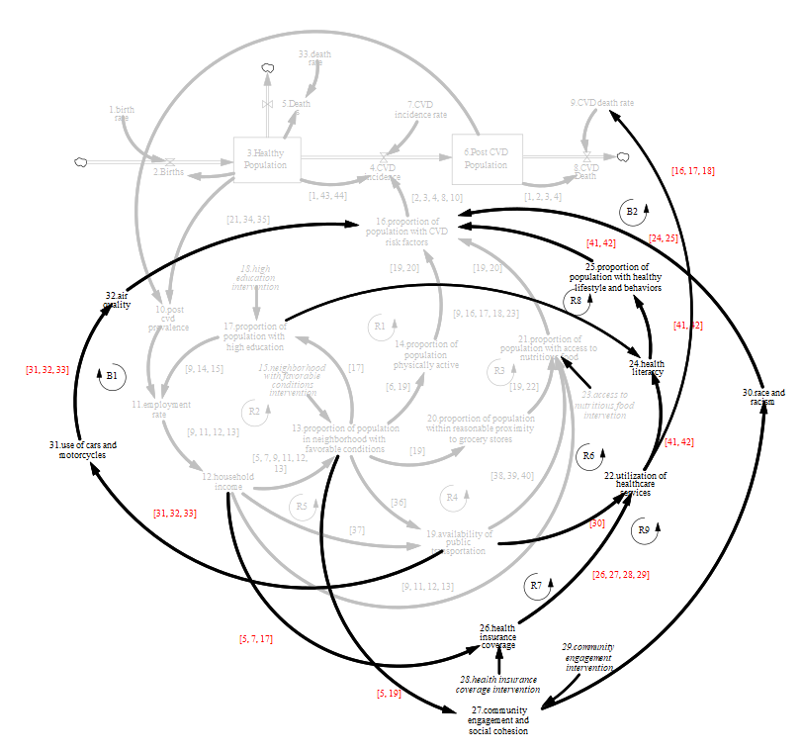
Adding Health services use,
Community engagement,
And Race

Slide 9
Intervention Experiments
Base case: The base case is the steady state where all model parameters remain unchanged over the simulation time.
Education intervention: Under this intervention, the proportion of the population with high education is assumed to increase by 4.5% annually from time 20 to 100.
Neighborhood intervention: The proportion of people in a neighborhood with favorable conditions is thought to increase by 4.5% annually from time 20 to 100.
Access to nutritious food intervention: The proportion of the population with access to nutritious food is assumed to increase by 4.5% from 20 to 100 annually.
Community engagement intervention: Under this intervention, community engagement and cohesion are presumed to increase by 4.5% per annum from time 20 to 100.
Health insurance intervention: The proportion of the population with health insurance coverage is assumed to increase by 4.5% annually from time 20 to 100.
Combined intervention: For the combined interventions, the education, neighborhood, access to nutritious food, community engagement, and health insurance interventions are implemented simultaneously over the simulation time. We assumed an equal annual increase for all the interventions to ensure that simulation outcomes are due to the strength of the feedback mechanisms generated by the interventions, not the magnitude of the intervention change.

Slide 11
Insights
Investment in SDoH has the potential to significantly improve population health (healthy population) and reduce the risk of CVD among the population.
In the short- to medium-term (<50 years), investment in SDoH is expected to decrease CVD incidence, post-CVD population, and CVD deaths, except for the health insurance intervention that increases post-CVD population as CVD deaths decline without a corresponding reduction in incidence.
Counterintuitively, the successful nature of the SDoH interventions suggests that more people are expected to survive CVD incidence, leading to an increased number of people with post-CVD.
Thus, in the long term (>50 years), as the healthy population increases, the number of people with CVD incidence begins to increase more than the CVD deaths, causing the post-CVD population to increase over time. As the post-CVD population increases, CVD deaths begin to increase as well.

Slide 12
Insights
Neighborhood intervention has the most decisive impact on population health (compared to all the single SDoH interventions).
This conclusion confirms the finding that “zip code matters more than genetic code regarding health outcomes.”
Neighborhood intervention leads to more community engagement and access to high-performing schools and colleges, sidewalks and green areas, local grocery stores, and public transportation.
Consequently, individuals will increase their chances to (a) acquire a high-quality education that will help them find better employment opportunities, (b) engage in physical activity in open areas, (c) access to healthy food in stores, (d) access to healthcare services, and (e) participate in the community life.
The conceptual model provides a framework for hypothesizing the mechanism through which investment in SDoH improves population health.
The causal map of SDoH allows policymakers and stakeholders to develop a deeper dynamic understanding of the relationship between SDoH and population health.

