Slide 1
THE 39TH INTERNATIONAL CONFERENCE OF THE SYSTEM DYNAMICS SOCIETY
Virtually everywhere including Chicago, USA
Instructions: Please do this!!!!
Get the slides in 2 weeks before your presentation (ASAP)
Submit them at https://webportal.systemdynamics.org
Click on the name of the presentation
Click on upload files
Upload as a work in progress slide
The session chair will pull them together with other presentations.
If you make updates send the chair a note
Use the contact email on https://isdc2020.systemdynamics.org
Follow the format and timing listed below
You may record your presentation and upload a link on the web portal under paper info (not files)
If you are not able to attend the session this will be used
If you do attend you can ask the chair to play this, or present live
IMPORTANT: You have exactly 5:00 minutes for the presentation
Notes:
Title page: Bold the name of the presenter and display your name as you want it read by the moderator (eg Bob instead of Robert). Do not include contact information. Timing in the bottom right. Moderator will change slide following that schedule, or earlier if requested. Change if needed.

Slide 2
Chicken and Egg - A Flight Simulator for Small-Scale Poultry Farm (SSPF) Management Optimization
THE 39TH INTERNATIONAL CONFERENCE OF THE SYSTEM DYNAMICS SOCIETY
Virtually everywhere including Chicago, USA
Thomas Wittig, WITTIGONIA
Kelechi Odoemena, Ag-AIM Solutions
Daniel Masaba, Farm Up
0:00-0:30
Notes:
Title page: Bold the name of the presenter and display your name as you want it read by the moderator (eg Bob instead of Robert). Do not include contact information. Timing in the bottom right. Moderator will change slide following that schedule, or earlier if requested. Change if needed.

Slide 3
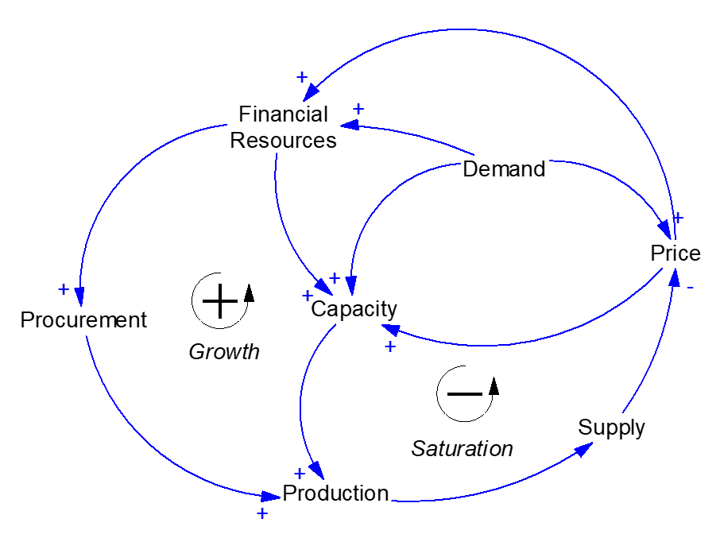
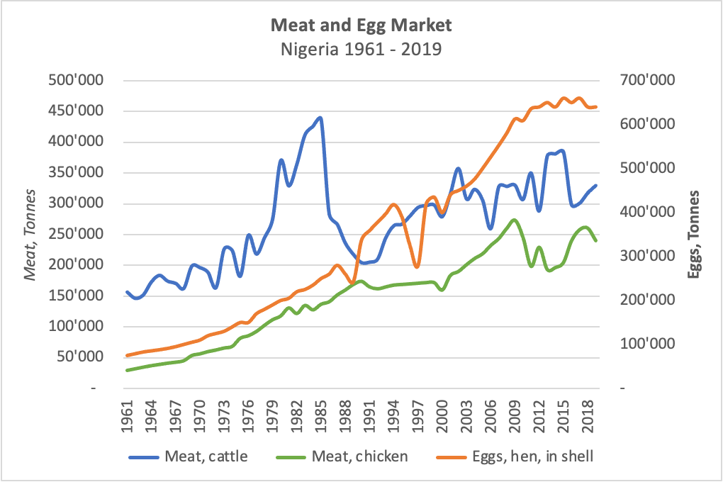
Problem Statement
SSPF in developing countries still struggle with starting and sustaining farm operations
Productivity, Profitability and Income
Seasonality and demand shock
Simple individual sub-sector perspectives
SSPF are complex operations, embedded in multiple supply chains and markets (e.g. live stock, food, eggs, meat).
SSPF decisions are usually made without investigating
Feedbacks and delays from on- and off-farm activities
Management strategies for optimization
If an innovation/technology is best suited for the specific farm
What happens when certain situations change
uncertainties in market prices and supply chain risk
Note: SSPF = Small Scale Production Farming
0:30-2:00
Notes:
Problem Statement: Do not change this title. Keep fonts big (24 pt or bigger). Indicate why the problem is important.

Slide 4
Approach or Dynamic Hypothesis
Hypothesis: Experienced based learning and planning with management flight simulators has a favorable impact on farm operating results.
Farm management decisions should account for complex interactions and dynamics of the entire poultry supply chain system
Relationship between the egg and meat market
Timing of procurement and production
A tool for informing management decisions
An easy-to-use, ready-to-adopt simulator
Promote SSPF establishments
Educational support and stakeholders engagement
Sensitization of practical use of technological innovation and management practices
Virtual farm as a “Digital Twin”
Advance mental models of farm system
Develop insights from multiple simulations using machine learning
Encourage understanding of best SSPF practices
A learning community for stakeholders to provide feedback
2:00-3:30
Notes:
Again big fonts, do not alter title

Slide 5
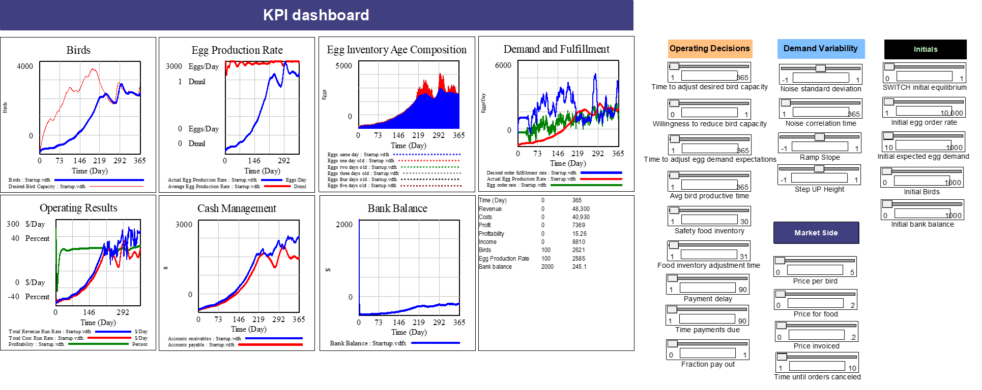
Progress, Insights and Questions
Management Dashboard and Interface
Sectors: Bird capacity, feed and inventory managements
Scenarios: bird capacity, resources, productivity and financials
Thoughts, feedback or questions?
3:30-5:00
Notes:
Again short. Show structure or behavior – may not be room for both (some flexibility on font for these). No need to conclude, there is always more to be done. Any questions you want to pose to the audience can go here. Note the timing in the bottom right.

