Slide 1
System Dynamics Applications in Emergency Department for Waiting Time Improvement
THE 36TH INTERNATIONAL CONFERENCE OF THE SYSTEM DYNAMICS SOCIETY
REYKJAVÍK, ICELAND
Stéphane Copin, Paris 1 Sorbonne
Tamin Hammadi, Paris 1 Sorbonne University
Selmin Nurcan, Paris 1 Sorbonne University
0:00-0:30
Notes:
Title page: Bold the name of the presenter and display your name as you want it read by the moderator (eg Bob instead of Robert). Do not include contact information. Timing in the bottom right. Moderator will change slide following that schedule, or earlier if requested. Change if needed.

Slide 2
Problem Statement
System of emergency departments of unscheduled care, supposed to provide quick and appropriate responses to life-threatening situations
First responders in the event of a disaster
Available at any time of the day…
…and every day of the year
Waiting times for access to care in emergency departments, is a major problem for health care systems in the world
Public concerns about long wait times for care,
Effects of overcrowding are numerous
Pressure on health workers and increased violence in emergency services
0:30-2:00
Notes:
Problem Statement: Do not change this title. Keep fonts big (24 pt or bigger). Indicate why the problem is important.

Slide 3
Approach or Dynamic Hypothesis
We want to tackle the problem by providing a systemic vision of the treatment process of a patient
From this systemic perspective, we can better understand the role of various internal stakeholders, and the external factors that contribute to long waiting times
Our analysis was conducted from interview key people emergency services (medical practitioners, nurses and coordinators of patient flows)
This collaborative approach helped to ensure ownership and confidence in the model by those working in the system who could help to adopt the model for decision-making at a later stage.
The model can then be used to identify improvement options, based on a more complete understanding of cause and effect relationship
2:00-3:30
Notes:
Again big fonts, do not alter title

Slide 4
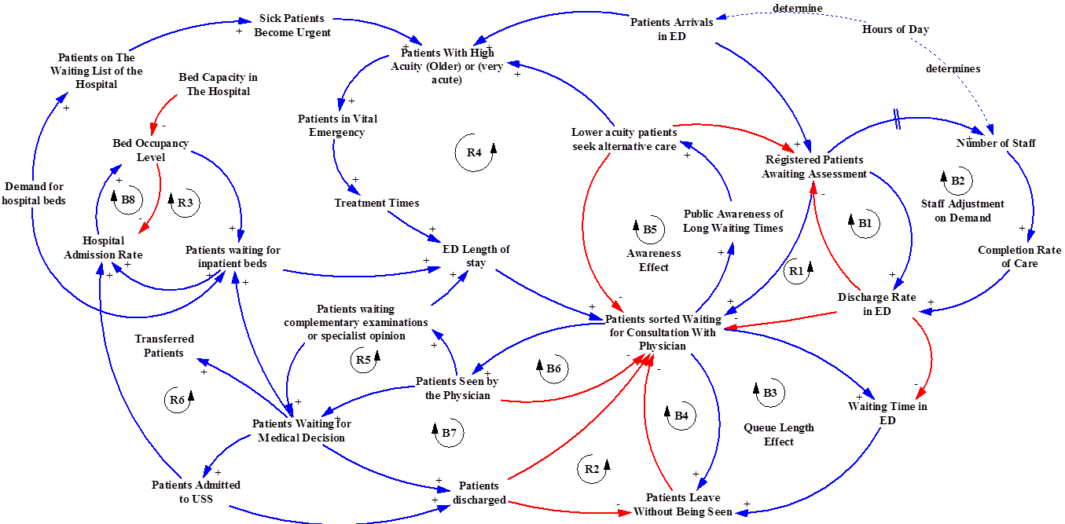
Progress and Insights to Share
Causal loops of the main effects determining wait times in an emergency department
3:30-5:00
Notes:
Again short. Show structure or behavior – may not be room for both (some flexibility on font for these). No need to conclude, there is always more to be done. Note the timing in the bottom right.

